Slide 1
ELEC S212 (2018)
Network
Programming & Design
Surgery 7
(Internet Application)
Course Coordinator : Dr. Steven Choy
Tutor : Mr. Joe Lee
URL of my teaching website : http://learn.ouhk.edu.hk/~t441051/s212
P.<number>
Notes:
CT212 (02/03)-Network Programming and design
27 April, 2002
School of Science & Technology

Slide 2
Agenda for Surgery 7
What is network program/application
WWW
HTML framework and form
Server-side script Vs client-side script
CGI
Javascript
P.<number>
Notes:
CT212 (02/03)-Network Programming and design
27 April, 2002
School of Science & Technology

Slide 3
What is network program/application
Network program/application is any program/application which
  runs over Network (eg. INTERNET )
  Invoked from browser
Concurrent programming is almost network programming due to popularity of INTERNET.
Examples:
  E-commerce such as online-banking
  Shopping over INTERNET (amazon.com),
  Network game …..
To write network program, you need to understand
  WWW
  HTML
  Client-side or server-side script or both
P.<number>
Notes:
CT212 (02/03)-Network Programming and design
27 April, 2002
School of Science & Technology

Slide 4
WWW (1) - components
Components of WWW :
  Web browser (IE or netscape)
    Tool you used to view web page or run network program
  Web server
    Location where web page & scripts are stored and service your network service request
  Optional database server
  “Web page (static or dynamic)” + “client-side or server-side script”
  INTERNET
    Path connection, connecting devices, networking protocol between web browser and server
  HTTP protocol
    Application protocol for web browsing. Runs on TCP/IP
P.<number>
Notes:
CT212 (02/03)-Network Programming and design
27 April, 2002
School of Science & Technology

Slide 5
WWW (2) - architecture
3-tier client-server model :
Web server,
where web pages are stored
(server)
(1) URL request via http
Browser
(client)
(4) Requested Web page is sent to browser via http
(3) Return data
(2) Script access data
Step (2), (3) is optional , depending on database access is required or not
Database server
(data)
P.<number>
Notes:
CT212 (02/03)-Network Programming and design
27 April, 2002
School of Science & Technology

Slide 6
WWW (3) – Web Server side
What components are involved in server side:
(server-side script)
(client-side script)
ASP, CGI, ISAPI, SSI, JavaServlet
Javascript, Java-applet, VBscript,
HTML
HTTP protocol
INTERNET
P.<number>
Notes:
CT212 (02/03)-Network Programming and design
27 April, 2002
School of Science & Technology

Slide 7
WWW (4) – web page classification
Web page classification :
  Static
    content never change, unless updated by owner
    *built from HTML only
    Eg. Joe’s teaching website
  Dynamic
    Content changes based on user-input or event
    More interactive, more suitable for e-commerce
    *built from combination of HTML and script (server-side or client-side)
    Eg. OUHK OLE website
P.<number>
Notes:
CT212 (02/03)-Network Programming and design
27 April, 2002
School of Science & Technology

Slide 8
HTML framework
<html>
<head>
<title>……. </title>
</head>
<body>
……..
</body>
</html>
Demo. : http://learn.ouhk.edu.hk/~t441051/s212/workshop/HTML_workshop/html_frame.html
P.<number>
Notes:
CT212 (02/03)-Network Programming and design
27 April, 2002
School of Science & Technology

Slide 9
HTML form (1)
Function : get user inputs and submit to the server
General format :
<FORM ACTION=“URL” METHOD=[get|post] >
Form input elements…
Regular HTML content…
</FORM>
where URL is relative or absolute URL of script that will process the form data;
P.<number>
Notes:
CT212 (02/03)-Network Programming and design
27 April, 2002
School of Science & Technology

Slide 10
HTML form (2)
Input element :
  1. Text box
  2. Scrollbar textbox
  3. Checkbox
  4. Radio button
  5. Select Menu
  6. Submit button
  7. Reset button
  8. Password
  9. Hidden field
2 types of methods : GET or POST
  For security , use POST
Demo. :
http://learn.ouhk.edu.hk/~t441051/s212/workshop/HTML_workshop/html_form_combined.html
P.<number>
Notes:
CT212 (02/03)-Network Programming and design
27 April, 2002
School of Science & Technology

Slide 11
Client-side Script Vs Server-side Script
Classification of script in terms of where the script executes
  Executed by server => server-side script
  Executed by client (browser) => client-side script
Both server-side and client-side script are stored in web server.
Advantages of client-side script :
  Processing load is distributed to clients => web server won’t be overloaded & better performance
  More interactive
  INTERNET bandwidth can be saved
Disadvantage of client-side script :
  If application requires accessing database, server-side script must be used
P.<number>
Notes:
CT212 (02/03)-Network Programming and design
27 April, 2002
School of Science & Technology

Slide 12
Flow for client-side script application
(1) Request URL via http
Browser
(client)
Web server
(2) page sent
to browser
Web page embedded with client-side script
Web page
HTML0
(3) Browser scan for script
Client-side script
(4) Script generate HTML1 or validates input data on client machine
(5) Browser displays the Web page
Web page HTML0 HTML1
P.<number>
Notes:
CT212 (02/03)-Network Programming and design
27 April, 2002
School of Science & Technology

Slide 13
Flow for server-side script application
Browser
(client)
(1) URL request via http
Web server,
where script and static html page are stored
(server)
(2) Empty Form of URL is sent back for user input
(3) User enters input to form
(7) Another web page is sent to browser via http
(5) Return data
(4) Script access data
(6)Script insert data into a web page
Database server
(data)
P.<number>
Notes:
CT212 (02/03)-Network Programming and design
27 April, 2002
School of Science & Technology

Slide 14
Flow for Combined server-side & client-side script
Browser
(client)
(1) Request URL via http
Web server
(server)
(2) Empty Form (HTML0) & client side script are sent back for user input
Web page
HTML0
(4) Client-side script validates inputs
client-side script
(3) User enters input to form
(5) Valid inputs sent to server-side script
server-side script
(7) Browser displays the Web page HTML1
(6) server-side script is executed (database is accessed, if required) and generate HTML1 on server side
Web page HTML1
P.<number>
Notes:
CT212 (02/03)-Network Programming and design
27 April, 2002
School of Science & Technology

Slide 15
Server-side script programming (1)
Server-script script can run with following interface/protocol:
  CGI (Common Gateway Interface)
    All popular Web servers, in both windows and UNIX/Linux, support it
    The program can be
      any executable compiled program such as c/c++, java, etc
      script such as Unix/Linux shell script, Perl, etc
  ISAPI (Internet Server Application Programming Interface)
    By Microsoft, only windows NT IIS web server support it
    Resident =>more efficient than CGI. DDL=> harder to implement
    The program type is similar to CGI.
P.<number>
Notes:
CT212 (02/03)-Network Programming and design
27 April, 2002
School of Science & Technology

Slide 16
Server-side script programming (2)
  ASP (Active Server Page)
    by Microsoft
    Program can be VBScript and JavaScript
  SSI (Server-Side Include)
    Suitable for document with large amount of static content and a relatively small amount of dynamic content
    Less server resource than CGI
    Embed server-side tags into HTML document.
    Dynamic data is inserted into the HTML document in place of the tags
P.<number>
Notes:
CT212 (02/03)-Network Programming and design
27 April, 2002
School of Science & Technology

Slide 17
CGI
For CGI, please refer to my CGI workshop
  http://learn.ouhk.edu.hk/~t441051/s212/workshop/cgi_workshop/index.html
P.<number>
Notes:
CT212 (02/03)-Network Programming and design
27 April, 2002
School of Science & Technology

Slide 18
Client-side script programming
Client-side script can written with
  Javascript
  Java applet
  VBScript
P.<number>
Notes:
CT212 (02/03)-Network Programming and design
27 April, 2002
School of Science & Technology

Slide 19
JavaScript (1) - introduction
Most popular client-side script, from Netscape
Based on Java, most are syntactically compatible with Java
Similar to C++ programming (object-oriented)
Provides 3 main features for client-side scripting :
  Validate data input to form and prompt for any input error in client => faster response
  Handle events triggered by the reader, eg. Swap image when mouse click or is over => web page will be more interactive and attractive
  Calculation on client side => offload server
P.<number>
Notes:
CT212 (02/03)-Network Programming and design
27 April, 2002
School of Science & Technology

Slide 20
JavaScript (2) - Basics
Embedded within HTML file (Head or Body section) & interpreted by browser
All JavaScript statements are enclosed within <script language=“JavaScript”> ……. </script>
Each statements end with semi-colon “;”
// comment or /* comment */
Operator :
  Comparison ( numeric or string) : ==, !=, >, >=, <, <=
  Arithmetic : +, -, *, /, %, ++, --, -
  Bitwise logical : &, |, ^, ~
  Bitwise shift : <<, >>, >>>
  Logical : &&, ||, !
Flow control : refer to http://docs.oracle.com/javase/tutorial/java/nutsandbolts/flow.html
P.<number>
Notes:
CT212 (02/03)-Network Programming and design
27 April, 2002
School of Science & Technology

Slide 21
JavaScript (3) – Basics (cont’d)
Variable (global or local):
  Variable_name is case-sensitive
  Loosely typed, no need to explicitly define data type
  Declaration : var variable_name = value;
  or var variable_name;
  Data type (number, Boolean, string, null, object) is automatically converted as needed
  Better declare between <head> …</head>, but not a necessary
  Concatenation of strings with + :
    Var str_var1 = “The number is ”; var number_var2 = 123;
    Var str_var3 = str_var1 + number_var2
    Then str_var3 will be “The number is 123”
Demo. :
  http://learn.ouhk.edu.hk/~t441051/s212/workshop/HTML_workshop/javascript_intro.html
  http://learn.ouhk.edu.hk/~t441051/s212/workshop/HTML_workshop/javascript_basic.html
P.<number>
Notes:
CT212 (02/03)-Network Programming and design
27 April, 2002
School of Science & Technology

Slide 22
JavaScript (4) – Function
2 types :
  built-in : eg. write, prompt, alert, etc.
  user-defined
    Better define between <head> …</head>, but not a necessary
    Definition : function func_name(arg1, arg2,…) {
    javascript statement(s);
    [return expression;]
    }
    How to access function : func_name(a,b,….);
Demo. :
http://learn.ouhk.edu.hk/~t441051/s212/workshop/HTML_workshop/javascript_func.html
P.<number>
Notes:
CT212 (02/03)-Network Programming and design
27 April, 2002
School of Science & Technology

Slide 23
JavaScript (5) – event handler (1)
“Event” : result of user action
  Eg. “Click” event -> User click mouse button
  Eg. “Mouse-over” event -> user move mouse pointer over a hyperlink or image.
“Event handler” : reaction to an event
  Eg. onClick -> Event handler for “Click” event
  Eg. onMouseOver -> Event handler for “Mouse-over” event
  For each event handler, a function is called to give responses in handling an event
  Only effective to some web page elements such as form input elements (text, select list, submit, etc), image, hyperlink, etc. (refer to next page)
Demo. : http://learn.ouhk.edu.hk/~t441051/s212/workshop/HTML_workshop/javascript_event.html
P.<number>
Notes:
CT212 (02/03)-Network Programming and design
27 April, 2002
School of Science & Technology

Slide 24
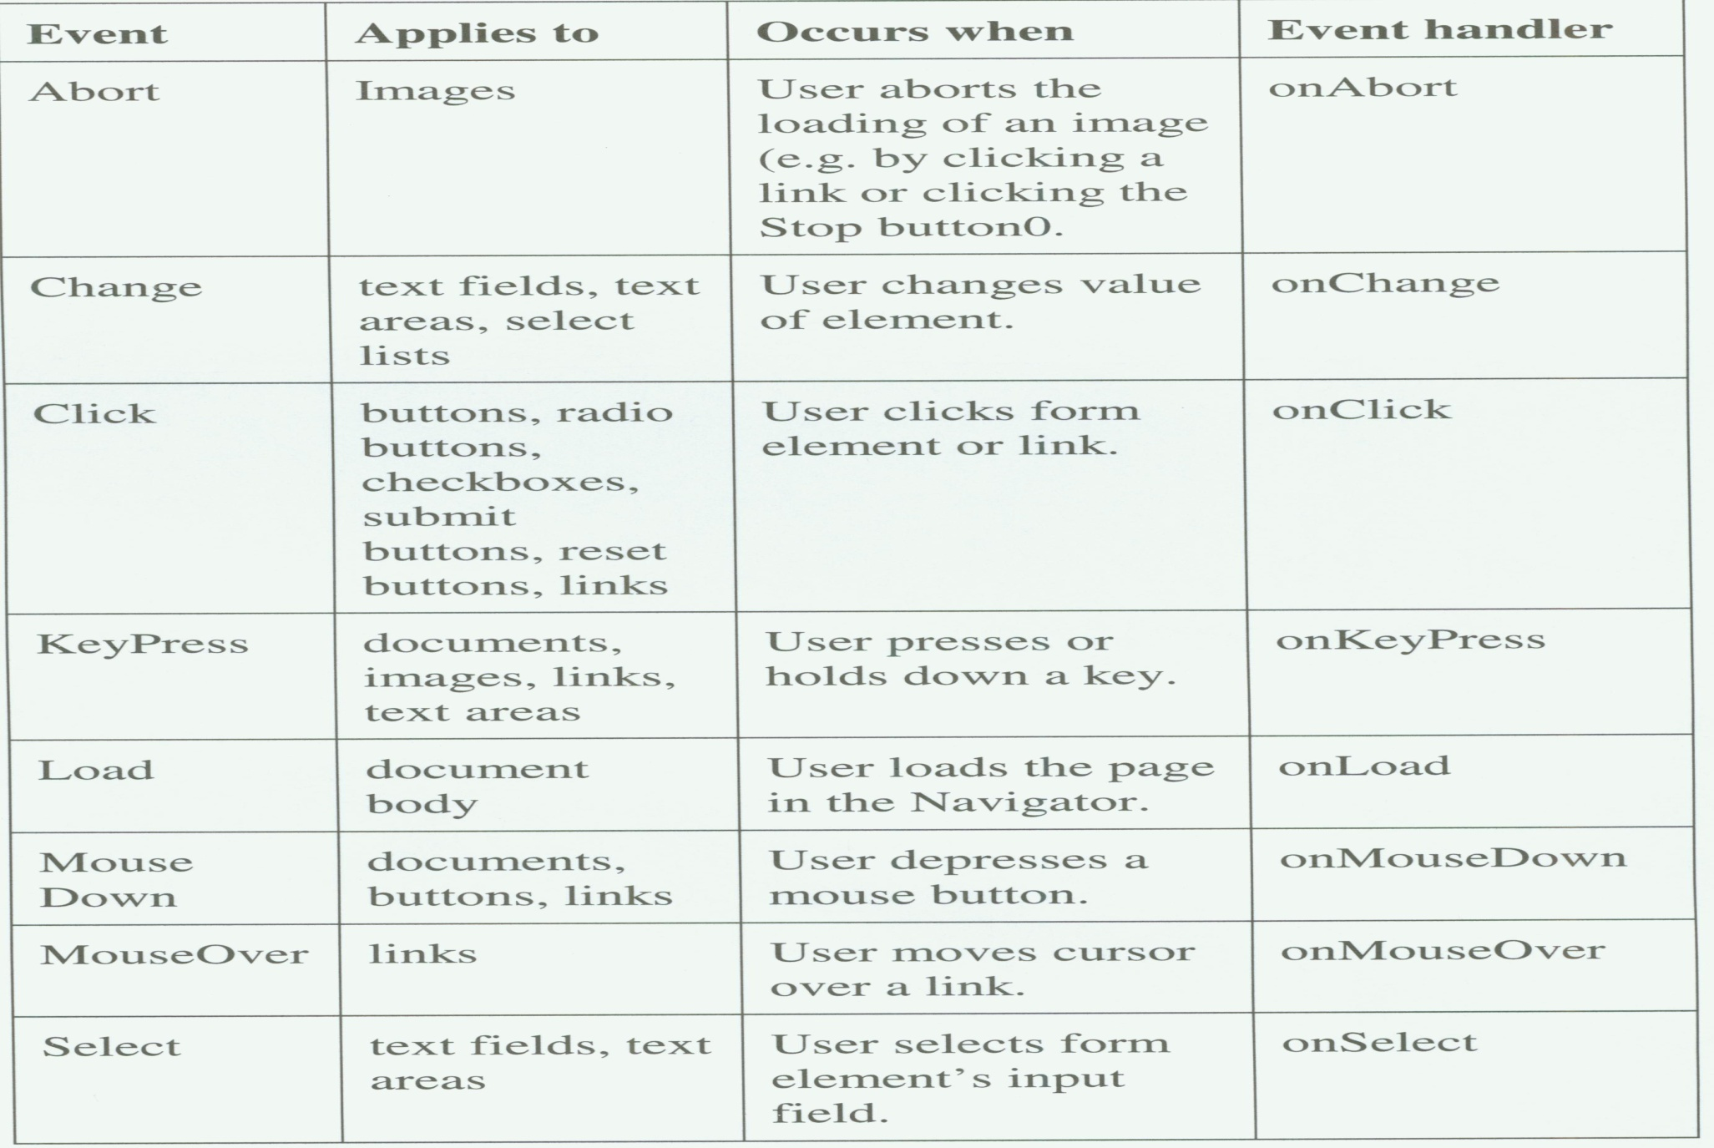
JavaScript (6) – event handler (2)
P.<number>
Notes:
CT212 (02/03)-Network Programming and design
27 April, 2002
School of Science & Technology

Slide 25
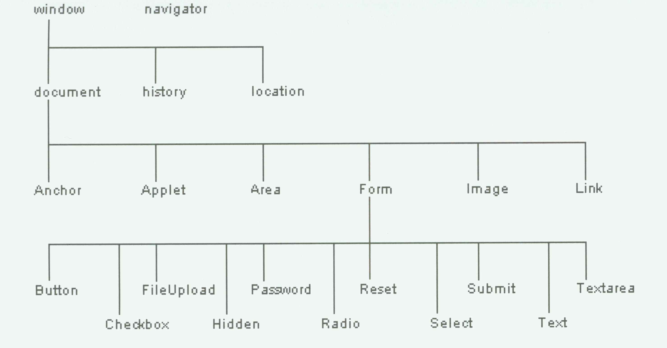
JavaScript (7) – Object model
P.<number>
Notes:
CT212 (02/03)-Network Programming and design
27 April, 2002
School of Science & Technology

Slide 26
JavaScript (8) – Object model (cont’d)
<html>
…
<img src=“URL1” name=“myImage” …>
<form name=“myForm” action=“URL2”>
  <input type=text name=“myText” …….>
  <input type=password name=“myPass” …>
  ..
</form>
..
</html>
P.<number>
Notes:
CT212 (02/03)-Network Programming and design
27 April, 2002
School of Science & Technology

Slide 27
JavaScript (9) – Object model (cont’d)
JavaScript arrange all elements on a web page in a hierarchical object model
Each element is an object, associated with properties (eg. Text value for text input of form) and methods (functions).
*To access an object on a web page, we need to identify it in JavaScript. Eg.
  document.myImage (document.myImage.src)
  document.myform
  document.myform.myText (document.myform.myText.value)
  document.myform.myPass (document.myform.myPass.value)
*To access property of an object : object_id.property_name
*To invoke method (or function) acting on an object : object_id.method_name();
Demo. :
http://learn.ouhk.edu.hk/~t441051/s212/workshop/HTML_workshop/javascript_form.html
P.<number>
Notes:
CT212 (02/03)-Network Programming and design
27 April, 2002
School of Science & Technology

Slide 28
JavaScript (9) – control browser window
You can design your web page such that when a link is click, a new browser, with different configuration than original browser, is opened.
This new window may have no menubar, no toolbar, no statusbar.
This is done by JavaScript, through setting values of properties of window object and built-in function “open”
Demo. :
http://learn.ouhk.edu.hk/~t441051/s212/workshop/HTML_workshop/javascript_window.html
P.<number>
Notes:
CT212 (02/03)-Network Programming and design
27 April, 2002
School of Science & Technology

Slide 29
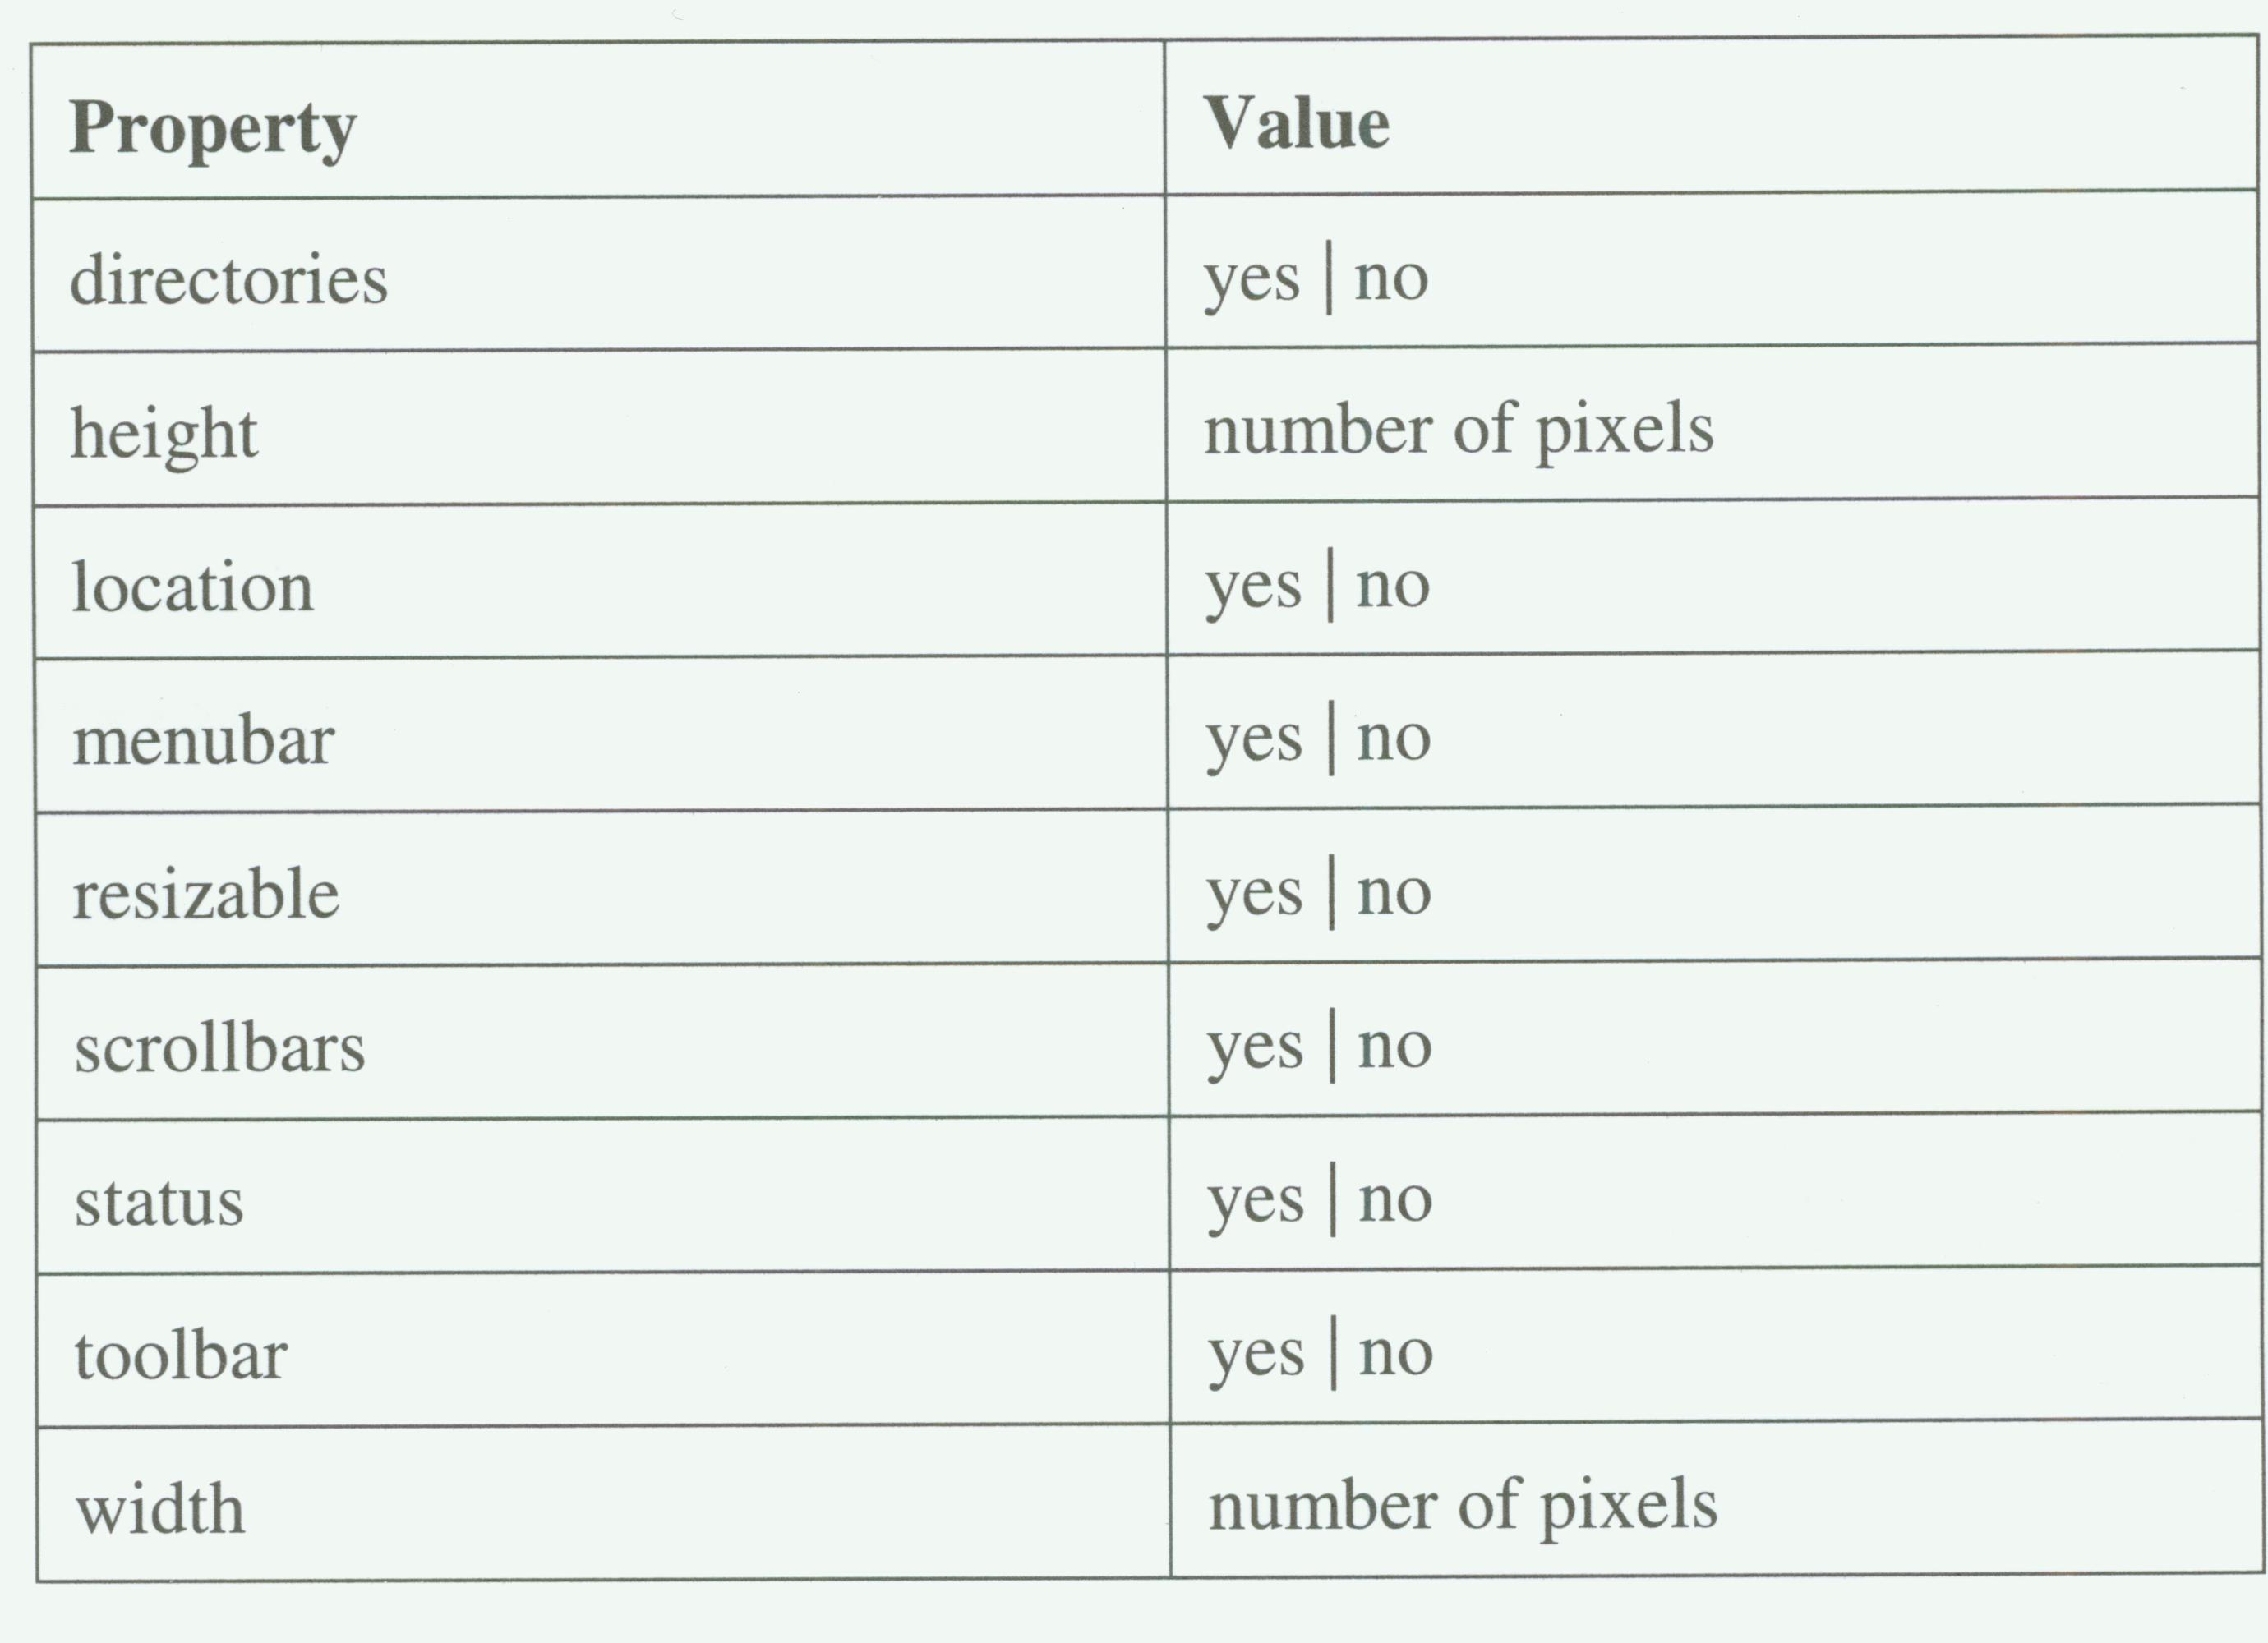
JavaScript (9) – window object property
P.<number>
Notes:
CT212 (02/03)-Network Programming and design
27 April, 2002
School of Science & Technology

Slide 30
Open
Discussions
P.<number>
Notes:
CT212 (02/03)-Network Programming and design
27 April, 2002
School of Science & Technology

