Slide 1
ELECS 212 (2018)
Network
Programming and Design
Surgery Tutorial 8
(Security in Networks)
Course Coordinator : Dr. Steven Choy
Tutor : Mr. Joe Lee
URL of my teaching website : http://learn.ouhk.edu.hk/~t441051/s212
P.<number>

Slide 2
Agenda (1)
4 Security goals
Encryption concepts & PKI
  asymmetric (public) key encryption
  symmetric (private) key encryption
Network security protocol
Secure Network design
  DMZ
  Firewall
  Proxy server
  Remote access control
  Anti-virus
P.<number>

Slide 3
Agenda (2)
Secure Network design (cont’d)
  IDS
  VPN
  IPSEC
  Availability of network
  NOS security issues
Security management practice
  Identify security risk
  Develop security policies
  Carry out security audit
P.<number>

Slide 4
Network security
is threaten by a number of
evolving & growing hackings.
By Joe Lee
P.<number>
P.<number>

Slide 5
4 security goals for network communication
Confidentiality (or Secrecy) of transmitted or stored data:
  only intended recipient understand content of data.
Integrity of data
  ensure that received data has not been changed by 3 third party during transmission, or can be detected if changed
Authentication
  Identity of an individual should be verified before being granted access to system.
Availability
  It refers to availability of information, network and systems running on them.
P.<number>

Slide 6
Cryptography
By Joe Lee
P.<number>
P.<number>

Slide 7
Cryptography (encryption) concept
Cryptography :
  a formal term for “encryption”
  disguise information by algorithm with a encryption key
2 types of encryption :
  symmetric (private) key encryption
  asymmetric (public) key encryption
asymmetric encryption overrides symmetric key encryption in terms of security
symmetric encryption overrides asymmetric key encryption in terms of speed.
Actually, combination of both symmetric & asymmetric key encryption is sometimes used to take advantages of both security & speed.
By Joe Lee
P.<number>
P.<number>

Slide 8
Symmetric (Private) key encryption
Symmetric encryption :
(done on sender’s side) :
Plaintext (original information)
Symmetric encryption algorithm
Ciphertext (Encrypted information)
(Sent to receiver via network)
1. Encryption & decryption key are identical.
2. both sender & receiver need to agree on this private key before data transmission.
3. Thus has problem of distribution of private key securely
Encryption key
Symmetric decryption :
(done on receiver’s side) :
Ciphertext (Encrypted information)
Symmetric decryption algorithm
Plaintext (original information)
decryption key
By Joe Lee
P.<number>
P.<number>

Slide 9
Asymmetric (Public) key encryption (1)
*Everybody/host/organization has a pair of key - (public key, private key).
*Public key of anyone is known to the world while his/her private key is kept secret and only known by owner (refer to digital certificate)
*Has 2 properties (refer to next 2 pages)
Public key encryption can solve :
  the problem of key distribution automatically as public key is known to the world
  CIA problem
By Joe Lee
P.<number>
P.<number>

Slide 10
Asymmetric (Public) key encryption (2)
Property 1 (mainly for data encryption) :
  Sender encrypt info using public key of receiver
  Receiver can decrypt info using private key of receiver
Encryption (done on sender’s side) :
asymmetric encryption algorithm
Plaintext
( I am a man)
Cipher text
(#@34@fklaj)
public key of receiver
Decryption (done on receiver’s side) :
asymmetric decryption algorithm
Cipher text
(#@34@fklaj)
Plaintext
( I am a man)
Private key of receiver
By Joe Lee
P.<number>
P.<number>

Slide 11
Asymmetric (Public) key encryption (3)
Property 2 (mainly for digital signature) :
  Sender encrypt info using private key of sender
  Receiver can decrypt info using public key of sender
Encryption (done on sender’s side) :
asymmetric encryption algorithm
Plaintext
( I am a man)
Cipher text
(#@34@fklaj)
private key of sender
Decryption (done on receiver’s side) :
asymmetric decryption algorithm
Cipher text
(#@34@fklaj)
Plaintext
( I am a man)
public key of sender
By Joe Lee
P.<number>
P.<number>

Slide 12
Confidentiality (1)
To solve “C” of “CIA” (2 steps) :
1. Sender randomly select a session key and encrypted using property 1 of asymmetric encryption. Then sends to receiver
Encryption (done on sender’s side) :
asymmetric encryption algorithm
Encrypted session key
Session key
public key of receiver
Only receiver can decrypt & know this session key
Decryption (done on receiver’s side) :
asymmetric decryption algorithm
Encrypted session key
Session key
Private key of receiver
By Joe Lee
P.<number>
P.<number>

Slide 13
Confidentiality (2)
2. Both sender and receiver encrypt & decrypt symmetrically actual data using this session key
Encryption (done on sender’s side) :
Plaintext
( I am a man)
symmetric encryption algorithm
Cipher text
(#@34@fklaj)
Session key
Why encrypt data in this way?
Decryption (done on receiver’s side) :
Cipher text
(#@34@fklaj)
symmetric decryption algorithm
Plaintext
( I am a man)
Session key
By Joe Lee
P.<number>
P.<number>

Slide 14
Integrity (1)
Message Digest :
  One-way hash function – given a message digest, it is difficult to determine original information
  Almost impossible to find 2 information with same message digest
  **Output is of fixed length, whatever the length of input is.
  Algorithm is open – MD5 (by Rivest) or SHA (by NSA)
Message digest
(fixed length)
Information
Message Digest
algorithm
By Joe Lee
P.<number>
P.<number>

Slide 15
Integrity (2)
To solve “I” of “CIA” by digital signature :
(using message digest and property 2)
On sender’s computer
asymmetric encryption algorithm
Message Digest
Message digest 1
Digital Signature
plaintext
algorithm
private key of sender
Both digital signature & cipher text are sent to receiver side via network
session key
symmetric encryption algorithm
plaintext
Cipher text
By Joe Lee
P.<number>
P.<number>

Slide 16
Integrity (3)
To solve “I” of “CIA” by digital signature :
On receiver’s computer
asymmetric decryption algorithm
digital signature
Message digest 2
pubic key of sender
Compare
same
accept
Message digest 3
symmetric decryption algorithm
different
Cipher text
message digest algorithm
reject
session key
Plaintext
By Joe Lee
P.<number>
P.<number>

Slide 17
Authentication (1)
Previously, you are told that everyone’s public key is known to the world.
How does this happen?
  Everyone need to apply a digital certificate from certificate authority (CA). There are multiple CA’s in the world. They form distributed layer structure to each other
  CA is responsible for generating a pair of public and private key for each applicant.
  (cont’d)
By Joe Lee
P.<number>
P.<number>

Slide 18
Authentication (2)
  For digital certificate :
    it includes applicant’s public key & his personal information
    Content of digital certificate is digitally signed by CA’s private key
  Before network communication between A & B, Both A & B send their own digital certificates to each other. A verifies content of B’s digital certificate with public key of issuing CA. B verifies A’s too.
  Upon successful verification, public key is extracted from the digital certificate for CIA. This public key is an identity of each party.
By Joe Lee
P.<number>
P.<number>

Slide 19
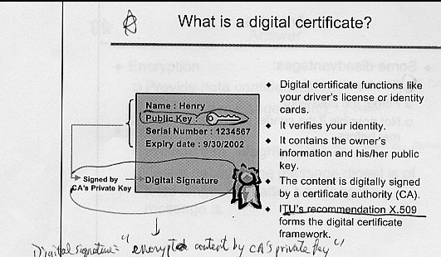
Authentication (3)
P.<number>

Slide 20
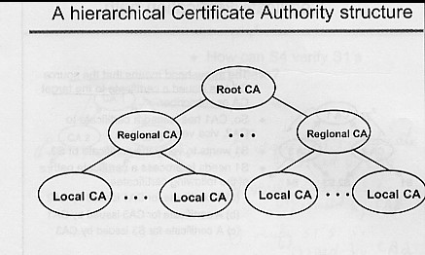
Authentication (4)
P.<number>

Slide 21
PKI
PKI (Public Key Infrastructure) is composed of the CA, digital certificates and public-key encryption
 | PKI | Traditional
Confidentiality | Session key | Symmetric encryption but with key distribution problem
Integrity | Digital signature | Nil
authentication | Digital certificate | Password, Kerberos
P.<number>
P.<number>

Slide 22
CA for Hong Kong
Under ETO (Electronic Transaction Ordinance), there are TWO CAs for Hong Kong:
  The Postmaster General
  Digi-Sign Certification Services Limited
For more details, refer to http://www.ogcio.gov.hk/en/regulation/eto/ordinance/ca_in_hk/
P.<number>
P.<number>

Slide 23
Network security protocol
P.<number>
P.<number>

Slide 24
Network security protocol (1)
SSL
  Provide encryption and authentication between client and server
  128 or 256 bit key
  Usually for http, ftp and pop
SSH
  Encrypted version to replace telnet
  Provide encryption (username/password and data transferred) and authentication between client and server
  Use port 22, eg. putty
P.<number>

Slide 25
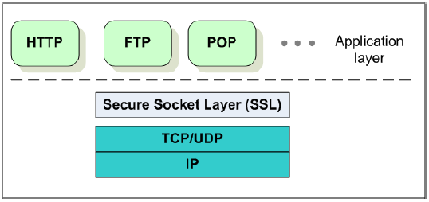
Network security protocol (2)
P.<number>

Slide 26
Network security protocol (3)
SCP
  Secure file transfer
  username/password and content are all encrypted during transmission
  Eg. WINSCP supports SCP
SFTP
  Secure version to replace ftp
  SCP feature + encrypted “cd, file listing, etc”
  Eg. WINSCP supports SFTP
P.<number>

Slide 27
Secure network design
P.<number>
P.<number>

Slide 28
Security technologies
To reduce the risk, you should consider some technologies during network design phrase
  Isolate Intranet from Extranet (DMZ)
  Firewall
  Proxy server
  Remote access security
  Anti-virus protection
  Intrusion Detection System (IDS)
  VPN
  IPSec
  Fault tolerance
  NOS security
P.<number>

Slide 29
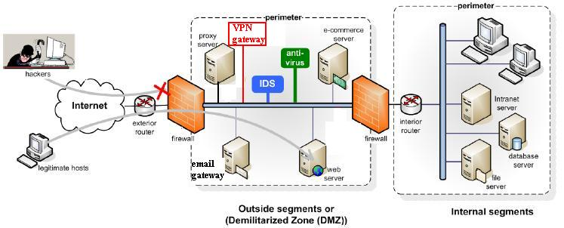
DMZ (1)
Remote access server
P.<number>
P.<number>

Slide 30
DMZ (2)
Servers which will be accessed by users from INTERNET should be located in DMZ
  Web server
  Email gateway/server
  Anti-virus server
  Proxy server
  IDS
  Remote access server
  External DNS server
DMZ is isolated from Internal network by firewall
P.<number>

Slide 31
FW (1)
Remote access server
P.<number>
P.<number>

Slide 32
FW (2)
Firewall is a specialized device or a computer installed with specialized S/W that selectively filters or blocks traffic between networks to protect systems.
Firewall is usually located between 2 interconnected networks and screen out unwanted traffic from moving from one network to another according to predefined requirement.
  Usually located at the perimeter of organization network
  Can be placed before sensitive network (eg. financial or personnel network) to enhance protection for those particular networks
P.<number>
P.<number>

Slide 33
FW (3)
How packet filtering firewall work?
  It examines IP header of every incoming packet and filter based on pre-defined criteria
    Match of source IP or destination IP or both
    Match of source port, or destination port or both
    Are required Flags set?
    Match of protocols (eg. TCP, UDP or ICMP)
    Is this is the first packet in the new session?
    Inbound or outbound traffic
P.<number>
P.<number>

Slide 34
Proxy Server (1)
Remote access server
P.<number>
P.<number>

Slide 35
Proxy server (2)
Proxy Server is a software that acts as an intermediary between external and internal networks, screening all incoming and outgoing traffic.
Mainly as web proxy server. Sometimes for ftp proxy.
When a user request a webpage of external web server, web proxy server will make the request on behalf of the user and then pass back the retrieved web page to the user. The retrieved web page is also cached in web proxy server.
Benefit
  Mainly for saving bandwidth of INTERNET link & reduce web accessing time
  Previous accessed web page are cached. If access cached web page => no need to go through INTERNET => better response time.
  Sometimes access time is faster, sometimes not but overall is better.
Drawback: cached data may be out of date
P.<number>
P.<number>

Slide 36
Remote access control (1)
Remote access server
P.<number>
P.<number>

Slide 37
Remote access control (2)
Remote access means users can access internal network of their company remotely, eg. At home, during business trip, etc
As remote access can access internal network, hacker may make use of it
Typical ways to protect internal network from attack via remote access:
  all remote access must via perimeter FW
  use remote access software (eg. Remote access client installed in your PC at home)
P.<number>
P.<number>

Slide 38
Remote access control (3)
Remote access software should include following controls:
  Username/password authentication
  2-factor authentication (eg. Smartcard or one-time password token)
  Ability of host system to call back
  Support for data encryption on transmission, eg VPN
P.<number>
P.<number>

Slide 39
Anti-virus (1)
Remote access server
P.<number>
P.<number>

Slide 40
Anti-virus (2)
There are 2 issues to consider:
  When email gateway receives emails from INTERNET, it should direct the incoming emails to anti-virus server for scanning before sending to email server in internal network
    This method eliminates virus from external
  Every client PC in internal network should be installed with anti-virus S/W so that every email sent from client PC is scanned before sending to internal email server.
    This method eliminates virus from internal
P.<number>
P.<number>

Slide 41
Anti-virus (3)
Following rules should be included in security policy.
  The anti-virus signature files, for both methods, should be updated at a regular period, defined by policy.
  End users are required to ensure
    Anti-virus scanning S/W, installed in their PCs, are always up and running.
    Their PCs should be patched with latest security updates.
    Their PCs cannot be installed with S/W from doubtful origins (eg. Freeware from INTERNET)
P.<number>
P.<number>

Slide 42
IDS (1)
Remote access server
P.<number>
P.<number>

Slide 43
IDS (2)
IDS (Intrusion Detection Systems) is responsible for preventing, detecting, abnormal or suspicious activities on your production system or network.
Once suspicious activities are detected, IDS will alert system administrator accordingly.
2 types of IDS:
  Network-based IDS
  Host-based IDS
P.<number>

Slide 44
IDS (3)
IDS uses signature files to detect the patterns of suspicious attack.
Regular update of signature file should be enforced by security policy.
IDS is located at strategic locations
  DMZ
  Network with sensitive information, eg. Finance, personnel department.
  Critical system
P.<number>
P.<number>

Slide 45
VPN (1)
Remote access server
P.<number>
P.<number>

Slide 46
VPN (2)
VPN (Virtual Private Network) is a secure network connection established over existing public network (eg. INTERNET), which is assumed to be unsecure.
Benefits of VPN
  Encryption and authentication technologies are used to provide security on the data transmitted.
  Private point-to-point link between main and remote offices is no longer needed. Cost is reduced.
Usually, a VPN gateway, which is located at DMZ, is responsible for all VPN traffic between internal network and INTERNET.
P.<number>
P.<number>

Slide 47
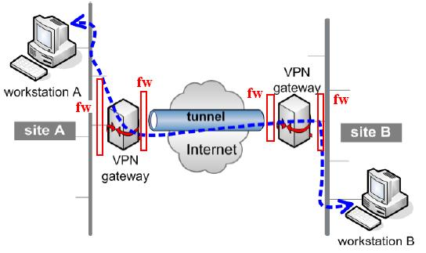
VPN (3) – tunneling (1)
P.<number>
P.<number>

Slide 48
VPN (4) – tunneling (2)
Tunneling is a process of encapsulating one type of packet inside another to facilitate some sort of transport advantage.
At the sending VPN gateway,
  Original IP packet becomes data portion of a new IP packet.
  The data portion is encrypted before sending out the new IP packet.
  A new IP header is created with different source and destination IP address.
    Source IP address is the IP address of your VPN gateway.
    Destination IP address is the IP address of VPN gateway of your communicating partner
  A hash is generated for authentication based on content of each new IP packet
P.<number>
P.<number>

Slide 49
VPN (5) – tunneling (3)
At the sending VPN gateway,
  The hash is extracted for authenticating the sending VPN gateway.
  The data portion is decrypted by VPN gateway.
  The decrypted data portion is extracted and restored to original form and forwarded to corresponding destination IP address
Different VPN system encrypts at different layers of TCP/IP model. This is a choice of implementation.
Application layer | SSH port-forwarding, application proxy
Transport layer | VPN over SSL (increasingly popular, simple)
Network layer | IPSEC
Data Link layer | L2TP (layer 2 Tunneling Protocol), PPTP (Point-to-Point Tunneling Protocol
P.<number>
P.<number>

Slide 50
VPN (6) – tunneling (4)
OpenVPN is a open source s/w for “VPN over SSL” solution.
  It is lighyweight design => simple
  It is free
  It overcomes limitation of “VPN over IPSec” approach.
  http://www.openvpn.org/BLUG-talk/BLUG-talk.ppt
P.<number>
P.<number>

Slide 51
IPSec (1)
IPSec (Internet Protocol SECurity) defines encryption, authentication and key management for TCP/IP transmission.
Enhancement to IPv4. Built-in for IPv6
Operates at network layer => any application can make use of IPSec without modification.
“VPN over SSL”, operating at application layer, requires modification of existing application.
IPSEC requires OS support. Most OS kernels do not allow direct manipulation of IP headers => interoperability problem among different OS.
VPN gateway is dedicated device and can solve this problem
P.<number>
P.<number>

Slide 52
IPSec (2) – Operation modes
2 operation modes for IPSEC:
  Transport mode
    Encrypts only payload of original IP packet
    Original source and destination IP address is used in the header of new IP packet => Less secure
    No tunneling
  Tunnel mode:
    Use tunneling
    All features described in tunneling => more secure
P.<number>
P.<number>

Slide 53
IPSec (3)
IPSEC can be worked as in following ways:
  host-to-gateway or gateway-to-host tunneling
  Gateway-to-gateway tunneling.
  Host-to-host (eg. client-to-server, server-to-client) tunneling
  Securing an application by specific hosts only
  Host-based packet filtering to eliminate unwanted traffic, similar to firewal.
P.<number>
P.<number>

Slide 54
Fault-tolerance (1)
Fault-tolerance is for the “Availability” goal
Fault-tolerance targets for without “single-point-of-failure” at different levels:
  Network level
    Backup router or switch
    2 connection links between switches OR/AND routers
    2 INTERNET connection links
  Server level
    Master and backup server
    Cluster
  Application level
    Application automatically authenticate via backup authentication server when master authentication server fail
P.<number>
P.<number>

Slide 55
Fault-tolerance (2)
  Power level
    2 or more independent power source
    UPS
  Information level:
    regular backup of user data
    Regular backup of configuration file of router, switch, server and etc.
P.<number>
P.<number>

Slide 56
NOS security (1)
NOS security functions that can contribute to overall network protection:
  Login restriction:
    Login time at office hour only
    Login from restricted IP address
    Limit on the number of unsuccessful attempt
  Password:
    Reasonable length. At least 8 characters
    Composed of upper-cased, lower-cased, alphanumeric and special characters
    Change password regularly (eg. at least every 3 months)
    Never to easy-to-guess password (eg. your name, birthday, telephone, etc)
    Don’t write down your password
P.<number>
P.<number>

Slide 57
NOS security (2)
  Logging system activities:
    User account logon/logout time
    Unsuccessful logon attempts
    Attempts of unauthorized access to network resources
    Attempts of unauthorized access to system settings
    Details of remote logon sessions
Logging information should be reviewed regularly.
  To look for any potential problems in early stages.
P.<number>
P.<number>

Slide 58
Other non-technical security issues
Understand your environment
Identify and evaluate your assumptions
Know your weakness
Remember human factors
Know your enemy
Control your secrets
Limit the scope of access
Limit your trust (don’t assume S/W is bug free)
Equipment failure
Count the cost
P.<number>

Slide 59
Security management practice
By Joe Lee
P.<number>
P.<number>

Slide 60
Security management practice
Conduct risk assessment
  Identify which part of organization network/information assets are at risk
  Assess the impacts and determine countermeasures
Develop security policy
  State security goals of organization
  Prepare guidelines/procedures to meet the targets
Carry out security audit
P.<number>

Slide 61
Identify risks (1)
Risk associated with people
  Dis-honest employee
  Incorrect handle of user ID, groups and rights
  Easy guess password
Risk associated with transmission
  Intrusion into network through modems attached to network devices
  Interceptions of unencrypted data transmitted over wireless or public network
Risk associated with hardware
  Exploitation of unused hubs, routers, or server ports by hackers
P.<number>

Slide 62
Identify risks (2)
Risk associated with protocols and software
  Security inadequacies in TCP/IP
    Eg. No authentication, no encryption, IP spoofing, etc
  Security flaws in NOS
  Accept default options (which is usually NOT optimized) after OS or application installation.
  Trust relationships between servers causes entire network vulnerable to attack
Risk associated with internet assess
  Improper firewall configuration
  Insecure applications (eg. telnet, ftp) which transmit un-encrypted username/passwords
  Virus attack through web browsing, email, instant messaging, etc.
P.<number>

Slide 63
Access the impact of risk (1)
To determine the impact of a risk, you need to find out
  Potential loss caused by risk
    High or low loss to organization.
  Probability of risk
    Eg. Probability of earthquake in HK is low.
Based on the estimated impact, assign different rankings to risks.
The ranking of risk lets you know the priority on handling the risks.
P.<number>

Slide 64
4 strategies to handle risk
*Risk avoidance
  Use alternative means, or do not proceed with the task/operation causing the risk
**Risk assignment: buy insurance to transfer some or all the loss
***Risk reduction method
  Security control (e.g. smartcard control, firewall, anti-virus, etc
  Provide early detection methods (eg. Intrusion detection /prevention system)
  Increase staff awareness on security through education
  Prepare a business continuity plan when risk happens
Risk acceptance
  Live with the risk, especially with those with low impacts or low probability.
P.<number>

Slide 65
Security policy (1)
The result of risk assessment helps top management develop a security policy
A committee under the charter of senior management is responsible for developing the security policy and communicating it throughout the organization.
Committee members should include representatives of:
  Management
  Information owners
  Application system owners
  Network administrators
  End users.
P.<number>

Slide 66
Security policy (2)
What is security policy?
  In the form of comprehensive statement
  Identify security goal, risks, level of authority, designated security team, responsibility of the team.
  Does not need to go into the details about the equipment or software to be installed.
  The details should be provided by security guidelines and procedures which are developed base the security policy.
By Joe Lee
P.<number>
P.<number>

Slide 67
Security policy (3)
Areas covered by security policy
  Password management
  Software installation
  Use of desktop, laptops and loaner machines
  Confidential and sensitive data
  Network access
  Email and Internet use
  Remote access
  Corporate network and connections to
    remote locations,
    Internet
    Customers’ and vendors’ network
P.<number>

Slide 68
Security audit (1)
What is security audit?
  is the process of examining the operation of networks and IT systems in great detail in order to determine if organization’s information assets are at the expected level of protection
Better to be done by external qualified auditors
Carried out with reference to common security standards such as
    BS7799/ISO 17799
    GASSP (Generally Accepted System Security Principles)
P.<number>

Slide 69
2 useful security websites
InfoSec website by HK government
  http://www.infosec.gov.hk
  http://www.infosec.gov.hk/english/business/security.html
HKCERT (Hong Kong Computer Emergency Response Team Coordination Centre)
  http://www.hkcert.org
  http://www.hkcert.org/chinese/rss.xml for latest security alert
By Joe Lee
P.<number>
P.<number>

Slide 70
Open
Discussions
P.<number>

