Slide 1
CT212 (Sept. 2018)
Network
Programming and Design
Surgery 9 for all groups
(WAN Area Network access
& Wireless technologies)
Course Coordinator : Dr. Steven Choy
Tutor : Mr. Joe Lee
URL of my teaching website : http://learn.ouhk.edu.hk/~t441051/s212
By Joe Lee
P.<number>

Slide 2
Agenda for Surgery 9
WAN topology
Major types of WAN access
Why use Wireless network
Wireless Vs wired network
Components of a wireless network
Wireless standards
Wireless design model
Wireless planning
2 modes of wireless topology
Wireless security
  Threats
  Security protocols
By Joe Lee
P.<number>

Slide 3
Objective of Unit 9
Identify and describe the operation and types of WAN technologies
Demonstrate awareness of local developments in WAN services
Discuss basic issues related to wireless communication
Evaluate wireless network protocols and standards
Describe common wireless security measure and standards
Practice security analysis for wireless networks
Outline the operation of wireless LAN survey
By Joe Lee
P.<number>

Slide 4
WAN
access
By Joe Lee
P.<number>

Slide 5
WAN vs LAN
 | LAN | WAN
Coverage | Covers a small geographic area, like a home, office, or within a building | Cover broad area, like across buildings, cities, regions, countries or world
Technology | FastEthernet, GE or wireless | Metro Ethernet, ATM, Frame Relay, Leased Line
Operation | by a single person or organization | by public network server providers (i.e. carriers)
Transfer rate | high data transfer rate (100M, 1G, 10G) | lower data transfer rate as compared to LANs
Cost | No monthly subscription fee | monthly subscription fee
By Joe Lee
P.<number>

Slide 6
WAN Topology (1)
WAN topology is similar to LAN topology.
  How to connect the communicating entities together so that they can exchange data with each other over the network
WAN topology includes:
  Bus
  Star
  Ring
  Full mesh
  Partial mesh
By Joe Lee
P.<number>

Slide 7
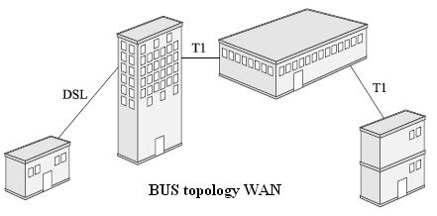
WAN Topology (2)
By Joe Lee
P.<number>

Slide 8
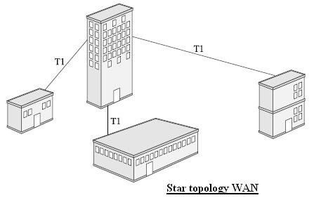
WAN Topology (3)
By Joe Lee
P.<number>

Slide 9
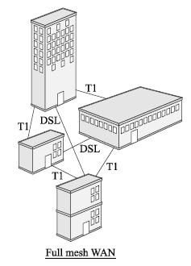
WAN Topology (4)
By Joe Lee
P.<number>

Slide 10
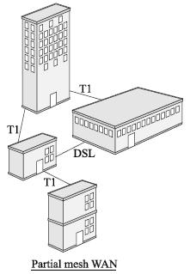
WAN Topology (5)
By Joe Lee
P.<number>

Slide 11
Major types of WAN access (1)
Major types of WAN access
  PSTN
  T-carries
  X.25
  Frame-relay
  SONET
  DSL
    ADSL
    SDSL
  Cable Modem
  Others….
By Joe Lee
P.<number>

Slide 12
PSTN (1)
PSTN stands for Public Switched Telephone Network
Most PSTN links (except links to homes/offices)
  use digital transmission
  Transmission media is fiber optic
By Joe Lee
P.<number>

Slide 13
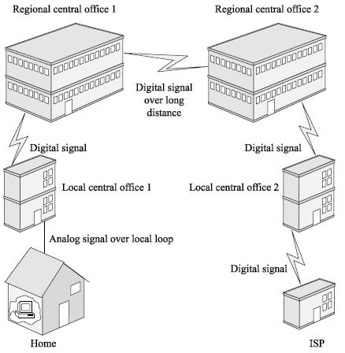
PSTN (2)
By Joe Lee
P.<number>

Slide 14
T-carrier (1)
Dedicated point-to-point leased line
  not cost-effective for multiple connection points
  For n connection points (remote sites), you need (n*(n-1)/2) leased lines for fully-meshed connection.
  Eg. n=5, you need (5*4 / 2) = 10 leased lines for fully-meshed connection
You need CSU/DSU to connect to T1 circuit
  CSU provides termination and ensures connection integrity through error correction and monitoring
  DSU converts T-carrier frames into frame that LAN can support.
By Joe Lee
P.<number>

Slide 15
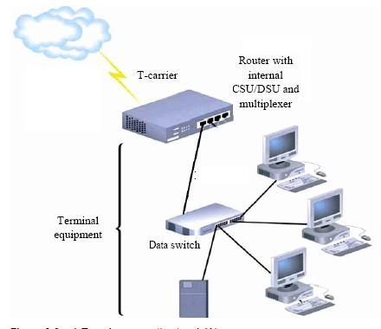
T-carrier (2)
By Joe Lee
P.<number>

Slide 16
T-carrier (3)
T-carrier standard
  Use digital transmission over 2 wires
    One wire for transmit
    One wire for receive
  Use TDM (time division multiplexing) to transmit multiple channels over 2 wires.
    Each channel has a transmission rate of 64Kbps
    Eg. T1 has 24 channels => 1.544Mbps
Usually rent from Carries. The cost depends on:
  Distance
  Bandwidth
You can subscribe fractional T-1 line (multiples of 64K)
By Joe Lee
P.<number>

Slide 17
T-carrier (4)
 | Speed (Mbps) | Number of channels
T1 | 1.544 | 24
T2 | 6.312 | 96
T3 | 44.737 (=T1 x 28) | 672
T4 | 274.176 | 4032
By Joe Lee
P.<number>

Slide 18
SONET
Lease line using SONET circuit – Ansi standard, higher bandwidth, use optic fiber
Optical carrier level | Speed
OC-1 | 51.84 Mbps
OC-3 | 155.52Mbps
OC-12 | 622.08 Mbps
OC-18 | 933.12 Mbps
OC-24 | 1.244 Gbps
OC-48 | 2.488 Gbps
OC-96 | 4.976 Gbps
OC-192 | 9.952 Gbps
By Joe Lee
P.<number>

Slide 19
Frame relay, X.25 (1)
Frame relay, X.25 :
  Frame relay is a similar & simpler protocol of X.25. Frame relay overrides X.25 as it is faster.
  Composed of DTE on router, DCE switch & PSE cloud on on telecom provider. DCE & PSE form a packet switching frame relay cloud
  The frame relay cloud is shared by a number of clients of telecom provider. Each client can occupy bandwidth of either 56K, 64K, 1.544M or higher.
  A logical PVC must be established for each pair of nodes (DTE or DCE). A physical link between DTE & DCE can support multiple logical PVCs. Each PVC is identified by a DLCI & locally significant.
  Each PVC is guaranteed with a CIR (Committed Information Rate), which is mutually agreed.
By Joe Lee
P.<number>

Slide 20
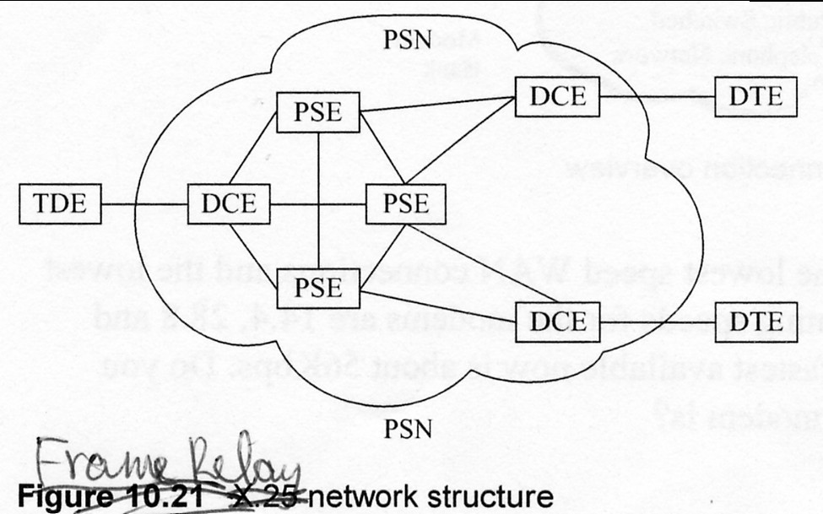
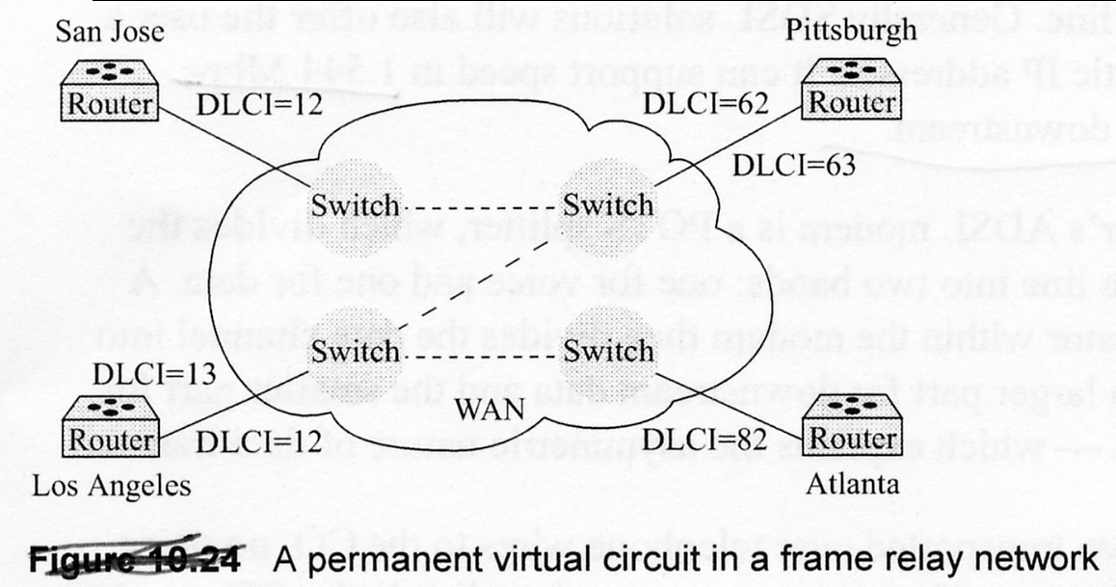
Frame relay, X.25 (2)
By Joe Lee
P.<number>

Slide 21
Broadband access (1)
DSL (Digital Subscriber Line)
  xDSL modem + existing 2-wire telephone line
  Provided by telephone provider
  2 categories :
  ADSL (Asymmetric Digital Subscriber Line) :
    higher speed in download than upload
    Suitable for residential or small business users
  SDSL (Symmetric Digital Subscriber Line) :
    Same upload and download speed.
    More suitable for server application
By Joe Lee
P.<number>

Slide 22
Broadband access (2)
Fiber to switch in building closet
  Optic fiber directly from your home to fiber switch in closet of your building
  Bandwidth can be up to 1000M from your PC to switch
  However, bandwidth from switch to INTERNET depends on ISP’s network => overall bandwidth should be less than 1000M
By Joe Lee
P.<number>

Slide 23
Wireless
technologies
By Joe Lee
P.<number>

Slide 24
Why wireless network?
To user, wireless network provides
  Mobility on accessing network
  Convenience
  Enhanced Productivity
To network manager and administrator
  Easy to build up compared to wired network
    Eg. home wireless network
    Eg. wireless network for SME office
  Reduced cost of wireless devices
  Matured technology
    Better bandwidth
    Better security
By Joe Lee
P.<number>

Slide 25
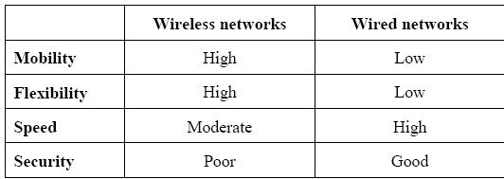
Wirelesss network Vs wired network
Poor if without WPA2
By Joe Lee
P.<number>

Slide 26
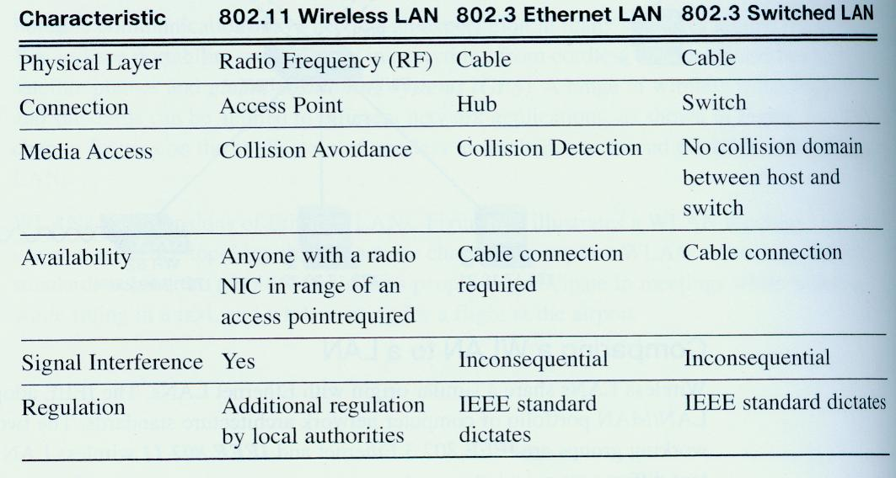
Standard (wireless vs wired)
By Joe Lee
P.<number>

Slide 27
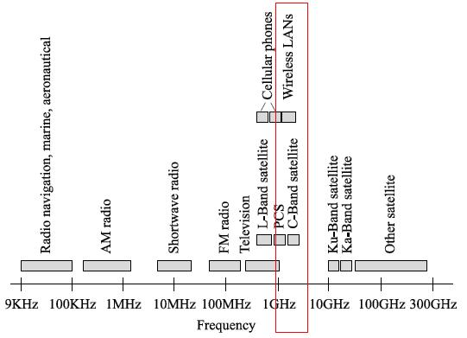
Frequency spectrum used by Wirelesss
1GHz to 5GHz
By Joe Lee
P.<number>

Slide 28
Frequency used by wireless network
Transmission media
  Electromagnetic wave over atmosphere
Frequency spectrum used: 1GHz to 5GHz
  Different wireless standards use different frequencies
    802.11b uses 2.4GHz
    802.11g uses 2.4GHz
    802.11a uses 5GHz
    802.11n uses 2.4GHz or 5GHz
    802.11ac uses 5GHz
  Frequency bands are divided into channels, similar to radio and TV broadcast, but with greater channel width and overlap
By Joe Lee
P.<number>

Slide 29
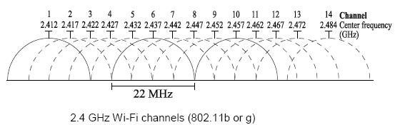
Divide wireless frequency band into channels
By Joe Lee
P.<number>

Slide 30
Access method used by wireless network
Access method
  Adapts from Ethernet’s CSMA/CD (Carrier Sense Multiple Access/Collision Detection)
  Use CSMA/CA (Carrier Sense Multiple Access/Collision Avoidance). CA is used to avoid waste of valuable transmission capacity due to collision.
  Use distributed access scheme with no centralized controller.
  Data transmission may be corrupted by external interference. So, positive acknowledge for all transmitted frames is used to ensure reliable transmission of data.
By Joe Lee
P.<number>

Slide 31
Association and SSID
There are many different wireless networks in the atmosphere
Each wireless network is identified by a SSID (Service Set Identifier). It is just a unique character string.
Association
  Before using a wireless network to transmit data, wireless client must go through association process to establish a link with particular wireless network.
  Wireless client needs to provide SSID for association.
  Authentication may or may not be required, depending on the implementation.
By Joe Lee
P.<number>

Slide 32
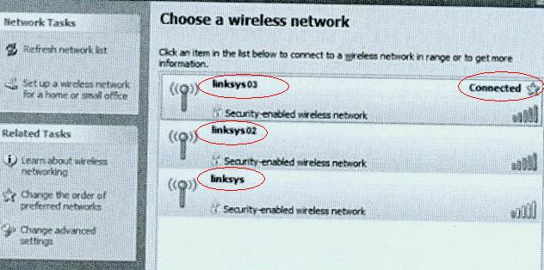
Broadcast SSID
By Joe Lee
P.<number>

Slide 33
Components of wireless network (1)
A wireless network may contain part or all following components:
  Wireless access point (AP)
  Wireless adapter/NIC for each wireless device (eg. host, printer, game console, etc).
  LAN switch with PoE (Power Over Ethernet) feature for connecting the access points
  A wireless gateway between wireless and wired network. It usually have firewall and NAT features.
  Router for multi-VLAN environment.
By Joe Lee
P.<number>

Slide 34
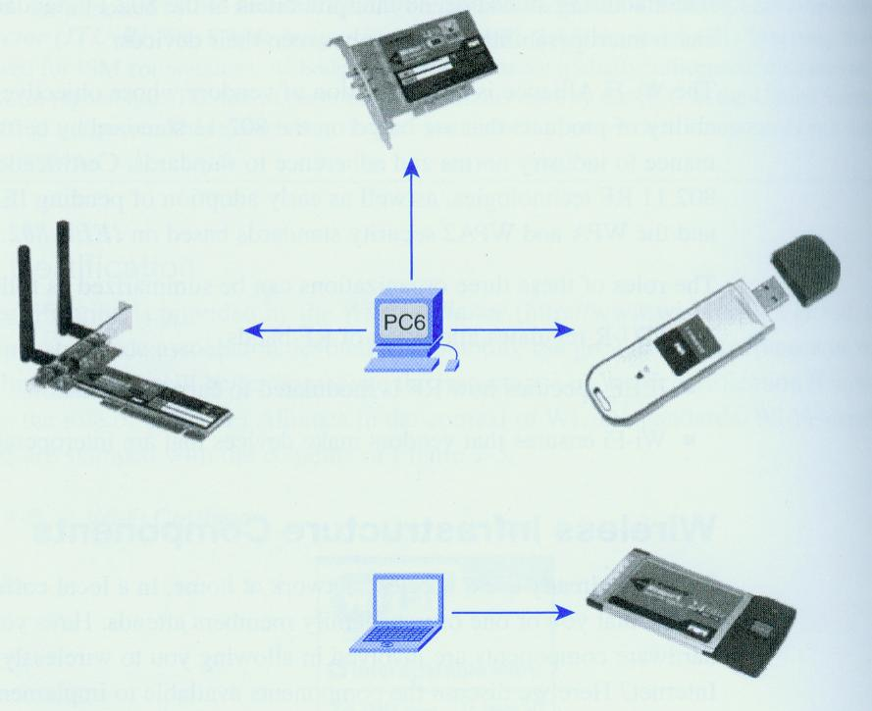
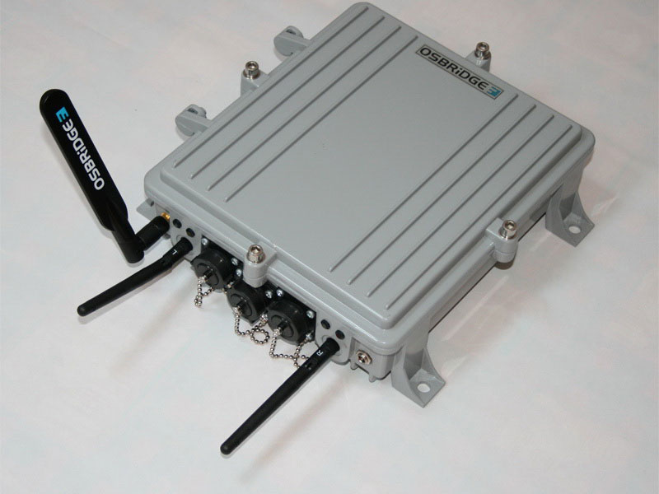
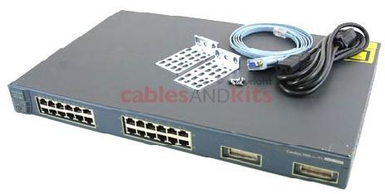
Components of wireless network (2)
By Joe Lee
P.<number>

Slide 35
Enterprise wireless network (1)
A typical enterprise wireless network is usually connected to wired infrastructure. Such wireless network requires
  Wireless access point (AP)
  Wireless adapter/NIC for each wireless host
  LAN switches with PoE feature for connecting the access points
  A wireless gateway between wireless and wired network. It usually have firewall and NAT features.
  Router for multi-VLAN environment.
By Joe Lee
P.<number>

Slide 36
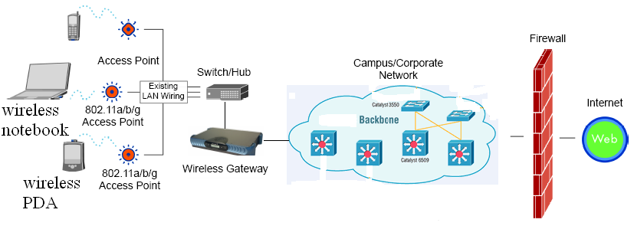
Enterprise wireless network (2)
PoE switch
By Joe Lee
P.<number>

Slide 37
Home wireless network (1)
A typical home wireless network is usually connected to ISP via DSL or ADSL modem . Such wireless network requires
  Wireless broadband router which contains
    access point (AP)
    4 or 8 ports LAN switch
    Router
    As DHCP server
    Firewall + NAT function
    PPPoE for authentication
  Wireless adapter/NIC for each wireless host
  ADSL or DSL modem depending on your ISP
By Joe Lee
P.<number>

Slide 38
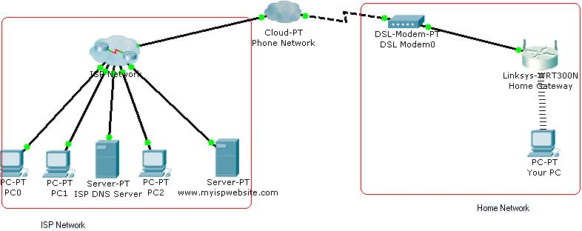
Home wireless network (2)
ADSL modem
Wireless broadband router
By Joe Lee
P.<number>

Slide 39
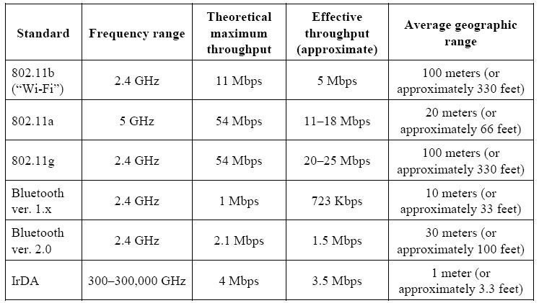
Features of wireless network protocols
By Joe Lee
P.<number>

Slide 40
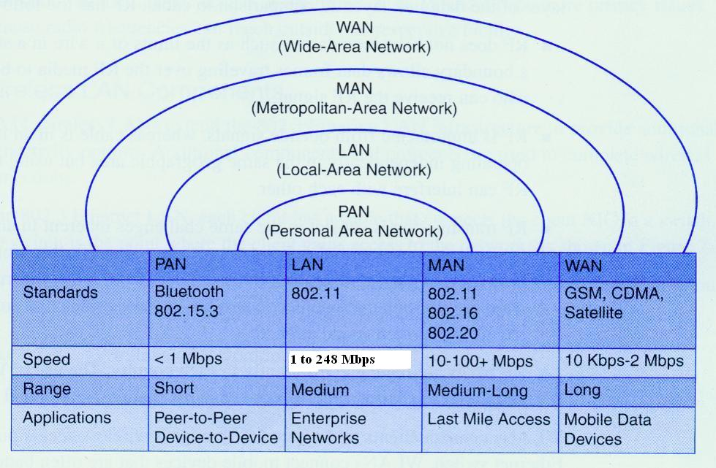
Overview of Wireless standards
By Joe Lee
P.<number>

Slide 41
Wireless LAN standards (1)
Wireless standards for LAN is developed by IEEE
Related wireless standards are categorized into IEEE 802.11x (where x is a letter)
Different standards for wireless LAN are developed:
  802.11 (release in 1997)
  802.11b (release in Oct 1999)
  802.11a (release in Oct 1999)
  802.11g (release in Jun 2003)
  802.11n (release in Oct 2009)
  802.11ac
    wave 1 (release in Dec 2013)
    wave 2 (release in 2016)
These standards are also called Wi-Fi standards.
By Joe Lee
P.<number>

Slide 42
Wireless LAN standards (2)
Effective date rate:
  decrease as “the distance between access point and wireless notebook” increases
  decrease as “the number of wireless notebooks associated with increases access point” increases
The range:
  is assumed in-door and without any obstacle between access point and wireless notebook.
  If there is obstacle between access point and wireless notebook, the max. range decreases.
Different countries allow different frequency channels for these standards.
  Refer to http://en.wikipedia.org/wiki/List_of_WLAN_channels
By Joe Lee
P.<number>

Slide 43
802.11n
802.11n
  announced in Oct, 2009
  Operates at either 2.4GHz or 5GHz
  20 MHz or 40 MHz channels
  With multiple-input multiple-output (MIMO) feature, up to 4 spatial streams
  Data rate
    At 40 MHz with 4 MIMO, up to 600Mbps
    At 20 MHz with 4 MIMO, up to 288.8 Mbps
  Effective indoor radius 70m
By Joe Lee
P.<number>

Slide 44
802.11ac
802.11ac
  announced in Dec, 2013
  Operates at 5GHz
  With multiple-input multiple-output (MIMO) feature, up to 8 spatial streams
  Max. throughput of 3650 Mbps in theory
By Joe Lee
P.<number>

Slide 45
802.11n Vs 802.11ac
 | 802.11n | 802.11ac
Frequency band | 2.4GHz or 5 GHz | 5 GHz only
Channel width | 20, 40 MHz | 20, 40, 80 MHz 160 MHz (optional)
Spatial Streams | 1 to 4 | 1 to 8
Multi-user MIMO | No | Yes
Max. Data rate per single stream | 150 Mbps | 450 Mbps
Max. Data rate in theory | 600 Mbps (4 streams) | 3650 Mbps (8 streams)
By Joe Lee
P.<number>

Slide 46
WiMax (1)
IEEE802.16 standard
Licensed frequencies are 2.3GHz, 2.5GHz or 3.5GHz
Throughput:
  ~40Mbps for fixed line of sight connection,
  ~15Mbps for mobile, non-line of sight connection
QoS mechanism is provided for timing critical application
Used in Wireless MAN (Metropolitan Area Network) => larger coverage distance
By Joe Lee
P.<number>

Slide 47
WiMax (2)
Cost of implementation and frequency license are expensive
  usually implemented by wireless Internet service provider (WISP)
  Lease to bandwidth to organization who need access to INTERNET but are too far from DSL stations
Wireless service provision:
  Wimax only
  WiMax from operation center to delivery area + IEEE802.11 technologies for end user connection
By Joe Lee
P.<number>

Slide 48
Choice of wireless network standards
Consider following factors when choose:
  Security of data. Newer standard provides better security.
  Data rate your expected
  Size and environment (any cement wall as partition) of your office
  Interference of frequency band with existing home appliance (microwave oven or cordless phone usually uses 2.4 GHz)
  Cost.
By Joe Lee
P.<number>

Slide 49
Key organizations for Wireless standards
3 organizations influences wireless standards
  ITU-R
    Regulate allocation of RF spectrum & satellite orbits
  IEEE
    Develops & maintains standards for wireless LAN and WAN
  Wi-Fi Alliance
    A global, non-profit association composed of industry leading vendors of wireless products.
    Improves inter-operability of products that are based on 802.11 standards.
    Certify wireless products.
    http://www.wi-fi.org/
By Joe Lee
P.<number>

Slide 50
2 Wireless design models
Intelligent edge (Obsolete)
  AP contains all the entire logic system needed to implement, manage and secure a WLAN.
  Benefit: quick to implement one AP
  Drawback: slow implementation for large numbers of APs
Distributed intelligence
  Centralized configuration management by a device/software called WLAN Network Management System (WNMS)
  Configuration and update of firmware of APs are done by WNMS using SNMP
  Provide scalability
  Easy implementation and management even for large number of APs
By Joe Lee
P.<number>

Slide 51
Wireless planning
Floor plan of covered area
Location of AP
Degree of redundancy between APs
Minimize overlapping of APs’ covered areas.
Trade-off between item 3 and 4
By Joe Lee
P.<number>

Slide 52
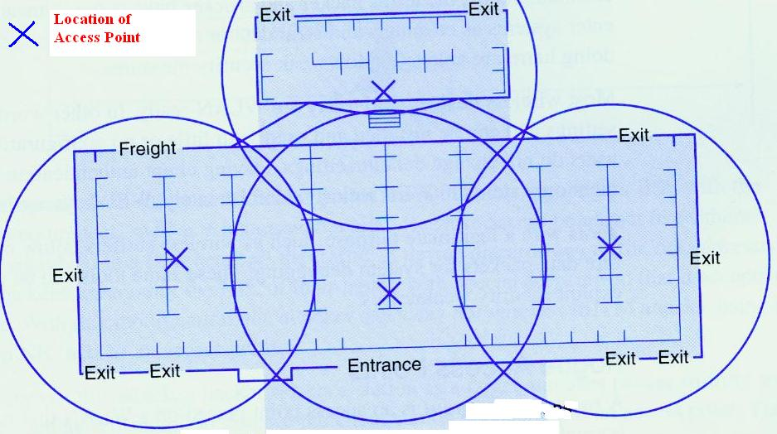
Floor planning
Correct location
By Joe Lee
P.<number>

Slide 53
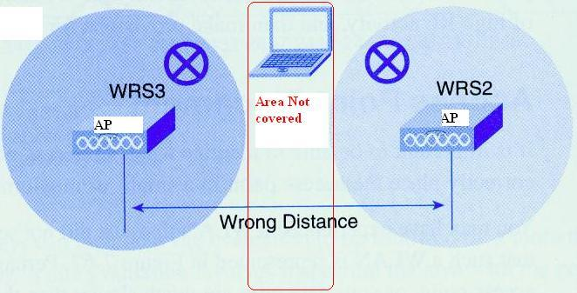
Wireless location & coverage (1)
Incorrect location
By Joe Lee
P.<number>

Slide 54
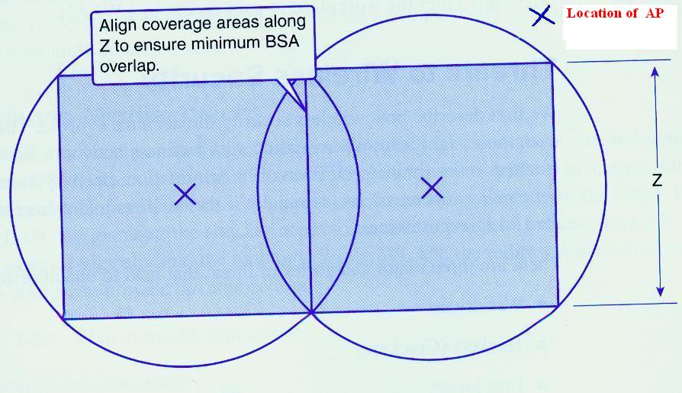
Wireless location & coverage (2)
Correct location
By Joe Lee
P.<number>

Slide 55
2 operation modes
Wireless network can operate in one of 2 modes
  Ad-hoc
    Peer to Peer – direct communication between 2 wireless devices (eg. notebook)
    No AP is required
  Infrastructure
    AP is required.
    Wireless device must connect to AP before communication between 2 wireless devices.
You must configure your wireless device to use correct mode.
By Joe Lee
P.<number>

Slide 56
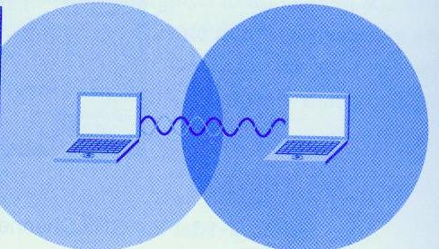
Ad-Hoc mode
By Joe Lee
P.<number>

Slide 57
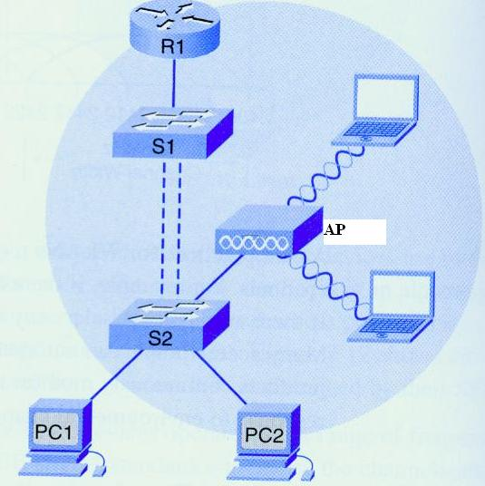
Infrastructure mode
By Joe Lee
P.<number>

Slide 58
Operational level considerations
In operational level, you need to consider
  Match standard between AP and wireless client
    Some APs support multiple standards
  Match SSID between AP and wireless client
    If AP is configured to broadcast SSID, wireless client can easily discover it.
  Match with configuration parameters on AP
    Is key required?
  Any access control by MAC-address of wireless client.
By Joe Lee
P.<number>

Slide 59
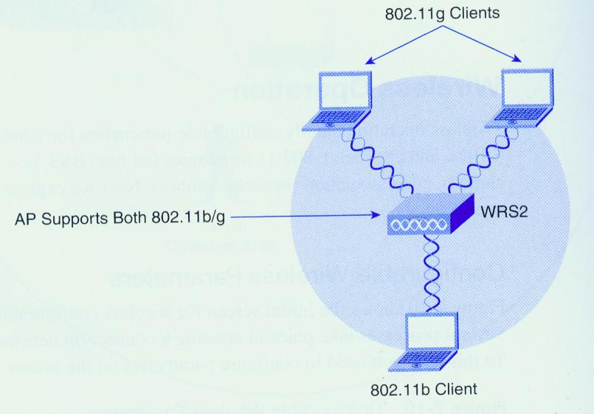
AP supports multiple standards
By Joe Lee
P.<number>

Slide 60
Wireless security threat
Security threat in wireless network
  Rogue AP
    Un-authorized AP plug to switch for wireless AP
    The un-authorized AP is configured with correct parameters so that client will be associated to it.
    The un-authorized AP can then capture any data between it and the client.
  Man-in-the-middle attack
  Orchestrated DoS (Denial-of-Service) attack:
    flood AP a series of dis-associate commands that cause all clients associated with AP to be dis-assoicated by AP.
    The client re-associates but dis-associate again.
    The cycle repeats
By Joe Lee
P.<number>

Slide 61
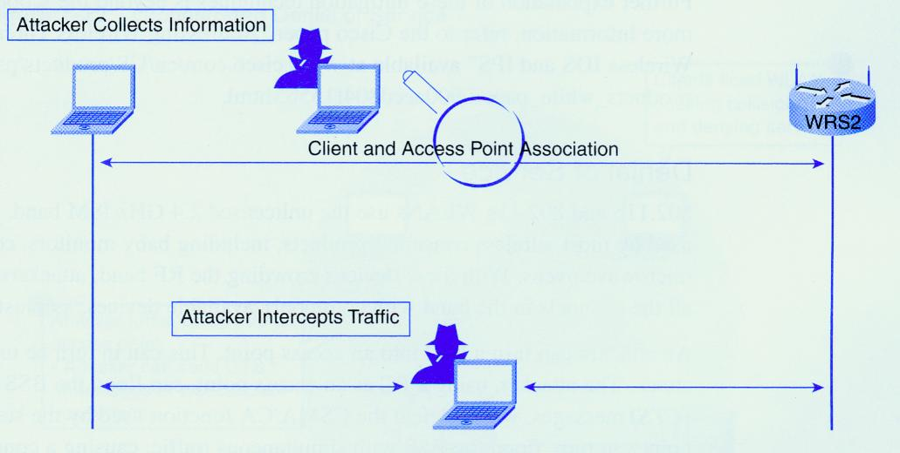
Man-in-the-middle attack
By Joe Lee
P.<number>

Slide 62
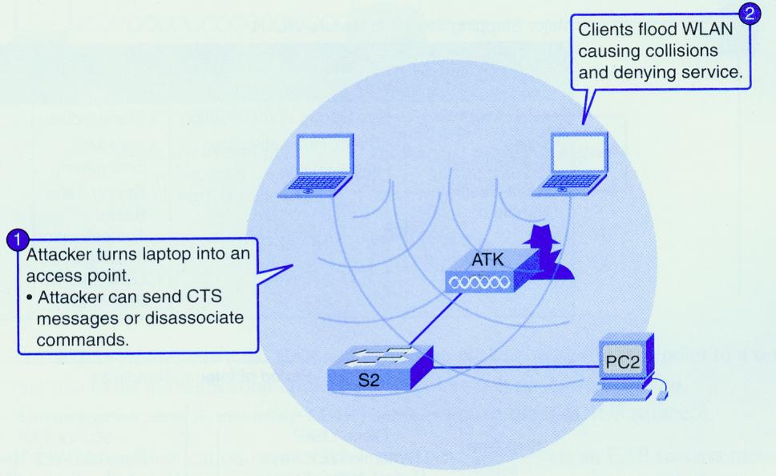
Orchestrated DoS attack
By Joe Lee
P.<number>

Slide 63
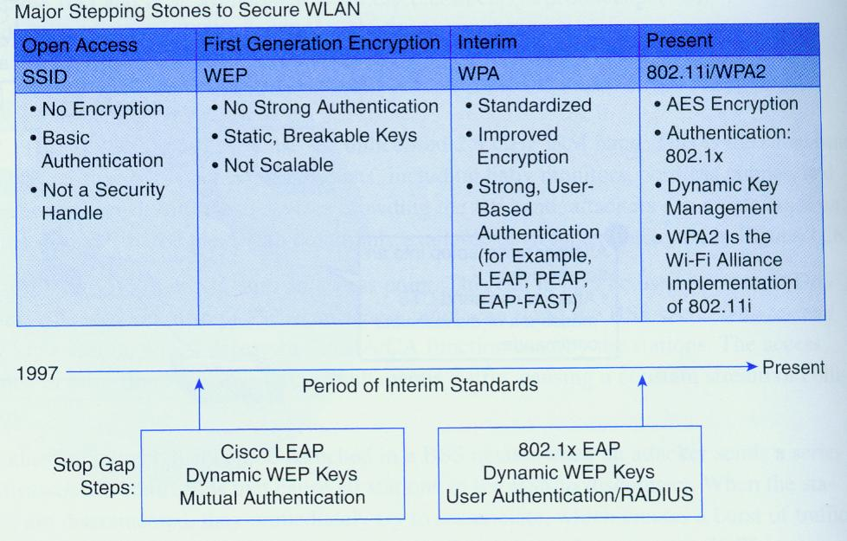
Wireless security protocol (1)
By Joe Lee
P.<number>

Slide 64
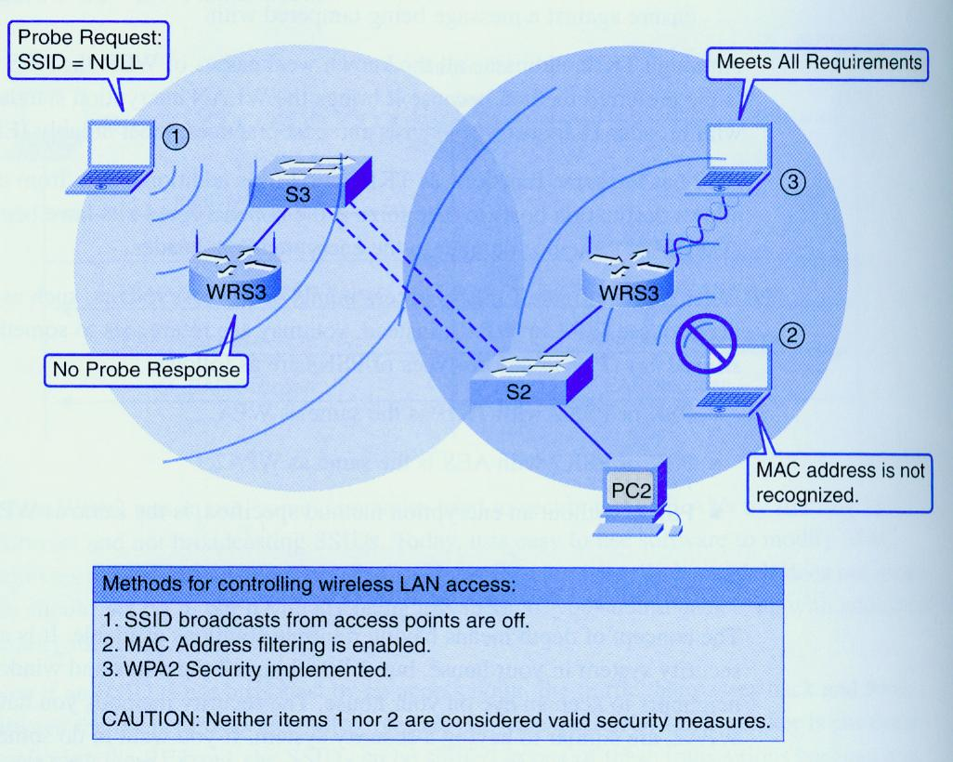
Wireless security protocol (2)
By Joe Lee
P.<number>

Slide 65
Wireless security protocol (3)
Security protocol must be implemented to protect wireless network for followings:
  Authentication between AP and client
  Encryption of data transmitted over the air
  Integrity of data transmitted over the air
  The key for encryption must be dynamic and long enough.
Some measures provide certain level of security but are NOT secure enough
  Disable broadcast of SSID
  Change default admin password of AP
  Access control by MAC address of wireless client
By Joe Lee
P.<number>

Slide 66
Wireless security protocol (4) - WPA
WEP (Wired Equivalent Privacy) use static key and was already known to be breakable.
WPA (Wi-Fi Protected Access) is compatible with legacy products which uses WEP. That means no hardware upgrade required.
WPA uses TKIP as encryption method.
  TKIP (Temporal Key Integrity Protocol )
    is part of 802.11i.
    uses the RC4 stream encryption algorithm as WEP
    TKIP encrypts each data packet with a unique encryption key. A re-keying mechanism to provide key generation every 10,000 packets => dynamic, random key encryption.
    TKIP provides integrity check to protect packets
By Joe Lee
P.<number>

Slide 67
Wireless security protocol (7) – WPA2 (1)
WPA2 stands for Wi-Fi Protected Access 2
WPA2 provides government grade security
  by implementing AES encryption algorithm
  and 802.1x-based authentication.
2 versions for WPA2
  WPA2-Personal
    No AAA server is required
  WPA2-Enterprise
    AAA server is required & EAP is used for authentication.
By Joe Lee
P.<number>

Slide 68
Wireless security protocol (8) – WPA2 (2)
AES (Advanced Encryption Standard)
  AES has a fixed block size of 128-bits and a key size of 128, 192, or 256-bits
  current encryption standard (FIPS-197) intended to be used by U.S. Government organizations to protect sensitive (and even secret and top secret) information => much stronger in terms of encryption.
  It also provide integrity of data packet.
WEP are considered NOT secure enough.
WPA2 is better than WPA. Both are much secure than WEP.
By Joe Lee
P.<number>

Slide 69
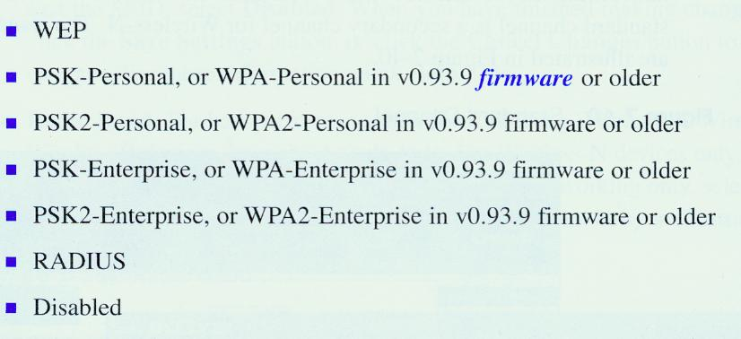
Wireless security protocol (8)
By Joe Lee
P.<number>

Slide 70
Open
Discussions
By Joe Lee
P.<number>

