Slide 1
ELECS212
Network
Programming and Design
Tutorial 3 for group 1 & 2
(Lab 1.6)
Course Coordinator : Dr. Steven Choy
Tutor : Mr. Lee, Bo-sing (Joe)
URL of my teaching website : http://learn.ouhk.edu.hk/~t441051/s212
P.<number>
Notes:
CT212 (02/03)-Network Programming and design
27 April, 2002
School of Science & Technology

Slide 2
Agenda
lab 1.6
  Build up, install & configure Apache web server in 103.247.158.246 (labsupport)
P.<number>
Notes:
CT212 (02/03)-Network Programming and design
27 April, 2002
School of Science & Technology

Slide 3
Publish web page & run web application
There are 2 possible ways to publish web page & run web applications
  To build up & configure your own Apache web server.
    Lab 1.6
    The web page is located DOCUMENTROOT directory of APACHE web server
    The web page is NOT located under home directory of any account
  To have an account in a system which already have installed and configured Apache web server
    Step 1 of Lab 1.8
    The web page is located in ~/public_html/ of any account
P.<number>
Notes:
CT212 (02/03)-Network Programming and design
27 April, 2002
School of Science & Technology

Slide 4
Lab 1.6 Apache web server
To have an APACHE WEB server running on a Linux system, you need to
  Download Apache web server source code to $HOME directory of your account in labsupport (Step 1)
  Extract downloaded tar-ball (Step 2)
  Configure APACHE before compilation (Step 3)
  Compile the source code of APACHE (Step 4)
  Install the APACHE (Step 5)
  Customize the configuration file of APCHE (Step 6)
  Start APACHE (Step 7)
  Edit and locate your web page file in DOCUMENTROOT directory of APACHE web server (Step 8)
P.<number>
Notes:
CT212 (02/03)-Network Programming and design
27 April, 2002
School of Science & Technology

Slide 5
Lab 1.6 – Step 1 (1)
Find out download URL for downloading latest stable release of UNIX source code by visiting http://httpd.apache.org/download.cgi using IE browser (Fig. 1.6.1)
  We use version 2.2.31
    (Don’t use latest version 2.4.23 or 2.4.25)
    you can find version 2.2.31 in URL http://archive.apache.org/dist/httpd/#archive
  After login 103.247.158.246 (labsupport), download to your home directory by command
    wget http://archive.apache.org/dist/httpd/httpd-2.2.31.tar.gz
P.<number>
Notes:
CT212 (02/03)-Network Programming and design
27 April, 2002
School of Science & Technology

Slide 6
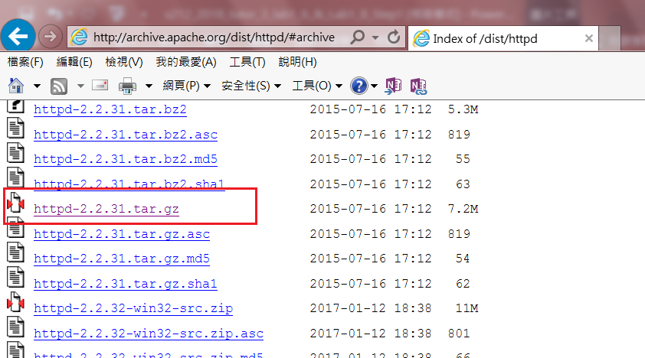
Lab 1.6 – Step 1 (2)
P.<number>

Slide 7
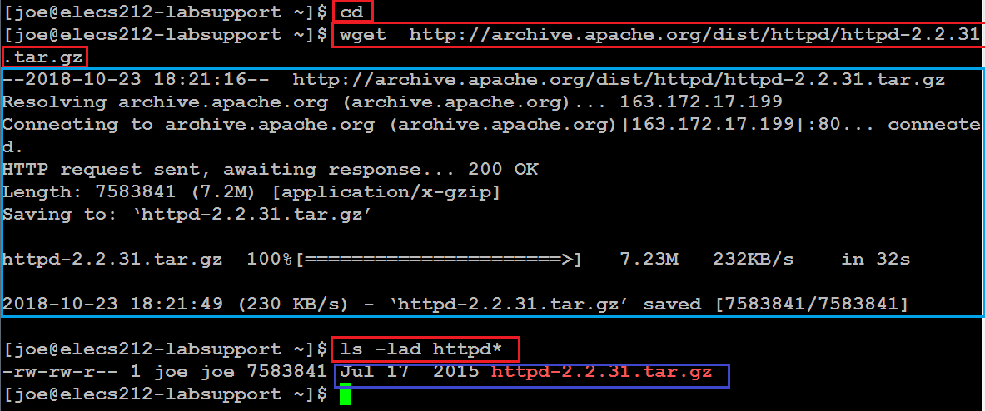
Lab 1.6 – Step 1 (3)
P.<number>
Notes:
CT212 (02/03)-Network Programming and design
27 April, 2002
School of Science & Technology

Slide 8
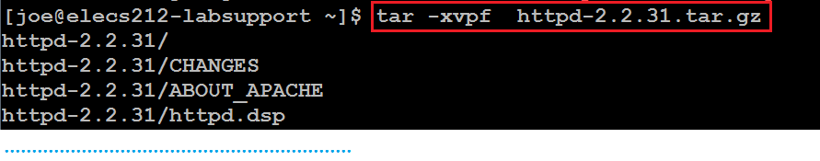
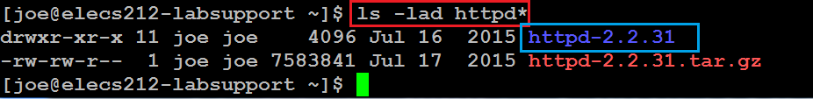
Lab 1.6 – Step 2
The downloaded file, httpd-2.2.31.tar.gz, is a compressed tar file.
  *.tar => tar file
  *.gz => compressed by gzip
You need to un-tar and un-compress it
  tar -xvzf ~/httpd-2.2.31.tar.gz
To check for success of un-tar and uncompress,
  ls -lad httpd*
P.<number>
Notes:
CT212 (02/03)-Network Programming and design
27 April, 2002
School of Science & Technology

Slide 9
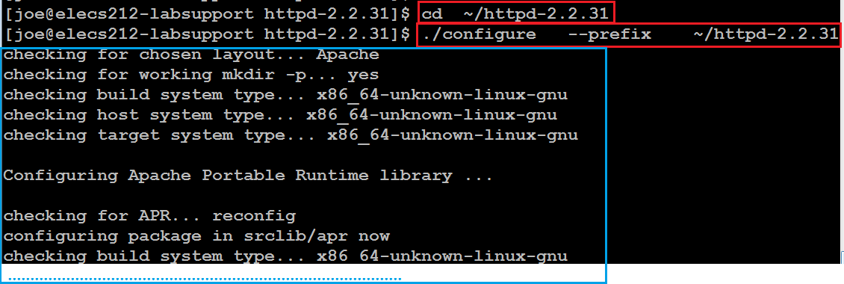

Lab 1.6 – Step 3
Now a new directory httpd-2.2.31 is created under your home directory. Note that your home directory is different from mine and that in lab book.
To configure before compilation, run following commands
  cd ~/httpd-2.2.31
  ./configure --prefix ~/httpd-2.2.31
  (./configure command takes about one minute to complete. Don’t proceed if there is any error message )
P.<number>
Notes:
CT212 (02/03)-Network Programming and design
27 April, 2002
School of Science & Technology

Slide 10
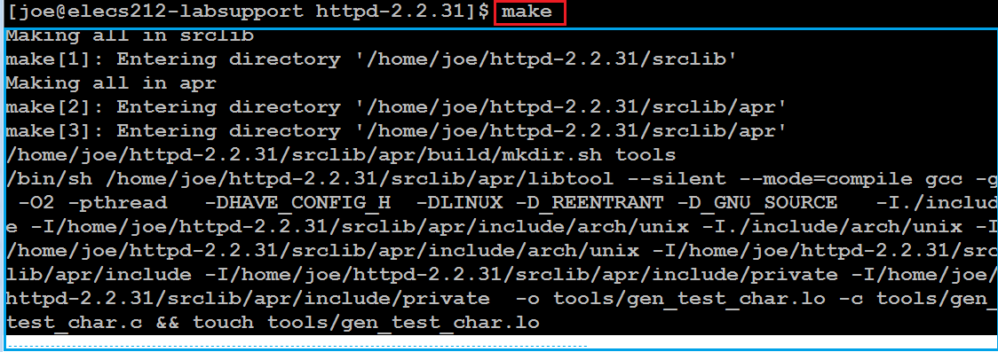
Lab 1.6 – Step 4
In current directory (i.e. ~/httpd-2.2.31), compile source code of APCHE by command
  make
  (The “make” command takes about 3 or more minutes to complete. Don’t proceed if there is any error message)
P.<number>
Notes:
CT212 (02/03)-Network Programming and design
27 April, 2002
School of Science & Technology

Slide 11
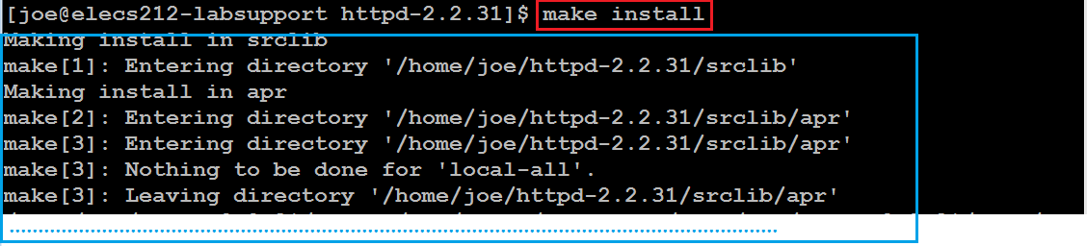
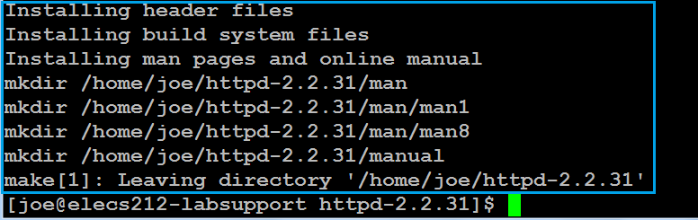
Lab 1.6 – Step 5
In current directory (i.e. ~/httpd-2.2.31), install APACHE by command below
  make install
  (The “make install” command takes about less than 1 minute to complete. Don’t proceed if there is any error message)
P.<number>
Notes:
CT212 (02/03)-Network Programming and design
27 April, 2002
School of Science & Technology

Slide 12
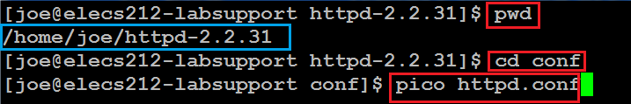
Lab 1.6 – Step 6 (1)
Customize APACHE
  Edit configuration file “~/httpd-2.2.31/conf/httpd.conf”
pwd (ensure that you are under ~/httpd-2.2.31)
cd conf (conf is a directory name)
pico httpd.conf
P.<number>
Notes:
CT212 (02/03)-Network Programming and design
27 April, 2002
School of Science & Technology

Slide 13

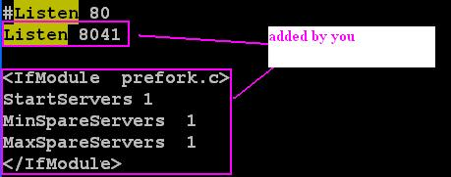
Lab 1.6 – Step 6 (2)
Locate and edit the line “Listen 80” to “Listen 8xxx”. xxx is the last 3 digits of your student ID.
Add following 5 lines after line “Listen 8xxx”:
  <IfModule prefork.c>
  StartServers 1
  MinSpareServers 1
  MaxSpareServers 1
  </IfModule>
P.<number>
Notes:
CT212 (02/03)-Network Programming and design
27 April, 2002
School of Science & Technology

Slide 14
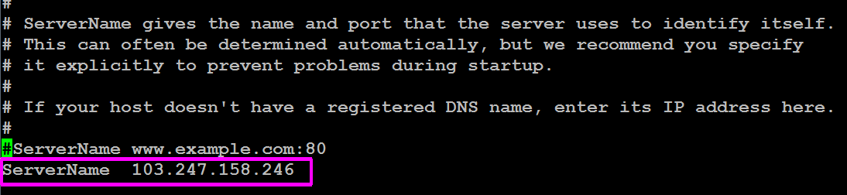
Lab 1.6 – Step 6 (3)
Specify ServerName by IP address
P.<number>
Notes:
CT212 (02/03)-Network Programming and design
27 April, 2002
School of Science & Technology

Slide 15
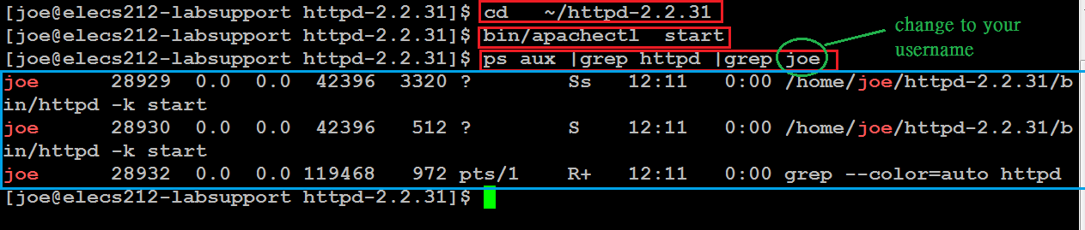
Lab 1.6 – Step 7
Start your APACHE server by commands below
  cd ~/httpd-2.2.31
  bin/apachectl start
Verify you started APACHE server successfully
  ps aux |grep httpd |grep your_username
P.<number>
Notes:
CT212 (02/03)-Network Programming and design
27 April, 2002
School of Science & Technology

Slide 16
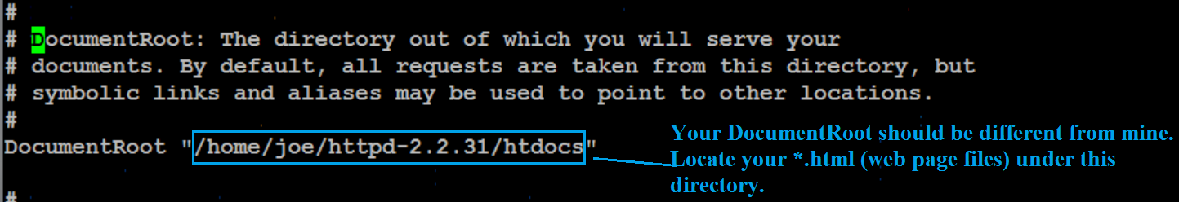
Lab 1.6 – Step 8
Publish your web page
  Determine where should you put your web page files (*.html)
    Open configuration file “~/httpd-2.2.31/conf/httpd.conf” and locate line “DocumentRoot ……..”
    A web page file “index.html” is already located in ~/httpd-2.2.31/htdocs/. Its URL is
      http:// 103.247.158.246:8xxx/index.html (xxx is last 3 digits of your SID)
P.<number>
Notes:
CT212 (02/03)-Network Programming and design
27 April, 2002
School of Science & Technology

Slide 17
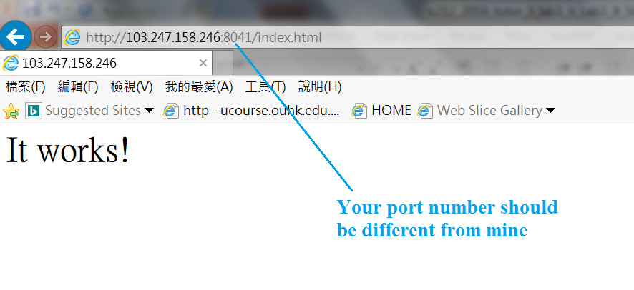
Access WebServer in browser
P.<number>

Slide 18
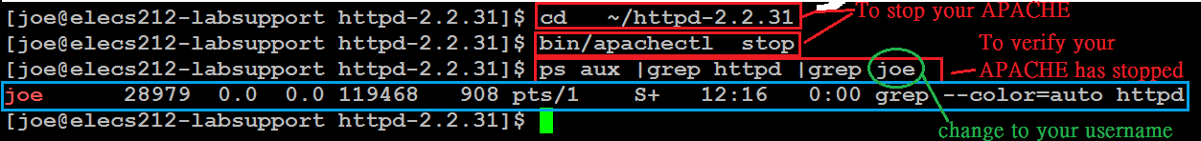
Lab 1.6 –Must do step before leave
You MUST stop your APACHE server, by commands below, before leave. Otherwise labsupport will be heavily loaded.
  cd ~/httpd-2.2.31
  bin/apachectl stop
  ps aux |grep httpd |grep your_username
P.<number>
Notes:
CT212 (02/03)-Network Programming and design
27 April, 2002
School of Science & Technology

