Slide 1
ELECS212
Network
Programming and Design
Tutorial 6 for group 1, 2
(Lab 2.5)
Course Coordinator : Dr. Steven Choy
Tutor : Mr. Lee, Bo-sing (Joe)
URL of my teaching website : http://ucourse.ouhk.edu.hk/~t441051/s212
P.<number>
Notes:
CT212 (02/03)-Network Programming and design
27 April, 2002
School of Science & Technology

Slide 2
Agenda
Flat-file database development with CGI
P.<number>
Notes:
CT212 (02/03)-Network Programming and design
27 April, 2002
School of Science & Technology

Slide 3
Lab 2.5 steps
To run cgi via browser, you need to
  Create directories ~/public_html/ and ~/public_html/cgi-bin. Change permission mode of these 2 directories to 701
  Download & extract prepared web database source files (Step 1)
  Check if CGI script can run your personal website (Step 2)
  Configure/Understand web database program (Step 3)
  addToDB.cgi - Enter data into web database (Step 4)
  viewDB.cgi - View record in web database (Step 5)
P.<number>
Notes:
CT212 (02/03)-Network Programming and design
27 April, 2002
School of Science & Technology

Slide 4
Lab 2.5 pre-requisite
In previous tutorial, you should have created 2 directories and change permission mode to 701
  ~/public_html / (701)
  ~/public_html/cgi-bin (701)
For your web page files (*.html)
  Locate them under ~/public_html/
  Change permission mode to 704
For your cgi-script files (*.cgi)
  Locate them under ~/public_html/cgi-bin
  Change permission mode to 705
P.<number>
Notes:
CT212 (02/03)-Network Programming and design
27 April, 2002
School of Science & Technology

Slide 5
Lab 2.5 – Step 1 (1)
Download prepared configuration files
  cd ~/public_html
  wget http://103.247.158.246/~joe/lab_src/labbook-db-1.3.tgz
Un-tar and un-compress labbook-db-1.3.tgz
  tar -xvpzf labbook-db-1.3.tgz
P.<number>
Notes:
CT212 (02/03)-Network Programming and design
27 April, 2002
School of Science & Technology

Slide 6
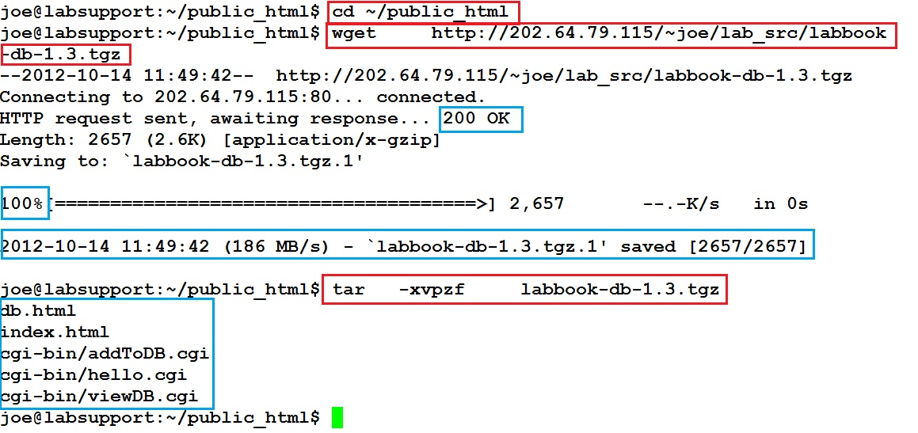
Lab 2.5 – Step 1 (2)
103.247.158.246
103.247.158.246
P.<number>
Notes:
CT212 (02/03)-Network Programming and design
27 April, 2002
School of Science & Technology

Slide 7
Lab 2.5 – Step 1 (3)
Ensure existence of following files and corresponding permission rights. You need to use “chmod” to change permission rights.
  File “~/public_html/index.html (704)
  File “~/public_html/db.html (704)
  File “~/public_html/cgi-bin/addToDB.cgi (705)
  File “~/public_html/cgi-bin/hello.cgi (705)
  File “~/public_html/cgi-bin/viewDB.cgi (705)
P.<number>
Notes:
CT212 (02/03)-Network Programming and design
27 April, 2002
School of Science & Technology

Slide 8
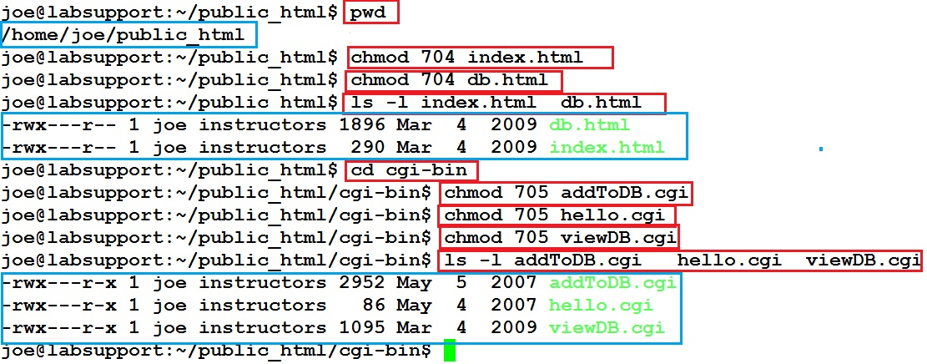
Lab 2.5 – Step 1 (4)
P.<number>
Notes:
CT212 (02/03)-Network Programming and design
27 April, 2002
School of Science & Technology

Slide 9
Lab 2.5 – Step 2 (1)
File “~/public_html/index.html
  Permission right is 704
  Web page to invoke hello.cgi
File “~/public_html/cgi-bin/hello.cgi
  Permission right is 705
  Used for displaying your username
  Written in Perl
  Don’t change the code
P.<number>
Notes:
CT212 (02/03)-Network Programming and design
27 April, 2002
School of Science & Technology

Slide 10
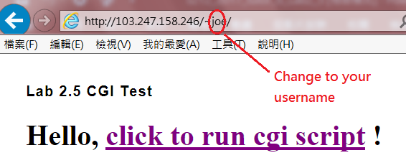
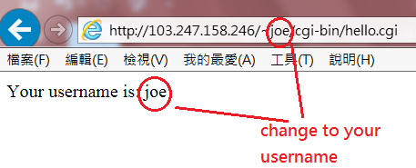
Lab 2.5 – Step 2 (2)
Open your browser, type “http://103.247.158.246/~sxxxxxxx/”
where sxxxxxxx is your username
P.<number>
Notes:
CT212 (02/03)-Network Programming and design
27 April, 2002
School of Science & Technology

Slide 11
Lab 2.5 – Step 3 (1)
  4 files are required for this flat-file database application
    File “~/public_html/db.html”
    File “~/public_html/cgi-bin/db.dat”
    File “~/public_html/cgi-bin/addtoDB.cgi”
    File “~/public_html/cgi-bin/viewDB.cgi
File “~/public_html/db.html”
  Web page/interface to invoke viewDB.cgi & addtoDB.cgi
P.<number>
Notes:
CT212 (02/03)-Network Programming and design
27 April, 2002
School of Science & Technology

Slide 12
Lab 2.5 – Step 3 (2)
  File “~/public_html/cgi-bin/db.dat”
  Database for lab2.5
  is just an ASCII plain-text file
  Can be read by “cat” command
File “~/public_html/cgi-bin/viewDB.cgi
  Used for read existing records in database
  Written in Perl
  Source code is listed in listing 2.5.1 (P.156 of labbook)
  You are suggested to read & understand the code.
  Don’t change the code
P.<number>
Notes:
CT212 (02/03)-Network Programming and design
27 April, 2002
School of Science & Technology

Slide 13
Lab 2.5 – Step 3 (3)
File “~/public_html/cgi-bin/addtoDB.cgi”
  Used for adding new records into database
  Written in Perl
  Source code is listed in listing 2.5.2 (P.157 of labbook)
  You are suggested to read & understand the code.
  Don’t change the code
P.<number>
Notes:
CT212 (02/03)-Network Programming and design
27 April, 2002
School of Science & Technology

Slide 14
Lab 2.5 – Step 4 (1)
To add new records by invoking addToDB.cgi
  Visit URL http://103.247.158.246/~sxxxxxxx/db.html
where sxxxxxxx is your username
  2. Input “first name”, “last name”, “E-mail address”
    3. Click link “Submit” button
  4. Confirm input by clicking “OK” in pop-up window
  5. Click “back to Registration Form” link.
  6. Click “View Current Database” link to check that new record is added to database
P.<number>
Notes:
CT212 (02/03)-Network Programming and design
27 April, 2002
School of Science & Technology

Slide 15
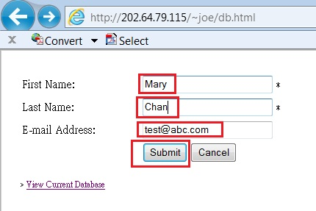
Lab 2.5 – Step 4 (2)
103.247.158.246/~joe/db.html
P.<number>
Notes:
CT212 (02/03)-Network Programming and design
27 April, 2002
School of Science & Technology

Slide 16
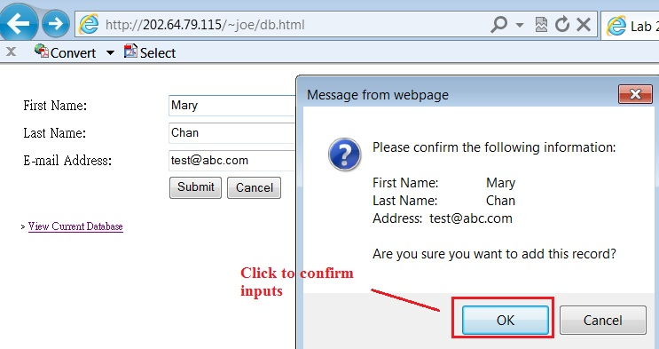
Lab 2.5 – Step 4 (3)
103.247.158.246/~joe/db.html
P.<number>
Notes:
CT212 (02/03)-Network Programming and design
27 April, 2002
School of Science & Technology

Slide 17
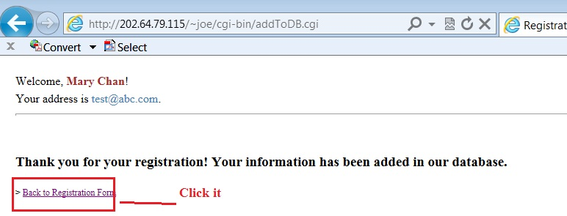
Lab 2.5 – Step 4 (4)
103.247.158.246/~joe/cgi-bin/addToDB.cgi
P.<number>
Notes:
CT212 (02/03)-Network Programming and design
27 April, 2002
School of Science & Technology

Slide 18
Lab 2.5 – Step 5 (1)
You can view content of database in 2 ways
  online access by invoking viewDB.cgi OR
  Display content of file db.dat directly by command “cat” under Linux prompt
To invoke viewDB.cgi
  1. Visit URL http://103.247.158.246/~sxxxxxxx/db.html
where sxxxxxxx is your username
2. Click link “View current database”
P.<number>
Notes:
CT212 (02/03)-Network Programming and design
27 April, 2002
School of Science & Technology

Slide 19
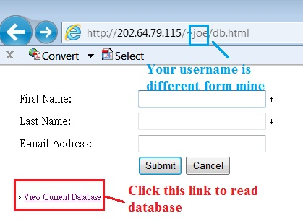
Lab 2.5 – Step 5 (2)
103.247.158.246/~joe/db.html
P.<number>
Notes:
CT212 (02/03)-Network Programming and design
27 April, 2002
School of Science & Technology

Slide 20
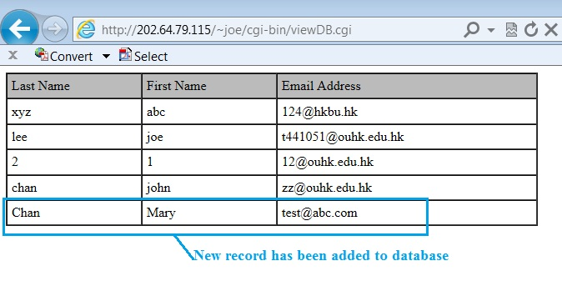
Lab 2.5 – Step 4 (6)
103.247.158.246/~joe/cgi-bin/viewDB.cgi
P.<number>
Notes:
CT212 (02/03)-Network Programming and design
27 April, 2002
School of Science & Technology

Slide 21
Lab 2.5 – Step 5 (3)
Besides online access, you can also display content of database by commands “cat db.dat”
  cd ~/public_html/cgi-bin
  cat db.dat
P.<number>
Notes:
CT212 (02/03)-Network Programming and design
27 April, 2002
School of Science & Technology

Slide 22
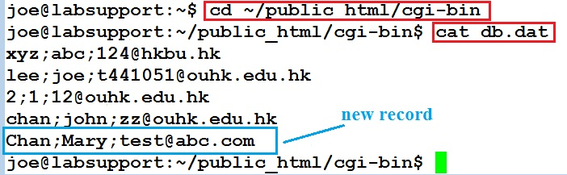
Lab 2.5 – Step 5 (4)
P.<number>
Notes:
CT212 (02/03)-Network Programming and design
27 April, 2002
School of Science & Technology

