Slide 1
PREDICTIVE ANALYTICS · GAMING OPERATIONS
Daily Casino Demand Forecast
A 28-day, machine-learned demand forecast — and the planning pipeline it drives, from patron hours to dealer shifts.
Model · Methodology · Validation · Operations
Notes:
Purpose: explain the full demand-forecast system to both management and technical stakeholders. Management: slides 2-7 and 21-25. Technical: slides 8-20.

Slide 2
AT A GLANCE
Executive summary
28
4.3%
-53%
170
days forecast
ahead, daily
forecast error
(2026 YTD)
error vs. naive
baseline
engineered
features
What it does
Why it matters
Predicts daily patron hours 28 days ahead, refreshed every day
Outputs a median (P50) plus a P10–P90 planning band
Feeds table-count, dealer-headcount and shift-assignment planning
Runs unattended in ~3 minutes; ~35 min for the highest-accuracy mode
Replaces judgement-based planning with an auditable, repeatable number
Cuts average daily mis-allocation from ~630 to ~300 patron hours
Halves Chinese New Year error — the year's single costliest planning week
Every run is archived by date — forecasts are traceable after the fact
Accuracy measured across 2026 year to date (1 Jan – 27 May, 147 days), re-forecasting weekly — the cadence the model is actually run at.
Notes:
Lead with -53% vs naive. 4.3% is the full-year operational number and includes Chinese New Year. A single CNY-free month scores ~3.4% - that better number is real but not representative, so it is not the headline.

Slide 3
OVERVIEW
How it works, in one picture
1
2
3
4
5
Demand history
Feature engineering
28 models
Holiday correction
28-day forecast
→
→
→
→
879 days of daily patron
hours and table counts
170 signals: weekday, holiday
windows, trends, momentum
One per forecast day, so each
uses only data it would have had
Chinese New Year adjusted
against last year's pattern
Median plus a planning band,
refreshed every run
What makes it trustworthy
What it does not do
A forecast never sees data that did not exist yet
Retrains from scratch each run — nothing to drift
Every claim in this deck is a measured backtest
Predict typhoon closures — a human applies that call
Replace judgement on Chinese New Year staffing
Guarantee its uncertainty band; treat it as relative
Sections 1–6 that follow expand each of these five stages in detail.
Notes:
This is the slide to leave up if you only have five minutes. Everything after it is elaboration.

Slide 4
WHERE WE STAND
Almost all remaining error sits in one week
Ordinary trading days are forecast tightly. Chinese New Year is the outlier — and this year it was cut by half.
Ordinary days
Chinese New Year
All days combined
3.8%
7.3%
4.3%
129 of 147 days
18 of 147 days
147 days, 2026 YTD
Well inside the tolerance that floor and roster planning needs.
Was 14.2% before this year's correction — the single biggest improvement made.
The number to quote. It includes the hard week rather than excluding it.
Chinese New Year, before and after the correction
Before
14.16%
The correction matches each CNY day to the same position in last year's CNY — not the same calendar date, because the holiday moves by up to three weeks. It touches only CNY days; every other day is left exactly as the model produced it.
After
7.29%
2026 year to date, re-forecast weekly. The correction weight was calibrated on a prior year and applied unchanged — it was not tuned on the period being scored.
Notes:
If asked 'why is 4.3% worse than the 2.5% we saw before' - the earlier figure was a single month with no Chinese New Year in it. This slide is the like-for-like full-year view.

Slide 5
01
THE BUSINESS PROBLEM
Staffing a floor against
an unknown tomorrow
Why a forecast is the foundation of every downstream planning decision.

Slide 6
THE DECISION
Every day, the floor makes an irreversible bet
Dealer rosters are locked weeks in advance. Tables are opened and closed on the day. Both decisions are made before demand is known.
1
Too few tables
2
Too many tables
3
The right number
Patrons wait, or walk to a competitor
Revenue lost that cannot be recovered
Service perception damaged on peak days
Dealers idle on paid shifts
Wage cost with no matching revenue
Floor looks empty — a second-order deterrent
Capacity matched to expected demand
Uncertainty made explicit via P10–P90
Consistent, auditable, repeatable
Demand swings 30–60% around major holidays — the periods where mis-staffing is most expensive.
Notes:
Frame the problem as a bet made under uncertainty. The model does not remove the uncertainty — it measures it.

Slide 7
QUANTIFYING THE GAP
What forecast error costs
On an average day of ~6,900 patron hours, every percentage point of forecast error is ~69 patron hours of capacity placed in the wrong hour or not placed at all.
Naive planning (same weekday, last year)
Model (with Chinese New Year correction)
9.14%
≈ 630 patron hours
mis-allocated per day
4.26%
≈ 300 patron hours
mis-allocated per day
≈ 330 patron hours per day of mis-allocation avoided
Equivalent to roughly 2–4 table-shifts per day, depending on seats per table and utilisation — recovered every day, at no marginal cost once the model is running.
Patron-hour figures derived from mean daily demand × MAPE. Table-shift conversion depends on local seats-per-table and utilisation assumptions.
Notes:
Be explicit that the table-shift conversion is an assumption, not a measured figure. The patron-hour numbers are direct from the model.

Slide 8
THE END-TO-END PIPELINE
From history to headcount
1
2
3
4
5
Daily demand
forecast
Hourly
split
Table count
per hour
Dealer
headcount
Shift
assignment
28-day patron
hours, P10/P50/P90
Distribute the day
across 24 hours
Erlang-B + newsvendor
service level
Relief factor ×
absence buffer
CP-SAT optimiser
per table
IN PRODUCTION
IN PRODUCTION
DESIGNED
DESIGNED
DESIGNED
This deck covers all five stages — stages 1 and 2 are built and running; stages 3–5 are designed and specified, awaiting operational data.
Notes:
Set expectations early: the forecast is live, the downstream optimisation is designed but needs per-table operational data.

Slide 9
02
DATA & FEATURE ENGINEERING
What the model sees
171 engineered features from four data sources — and the leakage rule that shapes them all.

Slide 10
DATA SOURCES
Four inputs, one contract
1
Demand history
Daily patron hours + floor table count. 879 days (Jan 2024 – May 2026).
Core
rawdata.csv
2
Holiday calendar
Anchor dates + demand windows for 9 holidays, plus Mainland China working-day calendar.
Core
_shared.py
3
Typhoon signals
HKO Signal 8+ events, scraped automatically. Forward-looking (from weather forecast).
Active
typhoons.csv
4
Hotel pacing
Rooms on the books by stay date and lead time. Wired and leakage-guarded.
Optional
reservations.csv
Demand data is the only mandatory input. The model degrades gracefully — a missing optional source becomes a neutral feature, never an error.

Slide 11
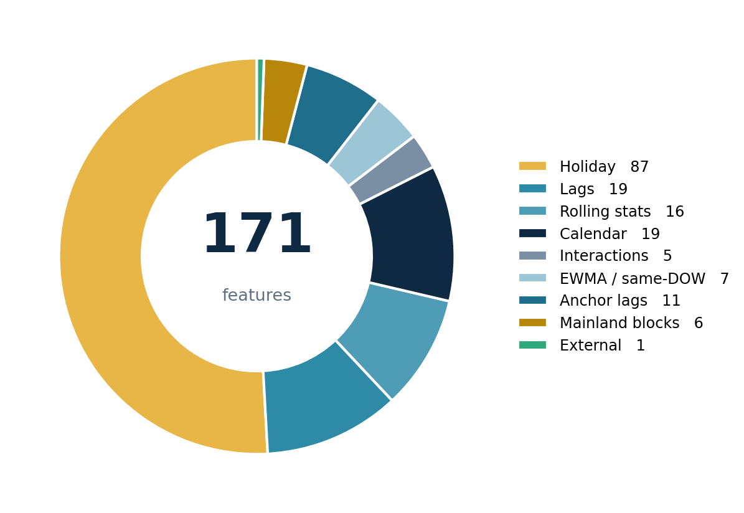
FEATURE ENGINEERING
Half the model is about holidays
87
Holiday features
Flags, day-offsets, distance to next holiday, holiday × weekday
46
History features
Lags, rolling statistics, moving averages — all horizon-gated
19
Calendar features
Weekday, month, cyclical encodings
19
Everything else
Mainland blocks, interactions, typhoon
Holiday periods are a small share of the calendar but the largest share of forecast risk — the feature set reflects that.
Notes:
Let the donut do the talking. The one number to say aloud: half the feature set exists to handle holidays.

Slide 12
HORIZON-AWARE FEATURES
The rule that shapes everything: no peeking
A forecast made 14 days out cannot use data from the last 13 days — that data does not exist yet. Every lag, rolling window and moving average is therefore gated by the forecast horizon.
lag_2, lag_3, lag_7, rolling_mean_7 …
Recent momentum available
1 day ahead
✓
✕
lag_1 (today is not closed yet)
lag_8, lag_14, rolling means from day 8 back
Recent momentum available
7 days ahead
✓
✕
lag_2 … lag_7
lag_28, lag_35, lag_365, lag_728
Long-memory signals only
28 days ahead
✓
✕
everything more recent than 28 days
Consequence: we train 28 separate models — one per forecast horizon — each with its own legal feature set.
Notes:
This is the single most important technical slide. It explains both the architecture and why accuracy decays with horizon.

Slide 13
FEATURE DEEP-DIVE
Holidays get special treatment
Holiday periods carry the largest demand swings and the largest forecast risk. Three mechanisms handle them.
Windows, not days
1
Each holiday has a demand window, not a single date — Chinese New Year runs −7 to +10 days; Dragon Boat −2 to +1 to capture the soft pre-holiday lull.
Per-offset flags
2
Within a window, each day-offset gets its own feature, so the model learns that day +1 behaves differently from day +4 rather than averaging them.
Fixed vs lunar split
3
Fixed-date holidays (Labour Day, Golden Week) align year-on-year, so last year's value is informative. Lunar holidays move by weeks — Chinese New Year gets a dedicated correction that matches position within the holiday, not calendar date.
Modelled holidays: Chinese New Year · Golden Week · Labour Day · Mid-Autumn · Dragon Boat · Ching Ming · Christmas · New Year · Easter

Slide 14
WEATHER & HOTEL PACING
Two external signals — and why one was removed
MANUAL
OPTIONAL
T
Typhoon Signal 8+
H
Hotel on-the-books
Removed from the model in 2026 — it could not be learned reliably
Nine typhoon days on record; impact ranged from +10% to −87%
The driver is whether operations SUSPEND, a business decision the storm signal does not predict
Now applied by a person, as an explicit override, once the closure call is known
Rooms booked for each future stay date, by lead time
Three features: current pace, 7-day pick-up, and pace vs. same-weekday norm
Strongest signal at 1–14 days out; naturally fades at longer horizons
Snapshot filtering ensures a run never sees bookings made after its run date
Design principle: every feature must earn its place in backtests. Fewer, stronger signals beat many weak ones.

Slide 15
03
METHODOLOGY
How the forecast
is actually produced
Per-horizon models, a six-model ensemble, and a validation design that cannot cheat.

Slide 16
CORE ARCHITECTURE
Twenty-eight models, not one
Because each horizon has a different legal feature set, each horizon gets its own model — trained, tuned and evaluated independently.
h1
h2
h3
h4
h5
h6
h7
h8
h9
h10
h11
h12
h13
h14
… through h28
Short horizons — rich recent history
Long horizons — long-memory signals only
1
Sample weighting
Recent days count more (240-day half-life). Holiday-window days carry 3× weight so rare, high-stakes periods are not drowned out.
2
Trained from scratch, every run
No stored model artefacts to drift or go stale — each run retrains on all data available at its run date.
3
Non-negative, quantile-consistent output
Predictions are floored at zero and ordered so P10 ≤ P50 ≤ P90 always holds.

Slide 17
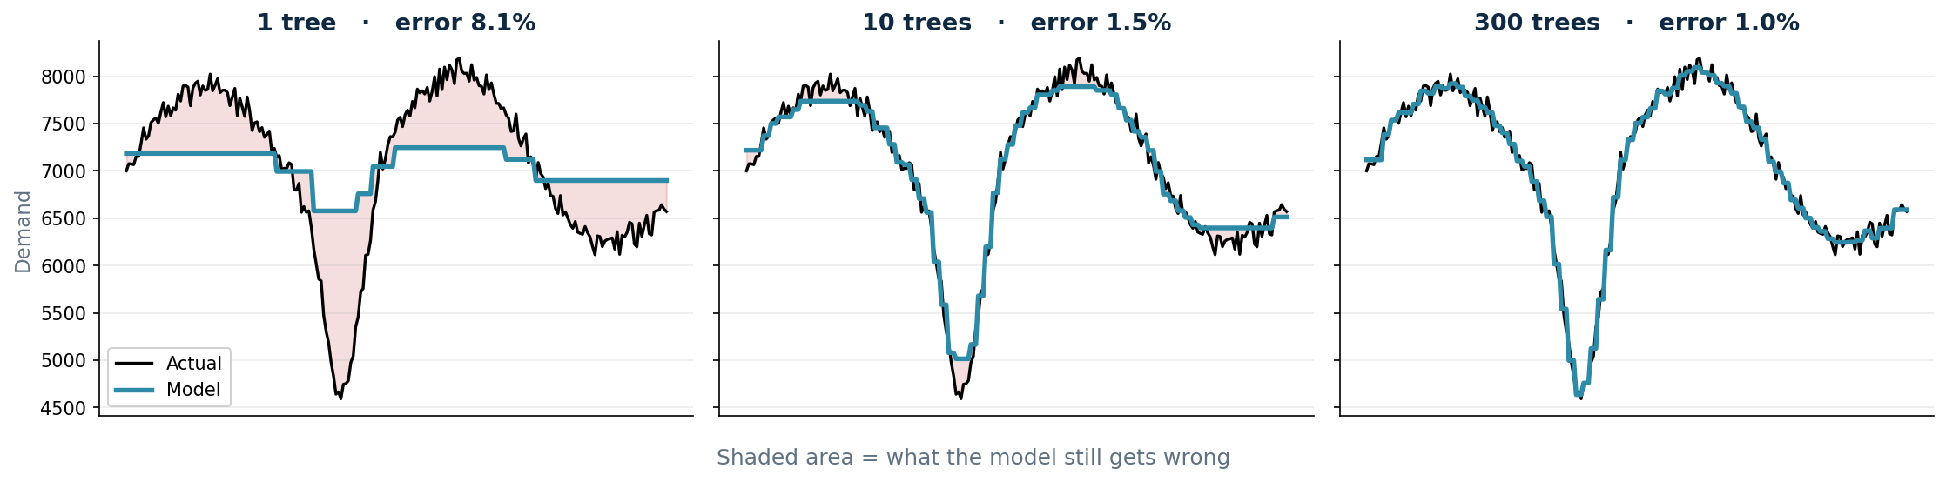
GRADIENT BOOSTING, IN PLAIN TERMS
What the model actually is
Every model in the ensemble belongs to one family: gradient-boosted decision trees. The idea is to build many small, deliberately weak models in sequence — each one correcting what the previous ones got wrong.
Each tree is trained on what the previous ones got wrong. Hundreds of small corrections add up to an accurate forecast.
✓
Finds interactions itself
✓
Handles gaps natively
✓
Built for small tabular data
Saturday-inside-Golden-Week is discovered, not coded
Long horizons have lags deliberately withheld
Hundreds of rows, hundreds of columns
Notes:
Point at the shaded red area shrinking across the three panels — that is the whole idea of boosting, visible.

Slide 18
LIGHTGBM · XGBOOST · CATBOOST
Three implementations, three ways to grow a tree
All three do gradient boosting, but they build their trees differently — which is exactly why their mistakes differ, and why blending them helps.
LightGBM
PRIMARY
XGBoost
DIVERSITY
CatBoost
DIVERSITY
How it grows trees
How it grows trees
How it grows trees
Leaf-wise growth — always splits the leaf that reduces error most, producing deep, asymmetric trees.
Level-wise growth — expands every node one depth at a time, giving balanced, symmetric trees.
Oblivious trees — the same split is applied across a whole level, plus ordered boosting to curb bias.
+
Fastest to train; handles many features well
+
Strong, well-tested regularisation
+
Resists a subtle overfitting bias others share
−
Can overfit small data if left unconstrained
−
Slower; wastes splits on unhelpful branches
−
Weakest of the three on its own here
Role here
Role here
Role here
Four of the six ensemble members, and the entire fast daily mode.
One ensemble member, using a median (quantile) objective.
One member, absolute-error loss — valuable for its different failure mode.
Hyperparameters are held deliberately conservative — shallow trees, low learning rate, strong regularisation — because each horizon trains on only a few hundred rows.

Slide 19
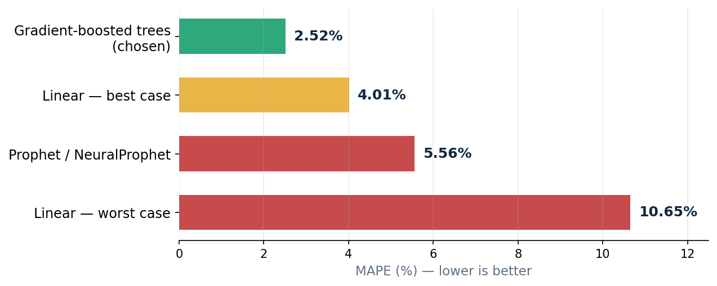
MODEL SELECTION
Why boosted trees, and not something else
Tested, not assumed — every alternative was run on this data.
Why trees win here
Best measured accuracy
Native missing-value handling
Trains in minutes on a laptop
Six variants disagree usefully — so they blend well
—
Classical time series
—
Neural networks
2.52%
best on the
May 2026 window
ARIMA, ETS — cannot absorb 171 features or holiday windows
LSTM, transformers — need far more than 880 days of history
NOT VIABLE HERE
NOT VIABLE HERE
MAPE from held-out backtests on this dataset, not published benchmarks. 2.52% is a single CNY-free month; the full-year figure is 4.26% — see Results.
Notes:
The NeuralProphet number is real - it was run as part of the v2 model comparison. Useful for pre-empting 'why not deep learning'.

Slide 20
THE ENSEMBLE
Six models, six different biases
Different algorithms fail differently. Blending them cancels individual quirks — the classic ensemble argument.
1
LightGBM L2
2
LightGBM quantile
3
XGBoost
Squared-error objective. The workhorse, and the default fast mode.
Median objective — naturally unbiased, robust to outliers.
Different split-finding and regularisation path.
4
CatBoost (MAE)
5
Bagged LightGBM
6
Two-stage holiday specialist
Ordered boosting, absolute-error loss. Weakest alone, valuable for diversity.
Three seeds averaged — variance reduction.
A baseline model plus a second model trained only on holiday-window residuals.
The two-stage specialist is the one component built specifically for this problem — it isolates “what is different about holidays” instead of asking one model to learn normal days and holidays at once.

Slide 21
BLENDING STRATEGY
Not all models are best everywhere
Two refinements on top of a plain average. Both are shown here on one real day: Friday 1 May 2026.
1
Pick the best models per cell
2
Nudge holidays toward last year
Instead of averaging all six models everywhere, use the best two for each weekday-and-lead-time combination.
Every model under-shoots holiday peaks. On holiday days we blend in last year's value, grown forward.
Weekday · lead
Models used
Last year — 1 May 2025
8,349
Friday · 1 day
XGBoost + CatBoost
× demand growth since
× 1.02
Friday · 14 days
LightGBM-bagged + 2-stage
= anchor estimate
8,517
Models alone said
7,939
Tuesday · 7 days
LightGBM-L2 + XGBoost
Blended 80 / 20 →
8,055
Actual demand on 1 May 2026: 8,653
Models alone were 8.3% low. With the anchor, 6.9% low — the same correction applied across every holiday.
3.30%
Plain average of 6 models
3.02%
+ best-two selection
2.52%
+ holiday anchor
This progression is measured on the May 2026 window (no Chinese New Year). Chinese New Year is corrected by a separate mechanism — see the overview and Results sections.
Notes:
Walk the 1 May 2026 example left to right. The point: selection picks WHICH models, the anchor corrects holiday under-shoot. Both learned from past data only.

Slide 22
GUARDING AGAINST LEAKAGE
A validation design that cannot cheat
The easiest way to produce an impressive but worthless forecast is to let the model see the answers. Three guards prevent it.
Round 1 — Calibration
Round 2 — Production
Train on data before the last 180 days
Predict those 180 days — unseen during training
Learn the selection table and anchor weight from these honest errors
Retrain on all available data
Forecast the true future
Apply the recipe learned in Round 1, unchanged
Demand
Hotel pacing
Typhoon
Training is restricted to dates on or before the run date, even when newer actuals sit in the file.
Booking snapshots taken after the run date are dropped before any feature is computed.
Kept for future dates by design — warnings are genuinely available ahead of time. A strict backtest switch exists.
Because of this design, reported accuracy is what the model would genuinely have achieved in production on those dates.
Notes:
For a technical audience this is the credibility slide. For management, the message is simply: the numbers are not flattered.

Slide 23
04
RESULTS
How accurate is it,
and against what?
Measured against three naive baselines on the same held-out window.

Slide 24
BASELINE COMPARISON
Every step earns its complexity
53%
lower error than
the naive baseline
9.14% → 4.26%
Read it as a ladder
Machine learning closes most of the gap. The Chinese New Year correction closes a further 0.84pp — and it is worth far more than that on CNY days themselves.
2026 year to date: 1 Jan – 27 May, 147 days, re-forecast weekly. Every forecast trained only on data available at that point in time.
Notes:
This ladder is measured across the full year to date including Chinese New Year, not a single favourable month. Each origin retrains from scratch on data available at that date only.

Slide 25
READING THE NUMBERS
Why you will see two accuracy numbers in this deck
Both are correct. They measure different periods, with different models, over different forecast distances.
2.52%
4.26%
appears on the model-selection slide
appears on the results slide — the one to quote
Period measured
1–28 May 2026
(28 days)
1 Jan – 27 May 2026
(147 days)
Chinese New Year included?
No — that month has none
Yes — 18 of the 147 days
Model configuration
6-model ensemble
+ selection + holiday anchor
Single fast model
+ CNY correction
Forecast distance
One 28-day forecast
Re-forecast weekly,
days 1–7 used
What it tells you
Best case on a clean month
What to expect operationally
On the SAME May window, today's production model scores 3.41% — the gap to 4.26% is Chinese New Year, not a regression.
Notes:
Use this slide if anyone challenges the numbers. The short answer: 2.52% is a best-case benchmark on a month with no Chinese New Year; 4.26% is the realistic full-year figure and is the one to plan against.

Slide 26
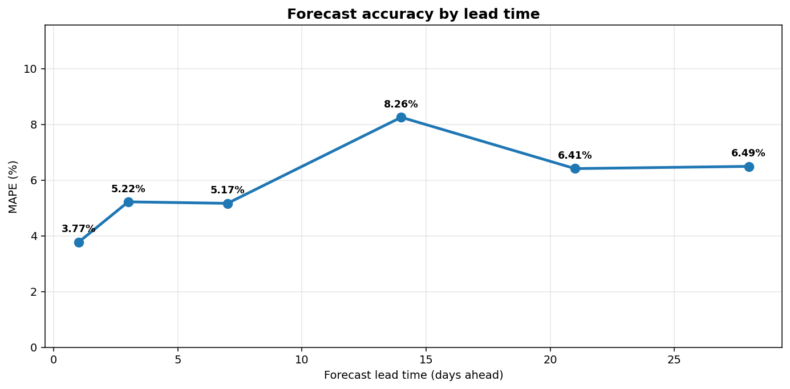
FORECAST HORIZON
Long-range error is concentrated in one week of the year
Accuracy decays with lead time — but almost all of that decay comes from Chinese New Year.
1
CNY is the hard case
At two weeks out the model misses the CNY collapse by 22%. The event's size and its shifting lunar date make it genuinely hard to anticipate.
2
Normal weeks hold up well
Outside CNY, error rises only from 3.4% to about 4.4% between one day and four weeks out — long-lead rostering is well supported.
3
Plan CNY differently
1 day
14 days
28 days
Do not commit CNY staffing on a 14–28 day forecast. Use short-lead updates, prior-year patterns and explicit management judgement.
Chinese New Year (10 days)
6.2%
22.5%
19.8%
Rest of year (62 days)
3.4%
6.0%
4.4%
Rolling-origin backtest, Jan–May 2026, 72 target dates per lead. Single LightGBM model; each origin retrained on data available only at that lead time.
Notes:
Important nuance: an earlier run on a March-May window showed a flat curve, because that window excluded CNY. Including CNY reveals the real horizon effect. Both results are consistent once you split the periods - this is the honest presentation.

Slide 27
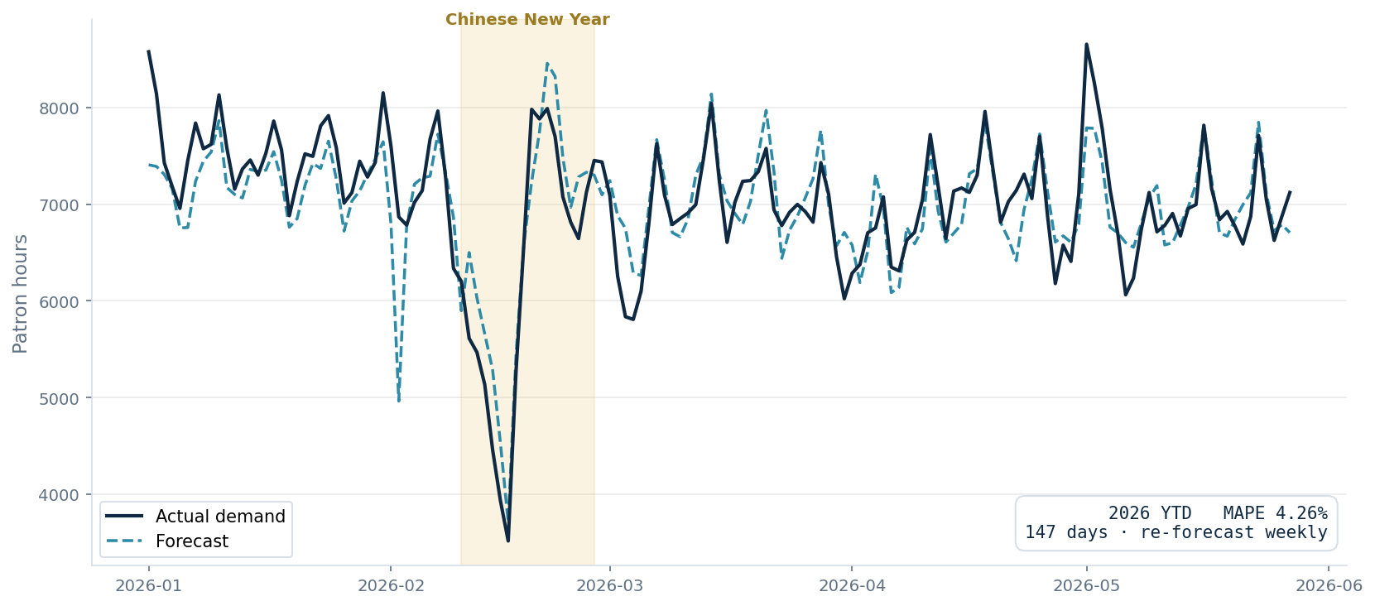
2026 YEAR TO DATE
Five months, tracked day by day
3.98%
MAPE over 148 days
−12
average bias (patron hours)
50%
demand drop at CNY, tracked
Single LightGBM at 1-day lead. The 2.52% quoted earlier is the full ensemble on the 28-day forecast — a different configuration and window.
Notes:
Be explicit if asked: 3.98% here vs 2.52% earlier is not a contradiction — this is a single model over a harder window that includes CNY, evaluated at 1-day lead. Both numbers are honest, they measure different things.

Slide 28
HONEST NEGATIVE RESULTS
What we tried that did not work
11
9
2
approaches tested
rejected
in production
✕
Log-transformed target
✕
Ratio-to-baseline target
✕
Learned blend weights
Compressed the holiday spikes
Amplified noise — 14.6% on one window
Overfitted the validation period
✕
Per-weekday bias scaling
✕
Ridge / ElasticNet
✕
ExtraTrees in the pool
Bias inverted on the next window
Unstable on thin history — 10.7%
Won one window, lost another
✓
Weekday × horizon selection
✓
Fixed-date holiday anchor
3.30% → 3.02%
3.02% → 2.52%
Documenting the failures prevents the next analyst re-treading the same ground.
Notes:
This slide buys credibility with a technical audience faster than any positive result.

Slide 29
WHERE THE MODEL IS WEAK
Known limitations
Accuracy varies by period
1
2.5–3% on a typical month; 5%+ on months with thin history or overlapping lunar holidays. A single headline number would be misleading.
Data volume is the binding constraint
2
Measured: 15 months of history → 8.4% error; 22 months → 4.7%; 28 months → 3.0%. Accuracy improves as history accumulates, at no development cost.
Prediction intervals are optimistic
3
The P10–P90 band currently captures roughly 55–79% of outcomes against an 80% design target. Treat the band as a relative confidence signal, not a guarantee.
Limited headroom from blending alone
4
On one window, even a hypothetical perfect model-picker reached only 2.20%. Further gains must come from better data, not cleverer combination.
Stating limitations explicitly is deliberate: a forecast presented without them invites misuse.

Slide 30
05
FROM FORECAST TO ROSTER
Turning patron hours
into people
Four downstream stages: hourly shape, table count, headcount, and shift assignment.

Slide 31
STAGE 2 — HOURLY SHAPE
Splitting the day into 24 hours
The daily total is multiplied by a 24-hour shape that sums to one. The question is which shape to use for each day.
hourly demand = daily forecast × hourly share
1
2
3
Local weekday shapes
Data decides for holidays
Inherit or specialise
Built from the previous 90 non-holiday days, recomputed every run so the shape tracks current behaviour rather than a stale annual average.
For each holiday-day we measure whether its hourly shape genuinely differs from a normal weekday, using Total Variation Distance against contemporary weekday baselines.
If the difference is small, the day inherits the weekday shape — more samples, more stable. If it is large, a recency-weighted holiday-specific shape is used instead.
Why it matters: on Chinese New Year day 1 the hourly rhythm is driven by the holiday, not by whether it falls on a Monday. The method detects this from data rather than assuming it.

Slide 32
STAGE 3 — CAPACITY SIZING
How many tables should be open?
Hourly patron hours convert directly to concurrent players. From there, two established methods size the floor.
A
Queueing (Erlang-B)
B
Service level (newsvendor)
Tables behave as a loss system — a patron who finds no seat leaves rather than queues. Erlang-B gives the minimum seat count that keeps the probability of turning someone away below a chosen target.
Whether to staff to P50 or P90 is an economic choice, not a statistical one. The critical ratio — cost of a lost patron against the cost of an idle dealer — sets the quantile to plan to.
open table c if marginal expected revenue of table c ≥ cost per table-hour
The profit-maximising stopping rule: keep opening tables while the next one still pays for itself. Requires revenue-per-patron-hour and cost-per-table-hour by tier.

Slide 33
STAGE 4 — HEADCOUNT
From tables to dealers
Continuous table coverage needs more dealers than tables — because dealers rotate off for breaks, and some are absent.
dealers per table = relief factor × absence buffer
Relief factor
Absence buffer
(deal minutes + break minutes) ÷ deal minutes
1 ÷ (1 − expected absence rate)
A 60-on / 20-off rotation gives 1.33. Shorter deal periods raise it.
A 5% absence rate gives 1.05. A sick-leave forecast can replace the flat assumption.
Worked example
1.33 × 1.05 = 1.40 dealers per open table → 10 tables require 14 dealers, plus ~3 supervisors at a span of five.

Slide 34
STAGE 5 — SHIFT ASSIGNMENT
Which table opens, and when
A constraint-programming optimiser assigns each table a shift pattern so that hourly coverage matches the forecast.
Decision
Objective
Table preference
One shift pattern per table
24-hour, 16-hour or 8-hour
Start times chosen by the optimiser from a candidate list
Penalise under-coverage heavily
Penalise surplus lightly
Respect each table's preferred opening length
Derived, not hand-typed
Flat demand → 24-hour; spiky demand → 8-hour, aligned to its own peak
Location score from distance to entrance, walkways and cage
Preferences are soft: if overall demand requires it, the optimiser will override a table's preferred pattern rather than leave an hour uncovered.

Slide 35
06
RUNNING IT
Operations, maintenance
and what comes next
The model is designed to be run by an operator, not a data scientist.

Slide 36
DAILY USE
Three commands cover normal operation
Fast daily forecast
~3 min
uv run python forecast.py
Single LightGBM model. The routine daily driver.
Highest accuracy
~35 min
uv run python forecast.py --full --blend selection
Six-model ensemble with selection and holiday anchor. For committed plans.
Scheduling cycle
varies
uv run python run_schedule.py --initial 2026-06-08 2026-07-05
Freezes an initial plan, then re-forecasts on set dates and tracks drift.
Every run is archived under forecasts/run_<date>/ with its predictions, chart and metadata — so any past forecast can be audited against what actually happened.

Slide 37
MAINTENANCE
What needs a human, and how often
Daily
Append yesterday's actual demand
One row in rawdata.csv. The only mandatory recurring task.
Weekly
Run the high-accuracy forecast
Refresh the committed plan with the full ensemble.
Quarterly
Refresh typhoon records
One command; picks up new Signal 8+ events from HKO.
Quarterly
Re-validate accuracy
Backtest on a recent window to confirm no drift.
Annually
Extend the holiday calendar
Add next year's holiday anchor dates before forecasting into it.
The forecast itself needs no retraining schedule — every run trains from scratch on all data available at that moment.

Slide 38
ROADMAP
Where the next gains come from
Now
Let history accumulate
The largest single lever, and it is free. Measured trajectory suggests typical-window error falls toward 2.5% as the dataset passes three years.
Next
Calibrate prediction intervals
Replace in-sample residuals with out-of-sample ones so the P10–P90 band delivers its stated 80% coverage.
Next
Activate hotel pacing
Infrastructure is built and leakage-guarded. Needs 18–24 months of daily snapshots to train the relationship.
Then
Complete the downstream chain
Table sizing, dealer headcount and shift assignment need per-table operational data — revenue per hour, utilisation, floor coordinates.
Then
Forecast dealer absence
A companion model for sick leave, replacing the flat absence assumption with a predicted rate.

Slide 39
In summary
A measured forecast,
honestly validated
Two-thirds less error than the planning method it replaces
Every accuracy figure measured out-of-sample, with leakage guards on all inputs
Running in production today; the downstream planning chain is specified and ready to build
The clearest path to further gains is more history — which accrues automatically
Questions welcome — technical detail available in the appendix and project documentation.

Slide 40
FOR FOLLOW-UP
Appendix — technical reference
Repository layout
Key configuration
forecast.py — production entry point
blend.py — selection + holiday anchor
v2/_shared.py — feature engineering
evaluate.py — accuracy analysis
run_schedule.py — scheduling cycle
hourly/ — hourly split module
research/ — validation experiments
HOLDOUT_DAYS = 28 — forecast horizon
HOLIDAY_ANCHORS — holiday dates by year
HOLIDAY_WINDOWS — demand window per holiday
HOLIDAY_UPWEIGHT = 3.0 — holiday sample weight
USE_RESERVATIONS — hotel pacing toggle
USE_WEATHER — typhoon feature toggle
Accuracy reference — 1 to 28 May 2026 holdout
Method
MAPE
WAPE
RMSE
Same day last week (peeks — see note)
7.36%
7.44%
705
Same week before cutoff (like-for-like)
6.03%
—
—
Flat 28-day average
5.12%
5.30%
551
Day-of-week average
4.70%
4.76%
454
LightGBM L2 (single model)
3.47%
3.50%
297
Six-model ensemble, equal weights
3.30%
3.36%
311
Selection + fixed-date holiday anchor
2.52%
2.55%
217
Current production (this deck's config)
3.41%
—
—
Rows 5–7 are the original benchmark and reproduce at the June 2026 code state. 'Same day last week' reads actuals from inside the test window, so the like-for-like naive row is given above it. Full-year performance (4.26%) is in Results — this table is a single CNY-free month.

