Slide 1
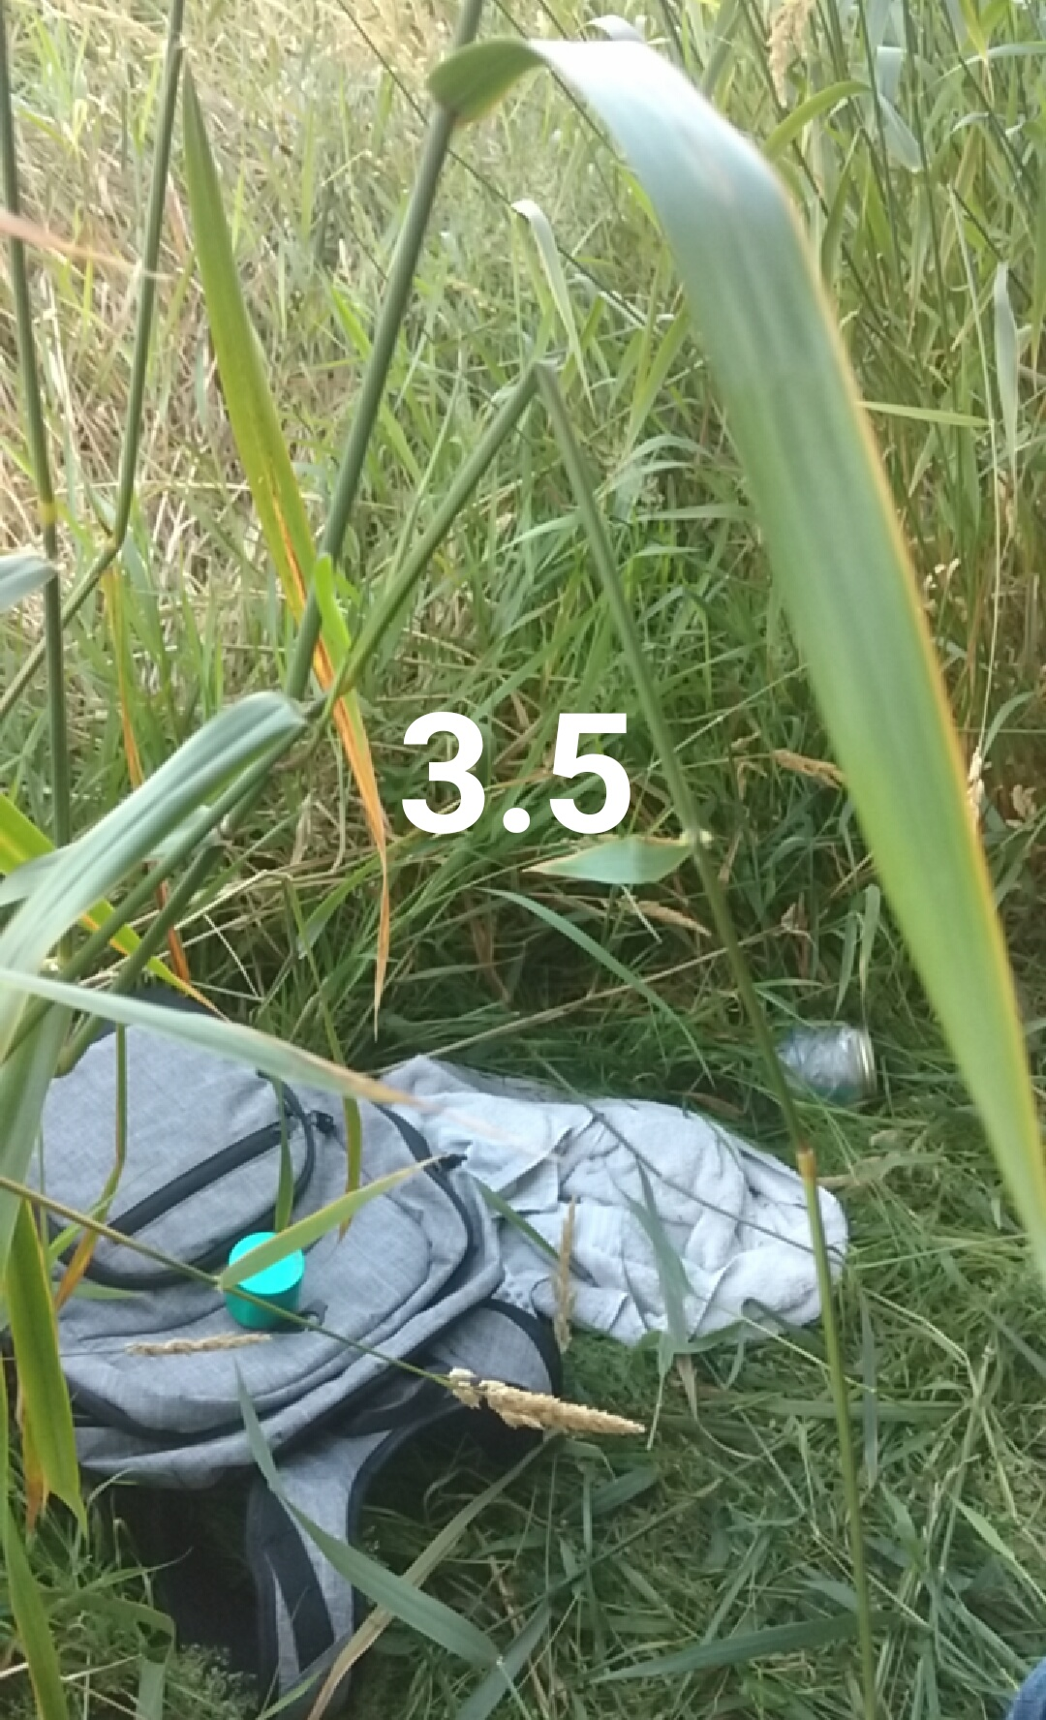
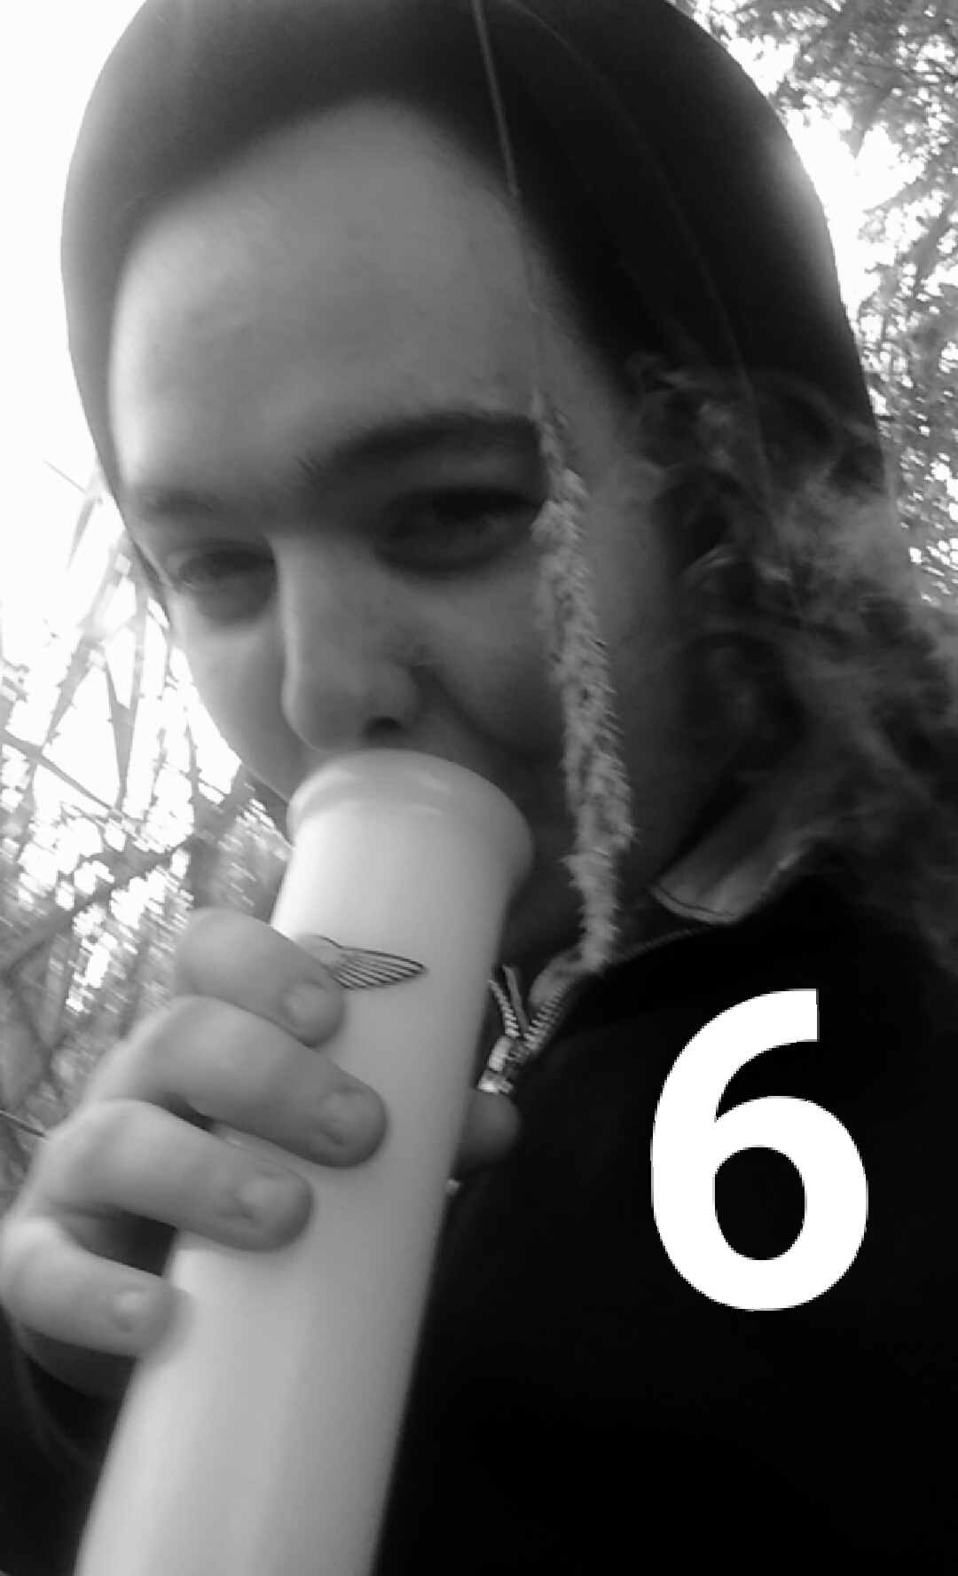
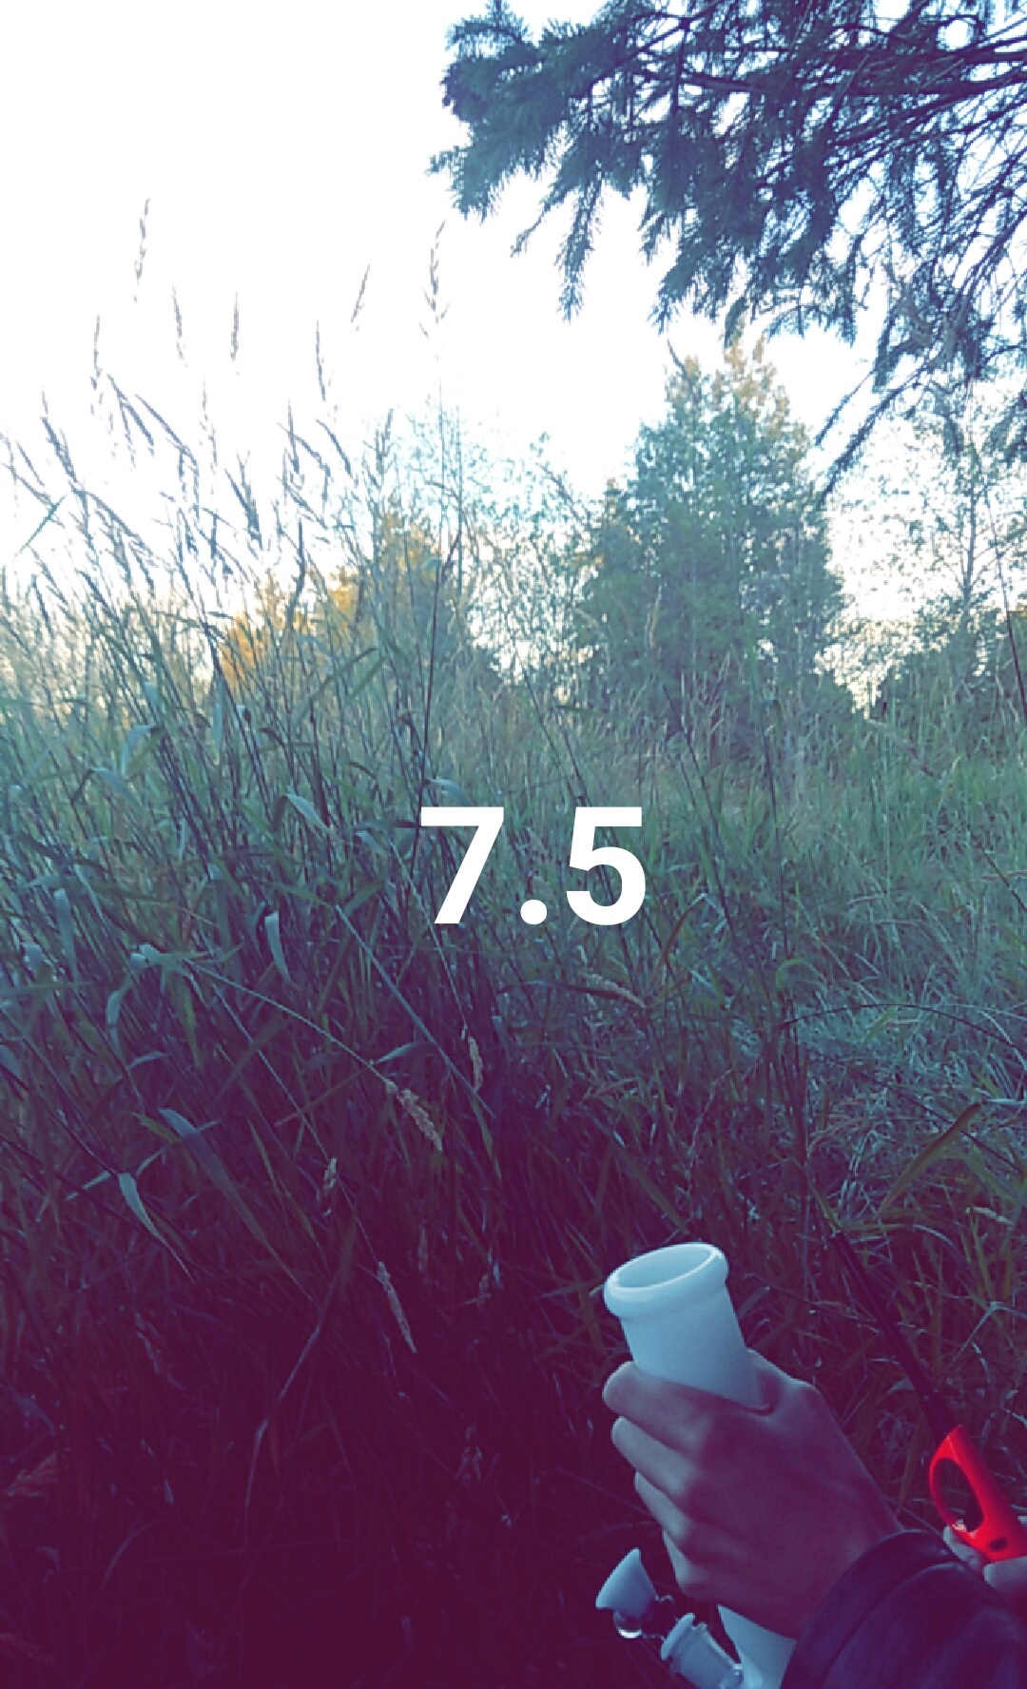
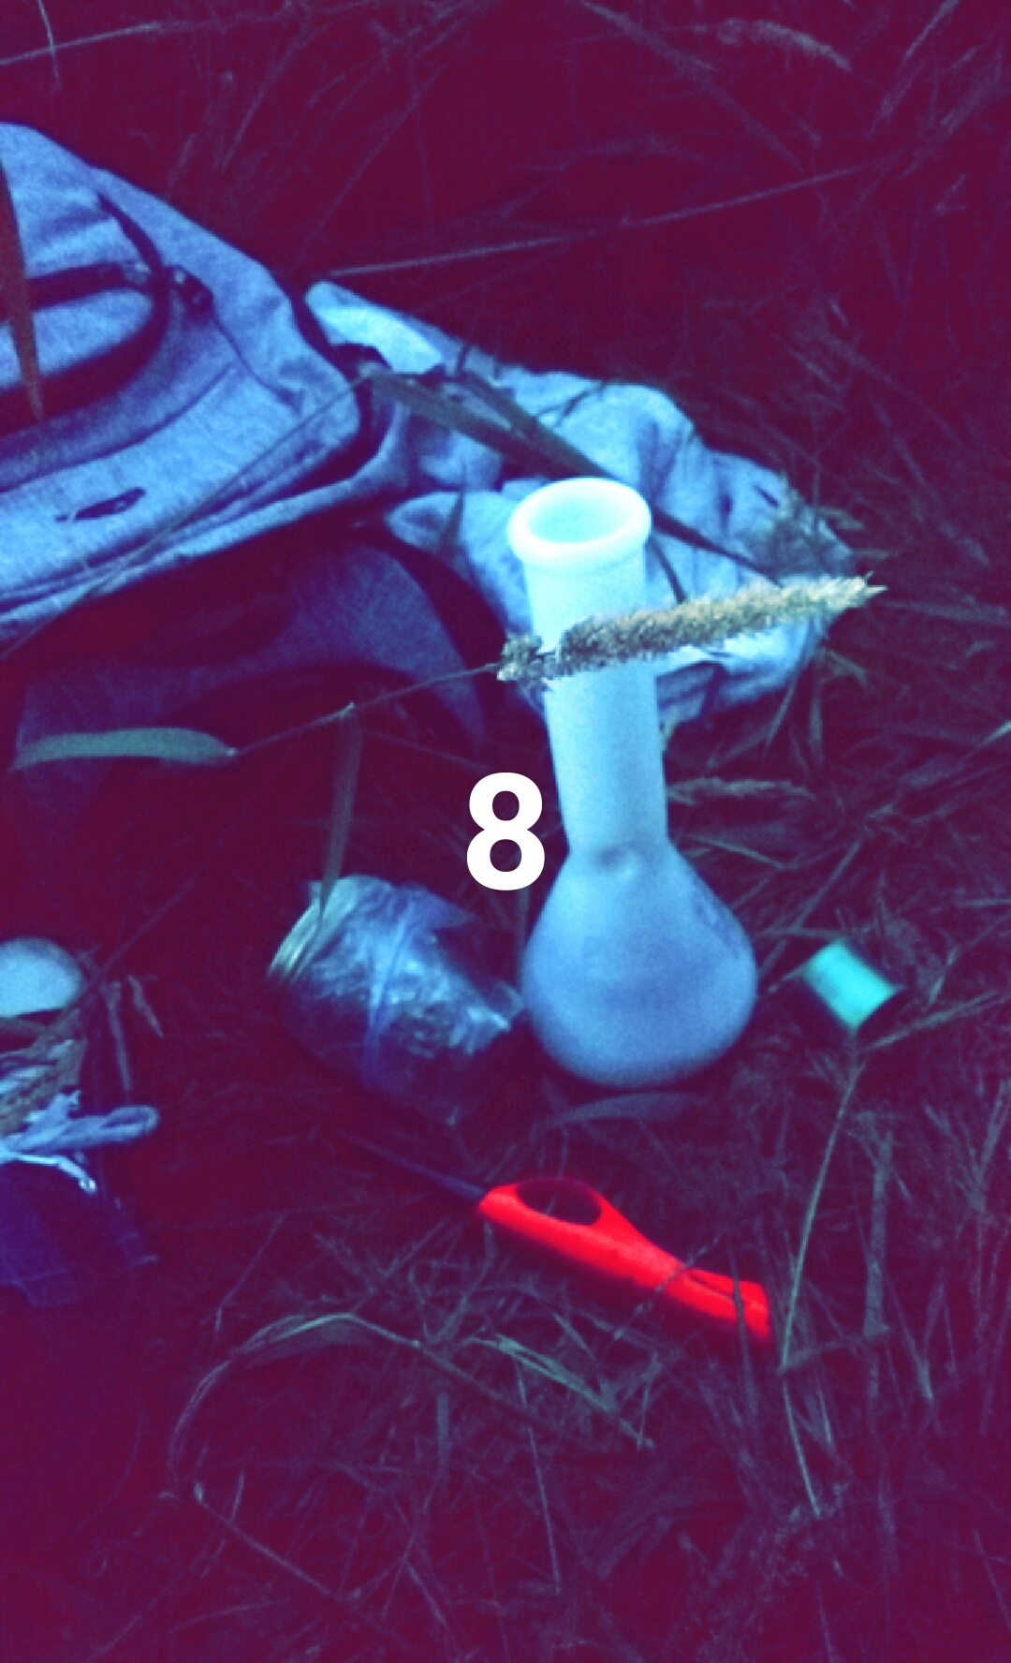
High10
Social Media Application

Slide 2
Business Concept
Image-sharing social-media application
“Snapchat-esq” built-in temporary chat
“Snapchat-esq” photo sharing with images, filters, etc.
Small ‘0’ at the top left to indicate “sober” snap
“Snapchat-esq” friends stories
Public gallery for High10 pictures.
Picture with just a number + filters + overlays. No text.
High10 pictures can be send privately, to friends, friend-story or public gallery
High10 can be sent anonymously (to public gallery & friend gallery, not privately)
Still gain points, but no one knows “who” sent it. Optional privacy
“Karma” system awarded to High10 pictures.
Swipe right to bring up number pad and rate /10. Rating = “karma”.
Heat map of how “Heated” your area is.

Slide 3
Our mission is to replaced Snapchat as the number one social media app and image sharing app for the stoners market
Try to use words that will help direct the growth of your company, but be as concise as possible.

Slide 4
Market
Individuals who use social media applications for messaging
420-friendly individuals
Snapchat market
Privacy-conscious individuals who want the privacy of snapchats “temporariness”
Sexual content, drunk texts/messages, explicit drug-related content, etc.
Funny/interesting image sharing (the /10 feature would get used as a “8/10 cut cat” way as well)
Community-feeling image sharing/stories market
Competitive/”e-peen” individuals who want the most karma/score.

Slide 5
Opportunities
Canadian legalization on April 20th
Recent Snapchat changes have made is less-appealing

Slide 6
Competition
Snapchat
Lead photo-sharing and private messaging app
Advantage: Anonymous messages, community/location approach, 10 rating
Facebook Messenger
Lead non-text messaging system
Advantage: Privacy of temporary messages

Slide 7
Features Breakdown
Private Messaging
“Snapchat-esq” private direct messages that disappear after being viewed
Ability to send a message to multiple people
However each message is sent privately, not as a group chat

Slide 8
Features Breakdown
Private Pictures
“Snapchat-esq” picture messages
Text
Optional-filters
Optional-overlays
Zero in top left to indicate a non-High10 message (0/10, no points)
High10 pictures
Text-less
White 1-10 on the image
Optional-filters
Optional-overlays

Slide 9
Features Breakdown
Story Pictures
“Snapchat-esq” picture messages
High10 pictures
By individual

Slide 10
Features Breakdown
Friends Timeline Pictures
“Snapchat-esq” picture messages
High10 pictures
By all friends (+anonymously submitted on friends)

Slide 11
Features Breakdown
Community Timeline Pictures
High10 pictures only
By everyone (friends, not-friends and anonymous) within a set range (e.g. 60km)

Slide 12
Features Breakdown
Points
“Karma-esq” point system attached to an account
High10 images can be swiped right to bring up a number pad to award 1-10 points
Anonymously submitted pictures can be award points
Your accounts points can be set to private (only you see), friends (only friends can see your points) or public (anyone who sees your account from some public image you shared can see your points)
Points awarded from sharing sponsored timeline images

Slide 13
Features Breakdown
Anonymous Posting
Account posted is unnamed. No one knows who submitted it.
Can submit to friend gallery or public.
Submitting to friends is so you can show your friends dank pictures without people knowing which friend it is, however it still feels close to home since it’s your friends.
High10 pictures only
Points are awardable
Pictures can be “Reported”. Once a picture is reported, it is not removed, however it is deemed to “explicit” and hidden from standard viewing.
People can see “hidden” images by turning on explicit images in the settings, default to off
A user who’s frequently flagged as submitting explicit content will have their pictures set to hidden by default. This solves the issue of some douche sending dick pics anonymously. Avoid becoming /b/.

Slide 14
Features Breakdown
Heat Map
Map showing where people are sending pictures from (not naming who sent them, just saying “it happened here” with a 1km point of radius to keep people safe.
Points last for days (e.g. 3 days), so you can’t even say for sure if someone is recently there.
Points are not added until 8 hours later for security/safety reasons

Slide 15
Features Breakdown
Achievements
Awarded for reaching certain points (100 accumulated points, etc. Big milestones)
First “10” submitted, etc.
First “10” awarded by someone else, etc.
First 10 “10”’s awarded on a single submitted picture, etc.
Achievements translate to more points. +50 for a certain achievement, etc.
Posting a High10 at 4:20, etc.

Slide 16
Features Breakdown
Streaks
“High10” streaks for friends that share at least one “High10” message a day
“Hot Streaks” for friends that share any message a day
“Contributor Streaks” for consecutive days submitting to the public gallery

Slide 17
Features Breakdown
Custom Overlays
Collectible/downloadable custom overlays
“Once your GPS says you are in BC, you can get BC Bud overlay. No one can get until they are in BC, and once they get they are permanent.”. Same concept for going to things like Disney Land, etc. Once you go, you get overlay forever.

Slide 18
The Team (Xamarin Approach)
Android/iOS Developer
Carson
Website (Purely informational. No features)
Arthur
REST API
Arthur
Server/Backend
Jaegar

Slide 19
The Team (Native Approach)
Android Developer
Jaegar
iOS Developer
Arthur
Website (Purely informational. No features)
Arthur
REST API
Carson
Server/Backend
Carson (+Jaegar if needed)

Slide 20
Financial Plan
Accounts free
Banner-ads at top
Opt-In sponsorship
Sponsor-stories viewable
Companies pay to be a sponsor based on number of users
Opt-In catalogue to find sponsors
This keeps the sponsors out of the stories page since that’s what people complain about
Keeps the opportunity there to make money off of
Get points for “sharing”/”forwarding” sponsored content to friends

Slide 21
Risks and Solutions
Legal issues of endorsing marijuana
Must only release after legalization
Not fully “endorse” it. Keep the plausible deniability real
Snapchat is perfect for sexting. No one admits to it. Snapchat does not endorse it publically, but they built it with the privacy in mind + notifying people of screenshots so people can sext safely.
Build the infrastructure, give it to them, hint at it, but don’t explicitely say stuff like the ranking system is based on /r/trees 10. “High10” is a High-Five rating system, and “I’m this HIGH out of 10”.
Heat Map allowing people to find out users
Post coordinates on the map inaccurate/1km radius
Post coordinates publically hours after the first image was posted

Slide 22
Risks and Solutions
Copyright/Trademark Snapchat Infringement
Rename “Story”/”Timeline”
Avoid looking too similar in our UI, while still looking close enough/familiar
Clients don’t want their points to directly reflect weed usage
Ability to set them to be private/friends only/public viewable
Keeping them private would directly get rid of stigma
Default to friends only(?)
Allow “private” to directly include friends.
E.g. “Arthur/Jaegar only” to see score. Hide from all other friends.

