Slide 1
Chapter 1
The Nature of Econometrics and Economic Data
Amended and modified by C. Lange

Slide 2
The Nature of Econometrics and Economic Data (1 of 22)
What is econometrics?
Econometrics is the use of statistical methods to analyze economic data.
Econometricians typically analyze nonexperimental data.
Typical goals of econometric analysis:
Estimating relationships between economic variables.
Testing economic theories and hypotheses.

Slide 3
The Nature of Econometrics and Economic Data (2 of 22)
Steps in econometric analysis
1) Economic model (this step is often skipped)
2) Econometric model
Economic models
Modeling behavior
Establish relationships between economic variables
Examples: demand equations, pricing equations, …

Slide 4
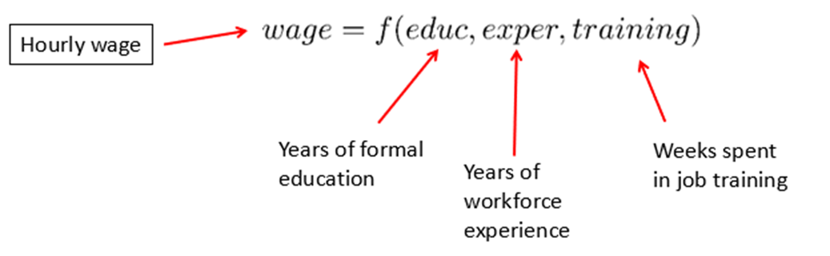
Model of job training and worker productivity
What is the effect of additional training on worker productivity?
Formal economic theory not really needed to derive equation:
Functional form of relationship not specified above. It will be specified in the econometric model
Equation could have been postulated without economic modeling.
Other factors may be relevant, but these are the most important.

Slide 5
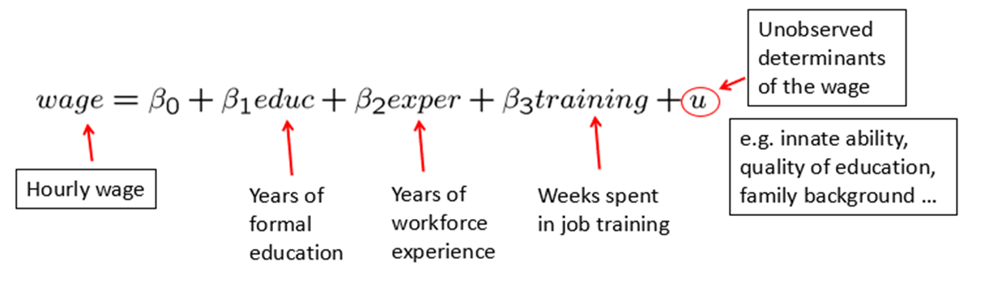
The Nature of Econometrics and Economic Data (6 of 22)
Econometric model of job training and worker productivity
Most of econometrics deals with the specification of the error u.
Econometric models may be used for hypothesis testing.
For example, the parameter β₃ represents the effect of training on wages.
How large is this effect? Is it different from zero?

Slide 6
The Nature of Econometrics and Economic Data (7 of 22)
Econometric analysis requires data.
There are several different kinds of economic data sets:
Cross-sectional data
Time series data
Panel/Longitudinal data
Econometric methods depend on the nature of the data used.
Use of inappropriate methods may lead to misleading results.

Slide 7
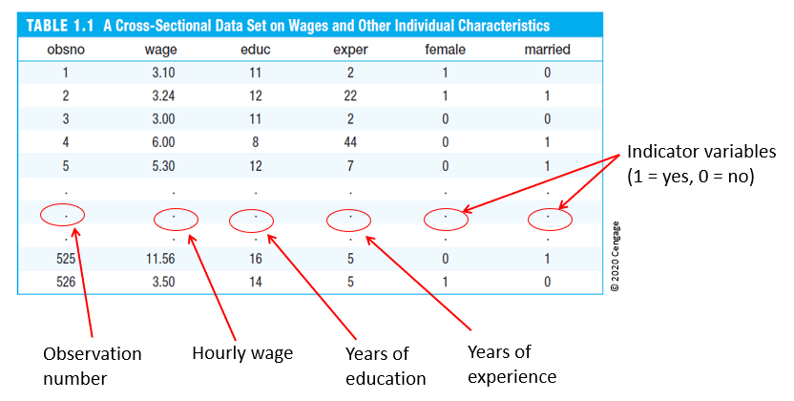
The Nature of Econometrics and Economic Data (9 of 22)
Table 1.1: Cross-sectional data set on wages and other characteristics
obsno | wage | educ | exper | female | married
1 | 3.10 | 11 | 2 | 1 | 0
2 | 3.24 | 12 | 22 | 1 | 1
3 | 3.00 | 11 | 2 | 0 | 0
4 | 6.00 | 8 | 44 | 0 | 1
5 | 5.30 | 12 | 7 | 0 | 1
. | . | . | . | . | .
. | . | . | . | . | .
. | . | . | . | . | .
525 | 11.56 | 16 | 5 | 0 | 1
526 | 3.50 | 14 | 5 | 1 | 0

Slide 8
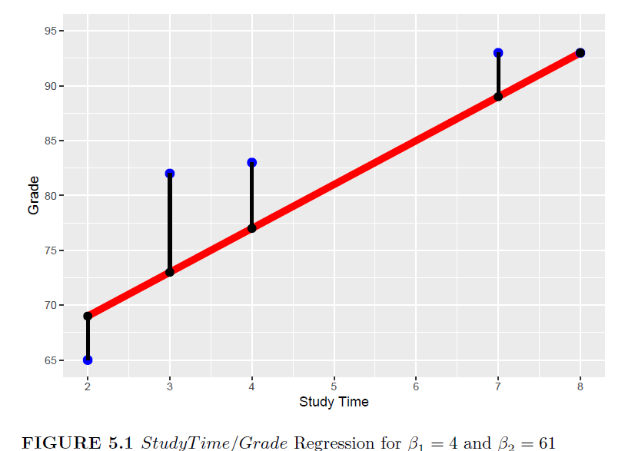
Correlation and Causation
Source: Lange, C., Practical Machine Learning with R, Taylor & Francis/CRC Press, 2024

Slide 9
Another Example
library(tidyverse);library(rio);library(janitor); DataHousing =import("https://ai.lange-analytics.com/data/HousingData.csv") |>
clean_names("upper_camel") |>
select(Price, Sqft=SqftLiving) |>
sample_n(10000)
ggplot(DataHousing, aes(x=Sqft, y=Price)) +
labs(title="Correlation between Sqft and Price", x="Sqft",y="Price")+
geom_point()+
geom_smooth(method = "lm", se=FALSE)

Slide 10
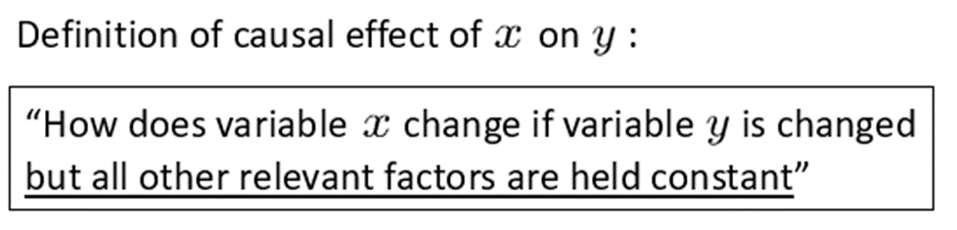
The Nature of Econometrics and Economic Data (17 of 22)
Causality and the notion of ceteris paribus
Ceteris paribus: “other relevant factors being equal.”
Most economic questions are ceteris paribus questions.
It is important to define which causal effect one is interested in.
It is useful to describe how an experiment would have to be designed to infer the causal effect in question.

Slide 11
Experiment (feasible)(18 of 22)
Marketing
“By how much will sales increase for customers that receive an advertisement in the mail”
Experiment = Feasible
Choose customers randomly, who receive the advertisement.
Keep sample large enough that you can assume that other factors influencing sales are similar in the treatment and in the non-treatment group.

Slide 12
Experiment (NOT feasible)((21 of 22)
Marketing
“By how much do sales increase if customers drink none, one, two, or three glasses of champagne?”
Experiment ≠ Feasible
The researcher randomly chooses attendees and tells them how much champagne to drink. This is obviously not feasible.

