Slide 1
CS 3700 Networks and Distributed Systems
DNS
(What’s in a Name?)
Revised 10/15/18

Slide 2
Names, Identifiers, Monikers, Nicknames, Aliases, ...
People have multiple identifiers
SSNs, Name/nickname, passport #, driver’s license #, phone #, …
directories, phone books, registries
Internet hosts have multiple identifiers too
IPv4/IPv6 addresses (10.107.98.101, fe80::ba:1373:76bd:18e1)
Used to address packets
Processed by routers
“Name”, www.khoury.northeastern.edu
Used by humans (who are really bad remembering strings of numbers)
Aliases may point to same host
How to map between Names and IP addresses? Why is this needed? Remember arp?

Slide 3
Human Involvement
If you want to…
Call someone, you need to ask for their phone number
You can’t just dial “P R O F J A C K S O N”
Mail someone, you need to get their address first
What about the Internet?
If you need to reach Google, you need their IP
Does anyone know Google’s IP?
Problem:
People can’t remember IP addresses
Need human readable names that map to IPs

Slide 4
Internet Names and Addresses
Addresses, e.g. 129.10.117.100
Computer usable labels for machines
Conform to structure of the network
Names, e.g. www.northeastern.edu
Human usable labels for machines
Conform to organizational structure
How do you map from one to the other?
Domain Name System (DNS)

Slide 5
History
Before DNS, all mappings were in hosts.txt
/etc/hosts on Linux
C:\Windows\System32\drivers\etc\hosts on Windows
Centralized, manual system
Changes were submitted to SRI via email
Machines periodically FTP new copies of hosts.txt
Administrators could pick names at their discretion
Any name was allowed
christos_server_at_neu_pwns_joo_lol_kthxbye

Slide 6
Towards DNS
Eventually, the hosts.txt system fell apart
Not scalable, SRI couldn’t handle the load
Hard to enforce uniqueness of names
e.g MIT
Massachusetts Institute of Technology?
Melbourne Institute of Technology?
Many machines had inaccurate copies of hosts.txt
Thus, DNS was born

Slide 7
Outline
DNS Basics
DNS Security

Slide 8
DNS at a High-Level
Domain Name System
Distributed database
No centralization
Simple client/server architecture
UDP port 53, some implementations also use TCP
Hierarchical namespace
As opposed to original, flat namespace
. → .com → google.com → mail.google.com

Slide 9
Naming Hierarchy
Root (dot, “.”)
net
edu
com
gov
mil
org
uk
fr
etc.
neu
mit
Top Level Domains (TLDs) are at the top
Each Domain Name is a subtree
.edu → neu.edu → ccs.neu.edu → www.ccs.neu.edu
Maximum tree depth: 128
Name collisions are avoided
neu.com vs neu.edu vs neu.org
ccs
ece
husky
www
login
mail

Slide 10
Exercise #1 dig www.ccs.neu.edu
; <<>> DiG 9.10.6 <<>> www.ccs.neu.edu
;; global options: +cmd
;; Got answer:
;; ->>HEADER<<- opcode: QUERY, status: NOERROR, id: 50636
;; flags: qr rd ra; QUERY: 1, ANSWER: 2, AUTHORITY: 0, ADDITIONAL: 1
;; OPT PSEUDOSECTION:
; EDNS: version: 0, flags:; udp: 4096
;; QUESTION SECTION:
;www.ccs.neu.edu. IN A
;; ANSWER SECTION:
www.ccs.neu.edu. 183 IN CNAME presscache.ccs.neu.edu.
presscache.ccs.neu.edu. 183 IN A 52.70.229.197
;; Query time: 58 msec
;; SERVER: 155.33.33.75#53(155.33.33.75)
;; WHEN: Tue Feb 19 11:05:55 EST 2019
;; MSG SIZE rcvd: 85

Slide 11
Hierarchical Administration
Verisign
Root
ICANN
net
edu
com
gov
mil
org
uk
fr
etc.
Northeastern
neu
mit
Tree is divided into zones
Each zone has an administrator
Responsible for that part of the hierarchy
Example:
Khoury controls *.ccs.neu.edu
NEU controls *.neu.edu
ccs
www
login
mail

Slide 12
Server Hierarchy
Functions of each DNS server:
Authority over a portion of the hierarchy
No need to store all DNS names
Store all the records for hosts/domains in its zone
May be replicated for robustness
Know the addresses of the root servers
Resolve queries for unknown names
Root servers know about all TLDs
The buck stops at the root servers

Slide 13
Root Name Servers
Responsible for the Root Zone File
Lists the TLDs and who controls them
~2MB in size
com. 172800 IN NS a.gtld-servers.net.
com. 172800 IN NS b.gtld-servers.net.
com. 172800 IN NS c.gtld-servers.net.
Administered by ICANN
13 root servers, labeled A→M
6 are anycasted, i.e. they are globally replicated
Contacted when names cannot be resolved
In practice, most systems cache this information

Slide 14
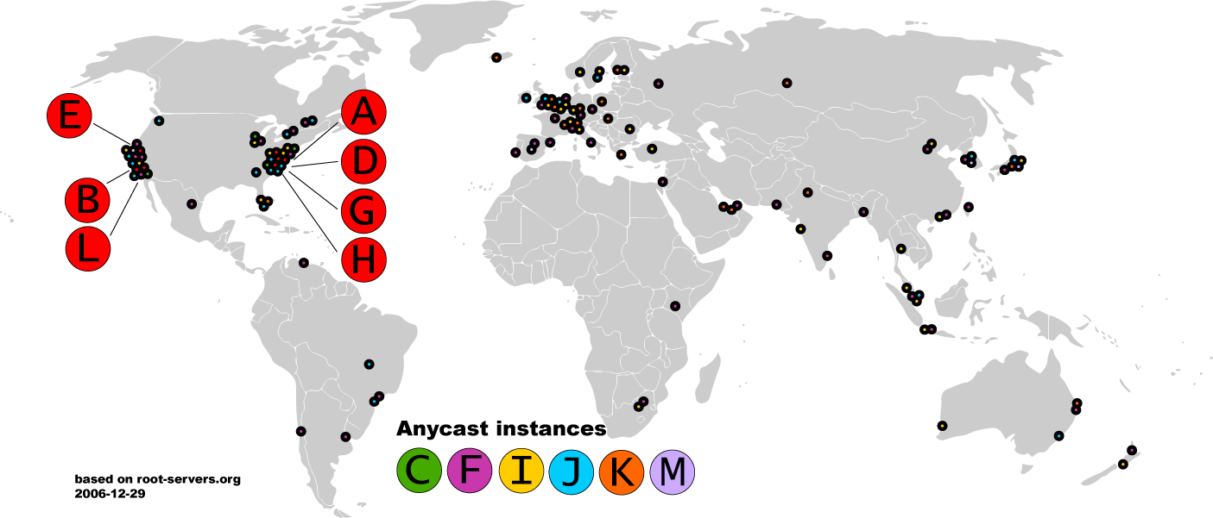
(Old) Map of the Roots

Slide 15
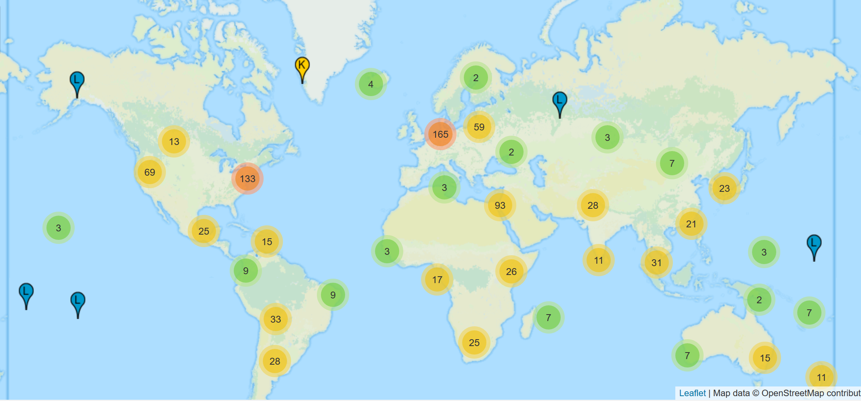
(New) Map of the Roots

Slide 16
Exercise #2: dig
; <<>> DiG 9.10.6 <<>>
;; global options: +cmd
;; Got answer:
;; ->>HEADER<<- opcode: QUERY, status: NOERROR, id: 57991
;; flags: qr rd ra; QUERY: 1, ANSWER: 13, AUTHORITY: 0, ADDITIONAL: 1
;; OPT PSEUDOSECTION:
; EDNS: version: 0, flags:; udp: 4096
;; QUESTION SECTION:
;. IN NS
;; ANSWER SECTION:
. 95556 IN NS k.root-servers.net.
. 95556 IN NS a.root-servers.net.
. 95556 IN NS f.root-servers.net.
. 95556 IN NS l.root-servers.net.
. 95556 IN NS g.root-servers.net.
. 95556 IN NS j.root-servers.net.
. 95556 IN NS b.root-servers.net.
. 95556 IN NS e.root-servers.net.
. 95556 IN NS h.root-servers.net.
. 95556 IN NS m.root-servers.net.
. 95556 IN NS d.root-servers.net.
. 95556 IN NS c.root-servers.net.
. 95556 IN NS i.root-servers.net.
...

Slide 17




Local Nameserver and Authorities
www.google.com
Where is www.google.com?
Local nameserver
Authority for *google.com
Local nameserver handles queries on behalf of clients
Authoritative nameservers know the zone mappings for a subset of the heirarchy
ns1.google.com
asgard.ccs.neu.edu
Authority for *.com
com
Root nameserver
Root

Slide 18
Basic Domain Name Resolution
Every host knows a local DNS server
Sends all queries to the local DNS server
If the local DNS can answer the query, then you’re done
Local server is also the authoritative server for that name
Local server has cached the record for that name
Otherwise, go down the hierarchy and search for the authoritative name server
Every local DNS server knows the root servers
Use cache to skip steps if possible
e.g. skip the root and go directly to .edu if the root file is cached

Slide 19
DNS Packet Format
Query/response?
Authoritative/non-authoritative response?
Success/failure?
ID number used to match requests and responses
0
16
32
TxID | Flags
Question Count | Answer Count
Authority Count | Additional Record Count
Question and answer data (Resource Records, variable length)
How many records are there of each type in the response payload?
DNS is a UDP-based protocol on port 53
No TCP means no connections
TxIDs are needed to correlate requests and responses
Serves as authentication for responses

Slide 20
Glue Records
DNS responses may contain more than a single answer
Example: resolving cyclic dependency
TxID: 5678
Q: 1 | A: 0
Auth: 1 | Addl: 1
Q: Where is www.google.com?
Auth: NS a.gtld-server.com
Addl: A a.gtld-server.com 12.56.10.1
TxID: 5678
Q: 1 | A: 0
Auth: 0 | Addl: 0
Q: Where is www.google.com?
asgard.ccs.neu.edu
Root
Known as glue records
Additional responses can contain any type of record (i.e. A, NS, etc.)

Slide 21
Exercise #2: dig (from a different DNS server)
$ dig
; <<>> DiG 9.10.6 <<>>
;; global options: +cmd
;; Got answer:
;; ->>HEADER<<- opcode: QUERY, status: NOERROR, id: 7982
;; flags: qr rd ra ad; QUERY: 1, ANSWER: 13, AUTHORITY: 0, ADDITIONAL: 25
;; OPT PSEUDOSECTION:
; EDNS: version: 0, flags:; udp: 512
;; QUESTION SECTION:
;. IN NS
;; ANSWER SECTION:
. 495128 IN NS g.root-servers.net.
. 495128 IN NS h.root-servers.net.
. 495128 IN NS i.root-servers.net.
. 495128 IN NS a.root-servers.net.
. 495128 IN NS j.root-servers.net.
. 495128 IN NS k.root-servers.net.
. 495128 IN NS l.root-servers.net.
. 495128 IN NS m.root-servers.net.
. 495128 IN NS b.root-servers.net.
. 495128 IN NS c.root-servers.net.
. 495128 IN NS d.root-servers.net.
. 495128 IN NS e.root-servers.net.
. 495128 IN NS f.root-servers.net.
;; ADDITIONAL SECTION:
m.root-servers.net. 581533 IN A 202.12.27.33
m.root-servers.net. 581549 IN AAAA 2001:dc3::35
b.root-servers.net. 581606 IN A 199.9.14.201
b.root-servers.net. 603914 IN AAAA 2001:500:200::b
c.root-servers.net. 581876 IN A 192.33.4.12
c.root-servers.net. 597962 IN AAAA 2001:500:2::c
d.root-servers.net. 582264 IN A 199.7.91.13
e.root-servers.net. 581732 IN A 192.203.230.10
e.root-servers.net. 584857 IN AAAA 2001:500:a8::e
f.root-servers.net. 581589 IN A 192.5.5.241
f.root-servers.net. 584857 IN AAAA 2001:500:2f::f
g.root-servers.net. 583191 IN A 192.112.36.4
g.root-servers.net. 602400 IN AAAA 2001:500:12::d0d
h.root-servers.net. 581545 IN A 198.97.190.53
i.root-servers.net. 583032 IN A 192.36.148.17
i.root-servers.net. 584858 IN AAAA 2001:7fe::53
a.root-servers.net. 581529 IN A 198.41.0.4
a.root-servers.net. 581542 IN AAAA 2001:503:ba3e::2:30
...

Slide 22


Iterative DNS Query Example
www.google.com
Where is www.google.com?
TxID: 12347
Q: 1 | A: 1
Auth: 0 | Addl: 0
Q: Where is www.google.com?
A www.google.com 182.0.7.34
TxID: 12346
Q: 1 | A: 0
Auth: 0 | Addl: 0
Q: Where is www.google.com?
TxID: 12345
Q: 1 | A: 0
Auth: 0 | Addl: 0
Q: Where is www.google.com?
TxID: 12347
Q: 1 | A: 0
Auth: 0 | Addl: 0
Q: Where is www.google.com?
asgard.ccs.neu.edu
ns1.google.com
TxID: 12345
Q: 1 | A: 0
Auth: 1 | Addl: 1
Q: Where is www.google.com?
Auth: NS a.gtld-server.com
Addl: A a.gtld-server.com 12.56.10.1
TxID: 12346
Q: 1 | A: 0
Auth: 1 | Addl: 1
Q: Where is www.google.com?
Auth: NS ns1.google.com
Addl: A ns1.google.com 8.8.0.1
a.gtld-server.com
Root

Slide 23
Recursive DNS Query
www.google.com
Where is www.google.com?
Puts the burden of resolution on the contacted name server
How does asgard know who to forward responses too?
Random IDs embedded in DNS queries
What have we said about keeping state in the network?
asgard.ccs.neu.edu
ns1.google.com
com
Root

Slide 24
[cbw@ativ9 ~] dig google.com
; <<>> DiG 9.9.5-3ubuntu0.1-Ubuntu <<>> google.com
;; global options: +cmd
;; Got answer:
;; ->>HEADER<<- opcode: QUERY, status: NOERROR, id: 39348
;; flags: qr rd ra; QUERY: 1, ANSWER: 16, AUTHORITY: 4, ADDITIONAL: 5
;; OPT PSEUDOSECTION:
; EDNS: version: 0, flags:; udp: 4096
;; QUESTION SECTION:
;google.com. IN A
;; ANSWER SECTION:
google.com. 161 IN A 4.53.56.93
google.com. 161 IN A 4.53.56.94
google.com. 161 IN A 4.53.56.104
google.com. 161 IN A 4.53.56.109
google.com. 161 IN A 4.53.56.99
google.com. 161 IN A 4.53.56.113
;; AUTHORITY SECTION:
google.com. 156797 IN NS ns2.google.com.
google.com. 156797 IN NS ns1.google.com.
;; ADDITIONAL SECTION:
ns2.google.com. 330052 IN A 216.239.34.10
ns1.google.com. 330052 IN A 216.239.32.10
Header info from the response
The original question
Answers(s)
Authority information
Glue records

Slide 25
DNS Queries and Resource Records
DNS queries have two fields: name and type
Resource record is the response to a query
Four fields: (name, value, type, TTL)
There may be multiple records returned for one query
What are do the name and value mean?
Depends on the type of query and response

Slide 26
DNS Types
Type = A / AAAA
Name = domain name
Value = IP address
A is IPv4, AAAA is IPv6
Type = NS
Name = partial domain
Value = name of DNS server for this domain
“Go send your query to this other server”
Name: www.ccs.neu.edu
Type: A
Query
Name: www.ccs.neu.edu
Value: 129.10.116.81
Resp.
Name: ccs.neu.edu
Type: NS
Query
Name: ccs.neu.edu
Value: 129.10.116.51
Resp.

Slide 27
DNS Types, Continued
Type = CNAME
Name = hostname
Value = canonical hostname
Useful for aliasing
CDNs use this
Type = MX
Name = domain in email address
Value = canonical name of mail server
Name: foo.mysite.com
Type: CNAME
Query
Name: foo.mysite.com
Value: bar.mysite.com
Resp.
Name: ccs.neu.edu
Type: MX
Query
Name: ccs.neu.edu
Value: amber.ccs.neu.edu
Resp.

Slide 28
Exercise #3: dig www.khoury.northeastern.edu (S1)
; <<>> DiG 9.10.6 <<>> www.khoury.northeastern.edu
;; global options: +cmd
;; Got answer:
;; ->>HEADER<<- opcode: QUERY, status: NOERROR, id: 20630
;; flags: qr aa rd ra; QUERY: 1, ANSWER: 4, AUTHORITY: 0, ADDITIONAL: 1
;; OPT PSEUDOSECTION:
; EDNS: version: 0, flags:; udp: 4096
;; QUESTION SECTION:
;www.khoury.northeastern.edu. IN A
;; ANSWER SECTION:
khoury.northeastern.edu. 28800 IN DNAME ccis.northeastern.edu.
www.khoury.northeastern.edu. 28800 IN CNAME www.ccis.northeastern.edu.
www.ccis.northeastern.edu. 300 IN CNAME presscache.ccis.northeastern.edu.
presscache.ccis.northeastern.edu. 300 IN A 52.70.229.197
...

Slide 29
Reverse Lookups
What about the IP→name mapping?
Separate server hierarchy stores reverse mappings
Rooted at in-addr.arpa and ip6.arpa
Additional DNS record type: PTR
Name = IP address
Value = domain name
Name: 129.10.116.51 Type: PTR
Query
Name: 129.10.116.51 Value: ccs.neu.edu
Resp.

Slide 30
DNS as Indirection Service
DNS gives us very powerful capabilities
Not only easier for humans to reference machines!
Changing the IPs of machines becomes trivial
e.g. you want to move your web server to a new host
Just change the DNS record!

Slide 31
Aliasing and Load Balancing
One machine can have many aliases
www.reddit.com
christo.blogspot.com
www.foursquare.com
sandi.blogspot.com
www.huffingtonpost.com
*.blogspot.com
One domain can map to multiple machines
www.google.com

Slide 32
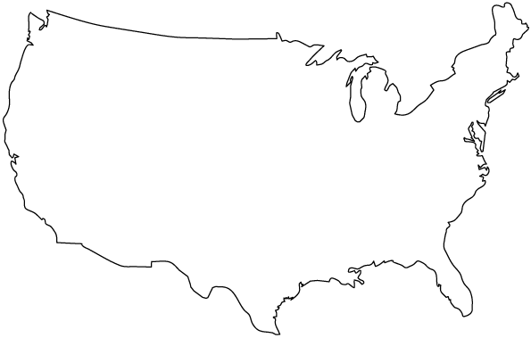


Content Delivery Networks
DNS responses may vary based on geography, ISP, etc

Slide 33
Exercise #4: dig www.northeastern.edu
; <<>> DiG 9.10.6 <<>> www.northeastern.edu
;; global options: +cmd
;; Got answer:
;; ->>HEADER<<- opcode: QUERY, status: NOERROR, id: 31072
;; flags: qr aa rd ra; QUERY: 1, ANSWER: 4, AUTHORITY: 0, ADDITIONAL: 1
;; OPT PSEUDOSECTION:
; EDNS: version: 0, flags:; udp: 4096
;; QUESTION SECTION:
;www.northeastern.edu. IN A
;; ANSWER SECTION:
www.northeastern.edu. 300 IN CNAME northeastern.edu.edgekey.net.
northeastern.edu.edgekey.net. 172 IN CNAME e12215.dscb.akamaiedge.net.
e12215.dscb.akamaiedge.net. 17 IN A 72.247.11.80
e12215.dscb.akamaiedge.net. 17 IN A 72.247.11.50

Slide 34
DNS Propagation
How many of you have purchased a domain name?
Did you notice that it took ~72 hours for your name to become accessible?
This delay is called DNS Propagation
www.my-new-site.com
Root
com
asgard.ccs.neu.edu
ns.godaddy.com
Why would this process fail for a new DNS name?

Slide 35
Caching vs. Freshness
DNS Propagation delay is caused by caching
Where is
www.my-new-site.com?
That name does not exist.
Cached Root Zone File
Cached .com Zone File
Cached .net Zone File
Etc.
asgard.ccs.neu.edu
Zone files may be cached for 1-72 hours
Root
com
www.my-new-site.com
ns.godaddy.com

Slide 36
Outline
DNS Basics
DNS Security
DNS Privacy

Slide 37
The Importance of DNS
Without DNS…
How could you get to any websites?
You are your mailserver
When you sign up for websites, you use your email address
What if someone hijacks the DNS for your mail server?
DNS is the root of trust for the web
When a user types www.bankofamerica.com, they expect to be taken to their bank’s website
What if the DNS record is compromised?

Slide 38
Denial Of Service
Flood DNS servers with requests until they fail
October 2002: massive DDoS against the root name servers
What was the effect?
… users didn’t even notice
Root zone file is cached almost everywhere
More targeted attacks can be effective
Local DNS server → cannot access DNS
Authoritative server → cannot access domain

Slide 39
Hijacking DNS
Instead of shutting DNS down, what if we could inject arbitrary records?
E.g. www.bankofamerica.com CNAME www.my-phishing-site.com
Three types of attacks
Old school attack: record injection
Somewhat old school attack: response spoofing
New, deadly attack: The Kaminsky Attack

Slide 40




Threat Model and Attacker Goals
Where is www.bofa.com?
Honest DNS Servers
Local
Nameserver
Active attacker, may send DNS packets
Remote attacker, may not eavesdrop
Attacker may control their own domains and DNS servers
I want to add a record to that local nameserver that directs www.bofa.com → 6.6.6.6
102.32.0.1
6.6.6.6

Slide 41


Record Injection
Honest DNS Servers
Local
Nameserver
Where is www.bofa.com?
TxID: 12346
Q: 1 | A: 1
Auth: 0 | Addl: 1
Q: Where is www.attacker.net?
A www.attacker.net 128.1.2.0
Addl: A www.bofa.com 6.6.6.6
Where is www.attacker.net?
102.32.0.1
6.6.6.6
ns.attacker.net

Slide 42
Bailiwick Checking
Record injection attacks no longer work in practice
All modern DNS servers implement bailiwick checking
Only records related to the requested domain are accepted in responses
In other words, DNS servers are less trusting of additional information

Slide 43
Response Spoofing
Honest DNS Servers
Local
Nameserver
TxID: 12347
Q: 1 | A: 0
Auth: 0 | Addl: 0
Q: Where is www.bofa.com?
TxID: ????
Q: 1 | A: 1
Auth: 0 | Addl: 1
Q: Where is www.bofa.com
A www.bofa.com 6.6.6.6
Where is www.bofa.com?
102.32.0.1
6.6.6.6

Slide 44
Implementing Response Spoofing
What info does the attacker need to spoof a DNS response?
IP address of the target nameserver and true authoritative nameserver
Easy, both pieces of info are readily available
Source port used by the authoritative nameserver
Easy, it must be 53
The question in the query
Easy, the attacker can choose the targeted domain name
Response port used by the target when they made the request
TxID in the query
Old DNS servers used one port for all queries and incremented TxID monotonically
Attacker can query the target DNS server for a domain they control and observe the query at their own DNS server
The query reveals the port used by the target, as well as the approximate TxID

Slide 45
Inspecting the Target
Honest DNS Servers
Local
Nameserver
TxID: 12347
Q: 1 | A: 0
Auth: 0 | Addl: 0
Q: Where is www.attacker.net?
Where is www.attacker.net?
102.32.0.1
6.6.6.6
ns.attacker.net

Slide 46
Conditions for Successful Response Spoofing
Attacker must infer the response port of the target nameserver and TxID
Attacker’s response must outrace the legitimate response
The attack must be executed after the target nameserver is queried for a domain that is not in the cache
If the target domain name is already cached, no queries will be sent
The attacker can send the initial query to the nameserver, but if the attack fails the legitimate response will be cached until the TTL expires
If the attack is successful, the record for a single domain is poisoned

Slide 47
Kaminsky Attack
Variation of the response spoofing attack that is much more powerful
Discovered by notable security researcher Dan Kaminsky in 2008
Poisons glue records rather than A records
Attacker repeatedly makes queries for non-existent subdomains of the target domain
Since these subdomains do not exist, they are guaranteed to not be in the target nameservers cache
Attacker then attempts to spoof a response with a poison glue record
The attacker can attempt the attack an infinite number of times until success
On success, entire zone is poisoned, rather than a single domain name

Slide 48
Kaminsky Attack
Honest DNS Servers
Local
Nameserver
Where is www.bofa.com?
Where is aaaa.bofa.com?
Where is aaab.bofa.com?
TxID: ????
Q: 1 | A: 1
Auth: 1 | Addl: 1
Q: Where is aaaa.bofa.com
A: aaaa.bofa.com = 127.0.0.1
Auth: NS = ns1.bofa.com
Addl: ns1.bofa.com = 6.6.6.8
TxID: ????
Q: 1 | A: 1
Auth: 1 | Addl: 1
Q: Where is aaab.bofa.com
A aaab.bofa.com 127.0.0.1
Auth: NS ns1.bofa.com
Addl: A ns1.bofa.com 6.6.6.8
ns.attacker.net
6.6.6.8
102.32.0.1
6.6.6.6

Slide 49
Mitigating the Kaminsky Attack
The Kaminsky attack relies on fundamental properties of the DNS protocol
Specifically, the ability to respond with NS records and glue to any query
The functionality is essential for DNS, it cannot be disabled
How do you mitigate the Kaminsky attack?
Make it harder to spoof DNS responses
All modern DNS servers randomize the TxID and query port for every request
2¹⁶ TxIDs * 2¹⁶ query ports = 2³² messages needed to spoof successfully
Use heuristics to detect flood of spoofed responses
Despite this mitigation, almost all existing DNS servers are still fundamentally vulnerable to Kaminsky attacks

Slide 50
Additional DNS Hijacks
Infect the target user’s OS or browser with a virus/trojan
e.g. Many trojans change entries in /etc/hosts
*.bankofamerica.com → evilbank.com
Man-in-the-middle
DNS is not encrypted or strongly authenticated

Slide 51
Authentication for DNS
Domain Name System Security Extensions (DNSSEC)
Integrates a public key infrastructure (PKI) into DNS
Provides end-to-end authentication and integrity, but not confidentiality
Prevents DNS hijacking!
But, complex to deploy, some performance overhead, much power given to DNS root
Deployment
On the roots since July 2010
Verisign enabled it on .com and .net in January 2011
Comcast was the first major ISP to support it (January 2012)

Slide 52
DNSSEC Details
Cryptographically sign critical resource records
Resolver can verify the cryptographic signature
Four new resource types
DNSKEY
Public key for a zone
Signed by the private key of the parent zone
Signatures from the root servers are trusted by default
DS
Delegated signer
RRSIG
Digital signature of a specific resource record
Signed by the private key of the zone
NSEC*
Signed denial of record existence
Creates a hierarchy of trust within each zone
Prevents hijacking and spoofing

Slide 53

DNSSEC Example
www.google.com
Where is www.google.com?
A www.google.com 128.1.0.4
DNSKEY P_{Google}
RRSIG {H(A Record)}_{SGoogle}
Q: Where is www.google.com?
asgard.ccs.neu.edu
ns1.google.com
NS a.gtld-server.com
A a.gtld-server.com 143.7.0.1
DS com
DNSKEY P_{Root}
NS ns1.google.com
A ns1.google.com 8.8.0.2
DS google.com
DNSKEY P_{com}
a.gtld-server.com
Root

Slide 54
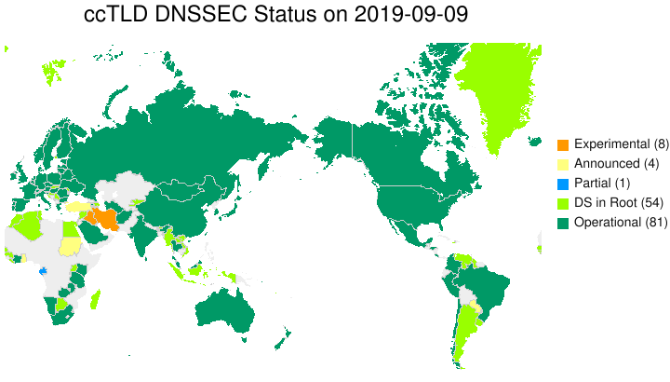
DNSSEC adoption by Country Code TLDs
https://www.internetsociety.org/deploy360/dnssec/maps/

Slide 55
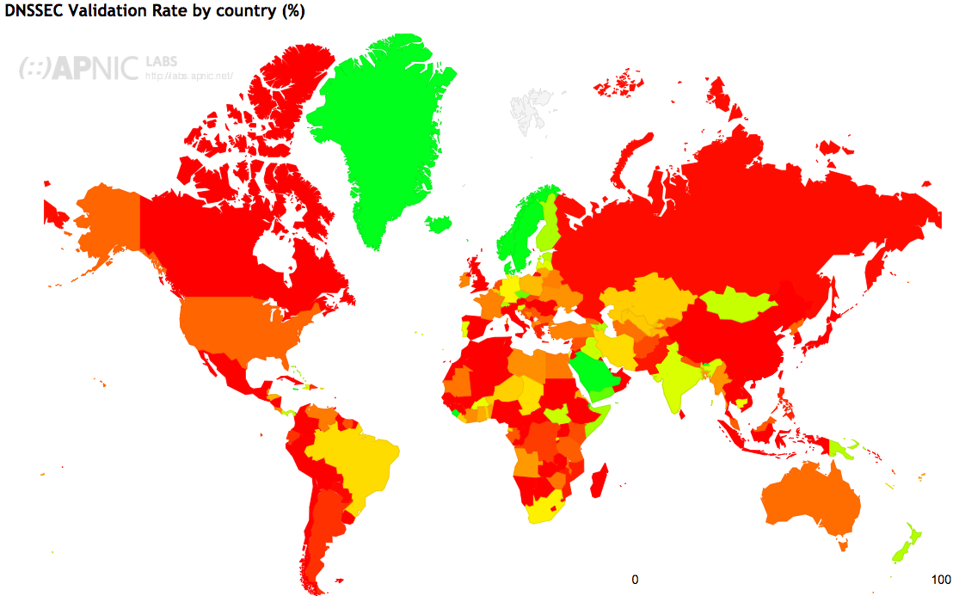
DNSSEC Validation Rate (10/2019)
https://stats.labs.apnic.net/dnssec

Slide 56
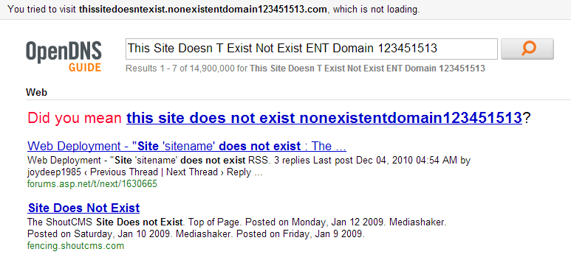
Site Finder
September 2003: Verisign created DNS wildcards for *.com and *.net
Essentially, catch-all records for unknown domains
Pointed to a search website run by Verisign
Search website was full of advertisements
Extremely controversial move
Is this DNS hijacking?
Definitely abuse of trust by Verisign
Site Finder was quickly shut down, lawsuits ensued

Slide 57
Much More to DNS
DNSSEC – cryptographically authenticated DNS entries
Caching: when, where, how much, etc.
Other uses for DNS (i.e. DNS hacks)
Content Delivery Networks (CDNs) and load balancing
Dynamic DNS (e.g. for mobile hosts)
DNS and botnets
Politics and growth of the DNS system
Governance
New TLDs (.xxx, .biz), eliminating TLDs altogether
Copyright, arbitration, squatting, typo-squatting

Slide 58
Outline
DNS Basics
DNS Security
DNS Privacy

Slide 59
Who sees your DNS requests?
Your local DNS server
Who owns that server?
What can they figure out about you by what names you ask about?
Heath, Financial, Social, other private data...
What can they do with that information? $$$
Anyone who cares to look...
DNS on port 53 is not a confidential service and DNSSEC is not encrypted
Initially, privacy was
Not considered a requirement for DNS traffic, or
Assumed that network traffic was sufficiently private
X

Slide 60
IETF RFC 7258 "Pervasive Monitoring Is an Attack"
"Pervasive Monitoring (PM) Is a Widespread Attack on Privacy"
PM is distinguished by being indiscriminate and very large scale
Surveillance through intrusive gathering of protocol artifacts, such as
application content
protocol metadata, e.g., headers.
active or passive wiretaps
traffic analysis, (e.g., correlation, timing or measuring packet sizes)
subverting the cryptographic keys used to secure protocols

Slide 61
What option do you have?
Select your DNS provider
No need to rely on the default given by DHCP
There may be reasons to use/trust one DNS service over another
$$$
Speed
Resilience to attacks; Block domains associated with malicious activity
Privacy: Delete or not keep the IP addresses from requests
Examples
Google DNS: 8.8.8.8
Fast, Resistant to DNS attacks (Kaminsky, …), keep request IP for 24 hours
Cloudflare & APNIC: 1.1.1.1
Faster (according to dnsperf.com), does not log request IPs
Quad9: 9.9.9.9
Not for profit org, does not log request IPs
…
However your queries are still in the clear

Slide 62
DNS over TLS (DoT)
Encrypt DNS queries and answers via the Transport Layer Security (TLS) protocol
Increase privacy and security
Prevent eavesdropping and data manipulation
For recursive servers over port 853 TLS over TCP
Multiple ways to authenticate the DNS server
Opportunistic, Public keys, Shared keys, …
Issues
Performance (TCP and TLS), use for many queries to amortize handshakes
No native client implementations (as of Spring 2019), install s/w

Slide 63
DNS over HTTPS (DoH)
DNS queries and answers via HTTPS
Increase privacy and security, while improving performance
Prevent eavesdropping and data manipulation
DoH Client selects server using client's URI template(s)
DoH Server
DNS accepts requests in POST and GET messages: application/dns-message
If HTTP/2, can PUSH additional information
Issues
DoH client implemented directly in app (hard to tell when queries do NOT use DoH)
DoH proxy implemented on DNS server (connect on 53 or 853) or individual host
None of the above is an e2e encrypted solution

