Slide 1
CS 3700 Networks and Distributed Systems
Transport Layer Security

Slide 2
Definitions
Crypto Basics
Transport Layer Security

Slide 3
Defining Security
Policies and mechanisms for preserving desirable protection properties over data and resources.
We reason about security in terms of properties
Policies specify what we want to enforce
Mechanisms are the means by which we enforce policies
Always in the context of an attacker

Slide 4
Security Properties
Let's consider an example where a general wants to give the order "Attack at dawn."
In a network, messages must be distributed from one principal to various other principals.
What are the properties we would like to enforce on messages?
Alternatively, what are the bad things that could be done to this message?

Slide 5
Confidentiality
"Hey, we're attacking at dawn!"
Data must only be released to authorized principals
Cryptography has historically focused on providing confidentiality
But, there are other mechanisms
Can have a temporal aspect

Slide 6
Integrity
“Attack Retreat at dawn."
Data must not be modified (in an undetectable manner)
What constitutes a modification?
Corruption
Dropped, replayed, or reordered messages
Cryptography has also historically provided this
e.g, (cryptographic) hash functions, HMAC

Slide 7
Authenticity
Enemy commander: "Attack at dawn."
Establishment of identity
Or, verification of "genuineness"
Again, cryptography has long considered this
e.g., HMAC, signatures
Consider the PKI that underlies SSL certificates or DNSSEC

Slide 8
Availability
“Xfk3^#M3mf a __ q3rf” – jamming results in garbled message
Data and resources must be accessible when required
Related to integrity, but more concerned with denial of service (DoS) attacks
Resource exhaustion (e.g., CPU, memory, network bandwidth)
Usually easy to perform, and very difficult to defend against

Slide 9
Non-repudiation
"I never said to attack at dawn!"
Data must be bound to identity
Prevents denial of message transmission or receipt
Cryptographic techniques
e.g., HMAC, certificates

Slide 10
Authentication
Verification of identity claim made by a subject on behalf of a principal
Involves examination of factors or credentials
Something you have – e.g., a badge
Something you know – e.g., a password
Something you are – e.g., your fingerprint
Desirable properties include being unforgeable, unguessable, and revocable

Slide 11
Definitions
Crypto Basics
Transport Layer Security

Slide 12
Cryptography is Fundamental
The study and practice of techniques for secure communication in the presence of adversaries
Critical for many important security properties
Confidentiality
Integrity
Authentication and non-repudiation
Anonymity
Two basic types
Symmetric key
Asymmetric key (a.k.a. public-key)

Slide 13
Symmetric Key Crypto
Algorithms that use a single key for encryption and decryption
i.e. the algorithm is reversible
Keys are a form of shared secret
Ancient examples:
Caeser shift – simple rotational cypher
Vigenère – Multiple Caesar shifts with independent keys
Modern examples:
DES, 3DES, RC4, Blowfish, Twofish, AES
Warning: many of these methods are known to be vulnerable

Slide 14






AES Example
Alice
Eavesdropper
Bob
K_{AES}
K_{AES}
M
{M}_{KAES}
{M}_{KAES}
M

Slide 15
Weakness of Symmetric Key Crypto
How do you securely exchange keys with someone?
Easy to do if you can meet them in person
However, the Internet is untrusted
You can’t exchange shared secrets over an untrusted medium
Alice
Eavesdropper
Bob
K_{AES}
K_{AES}
K_{AES}

Slide 16
Public Key Cryptography
Public key cryptography, a.k.a. asymmetric cryptography
Each principal has two keys: private (secret) and public
A message encrypted with one key must be decrypted by the other
Thus, the public key can be sent in-the-clear over the Internet
Security is based on Very Hard Math Problems
O(1) time to verify a given solution for a given instance
Exponential time to check all possible solutions for a given instance
Forms the basis for most modern secure protocols
IPsec, SSL, TLS, S/MIME, PGP/GPG, etc.

Slide 17
RSA
Invented by Rivest, Shamir, and Adleman in 1978
Equivalent system invented by Clifford Cox in 1973, but GCHQ classified it
RSA is the dominant public key cryptosystem today for historical reasons
Algorithm was commercialized by RSA Security
RSA Security created a certificate authority that eventually became Verisign

Slide 18
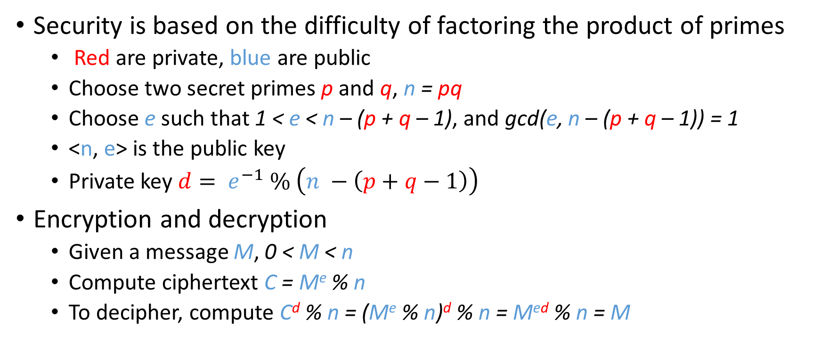
RSA Algorithm
Security is based on the difficulty of factoring the product of primes
Red are private, blue are public
Choose two secret primes p and q, n = pq
Choose e such that 1 < e < n – (p + q – 1), and gcd(e, n – (p + q – 1)) = 1
<n, e> is the public key
Private key $d= e^{−1} \% \left(n −\left(p+q−1\right)\right)$
Encryption and decryption
Given a message M, 0 < M < n
Compute ciphertext C = Me % n
To decipher, compute C^{d} % n = (Me % n)^{d} % n = M^{ed} % n = M

Slide 19
RSA Examples
p = 11, q = 7, n = pq = 77, n – (p + q – 1) = 60
e = 37, d = 13 (ed = 481, ed % 60 = 1)
If M = 15 then C = Me % n = 15³⁷ % 77 = 71
C^{d} % n = M = 71¹³ % 77 = 15

Slide 20
Public Key Crypto Example
Brand new AES symmetric key
Alice
Eavesdropper
Bob
S_{a}
P_{a}
M
P_{a}
P_{a}
K_{AES}
{M}_{KAES}{K_{AES}}_{Pa}
{M}_{KAES}{K_{AES}}_{Pa}
{M}_{KAES}
K_{AES}
Why bother with the symmetric key?
Why not just encrypt M with P_{a}?
Performance
Asymmetric crypto is slow, symmetric is fast
Use asymmetric for K (which is small)
Use symmetric for M (which is large)
M

Slide 21
Cryptographic Hash Functions
Cryptographic hash function transform input data into scrambled output data
Deterministic: hash(A) = hash(A)
High entropy:
md5(‘security’) = e91e6348157868de9dd8b25c81aebfb9
md5(‘security1’) = 8632c375e9eba096df51844a5a43ae93
md5(‘Security’) = 2fae32629d4ef4fc6341f1751b405e45
Collision resistant
Locating A’ such that hash(A) = hash(A’) takes a long time
Example: 2²¹ tries for md5
Examples: md5, sha1, sha256, sha512
Warning: md5 and sha1 are considered broken and unsafe

Slide 22

Digital Signatures
Alice
Bob
S_{a}
P_{a}
P_{a}
M
M
H(M)
M{H(M)}_{Sa}
H(M) ?= H(M)
What can you infer about a signed message?
The holder of S_{a} must have produced the signature, since P_{a} decrypts the hash
The message was not modified, otherwise the hash would not match

Slide 23
Encryption vs. Signatures
Public Key Encryption
Digital Signatures
What does encryption give you?
Confidentiality – only the holder of the private key can read the message
Integrity – if the message is modified, it will no longer decrypt properly
What does encryption not give you?
Authentication – you have no idea who used your public key to encrypt the message
What do signatures give you?
(Weak) Authentication – only the holder of the private key could have signed the message
Integrity – if the message is modified, the signature will be invalid
What do signatures not give you?
Confidentiality – the message is not encrypted, it’s public

Slide 24
Authentication
Does public key cryptography provide authenticity guarantees?
Yes – if you obtain Alice’s public key through a secure, out-of-band exchange
No – if you obtain Alice’s key via an untrusted network

Slide 25
The Man-in-the-Middle Attack
Bob has no way of knowing that P_{e} does not belong to Alice
Alice
Attacker
Bob
P_{a}
S_{e}
M
P_{a}
P_{e}
S_{a}
P_{a}
P_{e}
K_{AES}
{M}_{KAES}{K_{AES}}_{Pe}
{M}_{KAES}
K_{AES}
{M}_{KAES}
K_{AES}
Total compromise! The attacker can read, modify, or drop the message
M
M
Alice has no idea message has been compromised
{M}_{KAES}{K_{AES}}_{Pa}

Slide 26
Signing Public Keys
The only way to authenticate a public key is to rely on trust
One or more third-party, trusted principals vouch for Alice’s key by signing it
Bob can verify the signatures using the public keys of the trusted third-parties
If Alice’s key is not signed, maybe Bob should not trust it
Question: who do you trust?
Web of trust: a social network of private individuals who sign each others keys
OpenPGP keys
Certificate authorities: companies that verify individuals and sign public keys for a fee
X.509 certificates (more on these later)

Slide 27




Web of Trust
Fred
P_{f}
Bob
Eric
Is this Fred’s key?
No way to tell, none of my friends can vouch for it.
e
P_{b}
P_{e}
Alice
Dave
a
d
d
f
Is this Eric’s key?
Maybe. Dave is two hops away, but I don’t know Fred.
P_{a}
Chris
P_{d}
b
c
b
c
Is this Dave’s key?
Bob and Chris say it is, and I trust them, so I trust this key.
e
P_{c}
a
d

Slide 28
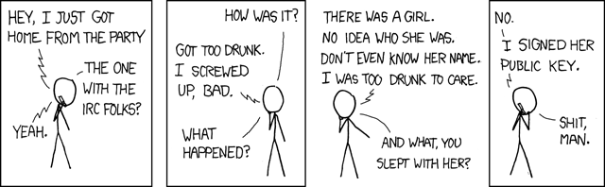

Slide 29

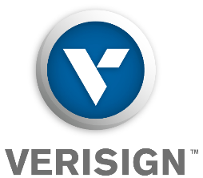


Public Key Infrastructure (PKI)
The whole chain is valid because I trust Verisign.
P_{Verisign}
Alice
Is this GoDaddy’s key?
P_{GoDaddy}
Is this BofA’s key?
Verisign
P_{Verisign}
Your OS and web browser ship with ~200 trusted public keys by default.
P_{BofA}
GoDaddy

Slide 30
Definitions
Crypto Basics
Transport Layer Security

Slide 31
SSL/TLS
Application-layer protocol for confidentiality, integrity, and authentication between clients and servers
Introduced by Netscape in 1995 as the Secure Sockets Layer (SSL)
Designed to encapsulate HTTP, hence HTTPS
Transport Layer Security (TLS) is the upgraded standard
Defined in an RFC in 1999
Supersedes SSL: SSL is known to be insecure and should not be used
Sits between transport and application layers
Thus, applications must be TLS-aware
Both client and server must have an asymmetric keypair
X.509 certificates contain signed public keys
PKI rooted in trusted (?) Certificate Authorities (CAs)

Slide 32



Goals of TLS
Confidentiality and integrity: use BofA’s public key to negotiate a session key; encrypt all traffic
Authentication: BofA’s cert can be validating by checking Verisign’s signature
Verisign
S_{Verisign}
https://www.bankofamerica.com
Trusted Key Store
Verisign
S_{BofA}
BofA
Contains BofA’s public key
Signed by Verisign

Slide 33
Let’s Talk about Certificates
Suppose you start a new website and you want TLS encryption
You need a certificate. How do you get one?
Option 1: generate a certificate yourself
Use openssl to generate a new asymmetric keypair
Use openssl to generate a certificate that includes your new public key
Problem?
Your new cert is self-signed, i.e. not signed by a trusted CA
Browsers cannot authenticate your cert to a trusted root CA
Users will be shown a scary security warning when they visit your site
Option 2:
Pay Get a well-known CA to sign your certificate
Any browser that trusts the CA will also trust your new cert

Slide 34
Certificate Authorities
Certificate Authorities (CAs) are the roots of trust in the TLS PKI
Symantec, Verisign, Thawte, Geotrust, Comodo, GlobalSign, Go Daddy, Digicert, Entrust, and hundreds of others
Issue signed certs on behalf of third-parties
How do you become a CA?
Create a self-signed root certificate
Get all the major browser vendors to include your cert with their software
Keep your private key secret at all costs
What is the key responsibility of being a CA?
Verify that someone buying a cert for example.com actually controls example.com
Any CA can issue a cert for any domain!
The only thing that stops me from buying a cert for google.com is a manual verification process

Slide 35

Acquiring a Certificate
Generate a new certificate using the data in the CSR, sign it with the CA’s private key
Generate a new keypair
Verify that the requestor owns the domain in the CSR
Generate a Certificate Signing Request (CSR).
Contains BofA’s details, the DNS name for the cert, and P_{BofA}
S_{BofA}
P_{BofA}
S_{Verisign}
Verisign
CSR
bofa.com
P_{BofA}
BofA

Slide 36
Recap from last class
Security: Policies and Mechanisms
Confidentiality, Integrity, Authentication, Non-repudiation, Authenticity, Availability
Crypto: Symmetric Key (e.g., AES) vs Public Key (e.g., RSA)
Strengths and weaknesses
Cryptographic Hash Functions and Digital Signatures
Web of Trust, Key Signing, and PKIs
SSL/TLS
Add confidentiality, integrity and authentication to http via certificates and PKI
CAs, their role, how do you get root/CA certificates?
How do you get a certificate? Who / what needs one?
What is in a certificate...

Slide 37
X.509 Certificate (Part 1)
Certificate:
Data:
Version: 3 (0x2)
Serial Number:
0c:00:93:10:d2:06:db:e3:37:55:35:80:11:8d:dc:87
Signature Algorithm: sha256WithRSAEncryption
Issuer: C=US, O=DigiCert Inc, OU=www.digicert.com, CN=DigiCert SHA2 Extended Validation Server CA
Validity
Not Before: Apr 8 00:00:00 2014 GMT
Not After : Apr 12 12:00:00 2016 GMT
Subject: businessCategory=Private Organization/1.3.6.1.4.1.311.60.2.1.3=US/1.3.6.1.4.1.311.60.2.1.2=Delaware/serialNumber=5157550/street=548 4th Street/postalCode=94107, C=US, ST=California, L=San Francisco, O=GitHub, Inc., CN=github.com
Subject Public Key Info:
Public Key Algorithm: rsaEncryption
Public-Key: (2048 bit)
Modulus:
00:b1:d4:dc:3c:af:fd:f3:4e:ed:c1:67:ad:e6:cb:
Issuer: who generated this cert? (usually a CA)
Certificates expire
Used for revocation
Github’s public key
Subject: who owns this cert?
This is Github’s certificate
Must be served from github.com

Slide 38
X.509 Certificate (Part 2)
Additional DNS names that may serve this cert
X509v3 extensions:
X509v3 Subject Alternative Name:
DNS:github.com, DNS:www.github.com
X509v3 CRL Distribution Points:
Full Name:
URI:http://crl3.digicert.com/sha2-ev-server-g1.crl
Full Name:
URI:http://crl4.digicert.com/sha2-ev-server-g1.crl
X509v3 Certificate Policies:
Policy: 2.16.840.1.114412.2.1
CPS: https://www.digicert.com/CPS
Authority Information Access:
OCSP - URI:http://ocsp.digicert.com
If this cert is revoked, it’s serial will be in the lists at these URLS
Policy numbers are magic (more on this later)
This cert’s revocation status may also be checked via OSCP

Slide 39
TLS Connection Establishment
S_{BofA}
BofA
ClientHello(Version, Prefs, Nonce_{c})
ServerHello(Version, Prefs, Nonce_{s})
Certificates({C_{BofA}, C_{Verisign}})
Certificate chain
Both sides derive symmetric session key K from the PreMasterKey
ServerHelloDone
ClientKeyExchange({PreMasterKey K}_{PBofA})
Encrypted using server’s public key
ChangeCipherSpec
{Finished}_{K}
Encrypted using symmetric session key
ChangeCipherSpec
{Finished}_{K}

Slide 40
TLS Authentication
During the TLS handshake, the client receives a certificate chain
Chain contains the server’s cert, as well as the certs of the signing CA(s)
The client must validate the certificate chain to establish trust
i.e. is this chain authentic, correct, cryptographically sound, etc.
Client-side validation checks
Does the server’s DNS name match the common name in the cert?
E.g. example.com cannot serve a cert with common name google.com
Are any certs in the chain expired?
Is the CA’s signature cryptographically valid?
Is the chain’s root cert present in the client’s trusted key store?
Is any cert in the chain revoked? (more on this later)

Slide 41
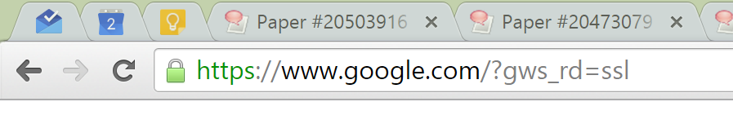
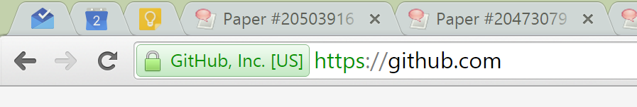
Little Green Locks
If the TLS handshake succeeds, and the server’s certificate chain is valid, then the connection is authenticated and encrypted
Green lock icon indicates secure TLS connection to the user
Most certificates are Domain Validation (DV) certificates
Some certs are Extended Validation (EV) certificates
EV certs get the green bar

Slide 42
Extended Validation Certificates
What differs between a DV and an EV certs?
To get a DV cert, the CA verifies that you control the given common name
To get an EV cert, the CA does a background check on you and your company
EV certs cost a lot more than DV certs
Other than the background check, EV certs offer the same security as DV certs
How does your browser tell the difference between DV and EV certs?
Remember the policy number in the X.509 certificate?
Each CA designates certain magic policy numbers to indicate EV status
Your browser contains a hard-coded list of magic policy numbers to identify EV certs :(

Slide 43
Problems with TLS
TLS is a widely deployed and extremely successful protocol
… but it’s not perfect
Problems with TLS:
CA trustworthiness
Weak cyphers and keys
Protocol Attacks
Man-in-the-middle attacks
Secret key compromise
Implementation Bugs

Slide 44
Certificate Authorities, Revisited
A CA is essentially a trusted third party
Certificate signatures are attestations of authenticity for the server and (optionally) the client
Remember: trust is bad and should be minimized!
If a CA mistakenly (or purposefully) signs a certificate for a domain and provides it to a malicious principal, TLS can be subverted
Recall: any CA can sign a cert for any domain
Not only must we trust root CAs, but also intermediate CAs that have been delegated signing authority

Slide 45
CA Failures
Issued to: Microsoft Corporation
Issued by: VeriSign Commercial Software Publishers CA
Valid from 1/29/2001 to 1/30/2002
Serial number is 1B51 90F7 3724 399C 9254 CD42 4637 996A
Issued to: Microsoft Corporation
Issued by: VeriSign Commercial Software Publishers CA
Valid from 1/30/2001 to 1/31/2002
Serial number is 750E 40FF 97F0 47ED F556 C708 4EB1 ABFD
In 2001, Verisign issued two executable signing certificates to someone claiming to be from Microsoft
Could be used to issue untrusted software updates

Slide 46
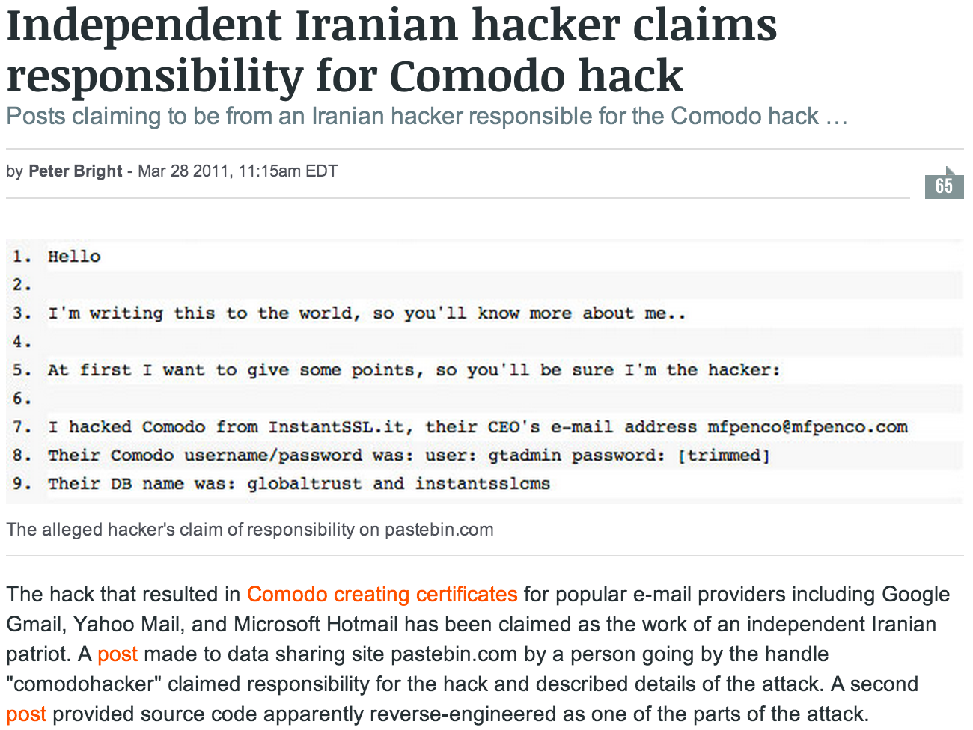
Comodo

Slide 47
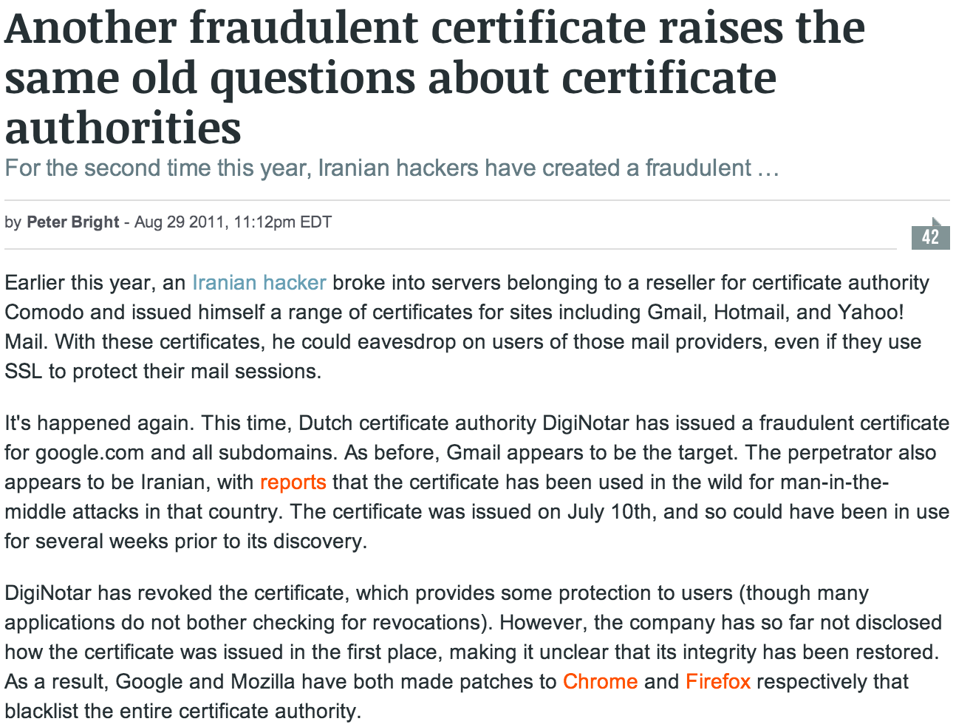
DigiNotar

Slide 48
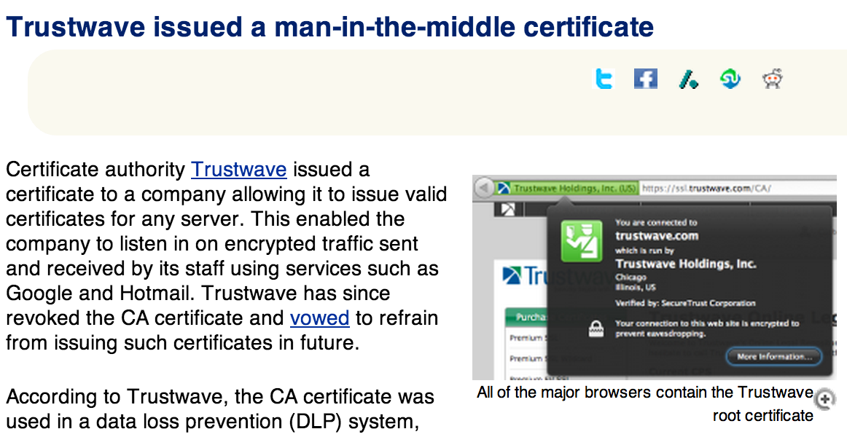
TrustWave

Slide 49
Weak Cipher Suites
Cipher Suite | Usage in Certs (as of 2013)
RC4-MD5 | 2.8%
RC4-SHA1 | 48.9%
AES128-SHA1 | 1.2%
AES256-SHA1 | 46.3%
TLS allows the use of different cryptographic algorithms
Known weaknesses in RC4, MD5, and CBC-mode ciphers

Slide 50
Weak Keys
The ZMap team constantly collects all TLS certificates visible in the IPv4 address space
http://zmap.io/ (data at https://scans.io/)
Currently, around 8.3 million certs being served on the Internet
Observed repeated keys in-the-wild due to low entropy
Some systems auto-generate TLS keys at boot
Low boot-time entropy results in duplicate keys
Default TLS keys often shipped in network devices
Attackers can extract private keys from firmware!

Slide 51
Protocol Attacks
Renegotiation attacks
Allows attacker to renegotiate a connection to the NULL algorithm and inject plaintext data
Fixed by requiring cryptographic verification of previous TLS handshakes
Version downgrade attacks
False Start TLS extension allows attackers to modify the cipher suite list the client sends to server during handshake
Can force the usage of a known insecure cipher
Padding Oracle On Downgraded Legacy Encryption (POODLE)
Cryptographic attack against CBC-mode cyphers when used with SSL 3.0
Attacker can use a downgrade attack to force TLS connections into SSL 3.0
Allowing security degradation for the sake of interoperability is dangerous

Slide 52
TLS Man-in-the-Middle Attack
Does C_{e} validate?
S_{e}
S_{BofA}
e
BofA
ClientHello
ClientHello
e
BofA
If C_{e} is self-signed, the user will be shown a warning
If the attacker manages to buy a valid BofA cert from a CA, then the only defense against this attack is certificate pinning
If the attacker steals C_{BofA} and S_{BofA}, then this attack will succeed unless:
Bank of America revokes the stolen cert…
And the client checks to see if the cert has been revoked

Slide 53
Certificate and Public Key Pinning
Certificate pinning is a technique for detecting sophisticated MitM attacks
Usually, only certs from root CAs are included in the trusted key store
Browser adds certs from well-known websites into the trusted key store
Implemented using the HTTP Strict Transport Security (HSTS) and HTTP Public Key Pinning (HPKP) headers [pins hashes of public keys of well-known websites]
Pinning isn’t just for browsers
Many Android and iPhone apps now include pinned certificates
E.g. Facebook’s apps include a pinned cert
Certificate Transparency (CT)
Public logs that record certificates issued by publicly trusted certificate authorities
Permits efficient identification of mistakenly or maliciously issued certificates
Trusted Key Store
Verisign
BofA
Google

Slide 54
Key Compromise
C_{BofA} is totally legit
S*_{BofA}
S_{BofA}
S_{BofA}
BofA
*BofA
BofA
ClientHello
ClientHello
BofA
*BofA
BofA
Secret key compromise leads to many devastating attacks
Attacker can successfully MitM TLS connections (i.e. future connections)
Attacker can decrypt historical TLS packets encrypted using the stolen key
Changing to a new keypair/cert does not solve the problem!
The old, stolen key is still valid!
Attacker can still MitM connections!

Slide 55
Expiration
Certificate expiration is the simplest, most fundamental defense against secret key compromise
All certificates have an expiration date
A stolen key is only useful before it expires
Ideally, all certs should have a short lifetime
Months, weeks, or even days
Problem: most certs have multi-year lifetimes
This gives an attacker plenty of time to abuse a stolen key
X.509 Certificate
Validity
Not Before: Apr 8 00:00:00 2014 GMT
Not After : Apr 12 12:00:00 2016 GMT

Slide 56
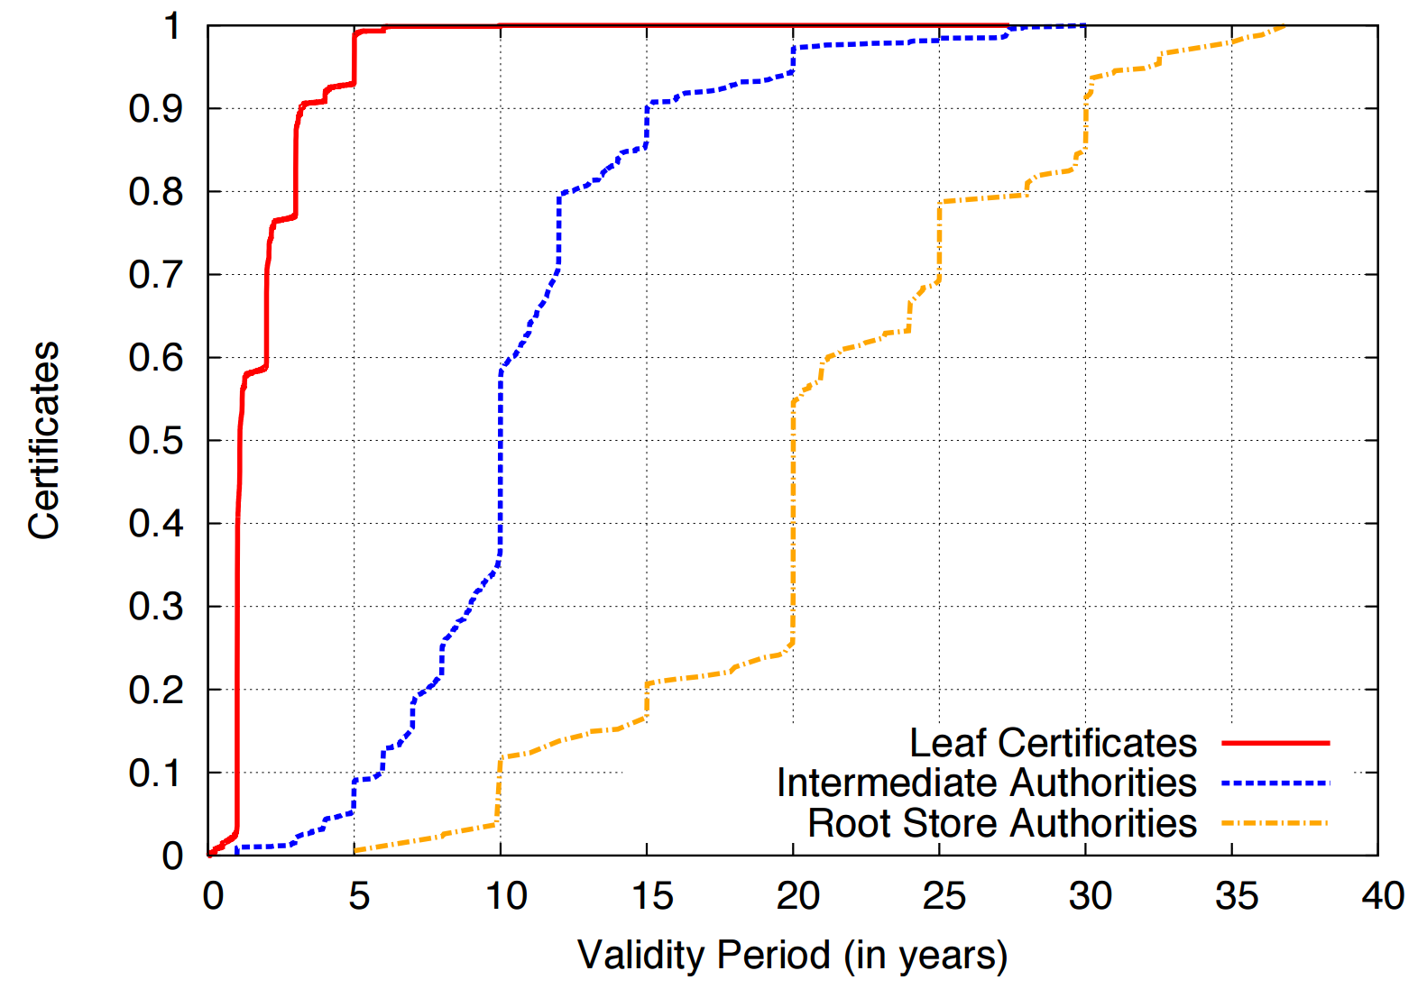
Certificate Lifetimes

Slide 57
Perfect Forward Secrecy
Given S_{BofA}, attacker can decrypt the {PreMasterKey}_{PBofA} of any TLS sessions, thus past and future TLS packets can be decrypted
…
ClientKeyExchange({PreMasterKey}_{PBofA})
ChangeCipherSpec
S_{BofA}
{Finished}_{K}
…
BofA
Perfect Forward Secrecy (PFS) addresses the issue of an attacker decrypting past TLS sessions after a secret key compromise
Uses Diffie-Hellman to compute the TLS session key
Session key is never sent over the wire, and is discarded after the session completes
Since the session key cannot be recovered, the attacker cannot decrypt historical TLS packets, even if they hold the secret key
PFS does not prevent MiTM attacks; future TLS sessions are still in danger

Slide 58
Revocation
Certificate revocations are another fundamental mechanism for mitigating secret key compromises
After a secret key has been compromised, the owner is supposed to revoke the certificate
CA’s are responsible for hosting databases of revoked certificates that they issued
Clients are supposed to query the revocation status of all certificates they encounter during validation
If a certificate is revoked, the client should never accept it
Two revocation protocols for TLS certificates
Certificate Revocation Lists (CRLs)
Online Certificate Status Protocol (OCSP)

Slide 59
Certificate Revocation Lists
CRLs are the original mechanism for announcing and querying the revocation status of certificates
CAs compile lists of serial numbers of revoked certificates
URL for the list is included in each cert issued by the CA
CRL is signed by the CA to protect integrity

Slide 60
X.509 Certificates, Revisited
If the cert is revoked, this serial number will appear in the CRL
Certificate:
Data:
Subject: businessCategory=Private Organization/1.3.6.1.4.1.311.60.2.1.3=US/1.3.6.1.4.1.311.60.2.1.2=Delaware/serialNumber=5157550/street=548 4th Street/postalCode=94107, C=US, ST=California, L=San Francisco, O=GitHub, Inc., CN=github.com
X509v3 extensions:
X509v3 Subject Alternative Name:
DNS:github.com, DNS:www.github.com
X509v3 CRL Distribution Points:
Full Name:
URI:http://crl3.digicert.com/sha2-ev-server-g1.crl
Full Name:
URI:http://crl4.digicert.com/sha2-ev-server-g1.crl
Authority Information Access:
OCSP - URI:http://ocsp.digicert.com
URLs where clients can find the CRLs for this cert

Slide 61
CRL Example
Whoa, C_{BofA} has been revoked!
CRL
C_{a}
C_{b}
C_{BofA}
http://crl.verisign.com/master.crl
Please revoke C_{BofA}
BofA
We’ve been robbed!
S_{BofA}
BofA
S*_{BofA}
*BofA

Slide 62
Problems with CRLs
Clients should check the revocation status of every cert they encounter
Leaf, intermediate, and root certs
Problems
Latency – additional RTTs of latency are needed to download CRLs before a page will load
Size – CRLs can grow to be quite large (~MBs), downloads may be slow
MitM attackers can block access to the CRL/OCSP URLs
Browsers default-accept certificates if the revocation status cannot be checked
Known as soft-fail or fail-open security posture
Does caching CRLs mitigate these performance problems?
Yes, somewhat
But caching CRLs for long periods is dangerous: they may be out of date

Slide 63
Online Certificate Status Protocol
OCSP is the modern replacement for CRLs
API-style protocol that allows clients to query the revocation status of one or more certs
No longer necessary to download the entire CRL
CA’s host an OCSP server that clients may query
OCSP URL included in OCSP-compliant certs
Responses are signed by the CA to maintain integrity
Responses also include an expiration date to prevent replay attacks

Slide 64
X.509 Certificates, Revisited
Query the serial number to see if this cert has been revoked
Certificate:
Data:
Subject: businessCategory=Private Organization/1.3.6.1.4.1.311.60.2.1.3=US/1.3.6.1.4.1.311.60.2.1.2=Delaware/serialNumber=5157550/street=548 4th Street/postalCode=94107, C=US, ST=California, L=San Francisco, O=GitHub, Inc., CN=github.com
X509v3 extensions:
X509v3 Subject Alternative Name:
DNS:github.com, DNS:www.github.com
X509v3 CRL Distribution Points:
Full Name:
URI:http://crl3.digicert.com/sha2-ev-server-g1.crl
Full Name:
URI:http://crl4.digicert.com/sha2-ev-server-g1.crl
Authority Information Access:
OCSP - URI:http://ocsp.digicert.com
URLs where clients can find the OCSP server for this cert

Slide 65
OCSP Example
OCSP Database
C_{a}
C_{b}
C_{BofA}
Yes it is.
http://ocsp.verisign.com
Is C_{BofA} revoked?
Please revoke C_{BofA}
BofA
We’ve been robbed!
Good – Clients no longer need to download the entire CRL
Bad – Attackers can still block access to the OCSP server
Bad – OCSP check still adds latency to TLS connections
Bad – OCSP potentially violates user privacy
S_{BofA}
BofA
S*_{BofA}
*BofA

Slide 66


OCSP Must-Staple
OCSP Database
C_{a}
C_{b}
C_{BofA}
Client only accepts the cert if the OCSP response is stapled and valid
No, its not.
Yes, it is.
ocsp.verisign.com
The good:
Clients don’t need to query revocation status at all
Attacker cannot prevent clients from receiving revocation information
No leakage of browsing history
The bad: OCSP Must-Staple is very new, not supported by many browsers and certs
BofA
http://ocsp.verisign.com
BofA
Is C_{BofA} revoked?
Is C_{BofA} revoked?
S_{BofA}
OCSP response is “stapled” to the cert
BofA

Slide 67
Revocation in Practice
Revocation is one of the most broken parts of the TLS ecosystem
MitM attackers can block access to the CRL/OCSP URLs
Browsers default-accept certificates if the revocation status cannot be checked
Solved by OCSP Must-Staple, but this extension is not well deployed
Many browsers no longer perform proper revocation checks
Chrome only does CRL/OCSP checks on EV certs, and only on some platforms
Windows – Yes, Linux and Android – No
Chrome uses an alternative implementation called CRLset which is busted
Firefox only supports OCSP
But fewer than 5% of certificates use OCSP
Mobile browsers never check for revocations
Adds additional latency to HTTPS connections onto already slow mobile networks
Many administrators fail to revoke compromised certificates

Slide 68
Implementation Bugs
Cryptography often assumed to be perfect
Usually the math is solid, but the implementation is found wanting
Two major recent examples of security vulnerabilities due to TLS implementation bugs
Apple's Double Fail
Heartbleed

Slide 69
Apple’s Double Fail, a.k.a. Goto Fail
What’s wrong with this code?
// ...
if ((err = SSLHashSHA1.update(&hashCtx, &serverRandom)) != 0)
goto fail;
if ((err = SSLHashSHA1.update(&hashCtx, &signedParams)) != 0)
goto fail;
goto fail;
if ((err = SSLHashSHA1.final(&hashCtx, &hashOut)) != 0)
goto fail;
// ...
fail:
SSLFreeBuffer(&signedHashes);
SSLFreeBuffer(&hashCtx);
return err;
}
Example of an implementation vulnerability in TLS signature verification
Found in February 2014, present in iOS 6 and OS X

Slide 70
HeartBleed
Serious vulnerability OpenSSL versions 1.0.1 – 1.0.1f
Publicly revealed April 7, 2014
Exploits a bug in the TLS heartbeat extension
Allows adversaries to read memory of vulnerable services
i.e., buffer over-read vulnerability
Discloses addresses, sensitive data, potentially TLS secret keys
Major impact
OpenSSL is the de facto standard implementation of TLS, so used everywhere
Many exposed services, often on difficult-to-patch devices
Trivial to exploit

Slide 71
Heartbleed Exploit Example
Heartbeat(str=“Hello”, len=5)
Echo(“Hello”)
S_{BofA}
Heartbeat(str=“”, len=65535)
BofA
Echo(“A$fskndvknla… CERTIFICATE – PRIVATE KEY 234nwlkw3rFAF … *$DvdsaeE”)

Slide 72
Heartbleed as a Natural Experiment
Secret keys could have been stolen from all Heartbleed-vulnerable servers
We know that administrators should have done three things on April 7, 2014:
Patch their copy of OpenSSL
Reissue their certificate with a new asymmetric keypair
Revoke their old (potentially compromised) certificate
Question: did administrators do these things?
If so, how quickly did they respond?

Slide 73
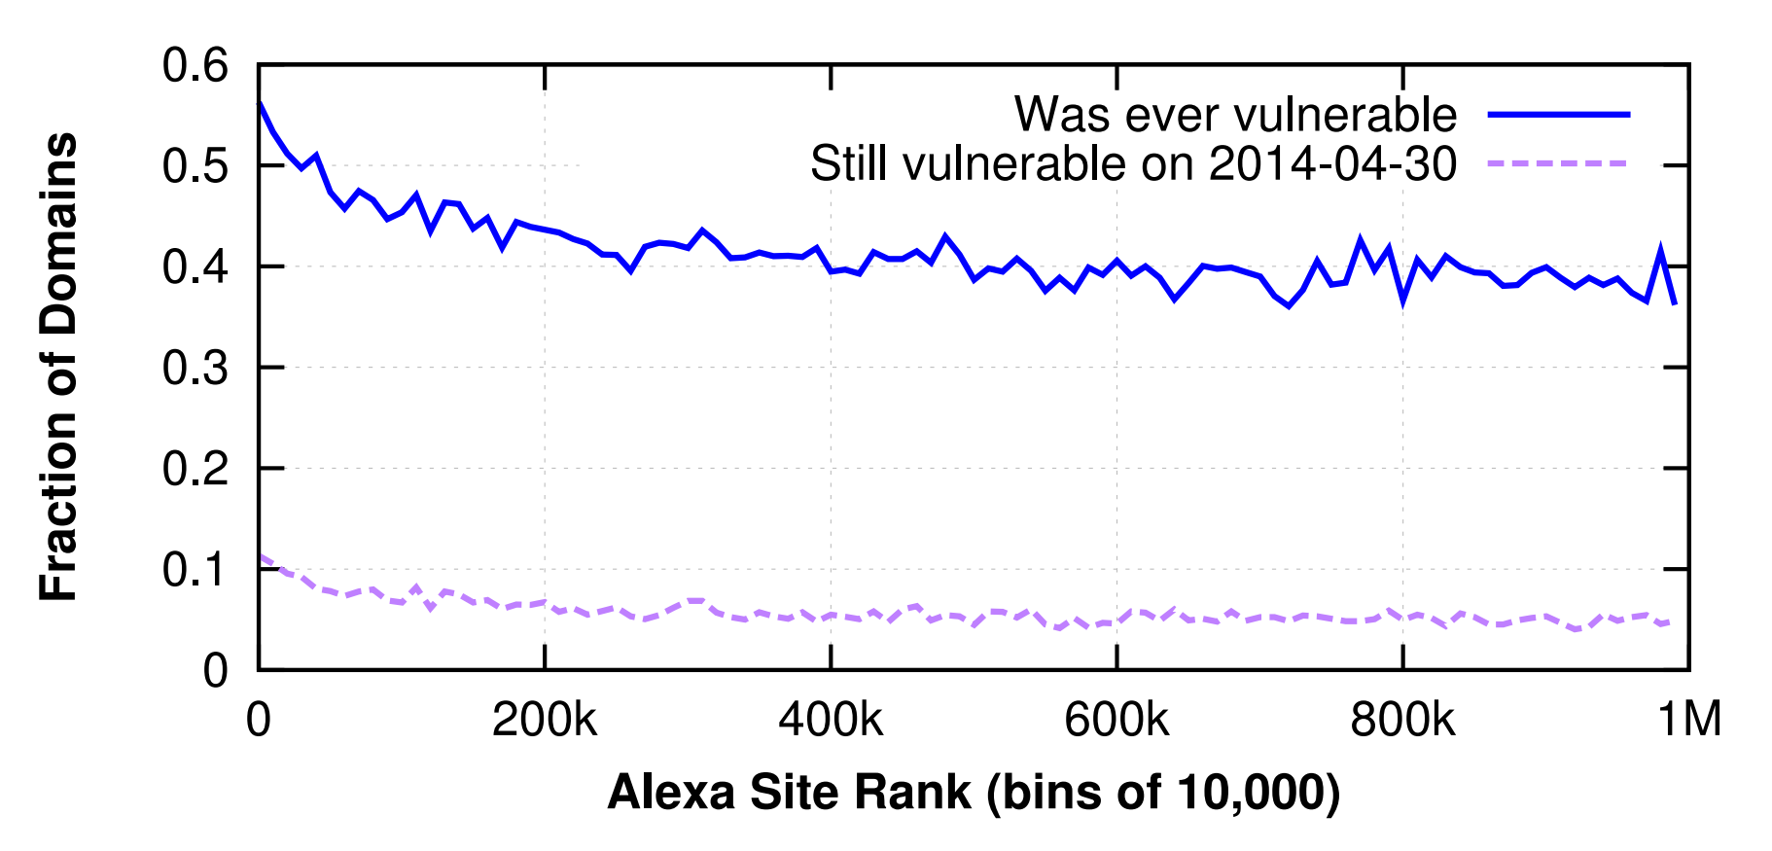
Heartbleed-vulnerable Servers
23 days after Heartbleed, 5% of servers still unpatched

Slide 74
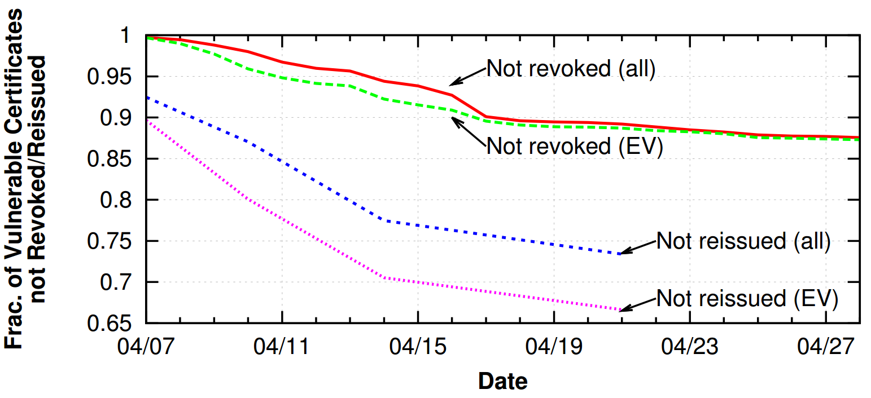
Reissues and Revocations
87% of vulnerable certs were never revoked!
72% of vulnerable certs were never reissued!

Slide 75
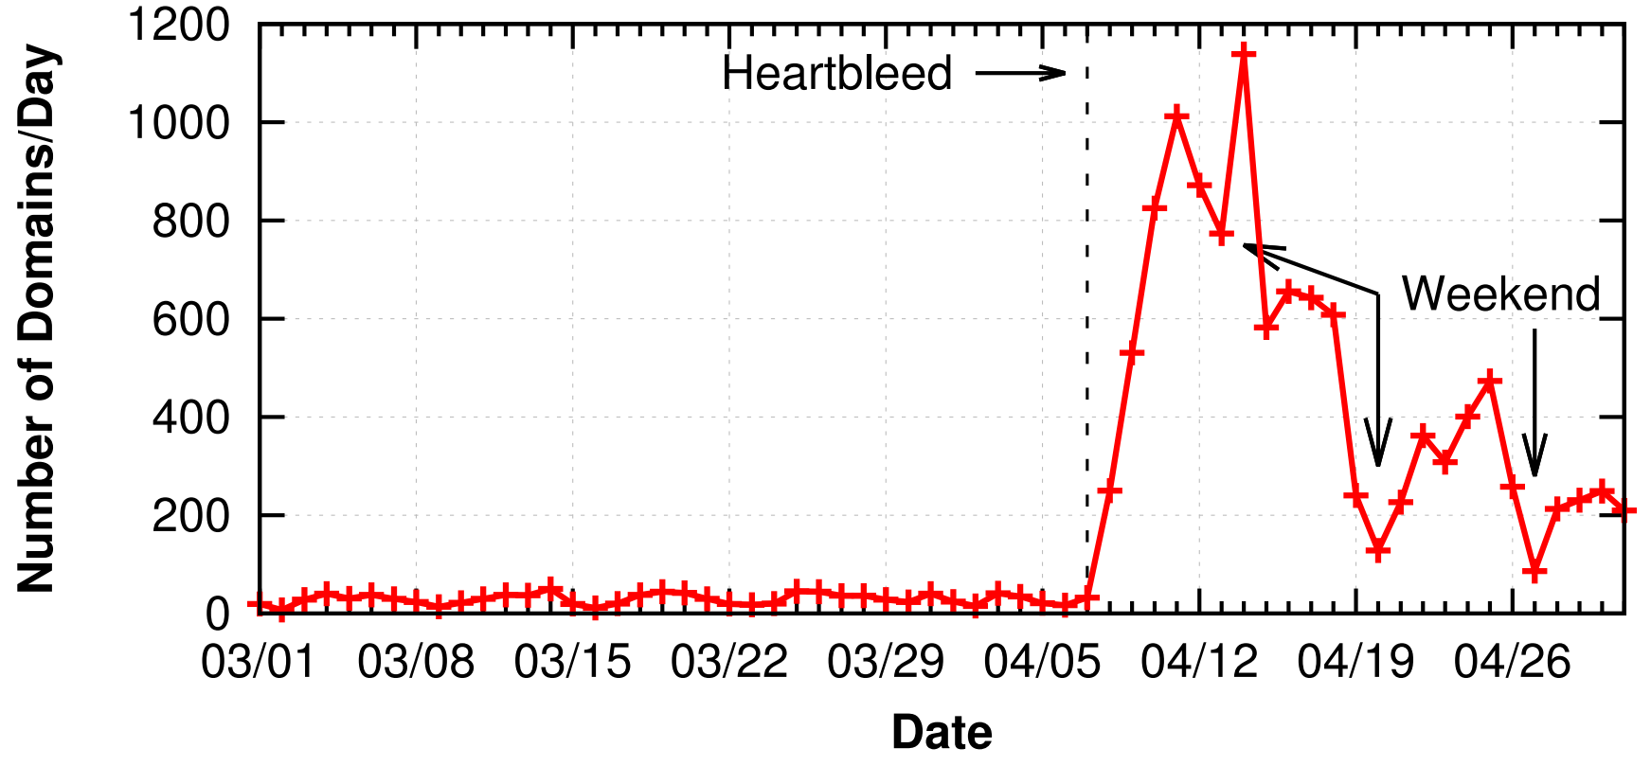
Revocations Over Time
People did revoke many vulnerable certs
But, security takes the weekend off :(

Slide 76
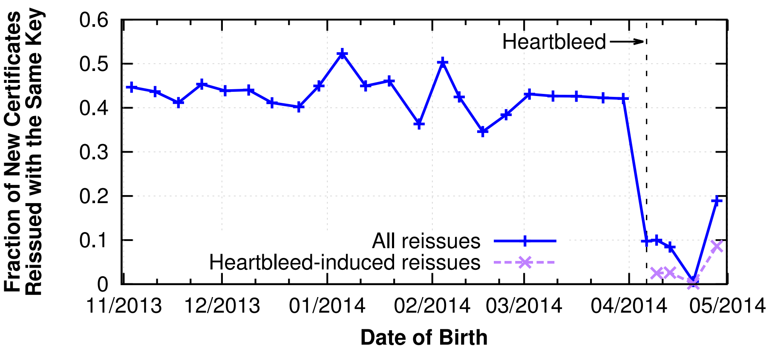
Are People Stupid?
Before Heartbleed, 43% of certs are reissued with the same key pair
After Heartbleed, 4% of certs are reissued with the same key pair

Slide 77
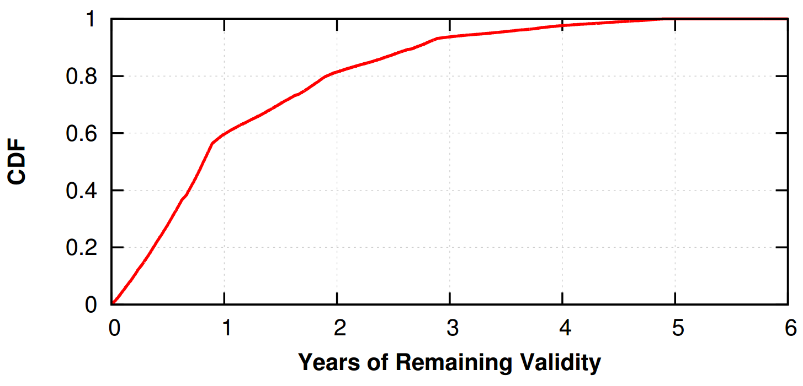
How Long Will Did We Deal With Heartbleed?
We are here now! ☺
60% of vulnerable certs didn’t expire for year :(

Slide 78
Other TLS Attacks
Other interesting attacks on TLS
TLS stripping
BEAST
CRIME
BREACH
POODLE
Logjam
Lucky Thirteen

Slide 79
What Have We Learned?
TLS is crucial for maintaining security and privacy on the Web
Mature, well supported protocol
In theory, offers strong security guarantees
Unfortunately, TLS is plagued by many issues
Many different protocol-level issues that enable MitM attacks
TLS implementations are buggy
Browsers fail to perform revocation checks
Human beings fail to reissue/revoke certificates properly

Slide 80
Sources
Many slides courtesy of Wil Robertson: https://wkr.io
Analysis of the HTTPS Certificate Ecosystem, IMC 2013: https://jhalderm.com/pub/papers/https-imc13.pdf
Analysis of SSL certificate reissues and revocations in the wake of Heartbleed, IMC 2014: http://www.ccs.neu.edu/home/cbw/pdf/imc254-zhang.pdf
An End-to-End Measurement of Certificate Revocation in the Web's PKI, IMC 2015: http://www.ccs.neu.edu/home/cbw/pdf/liu-imc15.pdf

