Slide 1
CS 3700 Networks and Distributed Systems
NAT
(You Better Forward Those Ports)
Revised 10/7/16

Slide 2
The IPv4 Shortage
Problem: consumer ISPs typically only give one IP address per-household
Additional IPs cost extra
More IPs may not be available
Today’s households have more networked devices than ever
Laptops and desktops
TV, bluray players, game consoles
Tablets, smartphones, eReaders
How to get all these devices online?

Slide 3
Private IP Networks
Idea: create a range of private IPs that are separate from the rest of the network
Use the private IPs for internal routing
Use a special router to bridge the LAN and the WAN
Properties of private IPs
Not globally unique
Usually taken from non-routable IP ranges (why?)
Typical private IP ranges
10.0.0.0 – 10.255.255.255
172.16.0.0 – 172.31.255.255
192.168.0.0 – 192.168.255.255

Slide 4

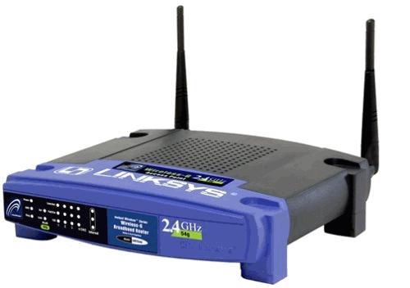
Private Networks
Private
Network
192.168.0.1
192.168.0.1
Private
Network
192.168.0.2
192.168.0.2
Internet
NAT
NAT
71.2.33.56
192.168.0.0
192.168.0.0
66.31.210.69

Slide 5
Network Address Translation (NAT)
NAT allows hosts on a private network to communicate with the Internet
Warning: connectivity is not seamless
Special router at the boundary of a private network
Replaces internal IPs with external IP by modifying packet headers
This is “Network Address Translation”
May also replace TCP/UDP port numbers
Maintains a table of active flows
Outgoing packets initialize a table entry
Incoming packets are rewritten based on the table

Slide 6
Basic NAT Operation
Private Network
Internet
Source: 192.168.0.1:2345
Dest: 74.125.228.67:80
Source: 66.31.210.69:2345
Dest: 74.125.228.67:80
Private Address | Public Address
192.168.0.1:2345 | 74.125.228.67:80
192.168.0.1
66.31.210.69
74.125.228.67
Source: 74.125.228.67:80
Dest: 192.168.0.1:2345
Source: 74.125.228.67:80
Dest: 66.31.210.69:2345

Slide 7
Advantages of NATs
Allow multiple hosts to share a single public IP
Allow migration between ISPs
Even if the public IP address changes, you don’t need to reconfigure the machines on the LAN
Load balancing
Forward traffic from a single public IP to multiple private hosts

Slide 8


Natural Firewall
Private Network
Internet
Private Address | Public Address
192.168.0.1
66.31.210.69
74.125.228.67
Source: 74.125.228.67
Dest: 66.31.210.69
Source: 74.125.228.67
Dest: 192.168.0.1

Slide 9
Concerns About NAT
Performance/scalability issues
Per flow state!
Modifying IP and Port numbers means NAT must recompute IP and TCP checksums
Breaks the layered network abstraction
Breaks end-to-end Internet connectivity
192.168.*.* addresses are private
Cannot be routed to on the Internet
Problem is worse when both hosts are behind NATs
What about IPs embedded in data payloads?

Slide 10

Port Forwarding
Private Network
Internet
Private Address | Public Address
192.168.0.1:7000 | *.*.*.*:*
192.168.0.1
66.31.210.69
74.125.228.67
Source: 74.125.228.67:8679
Dest: 192.168.0.1:7000
Source: 74.125.228.67:8679
Dest: 66.31.210.69:7000

Slide 11

Hole Punching
Problem: How to enable connectivity through NATs?
NAT 1
NAT 2
192.168.0.2
192.168.0.1
66.31.210.69
59.1.72.13
Two application-level protocols for hole punching
STUN
TURN

Slide 12

STUN
Session Traversal Utilities for NAT
Use a third-party to echo your global IP address
Also used to probe for symmetric NATs/firewalls
i.e. are external ports open or closed?
What is my global IP address?
Please echo my IP address
Your IP is 66.31.210.69
192.168.0.1
STUN Server
66.31.210.69

Slide 13
Problems With STUN
Only useful in certain situations
One peer is behind a symmetric NAT
Both peers are behind partial NATs
Not useful when both peers are fully behind full NATs
NAT 1
NAT 2
192.168.0.2
192.168.0.1
66.31.210.69
59.1.72.13

Slide 14
TURN
Traversal Using Relays around NAT
NAT 1
NAT 2
192.168.0.2
192.168.0.1
Please connect to me on 66.31.210.69:7000
192.168.0.1:7000
192.168.0.2:7000
66.31.210.69
59.1.72.13
TURN Server

