Slide 1
ASEN 4018 · SENIOR PROJECTS · SMEAD AEROSPACE
Team D.R.O.I.D.S.
DR-1
9/29/2026 - 10/01/2026
Fall 2026 · University of Colorado Boulder

Slide 2

Table of Contents
Con-Ops
Block Diagrams
Key Requirements
Trade Studies
Q & A
Current Design Space
Modeling and Prototyping Plan
Background

Slide 3
ASEN 4018-013
Background

Slide 4

Project Description
Background
An Autonomous and Cooperative UAS Multirotor and Rover Network for Exploration, Search, and Payload Delivery/Retrieval
Design Problem: While conducting search and exploration missions, the utilization of a single type of vehicle may be ineffective for exploring an area of interest to deliver or retrieve a payload.
UAS: Contains the benefit of maneuvering and wider FOV for search over a given location to perform a increased search but may be restricted on landing clearance.
Rover: Contains the benefit of accessing terrain inaccessible to the UAS, but is restricted on FOV search bandwidth.
Background
ConOps
Block Diagrams
Key Requirements
Trade Studies
Current Design Space
Moving Forward
Q & A

Slide 5
Motivation
Background
UAS (Search Capabilities) + Rover (Terrain Maneuverability) = Effective Search and Rescue Team
Using the strengths of both vehicles allows increases chance of mission success
Applications Include:
  Stranded Hiker Retrieval
  Medical Supplies Delivery
  Combat Supply Delivery
  On-Demand Delivery Services
Background
ConOps
Block Diagrams
Key Requirements
Trade Studies
Current Design Space
Moving Forward
Q & A

Slide 6
Mission Objective
Background
"The multi-agent network shall comprise one UAS and one rover working autonomously/semi-autonomously and cooperatively, search an area of interest, determine the coordinates of a location of interest, and deliver/retrieve a payload at the location of interest, which is specified​
by an ArUco marker.​"
MO-1
Background
ConOps
Block Diagrams
Key Requirements
Trade Studies
Current Design Space
Moving Forward
Q & A

Slide 7
ASEN 4018-013
Concept of Operations

Slide 8

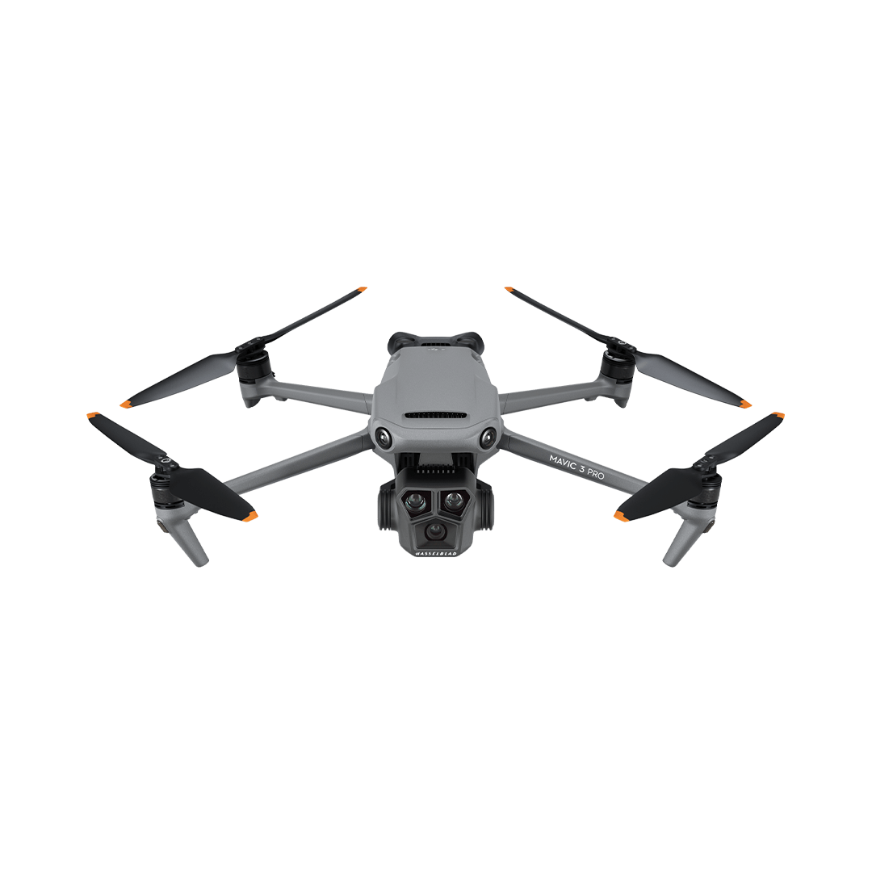

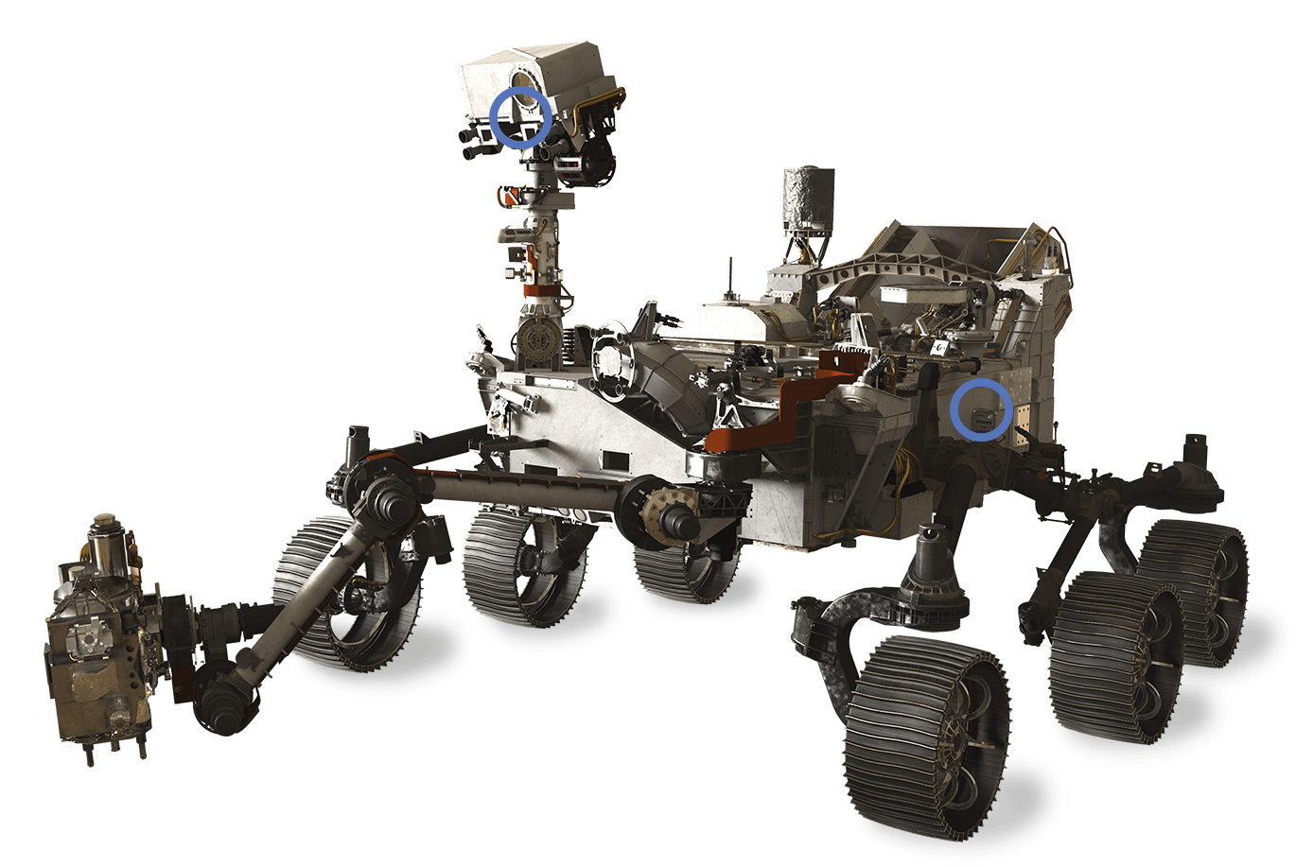
0. Pre-Mission Setup and Initialization
  Ground crew places the UAS at Point A and the rover at Point B. Both vehicles are powered on. Both initial positions are localized and initialized in an agreed shared coordinate frame. Systems check is performed.
Communication Link Established
  The UAS and rover establish the communication link. The shared frame is confirmed across both agents.
UAS Takeoff
  The UAS Takes off from point A
UAS Transit to Area of Interest
  The UAS maneuvers from Point A to the predetermined area of interest.
UAS Search and Marker Detection
  The UAS searches the area of interest and detects the ArUco marker to within a 30 cm radius of accuracy.
Marker Coordinate Relay
  The UAS transmits the target state and associated uncertainty, expressed in the shared frame, to the rover.
UAS Return, Landing, and Disarm
  The UAS returns to Point A, lands, and disarms.
Rover Transit to Marker
  The rover autonomously navigates from Point B to the marker location, traversing at least one terrain feature of at least 3 cm height en route.
Payload Deployment / Retrieval
  Delivery and retrieval differ only in this phase, in where the payload starts, and in how the rover returns. See Section 6.
Rover Return and Disarm
  The rover autonomously navigates back to Point B under the same constraints as the outbound transit.
5
4
3
Location of Interest
8
Area of Interest
6
9
7
2
1
Starting Point A
Starting Point B
(Autonomous, Manual Override)
(Autonomous, Manual Override)
Background
ConOps
Block Diagrams
Key Requirements
Trade Studies
Current Design Space
Moving Forward
8
Q & A

Slide 9
0. Pre-Mission Setup and Initialization
  Ground crew places the UAS at Point A and the rover at Point B. Both vehicles are powered on. Both initial positions are localized and initialized in an agreed shared coordinate frame. Systems check is performed.
1. Communication Link Established
  The UAS and rover establish the communication link. The shared frame is confirmed across both agents.
2. UAS Takeoff
  The UAS Takes off from point A
3. UAS Transit to Area of Interest
  The UAS maneuvers from Point A to the predetermined area of interest. At a Rate of 0.5 m/s
4. UAS Search Pattern
  The UAS conducts a search pattern over the area of interest.
5. UAS Marker Detection
  The UAS detects the ArUco marker to within a 30 cm radius of accuracy. The UAS verifies location certainty and position of the ArUco Marker via onboard sensors.
6. Marker Coordinate Relay
  The UAS transmits the target state and associated uncertainty, expressed in the shared frame, to the rover. UAS confirms coordinate transfer with Rover
7. UAS Return Landing, and Disarm
  The UAS returns to Point A, lands, and disarms.
5
4
3
Location of Interest
Area of Interest
6
Rover
2
7
1
Starting Point A
UAS Specific
(Autonomous, Manual Override)
Background
ConOps
Block Diagrams
Key Requirements
Trade Studies
Current Design Space
Moving Forward
9
Q & A

Slide 10
ASEN 4018-013
Block Diagrams

Slide 11
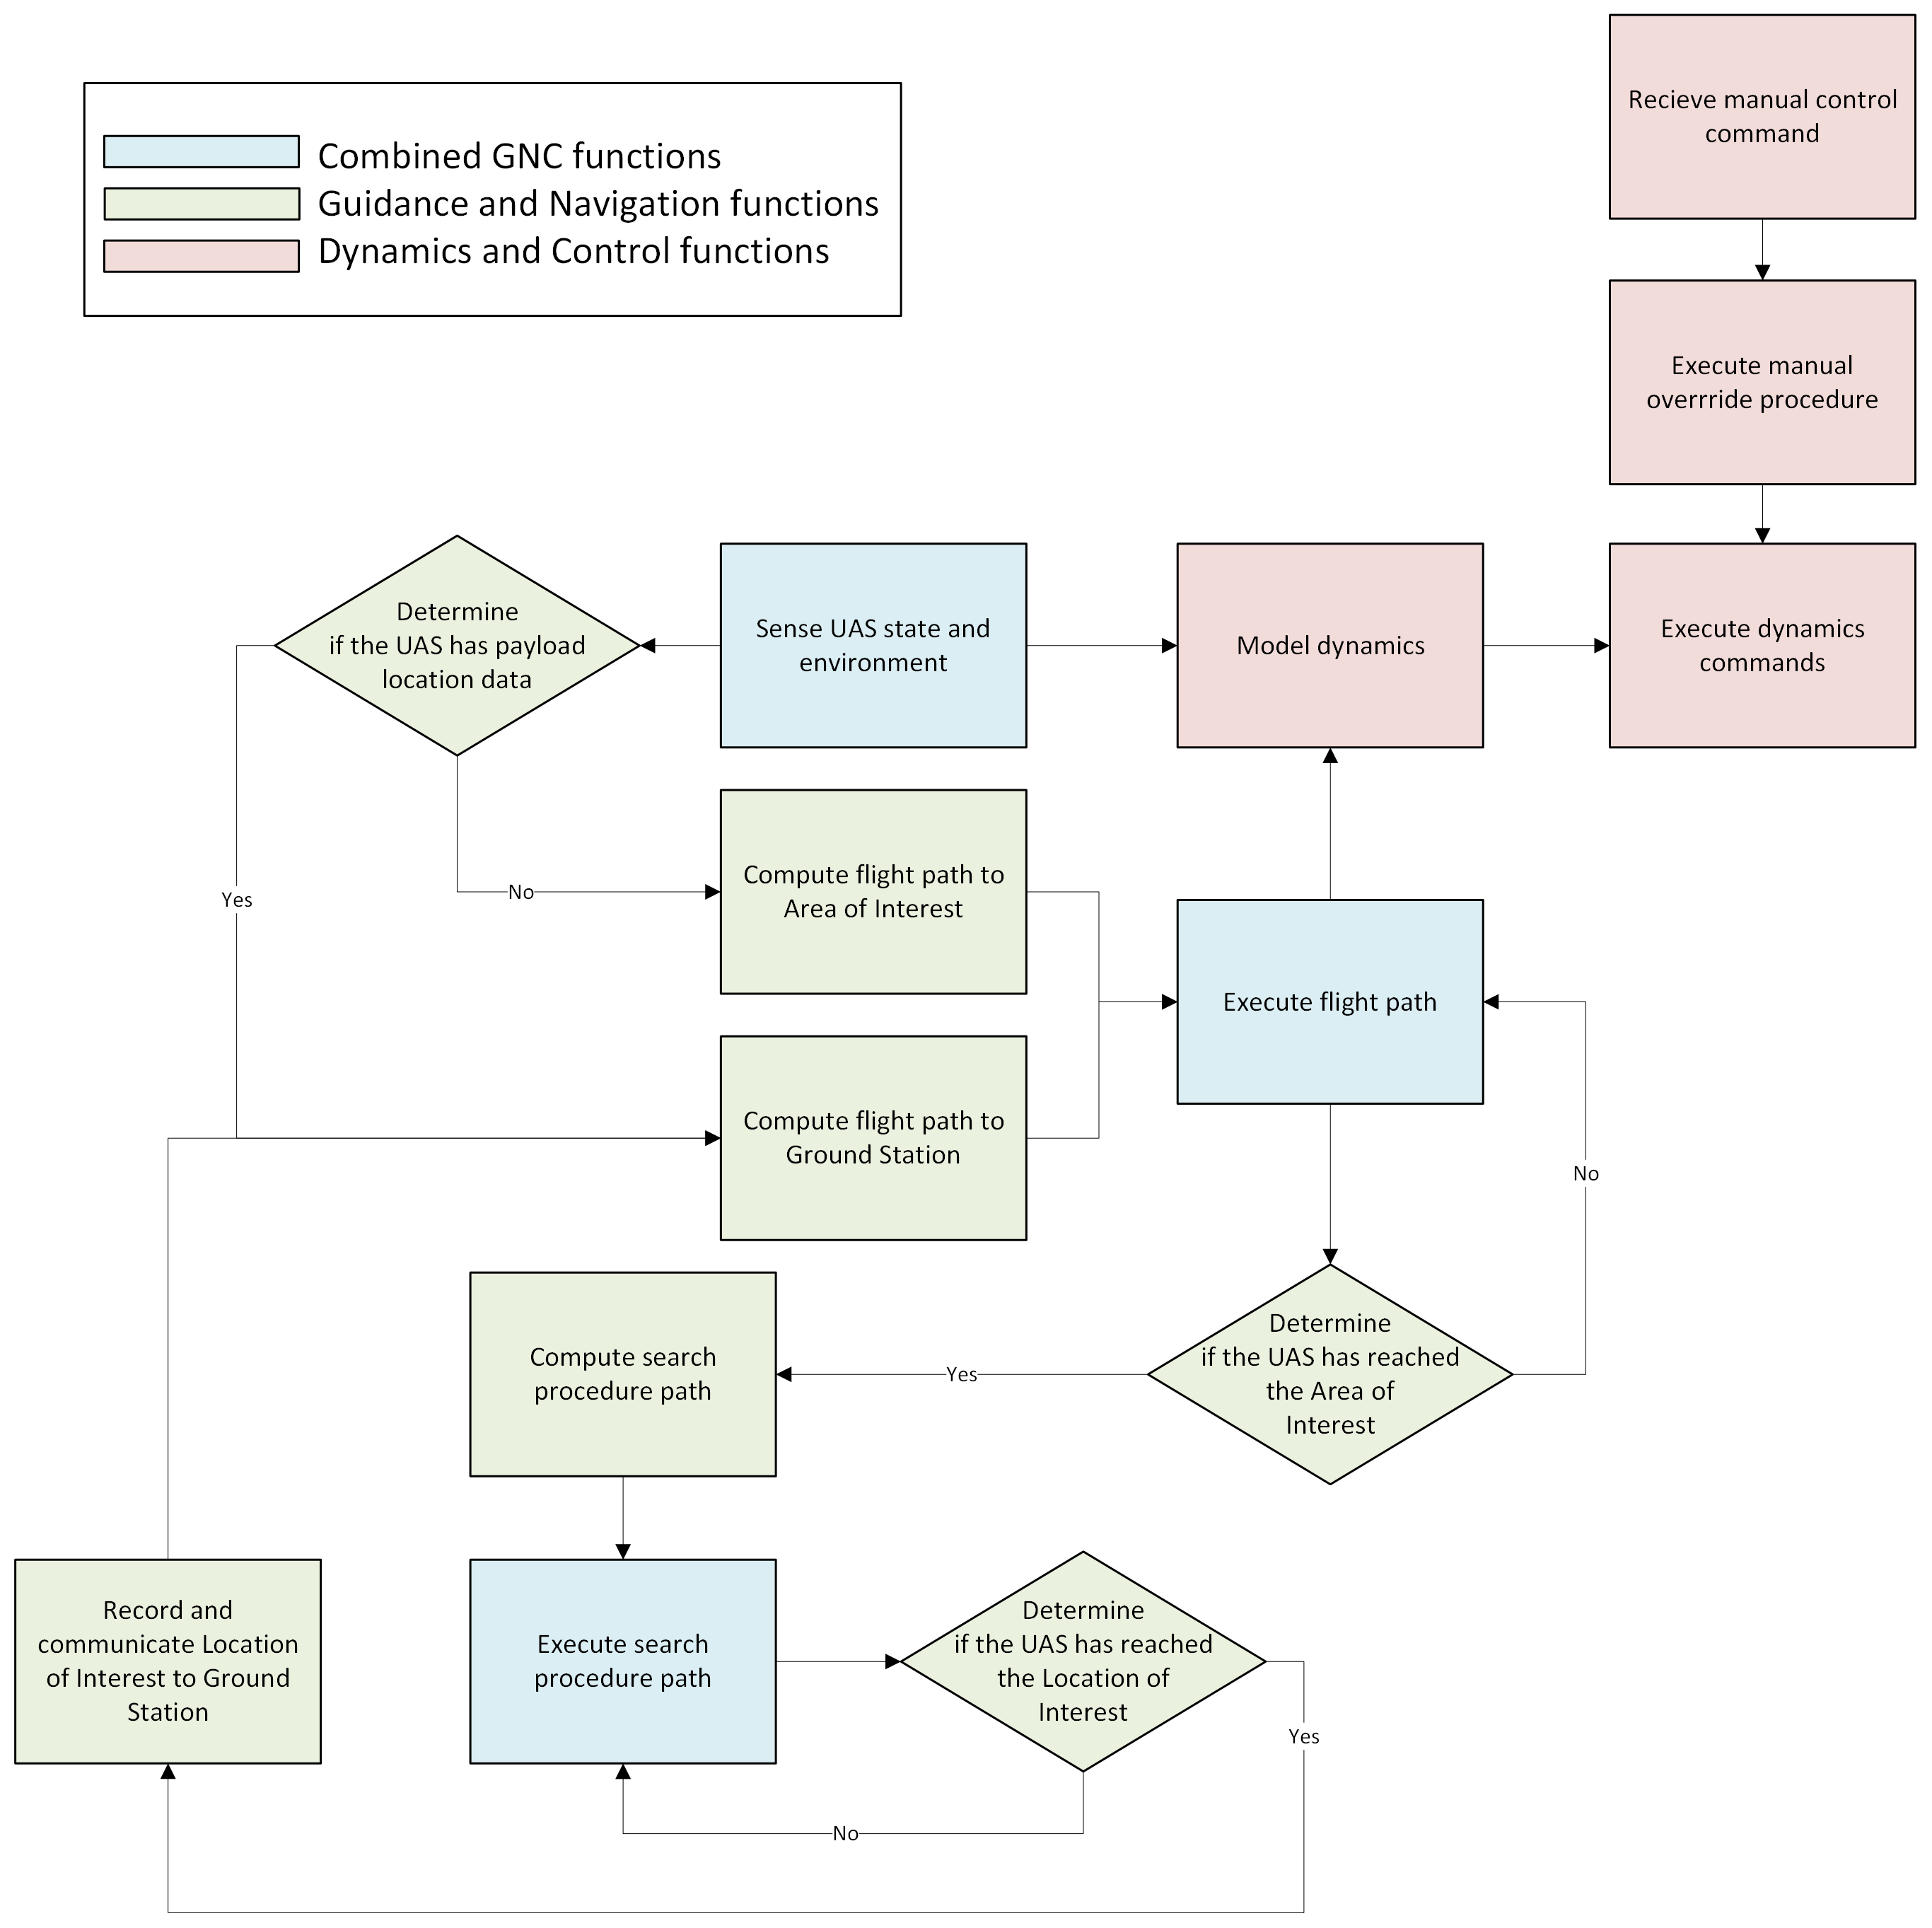
Functional Block Diagram
Block Diagrams
  Required Functions:
  Dynamics simulation and execution
  Flight path simulation and execution
  Search path simulation and execution
  Communication with Ground Station
  Manual override
Background
ConOps
Block Diagrams
Key Requirements
Trade Studies
Current Design Space
Moving Forward
Q & A
Notes:
MO-1 and Con-Ops flow down into required functions
Through this FBD we can "identify our primary control loops"
Compute / execute flight paths
Compute / execute search procedure
Manual override bypasses both of these loops

Slide 12
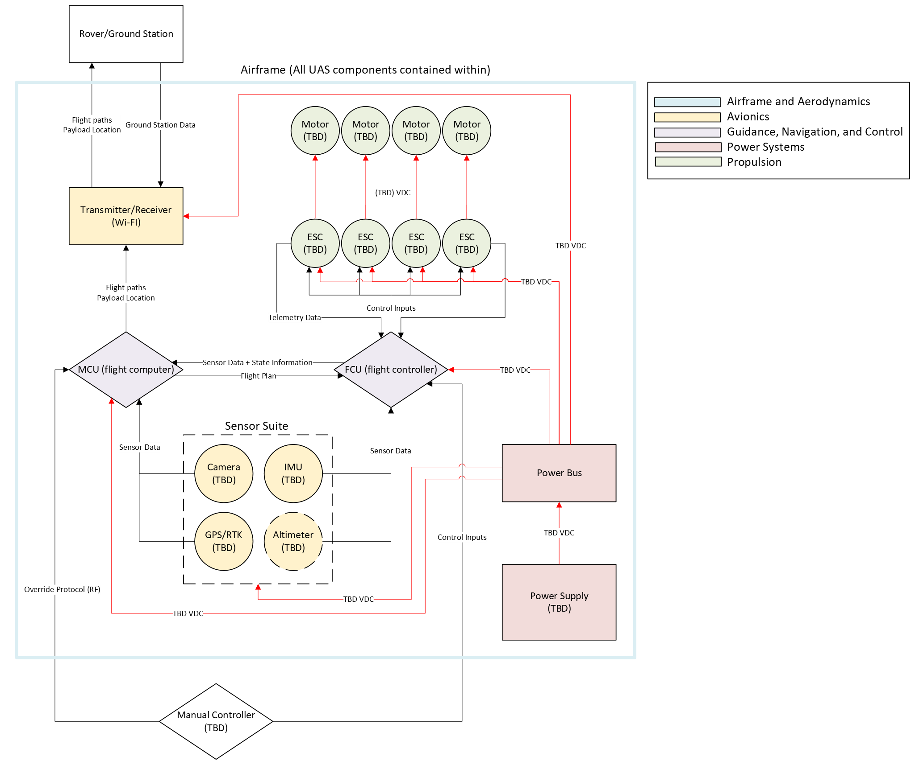
Physical Block Diagram
Block Diagrams
  System Components:
  Airframe
  Avionics
    Communications
    Sensor suite
  GNC
    Guidance and Navigation
      Flight computer
    Dynamics and Control
      Flight controller
  Power Systems
    Power supply
    Power converter
  Propulsion
    Motors
    Electronic speed controllers
Background
ConOps
Block Diagrams
Key Requirements
Trade Studies
Current Design Space
Moving Forward
Q & A
Notes:
FBD guides a list of required system components and their interfaces
This diagram covers 2 tpyes of interfaces:
Data flow
Power flow
This is important because interfaces will guide our plan moving forward

Slide 13
ASEN 4018-013
Key Requirements

Slide 14
UAS-L1 Requirements
Key Requirements
Primary Stakeholder
UAS-1 | The UAS multirotor platform shall contain communication equipment to transmit data to the rover.
UAS-2 | The UAS shall provide power to the UAS GNCC, Propulsion, and Avionics Components.
UAS-3 | The UAS shall provide mounting fixtures for the GNCC, Propulsion, and Power Subsystems.
UAS-5 | Structural testing shall be completed for the UAS system
UAS-6 | The UAS shall have a volumetric footprint of at most 50 cm length x 50 cm width x 30 cm height.
UAS-7 | The UAS shall have an endurance of at least 15 minutes.
UAS-8 | The UAS shall be able to function in temperatures ranging from 15°C to 25°C.
UAS-9 | The UAS shall weigh no more than 12.5 lb (5.6 kg).
UAS-14 | The UAS shall maneuver at an altitude no greater than 2 m.
UAS-15 | The UAS shall maneuver at a speed no greater than 0.5 m/s.
UAS-VSYS
UAS-4 | The UAS shall provide the onboard computing required for aircraft controls, sensing, and navigation
UAS-10 | The UAS shall detect an ArUco marker to within a 30 cm radius of accuracy.
UAS-11 | The UAS shall have autonomous manueverabiltiy capabilities.
UAS-12 | The UAS shall have autonomous navigation capabilities.
UAS-13 | The UAS shall have an autonomous search procedure for the area of interest.
UAS-16 | The UAS shall remain in the line of sight of the operator during operation.
UAS-17 | The UAS shall have a manual override control during flight.
UAS-GNCC
(Derived from given RFP)
Background
ConOps
Block Diagrams
Key Requirements
Trade Studies
Current Design Space
Moving Forward
Q & A

Slide 15
ASEN 4018-013
Trade Studies

Slide 16
Trades Status Overview – UAS-VSYS
Trades Studies
Trade Study | Trade Details | Sub-Team | Status
Propeller Material | Conducted a trade study on various materials for the propeller. | Propulsion | Completed
Motor Sizing/Power Draw | Created an excel calculator that takes in input from other teams and gives estimates on the anticipated motor specs. | Propulsion | Completed
Propeller Type | Created trade study on different propeller configurations to maximize efficiency and find a suitable candidate for achieving necessary thrust. | Propulsion | Completed
Battery Chemistry Trade Study​ | Comparison of Lithium Ion and Lithium Polymer battery chemistries across performance criteria ​ | Power Systems | Completed
PCB Voltage Separation Trade Study​ | Comparison of types of circuit boards for prototyping and final design complexity​ | Power Systems | Completed
Material Trade Study​ | Conducted a trade study on various materials for the airframe structure.​ | Airframe and Aerodynamics | Completed
Shape & Configuration​ | Conducted a trade study concerning different drone rotor arm configurations and spatial sizing for avionics and power.​ ​ Conducted a trade study on the primary shape of the chassis.​ | Airframe and Aerodynamics | Completed
Thermal Dissipation & Conductivity​ | Conducted a trade study for heat transfer and thermal conductivity through airframe structure.​ | Airframe and Aerodynamics | Completed
Background
ConOps
Block Diagrams
Key Requirements
Trade Studies
Current Design Space
Moving Forward
Q & A

Slide 17
Trades Status Overview – UAS-GNCC
Trades Studies
Trade Study | Trade Details | Sub-Team | Status
Control Laws​ | Conducted a trade study on various Control Laws methods for disturbance responses.​ | GNC | Completed
Transient Responses​ | Conducted a trade study on underdamped vs. overdamped transient responses.​ | GNC | Completed
Sensor Fusion Algorithms​ | Conducted a trade study on different kinds of Kalman filters for state-estimation and responses.​ | GNC | Completed
Input Types​ | Conducted a trade study on different input types for packaging, modeling & stability accuracy.​ | GNC | Completed
Navigation Method​ | Analyzed alternative forms of Navigation and UAS Positioning.​ | Avionics | Completed
Communication Protocol​ | Analyzed alternative protocols of communication between UAS, Rover and Ground Station.​ | Avionics | Completed
Computing Architecture​ | Weighed effectiveness of various computing architectures for Onboard/Offboard processing.​ | Avionics | Completed
Manual Override Architecture​ | Determined method of manual override​ | Avionics | Completed
Data Flow Architecture​ | Determine method of data flow​ | Avionics | Completed
Background
ConOps
Block Diagrams
Key Requirements
Trade Studies
Current Design Space
Moving Forward
Q & A

Slide 18
ASEN 4018-013
Sub-System Trade Studies
Trade Studies
Propulsion
Power Systems
Airframe
GNC
18
Avionics
Notes:
SECTION DIVIDER — duplicate for each major section. Replace the kicker, title, and one-line description.

Slide 19
ASEN 4018-013
UAS - Propulsion
Trade-studies
19
Notes:
SECTION DIVIDER — duplicate for each major section. Replace the kicker, title, and one-line description.

Slide 20
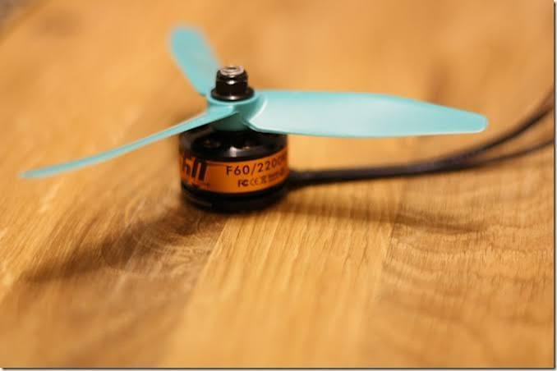
Subsystem Background
Trade Studies
Provide the thrust needed to meet UAS flight requirements
Balance propulsion performance, weight, and power consumption
Components responsible for:
  Motors
  ESCs (Electronic Speed Controllers)
  Propellers
Trade Studies
Propulsion
Power Systems
Airframe
GNC
Avionics
Notes:
STANDARD CONTENT — the default working slide. Replace the title, bullets, and visual box. Drop the visual box and widen the text if you don't need an image.

Slide 21
Summary of Trades Conducted
Trade Studies
Trades Conducted | Trade Description | Rationale | Results
Propeller Material | Conducted a trade study on various materials for the propeller. | Determined the viability of various materials due to cost, strength, and weight savings. | Carbon fiber reinforced nylon
Motor Sizing/Power Draw | Created an excel calculator that takes in input from other teams and gives estimates on the anticipated motor specs. | Our requirements for RPM, propeller efficiency, and UAS weight may change throughout the design process. This creates a tool to define motor performance requirments. | Requirements Calculator Created
Propeller Type | Created trade study on different propeller configurations to maximize efficiency and find a suitable candidate for achieving necessary thrust. | Determined exact shape of propeller is going to satisfy thrust and power requirements for the UAS. | 7×3.8WSF
Weight and Power | Considering different possible inputs from other subteams, determined the thrust range and propulsion's energy consumption | Since PROP provides the thrust and consumes the most mass, considering project requirements, needed to put bounds on mass and power. | 2.6 Kg / 600W / 151 Wh
ESCs quantitative | Considered different qualitative aspects of COTS ESCs | Since we can't narrow down the design space for ESCs until we have finalized other design input variables, only considered qualitative and types of ESCs | 1 ESC per Propulsion Channel
Trade Studies
Propulsion
Power Systems
Airframe
GNC
Avionics
Notes:
STANDARD CONTENT — the default working slide. Replace the title, bullets, and visual box. Drop the visual box and widen the text if you don't need an image.

Slide 22
Relevant Requirements for Materials, Power Draw, and Propeller Type Trades
Trade Studies
Requirement # | Requirement | Rationale for Relevance
UAS-VSYS-4 | The UAS shall have Thrust to Weight ratio > 1. | In order to be able to maneuver and also increase altitude/hover.
UAS-7 | The UAS shall have an endurance of at least 15 minutes. | Motor and propeller selection must provide sufficient thrust, control, and efficiency to complete takeoff, maneuvering, searching, and return flight within the available battery capacity.
UAS-VSYS-14 | The UAS propulsion system shall maintain steady level flight at an altitude of 2m above the ground and can't move faster than 0.5 m/s | The propulsion system must support stable hover and precise thrust adjustments for controlled flight within the specified altitude and speed limits.
Trade Studies
Propulsion
Power Systems
Airframe
GNC
Avionics
Notes:
STANDARD CONTENT — the default working slide. Replace the title, bullets, and visual box. Drop the visual box and widen the text if you don't need an image.

Slide 23
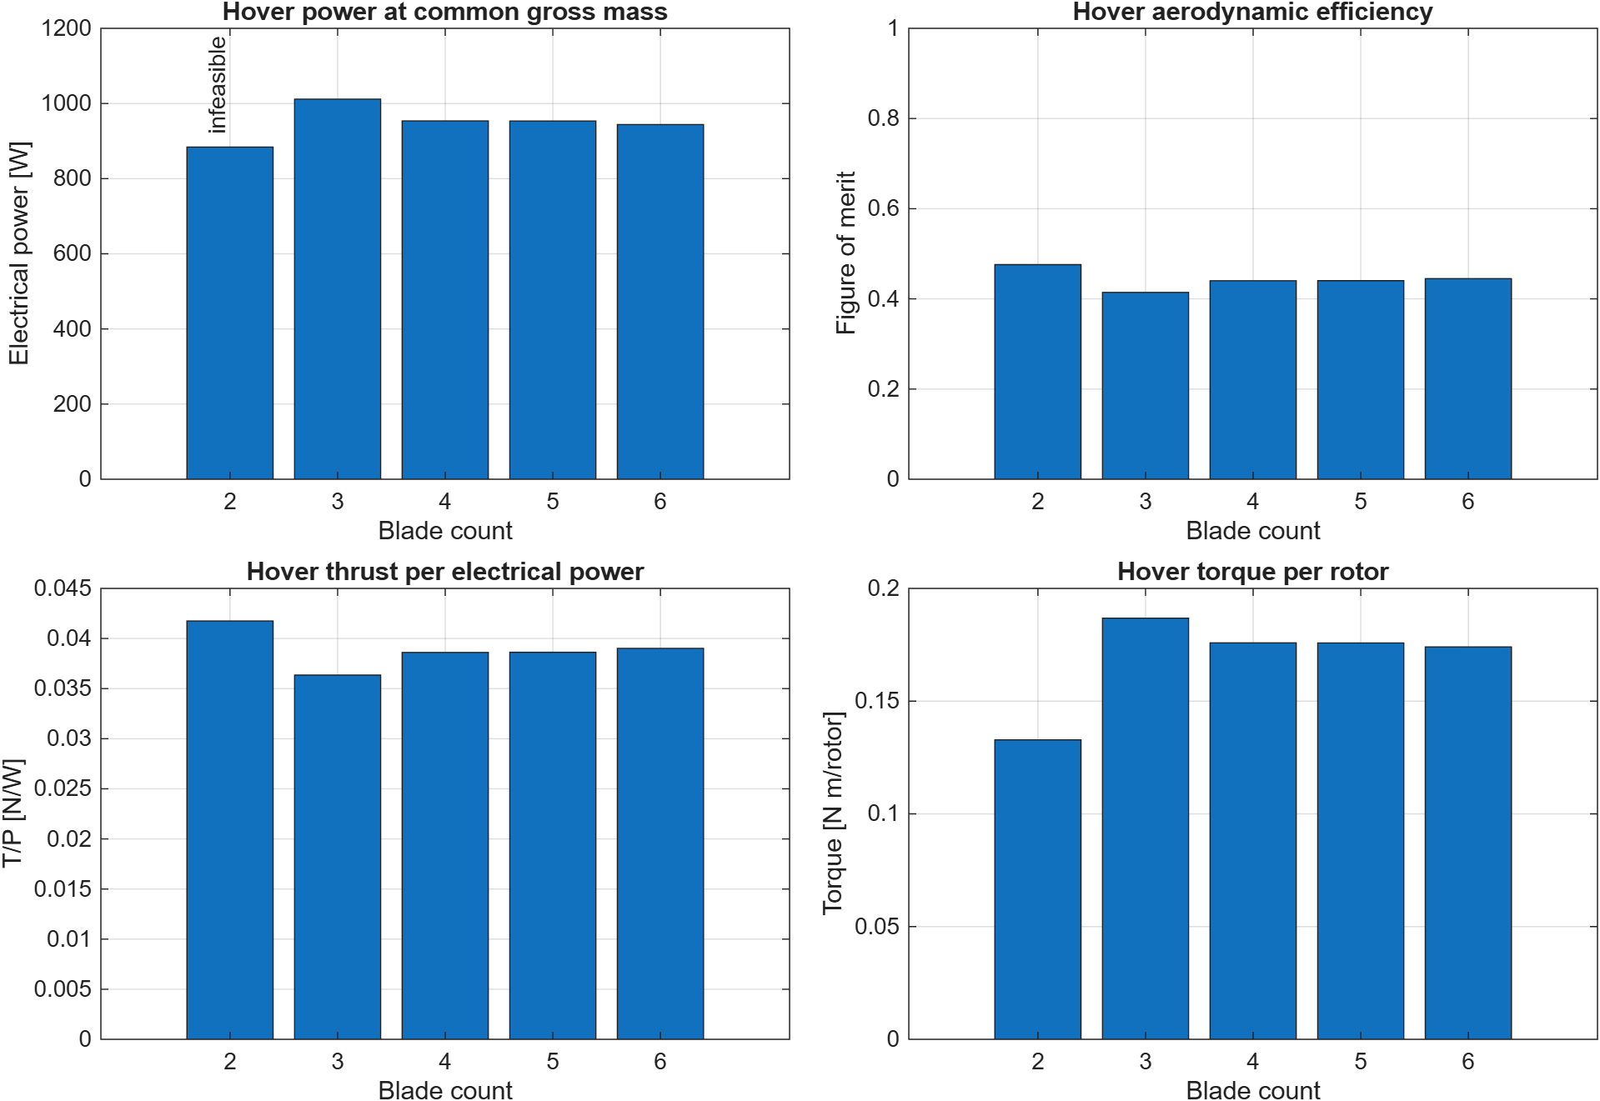
Propeller Geometry – Blade Count
Trade Studies
• 2 bladed propellers outperform all the other ones in the metrics we most care about(figure of merit, torque and hover efficiency)
Most data only tested APC's 2 bladed propellers
Trade Studies
Propulsion
Power Systems
Airframe
GNC
Avionics
Notes:
STANDARD CONTENT — the default working slide. Replace the title, bullets, and visual box. Drop the visual box and widen the text if you don't need an image.

Slide 24
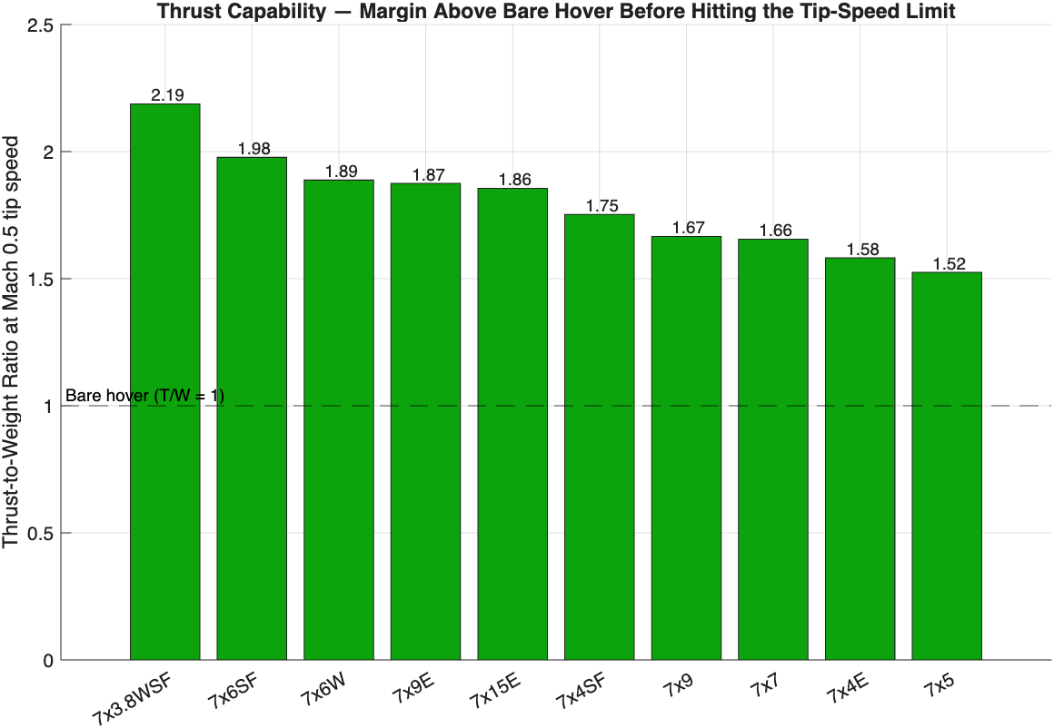
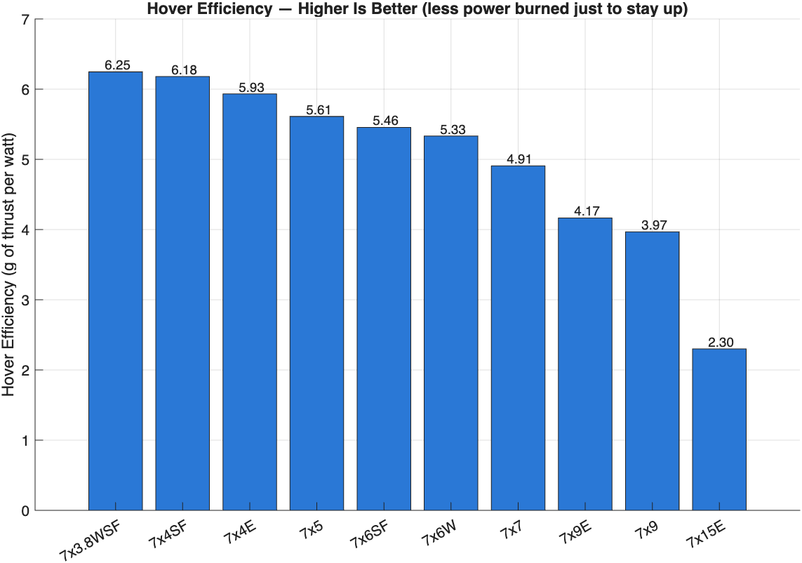
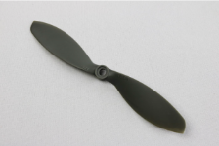
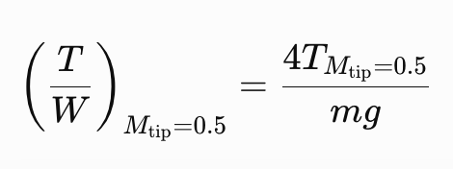
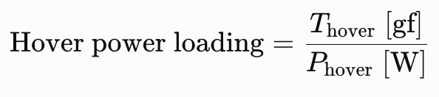
Propeller Configuration Selection
Trade Studies
Configurations
Configurations
• Assumptions: 8 lb total weight, four rotors, 7-inch propellers, and static performance data interpolated to the hover condition.
• The 7×3.8WSF leads both plotted metrics: 2.19 thrust-to-weight at Mach 0.5 tip speed and 6.25 g/W at hover.
Trade Studies
Propulsion
Power Systems
Airframe
GNC
Avionics
Notes:
STANDARD CONTENT — the default working slide. Replace the title, bullets, and visual box. Drop the visual box and widen the text if you don't need an image.

Slide 25
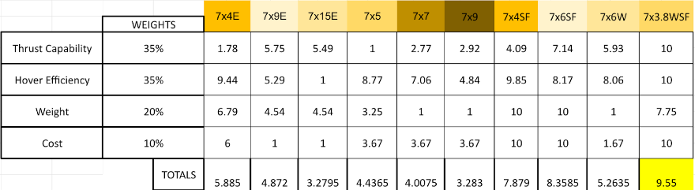
Priority: Thrust and hover power loading (70% combined)
Top choice: 7×3.8WSF - 9.55/10
Runner-up: 7×6SF - 8.36/10
Next step: Create CAD Models to be able to 3D Print chosen Materials
Trade Studies
Propulsion
Power Systems
Airframe
GNC
Avionics

Slide 26
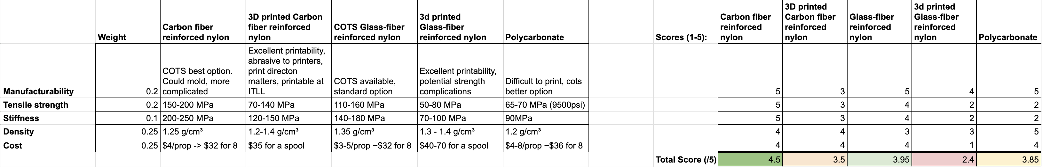
Propeller Material Selection
Trade Studies
The main driver for the selection of these materials is the method of manufacturing/procurement.
  Some materials are only practically available COTS
  Other materials can be 3d printed if we want our own geometry
  We ignore other methods of manufacturing (i.e. injection molding) due to the increases in complexity and risk.
Weights were selected to put less emphasis on the material strength because each one already had an acceptable FOS.
The study suggests that Carbon Fiber Reinforced Nylon is the best option if we can buy a COTS propeller
The study also suggests that 3d Printed Carbon Fiber Reinforced Nylon is the best option if we need to use a specific geometry for performance.
Trade Studies
Propulsion
Power Systems
Airframe
GNC
Avionics
Notes:
STANDARD CONTENT — the default working slide. Replace the title, bullets, and visual box. Drop the visual box and widen the text if you don't need an image.

Slide 27
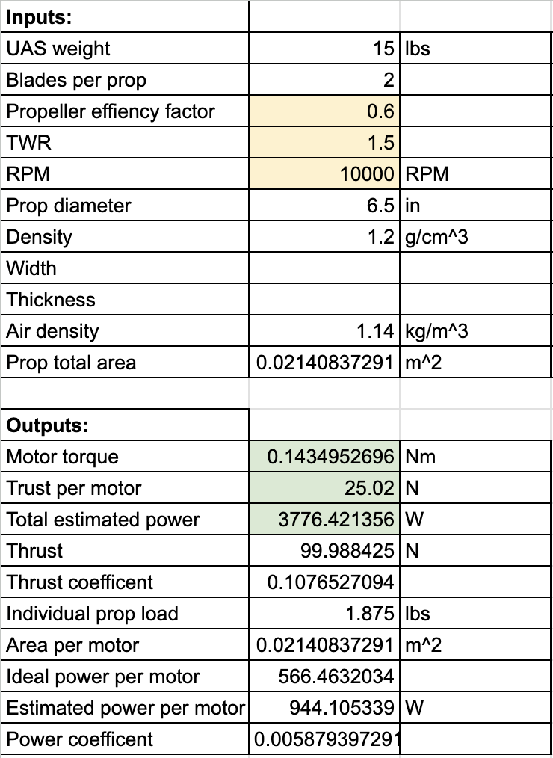
Motor Specifications Calculator
Trade Studies
The current inputs are based on estimates from other sub teams => Results are reasonable estimates.
The main factors that may change are:
  Propeller efficiency factor: Measure of how efficiently the propeller turn kinetic energy from the motor into thrust. The final value will depend on CFD over our final selected propeller geometry
  Thrust to Weight Ratio: 1.5 is a reasonable estimate to provide a healthy margin for hover and maneuvering. Another sub team might request more or less as the design is boiled down.
  RPM: RPM will change depending on the thrust output. 10000 was chosen as an average value to create rough estimates on power consumption. We'll be able to create plots between RPM, power input, and thrust output once we run CFD on our final propeller geometry.
Trade Studies
Propulsion
Power Systems
Airframe
GNC
Avionics
Notes:
STANDARD CONTENT — the default working slide. Replace the title, bullets, and visual box. Drop the visual box and widen the text if you don't need an image.

Slide 28
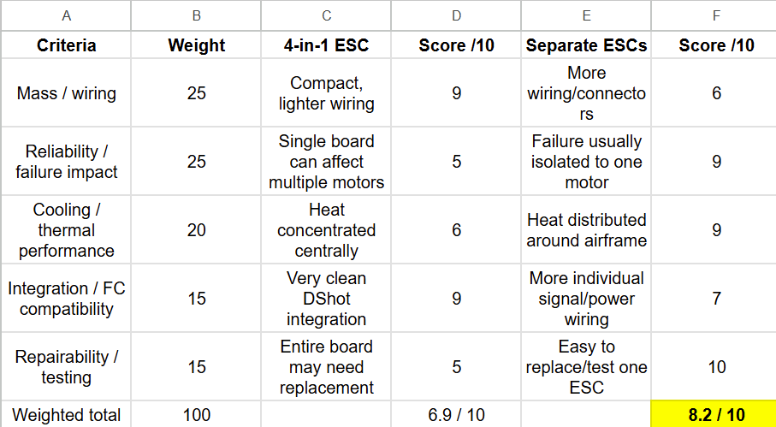
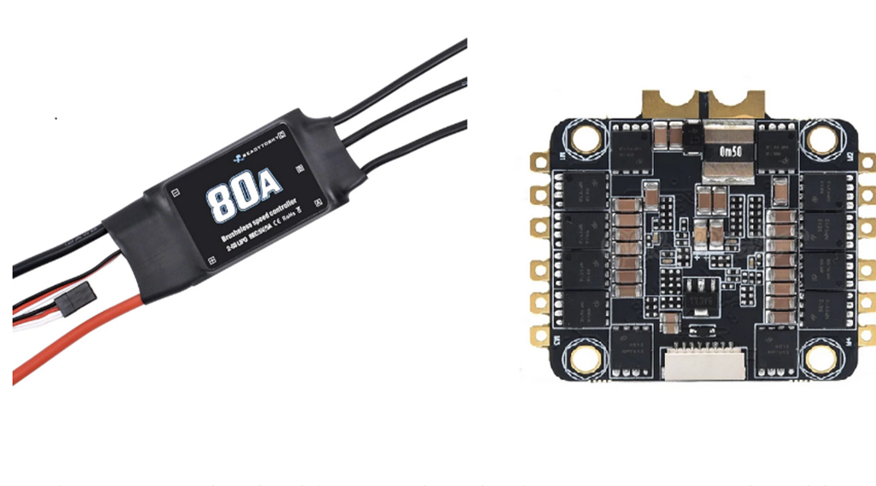
ESCs
Trade Studies
Trade Studies
Propulsion
Power Systems
Airframe
GNC
Avionics
Notes:
STANDARD CONTENT — the default working slide. Replace the title, bullets, and visual box. Drop the visual box and widen the text if you don't need an image.

Slide 29
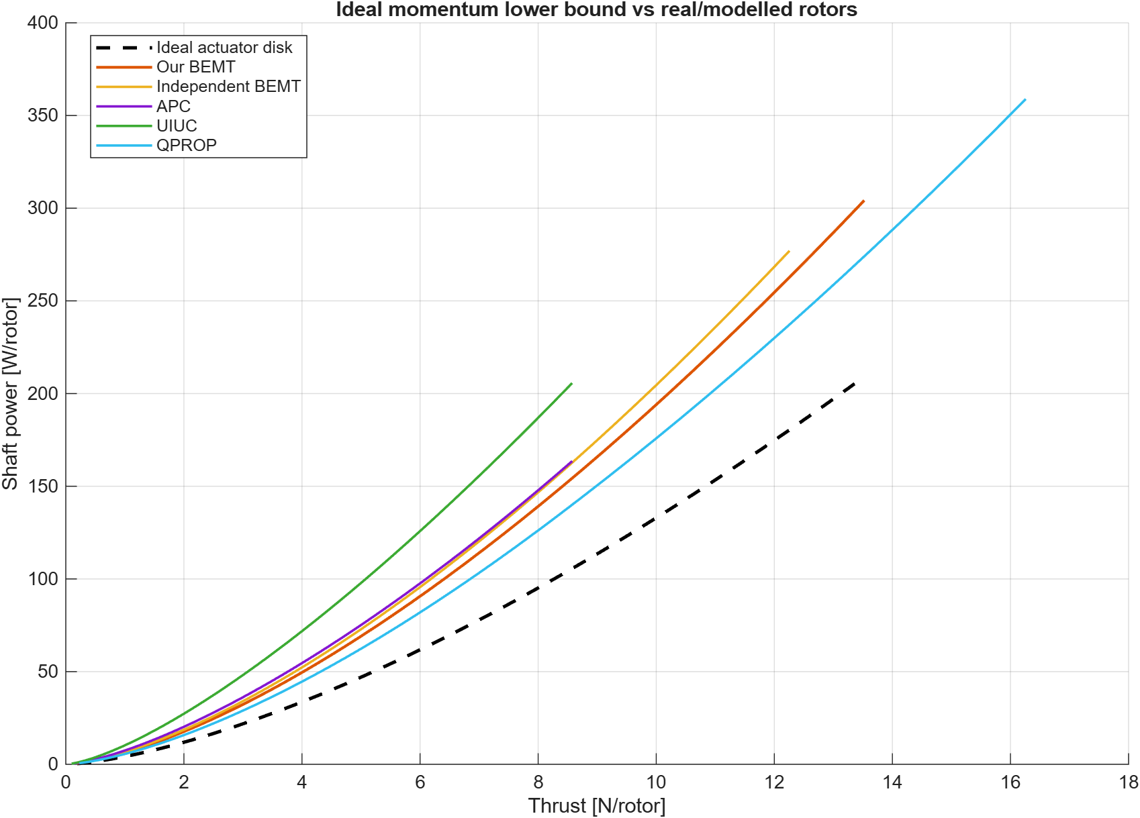
Mass/Weight and Energy/Power Sizing
Trade Studies
• Used different models to be able to put upper bounds on mass and lower bounds on power
Trade Studies
Propulsion
Power Systems
Airframe
GNC
Avionics
Notes:
STANDARD CONTENT — the default working slide. Replace the title, bullets, and visual box. Drop the visual box and widen the text if you don't need an image.

Slide 30
Summary of Trade Results
Trade Studies
Trade | Preferred Outcome | Reason
Propeller Type | 7×3.8WSF | Highest thrust and hover power loading scores
Propeller Material | Carbon fiber reinforced nylon/COTs depending on final weights/RPM | Best overall material trade result, with purchased or printed options
Motor Sizing / Power Draw | Requirements calculator developed | Updates motor requirements as aircraft weight and propeller performance change
ESC Configuration | One ESC per motor | Allows flexible placement and individual replacement of failed ESCs
Trade Studies
Propulsion
Power Systems
Airframe
GNC
Avionics
Notes:
STANDARD CONTENT — the default working slide. Replace the title, bullets, and visual box. Drop the visual box and widen the text if you don't need an image.

Slide 31
Path Forward
Trade Studies
PENDING ITEMS | PLANNED
CFD Models and Matlab Graphs of Varying RPMs to improve on motor specification calculator. | DR2
CAD models perfected of chosen Propeller Config | DR2
Trade Studies
Propulsion
Power Systems
Airframe
GNC
Avionics
Notes:
STANDARD CONTENT — the default working slide. Replace the title, bullets, and visual box. Drop the visual box and widen the text if you don't need an image.

Slide 32
ASEN-4018-013
UAS – Power Systems
Trade-studies
Notes:
SECTION DIVIDER — duplicate for each major section. Replace the kicker, title, and one-line description.

Slide 33

Power Systems Background
Trade Studies
The UAS shall sustain stress loads of TBD for a duration of 15 minutes.​
  The UAS computing system shall draw no more than TBD Watts of power at peak operation
  The UAS power system shall provide power to flight components for a minimum of 15 minutes.
  The UAS power system shall provide stable power to the propulsion system (To accommodate steady level flight).
The UAS Power System shall be fitted with wire harnessing.
  The Power System wire management shall be accessible for maintenance and repairs.
  The Power System shall not exceed the maximum operating temperature of TBD.
Trade Studies
Propulsion
Power Systems
Airframe
GNC
Avionics
4
Notes:
STANDARD CONTENT — the default working slide. Replace the title, bullets, and visual box. Drop the visual box and widen the text if you don't need an image.

Slide 34
Power Systems Background​
Trade Studies
Sub-Team Role:
Responsible for the design, creation, and maintenance of the onboard electronics power supply and power source. This includes battery type, voltage separation, wire management, and subsystem integration. Owns breadboarding and perfboard prototyping, alongside wire securement and organization.
Trade Studies
Propulsion
Power Systems
Airframe
GNC
Avionics
4
Notes:
STANDARD CONTENT — the default working slide. Replace the title, bullets, and visual box. Drop the visual box and widen the text if you don't need an image.

Slide 35
Summary of Trades Conducted
Trade Studies
Trades Conducted | Trade Description | Rationale | Results
Battery Chemistry Trade Study | Comparison of Lithium Ion and Lithium Polymer battery chemistries across performance criteria | Determined the viability of batteries due to energy density, charge time, cost, etc. | LiPo Battery
PCB Voltage Separation Trade Study | Comparison of types of circuit boards for prototyping and final design complexity | Determined the best PCB option for cost, ability to prototype, durability, complexity, etc. | 3d Printed PCB
Trade Studies
Propulsion
Power Systems
Airframe
GNC
Avionics
4
Notes:
STANDARD CONTENT — the default working slide. Replace the title, bullets, and visual box. Drop the visual box and widen the text if you don't need an image.

Slide 36
Relevant Requirements: Battery Chemistry
Trade Studies
Requirement # | Requirement | Rationale for Relevance
UAS-9 | The UAS shall weigh no more than 12.5 lbs (5.67 kg). | Influences the weight of the battery.
UAS-8 | The UAS shall be able to function in temperatures ranging from 15°C to 25°C. | Influences the Voltage and Amp Hour choices.
UAS-7 | The UAS shall have an endurance of at least 15 minutes. | Influences the energy density of the battery.
UAS-6 | The UAS shall have a volumetric footprint ≤ 50cm x 50cm x 30cm. | Influences the size of the battery.
Key Requirement Impact:
Battery Chemistry will directly impact our flight time and weight. Balancing energy needs with system weight is of paramount importance.
Trade Studies
Propulsion
Power Systems
Airframe
GNC
Avionics
4
Notes:
STANDARD CONTENT — the default working slide. Replace the title, bullets, and visual box. Drop the visual box and widen the text if you don't need an image.

Slide 37
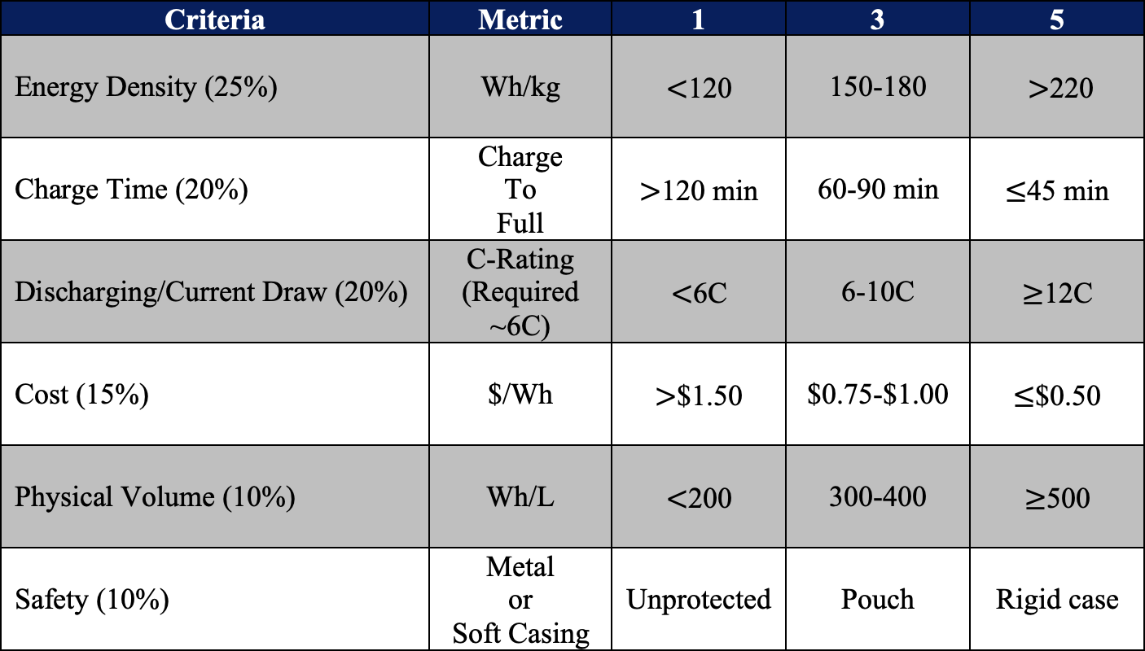
Summary of Scoring 1: Battery Chemistry
Trade Studies
Assumed Battery Packs
• Li-Ion: high-drain 21700 pack (~10C)
• LiPo: 6S pouch pack (≥25C, ≥1.5C charge)
Method
• Scored 1–5; 2 and 4 fall between thresholds
• Energy Density & Volume are full Pack-level values (not individual cells)
• Required ~6C peak, estimated from 15 min endurance requirement.
Trade Studies
Propulsion
Power Systems
Airframe
GNC
Avionics

Slide 38
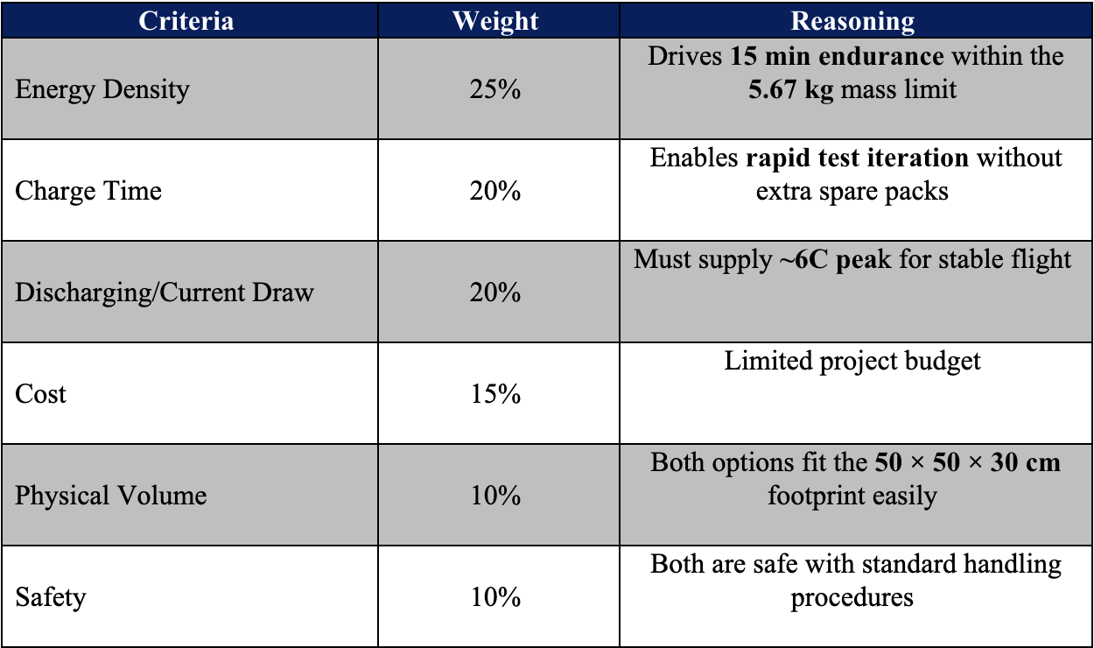
Summary of Scoring 2: Battery Chemistry
Trade Studies
Note: A 4.5 Ah pack at 1C supplies 4.5 A, and at 10C it supplies 45 A.
The equation is
𝐼 = 𝐶 ∗ 𝐴h
Trade Studies
Propulsion
Power Systems
Airframe
GNC
Avionics

Slide 39
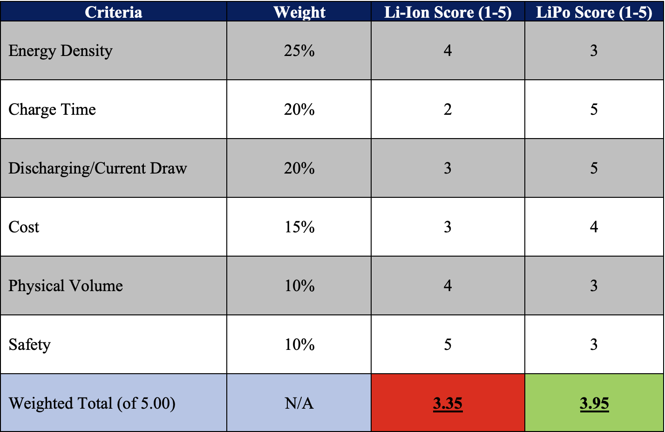
Summary of Trade Results: Battery Chemistry
Trade Studies
Selected: 6S LiPo
• Highest weighted score (3.95 vs. 3.35)
• Charge time weighted heavily (20%) to enable rapid test iteration without waiting on pack recharge
• Discharge margin: LiPo >2x required vs. Li-Ion ~1.5x
• Multiple 6S packs may be required if power/weight estimates increase.
Trade Studies
Propulsion
Power Systems
Airframe
GNC
Avionics
4
Notes:
STANDARD CONTENT — the default working slide. Replace the title, bullets, and visual box. Drop the visual box and widen the text if you don't need an image.

Slide 40
Relevant Requirements: PCB Voltage Separation
Trade Studies
Requirement # | Requirement | Rationale for Relevance
UAS-VSYS-9 | The UAV Power System must provide necessary voltage, current, and power to each relevant subsystem. | The PCB will serve as a power distribution system for each subsystem of the UAV. It is crucial that it is able to accommodate the necessary complexity to regulate power.
UAS-VSYS-16 | The UAV will be fitted with proper wire harnessing and troubleshooting indicators | The PCB will be a central component involved in the organization and wire management of the UAV, and the PCB will need to accommodate troubleshooting indicators.
Key Requirement Impact:
A method of voltage separation (PCB) is critical to regulate power to match the needs of each subsystem using the collective battery
Trade Studies
Propulsion
Power Systems
Airframe
GNC
Avionics
4
Notes:
STANDARD CONTENT — the default working slide. Replace the title, bullets, and visual box. Drop the visual box and widen the text if you don't need an image.

Slide 41
Summary of Scoring 1: PCB Voltage Separation
Trade Studies
Criteria | Metric | 1 | 3 | 5
Cost (20%) | $ | >$50 each | ~$10 each | <$1 each
Complexity (20%) | Can this PCB accommodate a complex circuit? | May not accommodate enough components to achieve goals | Able to accommodate sufficient components but may not be complex enough to power entire UAV | Fully customizable and able to accommodate more than enough components
Ability to Prototype (25%) | Can the design be easily iterated? | No easy way to alter the circuit or create new one | Can alter circuit or create new one, but it may impact cost and timeline | Very easy to alter the circuit or create new one
Lead Time (10%) | Days until delivery | >1 week | 4-5 days | 1-2 days
Durability (25%) | Will the PCB break under external force? | Prone to fracturing or short-circuiting | The circuit may break, but it is not difficult to fix | Very likely to survive extreme flight conditions and collisions
Trade Studies
Propulsion
Power Systems
Airframe
GNC
Avionics

Slide 42
Summary of Scoring 2: PCB Voltage Separation
Trade Studies
Criteria | Weight (%) | Reasoning
Cost | 20% | Limited by project budget
Complexity | 20% | Influences the ability to accommodate potentially complex circuits for each subsystem
Ability to Prototype | 25% | Enables iterative designs to allow for adjustments and/or errors
Lead Time | 10% | Accommodates project timeline
Durability | 25% | Minimizes risk of failure given different flight conditions or collisions
Note: Scoring was done qualitatively based on research on the different types of voltage separation systems
Trade Studies
Propulsion
Power Systems
Airframe
GNC
Avionics

Slide 43
Summary of Trade Results: PCB Voltage Separation
Trade Studies
Criteria | Weight (%) | Custom PCB | 3D Printed PCB | Perfboard | Stripboard
Cost | 20% | 1 | 4 | 5 | 4
Complexity | 20% | 5 | 4 | 3 | 1
Ability to Prototype | 25% | 1 | 4 | 5 | 3
Lead Time | 10% | 1 | 5 | 4 | 4
Durability | 25% | 4 | 3 | 2 | 1
Weighted Total out of 5 | N/A | 2.55 | 3.85 | 3.75 | 2.4
Final decision:
Perfboard to prototype the circuit design: low cost and ease of repetitive designs
  Similar to a permanent breadboard
3D printed PCB for final design: permanent, more durable solution.
Both options had similar final scores that were the highest (3.85 and 3.75)
Trade Studies
Propulsion
Power Systems
Airframe
GNC
Avionics
4
Notes:
Weighted at 20% due to budget
Weighted at 20% to ensure proper power management is possible
Weighted at 25% because prototyping is a critical step is design
Weighted at 10% due to timeline
Weighted at 25% to ensure that the circuit is safe and does not get damaged

Slide 44
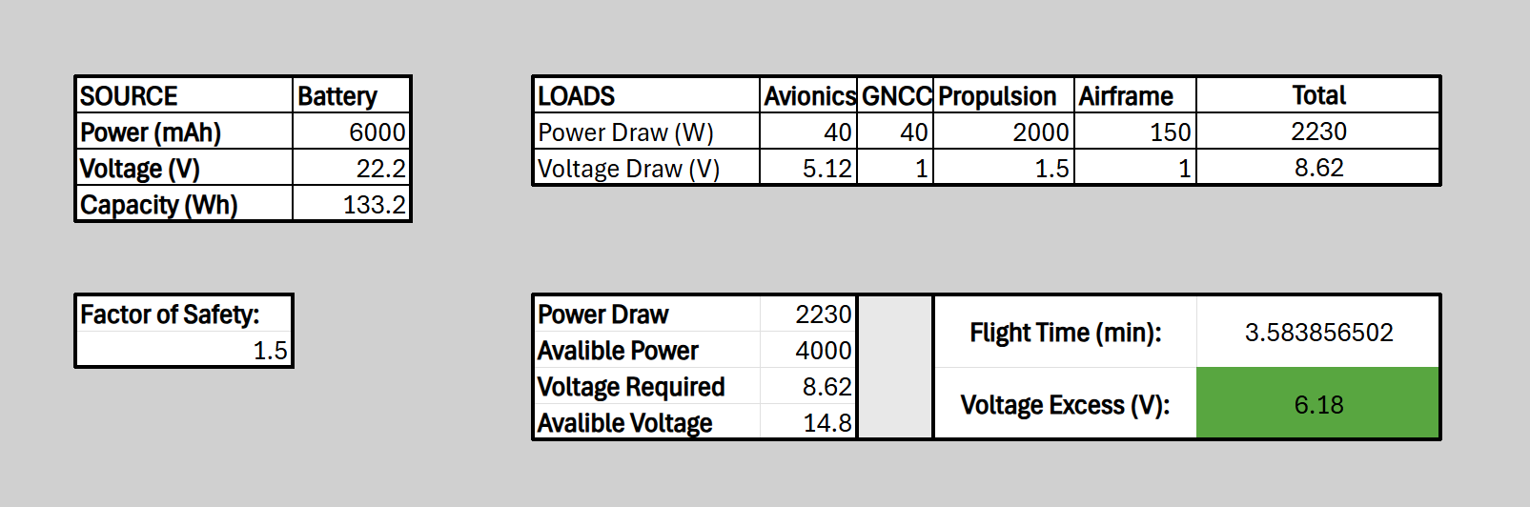
Energy Modeling
Trade Studies
Cells turn green when within acceptable range (>15min and >0 V)
Note: Values shown do not reflect reality
Living sheet with inputs for each UAS subsystem
Uses energy requirements from subsystems and battery to calculate viability
Factor of Safety: 1.5 - To reflect and exceed the 80% power margin used in industry.
(i.e. , if a system has 10W of power available, only 8W may be used)
Trade Studies
Propulsion
Power Systems
Airframe
GNC
Avionics
4
Notes:
STANDARD CONTENT — the default working slide. Replace the title, bullets, and visual box. Drop the visual box and widen the text if you don't need an image.

Slide 45
Path Forward
Trade Studies
PENDING ITEMS | Description
PCB Design | Begin drafting rough plans for voltage separation PCB using breadboards and perfboards.
Battery Model | Finalize power estimates with various sub-teams and purchase the battery.
Trade Studies
Propulsion
Power Systems
Airframe
GNC
Avionics
4
Notes:
STANDARD CONTENT — the default working slide. Replace the title, bullets, and visual box. Drop the visual box and widen the text if you don't need an image.

Slide 46
ASEN 4018-013
Airframe and Aerodynamics
Trade-studies
46
Notes:
SECTION DIVIDER — duplicate for each major section. Replace the kicker, title, and one-line description.

Slide 47
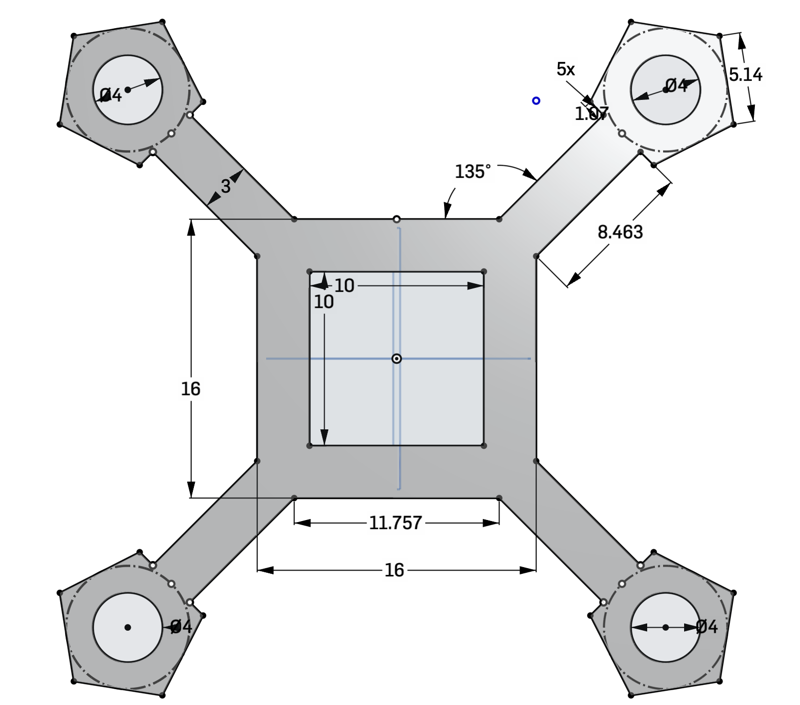
Subsystem Background
Trade Studies
Airframe & Aerodynamics Team:
Minimum weight without losing structural integrity
The airframe structure will provide enough spatial sizing to house all components.
  Accessible battery housing
  Easily access internals for maintenance or repair
  Reduce size when possible
The structure will need to resist or dissipate
  Impact & shear forces
  Stresses
  Heat
  Environmental conditions
Trade Studies
Propulsion
Power Systems
Airframe & Aerodynamics
GNC
Avionics
Notes:
STANDARD CONTENT — the default working slide. Replace the title, bullets, and visual box. Drop the visual box and widen the text if you don't need an image.

Slide 48
Relevant Requirements for Shape & Configuration
Trade Studies
Requirement # | Requirement | Rationale for Relevance
UAS-VSYS-1.1 | The UAS shall sustain stress loads of TBD for a duration of 15 minutes. | Airframe must remain robust in all expected conditions to facilitate mission success.
UAS-VYS-5 | The UAS shall have a volumetric footprint of 50 cm length x 50 cm width x 30 cm height. | Airframe must meet the volumetric footprint requirement and be able to accommodate all other subsystem functions.
UAS-VSYS-6 | The UAS shall weight no more than 12.5 lb (5.6 kg). | Airframe must not exceed the weight limit to stay within a reasonable operation condition of other UAS models.
UAS-VSYS-7 | The UAS structure shall be able to function in temperatures ranging from 15°C to 25°C. | Airframe must be able to sustain operation in a range of ambient temperature conditions.
Key Requirement Impact: Structural loading, geometry, weight, and operating conditions drive the design configuration of the UAS to be structurally robust, compact, and be of minimal weight.
Trade Studies
Propulsion
Power Systems
Airframe & Aerodynamics
GNC
Avionics
Notes:
STANDARD CONTENT — the default working slide. Replace the title, bullets, and visual box. Drop the visual box and widen the text if you don't need an image.

Slide 49
Relevant Requirements for Material Composition
Trade Studies
Requirement # | Requirement | Rationale for Relevance
UAS-VSYS-1.1 | The UAS shall sustain stress loads of TBD for a duration of 15 minutes. | Airframe structure material must resist axial, transverse, vibrational, and bending stresses in main body and arms.
UAS-VSYS-1.2 | The UAS shall sustain shear loads of 80-166 N for a duration of 15 minutes. | The material of the arms are important for accounting for the sheer force and deflection due to the thrust generated by the rotor fans.
UAS-VSYS-2.2 | The UAS shall provide mounting provisions for the wire provisions. | Arm cross section affects material strength, need to determine whether internal or external wiring is feasible.
UAS-VSYS-6 | The UAS shall weigh no more than 25 lbs (11.3 kg). | Material must have a high strength to weight ratio to allow positive net thrust.
Key Requirement Impact: The structural loading and weight requirements drive a material selection with a high strength-to-weight ratio capable of resisting operational, shear, and bending stresses.
Trade Studies
Propulsion
Power Systems
Airframe & Aerodynamics
GNC
Avionics
Notes:
STANDARD CONTENT — the default working slide. Replace the title, bullets, and visual box. Drop the visual box and widen the text if you don't need an image.

Slide 50
Summary of Trades Conducted
Trade Studies
Trades Conducted | Trade Description | Rationale | Results
Material Trade Study | Conducted a trade study on various materials for the airframe structure. | Determined the viability of various materials due to cost, rigidity, and weight savings. | Carbon Fiber Arms Carbon Fiber Chassis
Shape & Configuration | Conducted a trade study concerning different drone rotor arm configurations and spatial sizing for avionics and power. Conducted a trade study on the primary shape of the chassis. | Rotor arm configuration determines arm length, main body sizing, and relative internal electronics spacing. Chassis shape determines volume allotment for other subsystems and has down stream effects with aerodynamic performance. | X-Shape + Streamlined Body
Thermal Dissipation & Conductivity | Conducted a trade study for heat transfer and thermal conductivity through airframe structure. | Determine if venting or thermal dissipation needs to be integrated into the airframe structure. | Carbon Fiber Chassis
Trade Study Purpose: compare different design alternatives for a UAS airframe to identify the best option that balances requirements, cost, and performance.
Trade Studies
Propulsion
Power Systems
Airframe & Aerodynamics
GNC
Avionics
Notes:
STANDARD CONTENT — the default working slide. Replace the title, bullets, and visual box. Drop the visual box and widen the text if you don't need an image.

Slide 51
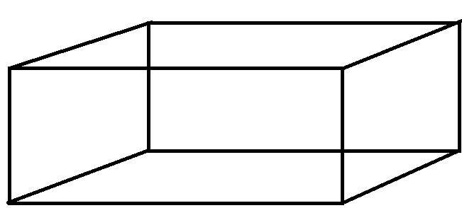
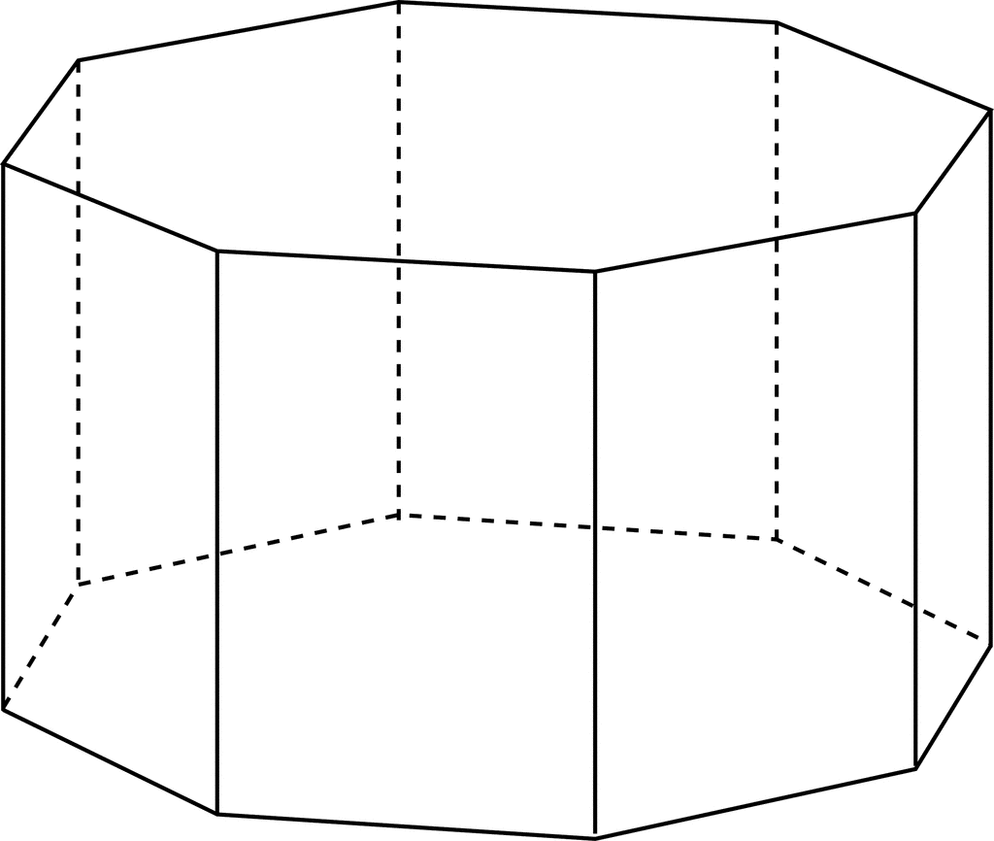
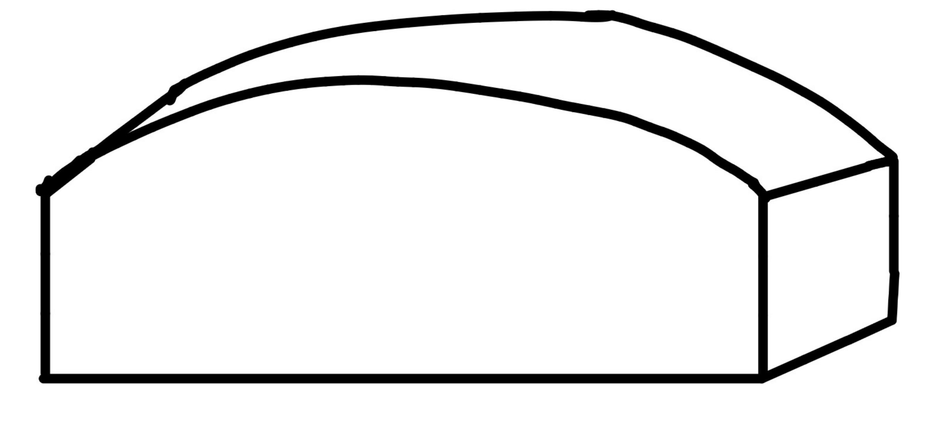
Chassis Shape Trade Study: Modeling and Analysis
Trade Studies
  Rectangular Prism
  Usable Volume: 0.001764 m³
  Mass: 1.8311 kg
  Octagonal Prism
  Usable Volume: 0.0022732 m³
  Mass: 1.8726 kg
  Streamlined + Prism
  Usable Volume: 0.0018569 m³
  Mass: 1.786 kg
Key Takeaway: The streamlined prism provides the best balance of usable volume and overall mass when keeping as many geometric parameters constant. It is worth noting that the octagonal prism provides the largest overall volume.
Trade Studies
Propulsion
Power Systems
Airframe & Aerodynamics
GNC
Avionics
Notes:
STANDARD CONTENT — the default working slide. Replace the title, bullets, and visual box. Drop the visual box and widen the text if you don't need an image.

Slide 52
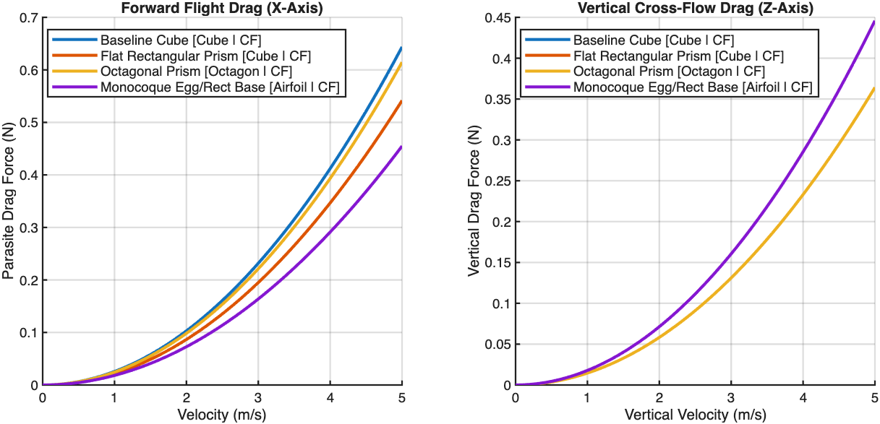
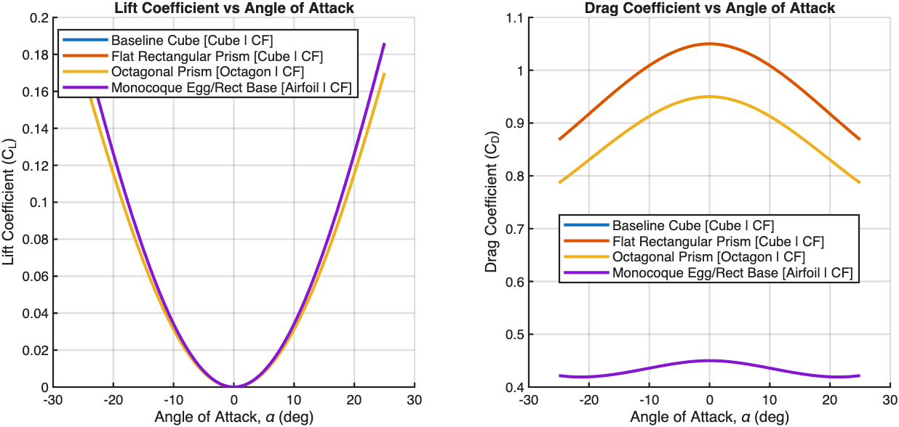
Chassis Shape Trade Study: Modeling and Analysis
Trade Studies
Mathematical Model: Uses an analytical model to estimate the directional drag forces and total lift-drag polars.
Assumptions:
Bluff Bodies
Cross Flow Theory + Projected Cross Sections
Steady, Incompressible Flow
Key Takeaway: Streamlined body is substantially better in drag performance and marginally better in overall lift generation. Other configurations all have similar performance profiles.
Trade Studies
Propulsion
Power Systems
Airframe & Aerodynamics
GNC
Avionics
Notes:
STANDARD CONTENT — the default working slide. Replace the title, bullets, and visual box. Drop the visual box and widen the text if you don't need an image.

Slide 53
Chassis Shape Trade Study: Summary
Trade Studies
Material Properties
External Factors
Factor | Factor Weight | Cube/ Rectangular | Egg/ Monocoque | Octagonal
Stiffness/ Density | 20% | 3 | 5 | 4
Environmental Limitations | 10% | 4 | 4 | 4
Thermal Performance | 5% | 4 | 5 | 5
MAX Impact resistance | 10% | 3 | 5 | 4
Repairability | 10% | 5 | 2 | 4
Machinability | 10% | 5 | 2 | 4
Mechanical Complexity | 10% | 5 | 4 | 5
Mass/Volume | 25% | 2 | 5 | 4
 | /100%
Weighted Score / 5 |  | 3.50 | 4.20 | 4.15
Factor | Factor Weight | Cube/Rectangular | Egg/Monocoque | Octagonal
Mission Reliability | 35% | 5 | 3 | 4
Ease of Verification | 20% | 5 | 3 | 5
Schedule | 25% | 4 | 2 | 4
Cost | 20% | 4 | 3 | 4
 | /100%
Weighted Score / 5 |  | 4.55 | 2.75 | 4.20
Streamlined monocoque is the most balanced in most metrics, besides production oriented.
  3D Printing!
53
Notes:
STANDARD CONTENT — the default working slide. Replace the title, bullets, and visual box. Drop the visual box and widen the text if you don't need an image.

Slide 54
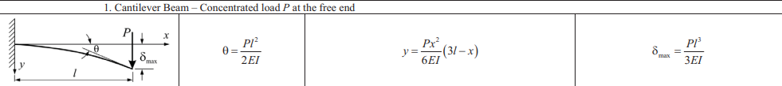
Material Trade Study: Modeling and Analysis
Trade Studies
Mathematic Model:
Rotor arms are modeled as a cantilever beam with a load at the free end representing the thrust. Deflection is calculated using the delta max equation.
Simplifying Assumptions:
The thrust force is estimated as a point load.
The mating joint between the UAS arm and chassis is modeled as rigidly connected.
Thrust to weight ratio estimated as 1.5:1 T/W ratio.
y
y
x
z
Inner diameter = 70% Outer diameter
Nominal L=150mm
Trade Studies
Propulsion
Power Systems
Airframe & Aerodynamics
GNC
Avionics
Notes:
STANDARD CONTENT — the default working slide. Replace the title, bullets, and visual box. Drop the visual box and widen the text if you don't need an image.

Slide 55
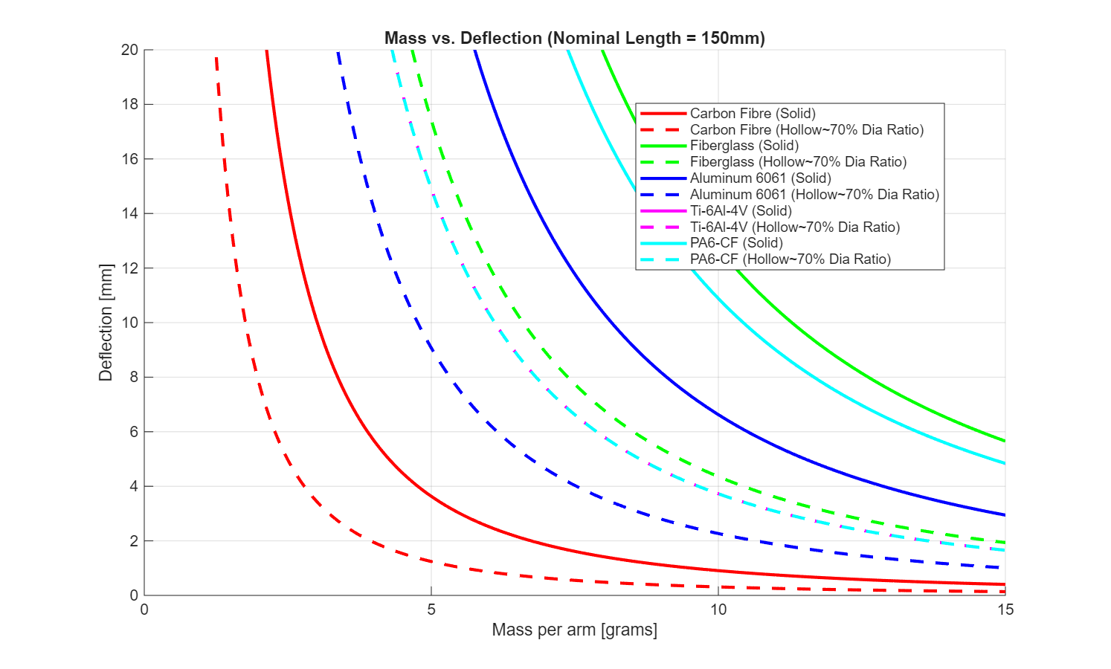
Material Trade Study: Modeling and Analysis
Trade Studies
Key Takeaway:
Carbon fiber shows the best mass to deflection path especially in a hollow configuration: the beam retains most of its strength while being lighter.
Honorable Mention:
Aluminum 6061
Lower is better
Lower is better
Trade Studies
Propulsion
Power Systems
Airframe & Aerodynamics
GNC
Avionics
Notes:
STANDARD CONTENT — the default working slide. Replace the title, bullets, and visual box. Drop the visual box and widen the text if you don't need an image.

Slide 56
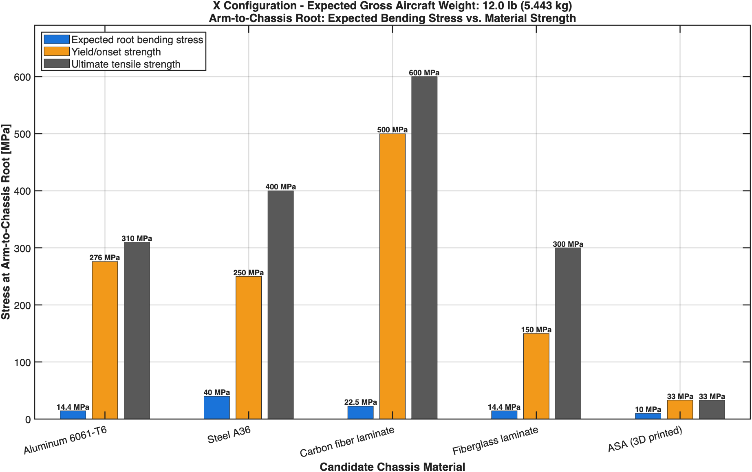
Chassis Material Trade Study: Modeling and Analysis
Trade Studies
Assumptions:
Thrust Weight Ratio:1.5:1
Forces as Point Loads
Single material throughout frame
Bending Stress Largest Margin
Key Takeaway: Confirmed structural feasibility because all expected loads are below their yield strength, material can be chosen based on yield-margin, weight, and cost.
Trade Studies
Propulsion
Power Systems
Airframe & Aerodynamics
GNC
Avionics
Notes:
STANDARD CONTENT — the default working slide. Replace the title, bullets, and visual box. Drop the visual box and widen the text if you don't need an image.

Slide 57
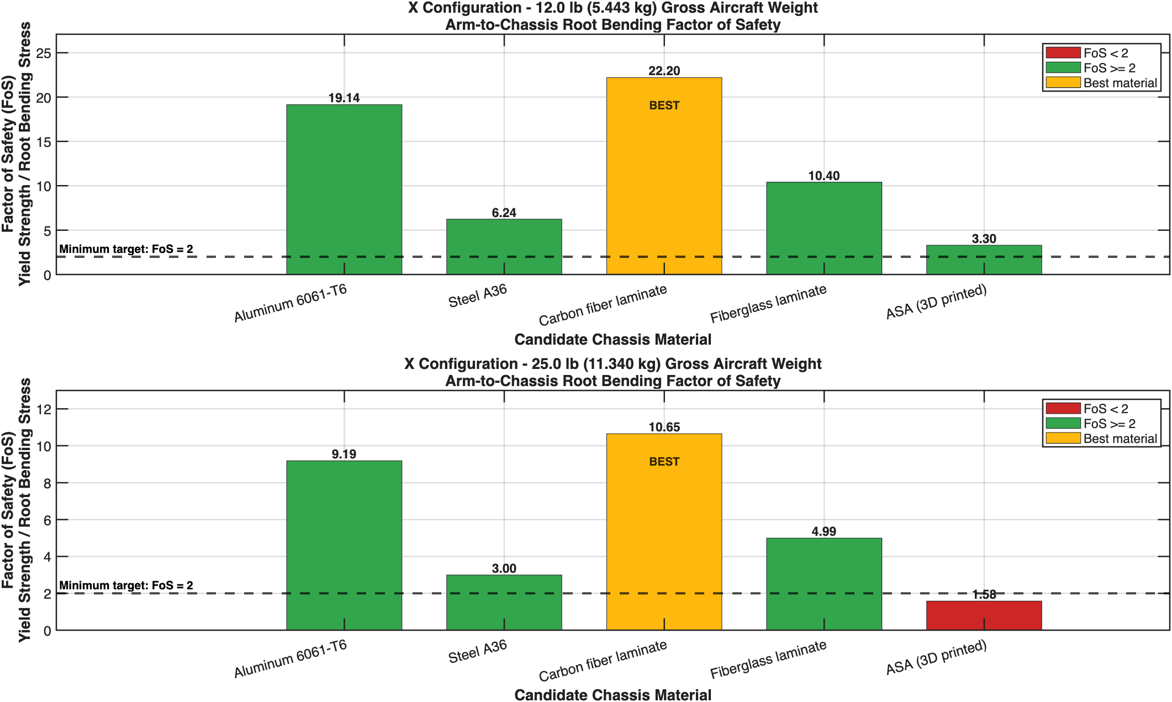
Trade Studies
Chassis Material Trade Study: Modeling and Analysis
Key Takeaway: Carbon fiber provides the greatest FoS at both weight configurations, while using only ASA fails to meet the FoS requirement at 25 lbs.
Meets Requirement Region
Requirement Failure
Meets Requirement Region
Requirement Failure
Trade Studies
Propulsion
Power Systems
Airframe & Aerodynamics
GNC
Avionics
Notes:
STANDARD CONTENT — the default working slide. Replace the title, bullets, and visual box. Drop the visual box and widen the text if you don't need an image.

Slide 58
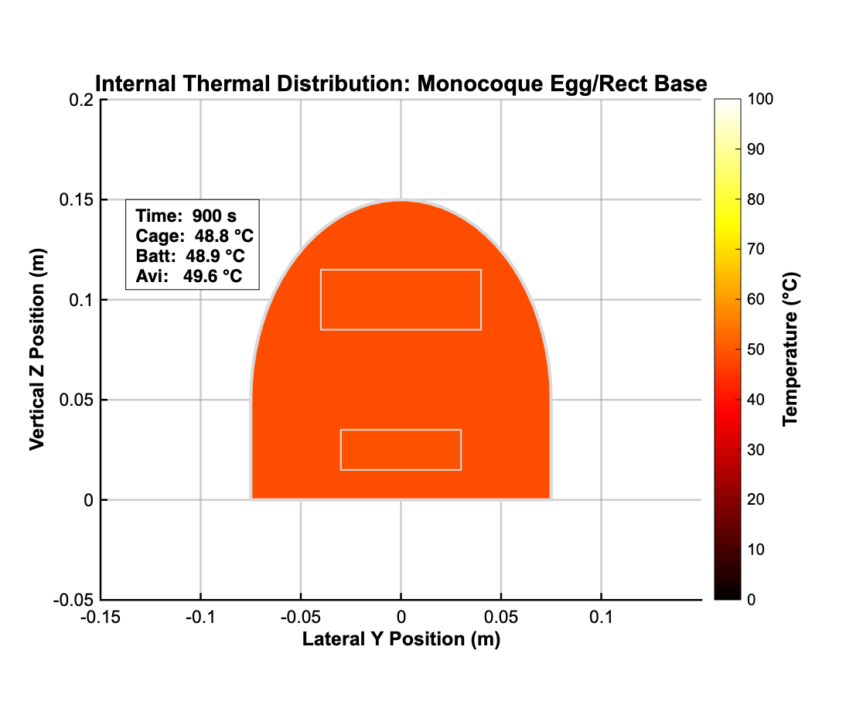

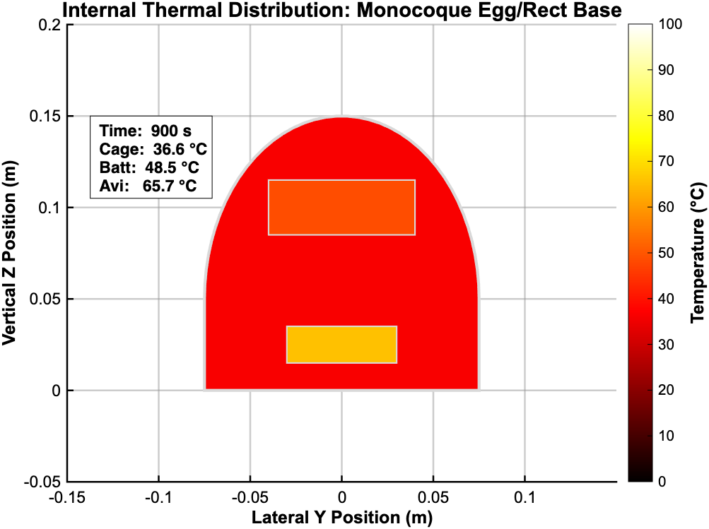
Chassis Material Trade Study: Modeling and Analysis
Trade Studies
Carbon Fiber
Aluminum
ASA
Maximum Temperatures:​
Avionics: 49.6 °C​
Battery: 48.9 °C​
Cage: 48.8 °C​
​
​
Maximum Temperatures:​
Avionics: 48.4 °C​
Battery: 48.5 °C​
Cage: 48.6 °C​
​
​
Maximum Temperatures:​
Avionics: 65.7 °C​
Battery: 48.5 °C​
Cage: 36.6 °C​
​
​
Key Takeaway: All profiles stay within the operational conditions of the other sub teams, however some form of thermal rejection or venting would be helpful in improving factor of safety and prevent thermal hazards.
Trade Studies
Propulsion
Power Systems
Airframe & Aerodynamics
GNC
Avionics
Notes:
STANDARD CONTENT — the default working slide. Replace the title, bullets, and visual box. Drop the visual box and widen the text if you don't need an image.

Slide 59
Materials Trade Study: Summary
Trade Studies
Material Properties
External Factors
Factor | Factor Weight | ASA | Aluminum 6061-T6 | Carbon Fiber
Stiffness/ Density | 20% | 2 | 3 | 5
Environmental Limitations | 10% | 3 | 5 | 4
Thermal Performance | 5% | 2 | 5 | 3
MAX Impact resistance | 10% | 3 | 4 | 3
Repairability | 10% | 5 | 4 | 3
Machinability | 10% | 5 | 4 | 3
Mechanical Complexity | 10% | 5 | 4 | 4
Mass/Volume | 25% | 4 | 3 | 5
 | /100%
Weighted Score / 5 |  | 3.55 | 3.65 | 4.25
Factor | Factor Weight | ASA | Aluminum 6061-T6 | Carbon Fiber
Mission Reliability | 35% | 3 | 5 | 5
Ease of Verification | 20% | 5 | 5 | 4
Schedule | 25% | 5 | 4 | 4
Cost | 20% | 5 | 4 | 3
 | /100%
Weighted Score / 5 |  | 4.30 | 4.55 | 4.10
Notes:
STANDARD CONTENT — the default working slide. Replace the title, bullets, and visual box. Drop the visual box and widen the text if you don't need an image.

Slide 60
Path Forward
Trade Studies
Decided Result and decided path forward:
PENDING ITEMS | PLANNED | REVISED | COMPLETED
CAD Models | Rotor arm Full Main Body Shell Iterations on Structural Frame
Trade Studies | Airframe CFD Vibration frequencies | Arm & Chassis Material Structural Frame
Simulation Models | Dynamics Thermal Conductivity
Trade Studies
Propulsion
Power Systems
Airframe & Aerodynamics
GNC
Avionics
Notes:
STANDARD CONTENT — the default working slide. Replace the title, bullets, and visual box. Drop the visual box and widen the text if you don't need an image.

Slide 61
ASEN 4018-013
Guidance, Nav. & Controls
Trade-studies
Notes:
SECTION DIVIDER — duplicate for each major section. Replace the kicker, title, and one-line description.

Slide 62
Subsystem Background
Trade Studies
Guidance & Navigation
Drone requires autonomous guidance and navigation to AOI and for search patterns
  Autonomously reach point on AOI border
  Search AOI efficiently to find ArUco marker
  Autonomously return to starting position
Pathfinding algorithms define efficiency of drone trajectory
Dynamics & Control
Drone must correctly control propellor thrusts to navigate properly
  Need to maintain SLUF during search patterns
  Control laws (PID, LQR, etc.) used to keep drone on simulated trajectory
  Quadrotor dynamics define control laws
Control laws maintain accuracy of drone positioning for precise operation
Trade Studies
Propulsion
Power Systems
Airframe & Aerodynamics
GNC
Avionics
Notes:
STANDARD CONTENT — the default working slide. Replace the title, bullets, and visual box. Drop the visual box and widen the text if you don't need an image.

Slide 63
ASEN 4018-013
UAS – Dynamics & Controls
Trade-studies
Notes:
SECTION DIVIDER — duplicate for each major section. Replace the kicker, title, and one-line description.

Slide 64
Summary of Trades Conducted
Trade Studies
Trades Conducted | Trade Description | Rationale | Results
Control Laws | Conducted a trade study on various Control Laws methods for disturbance responses. | Determine the efficiency of various control laws due to endurance, accuracy and safety. | Cascaded PID
Transient Responses | Conducted a trade study on underdamped vs. overdamped transient responses. | Determine what kind of damping ratio to prioritize for our gains. | Underdamped
Sensor Fusion Algorithms | Conducted a trade study on different kinds of Kalman filters for state-estimation and responses. | Determine what kind of filter to use for safety, accuracy and computations. | Unscented Kalman Filter
Input Types | Conducted a trade study on different input types for packaging, modeling & stability accuracy. | Determine what type of motor input would provide the best stability for the integration. | RPM Direct Input
Trade Study Purpose: Reduce design error by selecting D&C models that best support mission performance, accuracy, reliability, and integration.
Trade Studies
Propulsion
Power Systems
Airframe & Aerodynamics
GNC
Avionics
Notes:
STANDARD CONTENT — the default working slide. Replace the title, bullets, and visual box. Drop the visual box and widen the text if you don't need an image.

Slide 65
Relevant Requirements for Control Laws
Trade Studies
Requirement # | Requirement | Rationale for Relevance
UAS-11 | The UAS shall have autonomous maneuverabiltiy capabilities. | The control law must support stable autonomous flight and accurately track commanded attitudes and trajectories.
UAS-14 & 15 | The UAS shall maneuver at an altitude no greater than 2 m. The UAS shall maneuver at a speed no greater than 0.5 m/s | Control law must limit overshoot to stay within the operating constraints for the duration of the search.
UAS-GNCC-8 | The UAS shall operate using a Closed Control Feedback loop | How complete does the feedback loop be with regards to integration, efficiency and safety?
UAS-GNCC-9 | The UAS shall remain within the feedback response parameters stated in UAS-GNCC-9 sub requirements | How effectively does the controller maintain and goes back to trim state? How sensitive is the controller to noise and does it require additional filtering?
Key Requirement Impact: Control Law selection must prioritize accuracy and integration while limiting compounding error during path execution.
Trade Studies
Propulsion
Power Systems
Airframe & Aerodynamics
GNC
Avionics
Notes:
STANDARD CONTENT — the default working slide. Replace the title, bullets, and visual box. Drop the visual box and widen the text if you don't need an image.

Slide 66
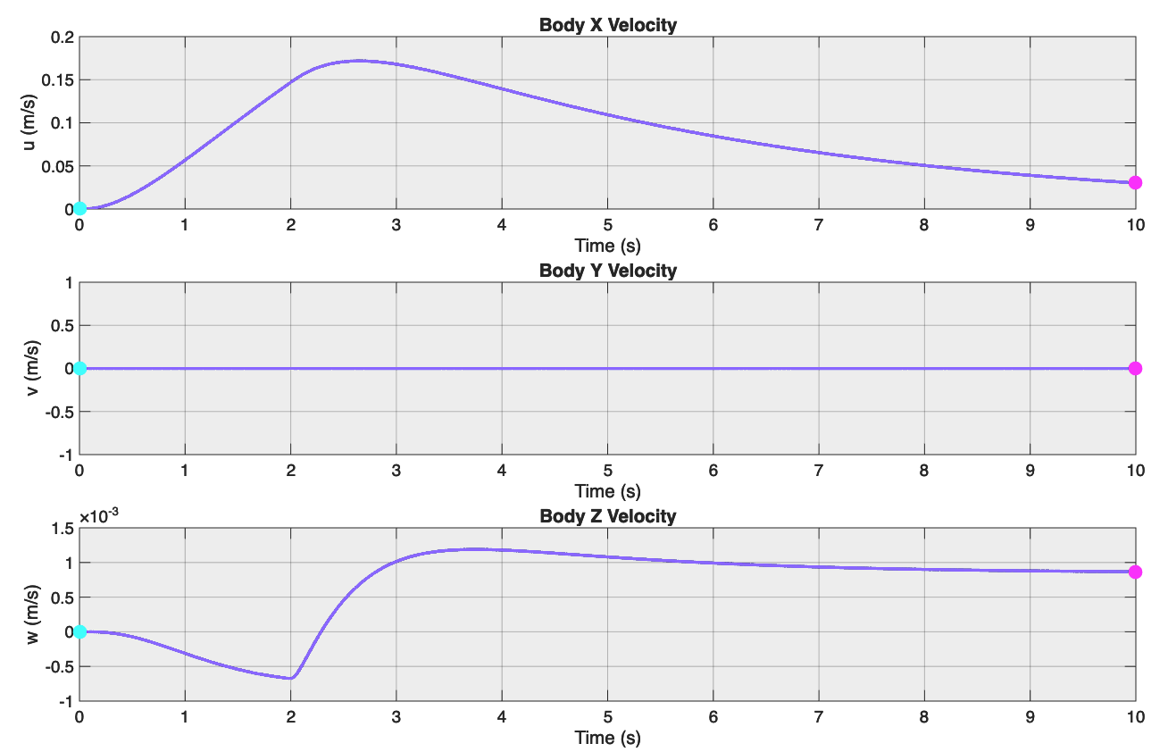
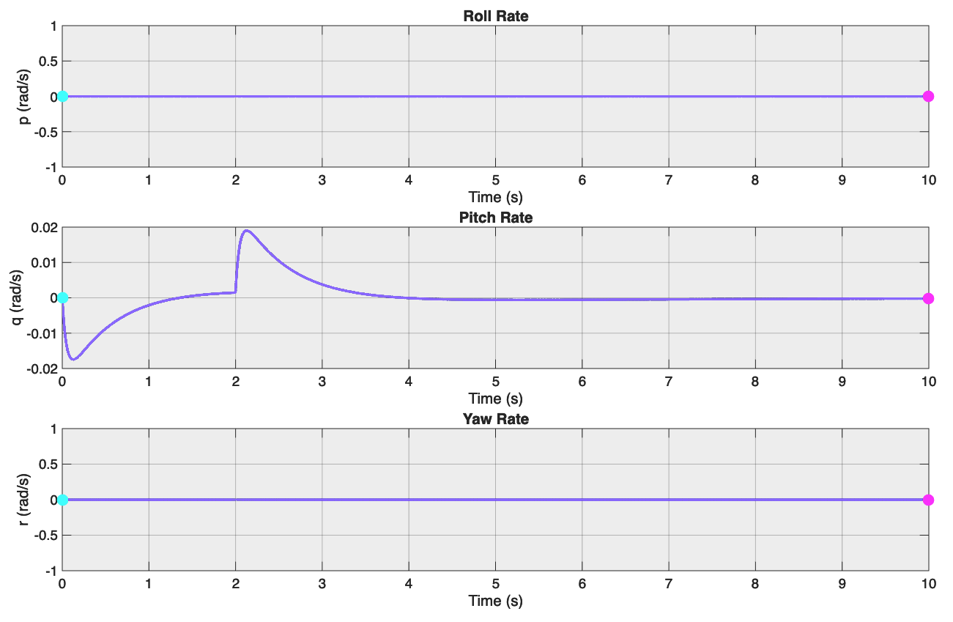
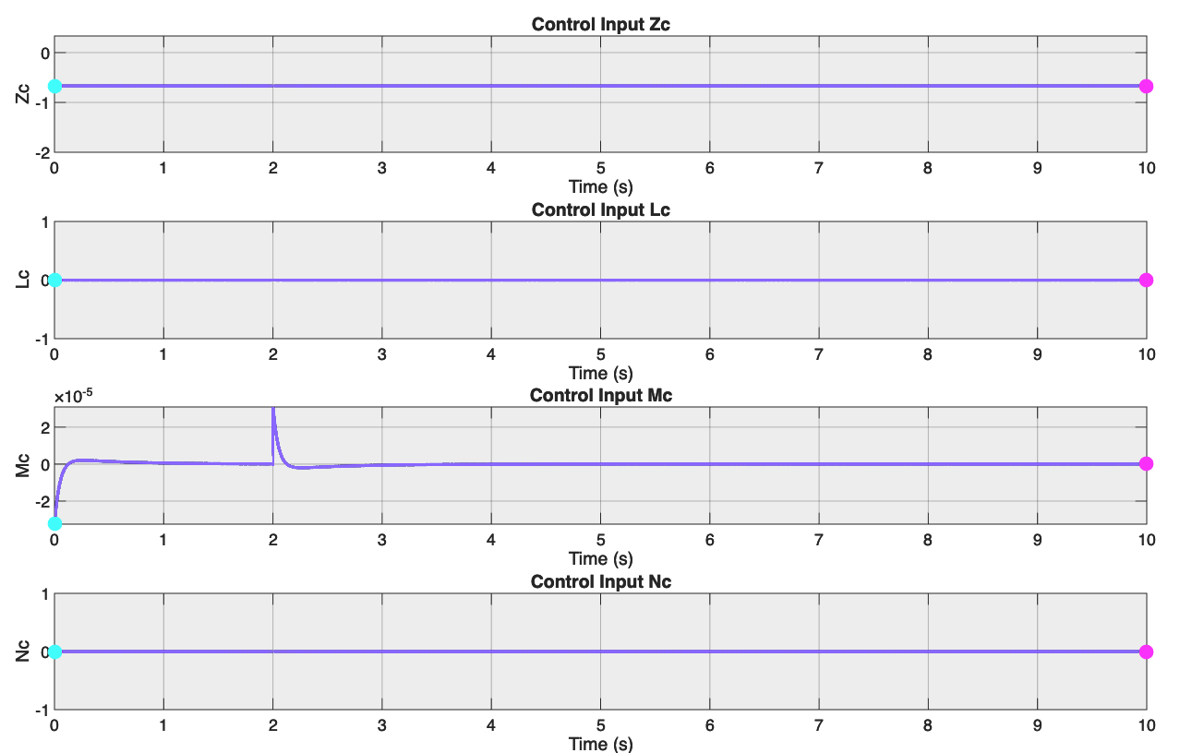
CPID&PD Modeling and Analysis
Trade Studies
Cascaded Outer PID & Inner PD response for non-singular +/- 0.1 rad/s disturbance in pitch rate
Non-linear response in blue
Notable Results:
  Low fluctuations
  Low noise
  Doesn't return to trim state for Z-velocity
  Missing an Integral gain in inner loop
Trade Studies
Propulsion
Power Systems
Airframe & Aerodynamics
GNC
Avionics
Notes:
STANDARD CONTENT — the default working slide. Replace the title, bullets, and visual box. Drop the visual box and widen the text if you don't need an image.

Slide 67

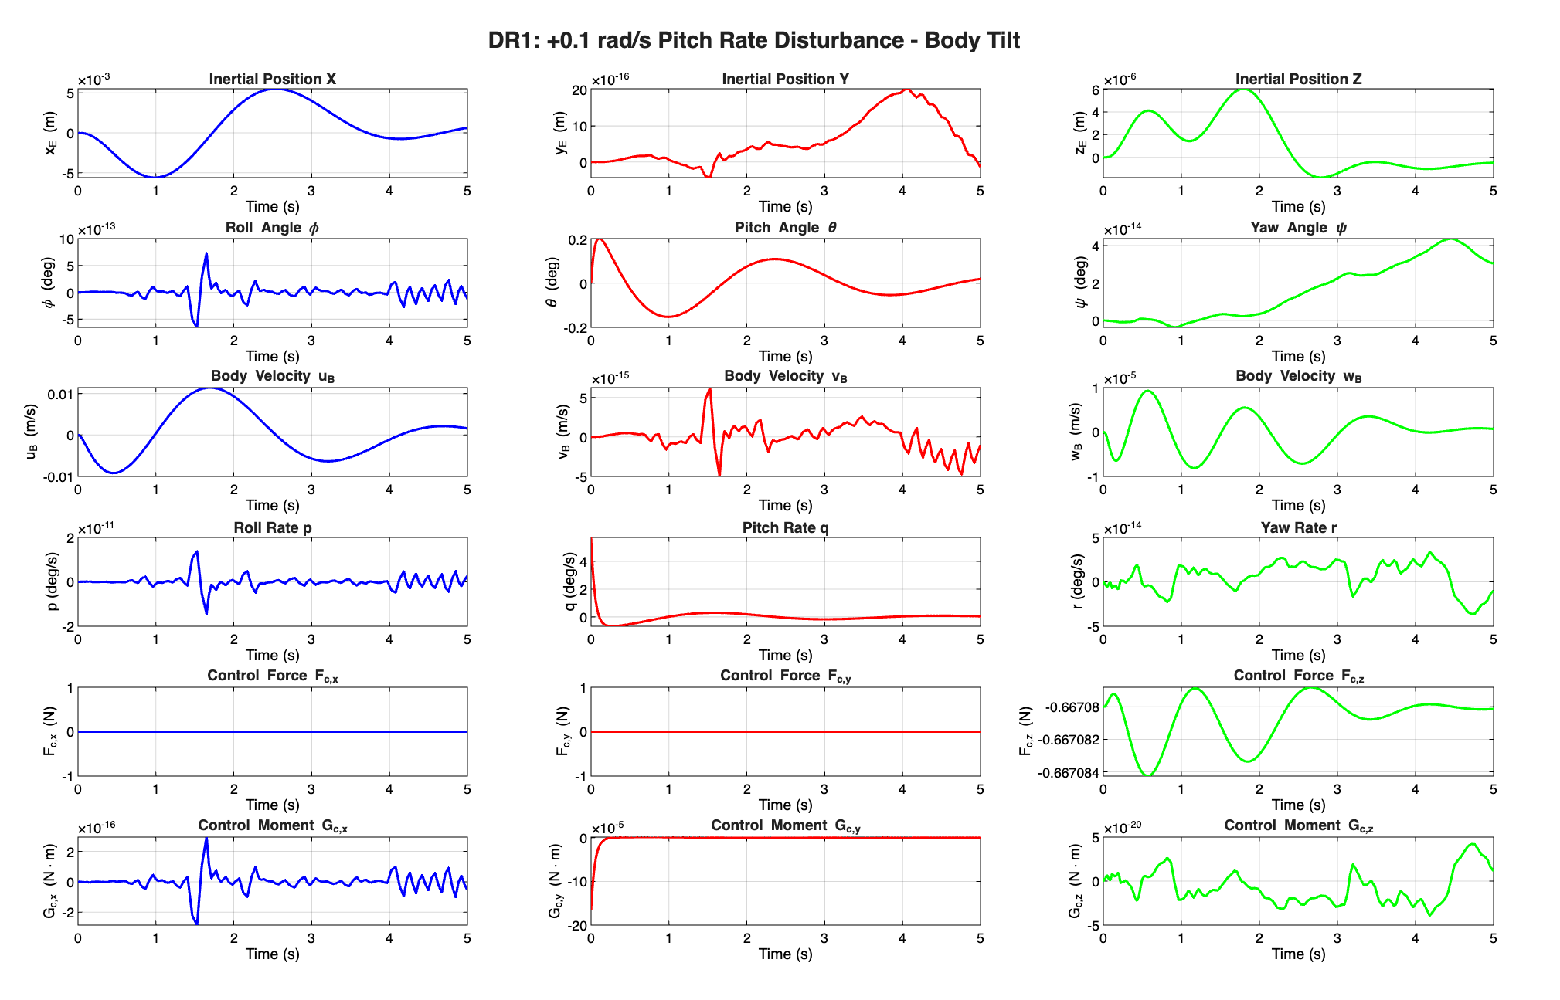
CPID Modeling and Analysis
Trade Studies
Cascaded Outer PID & Inner PID response for non-singular +/- 0.1 rad/s disturbance in pitch rate
Non-linear response in all directions
Notable Results:
  Low fluctuations
  Low noise
  All return to trim under 5s
  Errors decay exponentially over time
Trade Studies
Propulsion
Power Systems
Airframe & Aerodynamics
GNC
Avionics
Notes:
TWO-COLUMN — for comparisons, pros/cons, or UAS-vs-Rover splits. Recolor the accent tick to EVE blue (UAS) or amber (Rover).

Slide 68
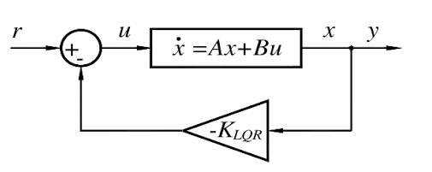
LQR Analysis & Rationale
Trade Studies
How it works?
Linearized 6-DOF quadrotor EOMs around a trim state operating point.
Computes and optimizes full state feedback gain matrix K by minimizing error and control effort.
multi-variable control by calculating thrust and body torques in one loop.
Pros
Cons
Optimal energy & tracking balance
Automatically accounts for dynamic coupling without needing a separate loop.
Great for micro-managing around trim state (smooth transient response)
Low effectiveness for high disturbances and maneuvers.
Sensitive to unmodeled non-linear forces (i.e. ground effect).
Mathematically dependent on Jacobian and may demand more computational overhead.
Sources
Ogata, K. (2010), Modern Control Engineering (5th Ed.).
Bouabdallah, S. (2007), Design and Control of Quadrotors with Application to Autonomous Flying, EPFL Thesis.
Armah et al. (2014), IEEE Flight Control Applications.
Sources
Castillo et al. (2005), Modelling and Control of Mini-Flying Machines, Springer.
Cheeseman & Bennett (1955), NACA Technical Note WR W-90 / Lu et al. (2018), Journal of Intelligent & Robotic Systems.
https://www.researchgate.net/figure/Block-diagram-of-an-LQR-controller_fig1_379427756
Trade Studies
Propulsion
Power Systems
Airframe & Aerodynamics
GNC
Avionics
Notes:
TWO-COLUMN — for comparisons, pros/cons, or UAS-vs-Rover splits. Recolor the accent tick to EVE blue (UAS) or amber (Rover).

Slide 69
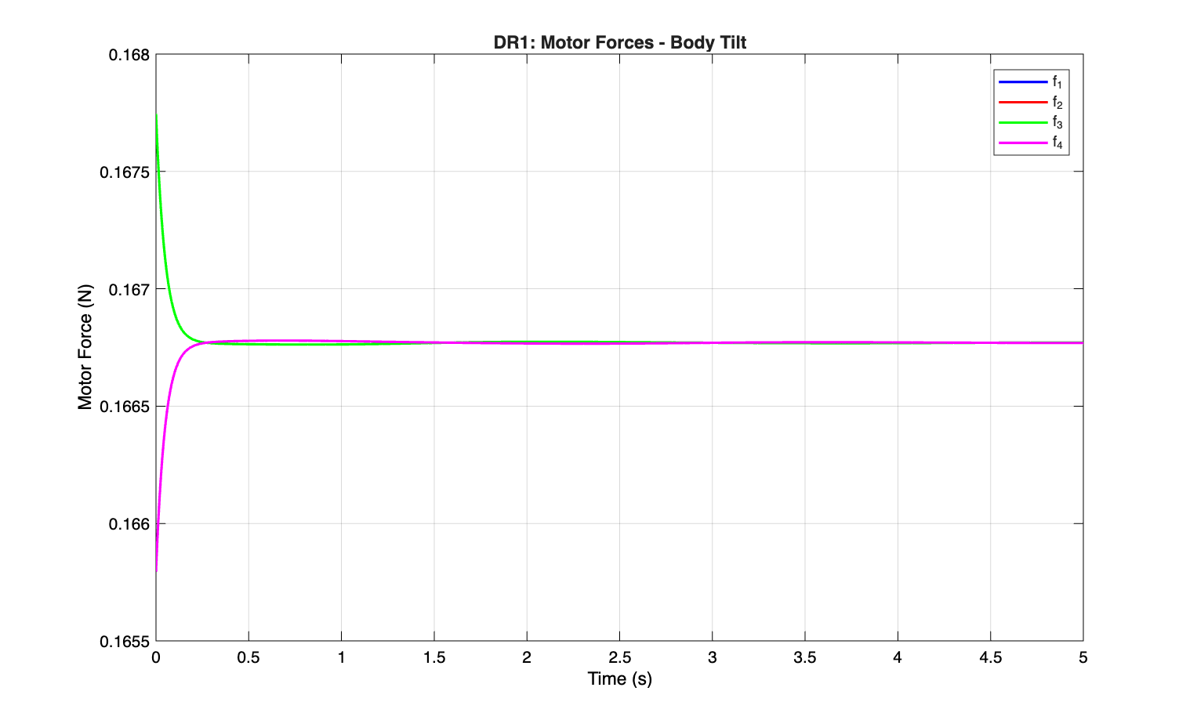
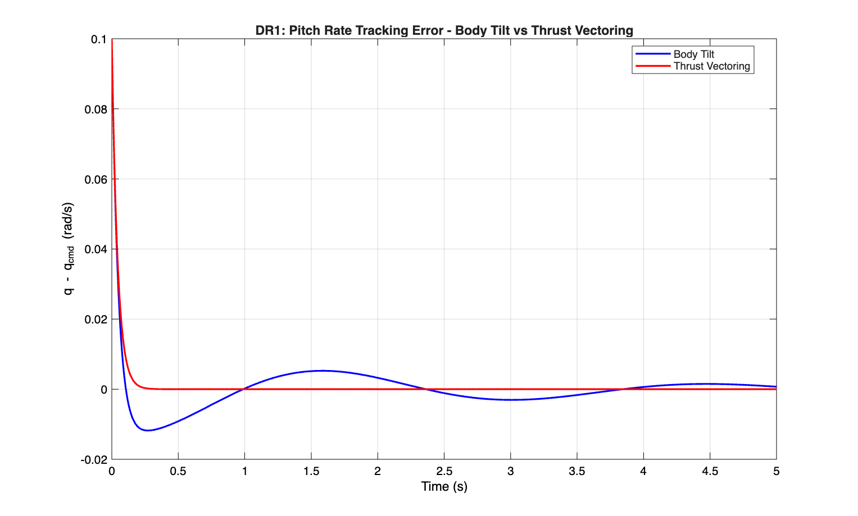
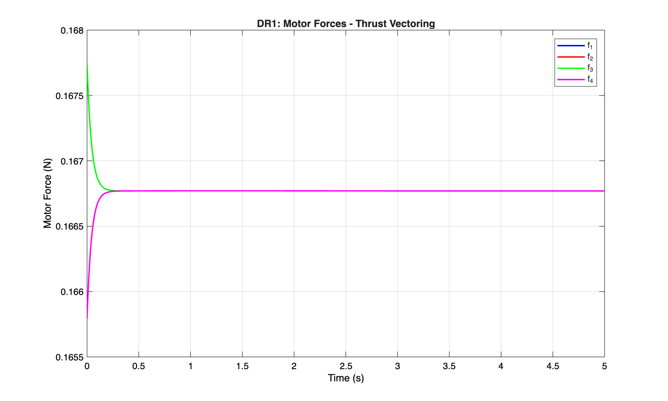
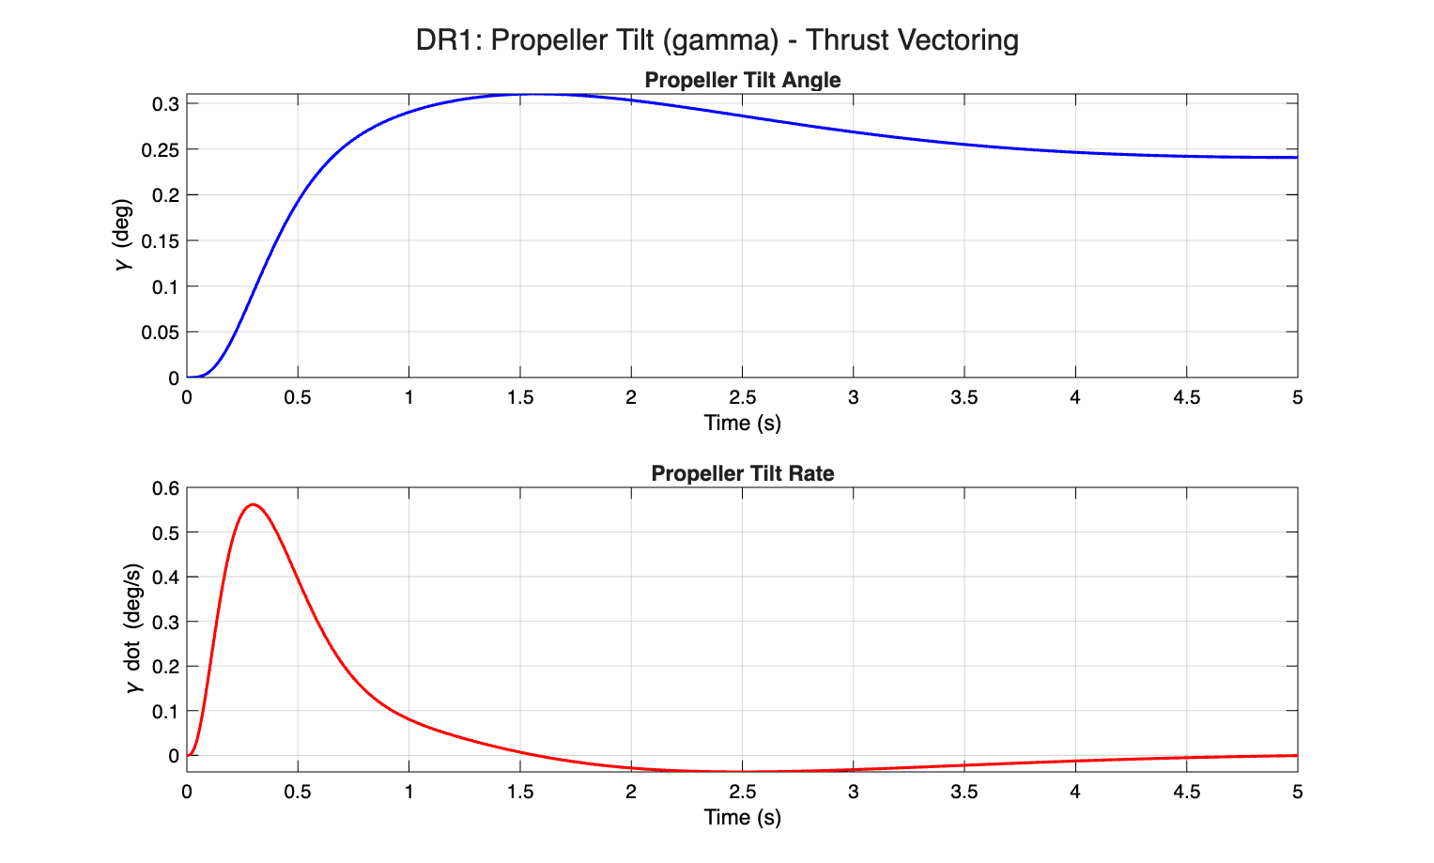
Hon. Mention: Input Method Trade Study
Trade Studies
Direct Thrust & RPM Input
Pros:
Simple Integration
Cons:
Unstable camera control
Slower response
Thrust Vectoring
Pros:
Pitch and roll stability
Faster response time
Stable camera control
Cons:
Complex integration
Trade Studies
Propulsion
Power Systems
Airframe & Aerodynamics
GNC
Avionics
Notes:
TWO-COLUMN — for comparisons, pros/cons, or UAS-vs-Rover splits. Recolor the accent tick to EVE blue (UAS) or amber (Rover).

Slide 70
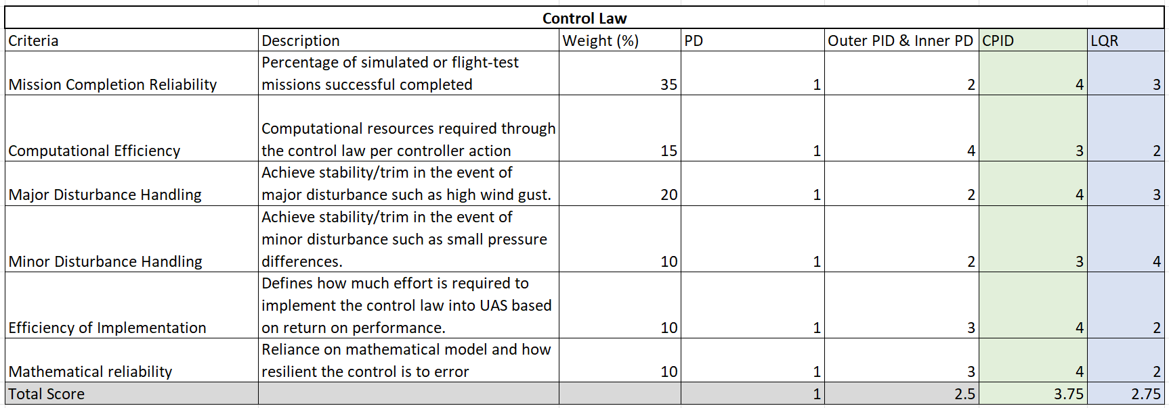
Control Law Trade Study Results
Trade Studies
Linear scoring scale, where higher = "better"
Weights influenced by UAS-11,14,15 & UAS-GNCC-9 L2 Requirements
LQR scoring influenced by UAS-GNCC-9 L2 Requirements & Input Method trade study
Trade Studies
Propulsion
Power Systems
Airframe & Aerodynamics
GNC
Avionics
Notes:
STANDARD CONTENT — the default working slide. Replace the title, bullets, and visual box. Drop the visual box and widen the text if you don't need an image.

Slide 71
ASEN 4018-013
UAS – Guidance & Navigation
Trade-studies
Notes:
SECTION DIVIDER — duplicate for each major section. Replace the kicker, title, and one-line description.

Slide 72
Summary of Trades Conducted
Trade Studies
Trades Conducted | Trade Description | Rationale | Results
Waypoint Guidance Methods | Study of various waypoint guidance methods and expected error responses to disturbances | Determine the guidance method that will most efficiently get the vehicle to the search zone with minimal error in measurement readings | Spline
Sensor Suite and Real-Time Processing | Assessing different sensors and combined effects of power consumption, accuracy, and reliability | Determine the sensor-suite that will most efficiently and reliable provide accurate positioning data to meet mission requirements | GPS/RTK
AOI Search patterns | Evaluating different search patterns and their effectiveness, search accuracy, and speed | Determine the fastest, most efficient method to search the AOI to save time and power | Serpentine
Software Architecture | Looking at different software architectures to build the autonomy algorithms | Determine the software that is most easily usable and integrable, efficient, computationally simple, and reliable | Tie between: 1) Simulink x C++/ROS Code Gen 2) Embedded C++
Trade Study Purpose: Reduce design uncertainty by selecting GN approaches that best support mission performance, accuracy, reliability, and integration.
Trade Studies
Propulsion
Power Systems
Airframe & Aerodynamics
GNC
Avionics
Notes:
STANDARD CONTENT — the default working slide. Replace the title, bullets, and visual box. Drop the visual box and widen the text if you don't need an image.

Slide 73
Relevant Requirements for Waypoint Guidance
Trade Studies
Requirement # | Requirement | Rationale for Relevance
UAS-GNCC-12 | The UAS shall compute and execute geometric flight paths | The waypoint method directly determines the geometric flight path used to navigate between mission waypoints and phases.
UAS-GNCC-14 | The UAS shall compute and execute a search procedure to locate an ArUco marker at a location within an area of interest | The selected waypoint method must support execution of the planned search pattern within the area of interest.
UAS-GNCC-12.4 | All flight paths shall be computed within TBD s | The computational complexity of the waypoint method affects how quickly a flight path can be generated and updated.
UAS-GNCC-10 | All flight paths shall be executed with an accuracy of +/- TBD cm in 3 degrees of freedom | Path-tracking accuracy is a primary trade metric, evaluated using RMS and maximum position error under sensor noise.
Key Requirement Impact: Waypoint selection must prioritize accurate and repeatable path execution under realistic navigation/sensor error.
Trade Studies
Propulsion
Power Systems
Airframe & Aerodynamics
GNC
Avionics
Notes:
STANDARD CONTENT — the default working slide. Replace the title, bullets, and visual box. Drop the visual box and widen the text if you don't need an image.

Slide 74
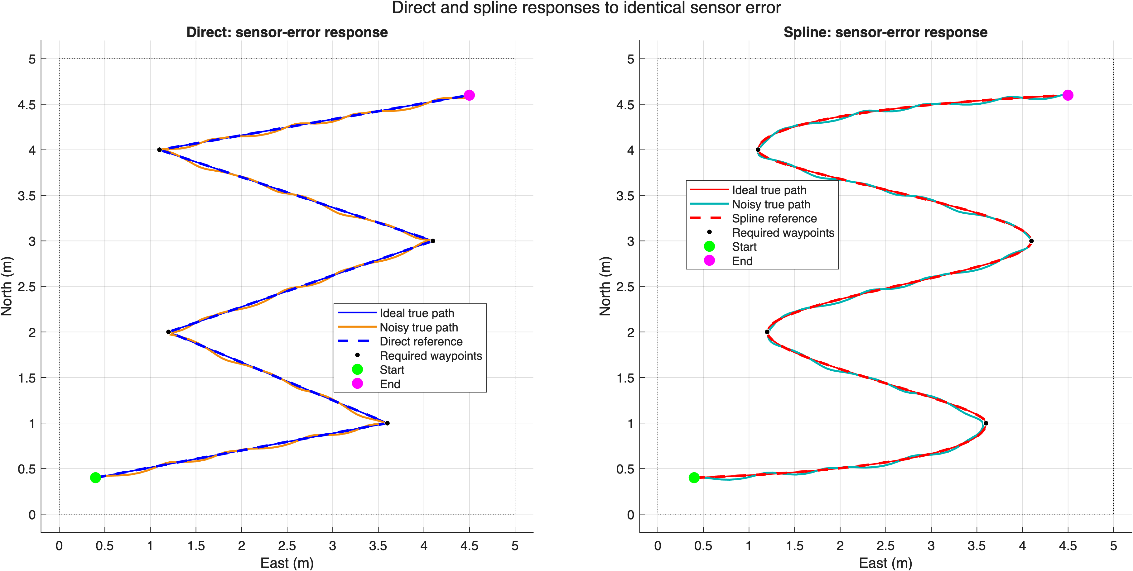
Waypoint Guidance Modeling and Analysis
Trade Studies
Objective:
Compare direct and spline waypoint guidance methods under identical position-sensor error.
Model Setup:
Two-dimensional kinematic model at constant altitude
Five fixed waypoints within a 5 m x 5 m test area
Average 0.4 m/s speed with 0.5 m/s limit
Direct method uses straight segments
Spline method uses PCHIP interpolation for smooth turns
Sensor-Error Analysis:
Both methods received the same fixed sensor-error sequence
Position sensor updated at 5 Hz with a 0.11 m peak error
Compared cross-track error and endpoint error
Modeling Summary: The kinematic model isolates guidance behavior and sensor-error sensitivity before adding full vehicle dynamics.
Trade Studies
Propulsion
Power Systems
Airframe & Aerodynamics
GNC
Avionics
Notes:
STANDARD CONTENT — the default working slide. Replace the title, bullets, and visual box. Drop the visual box and widen the text if you don't need an image.

Slide 75
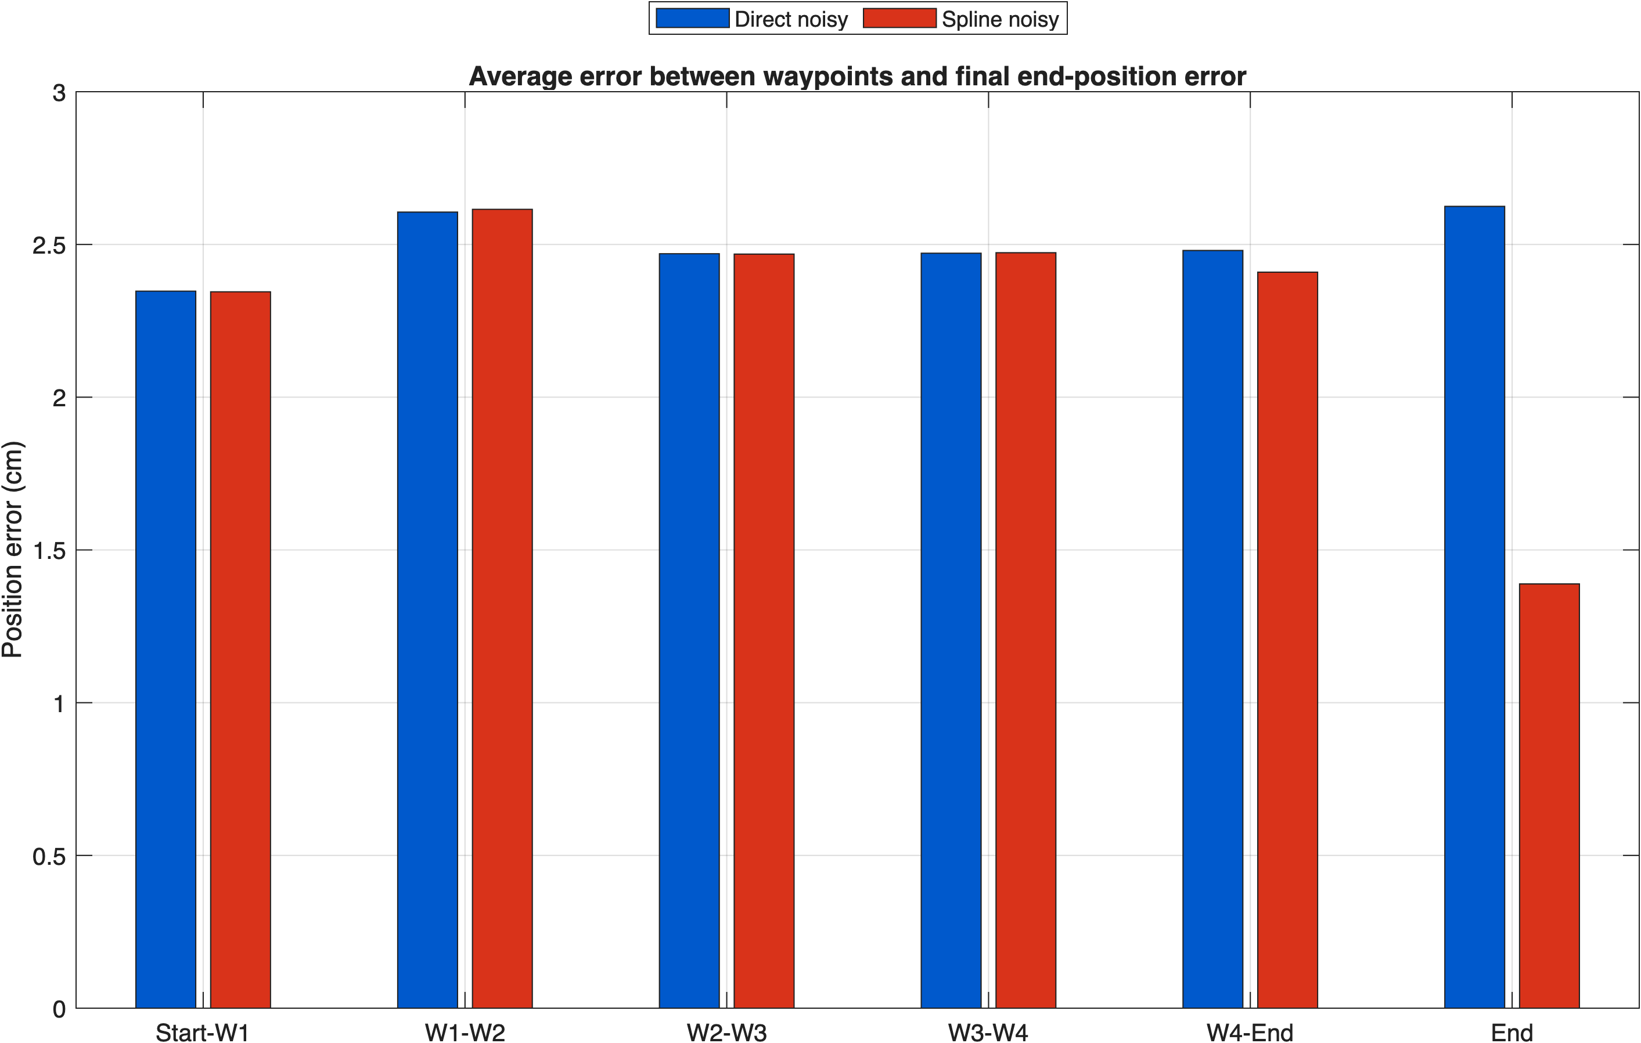
Waypoint Guidance Trade Results
Trade Studies
Decision: Spline Waypoint Guidance
Nearly identical sensor-error responses
Max average position error of ~2.6 cm
Spline produces smoother turns and lower endpoint error
Spline more accurately models the multirotor dynamics
Direct remains an easier alternative
 | Weight | Method 1: Direct | Method 2: Spline
Mission Completion Reliability | 25 | 1 | 2
Path Tracking Accuracy | 25 | 2 | 2
Sensor Error Response | 20 | 1 | 2
Path Efficiency | 15 | 2 | 1
Ease of Implementation | 15 | 2 | 1
Total Score | 100 | 1.55 | 1.77
Trade Study Takeaway: The trade study favored spline guidance due to its smoother trajectory, lower endpoint error, and better representation of expected multirotor behavior.
Trade Studies
Propulsion
Power Systems
Airframe & Aerodynamics
GNC
Avionics
Notes:
STANDARD CONTENT — the default working slide. Replace the title, bullets, and visual box. Drop the visual box and widen the text if you don't need an image.

Slide 76
ASEN 4018-013
UAS – GNCC: Design/Prototyping
Trade-studies
Notes:
SECTION DIVIDER — duplicate for each major section. Replace the kicker, title, and one-line description.

Slide 77
Path Forward
Trade Studies
PENDING ITEMS | PLANNED | IN PROGRESS | COMPLETED
Waypoint Development/Flight Algorithm Modelling | X
Sensor-Suite and Fusion Modeling | X
LQR Review & Control Law Integration | X
Monte-Carlo Gains Simulation | X
Software-In-The-Loop-Modeling | X | X
GPS Integration | X
Trade Studies
Propulsion
Power Systems
Airframe & Aerodynamics
GNC
Avionics
Notes:
STANDARD CONTENT — the default working slide. Replace the title, bullets, and visual box. Drop the visual box and widen the text if you don't need an image.

Slide 78
ASEN 4018-013
Avionics
Trade Studies
78
Notes:
SECTION DIVIDER — duplicate for each major section. Replace the kicker, title, and one-line description.

Slide 79
Sub-Team Role:
Responsible for the flight vehicle’s onboard electronics, computing, sensing, and communications infrastructure. Owns flight computers, sensors, data buses, telemetry, communications, software interfaces, and integration of the electronic systems supporting vehicle operations.
Includes electronics system architecture, system integration, and component level design and modeling
Subsystem Background
Trade Studies
Avionics Sub-Team
Drone requires avionics to perform all flight functions
  Flight
  Computing
  Sensing
  Communications
  Navigation
Sub-team Deliverables
  Electronics System Architecture
  Component level design and modeling
  System Integration and test
Trade Studies
Propulsion
Power Systems
Airframe
GNC
79
Avionics
Notes:
The avionics team is responsible for all of the necessary electronics on and offboard the UAS, from sensing and computing to communications and manual override.
For DR1, we worked to create a system architecture, essentially laying the framework for all of the electronics to interface with eachother.
Moving forward, our role will shift towards component level design, modeling and later on even systems integration and testing.

Slide 80
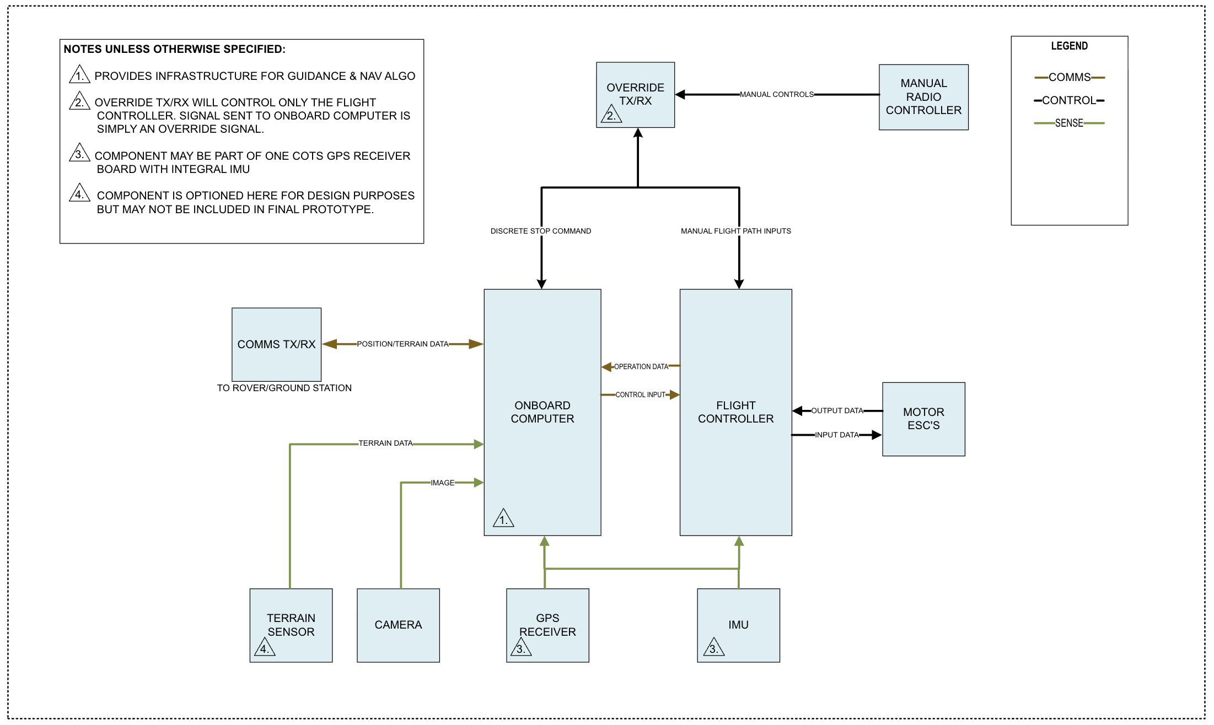
Avionics System Architecture
Trade Studies
Trade Studies
Propulsion
Power Systems
Airframe
GNC
80
Avionics
Notes:
This is our system architecture, our most consequential deliverable for DR1. It is drawn similarly to a system block diagram, with each box representing an individual component of the avionics system and connections drawn between components to show interfaces.
This system architecture is essentially the result of the findings of our higher level trade studies at this point in the design.
Some key design points in this architecture that you will notice in our following trade studies are the tandem flight controller and onboard computer, as well as a wifi based communications device and a separate (redundant) RF receiver/transmitter for manual override.

Slide 81
Summary of Trades Conducted
Trade Studies
Trades Conducted | Trade Description | Rationale | Results
Navigation Method | Analyzed alternative forms of Navigation and UAS Positioning. | Determined viability of certain Nav Methods and chose a path forward. | GNSS-RTK
Flight Controller | Weighed alternative options for UAS primary Flight controller. | Choose best flight controller with design and integration in mind. | Pixhawk 6C
Communication Protocol | Analyzed alternative protocols of communication between UAS, Rover and Ground Station. | Standardize data transmission between vehicles. | Wi-Fi
Computing Architecture | Weighed effectiveness of various computing architectures for Onboard/Offboard processing. | Begin system architecture design to provide a baseline to design around. | Flight controller + secondary computer
Manual Override Architecture | Determined method of manual override | Determine clear system architecture to minimize latency and ensure unobstructed command pathways | Separate RF controller linked to flight controller
Data Flow Architecture | Determine method of data flow | Assessing alternatives of a centralized or decoupled data flow is better for system performance | Decoupled (flight controller can operate independently of onboard computer for basic operations)
Trade Study Purpose: Reduce design uncertainty by selecting a system architecture that best supports ease of integration and satisfaction of requirements.
Trade Studies
Propulsion
Power Systems
Airframe
GNC
81
Avionics
Notes:
Ian Connolly—
The architecture you just saw is the result of these 6 trades. I'll go through them quickly, since the two most critical, comms and computing, get a deep dive in the upcoming slides.
For comms, we chose Wi-Fi. For computing, a flight controller plus an onboard computer.
The other four aren't covered later, so here's the rational. For navigation, we chose GNSS-RTK for centimeter-level positioning. For manual override, the pilot's radio controller connects directly to the flight controller. And for data flow The GPS and IMU feed the flight controller directly.
our flight controller for now is the Pixhawk 6c. However, that may change at a later date.

Slide 82
Relevant Requirements for All Trades
Trade Studies
Requirement # | Requirement | Resulting Design Work
UAS-GNCC-1 | The UAS shall communicate with the ground station using Wi-Fi | Communication Protocol Trade Study
UAS-GNCC-2 | The UAS shall transmit all of the data types listed in the UAS-GNCC-2 sub-requirements | Dataflow Trade Study
UAS-GNCC-3 | The UAS shall measure altitude with an accuracy of +/- TBD | Navigation Technology Trade Study
UAS-GNCC-4 | The UAS shall determine its GPS position with an accuracy of +/- TBD cm | Navigation Technology Trade Study
UAS-GNCC-11 | The UAS shall have a manual override procedure that takes precedence over all autonomous procedures | Manual Override Trade Study
UAS-4 | The UAS shall provide the onboard computing required for aircraft controls, sensing, and navigation | Computing Architecture Trade Study
UAS-11 | The UAS shall have autonomous maneuverability capabilities. | Flight Controller Trade Study
Trade Studies
Propulsion
Power Systems
Airframe
GNC
82
Avionics
Notes:
Ian Connolly —
These are the primary requirements that drove those trades.
GNCC-1 and 2 cover communications: protocol, bandwidth, and data types. GNCC-3 and 4 cover altitude and position accuracy. GNCC-11 defined the manual override trade, and UAS-4 the computing trade.
The remaining TBDs in these requirements will close through the component-level trades.

Slide 83
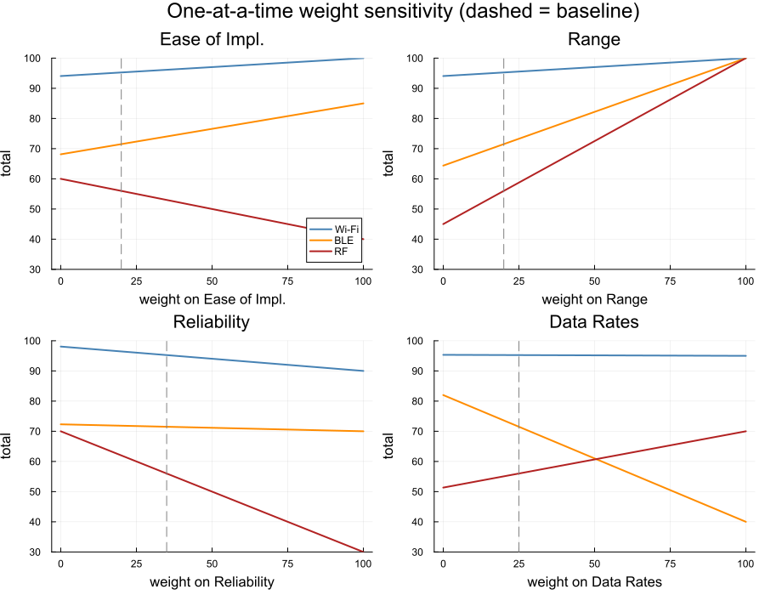
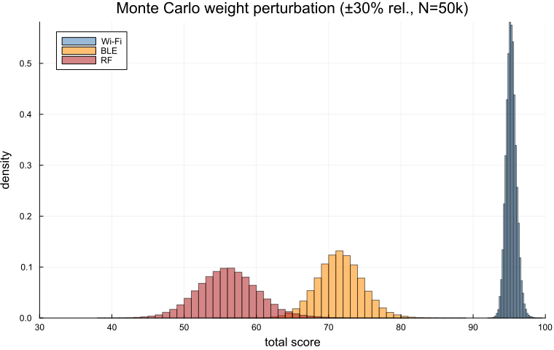
Critical Trade - Communication Protocol
Trade Studies
Methods: Wi-Fi, BluetoothLE (BLE), Custom RF Link
Primary Criteria: Reliability, Range Requirements
Reliability and data rates weighted higher due to range sufficiencies across all options
Wi-Fi was superior in all categories: easiest integration, best data rates, safest reliability
Driving Requirement: UAS-GNCC-1
Trade Studies
Propulsion
Power Systems
Airframe
GNC
83
Avionics
Notes:
One of the Critical Trades we ran was on the UAS-Rover Communication Link. We investigated three different methods of achieving the data transfer. Wi-Fi, Bluetooth Low Energy, and a Custom RF Link (a COTS radio but a custom communication protocol). The criteria we initially selected as primary were Reliability and Range requirements.
We chose those criteria as Reliability is incredibly important to make sure that the data is sent across correctly and effectively ever single time we run our test mission. Range Requirements are important as if we fly outside of the range of whatever communication protocol we choose, our mission will fall flat as we won’t be able to send the necessary data for the Rover to function. In our investigation we found that all three methods meet the range requirement of communicating in an outdoor environment with a 5x5m square search area within Line of Sight.
Since every methods met the requirement well in further analysis, we devalued the importance of the range criteria and brought more importance to data rates. As we have the potential to send larger amounts of data to the rover to aid it in its goal. We ran some sensitivity analysis where we adjusted the weights of each of our criteria to see which criteria had the most impact on the potential methods. We figured out that Wi-Fi had a generally positive relationship with all of our requirements whereas our other two methods have less desirable relationships depending on the criteria.
We also ran a Monte Carlo to show that there was no overlap with our top choice and the other two choices. We can see in the Monte Carlo plot that Wi-Fi is by far and away the best way performer for our communication link requirements.

Slide 84
Summary of Critical Trade Results
Trade Studies
UAS-Rover Comms Protocol
Criteria | Weight | Wi-Fi |  | Bluetooth (BLE) |  | RF
 | (Total = 100) | Value | Score(x/10) | Value | Score(x/10) | Value | Score(x/10)
Ease of Implementation | 20 | Most computing devices have Wi-Fi connective compatibility. | 10 | Fewer devices automatically support | 8.5 | Very few devices have in-built drivers | 4
Range | 20 | Meets indoor range req: (5x5m square plus any LOS position), (2.4 GHz Wi-Fi can reach up to 90 meters) | 10 | Meets indoor range req of the 5x5m square plus any LOS position. | 10 | Meets indoor range req as we can tune antenna gains | 10
Reliability and Correctness | 35 | TCP/IP with CSMA/CA | 9 | Frequency Hopping and TCP/IP-like | 7 | Limited already existing reliability and correctness spec | 3
Data Rates | 25 | 100-450 Mbps (2.4 GHz Wi-Fi 5) | 9.5 | 90-180 kbps | 4 | 10 kbps to 3 Mbps | 7
Max Score | 100 | 95.25 |  | 71.5 |  | 56
Trade Studies
Propulsion
Power Systems
Airframe
GNC
84
Avionics
Notes:
Talking about the specific values and their reasonings, for Wi-Fi it scores a 10 on Ease of Implementation as almost every device has Wi-Fi connectivity built in, and working with Wi-Fi in software is as simple as using a default network socket.
All three methods scored a 10 on the range requirement as they all meet or exceed the necessary range for our testing.
The Reliability and Correctness was our other primary criteria, Wi-Fi scores very high on this metric as it has TCP/IP to ensure correctness and automatic retransmission if packets are received inaccurately or aren’t received at all. Wi-Fi also uses a protocol CSMA/CA (Carrier Sense Mutual Access with Collision Avoidance) which ensures that we don’t lose our transmission due to cross talk in a high RF usage environment. (Can I talk more about CSMA/CA???)
With Data rates, Wi-Fi is by far and way the winner as it uses techniques such as QAM which modulates the spectrum to send multiple bits of information within a single bit time improving our link bandwidth.
As Wi-Fi scores very highly on all four of our metrics, it is the winner of our trade study and the technology we believe we should move forward with.

Slide 85
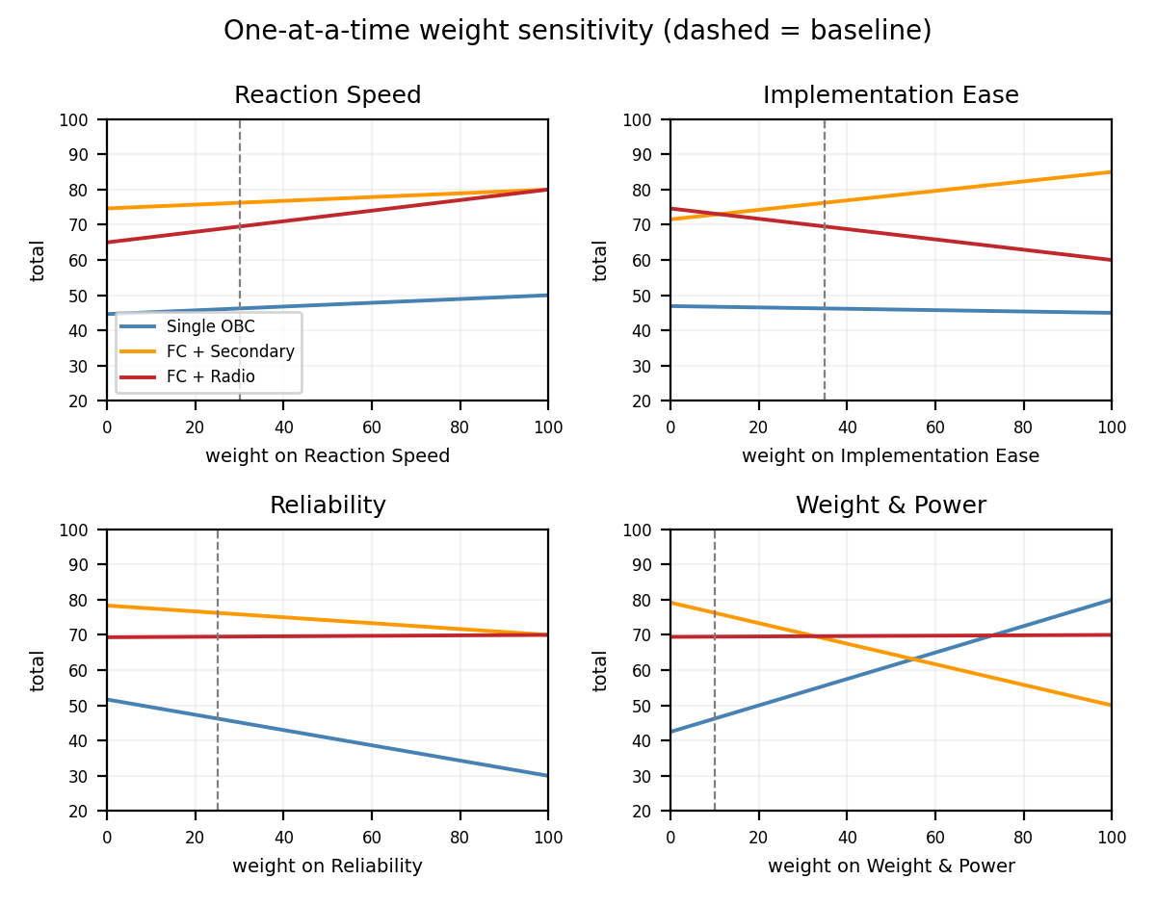
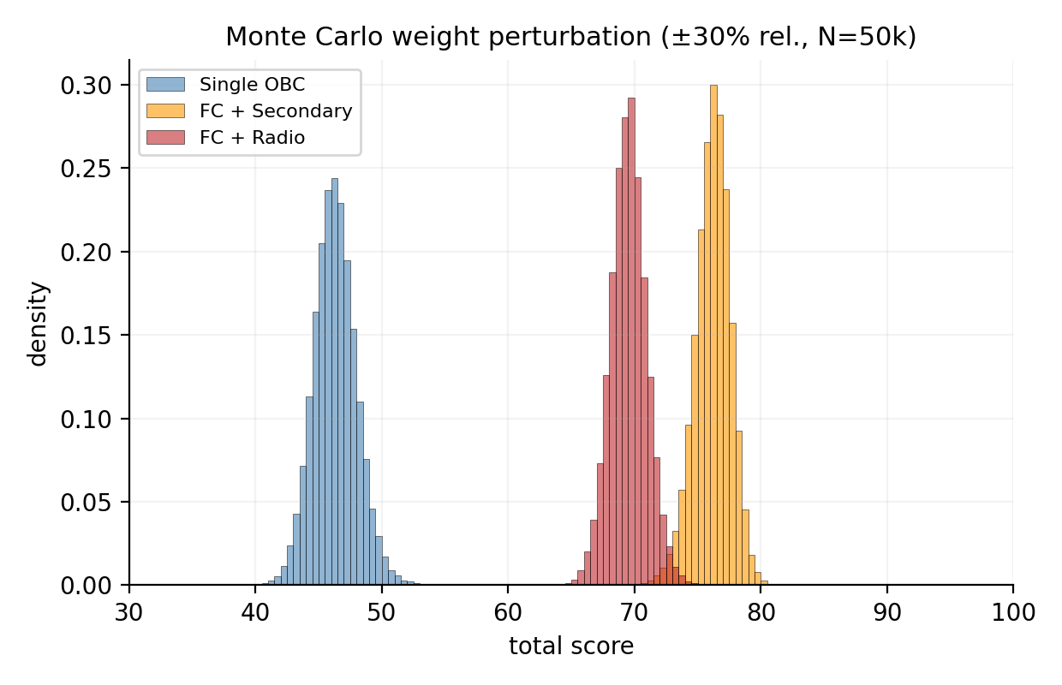
Trade Analysis - Computing Architecture
Trade Studies
Methods: Single Onboard Computer, FC + Secondary Computer, FC + Radio Only
Primary Criteria: Implementation Ease, Reaction Speed, Reliability
Implementation and reaction speed weighted highest to protect schedule and safety
FC + Secondary won 100% of Monte Carlo trials: COTS flight control that fails gracefully
Driving Requirement: UAS-4
Trade Studies
Propulsion
Power Systems
Airframe
GNC
85
Avionics
Notes:
So the other critical trade we ran was on our computing architecture. This was to evaluate the best option for us to distribute our compute load. We evaluated a single onboard computer, a flight controller with a secondary computer, and a flight controller with a radio that transmits sensor data to a ground station. When we're thinking about hardware, the most important criteria are ease of implementation, system reliability, and latency. Other factors to consider are weight and power requirements, however those are less significant since they're more relevant to optimizing our system rather than building a strong foundation.
Based on this criteria, we ran both sensitivity analysis and monte carlo trials to illustrate how each option performed under varying weights. As you can see from the charts on the right, both of the flight controller options clearly beat the single onboard computer, and although they appear close on those, the monte carlo chart on the left cements that the flight controller with a secondary computer is a step above the radio option.

Slide 86
Summary of Critical Trade Results
Trade Studies
High Level Computing Architecture
Criteria | Weight | Single On Board Computer Unit |  | Flight Controller + Secondary Computer On Board |  | Flight Controller and Radio Only
 | (Total = 100) | Value | Score (x/10) | Value | Score (x/10) | Value | Score (x/10)
Ability for Drone to React Quickly to Manual Override/Problems | 30 | Heavy processing on a general-purpose OS can preempt safety code, so real-time response isn't guaranteed. | 5 | A simple flight controller loop responds quickly, with only slight delays during long transactions. | 8 | Can be briefly unresponsive while sending data to the ground. | 8
Implementation Ease | 35 | Requires a custom flight control loop on a non-real-time OS, which has little documentation. | 4.5 | Buy a COTS flight controller and write the high-level software on the secondary computer. | 8.5 | A COTS controller must be modified to send data down for processing. | 6
Reliability | 25 | Single point of failure: one computer hang can crash the drone. | 3 | If the secondary computer fails, basic flight still works and the drone fails gracefully. | 7 | The radio link is the single point of failure, but losing it triggers graceful failsafe behavior. | 7
Weight and Power Draw (theoretical) | 10 | Lowest weight and power draw. | 8 | Heaviest option with the highest power draw. | 5 | Light and low power, but needs a higher-power radio. | 7
Max Score | 100 | 46.25 |  | 76.25 |  |  | 69.5
Trade Studies
Propulsion
Power Systems
Airframe
GNC
86
Avionics
Notes:
Now diving into the scoring and reasoning behind those charts. You can see that the flight controller with a secondary computer really wins on all fronts aside from weight and power. Having an onboard computer process the non-deterministic sensor data allows for the flight controller to operate independently which supports both the reliability of the system and the response time.
If for example, the onboard computer fails, the flight controller is still able to perform basic flight operations and can land safely. And in the case of manual override, we don't have heavy processing delays since our computing load is divided between the two computers, nor do we have to rely on radio transmission delay to a ground station. And even though having two computers demands the most weight and power, its well worth the strong foundation that this option provides for our architecture.

Slide 87
Path Forward
Trade Studies
PENDING ITEMS | PLANNED | REVISED | COMPLETED
Component Level Trades | Altimeter, Accelerometer, Camera, GPS Device, Flight Controller, Onboard Computer, OS
Modelling and Simulation | Flight controller sensor integration
Prototyping | Electronics layout in Avionics bay
Trade Studies
Propulsion
Power Systems
Airframe
GNC
87
Avionics
Notes:
Now with our trades complete for the system architecture, our plan is to dive into component level trades and modelling sensor integration so we're prepared when prototyping comes around the corner. Many of these component level trades are going to be in collaboration with other groups so we can conclude the best option for everyone's needs.

Slide 88
SECTION / PHASE
Current Design Space
88
Notes:
This section is intended to give a summary of our current best design choices
These items will be locked down in the time between now and DR-2 but they are currently still subject to change as we continue to develop solutions and work on interfacing

Slide 89


Current Design Space V-SYS
Current Design Space
Propulsion
Propeller Material: Carbon fiber reinforced nylon​
Motor Sizing/Power Draw: Motor specifications calculator developed in Microsoft Excel
Propeller Type: 7×3.8WSF​ (7 inch, 3.8 inch pitch, Wide Slow Flyer)
Airframe and Aerodynamics
Material Type​: Carbon Fiber Skin 3D Print or Al-6061
Shape & Configuration​: X-Shape Quad Rotor
Chassis: Egg Shape Chassis
7x3.8WSF Propeller:
X-Shape Design:
Power Systems
Battery Type: Li-Po Battery
PCB Voltage Separator Type:​ 3D- Printed PCB
Egg Shape Chassis:
Background
ConOps
Block Diagrams
Key Requirements
Trade Studies
Current Design Space
89
Moving Forward
Q & A

Slide 90
Current Design Space GNCC
Current Design Space
GNC
Control Laws: Cascaded PID (Inner & Outer loops)
Transient Responses: Underdamped
Sensor Fusion Algorithms:
Extended Kalman Filter (EKF) or Unscented Kalman Filter (UKF)
Input Types: direct thrust and RPM input
Waypoint guidance algorithm: Spline
Sensor Suite: GPS-RTK
Additionally anticipating: IMU, Altimeter, Visual sensor (most likely camera)
Avionics
Navigation Method: GNSS-RTK
Communication Protocol: Wi-Fi
Computing Architecture:
Flight controller + secondary flight computer
Anticipated pairing: Pixhawk 6C (controller), NVIDIA Jetson Nano (computer)
Manual Override Architecture:
Separate RF controller linked to the flight controller
Data Flow Architecture: Decoupled
flight controller can operate independently of onboard computer for basic operations
Background
ConOps
Block Diagrams
Key Requirements
Trade Studies
Current Design Space
90
Moving Forward
Q & A
Notes:
TBD with further modeling:
Sensor fusion algorithm
Specific controller + computer combination

Slide 91
Outstanding Decision Items
Current Design Space
Design Decision | Major Stakeholders
Power Draw and Distribution | Power Systems, Propulsion, Avionics, GNC,
Component Placement and Mass Allocation | Airframe and Aerodynamics, Avionics, Power Systems, Propulsions
Data Handling and Error Budget | Avionics, GNC
Manufacturing Cost and Timeline | Airframe and Aerodynamics, Propulsion, Power Systems
Vehicle Control Loops | GNC, Propulsion, Avionics
Background
ConOps
Block Diagrams
Key Requirements
Trade Studies
Current Design Space
91
Moving Forward
Q & A
Notes:
These design questions will drive our models going forward
How much power do we need, how do we make sure every component gets what it needs.
This is important to inform propulsion and dynamics models
See 4
These are both incredibly important for mission completion verifiability as we prepare to move into prototyping and testing
These will define how we are actually completing the main mission objective

Slide 92
ASEN 4018-013
Modeling and Prototyping Plan
92

Slide 93
Design Performance Models – UAS-VSYS
Model and Prototyping Plan
Models Used | Model Details | Sub-Team
Motor specifications calculator | Estimates motor specs and power from weight, T/W, RPM, and prop efficiency. | Propulsion
Mass/weight & energy/power sizing tool | Web tool (yahyarj.github.io/PROP/) bounding propulsion mass and power. | Propulsion
Propeller performance model | Compares props by T/W and hover power loading, blade counts by figure of merit. UIUC APC 2-blade data; 8 lb, 7-in props. | Propulsion
UIUC/APC data error analysis | Compares APC data to UIUC wind-tunnel data; final candidates need CFD or a thrust stand. | Propulsion
Energy Budget Model | Checks battery configuration against subsystem energy needs; FoS 1.5. | Power Systems
Motor and Propeller Sizing Models
Propeller Models
Battery Sizing
Model
Background
ConOps
Block Diagrams
Key Requirements
Trade Studies
Current Design Space
93
Moving Forward
Q & A

Slide 94
Design Performance Models – UAS-VSYS
Model and Prototyping Plan
Models Used | Model Details | Sub-Team
Chassis drag & volume/mass model | MATLAB bluff-body Cd, internal volume, and mass per shape at fixed dimensions. | Airframe and Aerodynamics
Chassis inertia estimate | Chassis inertia per shape from the initial design; input to vehicle dynamics. | Airframe and Aerodynamics
Preliminary frame CAD mass model | Frame mass/volume from initial CAD (fixed material, thickness, laser-cut). | Airframe and Aerodynamics
Rotor-arm cantilever deflection model | Hollow cantilever arm with tip thrust load; deflection vs. material, length, diameter. L = 150 mm, ID 70% of OD (trade sheet says 60%), rigid joint. | Airframe and Aerodynamics
Chassis bending-stress model | Chassis bending stress vs. yield strength. T/W 1.5, point loads, monobody frame. | Airframe and Aerodynamics
Lumped-capacitance thermal model | MATLAB estimate of avionics, battery, and cage temperatures per chassis material and shape. | Airframe and Aerodynamics
Volume
&
Mass Models
Moments
and
Thermal Models
Background
ConOps
Block Diagrams
Key Requirements
Trade Studies
Current Design Space
94
Moving Forward
Q & A

Slide 95
Design Performance Models – UAS-GNCC
Model and Prototyping Plan
Models Used | Model Details | Sub-Team
Nonlinear 6-DOF EOM & SLUF/hover model | 12 variable-state linearized EOM Model about hover to gain control laws, and plan to simulate UAS dynamics. | GNC
Disturbance-response simulations (control laws) | Response to a ±0.1 rad/s pitch-rate disturbance for PD, CPID/PD, CPID. PD is noisy; CPID/PD Z-velocity doesn't return to trim (no inner-loop integral). | GNC
Waypoint navigation noise model | 2-D sim comparing direct vs. PCHIP-spline paths under identical sensor noise; outputs cross-track/endpoint error, path length, time. 5×5 m AOI, 2 m altitude, 0.4 m/s, 5 Hz sensor with 0.11 m error. | GNC
Simulink mission model initialization | Simulink GNC sim setup: 100 Hz, 3-D NED box mission, first-order vehicle lag, GPS noise. Placeholder mission (5 m alt, 2 m/s) exceeds the 2 m / 0.5 m/s limits. | GNC
Monte Carlo trade-robustness simulation | FC + secondary, Ubuntu, decoupled: 100%; separate radio: 99% | Avionics
Dynamics and
Control
Guidance and
Navigation
Avionics
Background
ConOps
Block Diagrams
Key Requirements
Trade Studies
Current Design Space
95
Moving Forward
Q & A

Slide 96


Key Model 1 - Mass/weight & energy/power sizing tool
Model and Prototyping Plan
Why is this Model Necessary?
Needed a preliminary model to determine thrust capabilities based on preliminary mass
Furthermore, needed a model to determine minimum PWR required to sustain endurance requirement
What requirements does this model verify?
15 min endurance requirement
50x50 cm vehicle footprint
GNC selected Thrust to Weight ratio
Critical Assumptions
Boulder atmospheric density
APC RPM FOS of 1.5
80% motor + ESC + wiring efficiency
Vehicle drag neglected
Propulsion power only, avionics excluded
Background
ConOps
Block Diagrams
Key Requirements
Trade Studies
Current Design Space
96
Moving Forward
Q & A

Slide 97


Key Model 2 - 6-DOF EOM hover model
Model and Prototyping Plan
Why?
Necessary for state evaluation & controls modeling using MATLAB/Simulink for SIL modeling and Python/C++ for integration.
Directly verifies UAS-14/15 requirements:
The UAS shall maneuver at an altitude no greater than 2 m.
The UAS shall maneuver at a speed no greater than 0.5 m/s
Sets up UAS-GNCC-8/9 requirements:
Closed loop control law
Disturbance responses requirements
Assumptions:
Simple Aerodynamic model
EOMs evaluated near trim
6-DOF EOM Equations:
Hoffmann, G. M., Huang, H., Waslander, S. L., and Tomlin, C. J. (2007). Quadrotor Helicopter Flight Dynamics and Control: Theory and Experiment. In AIAA Guidance, Navigation, and Control Conference and Exhibit (AIAA Paper 2007-6461). Hilton Head, South Carolina.
https://ai.stanford.edu/~gabeh/papers/Quadrotor_Dynamics_GNC07.pdf
Background
ConOps
Block Diagrams
Key Requirements
Trade Studies
Current Design Space
97
Moving Forward
Q & A

Slide 98
Prototyping Plans
Model and Prototyping Plan
Planned Item | Details | Sub-Team
SITL Model | Runs flight software against simulated dynamics model Verify the 2 m altitude / 0.5 m/s limits | GNC
Electronics Layout in Avionics Bay | Place FCU, onboard computer, sensors, camera, GPS/RTK antenna, and PCB in the Avionics Bay | Avionics
Airframe and Propeller CFD | Fluid Dynamics model to measure and verify thrust, drag, and rotor downwash | Airframe & Propulsion
Voltage Separation PCB Prototype | Build the power-distribution board on perfboard/breadboard from the PCB design | Power Systems
Propeller Arm Prototype & Static Load Test | Model and prototype the propeller arm; Static load test based on T/W ratio | Airframe
Background
ConOps
Block Diagrams
Key Requirements
Trade Studies
Current Design Space
98
Moving Forward
Q & A

Slide 99



Project Schedule
Model and Prototyping Plan
Background
ConOps
Block Diagrams
Key Requirements
Trade Studies
Current Design Space
99
Moving Forward
Q & A

Slide 100
ASEN 4018-013
Questions?
Background
ConOps
Block Diagrams
Key Requirements
Trade Studies
Current Design Space
100
Moving Forward
Q & A

Slide 101
ASEN 4018-013
Backup Slides (GNC)
Notes:
SECTION DIVIDER — duplicate for each major section. Replace the kicker, title, and one-line description.

Slide 102



PD Control Modeling, and Analysis
Trade Studies
PD open-loop control law modeling for a +0.1 rad/s singular pitch rate disturbance
Linear response in blue
Non-linear response in magenta
Notable Results:
  High fluctuations
  High noise
  Does return to trim state
Notes:
STANDARD CONTENT — the default working slide. Replace the title, bullets, and visual box. Drop the visual box and widen the text if you don't need an image.

Slide 103
LQR why?
Trade Studies
How it works?
Linearized 6-DOF quadrotor EOMs around a trim state operating point.
Computes and optimizes full state feedback gain matrix K by minimizing error and control effort.
multi-variable control by calculating thrust and body torques in one loop.
Questions
Answers
Why would it be better to use an LQR over something like a CPID?
What is the benefit of the LQR?
What would the implementation look like for the LQR?
An LAQR tunes its gains on the go giving better responses to perturbations in our state.
The benefit of using an LQR is that it would go easier in implementation of our code, it goes well with things like a EKF, it also just works better than a CPID.
The implementation of an LQR would be very nice, we are assuming that we are going to want to build an EKF and then we could have a LQG be our state estimator.
https://www.researchgate.net/figure/Block-diagram-of-an-LQR-controller_fig1_379427756
5
Notes:
TWO-COLUMN — for comparisons, pros/cons, or UAS-vs-Rover splits. Recolor the accent tick to EVE blue (UAS) or amber (Rover).

Slide 104




Controls Design Matrix Scores Rationale
Trade Studies
Bouabdallah et al. (2004)
Mission Completion Reliability (35%)
Major Disturbance Handling (20%)​
Hoffmann et al. (2007)
Computational Efficiency (15%)
Implementation Efficiency (10%)
Argentim et al. (2013)
Minor Disturbance Handling (10%)
Castillo et al. (2005)
Mathematical Reliability & Model Uncertainty (10%)
CPID (4/4): Inner rate loop isolates wind gusts and downwash turbulence before position drift accumulates.
LQR (3/4): Multi-variable control stabilizes hover. Ttracking degrades when disturbances push the drone past linear bounds.
PD/PID (1–2/4): Single-loop architectures saturate under heavy turbulence, leading to high steady-state error and mission failure.
Out PID / In PD (4/4 Computation): Executes with O(1) algorithmic complexity, minimizing microcontroller CPU load.
CPID (4/4 Implementation): Max control performance per tuning step; integrates directly into PX4/ArduPilot.
LQR (2/4 Implementation): Requires continuous u = -Kx matrix math and full-state observers, raises software deployment friction.
LQR (4/4): Optimizes Q/R cost functions across all 6 axes simultaneously for near-hover trim adjustment.
CPID (3/4): Decoupled axis loops manage minor perturbations effectively, lacks global multi-axis energy optimization.
PD/PID (1–2/4): Un-cascaded loops exhibit small oscillations and slow convergence during micro-draft trim corrections.
CPID (4/4): Model-independent integral feedback (K_i) actively absorbs mass shifts and ground cushions without re-tuning.
LQR (2/4): Strictly depends on xdot = Ax + Bu. Gain margins collapse if airframe inertia deviates by > +/- 10%.
PD (1/4): Lacks integral action, making it mathematically incapable of eliminating steady-state offset errors.
Notes:
STANDARD CONTENT — the default working slide. Replace the title, bullets, and visual box. Drop the visual box and widen the text if you don't need an image.

Slide 105

Control Laws Weight Sensitivity Analyses
Trade Studies
Notes:
STANDARD CONTENT — the default working slide. Replace the title, bullets, and visual box. Drop the visual box and widen the text if you don't need an image.

Slide 106

Input Method Design Matrix
Trade Studies
Notes:
STANDARD CONTENT — the default working slide. Replace the title, bullets, and visual box. Drop the visual box and widen the text if you don't need an image.

Slide 107

Sensor Fusion Algorithm Design Matrix
Trade Studies
Notes:
STANDARD CONTENT — the default working slide. Replace the title, bullets, and visual box. Drop the visual box and widen the text if you don't need an image.

Slide 108

Transient Response Design Matrix
Trade Studies
Notes:
STANDARD CONTENT — the default working slide. Replace the title, bullets, and visual box. Drop the visual box and widen the text if you don't need an image.

Slide 109
ASEN 4018-013
Backup Slides (Avionics)
Notes:
SECTION DIVIDER — duplicate for each major section. Replace the kicker, title, and one-line description.

Slide 110


Trade Analysis - Operating System
Trade Studies
Methods: Ubuntu, Debian (Raspberry Pi), Yocto (Pixhawk)
Primary Criteria: Integration Ease, Real-time Performance, Compute Usage
Integration weighted highest since ROS 2 and library support drive development time
Ubuntu led in integration, latency, and compute; won 100% of Monte Carlo trials

Slide 111
Summary of Critical Trade Results
Trade Studies
Operating System
Criteria | Weight | Ubuntu |  | Debian (Raspberry Pi) |  | Yocto (Pixhawk)
 | (Total = 100) | Value | Score (x/10) | Value | Score (x/10) | Value | Score (x/10)
Integration Ease / Compatibility | 30 | Native ROS 2 support with prebuilt packages. | 10 | ARM builds often need compiling from source. | 6 | Packages must be added via custom layers. | 4
Real-time Performance/System Latency | 20 | Fast hardware, optional real-time kernel. | 10 | Decent latency, limited by the Pi's CPU. | 8 | Competes with the flight stack for resources. | 4
Compute Usage | 20 | Plenty of CPU/RAM headroom. | 10 | Moderate headroom, lightweight OS. | 8 | Flight control uses most resources. | 2
Hardware Support | 20 | Needs extra interfaces or drivers for sensors. | 6 | GPIO and camera support, but peripherals need HATs or USB. | 6 | Built for the board, with direct sensor access. | 10
Development Ease | 10 | Off-board setup requires a telemetry link and networking. | 4 | Large community, easy to develop on the device over SSH. | 8 | Vendor image and tools target the hardware directly. | 10
Max Score | 100 | 86 |  | 70 |  | 54
4
Notes:
STANDARD CONTENT — the default working slide. Replace the title, bullets, and visual box. Drop the visual box and widen the text if you don't need an image.
IWeights: 30,40,15,15

Slide 112


Trade Analysis - Data Flow Methods
Trade Studies
Methods: Decoupled, Centralized
Primary Criteria: Manual Override Ability, Bandwidth
Override and bandwidth weighted highest since the FC must stay in control if the OC fails
Decoupled won 100% of Monte Carlo trials: independent FC, lower latency, simpler wiring

Slide 113
Summary of Critical Trade Results
Trade Studies
Data Flow Methods
Criteria | Weight | Decoupled |  | Centralized
 | (Total = 100) | Value | Score (x/10) | Value | Score (x/10)
Manual Override Ability | 25 | Flight controller can operate independently even if our OC fails | 10 | Flight control depends on OC; OC failure blocks override | 4
Bandwidth | 25 | Offloads OC by distributing data | 8 | Introduces saturation risks from putting all data through OC | 6
Sensor Latency | 20 | Deterministic sensors go straight to FC for quicker latency | 10 | Data must unnecessarily pass through OC | 8
Architecture Complexity | 15 | Clear seperation of duties | 10 | Passing everything through OC adds redundancy | 4
Cabling Complexity | 15 | Minimizes wires travelling between FC and OC | 8 | More unnecessary cabling | 4
Max Score | 100 | 92 |  | 53
4
Notes:
STANDARD CONTENT — the default working slide. Replace the title, bullets, and visual box. Drop the visual box and widen the text if you don't need an image.
IWeights: 30,40,15,15

Slide 114


Trade Analysis - Manual Override / RC Failsafe
Trade Studies
Methods: Separate Radio, Wi-Fi Controller, GCS Software Interrupt
Primary Criteria: Reliability, Latency
Reliability weighted highest since override must work when other links fail
Separate radio won 99% of Monte Carlo trials: independent link, lowest latency, hardware failsafe

Slide 115
Summary of Critical Trade Results
Trade Studies
Manual Override / RC Failsafe Support
Criteria | Weight | Separate radio |  | WIFI controller |  | GCS software interrupt
 | (Total = 100) | Value | Score (x/10) | Value | Score (x/10) | Value | Score (x/10)
Latency/ responsiveness | 15 | Direct link with very low latency. | 10 | Latency changes with network traffic. | 6 | Low latency, passes through GCS software and telemetry. | 8
Reliability/ | 35 | Its own dedicated link, with failsafe built into the flight controller hardware. | 10 | Shares the Wi-Fi link, so it can drop out from interference or congestion. | 4 | Depends on telemetry link and the GCS software staying up. | 6
Integration Ease / Compatability | 15 | Needs receiver wiring and channel mapping. | 6 | Runs over the existing Wi-Fi network. | 8 | Already built into QGC and Mission Planner. | 10
Ease of Implementation | 15 | Needs binding, calibration and failsafe setup. | 4 | Needs a custom bridge to turn controller input into MAVLink commands. | 6 | Mostly configuration, little new code. | 8
Operator ergonomics | 10 | Dedicated transmitter with a learning curve. | 6 | Familiar gamepad controls. | 10 | One click from the GCS screen. | 10
Size, weight, power | 10 | Receiver is small and light and draws little power. | 10 | Uses the onboard Wi-Fi module, with a small power cost. | 8 | Needs a laptop or ground station running the whole time. | 4
Max Score | 100 | 81 |  | 62 |  | 74
4
Notes:
STANDARD CONTENT — the default working slide. Replace the title, bullets, and visual box. Drop the visual box and widen the text if you don't need an image.
IWeights: 30,40,15,15

Slide 116
Optional Two-Column (add more if needed)/ Comparison Slide of Various Trades
TEMPLATE
Option A / Left
Option B / Right
First point for this column.
Second point.
Third point.
First point for this column.
Second point.
Third point.
5
Notes:
TWO-COLUMN — for comparisons, pros/cons, or UAS-vs-Rover splits. Recolor the accent tick to EVE blue (UAS) or amber (Rover).

Slide 117



Manual override method
Trade Studies
Risk | Likelihood | Mitigation
ExpressLRS and WiFi radios both default to 2.4 GHz and can interfere with each other onboard the same airframe | Medium | Run the WiFi comms network on 5 GHz, or select the ExpressLRS 900 MHz variant, to put the two links in separate bands
Receiver wiring/mounting takes longer than planned | Low-Medium | COTS receivers use standard CRSF/SBUS connectors; budget 1-2 lab sessions for mounting, binding, and failsafe configuration
Parts backordered close to a deadline | Low | COTS hobby-RC parts (below) are stocked by multiple US retailers with 3-5 business day shipping; order early in the semester regardless
Interrupt input is mapped to the wrong flight mode/channel during testing | Low | Bench-test the override on the ground (props off) before any flight test, per standard RC-failsafe practice
4
Notes:
STANDARD CONTENT — the default working slide. Replace the title, bullets, and visual box. Drop the visual box and widen the text if you don't need an image.

Slide 118
ASEN 4018-013
Backup Slides (Propulsion)
Notes:
SECTION DIVIDER — duplicate for each major section. Replace the kicker, title, and one-line description.

Slide 119


# Rotors(moot because already decided quad-X)
Trade Studies
4
Notes:
STANDARD CONTENT — the default working slide. Replace the title, bullets, and visual box. Drop the visual box and widen the text if you don't need an image.

Slide 120


Propeller Diameter
Trade Studies
• information to be provided to the structures to justify why allocating us the maximum diameter for our propellers is beneficial for the entire UAS performance
4
Notes:
STANDARD CONTENT — the default working slide. Replace the title, bullets, and visual box. Drop the visual box and widen the text if you don't need an image.

Slide 121


Propeller Geometry – Chord and Twist/Pitch
Trade Studies
• at a given mass, diameter, TWR, endurance, optimized geometry:
4
Notes:
STANDARD CONTENT — the default working slide. Replace the title, bullets, and visual box. Drop the visual box and widen the text if you don't need an image.

Slide 122

Battery voltage and Motor Kv
Trade Studies
• required motor Kvs depending upon what PWR chooses for battery
4
Notes:
STANDARD CONTENT — the default working slide. Replace the title, bullets, and visual box. Drop the visual box and widen the text if you don't need an image.

Slide 123

UIUC and APC
Trade Studies
• run separate error analysis on entire families of APC performance data provided and validated against wind tunnel experimental data provided by UIUC who also validated their own testing method against Ohio State
4
Notes:
STANDARD CONTENT — the default working slide. Replace the title, bullets, and visual box. Drop the visual box and widen the text if you don't need an image.

Slide 124
Why CFD and maybe thrust test stand is needed?
Trade Studies
• different models and experimental datasets give wildly different predictions for thrust and power coefficients
Good for narrowing down design space but few final propeller candidates must be validated with CFD and maybe a thrust test stand
4
Notes:
STANDARD CONTENT — the default working slide. Replace the title, bullets, and visual box. Drop the visual box and widen the text if you don't need an image.

Slide 125

Why the disparity?
Trade Studies
• each radial section of the propeller blade, because it's twisted(and it must be twisted since each section rotating at different speeds), has a different angle of attack and is operating in different reynolds number regimes and most propellers use different airfoils along the radius
4
Notes:
STANDARD CONTENT — the default working slide. Replace the title, bullets, and visual box. Drop the visual box and widen the text if you don't need an image.

Slide 126
SECTION / PHASE
Backup Slides (Airframe and Aero)
Notes:
SECTION DIVIDER — duplicate for each major section. Replace the kicker, title, and one-line description.

Slide 127


Body Form Trade Study: Modeling and Analysis
Trade Studies
Screening Trade: Mass is the primary discriminating metric at this stage.
Objectives:
Evaluate frame geometry using initial CAD mass estimates under fixed envelope and material assumptions.
Controlled Variables:
Material, Thickness, Size
Motor size, Location
Mounting Requirements
Manufacturing Method (Laser Cutting)
Evaluation Criteria:
Preliminary CAD mass
Anticipated stress concentrations
Simplicity of fabrication
Results: X-shape is lighter by 30.6%.
Recommend proceeding with X-Shape as a working baseline, revisit for weight reduction and strengthening.
4
Notes:
STANDARD CONTENT — the default working slide. Replace the title, bullets, and visual box. Drop the visual box and widen the text if you don't need an image.

Slide 128





Slide 129


Slide 130


Slide 131


Slide 132


Slide 133


Slide 134


Slide 135


Slide 136


Slide 137


Slide 138


Slide 139


Slide 140


Slide 141


Slide 142


Slide 143


Slide 144


Slide 145


Slide 146


Slide 147


Slide 148


Slide 149


Slide 150


Slide 151


Slide 152


Slide 153


Slide 154


