Slide 1
Information in CCO
UB 25 April 2024

Slide 2
Where are we?
Many definitions for IBAs claim to be about something
Confusion about IBAs and IBEs
Many users balk at finding terms under IBA rather than ICE
CCO doesn’t make its “theory” of information clear
What is criteria for differentiating?
Where does line get drawn between generic and specific?

Slide 3
Research
Summary of issues: https://github.com/CommonCoreOntology/CommonCoreOntologies/issues/191
Also here: https://opensource.ieee.org/cyber-ontology-working-group/cyber-ontology-releases/-/issues/2

Slide 4
Generally
CCO adopted a view that specializing ICEs is done via “how” they are about something.
Primary or intended meaning vs usage
A zip code designates even though it can be used prescriptively to sort mail
ANYTHING that relates to formatting or language or units is specific to the carrier (bearer)

Slide 5
Is it a new ICE?
Font
Spacing
Color
Langauge
Measurement Units

Slide 6

Is it a new ICE?
Font
Spacing
Color
Langauge
Measurement Units

Slide 7
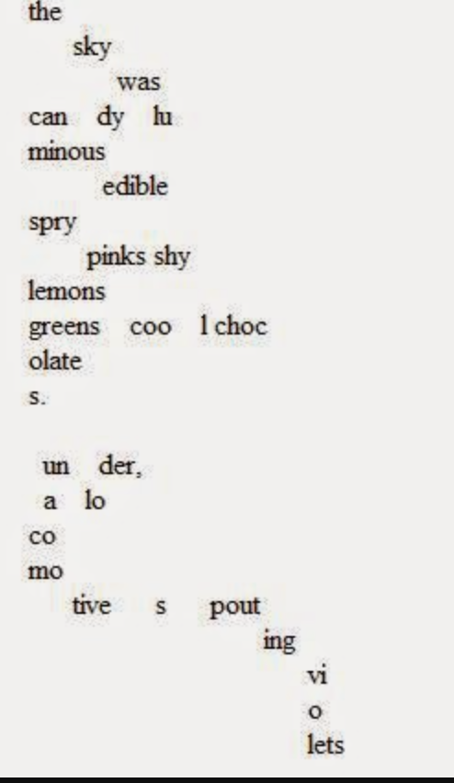
Tone, Timbre, Pacing, …

Slide 8
Same ICE?
Mark, Mark Jensen, Mark P Jensen, Mark Putnam Jensen
Jark Mensen
123-45-6789
February 3 vs 34th day of the year

Slide 9
Partitioning the ICE space
BFO does not enforce a way to discriminate GDC/ICEs
You could create ICEs base on format and color and font and units
All of that is repeatable sharable spreadable “content”

Slide 10
Good News
We don’t have to answer these questions today!

Slide 11
Where are we?
Many definitions for IBAs claim to be about something
Confusion about IBAs and IBEs
Many users balk at finding terms under IBA rather than ICE
CCO doesn’t make its “theory” of information clear
What is criteria for differentiating?
Where does line get drawn between generic and specific?

Slide 12
Proposal from RR
Change the definitions for the four main ICE subtypes.
Make IBA a subtype of IBE.
Introduce subtypes of ICE that are defined according to characteristics of their carrier.
Adopt some of the IAO classes for subtypes of ICE via import, but some will of the definitions will need improvement.
Relabel all of the subtypes of IBA to include ‘copy’. E.g., ‘Document Copy’.

Slide 13
Today
It has been agreed there needs to be ICE counterparts to most of the IBAs
TASK: mint new IRIs and define accordingly
Align with IAO?
NEXT: Do we keep all the IBAs and refactor def.s and labels?
Or deprecate most and let users decide
Would most be equivalencies?

Slide 14
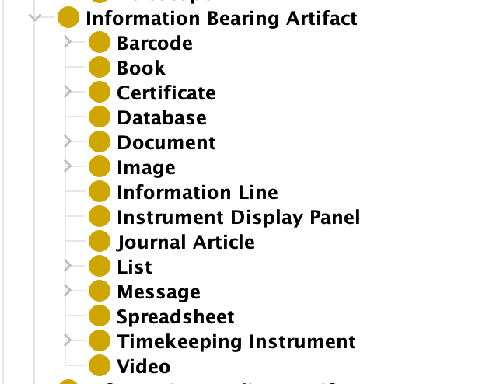
Currently

Slide 15
First steps
=
Create ICE & potentially deprecate

