Slide 1
Reworking CCO’s Information Bearing Entities
Alan Ruttenberg
March 25, 2024

Slide 2
The basics of what we have now
Information content – what’s the same across copies (ICE)
A particular copy (some IBA, IBE)
Kinds of things that are true across copies
Author
Aboutness
Commentary
Consequences
Kinds of things that are true of a particular copy
The material or process
How the material or process carries a copy (the pattern)
In the middle
Possession, ownership (can own physical copy or digital copy of book)
Deontic powers (some certificates are digital, some are particulars, like passport)

Slide 3
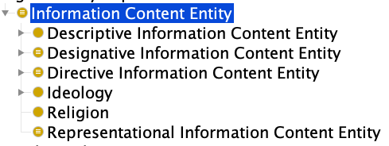
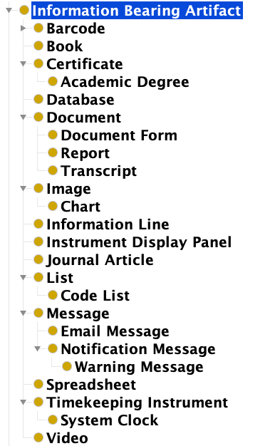
The problem with IBAs
Exceptions: Timekeeping instrument, Display Panel
History: CCO developers wanted to distinguish categories of information entities that weren’t specifically one of the 4 main ICE categories
A document could be prescriptive or directive or some combination of any of the four categories
The problem is that in most of these cases we want to represent what was common to the instances – the ICE
Note: In some cases we do want to represent these, for instance if we want to describe the contents of a box

Slide 4
Document
OBO IAO: A collection of information content entities intended to be understood together as a whole
CCO: An Information Bearing Artifact that is designed to bear some specific Information Content Entity in a series of paragraphs of text or diagrams in the form of physical pieces of paper or an electronic word processor file.
Fundamentally different
CCO document is a particular. The copy of this presentation on my machine is a different document that the copy on your machine
IAO document is defined by intent
An instance of CCO document is the bearer of a concretization of an IAO document
Both exist, what differs is the sort of statements one makes
The author and subject of an IAO document is of all the copies
The author of a CCO document is author only of the particular
In current CCO, how do we record the author of War and Peace. Not by using the current term Book

Slide 5
A stepwise solution
Understand that a collection of information content entities is an information content entity (aboutness is not singular)
Such a collection may sometimes be any of the 4 categories, or some combination of them
Define information content entity counterparts for some or all these classes, placed under Information Content Entity
Document -> Document content
Book -> Book content
Adjust definitions to make clear the difference
Possibly deprecate some or all the IBA terms

Slide 6
Definitions
Document content: Use IAO definition
All other IBA “content” subclasses other than Timekeeping instrument, Instrument display panel, database, and Image are subclass of document content [Possibly not Spreadsheet, List]
Current differentia
Publishing mode “as part of a Journal Issue” (Journal article)
Intent “rapidly searchable and retrievable.” (Database)
Audience “to be transmitted from a sender to a recipient.” (Message)
Deontic power “attests to certain demonstrated characteristics of an Object, Person, or Organization.” (certificate)
Structure (*) ”tabular form” (spreadsheet)

Slide 7
Image
Image: An Information Bearing Artifact that is designed to bear some specific Information Content Entity that represents some entity.
Also satisfies this definition: Any bearer of a representational information content entity, examples of which include phonograph records.
Image content: An information content entity that is intended to be concretized in such a way as to take advantage of visual perception capabilities that go beyond reading text
Add subclasses: Photograph, Diagram

Slide 8
Chart
An Image that is designed to represent an Information Content Entity by means of Written Symbols in order to convey that information in a readily understandable format.
Written symbols?
Readily understandable?
Also satisfy this definition: Checklist, Diagram
Chart content: An Image content that is designed to represent amounts or comparisons using lines and shapes that mirror differences in amount by differences in height, area, texture, or color

Slide 9
Database
An Information Bearing Artifact that is designed to bear some set of specific Information Content Entities and to be rapidly searchable and retrievable.
Also satisfy this definition: A list, hashtable, tree, book with a TOC or index, pictorial menu, spreadsheet,
Database content: A collection of information content entities access to which is by keyword, identifier, or structured query, such access designed to and intended to be fast relative to finding entities by examining each member of the collection in turn.

Slide 10
Barcode
An Information Bearing Artifact that consist of machine-readable symbols.
Also satisfy this definition: These days, any written material.
Barcode content: An information content entity consisting of one or more designative or directive content entities represented as a series of glyphs encoded as patterns consisting of rectangles and spaces of a small set of characteristic sizes, with the intention of being visually compact and able to be reliably decoded from image content

Slide 11
Easier: Certificate
An Information Bearing Artifact that bears an Information Content Entity which attests to certain demonstrated characteristics of an Object, Person, or Organization.
Certificate content: An Information Content Entity which attests to certain demonstrated characteristics of an Object, Person, or Organization.

Slide 12
Transcript
A Document that is designed to bear some specific Information Content Entity that was originally recorded in a different medium.
Also satisfies this definition: A digitized film photograph, A picture book version of a story book.
Question: What’s a non-specific information content entity?
Transcript content: An information content entity that is a textual representation of what was initially spoken
Does not include college transcript – that’s a different sort of thing
I include sign language as a kind of speech

Slide 13
Message
An Information Bearing Artifact that is designed to bear some specific Information Content Entity that is relatively brief and to be transmitted from a sender to a recipient.
Message content: an information content entity that is addressed to and intended to be received by one or more designated recipients
Regarding relatively brief: TL;DR. ‘nuff said.

Slide 14
Video
An Information Bearing Artifact that is designed to bear some specific Information Content Entity in the form of a sequence of representations that are presented sufficiently rapidly to create the appearance of motion and continuity.
Video content: An information content consisting of a sequence of images contents that are presented sufficiently rapidly to create the appearance of motion (counter video of nothing happening, slides)

Slide 15
And then
Redefine the original IBA terms as artifacts that carry the corresponding content.
Document: Carrier of some document content
Journal article: Carrier of some journal article content

Slide 16
Additional issues
Can we separate structure from content
Bar code structure: visual stripes encoding digits that are partitioned into groups being different descriptions, designators, or directives
Does encoding (pattern of stripes on a bar code, choice of character set for encoding numbers) fall under structure?
“Yes and No”: Can we enhance ICE ontology to distinguish a version of a document as individual ICE, vs a document that changes (e.g. as edited) which at some time concretizes the version.
Shared concretizations
How to draw a circle around a set of concretizations

Slide 17
Types of structures
Encoding
Content something bound to the encoding. If you were to encode it would have more randomness than the structure.

