Slide 1
DeepLearn
Defines Deep Learning class and learning functions
Outputs File for Behavior
Runs Simulation and Collects Data
Trains model
Reinforce
Enumerates the state space, action space, and defines the reward function.
Takes user Command line input
Loads, Trains, and Executes Models by Calling DeepLearn
Table.csv
BHV Input
Simulation and Data Processing

Slide 2
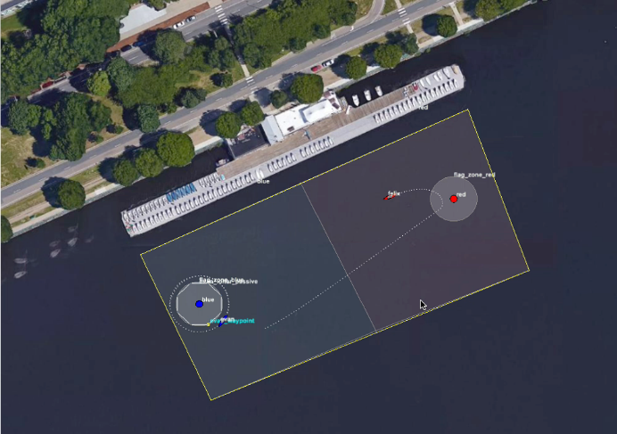
Tester
Runs simulation by calling Launch Reinforce
Extracts data from Simulation
Puts data into folder
Launch Reinforce
Launches the simulation with a robot named “Felix” exhibiting the learned behavior
Log Converter
Converts the data extracted by Tester into a format usable by the learning algorithms
Data Folder

Slide 3
…
…
State Vector Input
Action 1 Q value
...
...
...
…
…
…
…
Action 1 Q Value
…
…
State Vector Input
...
...
...
State Vector Input
Action 2 Q value
…
Action 2 Q Value
...
...
...
…
…
…

Slide 4
