Slide 1
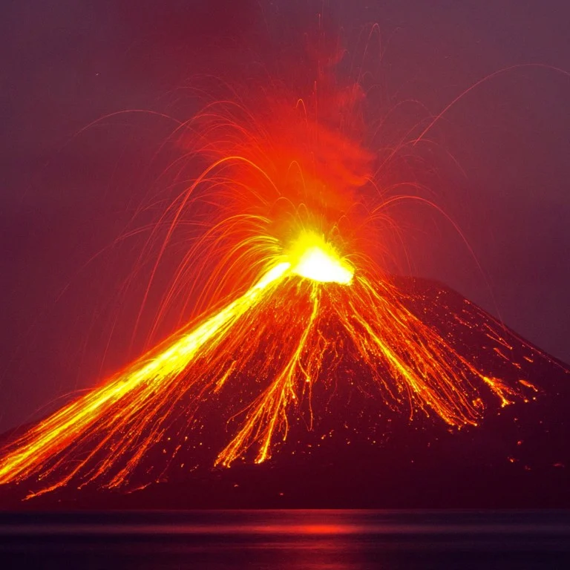


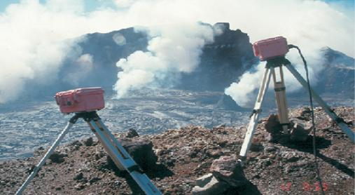
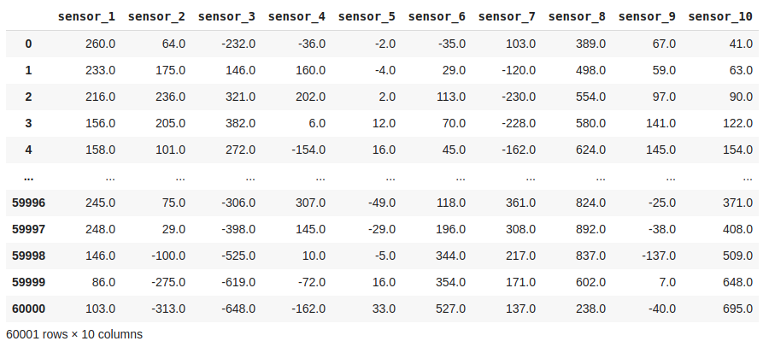
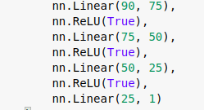
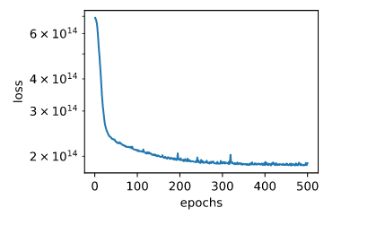
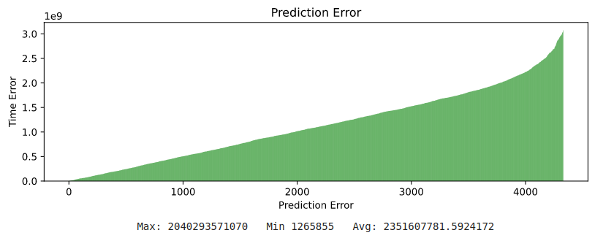
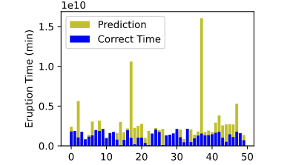
INGV – Volcanic Eruption Prediction
CS 5665
Carter Figgins
Undergraduate Student at Computer Science Dept., Utah State University
Your Photo
Problem
Data/Task
Source Code
The task is to predict volcanic eruptions from 10 sensor’s data that are setup around a volcano. The table below is the 10 sensor’s data for one volcano.
Colab: File
Github: Repository
Company Logo
Scientists are monitoring volcanoes with sensors to find if they are close to eruption. They do this by surveying volcanic tremors from seismic signals. The problem is that the patterns from the seismic signals are difficult to interpret. Scientists’ current approach helps predict eruptions in a short time period but fails at long time periods.
Analysis
Model for Neural Network
Figures that illustrate the problem and
solutions. Pick figures that show the reader
the big picture. Remember people may only
spend a few minutes on the poster.
What is the take away message about what
you did?
Results
Loss Converging
Approach
Prediction Error = |Correct Time - Prediction|
Max: 2040293571070 Min: 1265855 Avg: 2351607781
Steps I took for Project
1. Download data
2. Create More Features
3. Create Neural Network
4. Train Neural Network
5. Review Results
6. Predict Eruption Times
There are only 10 sensors for a volcano which is only 10 inputs to the neural network. To be able to get more features for the neural network, more information was created from the 10 inputs: sum, standard deviation, variation, etc., to reach 90 features to feed into the neural network.
Conclusions
The neural network was able to learn how to predict a time, but seemed to guess higher and some predictions were way off.
Kaggle Score: 12370277
Kaggle Position: 326
Neural network would usually guess high
References
- Kaggle: Eruption Prediction
Notes:
<number>

