Slide 1
Spring CORE
Andy Chen

Slide 2
Content
IOC container
ApplicationContext(.xml)
Spring Bean and Dependency Injection
XML vs Annotation
AOP

Slide 3
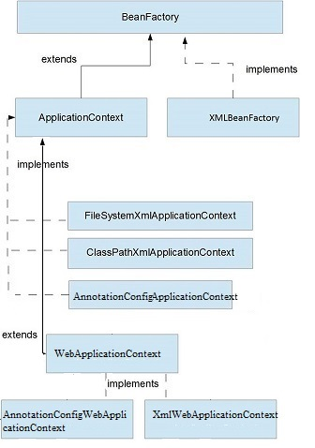
IoC Container (Inversion of Control)
Question: ApplicationContext vs BeanFactory
Bean Factory
Bean instantiation/wiring
Application Context
Bean instantiation/wiring
Automatic BeanPostProcessor registration
Automatic BeanFactoryPostProcessor registration
Convenient MessageSource access (for i18n)
ApplicationEvent publication

Slide 4
ApplicationContext vs BeanFactory
Example – How to Use
ApplicationContext ctx = new ClassPathXmlApplicationContext(“beans.xml”)
HelloBean hello = (HelloBean) ctx.getBean(“hello”);
hello.sayHello(“John”)
BeanFactory factory = new XmlBeanFactory(new ClassPathResource(“beans.xml”)
HelloBean hello = (HelloBean) factory.getBean(“hello”)
hello.getMessage();
Question: Difference between ApplicationContext.xml and Spring-servlet.xml?
Notes:
ApplicationContext.xml is not needed after Spring 4
ApplicationContext.xml configure beans for entire application while Spring-Servlet.xml configure beans for particular servlet
Spring-Servlet.xml can access ApplicationContext.xml beans but not the other way
Spring-Servlet.xml is for MVC and you can have multiple dispatcher servlet.. Just configure different URL-PATTERN for them
ApplicationContext.xml usually manages datasource and dao beans

Slide 5
XML Example: applicationContext.xml
https://gist.github.com/bigme666/5210042

Slide 6
Bean – a Spring managed Java Class
<bean id="serviceLocator“
name=“myServiceLocatorBean”
class="examples.DefaultServiceLocator">
<!-- inject any dependencies required by this locator bean -->
</bean>
<alias name=“serviceLocator” alias=“serviceLocatorAlias”> </alias>
@Configuration
public class ServiceLocatorConfiguration {
@Bean
public ServiceLocator serviceLocator() { ... }
// ...
}
Lecture Plan: from XML to annotation

Slide 7
XML: Dependency Injection
Constructor-based
public class ExampleBean {
private int years;
private String ultimateAnswer;
private MyBean myBean;
private String anotherAnswer
public ExampleBean(
int years,
String ultimateAnswer,
MyBean myBean,
String anotherAnswer
) {
this.years = years;
this.ultimateAnswer = ultimateAnswer;
//this…
}
}
<beans>
<bean id=“exampleBean" class="x.y.ExampleBean">
<constructor-arg type=“int” value=“100"/>
<constructor-arg type=“java.lang.String” ref=“ultimateAnswer"/>
<constructor-arg ref=“myBean"/>
<constructor-arg index=“3” value=“200"/>
</bean>
<bean id=“myBean" class="x.y.MyBean"/>
</beans>
Notes:
2 & 3 are dependency injection – 1 &4 are just properties

Slide 8
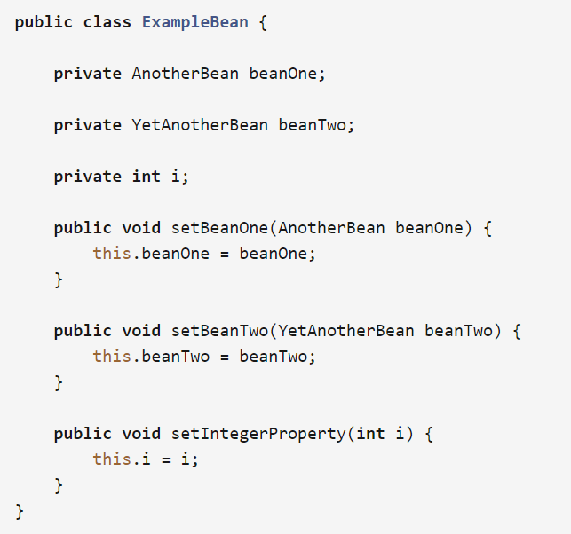
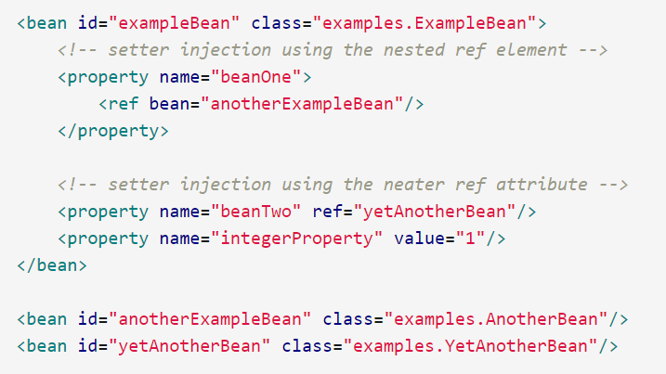
XML: Dependency Injection
Setter-based
Notes:
Property + ref ➔ injection; Property + value → Property

Slide 9
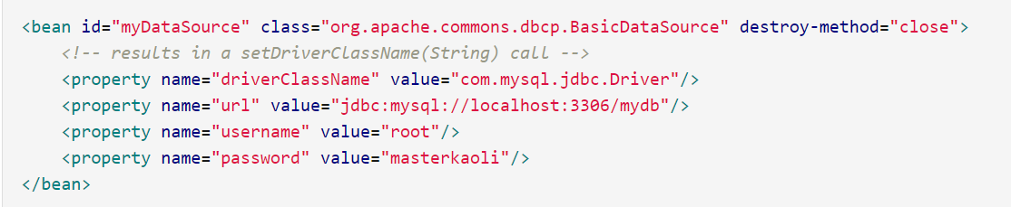
A special bean
Data Source
You can Also configure a bean for Java collections – list/set/map etc
Notes:
HomeWork: research on how to use set, list, map as bean in XML configuration

Slide 10
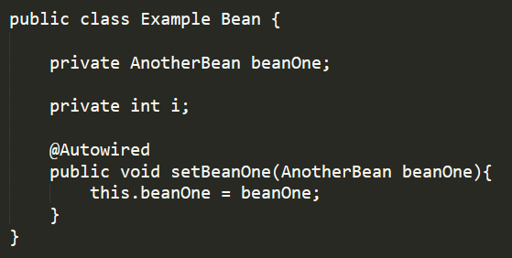
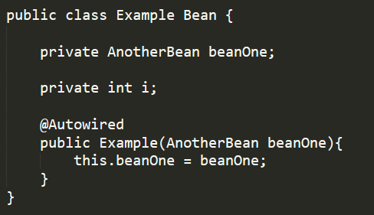
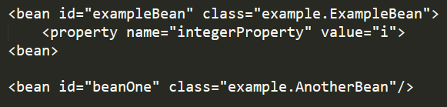
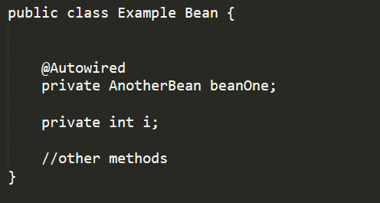
@Autowired (an intermediate step from pure XML to pure Annotation)
Setter
Constructor
Field
Notes:
Field is Java Reflection based and not suggested, but the mostly used

Slide 11
@Autowired --- Modes (an intermediate step from pure XML to pure Annotation)
No -- default
byType
byName
Constructor
Setter
Constructor
Field
Notes:
Field is Java Reflection based and not suggested, but the mostly used

Slide 12
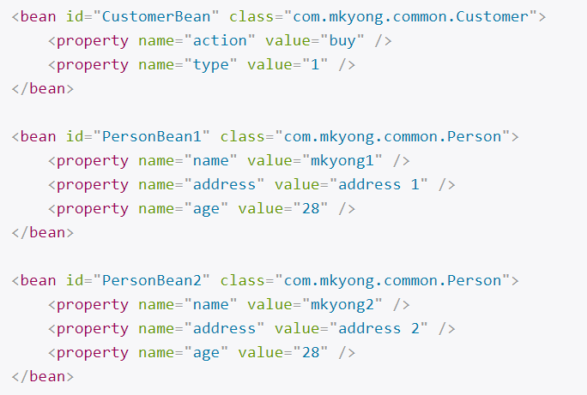
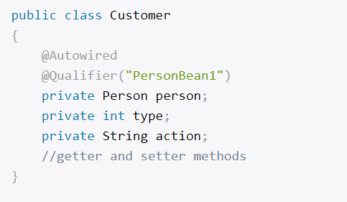
@Autowired + @Qualifier
Fallback: When byType finds multiple match, it will by default use byName

Slide 13
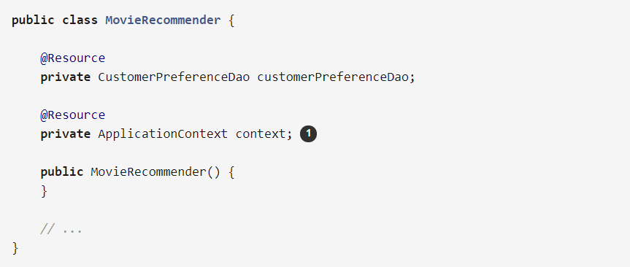
@Resource – alternative for @Autowired
Notes:
@Resource is mostly used for resource level wiring, such as ApplicationContext, BeanFactory, MessageResource etc
@Resource(name=“mybean”)

Slide 14
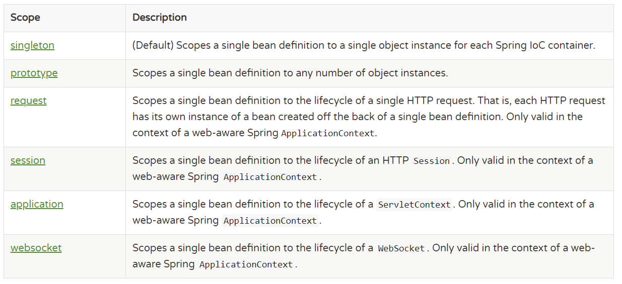
Bean Scope
** The Delegate Mechanism
Question: Is Spring Singleton Bean thread-safe?

Slide 15
Bean Scope
Implementation
Annotation:
@Scope(“prototype”)
@Bean
public User getUser(){}
XML:
<bean id=“user” class=“example.User” scope=“prototype”/>

Slide 16
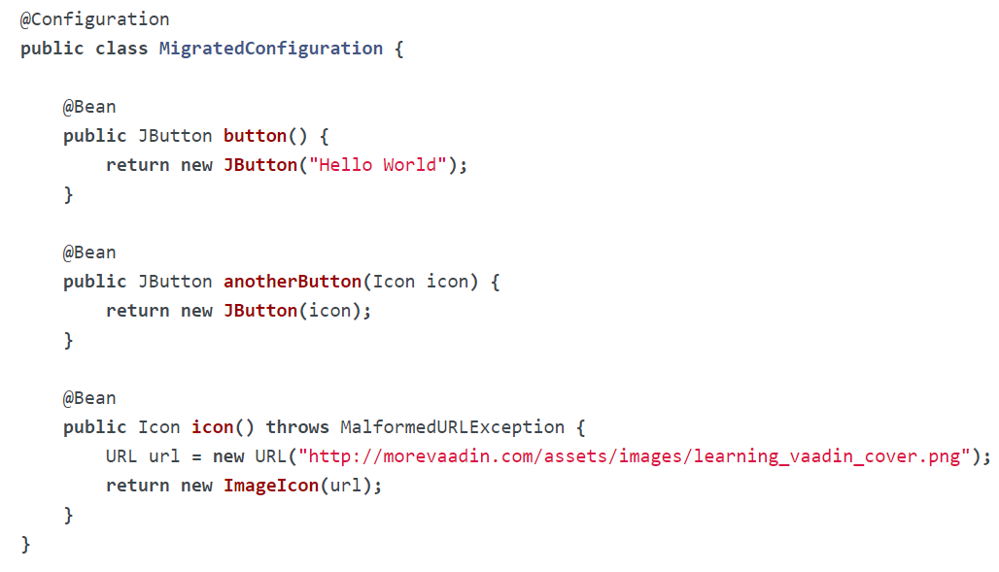
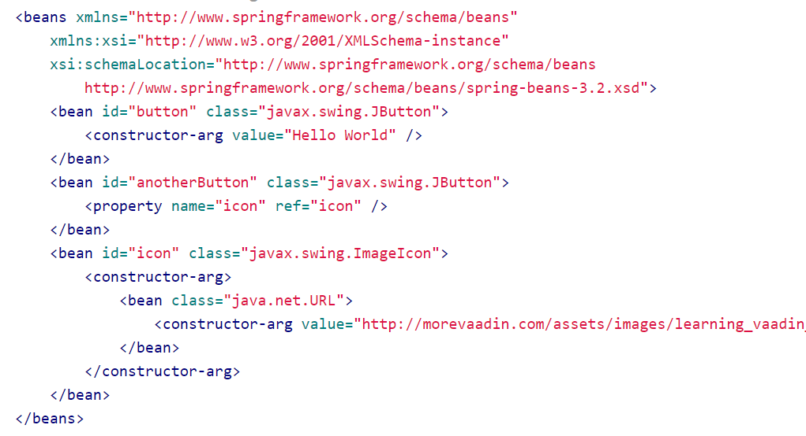
@Bean
Question: XML or Annotation?

Slide 17
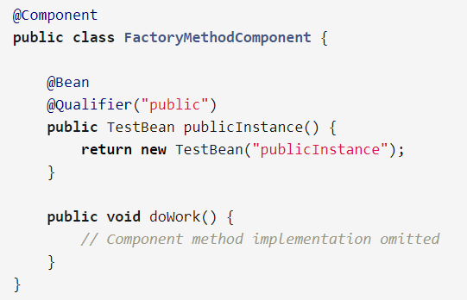
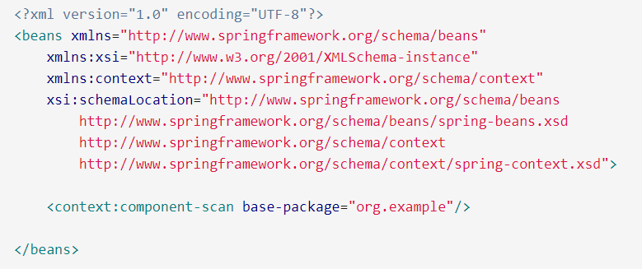
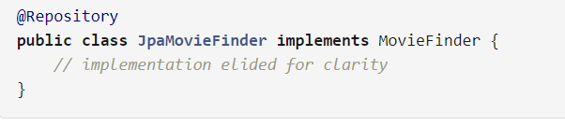
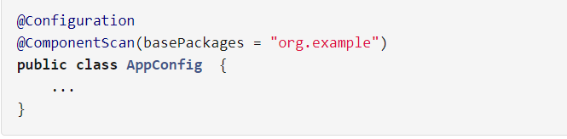
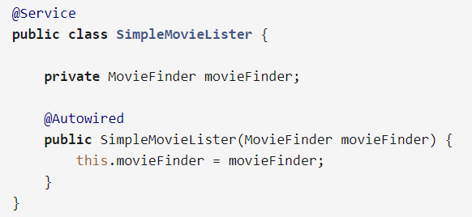
@Component & ComponentScan
Question? @Component vs @Bean ?

Slide 18
Other equivalent Annotations
@Component === @Named , @ManagedBean
@Autowired === @Resource, @Inject
@Scope(“singleton”) = @Singleton;; @Scope(“request”) == @RequestScope
@Scope(“session”) = @SessionScope etc

Slide 19
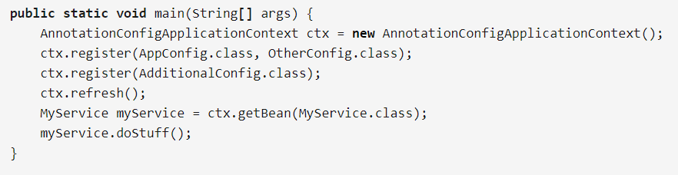
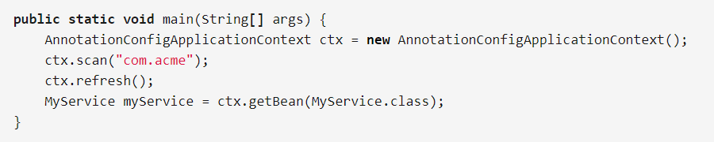
ApplicationContext Annotation
ApplicationContext <-- Component <-- Bean <-- Dependency Injection
Last Step for non-XML Spring is to annotate ApplicationContext
Notes:
To let Spring MVC application recognize “AnnotationConfigApplicationContext”, add it as <context-param> to web.xml just like applicationcontext.xml

Slide 20
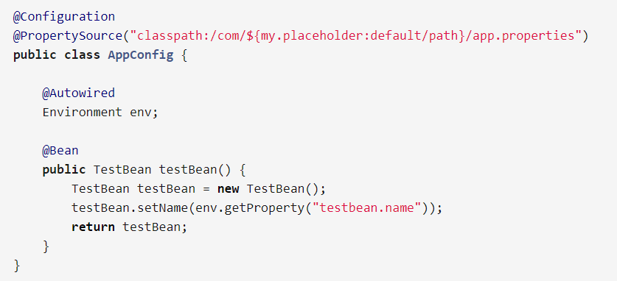
@PropertySource

Slide 21
End of IoC Container

Slide 22
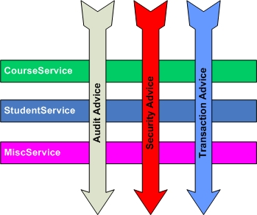
AOP: Aspect Oriented Programming
What?

Slide 23
Core Concepts:
Aspect
Pointcut
Advice
Before Advice
After Advice
Around Advice
After throwing Advice
AspectJ: add aspectjweaver.jar to the classpath
in XML, <aop: aspectj-autoproxy/>

Slide 24
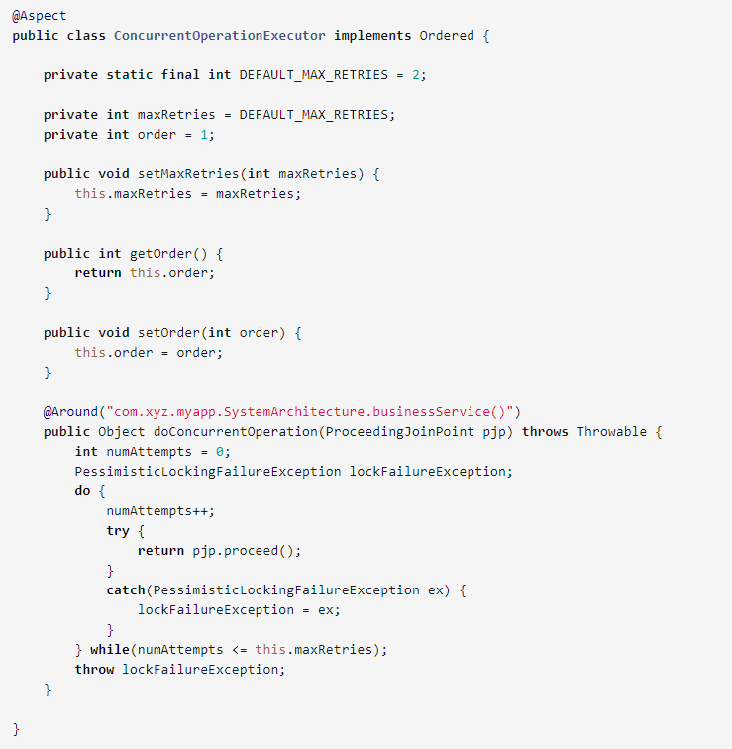
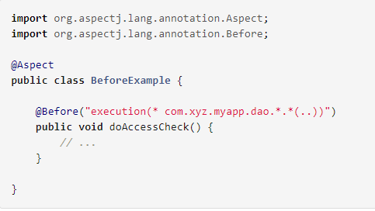
Annotation

Slide 25
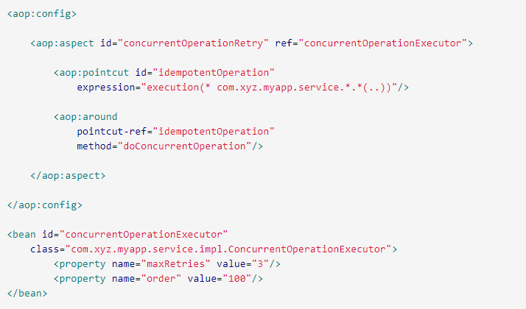
XML

Slide 26
Example
AOP Example

