Slide 1
J2EE
Andy Chen

Slide 2
Contents
Database(RDBMS / *NoSQL*) – SQL, PLSQL
JDBC
Jersey Rest Service
Front-End technologies
Git and Github
CICD

Slide 3
Database
NoSQL vs SQL -> which one to choose?
NoSQL -> json-based/document based UNSTRUCTURED data
NoSQL :
1. NoSQL is good at handling unstructured data, large amount of documents
2. NoSQL is not ideal for transaction handling – not good for accounting related data
ACID – Atomicity, Consistency, Isolation, Durability
Common NoSQL db to learn: MongoDB, Cassandra, Couchbase, Redis

Slide 4
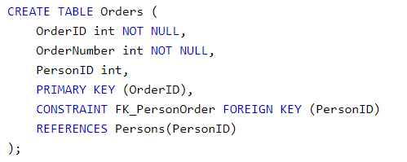
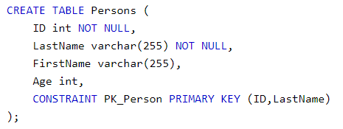


Database
Primary Key, Foreign Key, Unique Key
Interview Question: difference between them

Slide 5
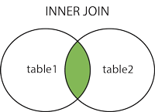
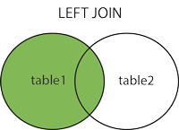
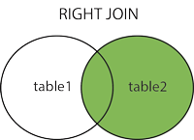
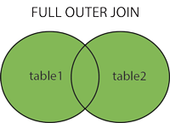
Database
Type of Joins (inner join, left join, right join, full outer join)
Notes:
SQL:: https://www.w3schools.com/sql/default.asp
PL/SQL:: https://www.tutorialspoint.com/plsql/index.htm

Slide 6
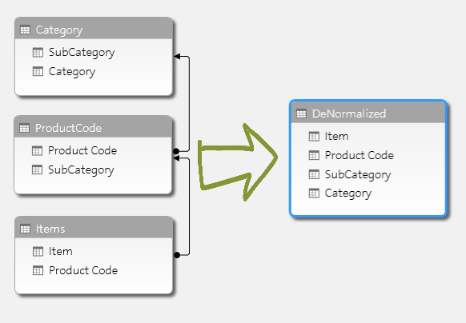
Database
Normalization vs De-normalization

Slide 7
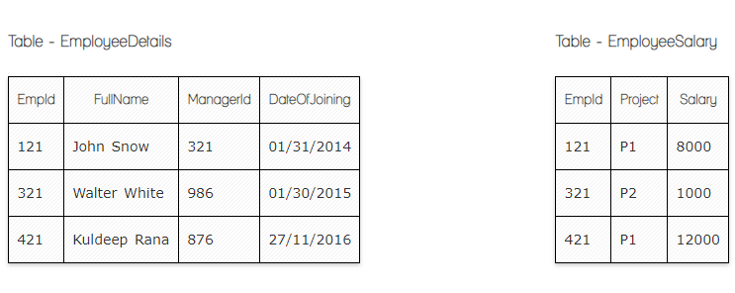
Database
Clob vs Blob
Truncate vs delete
View vs Materalized View vs Table
https://artoftesting.com/interviewSection/sql-queries-for-interview.html

Slide 8
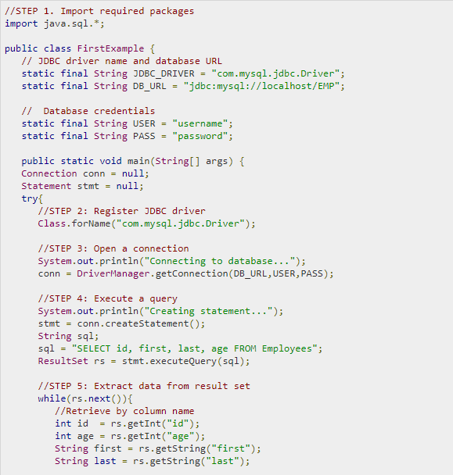
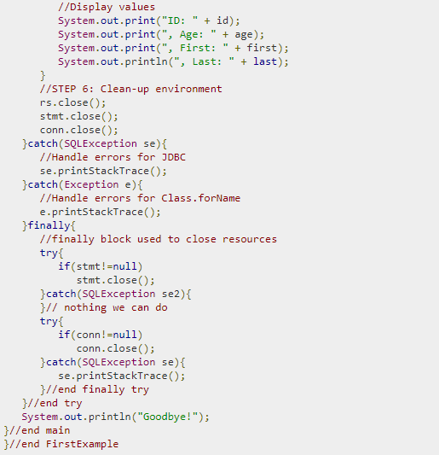
JDBC

Slide 9
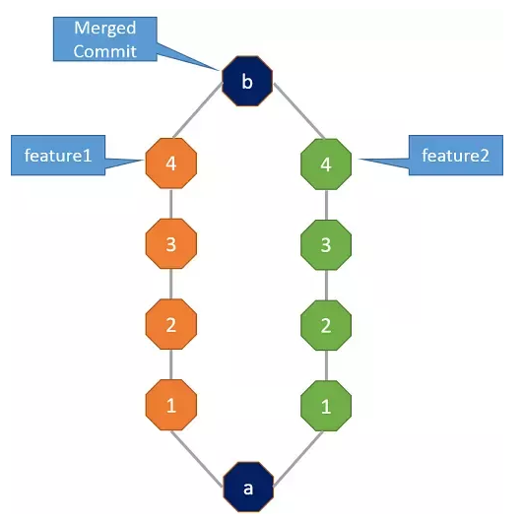
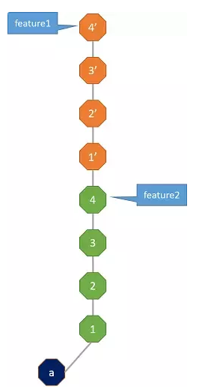
Git rebase vs merge
Git rebase, merge

Slide 10
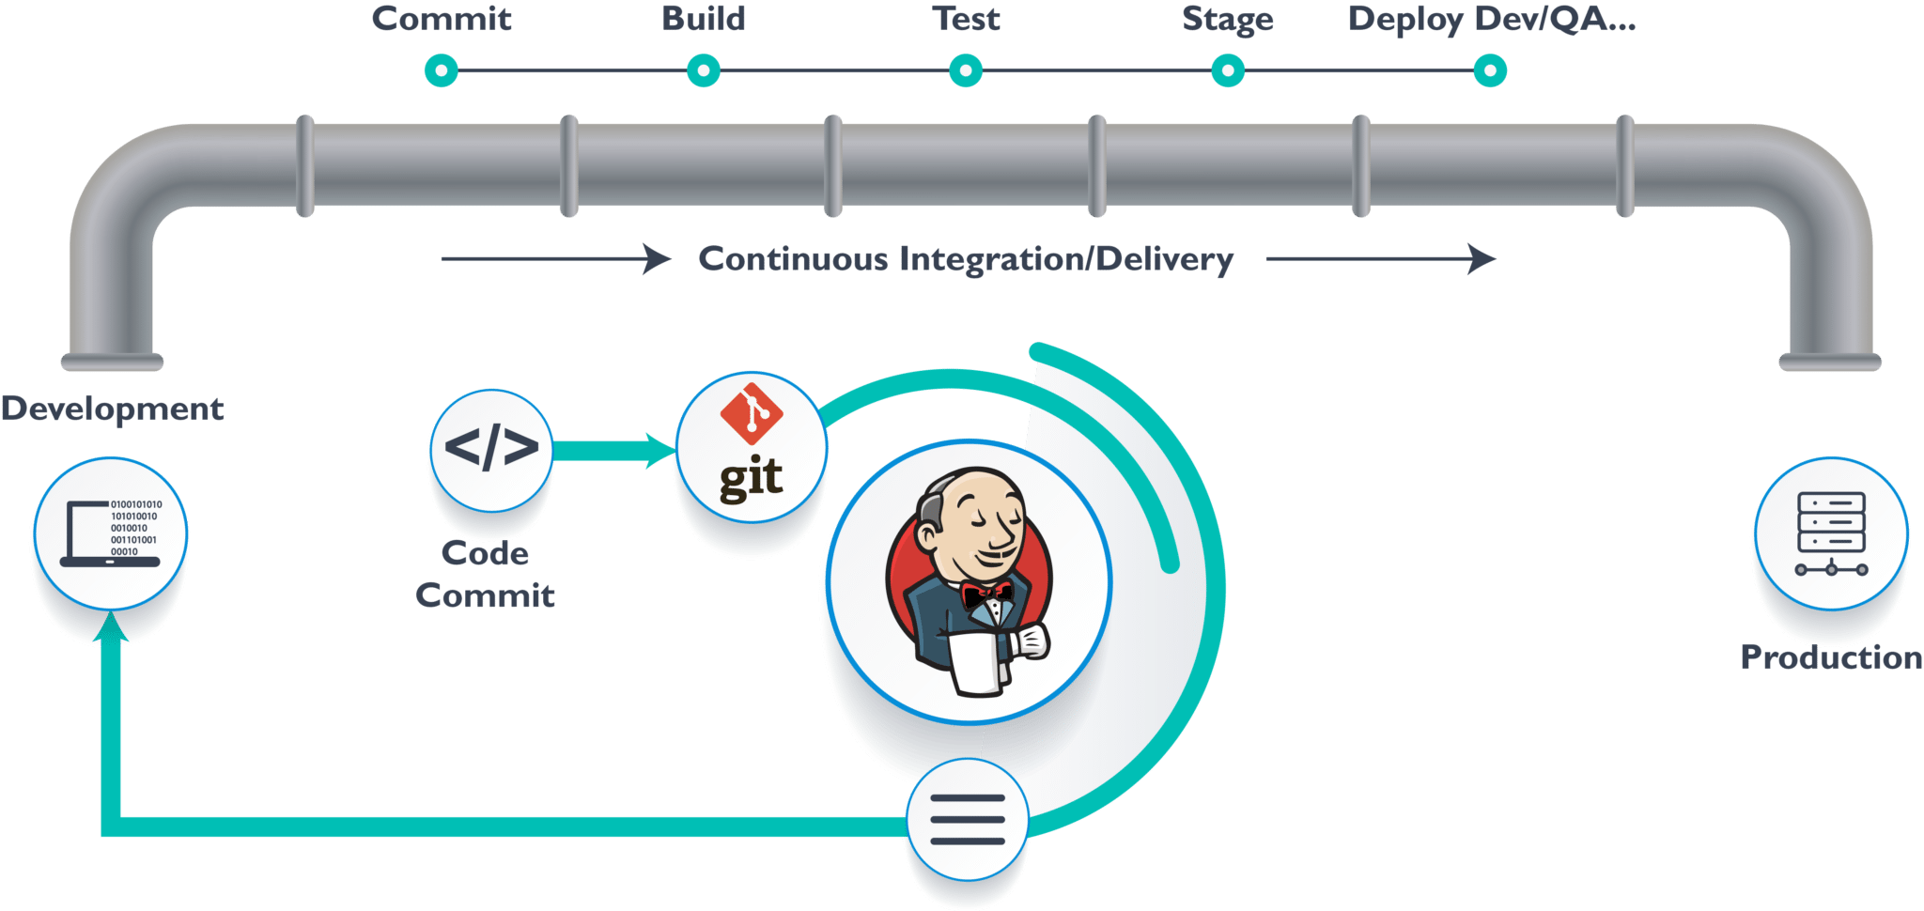
CICD

Slide 11
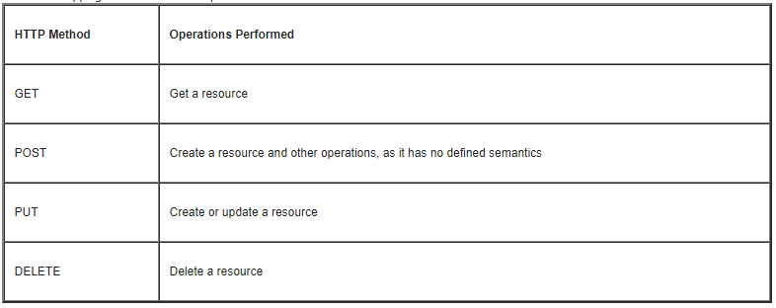
Jersey Rest Service

Slide 12
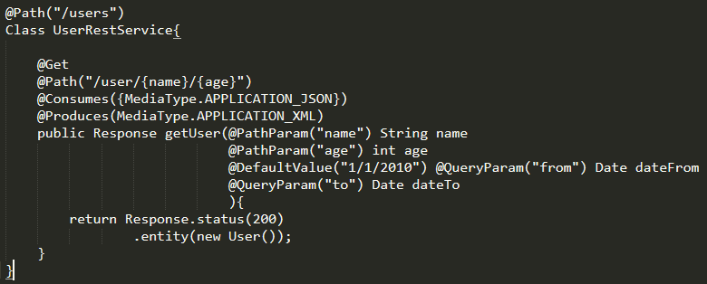
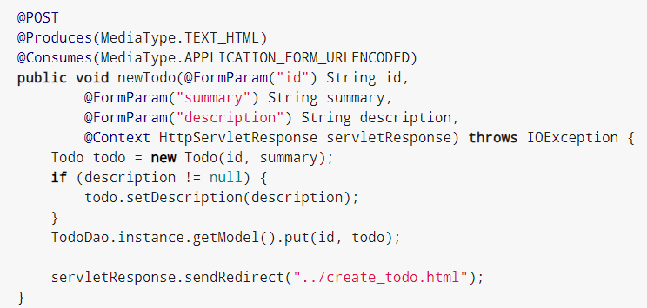
Jersey Rest Service
Get vs Post

Slide 13
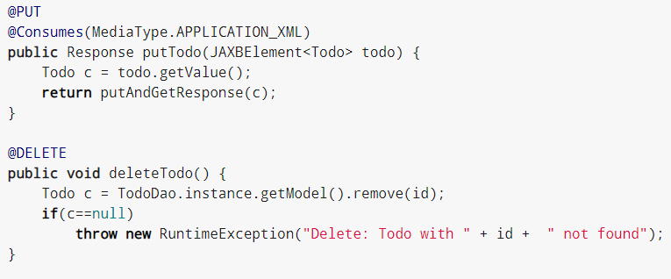
Jersey Rest Service
Put vs Delete

Slide 14
next
Spring MVC rest controller

