Slide 1
Spring BOOT
Andy Chen
11/4/2018

Slide 2
Content
What is Spring Boot?
Container. Stand-alone.
Easy Integrated with other Spring modules.
Tomcat/Jetty
Version:
boot: 2.0+
Java: 1.8+
Maven: 3.3+

Slide 3
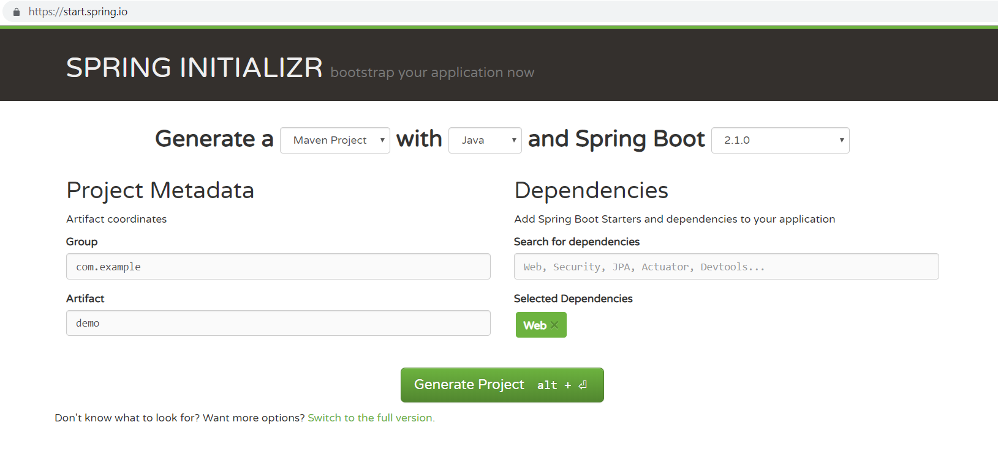
Spring boot web initializer

Slide 4
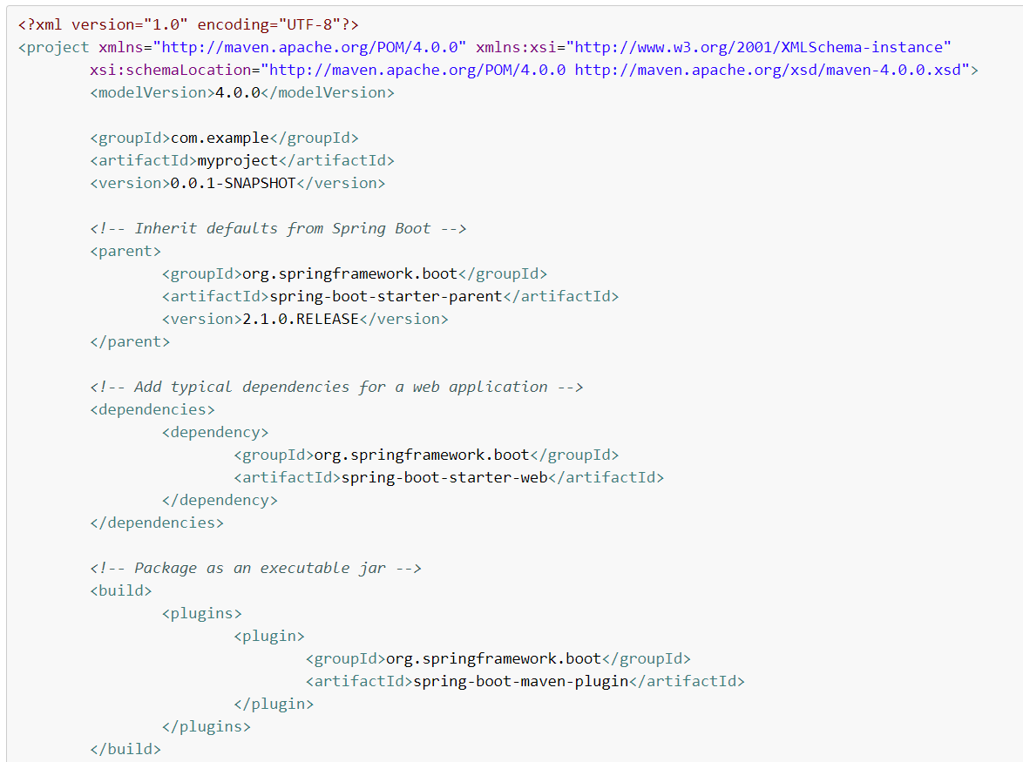
Starter
Common Starters
spring-boot-starter-data-jdbc
spring-boot-starter-data-jpa
Spring-boot-starter-jdbc
spring-boot-starter-json
spring-boot-starter-security
spring-boot-starter-test
spring-boot-starter-web
spring-boot-starter-logging
spring-boot-starter-tomcat

Slide 5
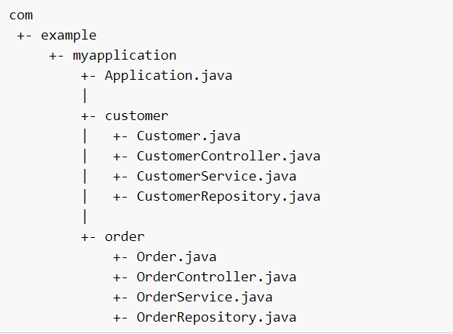
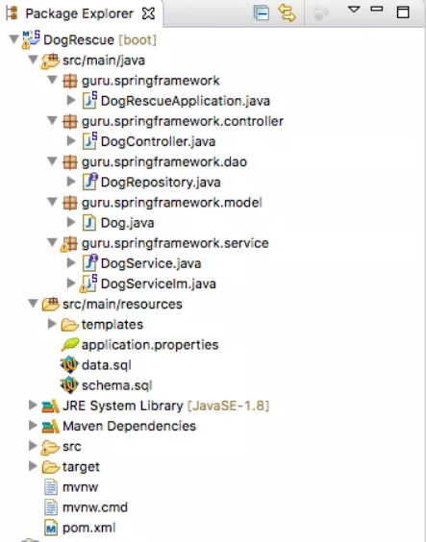
Code Layout

Slide 6
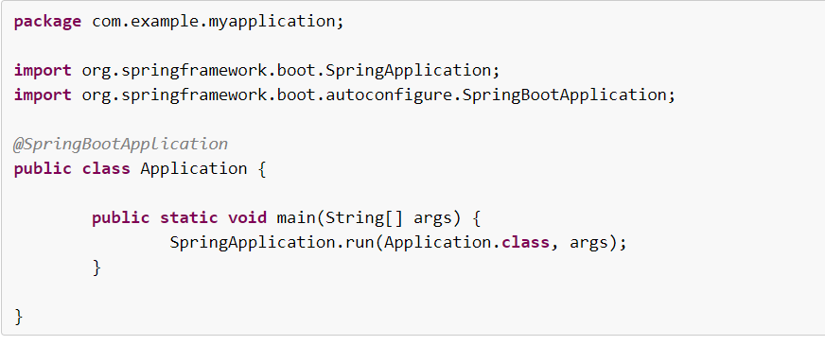
Application.java
How it works:
1. @SpringBootApplication tells this is a spring boot application file and it starts from here
2. Main -> SpringApplication.run() bootstrap spring and application and server/tomcat
3. Application.class – this is the primary spring component

Slide 7
Practice
Setup Maven to command line
Initialize a spring boot project, add starter: web, security and data
In “Main” method, add logging to print “Hello, BHT!”
Run your Spring boot project from Maven
Notes:
Mvn spring-boot:run

Slide 8
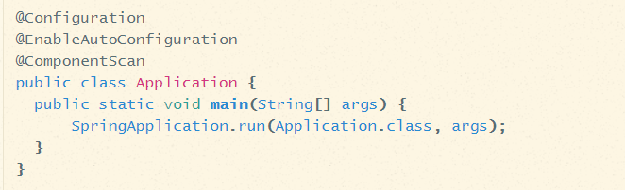
Annotations
@SpringBootApplication
= @EnableAutoConfiguration
+ @ComponentScan
(@Component vs @Bean)
+ @Configuration

Slide 9
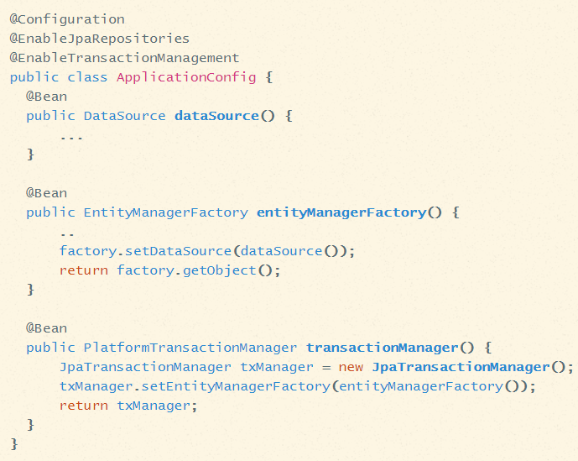
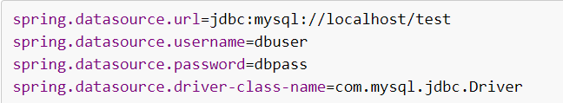
@EnableAutoConfiguration
Enable auto-configuration of the Spring Application Context, attempting to guess and configure beans that you are likely to need. Auto-configuration classes are usually applied based on your classpath and what beans you have defined.

Slide 10
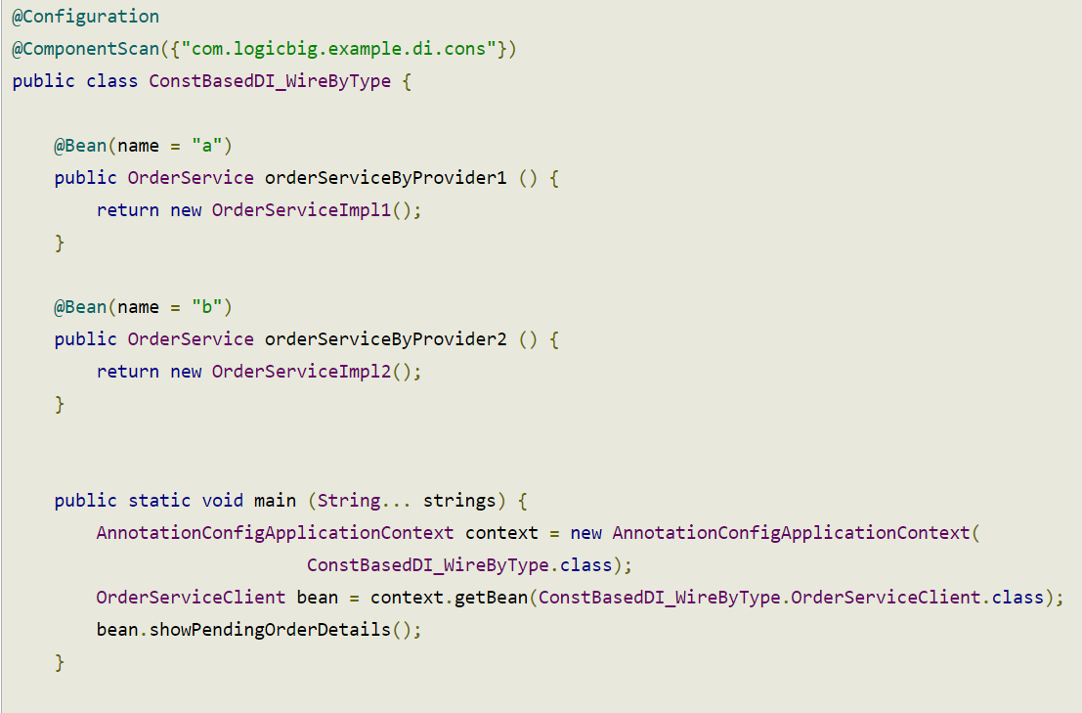
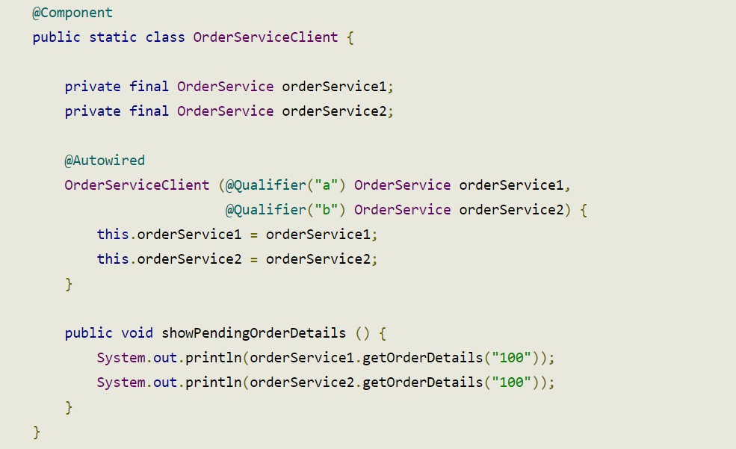
@Component vs @Bean
@Component (@Component, @Controller, @Service, @Repository) – class level
@Bean – method level

Slide 11
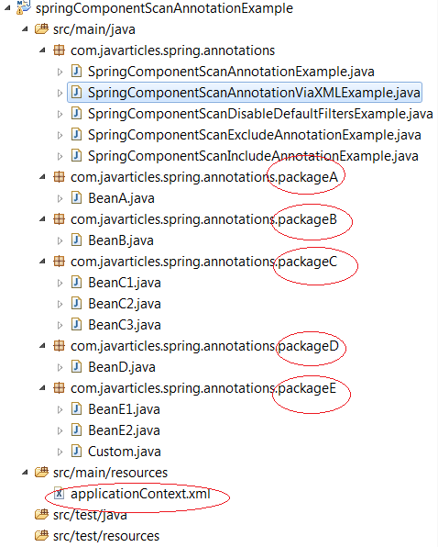
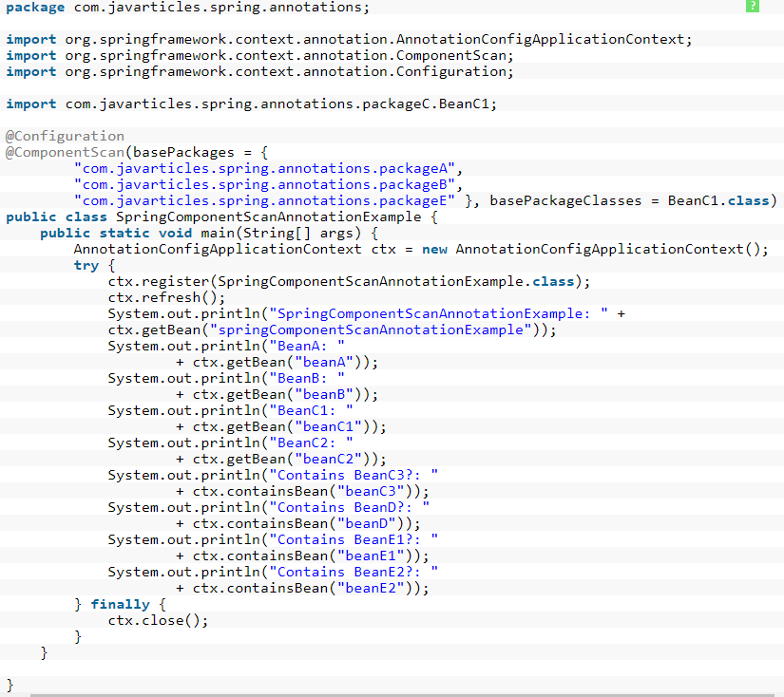
@ComponentScan

Slide 12
Load properties file
Application.properties is a default, auto-load file, no special treatment required
Foo.properties – put in src/main/resources (classpath)\
To load:
@Configuration
@PropertySource({
“classpath: foo.properties”
“classpath: foo-${env}.properties”
})
public class PropertiesWithJavaConfig {}
Inject/Use a property
@Value(“${jdbc.url}”)
private String jdbcUrl;
OR::
private Environment env;
String keyValue = env.getProperty(key);
OR::
@ConfigurationProperties(“app”)
POJO class with each field match the key (app.key) in the properties

Slide 13
Project
We will use Spring boot to start our first real-world project

