Slide 1
JPA (Hibernate, Spring Data JPA)
Andy Chen
Notes:
Database: ACID
Hibernate performance
Traditional DB vs NoSQL DB?

Slide 2
Hibernate

Slide 3
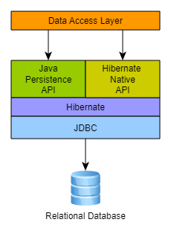
Core Concepts
Entity Mapping
CRUD → HQL/Criteria
What does Spring Data JPA do?
SessionFactory
Session
Transaction
Proxy
Persistence Context
Notes:
1. Session vs Transaction
REAL EXAMPLE:: Bank Deposit

Slide 4

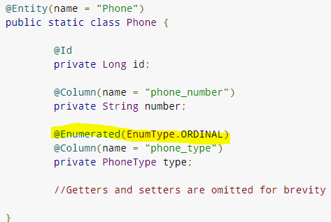
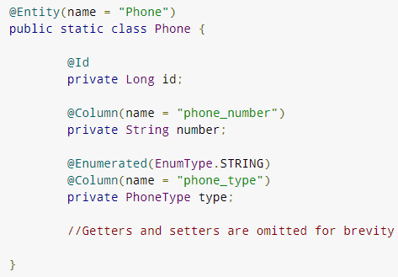


Entity Mapping: Enum
Notes:
@Entity
@Id
Pro & Con

Slide 5
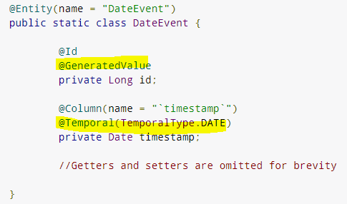
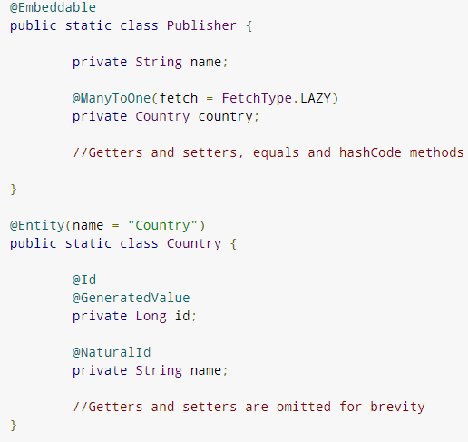

Entity Mapping : Embedding
@GeneratedValue
@Temporal
@NaturalId
@Embeddable

Slide 6
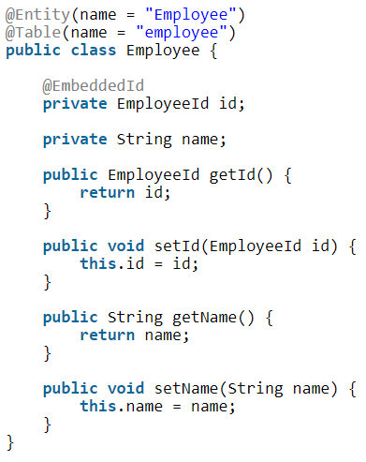
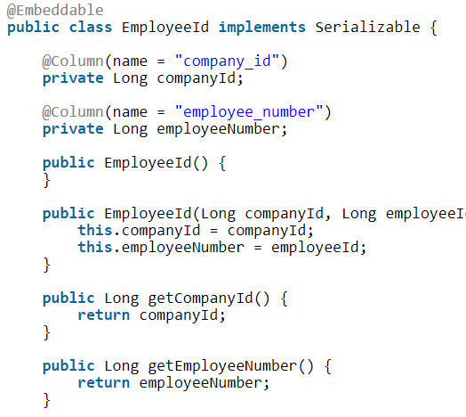
Entity Mapping: Composite Primary Key

Slide 7
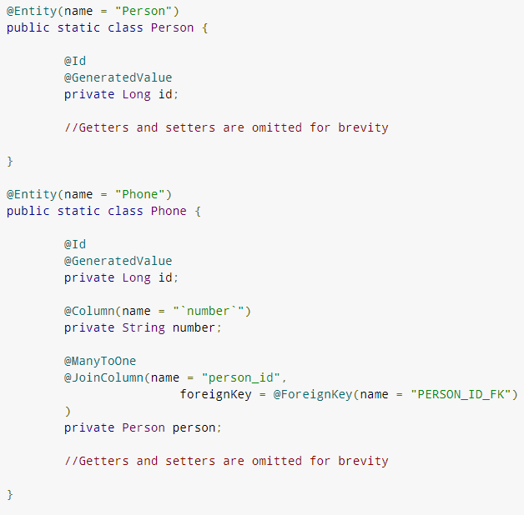
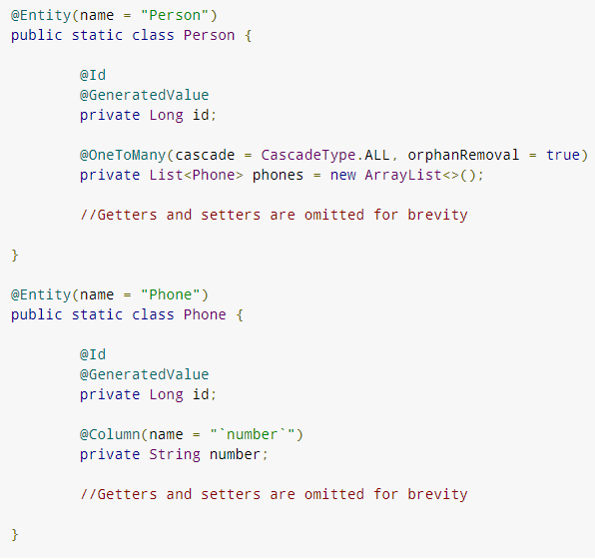
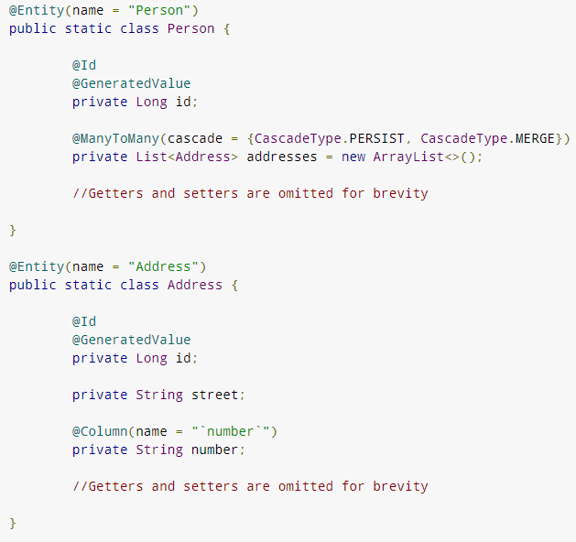
Entity Mapping: Foreign Key/Association
@OneToMany(cascade = CascadeType.ALL, fetch = FetchType.LAZY)
Notes:
@OneToOne

Slide 8
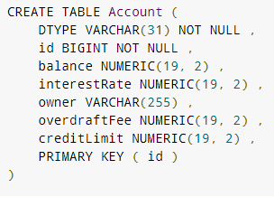
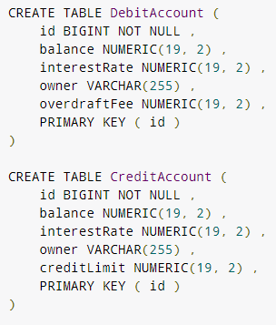
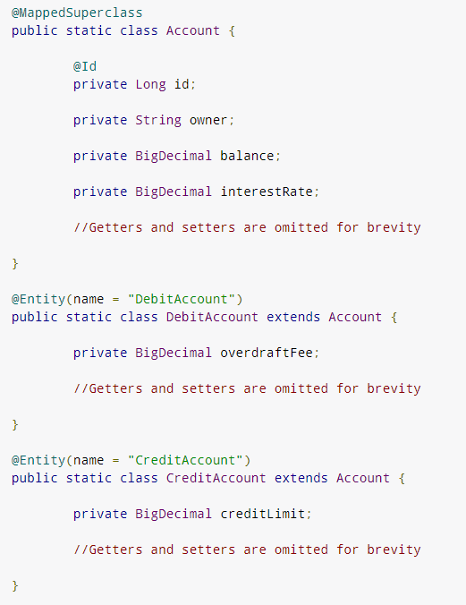
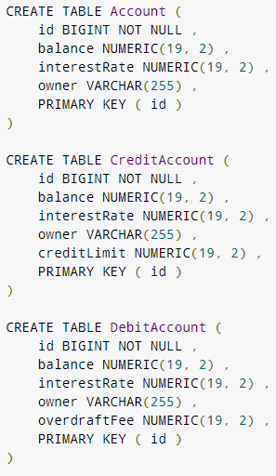
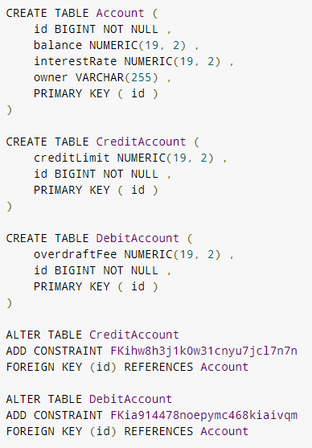
Entity Mapping: Inheritance
Mapped SuperClass
Single table
Table per class
Joined table
4 types
Notes:
FOR SCHEMA GENERATION
Single Table – is general good design
Joined Table – not good, because mapping @ManyToMany is heavy
Table-per-class – not efficient at all, have to use joins etc, should be avoided

Slide 9
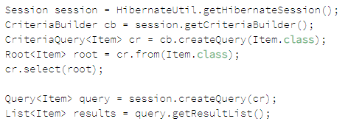

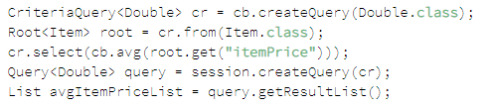
CRUD: Criteria API
select
Chain expression
Sort
aggregate

Slide 10
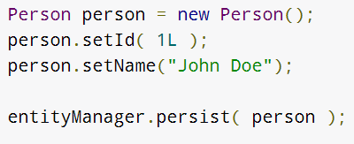
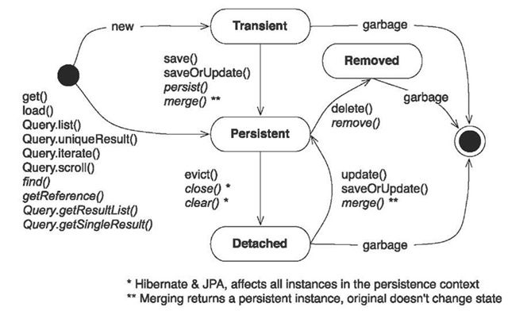
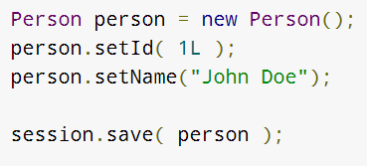
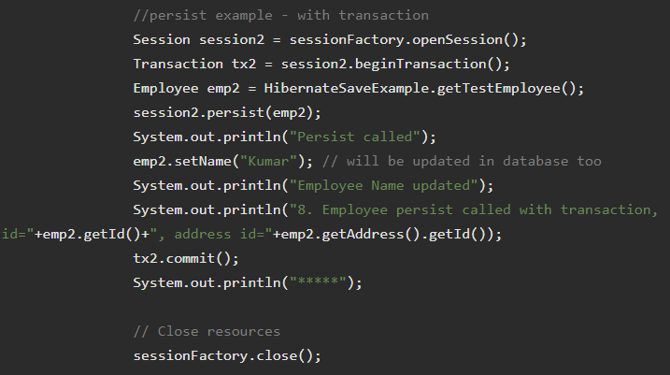

Persistence Context
Notes:
Persist ?

Slide 11
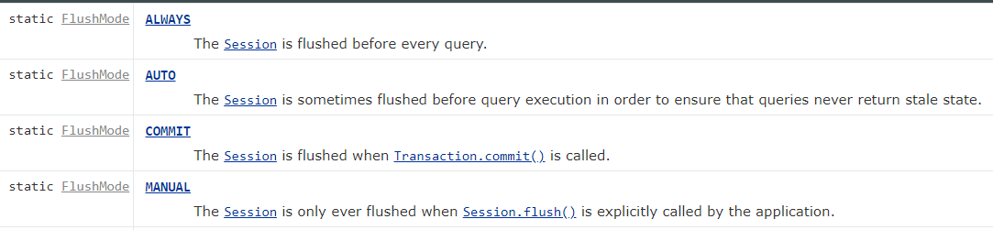
Flush Mode

Slide 12
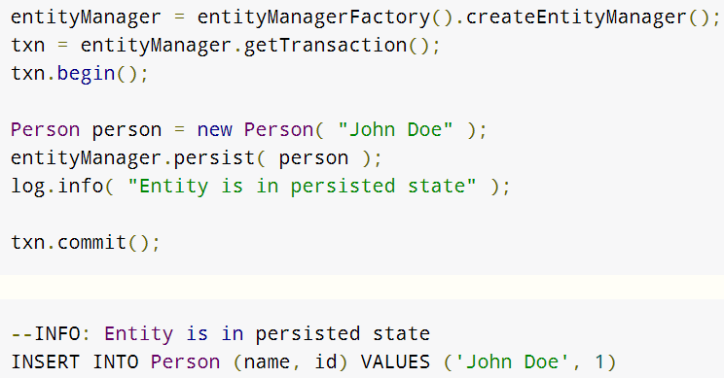
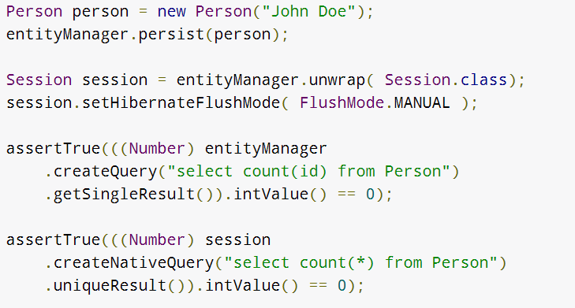
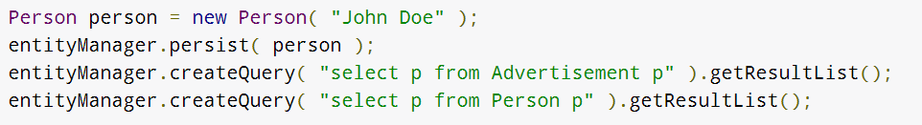
Example
Apply: Auto/Commit/Always/Manual
How to set Flushing Mode

Slide 13
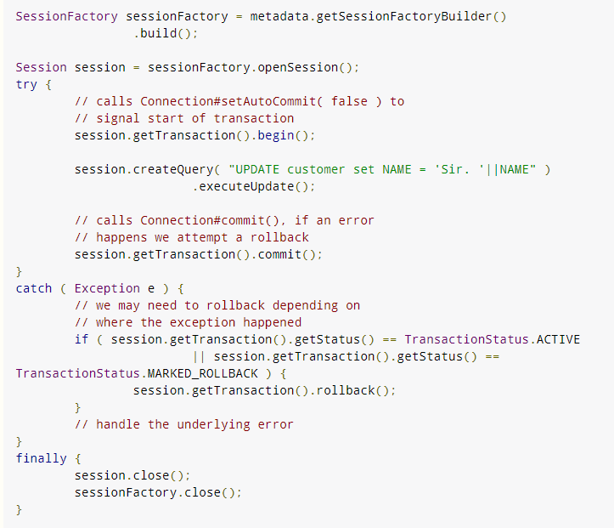
Transaction
a boilerplate session code

Slide 14
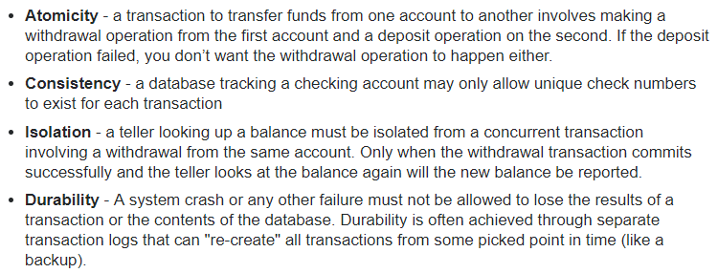
Database ACID
Transaction
Primary key
Locking
Replication

Slide 15
Locking
Concern:
A transaction reads data, update data and then commit the data. During commit, it needs to make sure the data is not stale – not modified by other concurrent on-going transaction.
What if it happens?
Rollback current transaction
Types of locking in hibernate
Optimisitic Locking and Pessimistic Locking

Slide 16
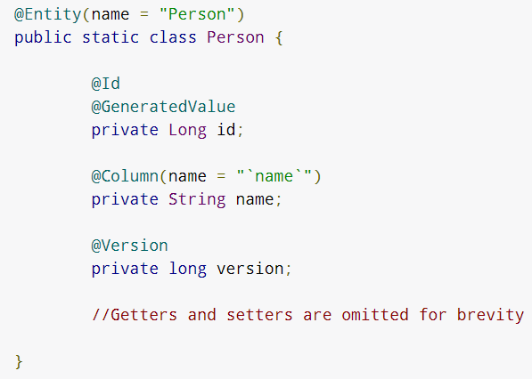
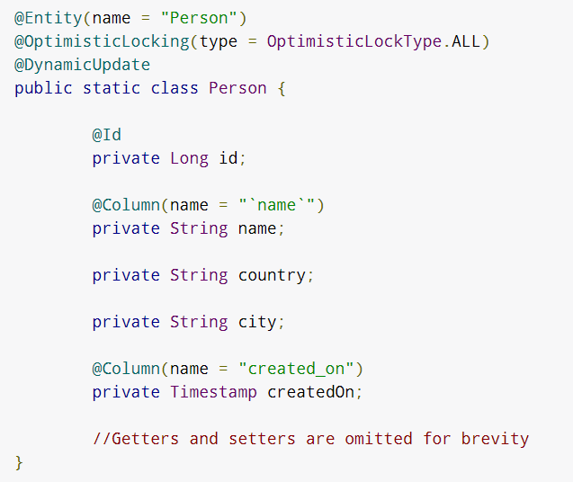
Optimistic Locking
Version
All
Dirty
timestamp
Approach 1: Version
Approach 2: OptimisticLocking with DynamicUpdate

Slide 17
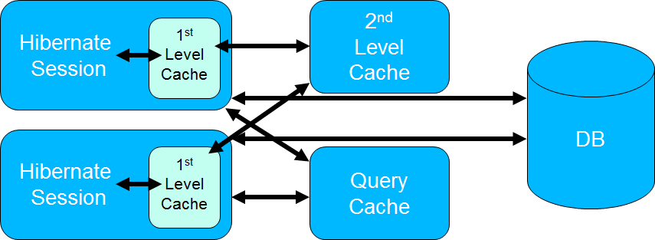
Caching
Two level cache
1st level cache: stays in session level. Purpose: minimize database visit
2nd level cache: stays in sessionFactory. Purpose: cross session use
Notes:
Session starts -> 1 level cache -> 2nd level cache -> Database
-> Database -> 1,2 level cache
The query cache is the only one which does not store entities. It caches query results and contains only entity references and scalar values. You need to activate the cache by setting the hibernate.cache.use_query_cache property in the persistence.xml file and set the cacheable property on the Query.

Slide 18
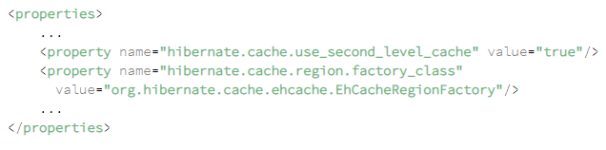
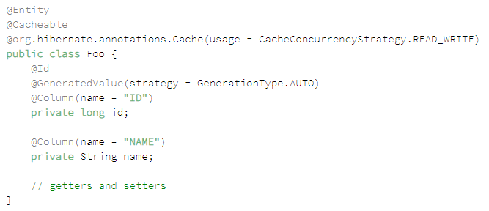
Configure 2nd level Cache

Slide 19
Performance Tuning
Use logging to track visiting to database
Optimize HQL or Native SQL Query
FetchType = LAZY
Use cache, but before using 2nd level cache, try to put heavy operation to database
Bulk updates/deletes

Slide 20
Spring Data JPA

Slide 21
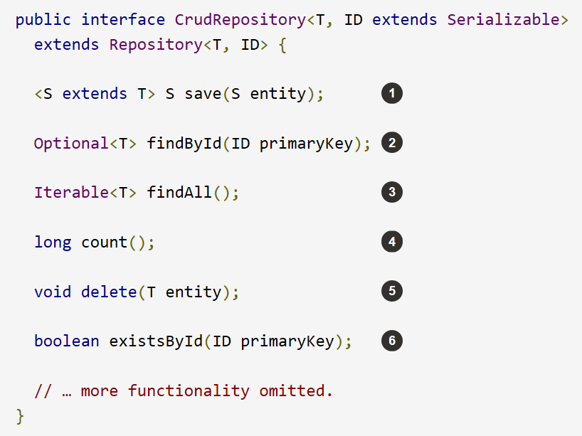
Why JPA?
Possible Ways to do CRUD?
What is JPA?
Who implements JPA?
What is Spring Data JPA?

Slide 22
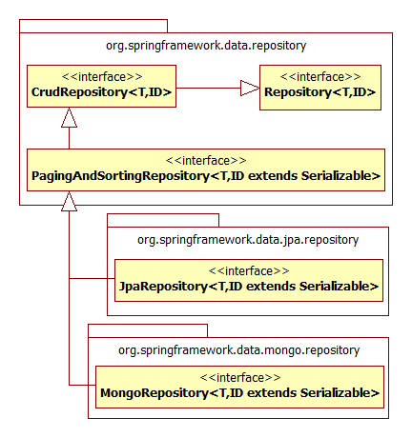
Repository
CrudRepository
PagingAndSortingRepository
JpaRepository
Notes:
When to use which?

Slide 23
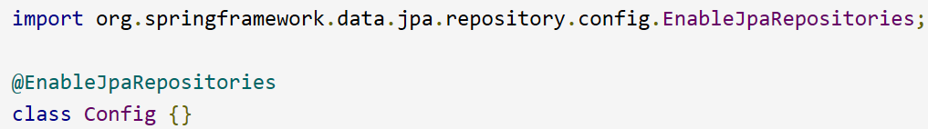
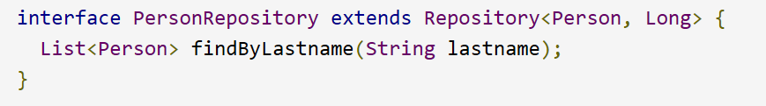
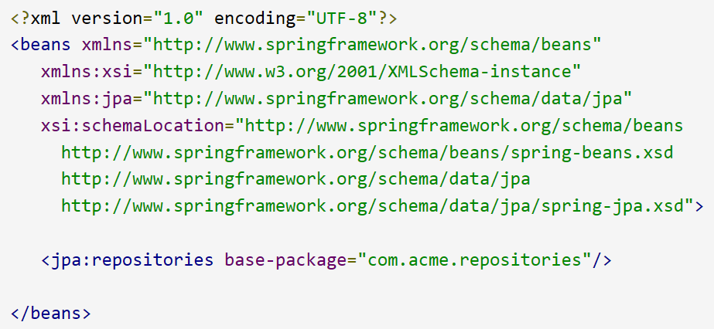
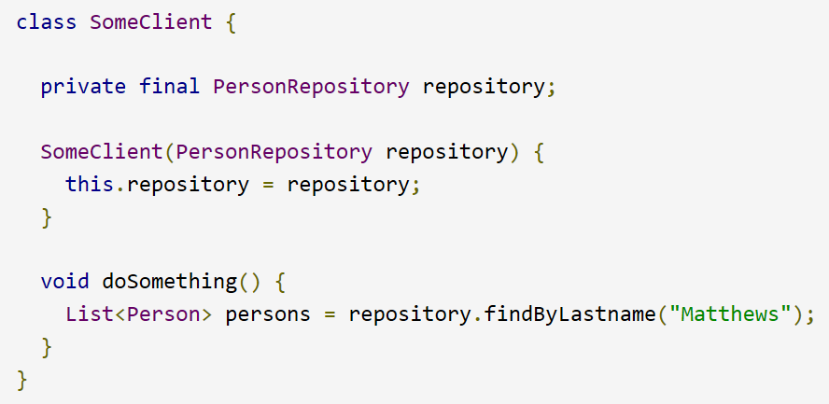
4-step Declaration
2
3
4
1
1. Enable JPA Scan → 2. Extends Repository → 3. Define CRUD Query → 4. Inject into Service
Notes:
@EnableJpaRepositories(“com.acme.repositories”)

Slide 24
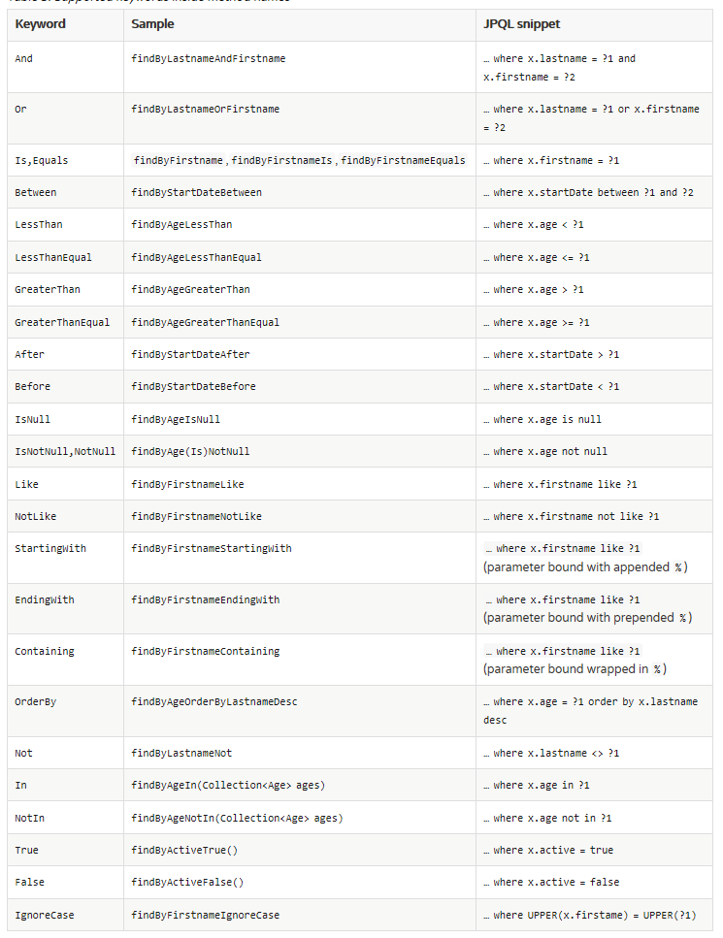
JPA CRUD

Slide 25
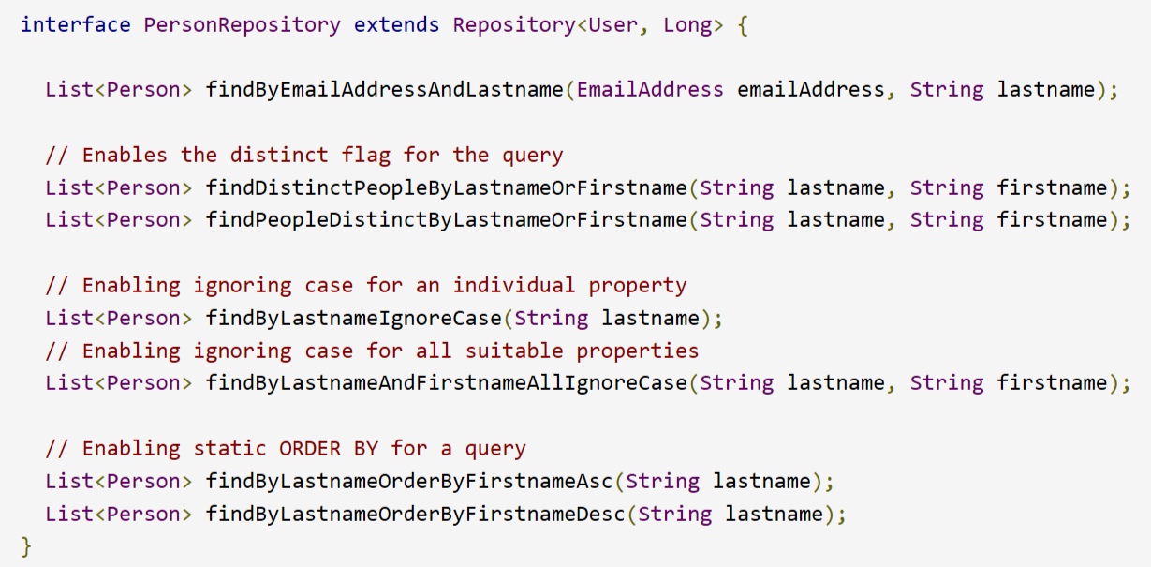
Exercise
Notes:
Convert to Select statement

Slide 26
Nested Properties
A Problem:
List<Person> findByAddressZipCode(ZipCode zipCode);
select * from Person where address.zipCode = zipCode ?
select * from Person where addressZip.Code = zipCode ?
Solution: List<Person> findByAddress_ZipCode(ZipCode zipCode);

Slide 27
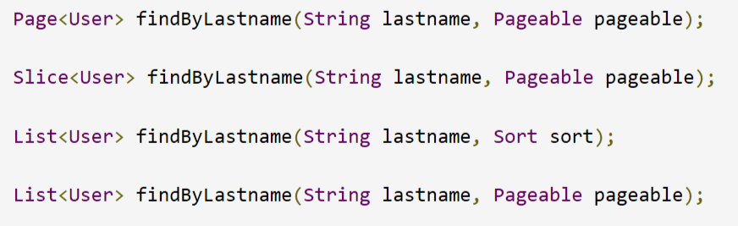
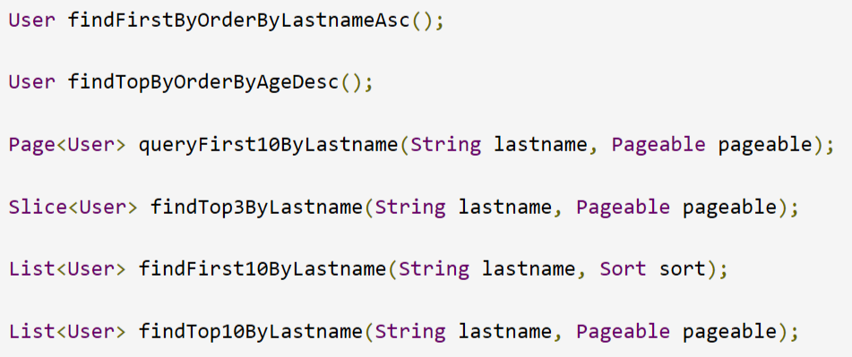
Some Special Cases

Slide 28
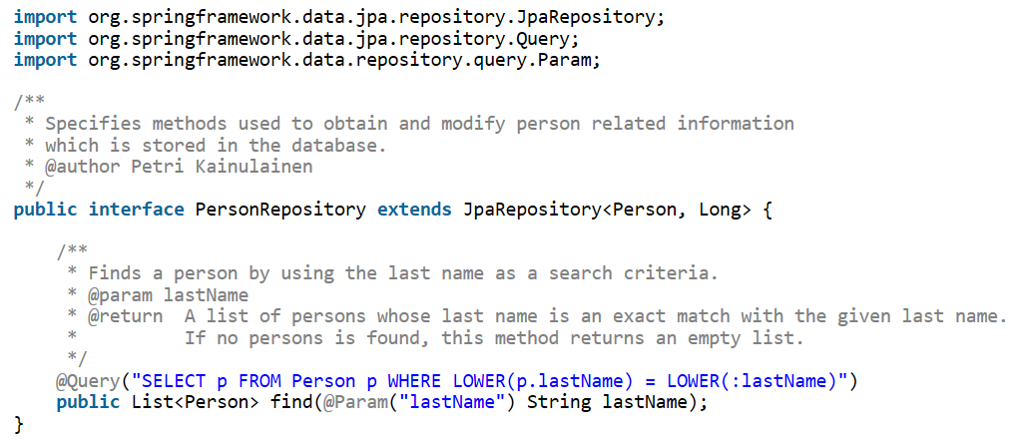
Your Own Query

Slide 29
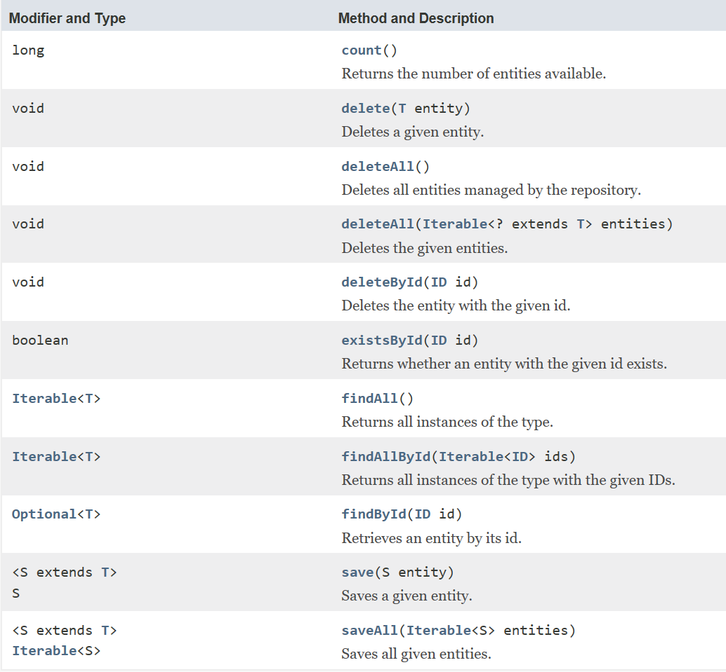
Insert Update Delete

Slide 30
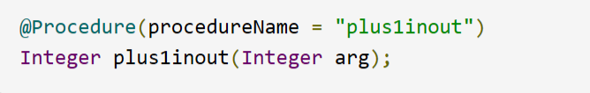
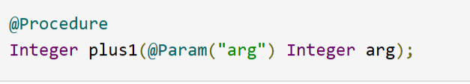
* Stored Procedure

Slide 31
Example
Lets look at a Spring Data JPA + Hibernate Example

