Slide 1
Relativistic Aberration or “What do Han and Chewie see from the Millennium Falcon’s cockpit, and why?”
Physics 230 Project Presentation
Carter Landon

Slide 2
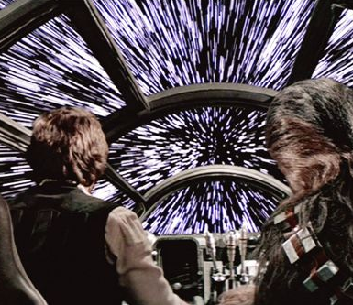
Introduction and Background
The motivation for this project is rooted in my love to think about what would actually happen in sci-fi movies if we accept some premises.
So, if we accept the premise that a spaceship can safely accelerate up to near-light-speeds, what would the crew actually see?

Slide 3
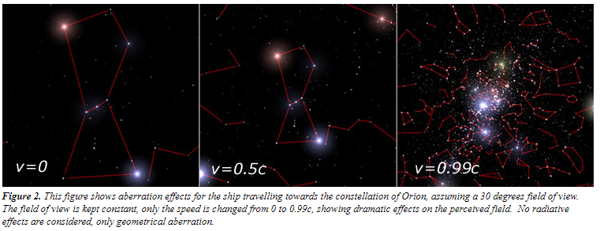
Introduction and Background
Unsurprisingly, the stretched-out stars is not what a relativistic space-traveler would see.
In reality, the field of view would be compressed towards the center, in the direction of travel.
This is a compound of classical and relativistic effects.
Picture from http://math.ucr.edu/home/baez/physics/Relativity/SR/Spaceship/spaceship.html

Slide 4
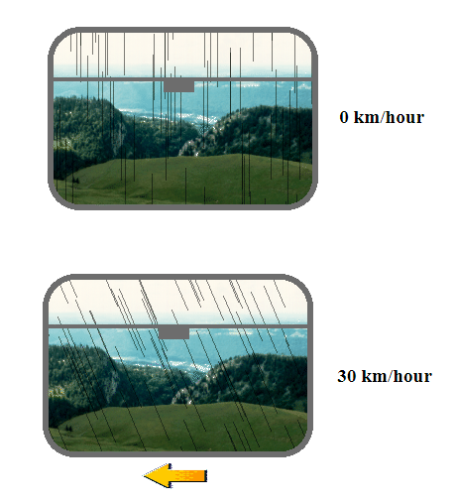
Introduction and Background
The effect is similar to how vertically-falling rain can appear to be falling at an angle when viewed from a moving vehicle.
Because the light enters the eye at a different angle, the object appears to be in a different location than it actually is.
This effect can be caused classically, and exaggerated relativistically via time and space dilation

Slide 5
Introduction and background
I found this hard to visualize, so I decided to make some animations to help understand this.

Slide 6
Methods
Graphics
Animate
Export

Slide 7
Stationary
Stationary white dots are stars
Red triangle is the spaceship
Yellow dots are photons
White circles are wavefronts of light

Slide 8
Stationary
White lines show the angle at which the photon hits the ship

Slide 9
Classically Moving Ship
V = 0.1c

Slide 10
Classically Moving Ship
V = 0.5c

Slide 11
Classically Moving Ship
V = Sqrt[3]/2

Slide 12
Classically Moving Ship
V = c

Slide 13
Classically Moving Ship
V = 2c

Slide 14
Relativistic Travel
Length dilation of ship
V = Sqrt[3]/2 c

Slide 15
Comparison
Classical
Relativistic

Slide 16
From the ship’s frame
V = Sqrt[3]/2 c

Slide 17
Future Work
Include accurate time dilation (which would also lead to a more accurate space dilation)
Not hard-code the relativistic animation, allowing varying ship-velocity input

Slide 18
Conclusions
Lorentz transforms are hard to animate
Relativity is much easier to visualize when somebody else can do the visualizing for you via animation

