Slide 1
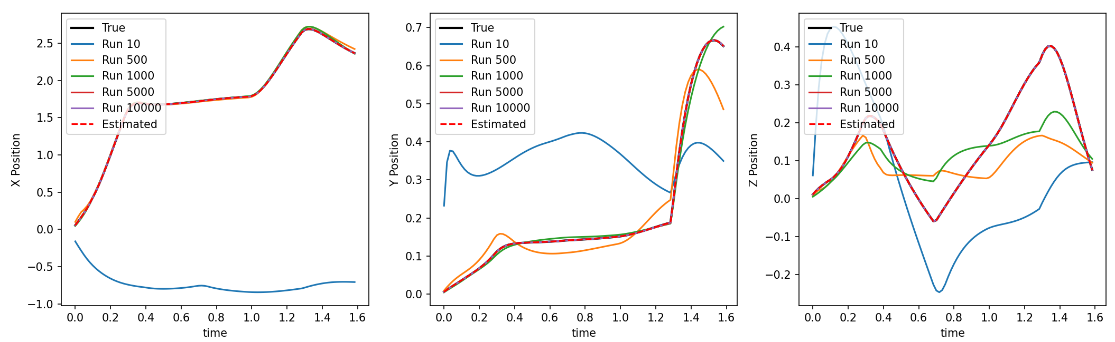
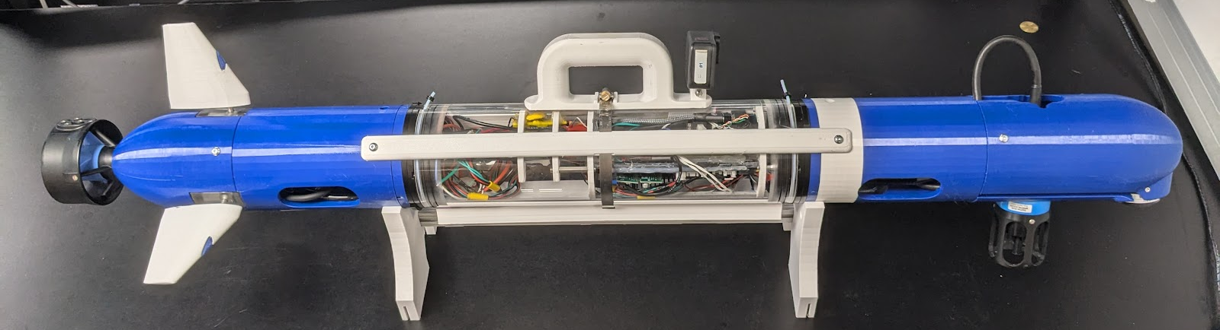
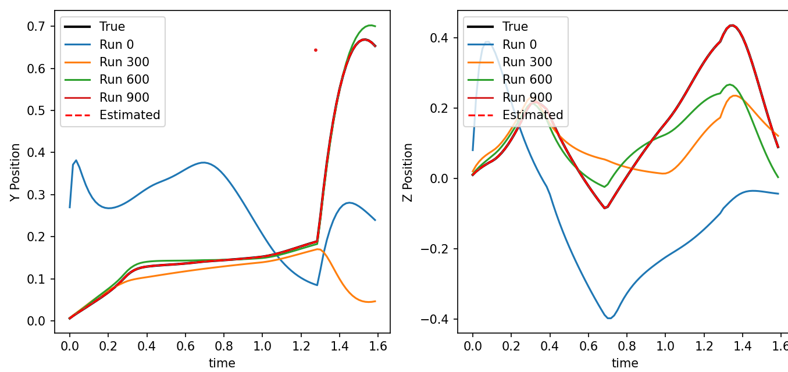
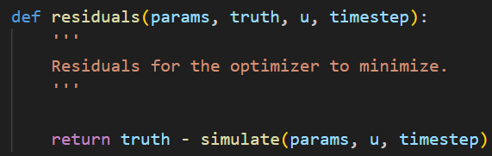
CougUV System Dynamics Identification in Simulation
Carter Noh, Blake Romrell
Problem Statement
Results
Discussion
CougUV:
Torpedo-style underwater vehicle developed by BYU FRoST Lab
Cheap AUV for multi-agent SLAM research
Single rear thruster, three control fins
Dynamics modeled by Thor Fossen in Marine Craft Hydrodynamics and Control
Model Paramenters: 39 total
Mass, inertia, buoyancy, drag, damping, thrust coeff., etc
13 easily measured or obtained from specs
12 known approximately or by assumption
14 completely unknown
Successfully Estimated 27 Parameters
All 14 of the unknown params
All 12 of the approximated params
1 of the measurable params
Pose Trajectory using Estimated Parameters:
Identifiability:
Highly nonlinear system makes analytic identifiability analysis difficult
Iterative, guess-and-check approach
Some parameters are very sensitive to initialization
Mostly “approximate” parameters, can drop if needed when running on real data
Desirable to also estimate measurable parameters
Derivation of model makes simplifying assumptions that may make the “optimal” values different from measured values
Possibly unidentifiable: requires further analysis
Real vehicle won’t estimate nearly as well (model not exact)
Future Work
Improve Performance
Detailed stability and identifiability analysis to find all unidentifiable parameter combinations
Design better sequence of inputs to isolate parameters and excite modes
Analysis to better identify regions of attraction and sensitive parameters
Field Testing
Gather sensor using actual Coug-UV vehicle
Run SLAM to get estimate of state.
Use this as “ground truth” data
Use pose data and simulation code to run SysID and find actual vehicle parameters
Objective
Formulate and solve a System Identification problem in simulation to identify the unknown and approximate parameters
Method
Simulated Problem:
Implement vehicle dynamics in Python
Input to SysID: list of control commands at each time step
Data: simulate full vehicle behavior with true parameters
Initialize desired parameters to incorrect values
At each iteration: simulate behavior from inputs using current parameters and compare to data from true parameters
Optimizer calculates gradient and adjusts parameters
Performance:
MSE: 1.618e-7
Iterations: 13368
Runtime: 10.5 minutes
With 22 parameters:
MSE: 2.62e-9
Iterations: 1146
Runtime: 0.5 mins
Conclusion
Successfully used System Identification to characterize a dynamic model for the CougUV
Recovered 27 parameters exactly
All crucial parameters, most nice-to-have parameters
Simulation lays groundwork for SysID on real vehicle

