Slide 1
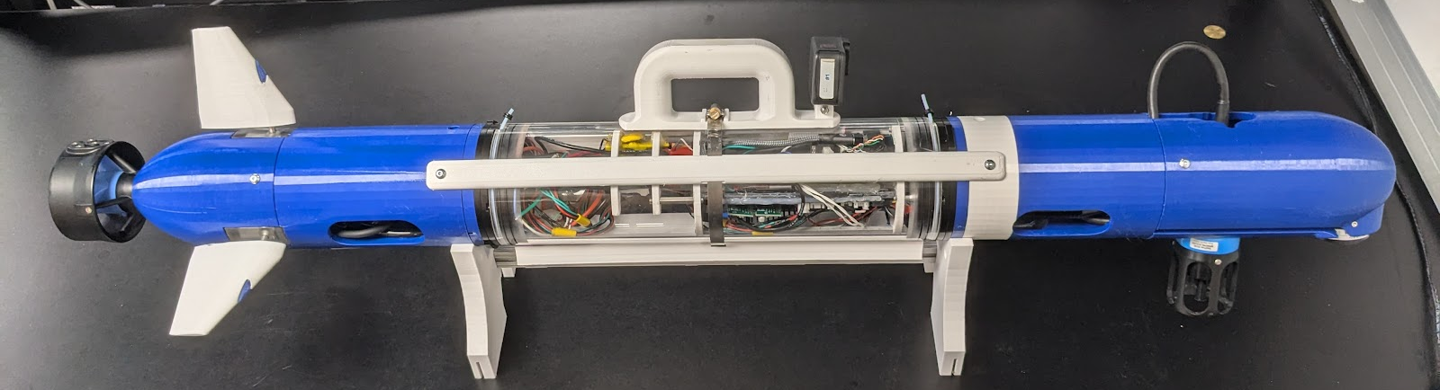
Coug-UV System Identification
Carter Noh, Blake Romrell
Problem Statement
The Coug-UV is a torpedo-style underwater vehicle with a single rear thruster and three rear control fins, developed by the BYU FRoST Lab and designed to be a cheap autonomous underwater vehicle for cooperative multi-agent localization and mapping algorithm testing.
A mathematical model for the vehicle dynamics of torpedo vehicles has been given by Thor Fossen in Marine Craft Hydrodynamics and Control. The dynamics naturally depend on several parameters of the vehicle, such as: weight, center of mass, center of buoyancy, drag, fin surface area, and maximum fin angle. Several of these are measurable or able to be calculated from measured quantities, but some of these parameters are unknown for the Coug-UV. Our goal is to develop a system identification method to find the true dynamic parameters of the Coug-UV and to validate the method in simulation.
Coug-UV: Torpedo-style underwater vehicle developed by BYU FRoST Lab
Designed to be cheap AUV for multi-agent SLAM research
Single rear thruster, three control fins
Dynamics: Modeled by Thor Fossen in Marine Craft Hydrodynamics and Control
44 parameters: mass, inertia, buoyancy, drag, damping, etc.
Only some parameters easily measurable
15 parameters unknown,

