Slide 1
A Year of Robots
Teens, Tech, and Transformations

Slide 2

Carter Wickstrom
Lead Software Engineer
https://www.linkedin.com/in/carterwickstrom
https://twitter.com/carterwickstrom

Slide 3
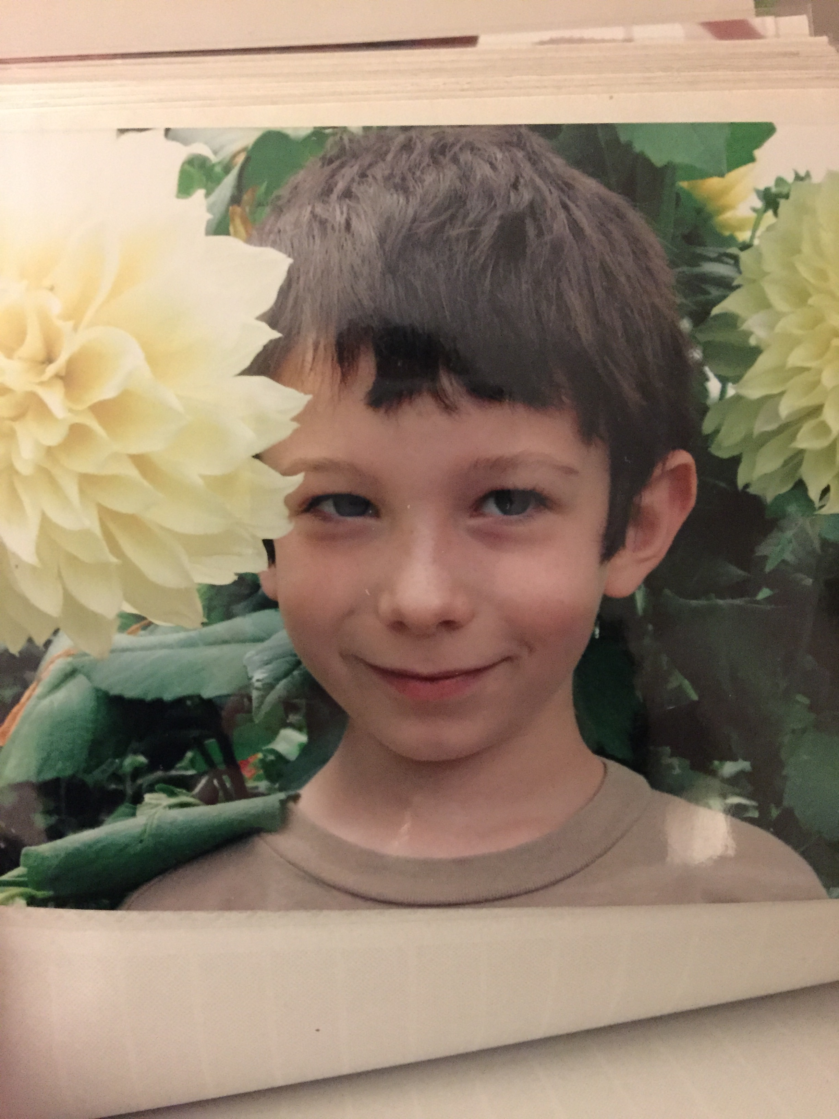
“Dad, when are you going to the hardware store next?”

Slide 4
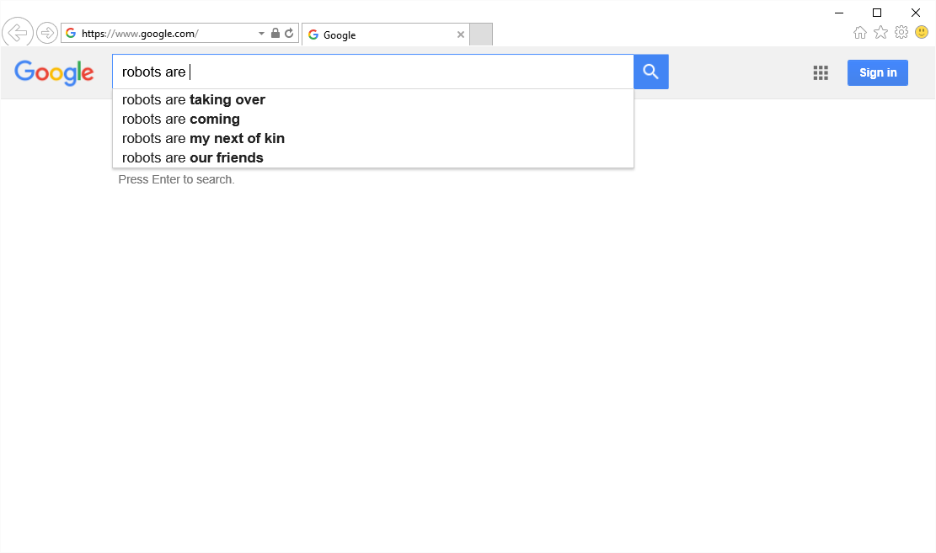
Robots are…

Slide 5
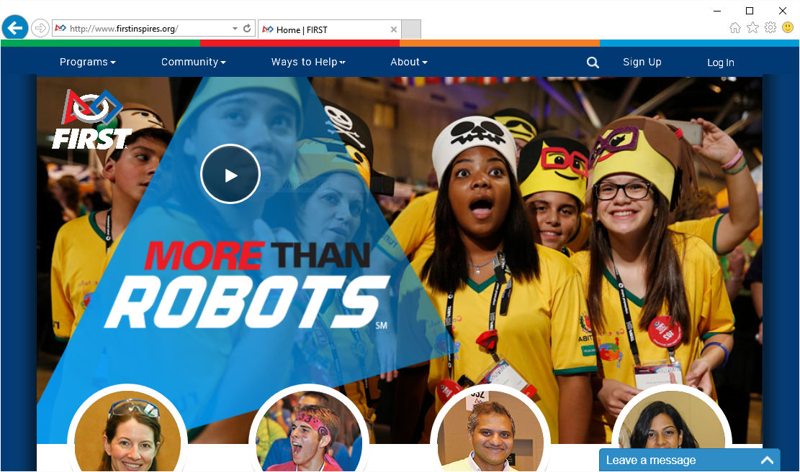

Slide 6
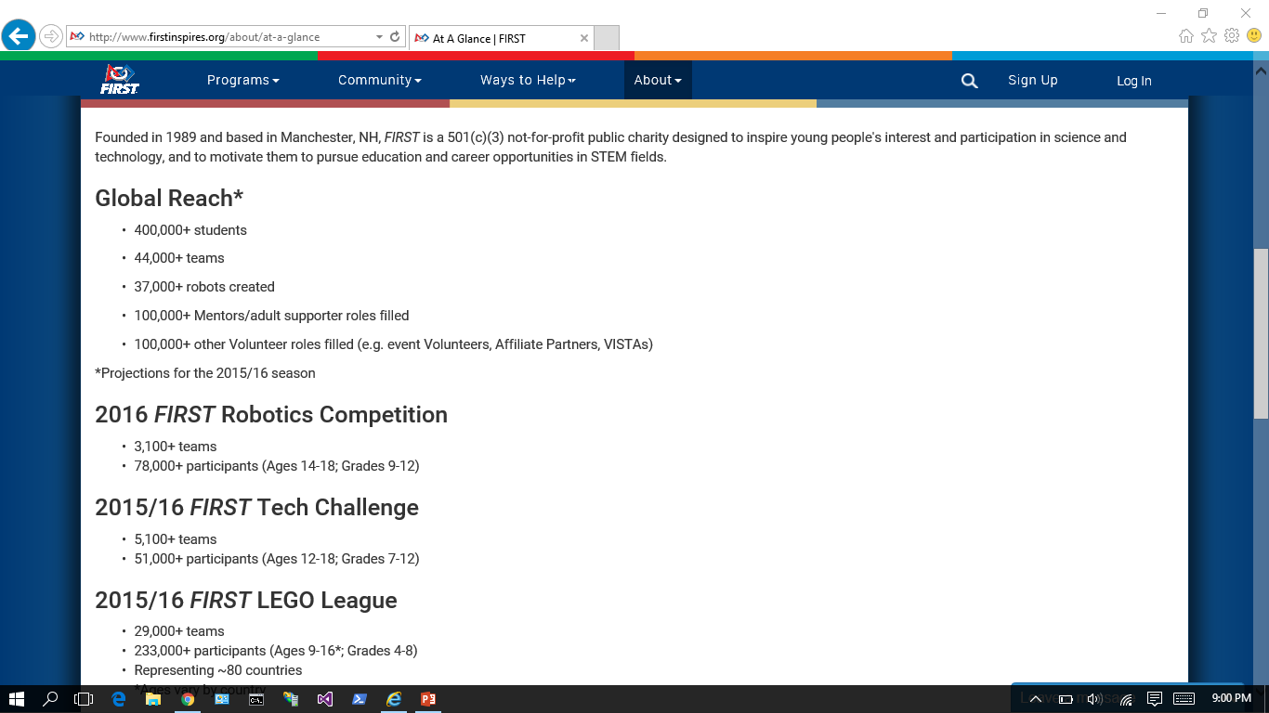

Slide 7
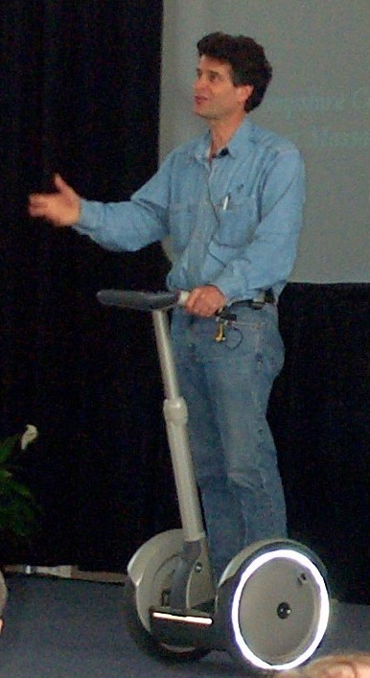

Slide 8
Video #1 – FTC RES-Q Challenge

Slide 9
My Vision:
Software Craftsmanship for Everyone

Slide 10
My Vision:
Software Craftsmanship for Everyone
Intentional, well-formed code

Slide 11
My Vision:
Software Craftsmanship for Everyone
Intentional, well-formed code
Expressive code

Slide 12
My Vision:
Software Craftsmanship for Everyone
Intentional, well-formed code
Expressive code
Automated tests

Slide 13
My Vision:
Software Craftsmanship for Everyone
Intentional, well-formed code
Expressive code
Automated tests
Learn More about Android

Slide 14
My Vision:
Software Craftsmanship for Everyone
Intentional, well-formed code
Expressive code
Automated tests
Learn More about Android
Spend Time Together

Slide 15
Reality?
Beta-level Software

Slide 16
Reality?
Beta-level Software
Simple Routines: < 100 lines of code

Slide 17
Reality?
Beta-level Software
Simple Routines: < 100 lines of code
Tightly-coupled to Hardware

Slide 18
Reality?
Beta-level Software
Simple Routines: < 100 lines of code
Tightly-coupled to Hardware
XML Config Files
Unique Hardware IDs

Slide 19
Reality?
Beta-level Software
Simple Routines: < 100 lines of code
Tightly-coupled to Hardware
XML Config Files
Unique Hardware IDs
Spend Time Together

Slide 20
Reality?
Beta-level Software
Simple Routines: < 100 lines of code
Tightly-coupled to Hardware
XML Config Files
Unique Hardware IDs
Spend Time Together (sorta)

Slide 21
The Actual Year: A Blur (Barely) Captured on YouTube

Slide 22
What Did I Learn?
No Plan Survives Contact With The Enemy

Slide 23
What Did I Learn?
No Plan Survives Contact With The Enemy
It’s OK to Not Know Stuff

Slide 24
What Did I Learn?
No Plan Survives Contact With The Enemy
It’s OK to Not Know Stuff
It’s Important to Know Limits

Slide 25
What Did I Learn?
No Plan Survives Contact With The Enemy
It’s OK to Not Know Stuff
It’s Important to Know Limits
Yours

Slide 26
What Did I Learn?
No Plan Survives Contact With The Enemy
It’s OK to Not Know Stuff
It’s Important to Know Limits
Yours
Theirs

Slide 27
What Did I Learn?
No Plan Survives Contact With The Enemy
It’s OK to Not Know Stuff
It’s Important to Know Limits
Yours
Theirs
You Aren’t There to Be Their Friend

Slide 28
What Did I Learn?
No Plan Survives Contact With The Enemy
It’s OK to Not Know Stuff
It’s Important to Know Limits
Yours
Theirs
You Aren’t There to Be Their Friend
Juiceboxes Are Still OK

Slide 29
What Did I Learn?
No Plan Survives Contact With The Enemy
It’s OK to Not Know Stuff
It’s Important to Know Limits
Yours
Theirs
You Aren’t There to Be Their Friend
Juiceboxes Are Still OK
The Kids Are Alright

Slide 30
What’s Next?
The FTC 2016-2017 Unveiling: Three Hours Ago

Slide 31
Carter Wickstrom
Lead Software Engineer
https://www.linkedin.com/in/carterwickstrom
https://twitter.com/carterwickstrom

Slide 32
The videos that I bookmarked for my talk are listed below. The first one is the one that I played at Slide #8. I had intended to play the remaining slides at Slide #21, but didn’t because of time. Still, I thought I’d include the full list because there’s some other fun stuff there.
Thanks!
1. 2015-2016 FTC Kickoff Animation https://youtu.be/b49Q3kqrSv0?t=2m35s
2. FTC 7462 at 2 weeks to go https://www.youtube.com/watch?v=GfBsNbdajuo&t=25s
3. Ingraham Robotics Jan 16 2016 https://www.youtube.com/watch?v=nlPdtDNPGpE
3a. FTC 7462 WA State Championship 2016 https://www.youtube.com/watch?v=kBjMV7yCUiw
4. FIRST STRONGHOLD Game Reveal https://www.youtube.com/watch?v=VqOKzoHJDjA
5. FRC 4030 Stronghold Jan24 2015 https://www.youtube.com/watch?v=_8ZLAW7W7r4
6. FRC 4030 Stronghold Mar 5 https://www.youtube.com/watch?v=WEyePh4JqQE
7. 2016 PNW FRC Glacier Peak Highlights https://www.youtube.com/watch?v=zqBOouMhyBc&index=2&list=PLwES-SbpsnxyykXlePasPcTTSQGYLGOtP

