Slide 1
NetGAN: Generating Graphs via Random Walks
Aleksandar Bojchevski
Oleksandr Shchur
Daniel Zügner
Stephan Günnemann

Slide 2
Related Work
NetGAN
Can GAN learn topological features of a graph?
Liu
Tavakoli
Learning social graph topologies using generative adversarial neural networks.

Slide 3
Training
Wasserstein GAN
VAL-CRITERION
Early stopping
EO-CRITERION

Slide 4
Graph Generation
Experiments
Link Prediction

Slide 5
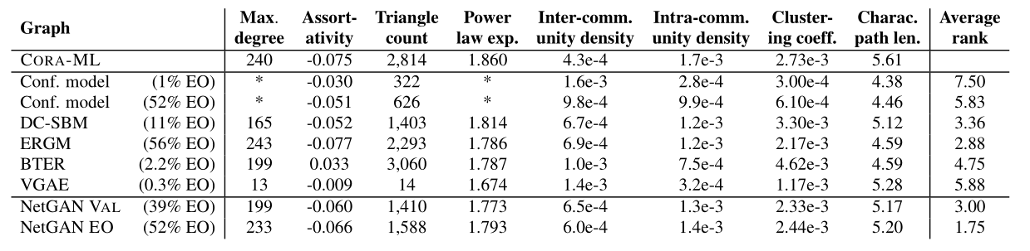
Experiments:Graph Generation
Fit NetGAN to the CORA -ML and CITESEER citation networks in order to evaluate quality of the generated graphs.

Slide 6
Experiments:Graph Generation

Slide 7
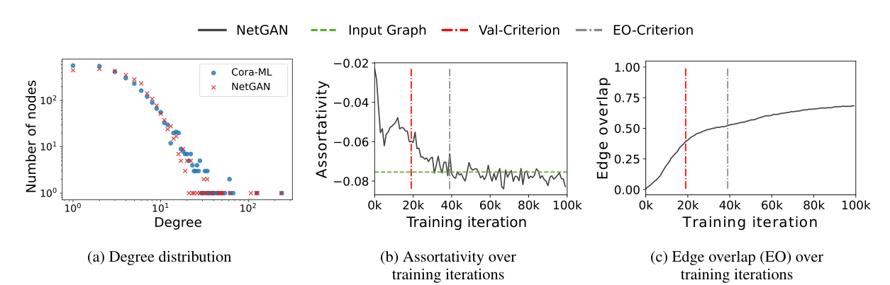
Experiments:Graph Generation
how the graph statistics evolve during the training process

Slide 8
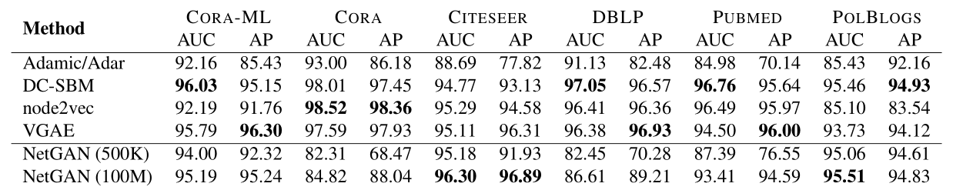
Experiments:Link Prediction

Slide 9
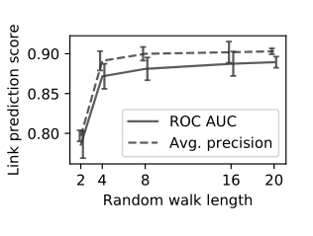
Experiments:Link Prediction
T=16

Slide 10
Discussion and Future Work
Scalability
Evaluation
Experimental scope
Other types of graphs

