Slide 1
ENSYS 5800: Applications of A.I. in Energy Systems
Spring 2022
Date: 4-25-2022

Slide 2
Bangalore Wind Power Generation
Project Presentation
Carthikswami Sunil Thoniparambil
002133000
4-25-2022
Date: 4-25-2022
Slide 2

Slide 3
Outline
Executive Summary
Problem Statement & Definition
Exploratory Data Analysis
AI/ML Modeling & Results
Conclusions & Recommendations
Date : 4-25-2022
Slide 3

Slide 4
Executive Summary
As we all know storage plays an important part in the success of renewable energy. However, the field of storage is currently lagging and is also very costly.
Forecasting the wind power with the current inputs will help in understanding the contribution of wind power to the total power generated. This in turn can help determine what the other methods should produce to meet the economy's demands.
The current AI/ML techniques provide the business with valuable information that they can use to make decisions about the future.
The clear estimate of the power generated can be an indicator to reduce wastage and maintain operating costs.
A time series model is used to forecast wind power and machine learning models to verify the predictions.
Date : 4-25-2022
Slide 4

Slide 5
Problem Statement & Definition
If we can predict the wind power at a particular time, we can reduce the use of fossil fuels to generate electricity and use the wind power in our main grids, and offset carbon release into the atmosphere.
Potential energy from a wind turbine is directly proportional to the cube of the wind’s speed, so an increase in average wind speed by even just 2 mph can produce a significantly larger amount of electricity.
Also, wind speed is depended on the weather. So, we are also considering the weather parameters as input variables.
Hence if we have the data for wind speed, we can accurately predict the wind power generation at that time.
Wind power forecasting using SARIMAX and prediction using ML and ANN.
Finding the patterns in the data using K-means clustering.
Date: 4-25-2022
Slide 5

Slide 6
Data Collection
Data Exploration and Preprocessing
Data Visualization (EDA)
Feature Selection
Model Fitting
Evaluate the models
Tune the best model
Deploy the model

Slide 7
Data Description
The Bangalore Wind Power data has 127,392 records and 8 variables, out of which 7 are numeric and 1 date-time format.
Variable | Definition
T_amb (Degree Celcius) | Ambient Temperature.
DewPoint (degree Celsius) | The temperature air needs to be cooled to achieve relative humidity of 100%.
Humidity (g/m3 in%) | The amount of water vapor present in air.
Pressure (Pa) | The atmospheric pressure.
Wind_Dir (degrees) | Wind Direction
Wind_Speed(Km/hr) | Wind velocity
Power_Generated(KW) | Power Generated
Date | Considered hourly

Slide 8
Data Preprocessing
The 3 null values of humidity were dropped.
Values with Z scores greater than 3 are considered outliers and are removed.
The dataset consists of 786 outliers ( T_amb = 266, Dew_Point = 22, Pressure = 263, Wind_Speed = 235).
The positively skewed columns are transformed into symmetric by using log and cube root transformation.
The negatively skewed data is transformed to symmetric using square transformation.
All the variables were converted to desired data types.

Slide 9
Exploratory Data Analysis
Date: 4-25-2022
Slide 9

Slide 10
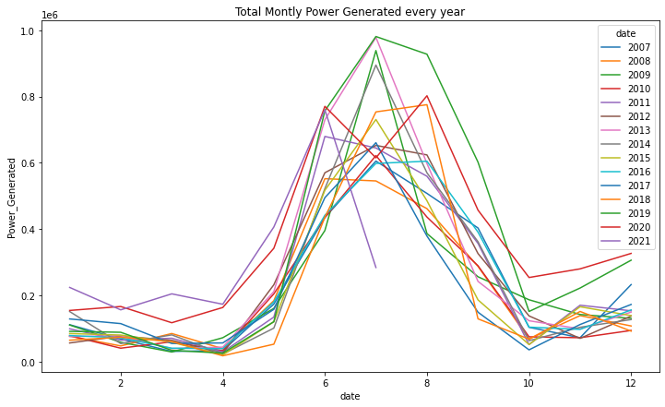
It is evident from the plot that the total monthly power generated peaks during the month of July every year. The reason for this might be the increased wind speed during the summer months. Since July is monsoon season it can be attributed that the wind speeds are high and hence there is a peak in power generated.

Slide 11
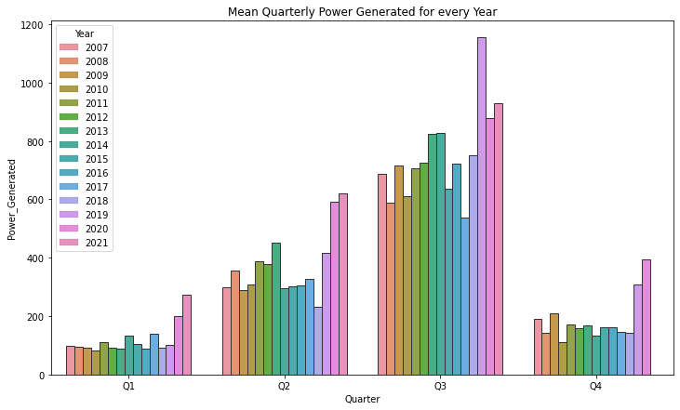
The first quarter of every year gets way lesser power compared to the other seasons. We experience a lot of power cuts during this time of the year. We can also assume that this can be a peak season for battery manufacturers.

Slide 12
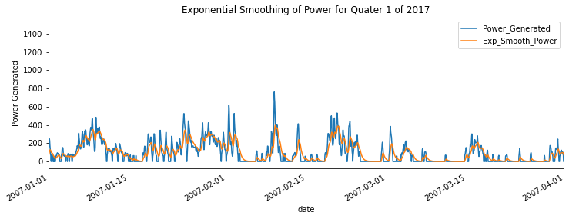
Exponential smoothing is used to remove the cyclic characteristics of the power distribution.

Slide 13
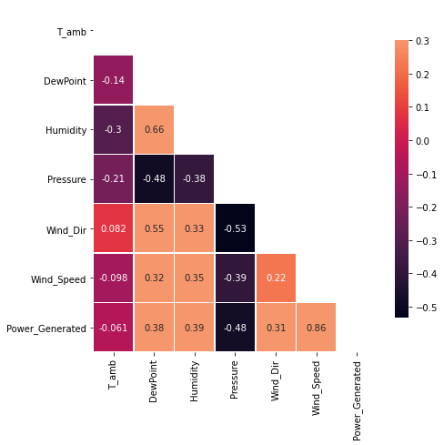
It is evident that wind speed is the most prominent factor for the power generated (correlation coefficient is 0.86). We can also interpret that the higher the pressure lower the power generated.

Slide 14
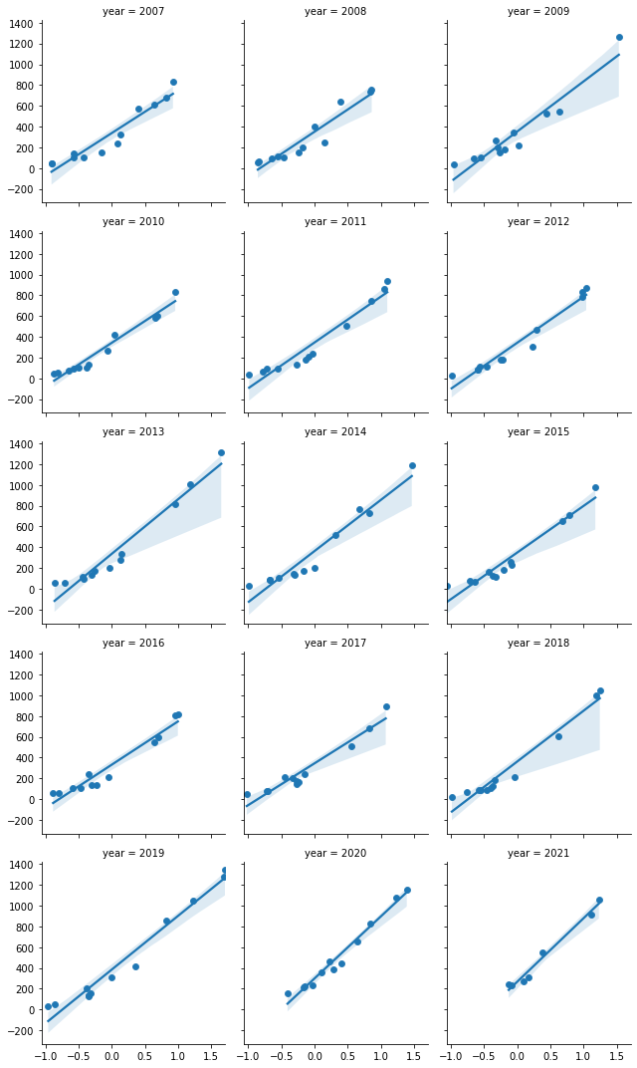
For the years 2009,2013,2014,2019, the gradient was comparatively higher indicating that with a small increase in wind speed there was a larger increase in the power generated.

Slide 15
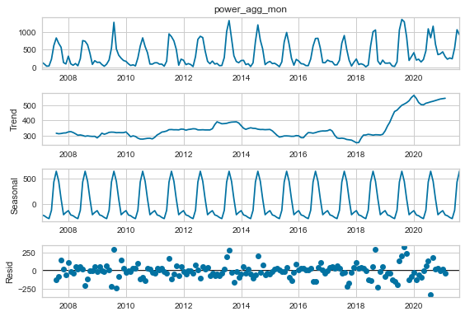
We can observe that there is an increasing trend in the time-series data after the year 2018.
There is a peak observed in the power generated in the mid of every year, indicating the seasonality.
The small Magnitude of the residuals indicates decomposition is done well.

Slide 16
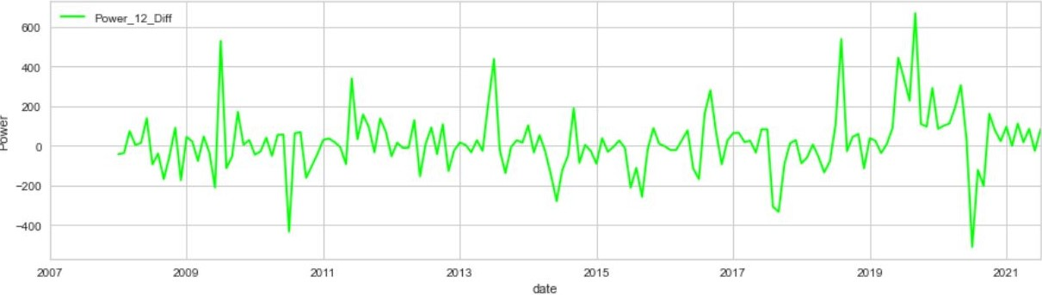
Stationarity check
The plot depicts the stationary power generated after differencing.

Slide 17
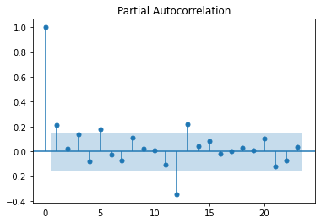
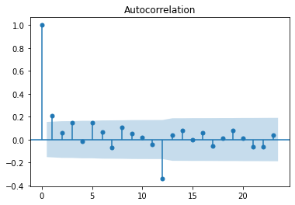
Partial Autocorrelation and Autocorrelation
The inputs of the SARIMAX model: The SARIMAX has 7 inputs – Order of seasonal component SO(P, D, Q, m) and Order of nonseasonal component (p, d, q).
The p = number of lag terms is found using a partial autocorrelation plot, d= number of times the differencing is carried out (integration factor), and q = moving average lag is found using an Autocorrelation plot, m = exogeneous variable.

Slide 18
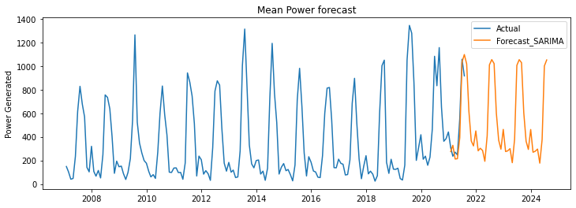
Power Forecast
The mean power forecast for 2021 to 2024
The RMSE and R-square values of the SARIMAX model are 102.10 and 0.9

Slide 19
AI/ML Modeling
Date: 4-25-2022
Slide 19

Slide 20
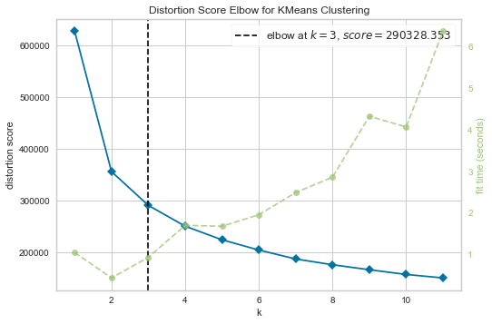
Elbow Method

Slide 21


Slide 22
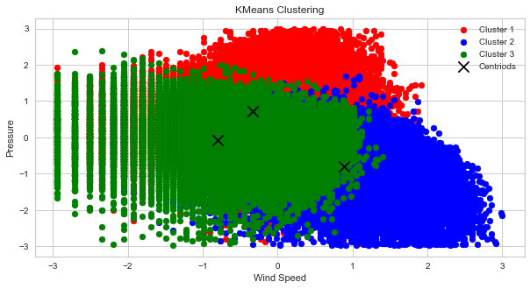
K-means Clustering

Slide 23
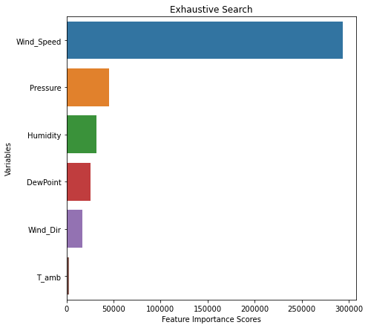
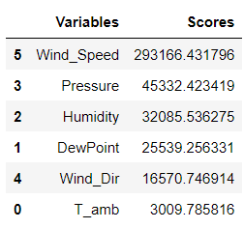
Feature Selection
The exhaustive search method is used to find the best feature and f_regression is used as a scoring function.

Slide 24
Model Building: Machine Learning
Model | RMSE | R-Square
Linear Regression | 214.172 | 0.783
KNN Regressor | 31.241 | 0.95
Random Forest Regressor | 2.989 | 1
Xgboost Regressor | 2.84 | 1

Slide 25
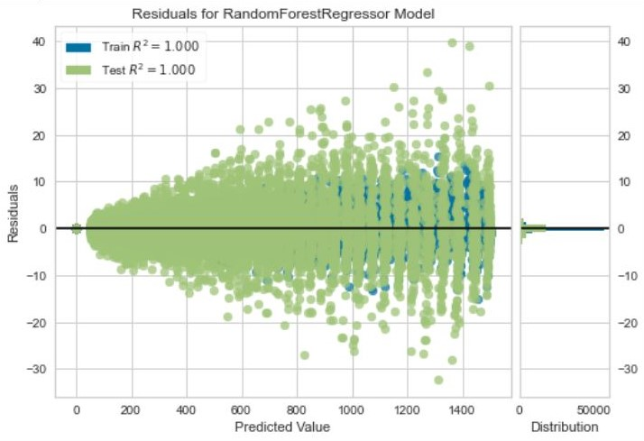
Residual Plot
The residual error follows the gaussian distribution. The variability of the response variable for a given set of predictors is the same across all values of predictors and hence the homoscedasticity is not violated.

Slide 26
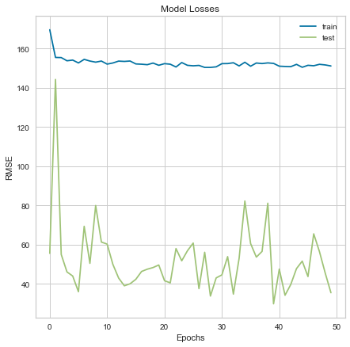
Model Building: Deep Learning
The model is trained with a Stochastic gradient descent optimizer with a learning rate of 0.01 and momentum of 0.9 for 50 epochs, with a batch size of 54.
The RMSE and R-Squared were found to be 35.404 and 0.9.

Slide 27
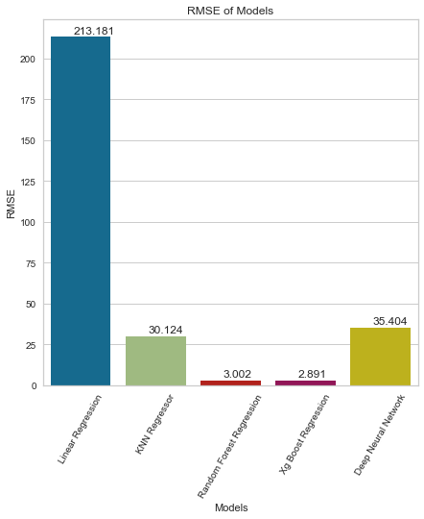
Performance Evaluation

Slide 28
Conclusions & Recommendations
After evaluating the performance of the model, it was found that machine learning algorithms like random forest regressor and Xgboost regressor gave impressive results.
Deep neural network gave decent results, but it also depends on the hyperparameters like activation function, hidden layer, learning rate, optimizer, batch size, and epochs.
The Windpower forecast model can be deployed to analyze the use cases like supply chain and demand forecasting. This can also be used to analyze resource allocation and cash flow management.
In the end it all depends upon how the data is structured to fit into a particular model.
Finally, the choice of the model depends upon how efficiently the results suit a particular application. If we have high-dimensional data with many records it is better to go for deep learning models than machine learning models.
Date: 4-25-2022
Slide 28

Slide 29
Thank you

