Slide 1
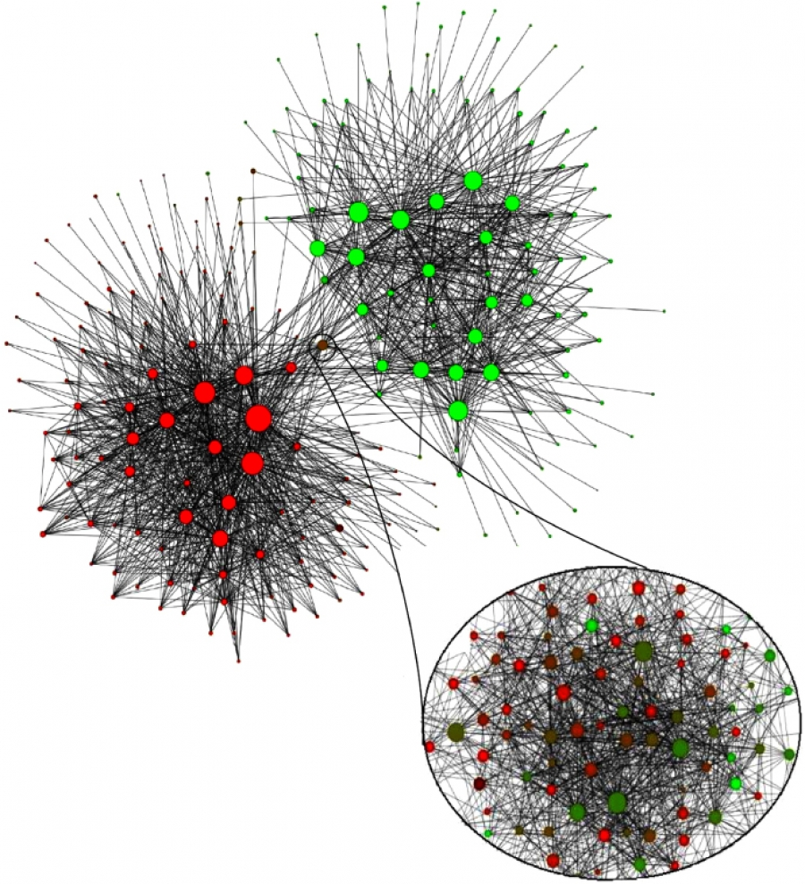
Network Science
CS 499/CS 599
Spring 2020
Morgan Vigil-Hayes

Slide 2
Notes:
Last week, we talked about nodes tendency to cluster or link together based on structural similarities.
This week, we will be discussing the tendency of nodes to cluster together and form communities.

Slide 3
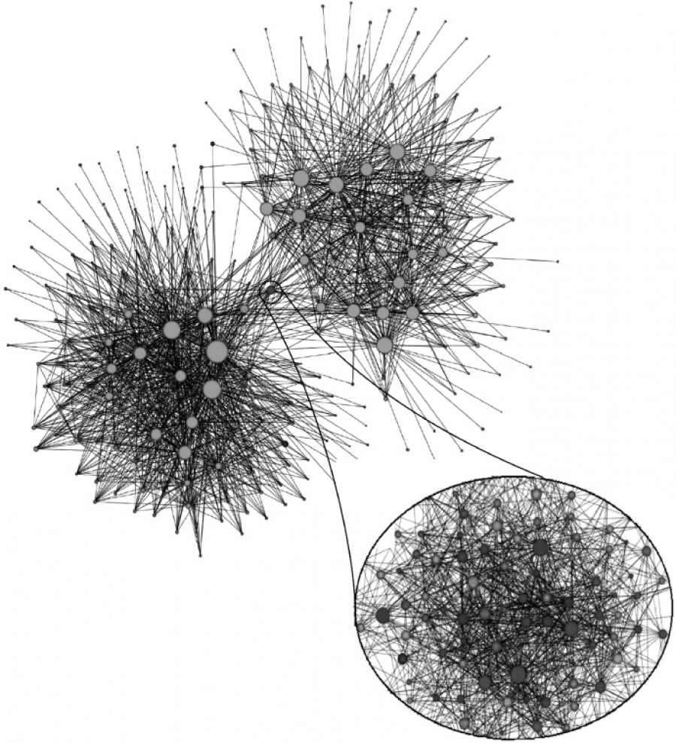
Case Study: Belgium
2 ethnic groups:
40% Walloons (French speaking)
59% Flemish (Dutch speaking)
Network of mobile phone calls from over 2 million users
Notes:
To highlight some examples of community detection, we will walk through a few case studies.
[CLICK]
The first case study centers on Belgium, which is built of two predominant ethnic groups, Walloons, who speak French, and Flemish, who speak Dutch.
As multiethnic countries break up all over the world, we must ask: How did this country foster the peaceful coexistence of these two ethnic groups since 1830? Is Belgium a densely knitted society, where it does not matter if one is Flemish or Walloon? Or we have two nations within the same borders, that learned to minimize contact with each other?
[CLICK]
One scientist, Vincent Blondel, decided to study this question with his students. They analyzed data from Belgium’s largest mobile phone company and built a network structure
Nodes represent communities and larger nodes represent nodes with a larger number of individuals in the community. Links represent frequency of calls between communities.
[CLICK]
Blondel and his students discovered that the communities formed two distinct clusters
[CLICK]

Slide 4
Case Study: Belgium
2 ethnic groups:
40% Walloons (French speaking)
59% Flemish (Dutch speaking)
Here we have a community of communities…but what exactly does “community” mean in network science?
Notes:
And when they added colors to the nodes based on the dominant language spoken in each community, they found that the cluster corresponded to language
[CLICK]
When they examined the small third cluster that connected the two separate clusters, they found many intermixed communities that corresponded to communities from Brussels, Belgium’s metropolitan center. Thus, they found that even when separating communities, there were still communities of communities that revealed interesting details about Belgium’s cultural structure.
[CLICK]
In this next chapter we will be examining what exactly community means in network science and how we can detect communities in networks

Slide 5
Community
A group of nodes with a higher likelihood of linking to each other than to nodes from other communities.

Slide 6
Week 12 Learning objectives
1. Define communities using structural definitions
2. Identify communities in networks using graph partitioning
3. Apply community detection algorithms to answer questions about a complex system

