Slide 1
SIDM subhalos and satellites: core, core-collapse, and diversity
Zhichao “Carton” Zeng
OSU → Texas A&M
Controlled/idealized simulations
Individual subhalo
Build the hybrid method
Understand physics driving DM evolution
ZCZeng et al 2110.00259
Population of subhalos
Statistical properties given SIDM models
ZCZeng et al 2310.09910
Individual subhalo + galaxy
DM+star particles
Numerical issues
Trace evolution of stellar properties: size, mass-light ratio, v-dispersion
Diversity & universality (tidal-track)
240x.xxxxx
DM only
DM+stars

Slide 2
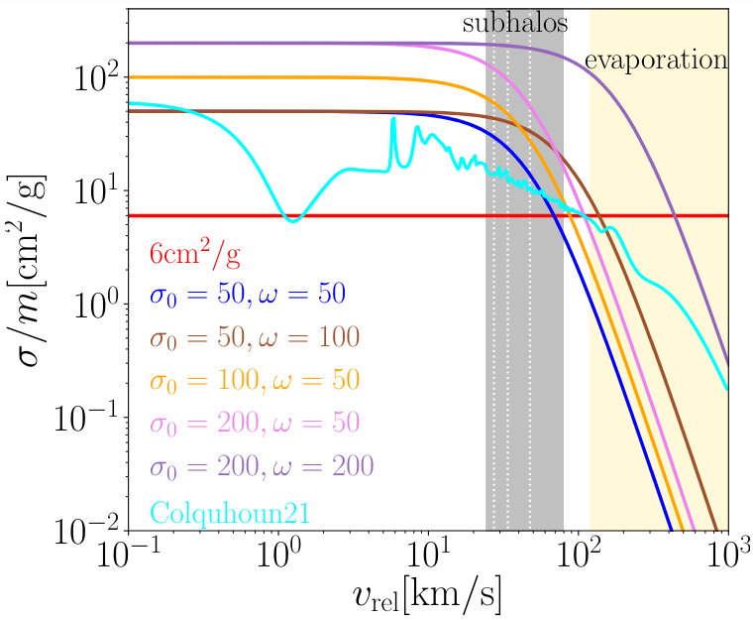

Controlled simulations
An isolated host + its subhalo(s)
Halos are initialized as halos at the beginning
High resolution, controllable orbits, etc
For our case:
The host is an analytic mass+velocity distribution
Capture the host-subhalo interaction
Tidal force – already mature
Evaporation: self-interaction of host-sub pair
Semi-analytically calculated

Slide 3
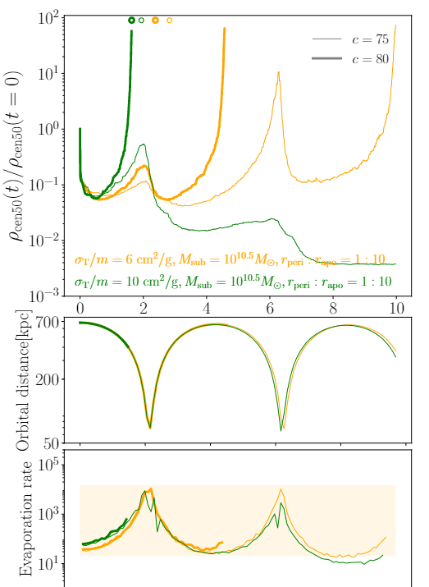
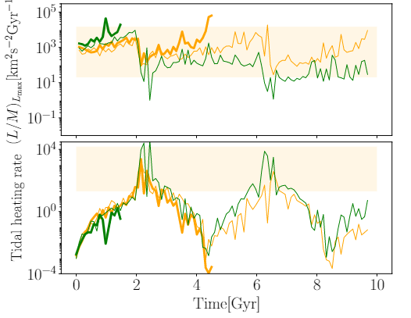
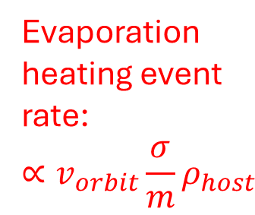
Individual SIDM subhalo
Core-collapse (terminate the simulation here)
Internal cooling by heat outflow
NFW
Central density
Tidal heating rate
core
[Gyr]
Orbital distance
Subhalo central density grows only if cooling > heating
Evaporation heating can be strong enough to disrupt pre-core-collapse
Core-collapse or not is highly sensitive to subhalo parameters
Diversity of subhalo central density!
Evaporation heating event rate:
$$∝v_{orbit}\frac{σ}{m}ρ_{host}$$

Slide 4
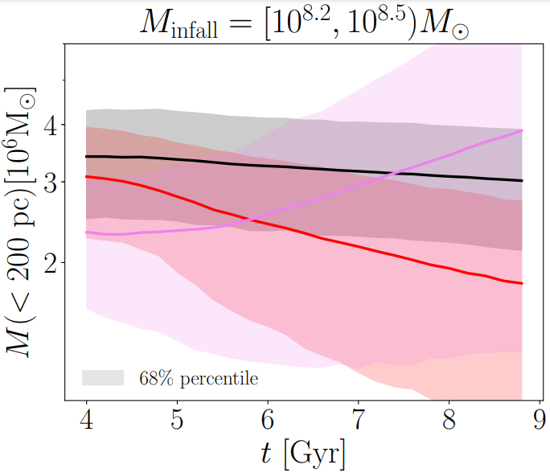
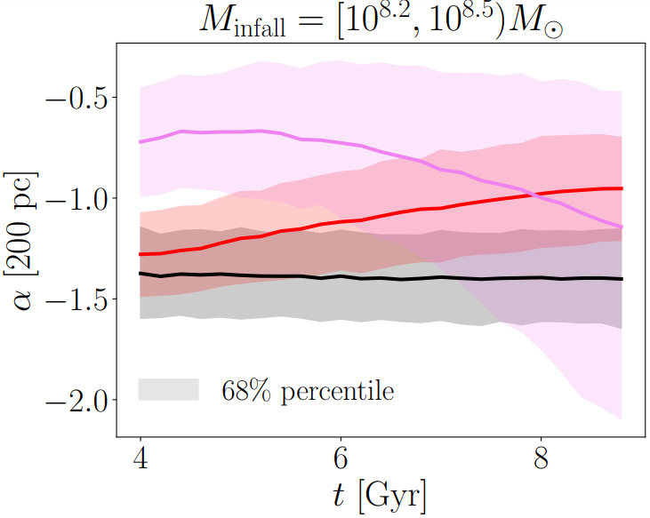
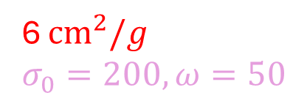
Population of subhalos
CDM
6 ${cm}^{2}/g$
$$σ_{0}=200,ω=50$$
Cored subhalos, evaporation
10-20% subhalos core-collapsed
Main features of core-collapse happening:
(near the center) denser, hotter, steeper density slope
Subhalos’ inner mass
Subhalos’ inner slope

Slide 5
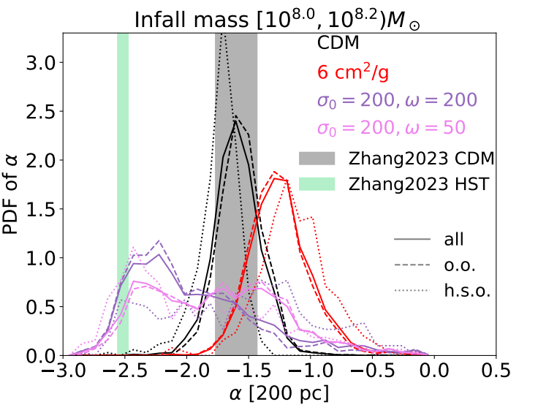
Population of subhalos
SIDM core-collapse in subhalos can explain ultra-steep inner slope in subhalos found by lensing with HST (13 images)
Zhang+ 2308.09739
At t=9Gyr

Slide 6
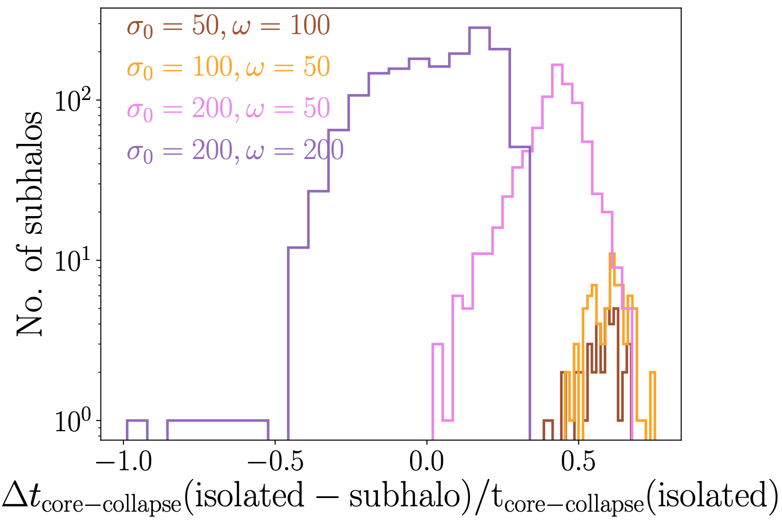
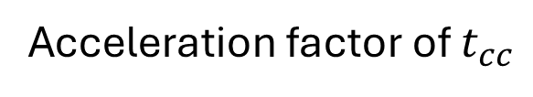
Subhalos vs. in-field halos: acceleration or deceleration?
decelerate
accelerate
Acceleration factor of $t_{cc}$

Slide 7
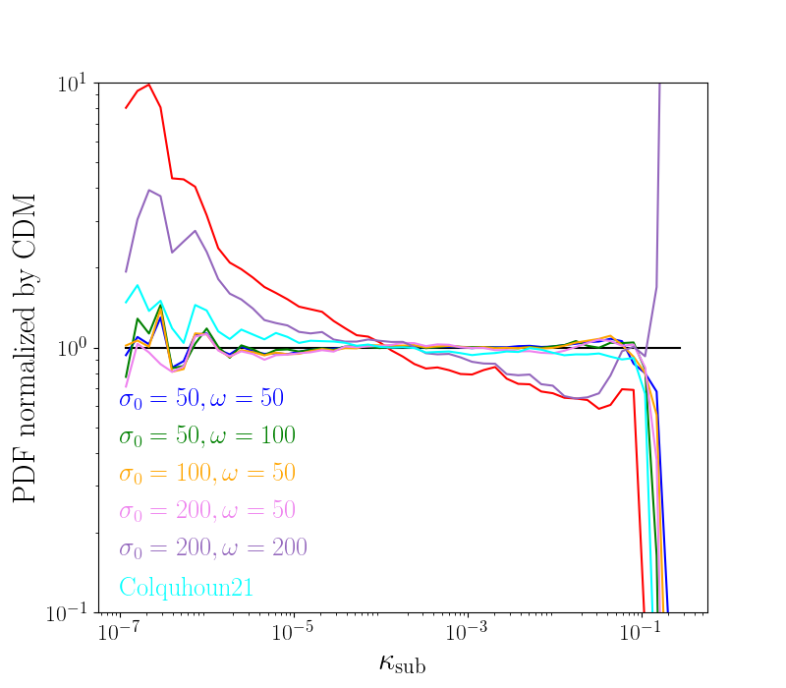
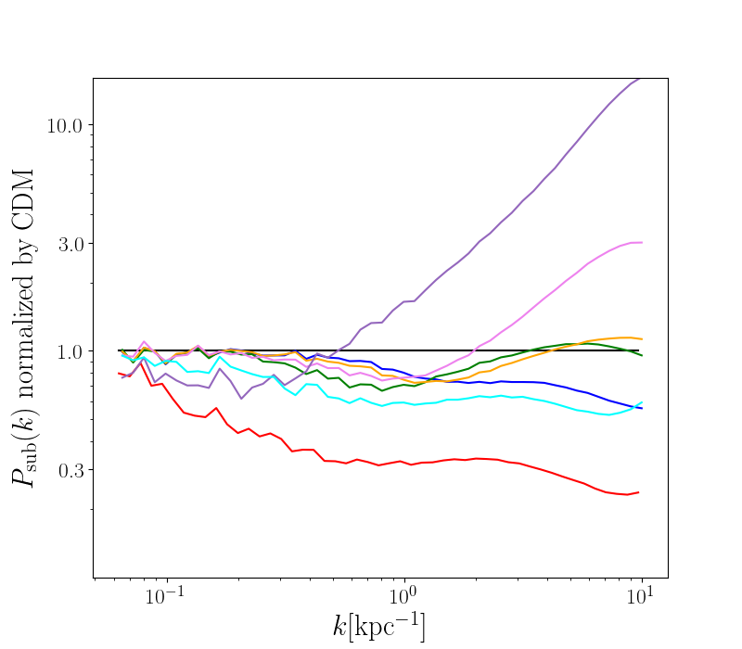
Population of subhalos: lensing statistics
Lensing density can probe core-collapse in massive subhalos
Higher-order term can probe c.-c. in smaller subhalos
Histogram of projected density (1-point function)
2-point function
c.-c. in massive subs
c.-c.
Low-fraction core-collapse
Mass loss from evaporation
Core
No c.-c. or c.-c. in small subhalos
Subhalo outlayer & 2-halo term
Massive sub center
Small sub center

Slide 8
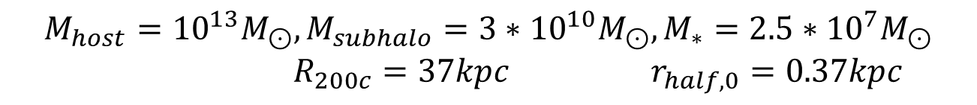
Dwarf satellites in SIDM subhalos: numerical issues of DM+star sims
Two parameters to test:
DM particle resolution
DM-star particle mass ratio
1:1 vs 5:1 --- mass segregation
Two conditions to be ‘good convergence’
Lower resolution converges to higher resolution
CDM galaxy in isolation should not evolve
 | DM particle no. | Star particle no. (1:1)
High-res | 8.5e6 | 5000
Mid-res | 1.7e6 | 1000
Low-res | 3.4e5 | 200
$${M_{host}={10}^{13}M_{⊙}, M}_{subhalo}={3∗10}^{10}M_{⊙}, M_{∗}=2.5∗{10}^{7}M_{⊙}$$
$R_{200c}=37kpc$ $r_{half,0}=0.37kpc$

Slide 9
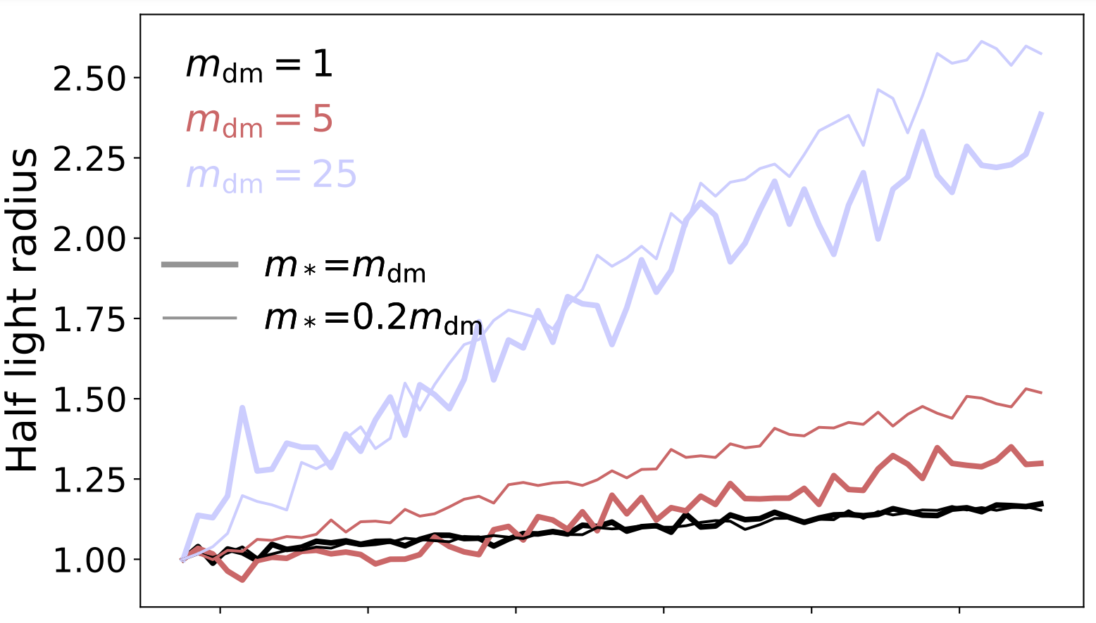
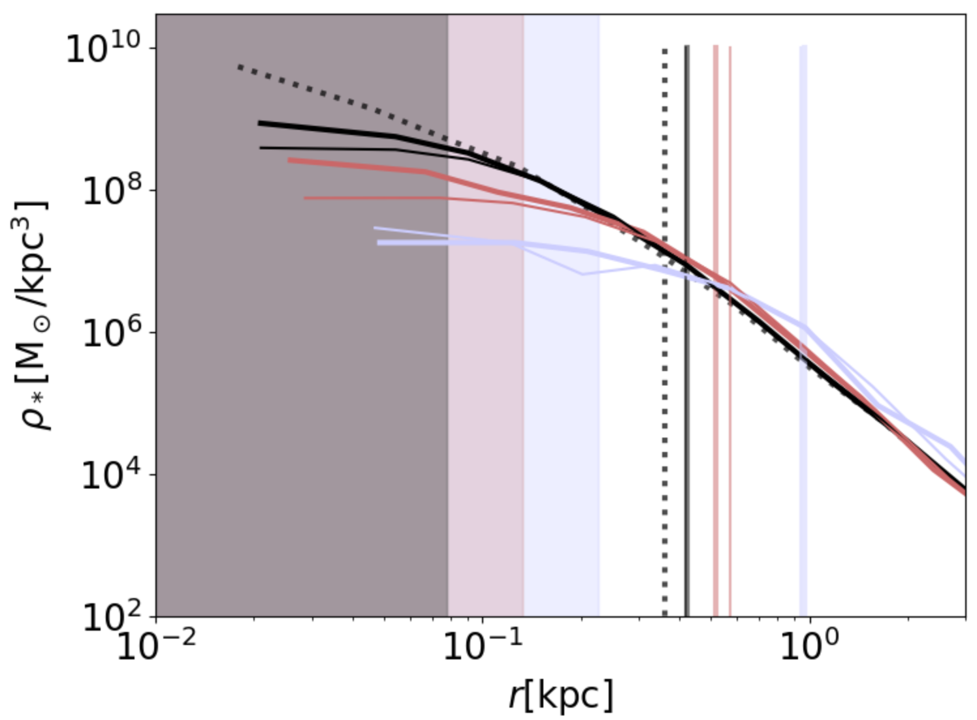
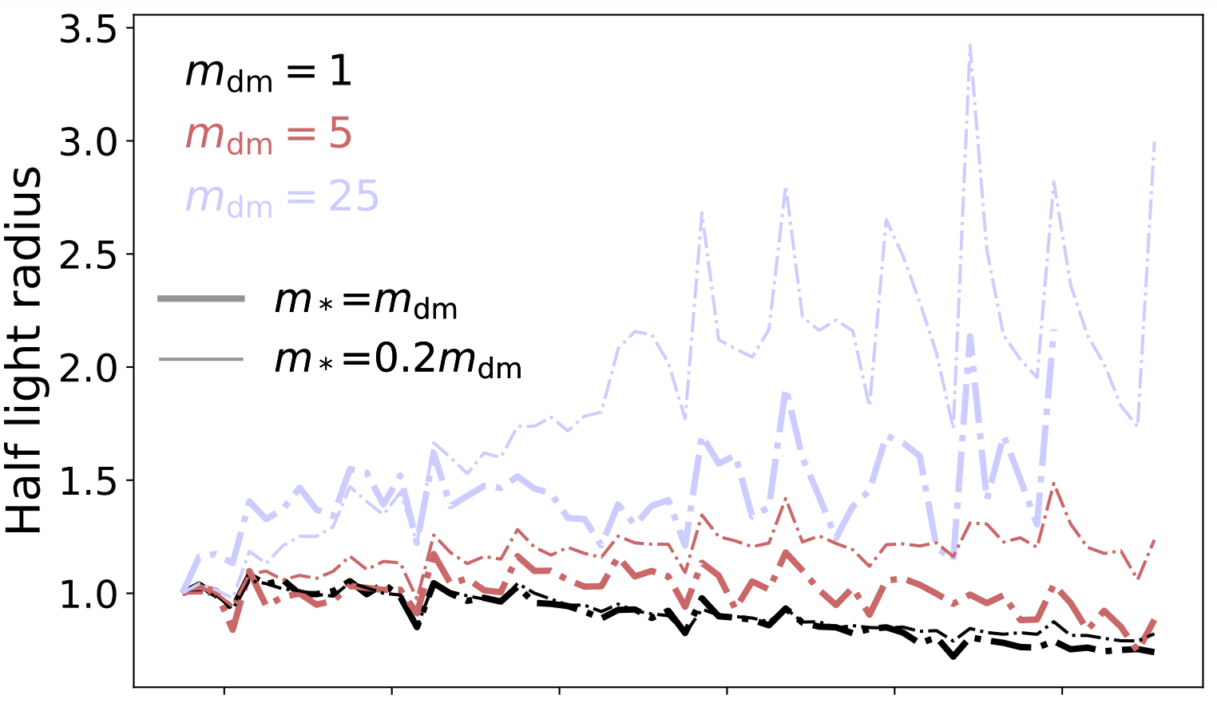
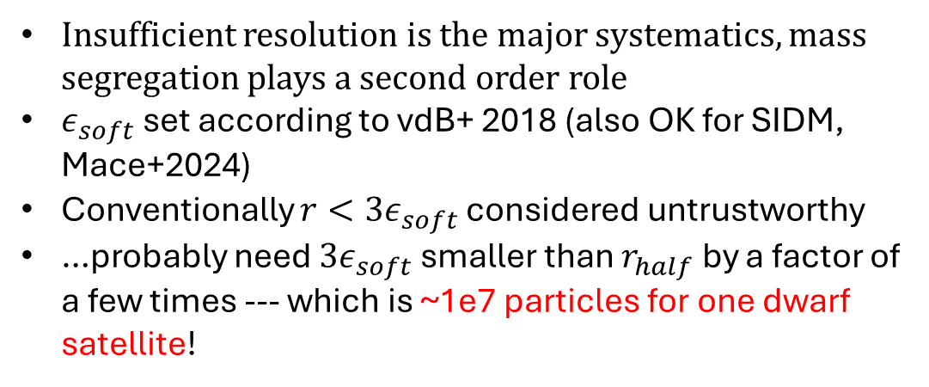
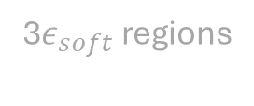
Isolated CDM
Insufficient resolution is the major systematics, mass segregation plays a second order role
$ε_{soft}$ set according to vdB+ 2018 (also OK for SIDM, Mace+2024)
Conventionally $r<3ε_{soft}$ considered untrustworthy
…probably need $3ε_{soft}$ smaller than $r_{half}$ by a factor of a few times --- which is ~1e7 particles for one dwarf satellite!
3$ε_{soft}$ regions
I.C.
CDM satellite

Slide 10
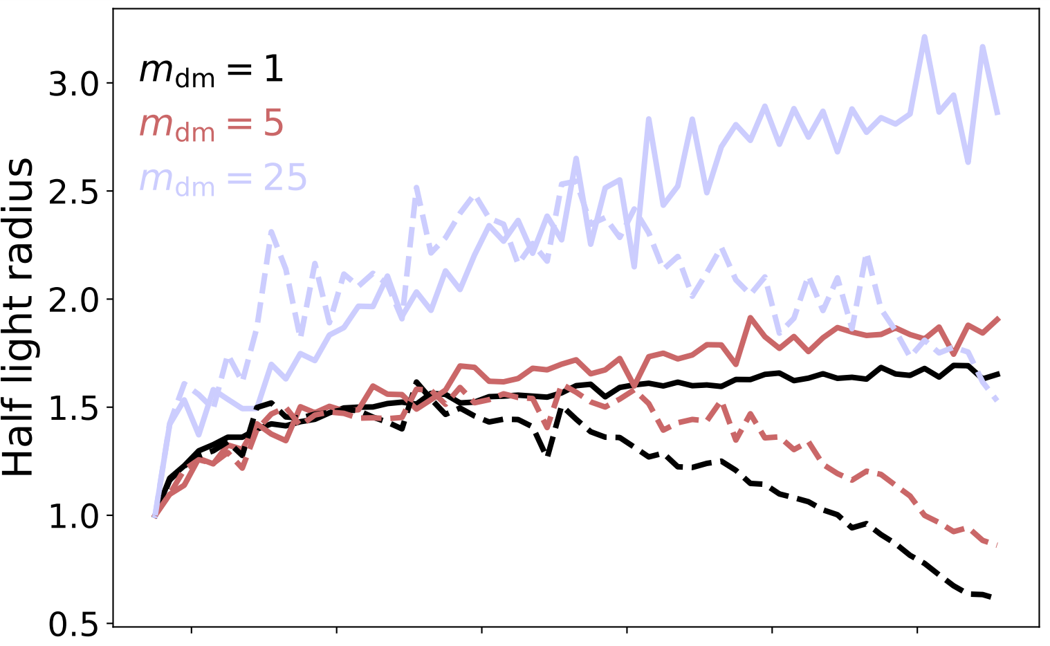
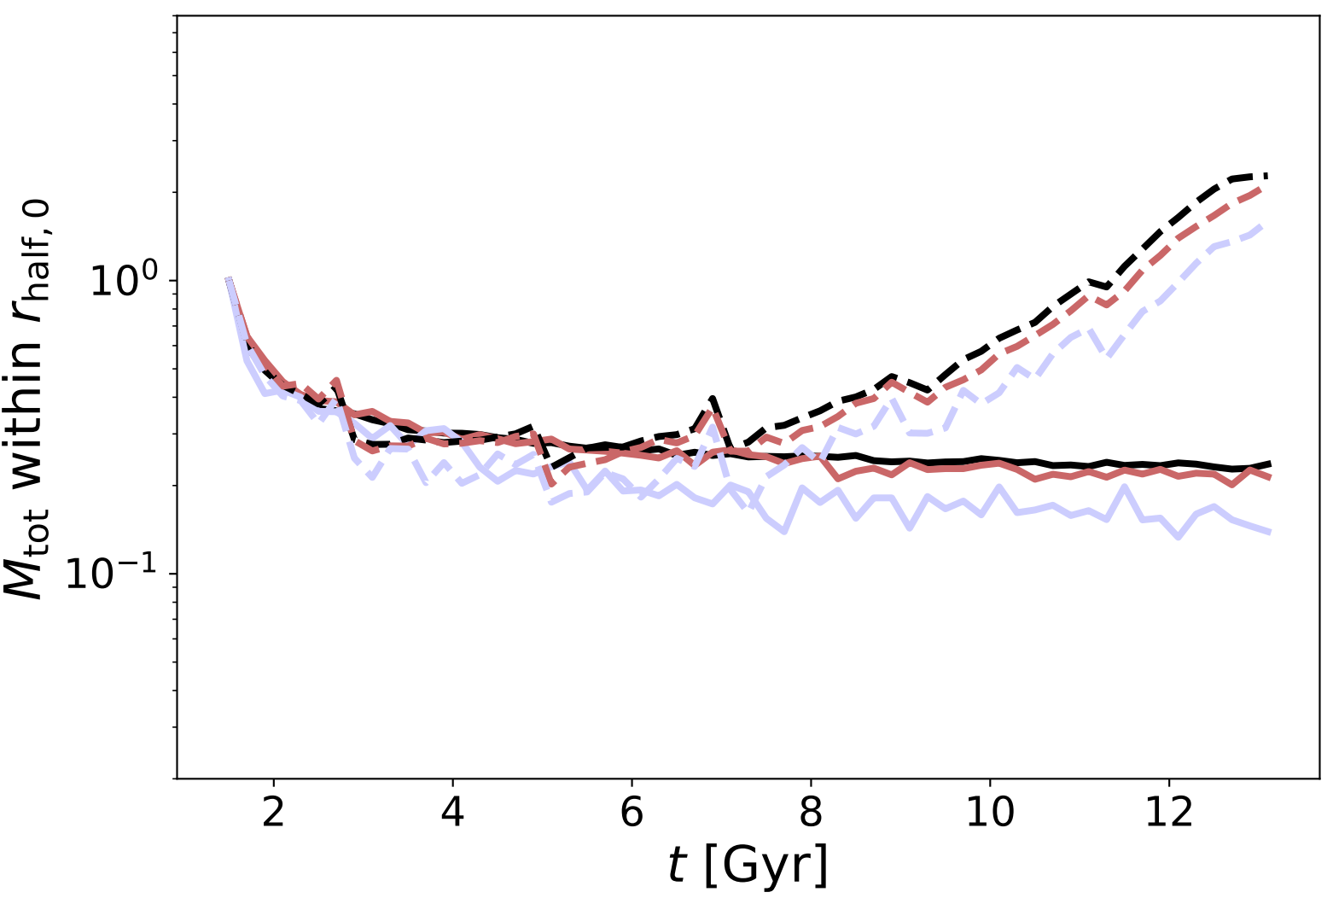
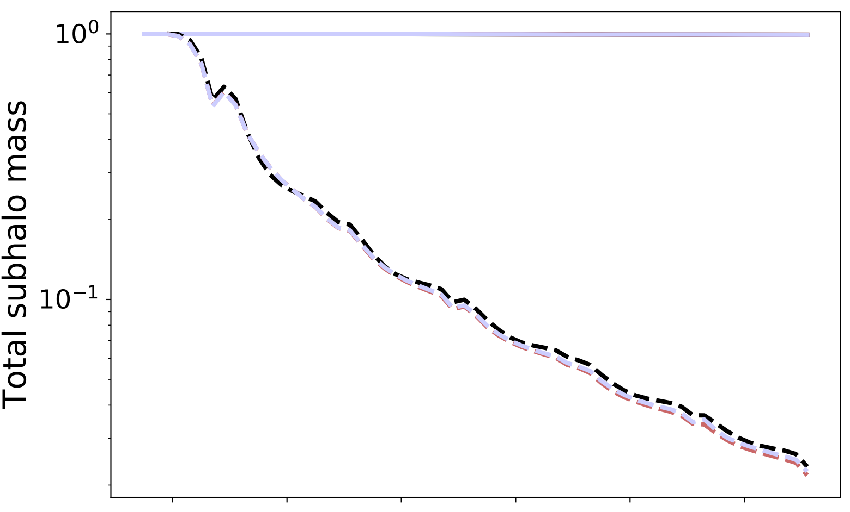
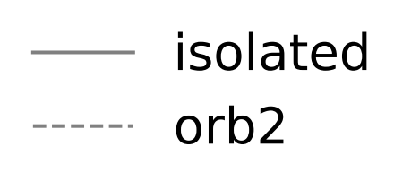
SIDM isolated/satellite
SIDM has resolution requirement similar to CDM
Convergence in subhalo virial radius scale doesn’t guarantee convergence in its inner galaxy scale
Inner mass is more robustly measured → tidal tracks?

Slide 11
Resolution -- the eternal pain of simulators

Slide 12
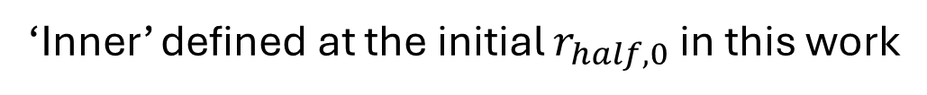
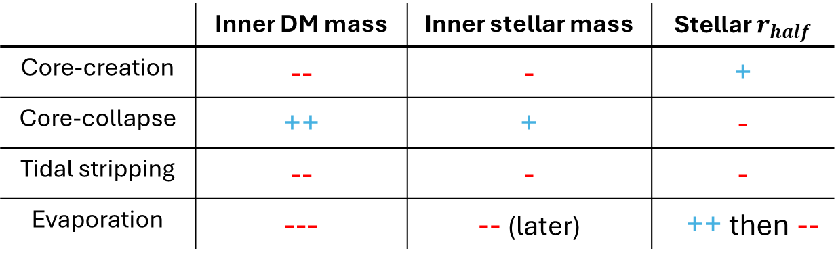
How do stars respond to SIDM core to core-collapse and orbital effects?
‘Inner’ defined at the initial $r_{half,0}$ in this work
(Qualitatively)
 | Inner DM mass | Inner stellar mass | Stellar $r_{half}$
Core-creation | -- | - | +
Core-collapse | ++ | + | -
Tidal stripping | -- | - | -
Evaporation | --- | -- (later) | ++ then --

Slide 13
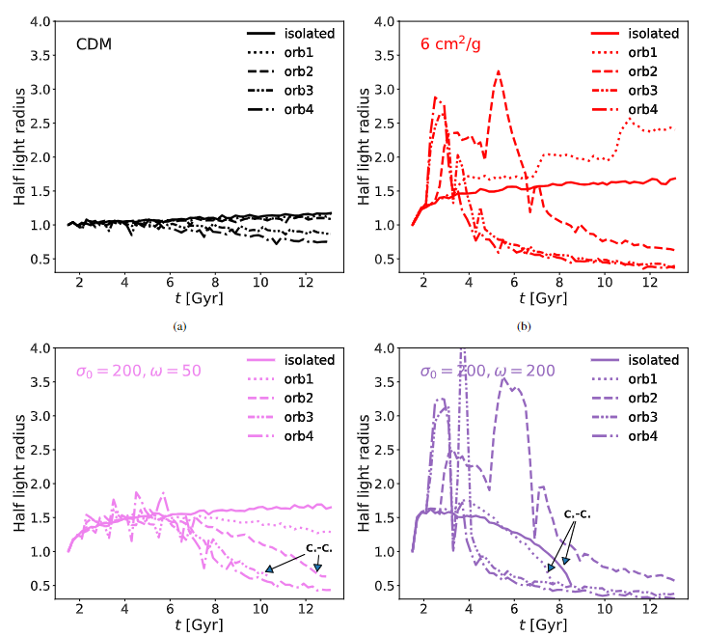
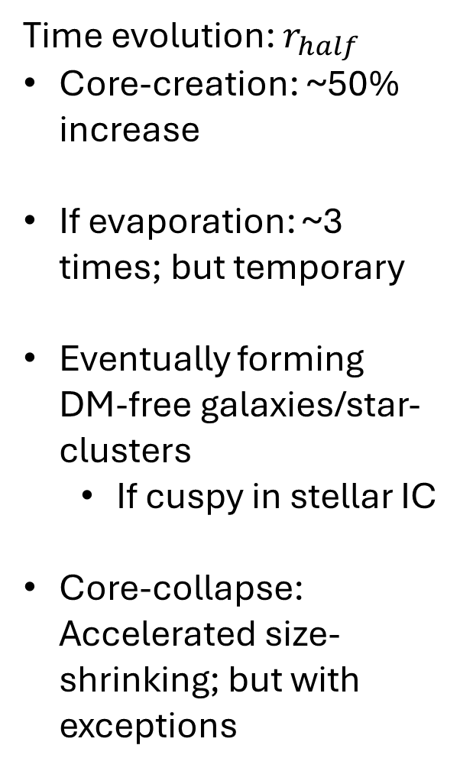
Time evolution: $r_{half}$
Core-creation: ~50% increase
If evaporation: ~3 times; but temporary
Eventually forming DM-free galaxies/star-clusters
If cuspy in stellar IC
Core-collapse: Accelerated size-shrinking; but with exceptions
closer orbit
Evaporation induced size boost
DM-free galaxy

Slide 14
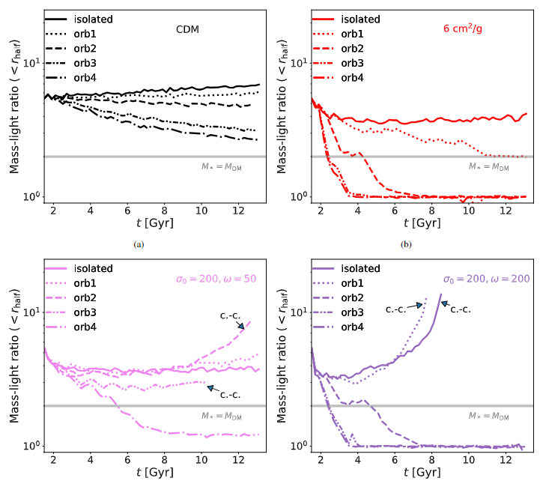
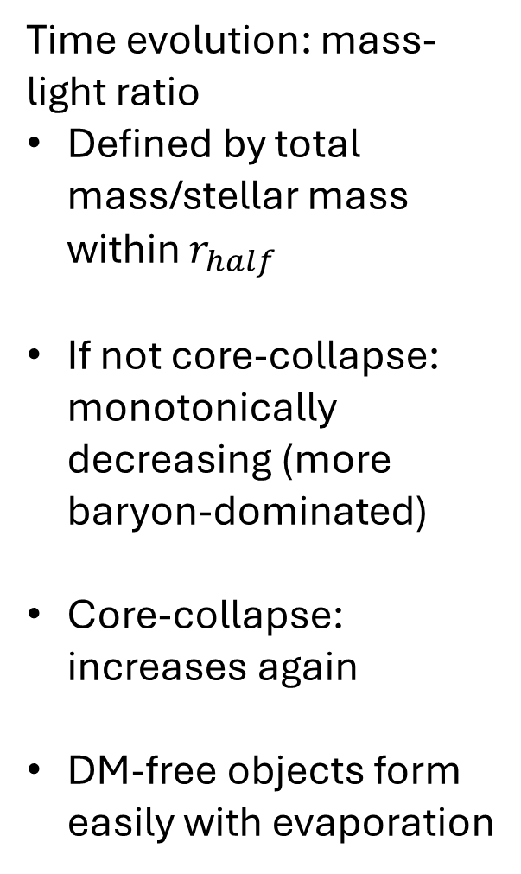
Time evolution: mass-light ratio
Defined by total mass/stellar mass within $r_{half}$
If not core-collapse: monotonically decreasing (more baryon-dominated)
Core-collapse: increases again
DM-free objects form easily with evaporation
DM-free galaxy

Slide 15
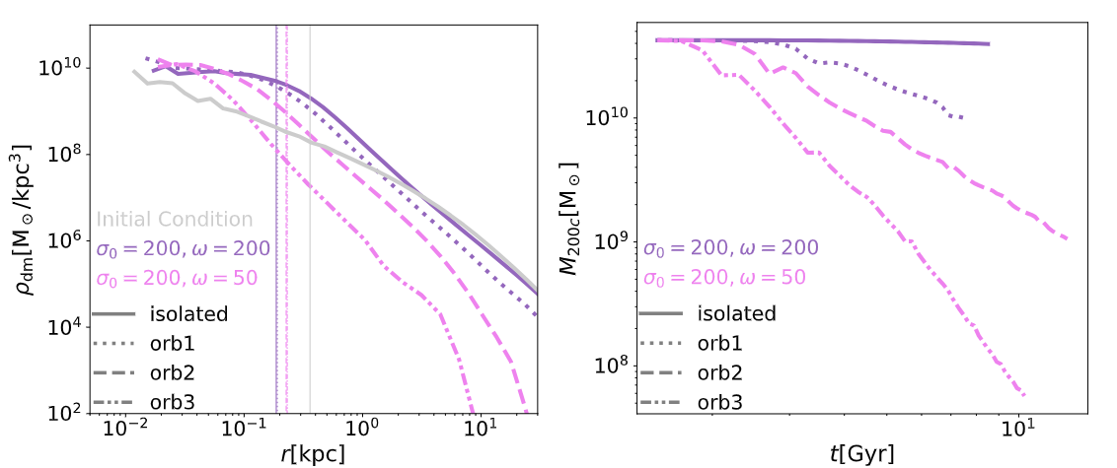
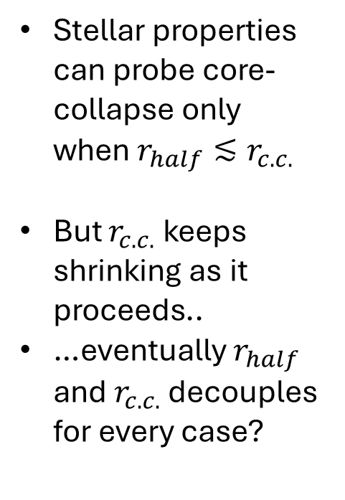
The core-collapsing cases: what happened to the exception?
DM density at core-collapse
Total mass loss history
Stellar properties can probe core-collapse only when $r_{half}≲r_{c.c.}$
But $r_{c.c.}$ keeps shrinking as it proceeds..
…eventually $r_{half}$ and $r_{c.c.}$ decouples for every case?

Slide 16
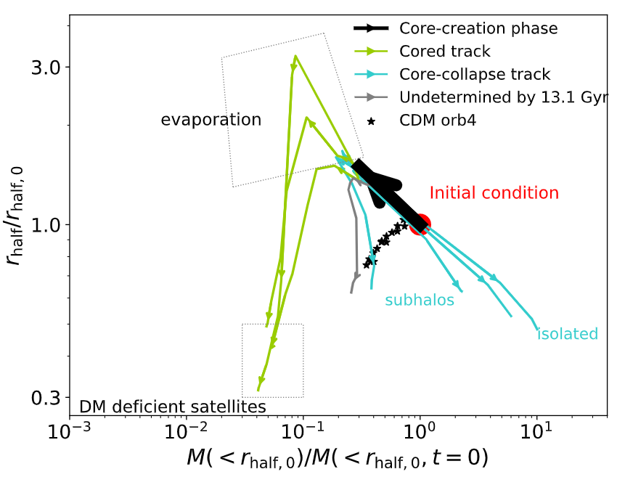
Stellar properties: the tidal-track approach
A universal core-creation stage
The core-collapse backward leg perfectly overlaps with the core-creation: adiabatic expansion & contraction
The whole thing seems highly parameterizable
Observable – but demands higher resolution to simulate
The tracer that demands lower resolution

Slide 17
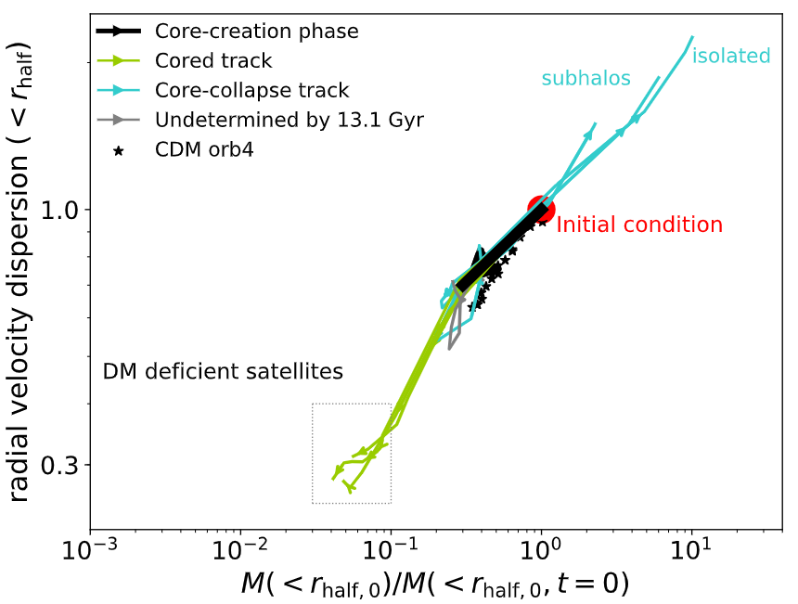
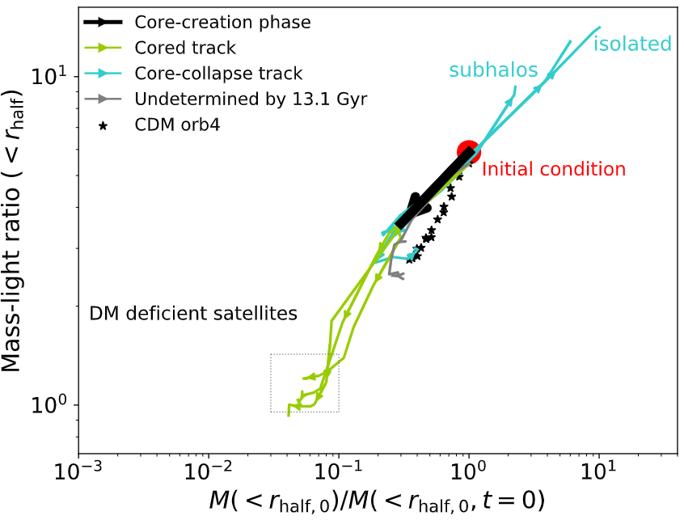
Stellar properties: the tidal-track approach
Radial velocity dispersion
Mass-light ratio

Slide 18
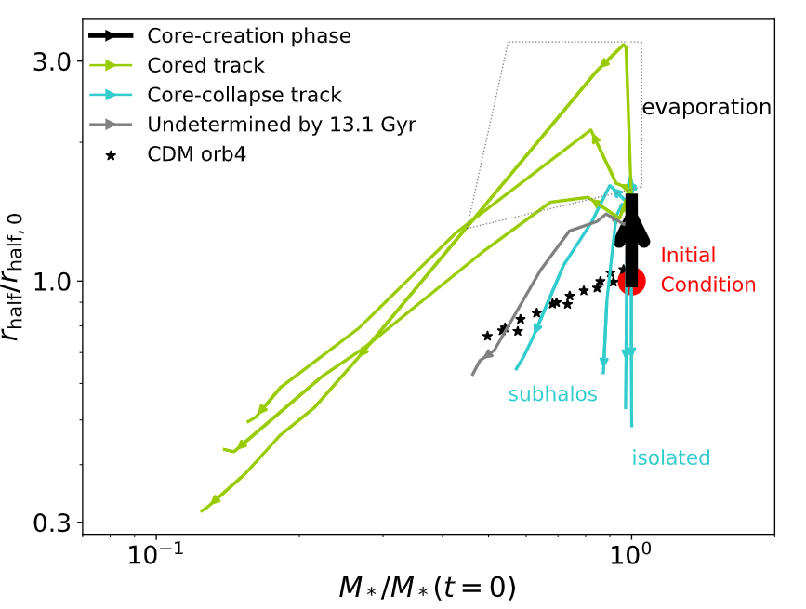
Not a tidal track but stellar mass-size plane

Slide 19
Speculation time!
Stars get more concentrated with core-collapse
If there’s gas, it should follow…? (credit: Akaxia Cruz & Stacy Kim)
Increasing density of gas -> bursty star formation -> stars that are concentrated at birth, also narrow spread in age
Globular cluster…?

Slide 20
Take away messages
Controlled simulations for small SIDM subhalos and dwarf satellites
Both halo statistics and stellar properties exhibit a large diversity in SIDM with (a fraction of) core-collapse
The DM+star simulations are very demanding in resolution for dwarfs
…but the stellar evolution also display a universality in co-evolution with inner total mass (mostly dominated by DM) → tidal tracks!

Slide 21
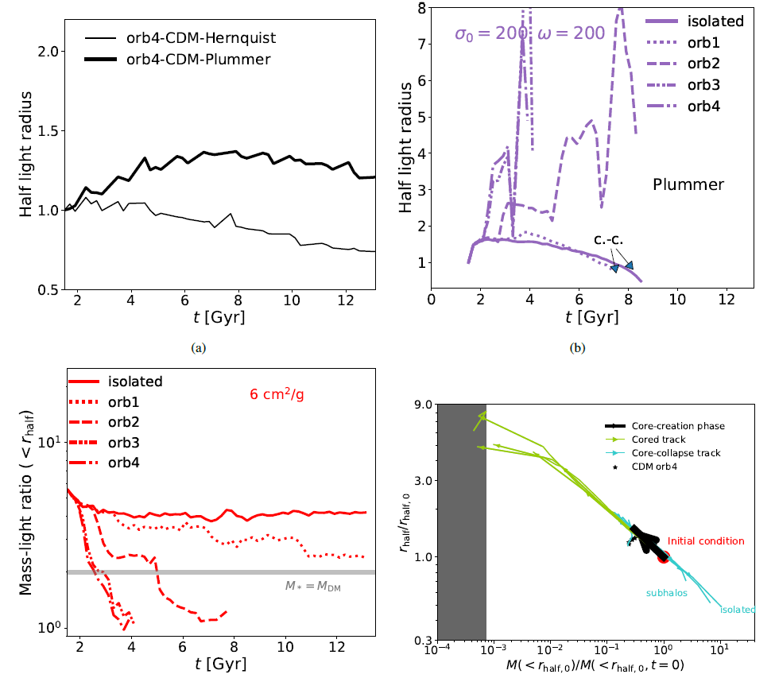

Slide 22
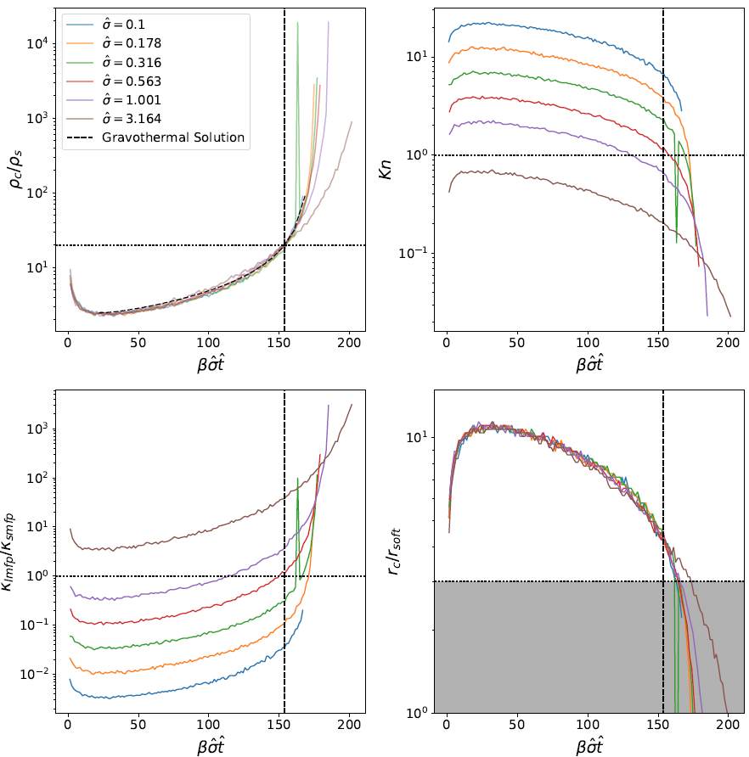
Credit: Charlie Mace

Slide 23
