Slide 1
Self-interacting dark matter substructures: a tale of diversity and more
Zhichao “Carton” Zeng
postdoc
Ohio State → Texas A&M
with Annika Peter, Xiaolong Du, Shengqi Yang, Andrew Benson, Francis-Yan Cyr-Racine, Stacy Kim, Fangzhou Jiang, Mark Vogelsberger, Charlie Mace, Ben Metcalf, Jiaxuan Li, Akaxia Cruz
Sept 2024
TAMU Seminar

Slide 2
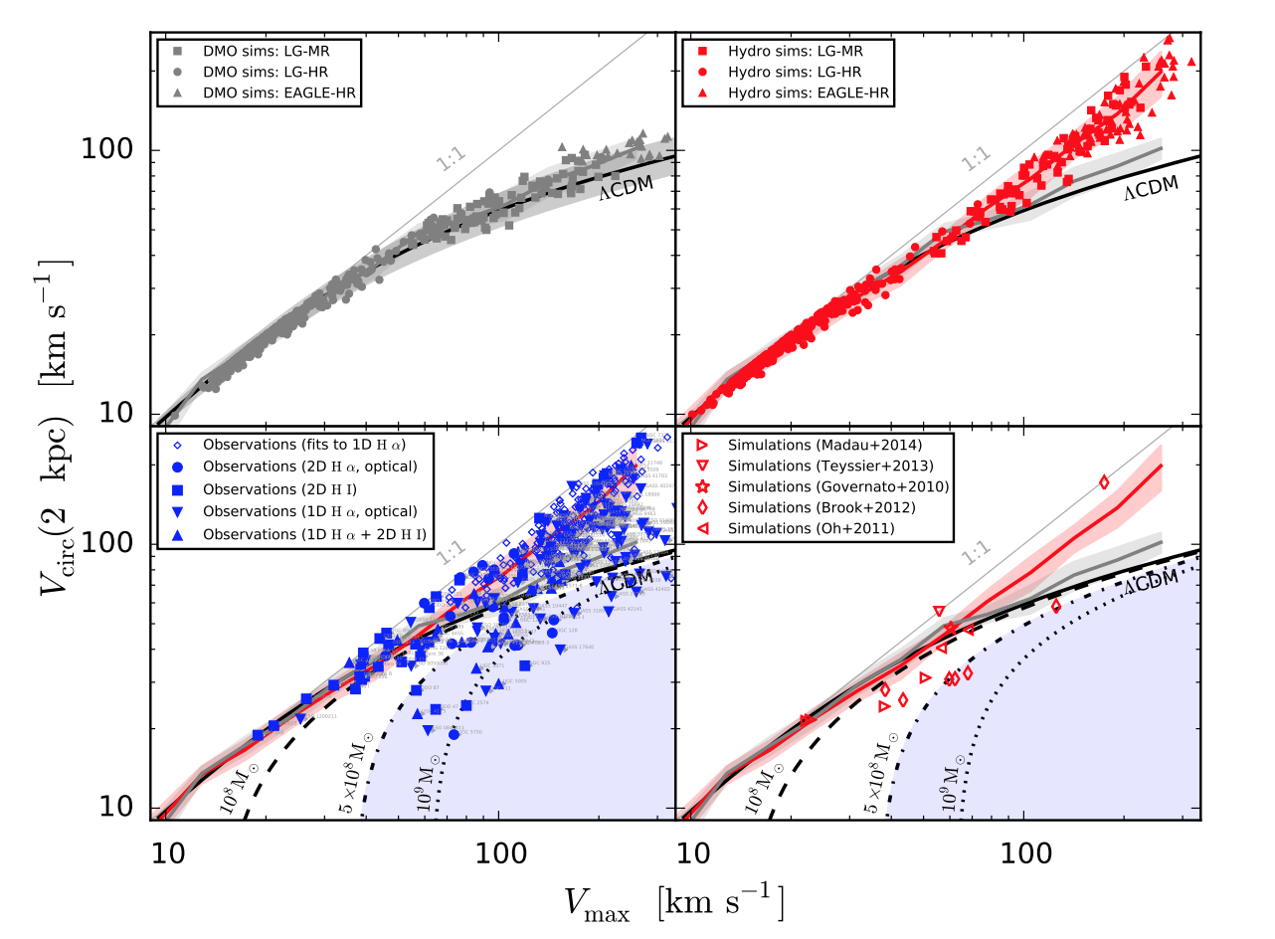
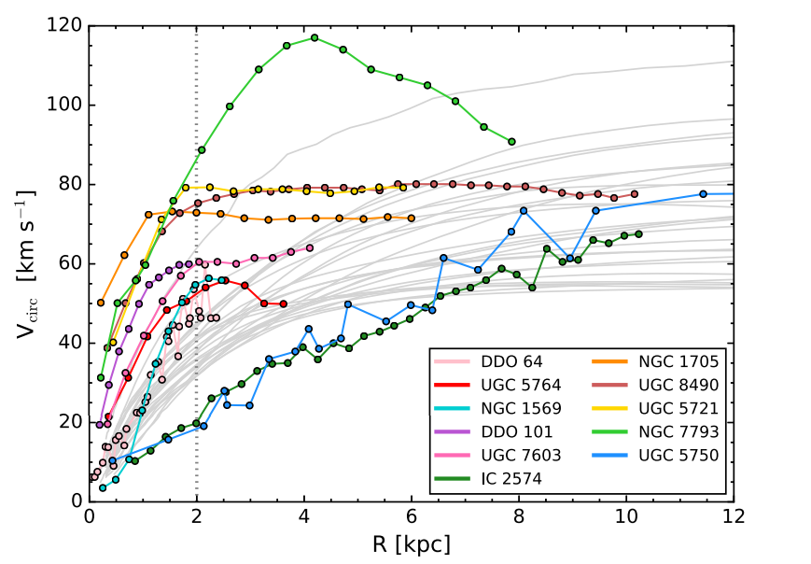
Diversity problem of dwarf galaxies
The observed dwarf galaxies display a larger scatter/diversity than cold dark matter (CDM) expectations
…suggests something funny is going on in the inner mass distribution of the DM halo
Diversity in rotation curves
Inner mass
Total mass
Santos-Santos+ 1706.04202
Oman et al 1504.01437

Slide 3
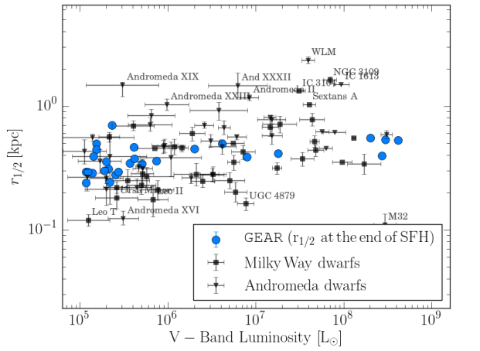
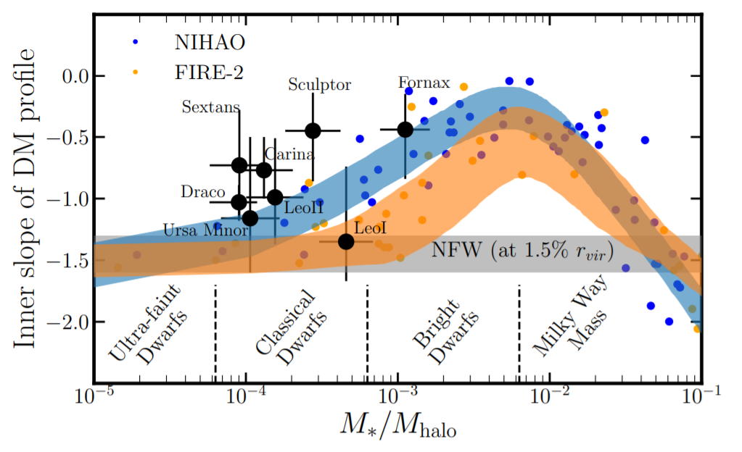
Diversity problem of dwarf galaxies
The observed dwarf galaxies display a larger scatter/diversity than cold dark matter (CDM) expectations
…suggests something funny is going on in the inner mass distribution of the DM halo
Diversity in DM inner density slope
Diversity in stellar mass-size plane
Revaz & Jablonka 1801.06222
Hayashi et al 2007.13780

Slide 4
SIDM halos: core-formation then core-collapse
DM Self-interaction in form of particle scatterings
Heat transfer among halo shells
Unique 2-phase evolution
CDM → core -------------------> core-collapse
Core-collapse:
Takes long-time to happen
But self-accelerating in late stages
Runaway process
…difficult to simulate
t=0
density
velocity dispersion
Negative T gradient
Heat
Heat
(temperature)
Negative heat capacity of self-gravitating system: globular clusters

Slide 5
SIDM halos core-collapse
SIDM halos can naturally have a large diversity in inner mass/density
…because they can be at different stages during core→core-collapse
Orbital effects further enhance the diversity (see later)
Main features of core-collapse happening:
(near the center) denser, hotter, steeper density slope

Slide 6
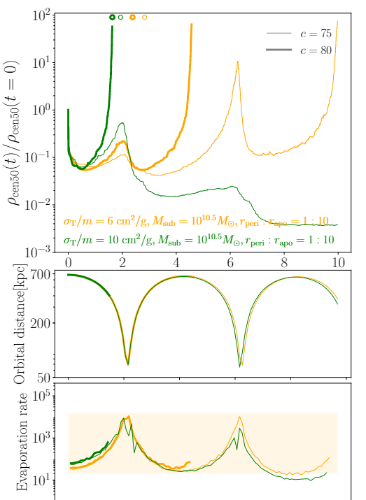
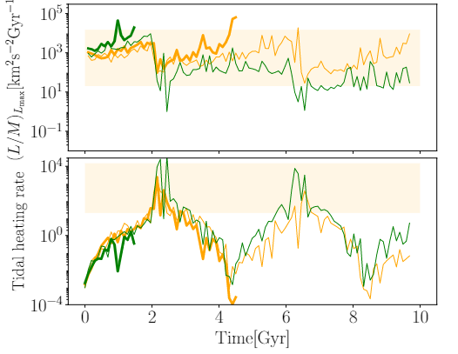
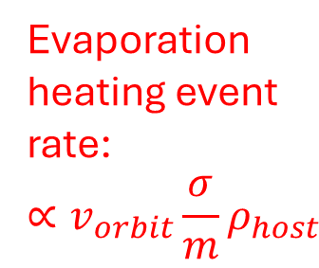
DM-only: individual SIDM subhalo
Getting more complicated and fun with orbits!
Core-collapse (terminate the simulation here)
Internal cooling by heat outflow
Central density
NFW
Tracer of core to core-collapse
Tidal heating rate
core
[Gyr]
Orbital distance
Subhalo central density grows only if cooling > heating
Evaporation heating can be strong enough to disrupt pre-core-collapse
Core-collapse or not is highly sensitive to subhalo parameters
Diversity of subhalo central density!
Evaporation heating event rate:
$$∝v_{orbit}\frac{σ}{m}ρ_{host}$$

Slide 7
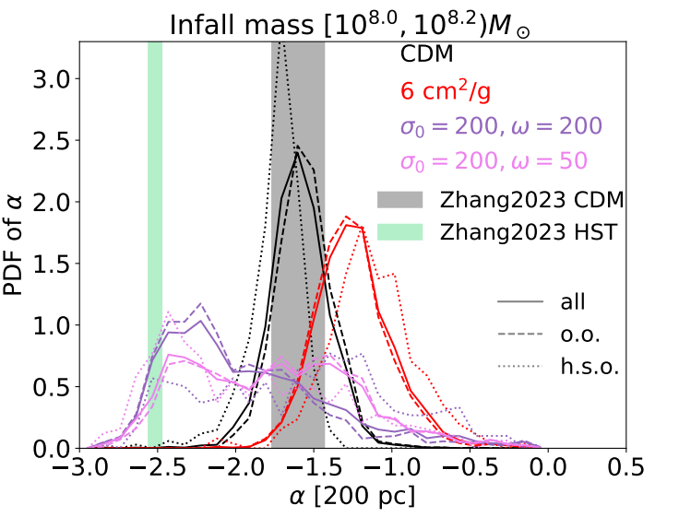
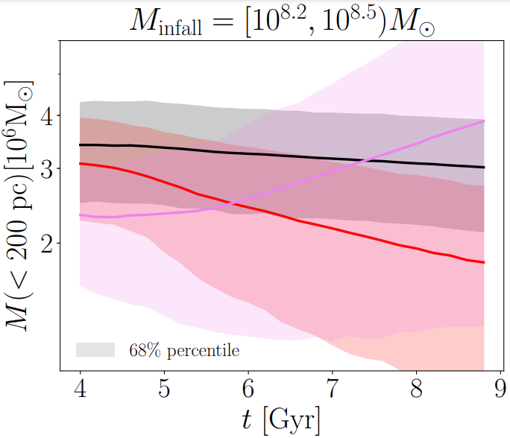
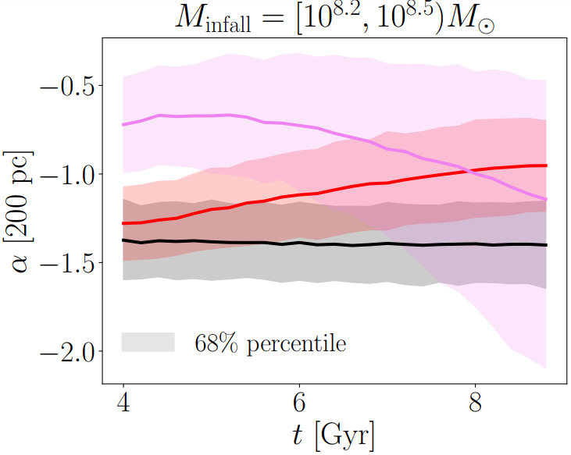
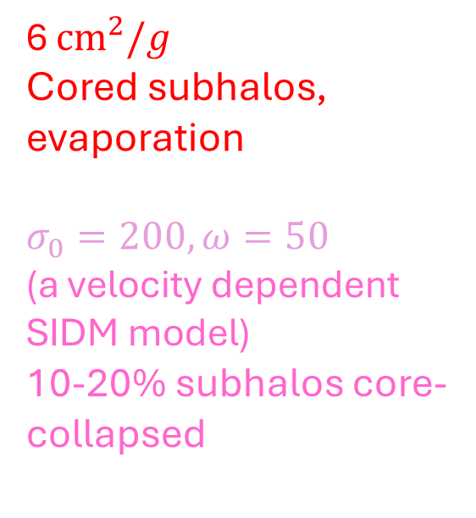
Population of subhalos
Main features of core-collapse happening:
(near the center) denser, hotter, steeper density slope
Subhalos’ inner mass
Subhalos’ inner slope
CDM
6 ${cm}^{2}/g$
Cored subhalos, evaporation
$$σ_{0}=200,ω=50$$
(a velocity dependent SIDM model)
10-20% subhalos core-collapsed

Slide 8
Now we see diversity in SIDM (sub)halos
…how much is this diversity propagated to observable properties of dwarf galaxies?
Simulation with two species of particles
Dark matter (gravity+self-interaction)
Stars (gravity)

Slide 9
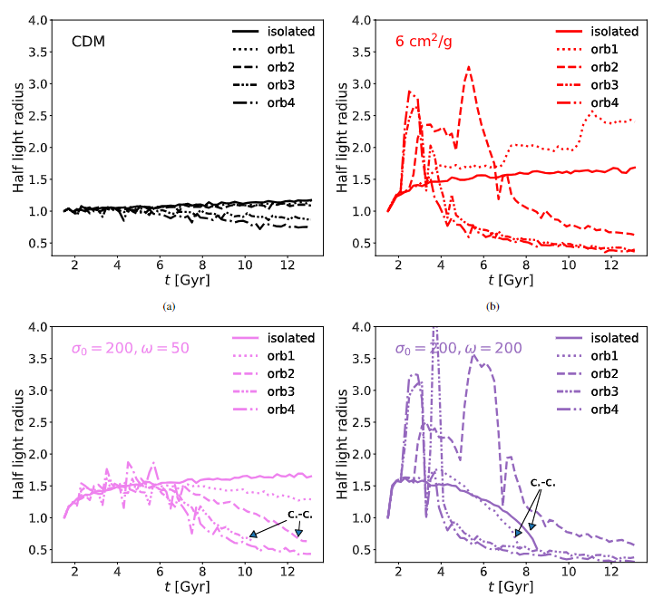
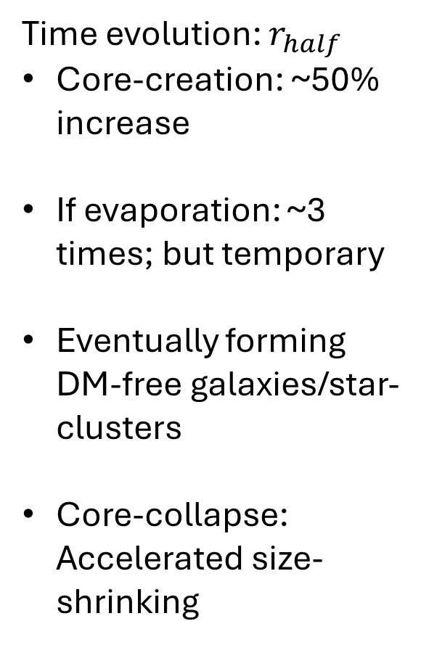
Time evolution: $r_{half}$
Core-creation: ~50% increase
If evaporation: ~3 times; but temporary
Eventually forming DM-free galaxies/star-clusters
Core-collapse: Accelerated size-shrinking
closer orbit
Evaporation induced size boost
DM-free galaxy

Slide 10
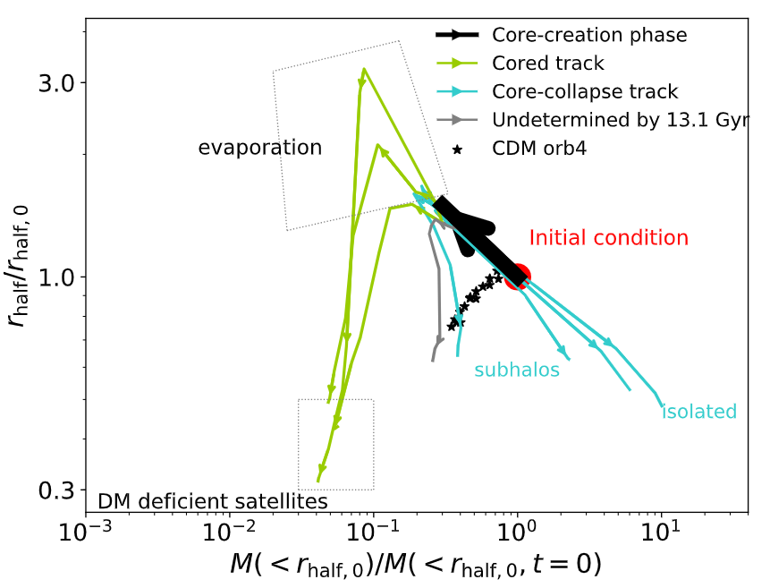
Stellar properties: the tidal-track approach
Diversity: larger span than CDM
Universality: the evolution tracks are highly interpretable, maybe parameterizable too
Fitting “tidal tracks” → a cost-efficient approach for future large-scale sims
Observable – but demands higher resolution to simulate
The tracer that demands lower resolution

Slide 11
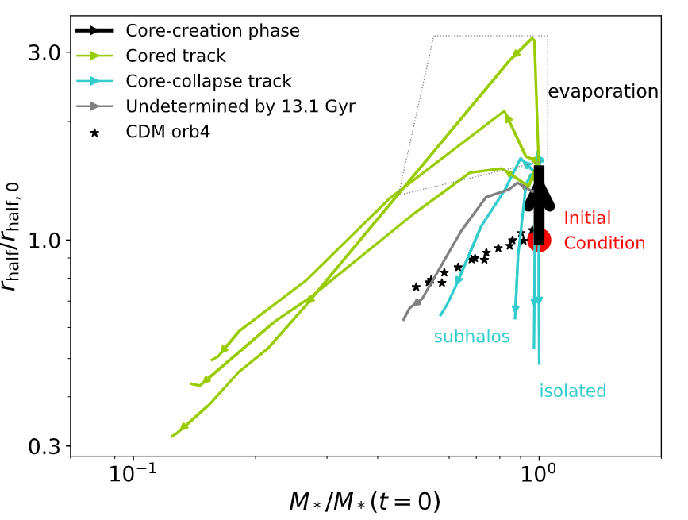
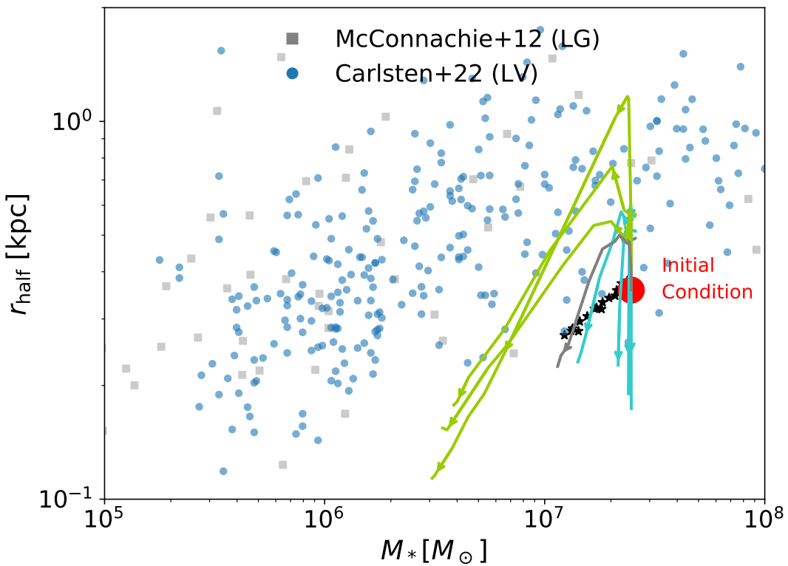
SIDM produced diversity in stellar mass-size plane
Same as the left, but a first, preliminary comparison with observations

Slide 12
Take away messages
SIDM halos have unique core to core-collapse evolution
This brings natural diversity in halos’ inner density/mass
Even larger diversity if orbiting host halos
Not only in DM components, this diversity is also propagated (in part) to stellar components
→ future: look into whether/what SIDM models can explain the full diversity problem in statistics

Slide 13
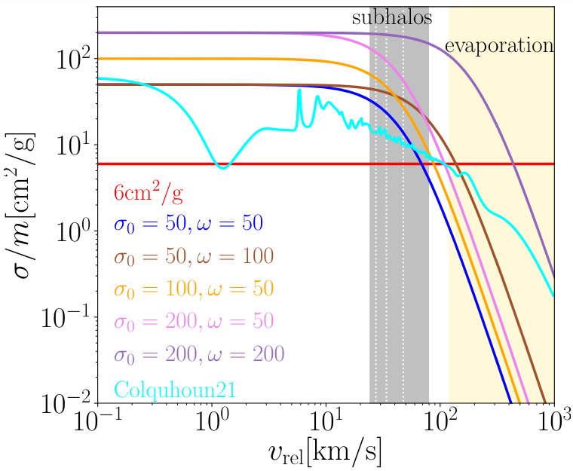


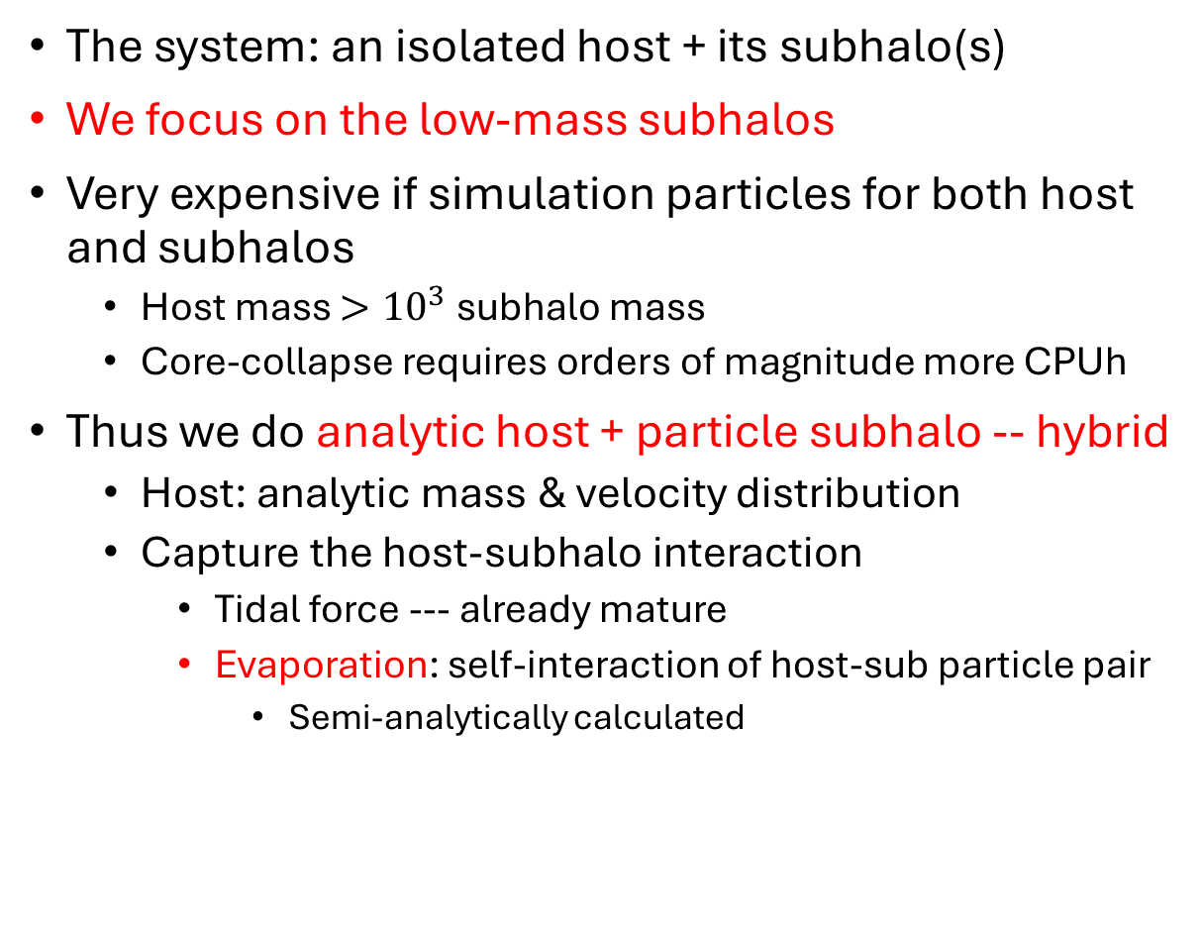
Method: controlled simulation + hybrid method
The system: an isolated host + its subhalo(s)
We focus on the low-mass subhalos
Very expensive if simulation particles for both host and subhalos
Host mass $>{10}^{3}$ subhalo mass
Core-collapse requires orders of magnitude more CPUh
Thus we do analytic host + particle subhalo -- hybrid
Host: analytic mass & velocity distribution
Capture the host-subhalo interaction
Tidal force --- already mature
Evaporation: self-interaction of host-sub particle pair
Semi-analytically calculated
Reduces CPUh by > 2 dex
For each subhalo particle:

Slide 14
Population of subhalos
SIDM core-collapse in subhalos can explain ultra-steep inner slope in subhalos found by lensing with Hubble Space Telescope (13 images)
Zhang+ 2308.09739
At t=9Gyr

Slide 15
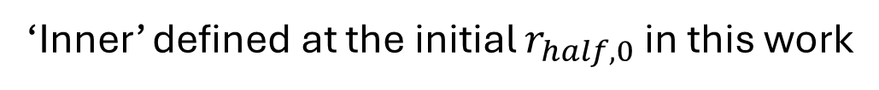
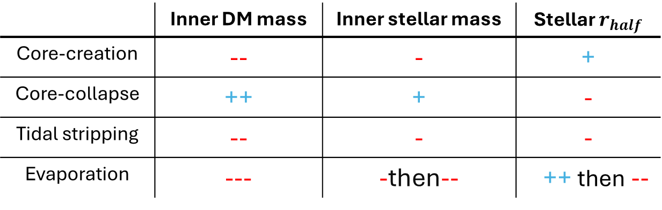
How do stars respond to SIDM core to core-collapse and orbital effects?
‘Inner’ defined at the initial $r_{half,0}$ in this work
(Qualitatively)
 | Inner DM mass | Inner stellar mass | Stellar $r_{half}$
Core-creation | -- | - | +
Core-collapse | ++ | + | -
Tidal stripping | -- | - | -
Evaporation | --- | -then-- | ++ then --

Slide 16
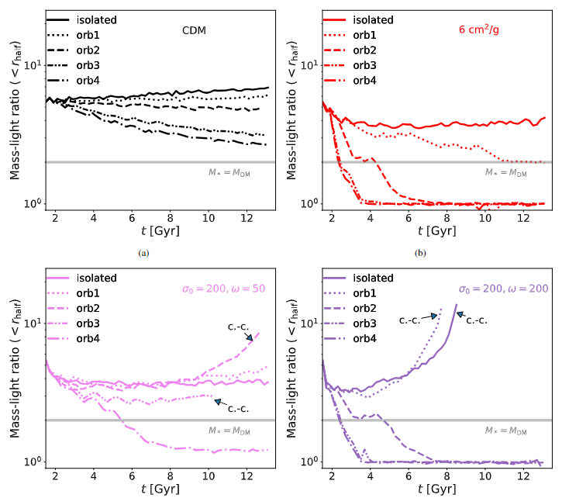
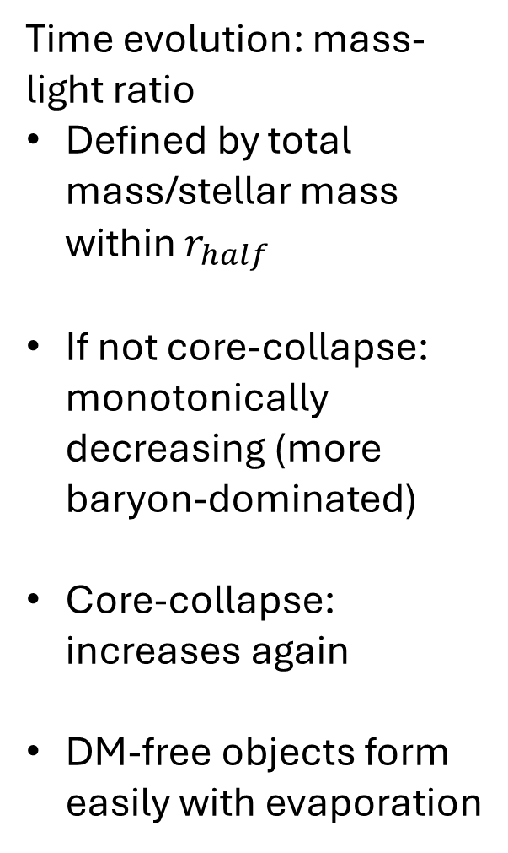
Time evolution: mass-light ratio
Defined by total mass/stellar mass within $r_{half}$
If not core-collapse: monotonically decreasing (more baryon-dominated)
Core-collapse: increases again
DM-free objects form easily with evaporation
DM-free galaxy

Slide 17
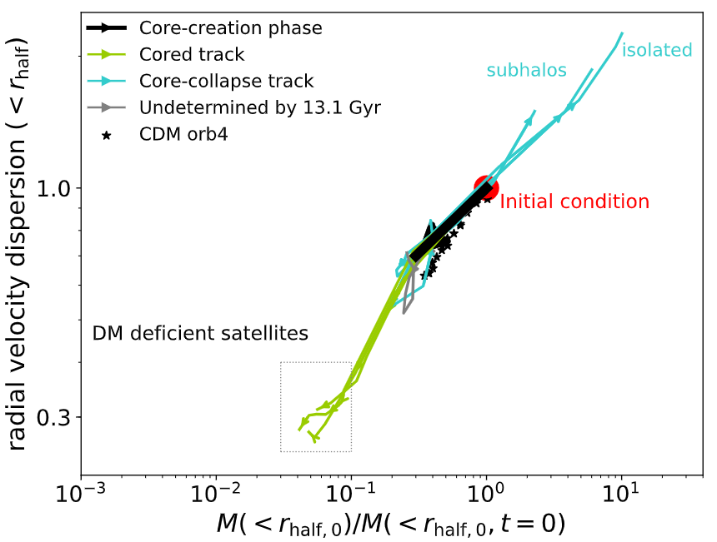
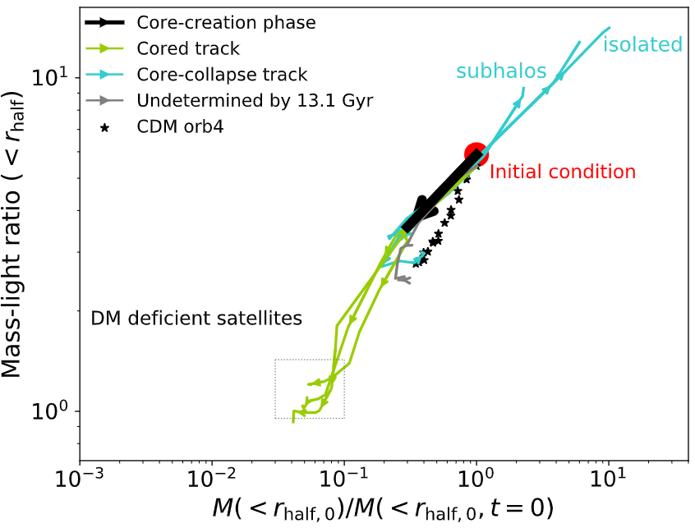
Stellar properties: the tidal-track approach
Radial velocity dispersion
Mass-light ratio
diversity (large spanned range)
& universality (similar, explainable trends)

Slide 18
SIDM halos: core-formation then core-collapse
Exchange of momentum / heat transfer between shells of halo
Phase 1: thermalizing the halo center – core formation
Phase 2:
The core slowly but continuously loses heat to outskirts
DM falls to center -> becomes even hotter
Self-accelerating, runaway process
Eventually core-collapses
Core-collapse: denser and hotter central region in halos, runaway process
t=0
density
velocity dispersion
Negative T gradient
Heat
Heat
(temperature)
Negative heat capacity of self-gravitating system

