Slide 1
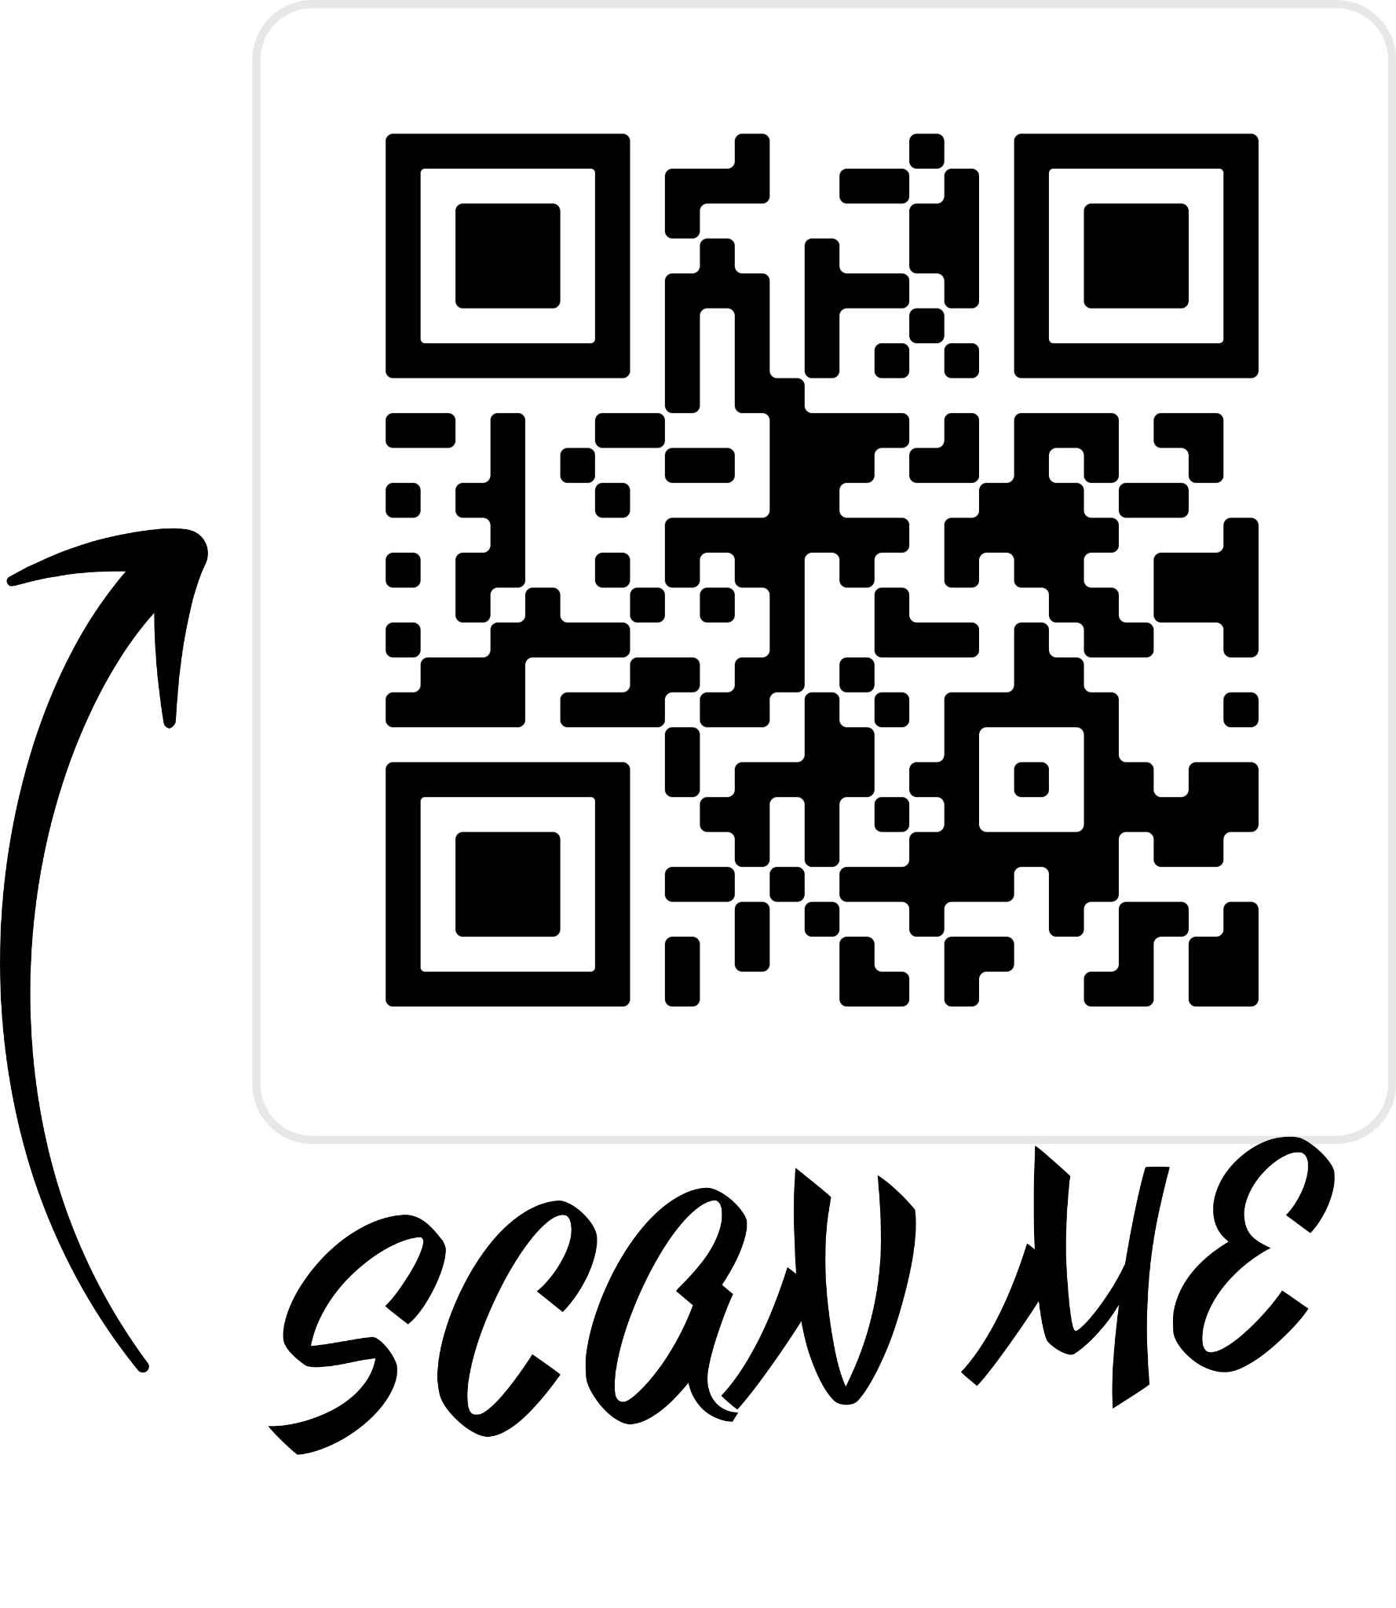

Slide 2

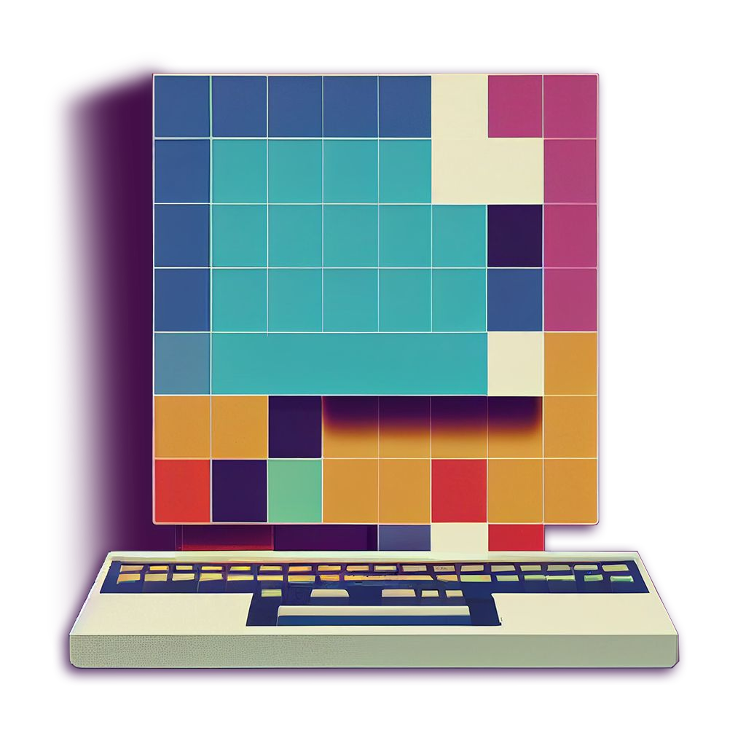
Software Development Technologies
13 January 2025

Slide 3

Instructor
Errahel Nazih
Senior Lecturer at BRICS School, Irkutsk National Research Technical University
Email: erraheln@ex.istu.edu / naziherrahel@gmail.com
Phone: +7 999 686 47 49
3

Slide 4

Introduction
Overview

Slide 5

Learning Outcomes
Learn to develop and operate AI-enabled (prediction) services
Develop and run feature pipelines
Deploy features and models
Train models and and run inference pipelines
Develop a UI for your prediction service
Learn MLOps fundamentals: versioning, automated testing, data validation, and operations
Develop and run a real-time machine learning system

Slide 6
Syllabus
Module 01
the basics of Git, a version control system for tracking changes, collaborating on projects, and managing code efficiently.
Module 02
Pandas and ML Pipelines in Python
Module 03
Feature Store and Model Registry. Credit-card fraud prediction service.
Module 04
Training Pipelines and Inference Pipelines

Slide 7
Syllabus
Module 05
Bring a Prediction Service to Life with a User Interface
Module 06
Automated Testing and Versioning of features and models
Module 07
Real-time machine learning systems. Project presentation.

Slide 8
Exercises and Assessment
Exercises - There will be homework exercises at the end of each module, and a final project at the end of the course.
Assessment
Presentations
Scores for homework and the project make up your mark

Slide 9
Introduction To Git

Slide 10
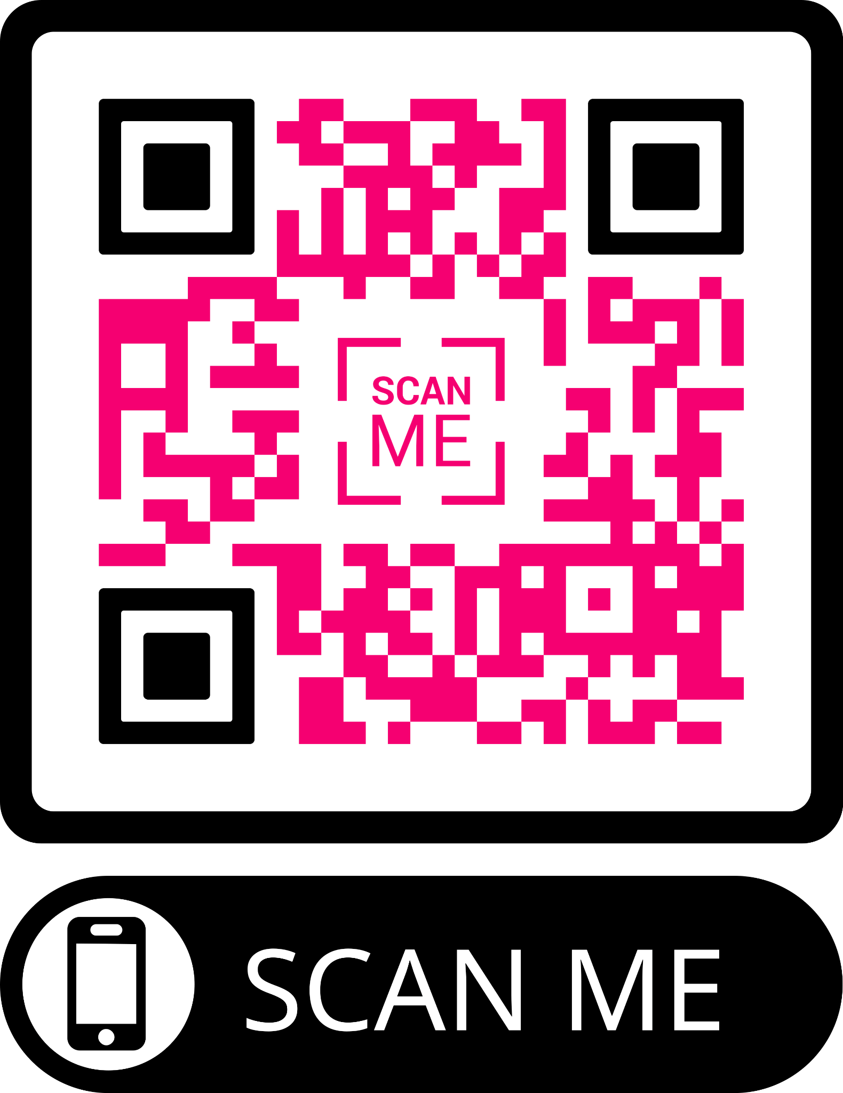
10

Slide 11
Outline of the talk
Why should you use it?
What is Git?
How to use Git locally?
Summary and conclusions

Slide 12
Why should you use it?

Slide 13
OK, let’s do it without git
13

Slide 14
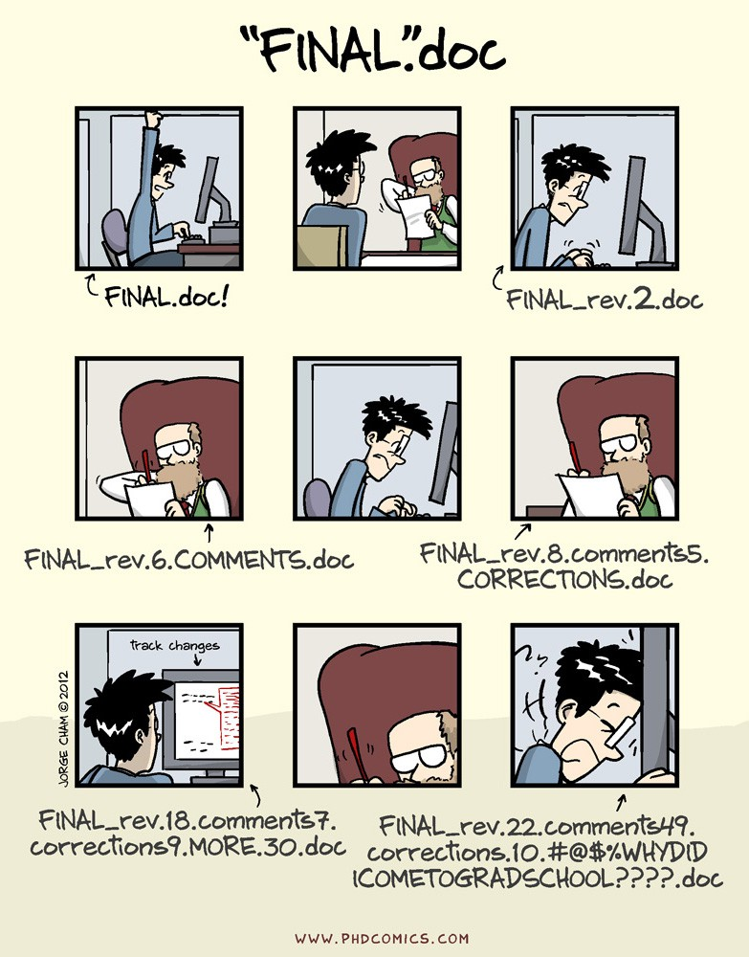
A possible workflow
Writing a review or a thesis
14

Slide 15
A possible workflow
Writing a review or a thesis
How do you make writing experiments?
15

Slide 16
A possible workflow
Writing a review or a thesis
How do you make writing experiments?
You make a backup of your file
You comment out a block of text in your source
If the old version was better, you restore it by hand
If the new version is better, you clean up by hand
16

Slide 17
A possible workflow
Writing a review or a thesis
How do you make writing experiments?
How do you create/view checkpoints?
17

Slide 18
A possible workflow
Writing a review or a thesis
How do you make writing experiments?
How do you create/view checkpoints?
Create a .tar or .zip file
Copy it somewhere and uncompress if needed
18

Slide 19
A possible workflow
Writing a review or a thesis
How do you make writing experiments?
How do you create/view checkpoints?
Which version did you send to your supervisor/colleagues?
19

Slide 20
A possible workflow
Writing a review or a thesis
How do you make writing experiments?
How do you create/view checkpoints?
Which version did you send to your supervisor/colleagues?
Put a copy of the PDF file or of the compressed folder somewhere
Keep the sent email for later use
20

Slide 21
A possible workflow
Writing a review or a thesis
How do you make writing experiments?
How do you create/view checkpoints?
Which version did you send to your supervisor/colleagues?
How long did it take to write this section?
When did I start writing this chapter?
How much did I write on average per day?
21

Slide 22
A possible workflow
Writing a review or a thesis
How do you make writing experiments?
How do you create/view checkpoints?
Which version did you send to your supervisor/colleagues?
How long did it take to write this section?
When did I start writing this chapter?
How much did I write on average per day?
Everything by hand, error-prone and big overhead!
22

Slide 23
Another possible workflow
Collaborating on a project
How can you collaborate on the same project with colleagues?
23

Slide 24
Another possible workflow
Collaborating on a project
How can you collaborate on the same project with colleagues?
You work on separate parts at the same time
Only one person works at the same time
24

Slide 25
Another possible workflow
Collaborating on a project
How can you collaborate on the same project with colleagues?
How do you merge work from other people in the team?
25

Slide 26
Another possible workflow
Collaborating on a project
How can you collaborate on the same project with colleagues?
How do you merge work from other people in the team?
You send the changed files per email and put them in the folder by hand
Copy/Rsync in some shared place the new status of the project
If only one person works at once, a compressed archive can be exchanged
3/26

Slide 27
Another possible workflow
Collaborating on a project
How can you collaborate on the same project with colleagues?
How do you merge work from other people in the team?
How do you work on different machines?
3/26

Slide 28
Another possible workflow
Collaborating on a project
How can you collaborate on the same project with colleagues?
How do you merge work from other people in the team?
How do you work on different machines?
You don’t, use SSH
Different machines are as different people, see above
3/26

Slide 29
Another possible workflow
Collaborating on a project
How can you collaborate on the same project with colleagues?
How do you merge work from other people in the team?
How do you work on different machines?
How do you know who did what?
3/26

Slide 30
Another possible workflow
Collaborating on a project
How can you collaborate on the same project with colleagues?
How do you merge work from other people in the team?
How do you work on different machines?
How do you know who did what?
This information is not important
Sending work around per email allows to trace this…
Put comments into the source!
3/26

Slide 31
Another possible workflow
Collaborating on a project
How can you collaborate on the same project with colleagues?
How do you merge work from other people in the team?
How do you work on different machines?
How do you know who did what?
How do you give credit to authors?
3/26

Slide 32
Another possible workflow
Collaborating on a project
How can you collaborate on the same project with colleagues?
How do you merge work from other people in the team?
How do you work on different machines?
How do you know who did what?
How do you give credit to authors?
Detailed information is not important
A rough idea about who worked on what is enough
See comments into the source!
3/26

Slide 33
Another possible workflow
Collaborating on a project
How can you collaborate on the same project with colleagues?
How do you merge work from other people in the team?
How do you work on different machines?
How do you know who did what?
How do you give credit to authors?
How do you go back in history e.g. in case of a bug?
3/26

Slide 34
Another possible workflow
Collaborating on a project
How can you collaborate on the same project with colleagues?
How do you merge work from other people in the team?
How do you work on different machines?
How do you know who did what?
How do you give credit to authors?
How do you go back in history e.g. in case of a bug?
Again, use the archives sent around per email
Using a shared place, this is not possible debug!
3/26

Slide 35

Another possible workflow
Collaborating on a project
How can you collaborate on the same project with colleagues?
How do you merge work from other people in the team?
How do you work on different machines?
How do you know who did what?
How do you give credit to authors?
How do you go back in history e.g. in case of a bug?
Again, use the archives sent around per email
Using a shared place, this is not possible debug!
?
3/26

Slide 36
OK, and how would it be with Git?

Slide 37
A possible workflow
Writing a review or a thesis
•
How do you make writing experiments?
Just do them (staging/stash area)
git-branch
How do you create/view checkpoints?
git-log git-tag git-checkout
•
Which version did you send to your supervisor/colleagues?
•
•
•
git-log git-tag
How long did it take to write this section?
When did I start writing this chapter?
How much did I write on average per day?
Git-shortlog
git-log
git-log gitstats‹
4/26
‹ This is just one of the pletora of libraries to make statistics based on a git repository.

Slide 38
Another possible workflow
Collaborating on a project
How can you collaborate on the same project with colleagues?
git-pull git-push git-branch
How do you merge work from other people in the team?
git-merge
How do you work on different machines?
•
•
git-pull git-push
How do you know who did what?
git-blame
How do you give credit to authors?
git-shortlog
How do you go back in history e.g. in case of a bug?
git-checkout git-bisect
•
•
5/26

Slide 39
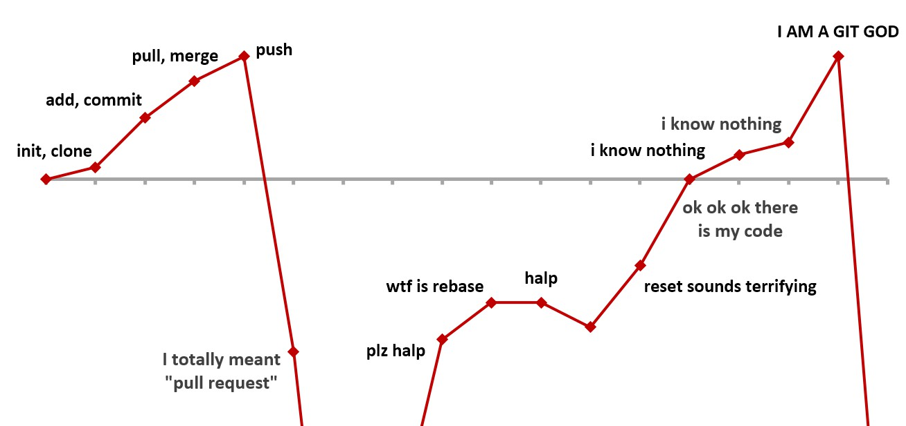
Yes, but I have to learn all those commands!
There are many jokes on the web…
This makes sense
…but after all it is about having the correct mental set up!
6/26
Git was not designed to aim to user-friendliness, but it is by far the most used version control system in the world and hence in continuous evolution.

Slide 40
Yes, but I have to learn all those commands!
As any new tool, it needs some practice
The short- to long-term payoff is worth the effort
It is plenty of GUI clients
Sourcetree: A Free GIT Client For Windows And Mac
Guitar: Portable { Windows, Mac & Linux }
Git-Cola: Powerful GUI For GIT { Windows, Mac, Ubuntu & Linux }
[…]
You can work in the terminal
after this course it will be possible and straightforward!
6/26
Git was not designed to aim to user-friendliness, but it is by far the most used version control system in the world and hence in continuous evolution.

Slide 41

Last but not least
Which large famous products are developed using Git?
Linux, Homebrew, Windows, Tensorflow, Angular, Inkscape, …
7/26

Slide 42
Last but not least
Which large famous products are developed using Git?
Linux, Homebrew, Windows, Tensorflow, Angular, Inkscape, …
And if I do not have so large projects?
It doesn’t matter! There are too many advantages‹ having a project under a source code management tool. Even alone.
Simply use one (Git). Now.
For collaborative projects like maintaining code in a group, handing it over from person to person and so on, Git is simply a must. As project leader, you should think about requiring everybody to work in a Git repository.
7/26
‹ Among many others, in a Git repository you can undo a rm command given by accident on a wrong file.

Slide 43
What is Git?

Slide 44
How does Git define itself ?
«Git is a free and open source distributed version control system designed to handle everything from small to very large projects with speed and efficiency. Git is easy to learn and has a tiny footprint with lightning fast performance.»
Git homepage
Free and open
2 Distributed version control system
3 From small to very large projects
4 With speed and efficiency
5 Easy to learn

Slide 45



How does it work?
Repository: a database containing all versions of the files
Repo
Workspace
A git repository
.git
Local repository
X
A normal folder
…
9/26

Slide 46
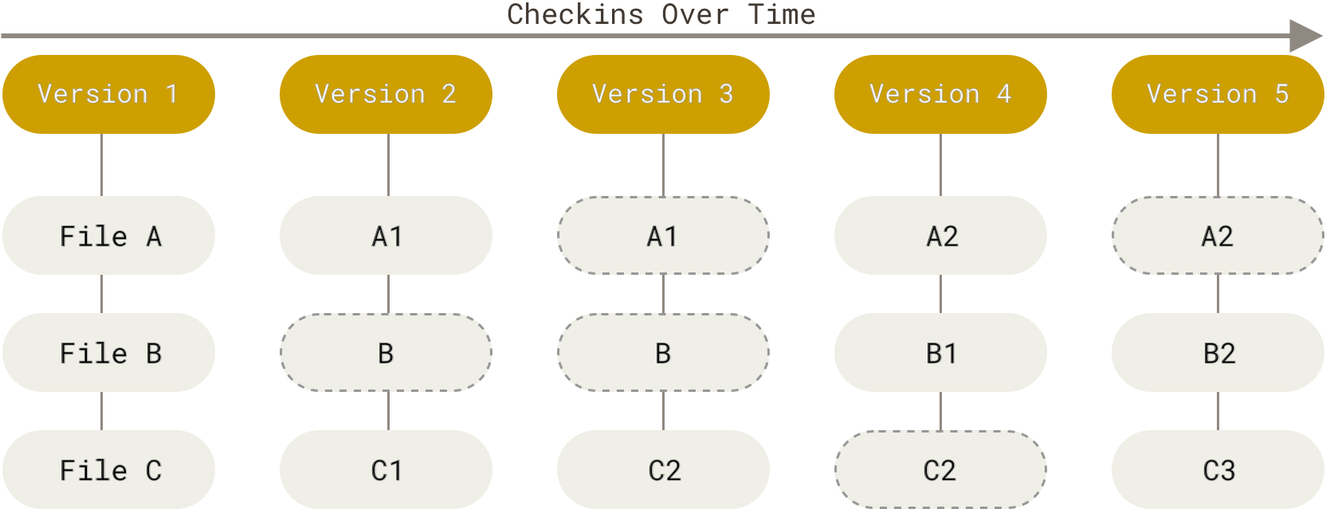
How does it work?
Repository: a database containing all versions of the files
Snapshot-based system
Snapshots are called commits
Commits are named by checksums (also used to ensure data integrity)
{ It’s impossible to change the contents of any file or directory without Git knowing about it }
From the Git-Book
9/26

Slide 47
How does it work?
Repository: a database containing all versions of the files
Snapshot-based system
Snapshots are called commits
Commits are named by checksums (also used to ensure data integrity)
{ It’s impossible to change the contents of any file or directory without Git knowing about it }
Almost every operation is local
Working without network connecting
Distributed system everyone carries a backup!
Are you curious to know how Git works bottom-up?
Refer to this 31-pages document , well written, but not needed at start.
9/26

Slide 48



An example of Git history
Every commit is a snapshot of the state of the repository at that point
First commit
HEAD
6d7253af8a986838f78adc25a801cd06897be033
54a94046deeb7117e77f0b6ee984165fedbc234
09c1b4321589b548be39063c828903901a3e14e7
b924cdb3101220b552cdd92c8c4e7b9eb887a83a
24ffea36e3b6b696cc537fbf05bae8d04c63a92b

Slide 49
The correct abstract mental setup
11/26

Slide 50
The correct abstract mental setup
Local machine
Stashing area
Staging area
Local repository
Remote repository
Workspace
11/26

Slide 51
The correct abstract mental setup
Local machine
Stashing area
Staging area
Local repository
Remote repository
Workspace
It’s all about having this picture clear in mind and understand how git commands affect it
11/26

Slide 52
The correct abstract mental setup
Local machine
Stashing area
Staging area
Local repository
Remote repository
Workspace
Next part of the course
Next part of the course
11/26

Slide 53
How to use Git locally?

Slide 54
Preliminary steps
Be sure to introduce yourself to Git on each machine from which you work
1 It is likely that Git is installed on your machine.
Check it in a terminal e.g. via git version
If needed, install it
2 Optionally, get/enable autocompletion in the terminal
3 Tell Git who you are and your email address
this information will be used to sign your work in history
$ git config -- global user.name 'NazihErrahel'
$ git config -- global user.email 'naziherrahel@gmail.com'
Set your favourite editor e.g. to write commit messages
4
$ git config -- global core.editor 'emacs -nw'
12/26
The dollar symbol $ denotes the end of the prompt in the terminal. It will be from now on to denote commands to be used in the terminal.

Slide 55


Asking for help about Git
1 There are 3 ways in terminal
git help <command>
git <command> --help
man git-<command>
e.g. git help config
e.g. git config --help
e.g. man git-config
2 List of commands on the
3 Ask Google
official reference
There is plenty of cheat-sheets online: GitHub education GitLab
Bitbucket
13/26
Every git <command> can be referred to as git-command, although the first notation has to be used to run the command.

Slide 56
Creating a repository
It is as simple as running one command
$ git config --get user.name naziherrahel
$ git config --get user.email
naziherrahel@gmail.com
# Suppose to be in a folder you want to turn into a repository
$ pwd
/home/nazih/Documents/first - repo
$ ls -a
. .. Paper.aux Paper.log Paper.out Paper.pdf Paper.tex
14/26

Slide 57
Creating a repository
It is as simple as running one command
$ git config --get user.name naziherrahel
$ git config --get user.email
naziherrahel@gmail.com
# Suppose to be in a folder you want to turn into a repository
$ pwd
/home/nazih/Documents/first - repo
$ ls -a
. .. Paper.aux Paper.log Paper.out Paper.pdf Paper.tex
$ git init # <--- Here you go!
Initialised empty Git repository in ~/Documents/first - repo/.git/
$ ls -a
. .. .git Paper.aux Paper.log Paper.out Paper.pdf Paper.tex
14/26

Slide 58
Creating a repository
It is as simple as running one command
$ git config --get user.name naziherrahel
$ git config --get user.email
naziherrahel@gmail.com
# Suppose to be in a folder you want to turn into a repository
$ pwd
/home/nazih/Documents/first - repo
$ ls -a
. .. Paper.aux Paper.log Paper.out Paper.pdf Paper.tex
$ git init # <--- Here you go!
Initialised empty Git repository in ~/Documents/first - repo/.git/
$ ls -a
. .. .git Paper.aux Paper.log Paper.out Paper.pdf Paper.tex
Do not shoot yourself!
Never ever touch by hand the content of the .git folder.
14/26

Slide 59
What comes next?
15/26

Slide 60
What comes next?
On your local machine
Staging area
Local repository
Workspace
Commands marked in dark red do not change anything in the repository!
15/26

Slide 61
What comes next?
On your local machine
git show git log
Local repository
Staging area
Workspace
git status
git diff
git diff --staged
git diff HEAD
{ only tracked files }
git add
git restore --staged
git commit
Commands marked in dark red do not change anything in the repository!
15/26
Git introduced git restore in v2.23 but this stayed buggy for a while. Use it from v2.27 on, otherwhise use git reset.

Slide 62
Git status
$ git status
On branch main
No commits yet
Untracked files:
( use " git add <file>..." to include in what will be committed)
Paper.aux Paper.log Paper.out Paper.pdf Paper.tex
nothing added to commit but untracked files present ( use " git add" to track)
You do not want to put everything in a repository!
It is possible to tell git to ignore some files, like temporary ones

Slide 63


Letting Git ignore some files
$ printf '*.%s\n' aux log out pdf
$ cat .gitignore
*.aux
*.log
*.out
*.pdf
$ git status
On branch main
No commits yet
Untracked files:
( use " git add <file>..." to include in what will be committed)
.gitignore Paper.tex
nothing added to commit but untracked files present ( use " git add" to track)
github/gitignore for LaTeX projects
> .gitignore

Slide 64
Our first commit
In your terminal
$ git log
fatal: your current branch 'main ' does not have any commits yet
$ git add .gitignore
$ git status
On branch main
No commits yet
Changes to be committed:
( use " git rm -- cached <file>..." to unstage)
new file: .gitignore
Untracked files:
( use " git add <file>..." to include in what will be committed)
Paper.tex
$ git commit
18/26

Slide 65
Our first commit
In your favourite editor
# Please enter the commit message for your changes. Lines starting
# with ' # ' will be ignored , and an empty message aborts the commit.
# On branch main
#
# Initial commit
# Changes to be committed:
# new file: .gitignore
# Untracked files:
# Paper.tex
18/26

Slide 66
Our first commit
In your favourite editor
Add .gitignore file for TeX project
# Please enter the commit message for your changes. Lines starting
# with ' # ' will be ignored , and an empty message aborts the commit.
# On branch main
#
# Initial commit
# Changes to be committed:
# new file: .gitignore
# Untracked files:
# Paper.tex
18/26

Slide 67
Our first commit
In your terminal
$ git log
fatal: your current branch 'main ' does not have any commits yet
$ git add .gitignore
$ git status
On branch main
No commits yet
Changes to be committed:
( use " git rm -- cached <file>..." to unstage)
new file: .gitignore
Untracked files:
( use " git add <file>..." to include in what will be committed)
Paper.tex
$ git commit
# Your editor opens -> type commit message , save and exit
[main (root - commit) bb8c78b] Add .gitignore file for TeX project
1 file changed , 4 insertions(+)
create mode 100644 .gitignore
18/26

Slide 68
Inspecting history
$ git log
commit bb8c78b68075dacf8467420bc00867c73ef5ba8c ( HEAD -> main)
Author: naziherrahel <naziherrahel@gmail.com>
Date: Thu Sept 23 10:13:05 2024 +0100
Add .gitignore file for TeX project
$ git log -- oneline
bb8c78b ( HEAD -> main) Add .gitignore file for LaTeX project
Use a pager to avoid polluting terminal
$ git config -- global core.pager 'less -+$LESS -R'
Use git show or git show <SHA1> to inspect what has been done in last or given commit

Slide 69
Our second commit
$ git status On branch main
Untracked files:
( use " git add <file>..." to include in what will be committed)
Paper.tex
nothing added to commit but untracked files present
( use " git add" to track)
$ git add Paper.tex # Always add to the staging
# area before committing!
$ git status
On branch main
Changes to be committed:
( use " git restore -- staged <file>..." to unstage)
new file: Paper.tex
$ git commit -m 'Add paper main document'
[main 9c6154d] Add paper main document
1 file changed , 147 insertions(+)
create mode 100644 Paper.tex

Slide 70
Use good commit messages
$ git log -- oneline
9c6154d ( HEAD -> main) Add paper main document
bb8c78b Add .gitignore file for LaTeX project
Write them like an email to yourself (or to the other developers)
Subject line + body, follow the 50/72 rule
Subject: Summarize what has been done
Use present tense and no period at the end!
Body: After empty line, document why you made the changes
{ add one only if needed }
Good commits
Commit small and conceptually separated changes, commit often and do not add binary files to your repository.
21/26
In coding projects, although not always possible/trivial, try to commit working/compiling code.

Slide 71
Back to our mental picture
On your local machine
git show git log
Local repository
Workspace
git status
Staging area
git diff
git diff --staged
git diff HEAD
{ only tracked files }
git add
git restore --staged
git commit
Commands marked in dark red do not change anything in the repository!
22/26
Git introduced git restore in v2.23 but this stayed buggy for a while. Use it from v2.27 on, otherwhise use git reset.

Slide 72
Working and displaying changes
In your terminal
# Make some changes
$ git status On branch main
Changes not staged for commit:
( use " git add <file>..." to update what will be committed)
( use " git restore <file>..." to discard changes in working directory)
modified: Paper.tex
no changes added to commit ( use " git add" and/or " git commit -a")
$ git diff
23/26

Slide 73
Working and displaying changes
In your pager, e.g. less
diff --git a/Paper.tex b/Paper.tex
index 3c408e5..3669114 100644
--- a/Paper.tex
+++ b/Paper.tex
@@ -42,7 +42,7 @@ pdftitle={LaTeX Seminar for PhD students}
{Sprecher \& Seminarleiter}%
}
-\date{\May 16, 2024}
+\date{23. Dezember 2021}
\ newcommand{\ etc}{etc.}
\ newcommand{\ zB}{z.B.}
23/26

Slide 74
Working and displaying changes
In your terminal
# Make some changes
$ git status On branch main
Changes not staged for commit:
( use " git add <file>..." to update what will be committed)
( use " git restore <file>..." to discard changes in working directory) modified: Paper.tex
no changes added to commit ( use " git add" and/or " git commit -a")
$ git diff
$ git diff -- staged # Nothing in the staging area!
$ git add Paper.tex
$ git diff # No changes anymore in the workspace!
$ git diff -- staged # Our changes are now staged
$ git commit -m 'Fix date for main document' # ...
23/26

Slide 75
What else can I easily explore?
Stage all tracked modified files at once
git add -u
Stage partial modification in a file
git add -p
Define your aliases
git config -- global alias.unstage 'restore -- staged --'
# From now on, you can use 'git unstage '
Let git correct you when you mistype‹
git config -- global help.autocorrect 1
Change/correct your last commit message
git commit --amend
24/26
‹ If you want a friend to correct your mistyped last command in general in the terminal, check-out this hilarious project .

Slide 76
Summary and conclusions

Slide 77
Your workflow from now on, right?
Work
25/26

Slide 78
Your workflow from now on, right?
Work
git status git diff
25/26

Slide 79
Your workflow from now on, right?
Work
git status
git diff
git add
25/26

Slide 80
Your workflow from now on, right?
Work
git status
git diff
git add
git commit
25/26

Slide 81
Your workflow from now on, right?
Work
git status
git diff
git add
git commit
25/26

Slide 82
Your workflow from now on, right?
Work
git status
git diff
git add
git commit
25/26

Slide 83

Quiz Time!!

