Slide 1

Version control, git, and GitHub
EPH Lunchtime hacks, June 29th 2020
Carlos Valencia-Hernández

Slide 2

VERSION CONTROL

Slide 3
What is git?
“A free and open source distributed version control system designed to handle everything from small to very large projects with speed an efficiency”
Advantages:
https://git-scm.com/

Slide 4

Version control
Management of changes to documents, programs, web sites, or any other information
Snapshots of every change you make
Example: Track changes in MS Word

Slide 5





Online version control?

Slide 6
What is Git(Hub?)
The GitHub
Open source program for version control
Multiple programming languages
The GitHub
A collaboration platform
Showcase
Repository

Slide 7
Frequently used term
Repository
A folder that contains a project. (Although you can have multiple projects inside a repository)
Commit
Each snapshot or version of the project
Branch
A sequence of commits that has an order.
A Master branch

Slide 8
Creating branches
This allows to work on the project while not touching the original files available in the Master branch
Committing the changes
This allows to work on the project while not touching the original files available in the Master branch
The commit messages should be short (50 characters or less)
Using active voice
You use commit when you are decided to make a change
Feature “B” branch
Master branch
Feature “A” branch

Slide 9
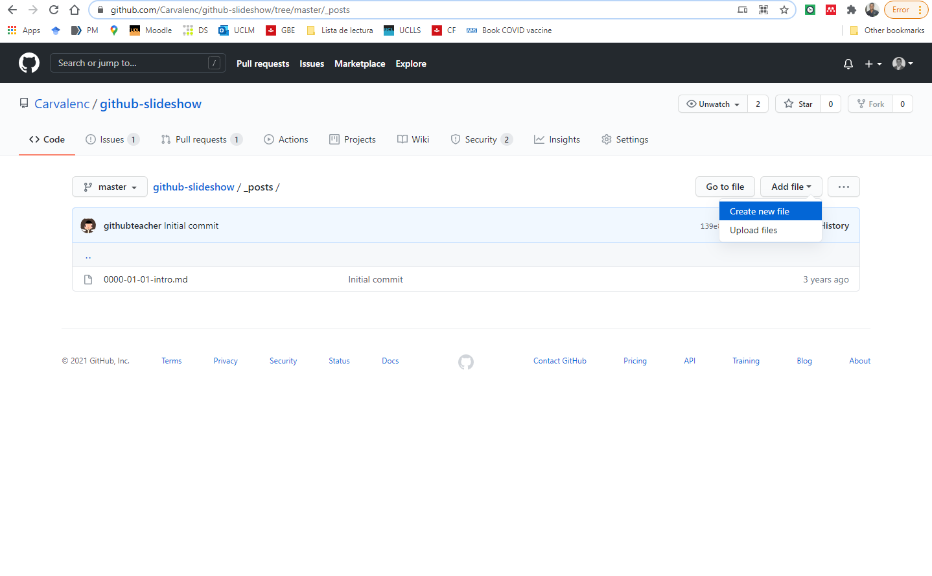

Slide 10
Pull request
Propose a work in progress to be pulled into the project

Slide 11
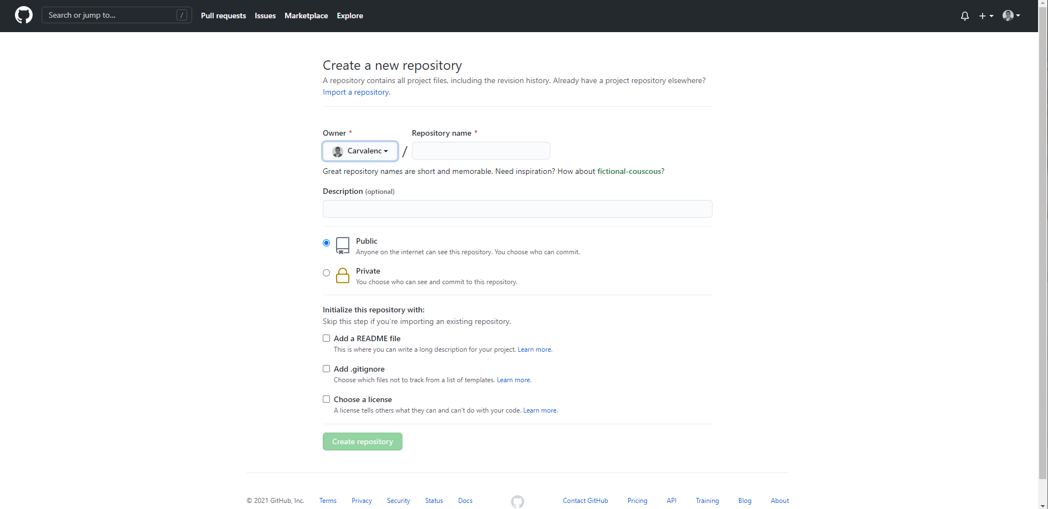
Creating a new repository

Slide 12
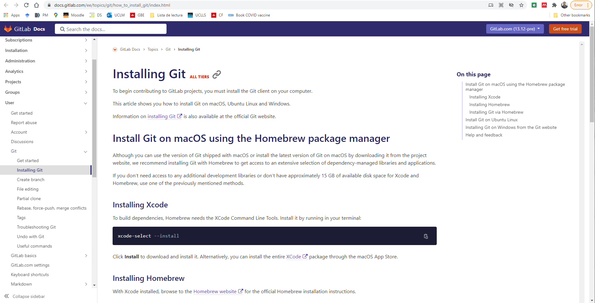

Slide 13
MAC terminal

Slide 14
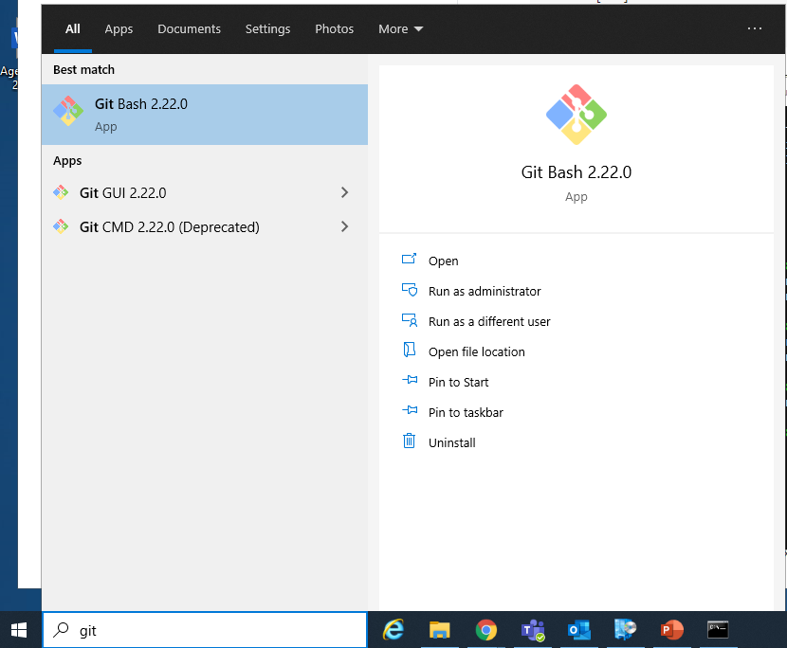
Windows on a UCL computer

Slide 15
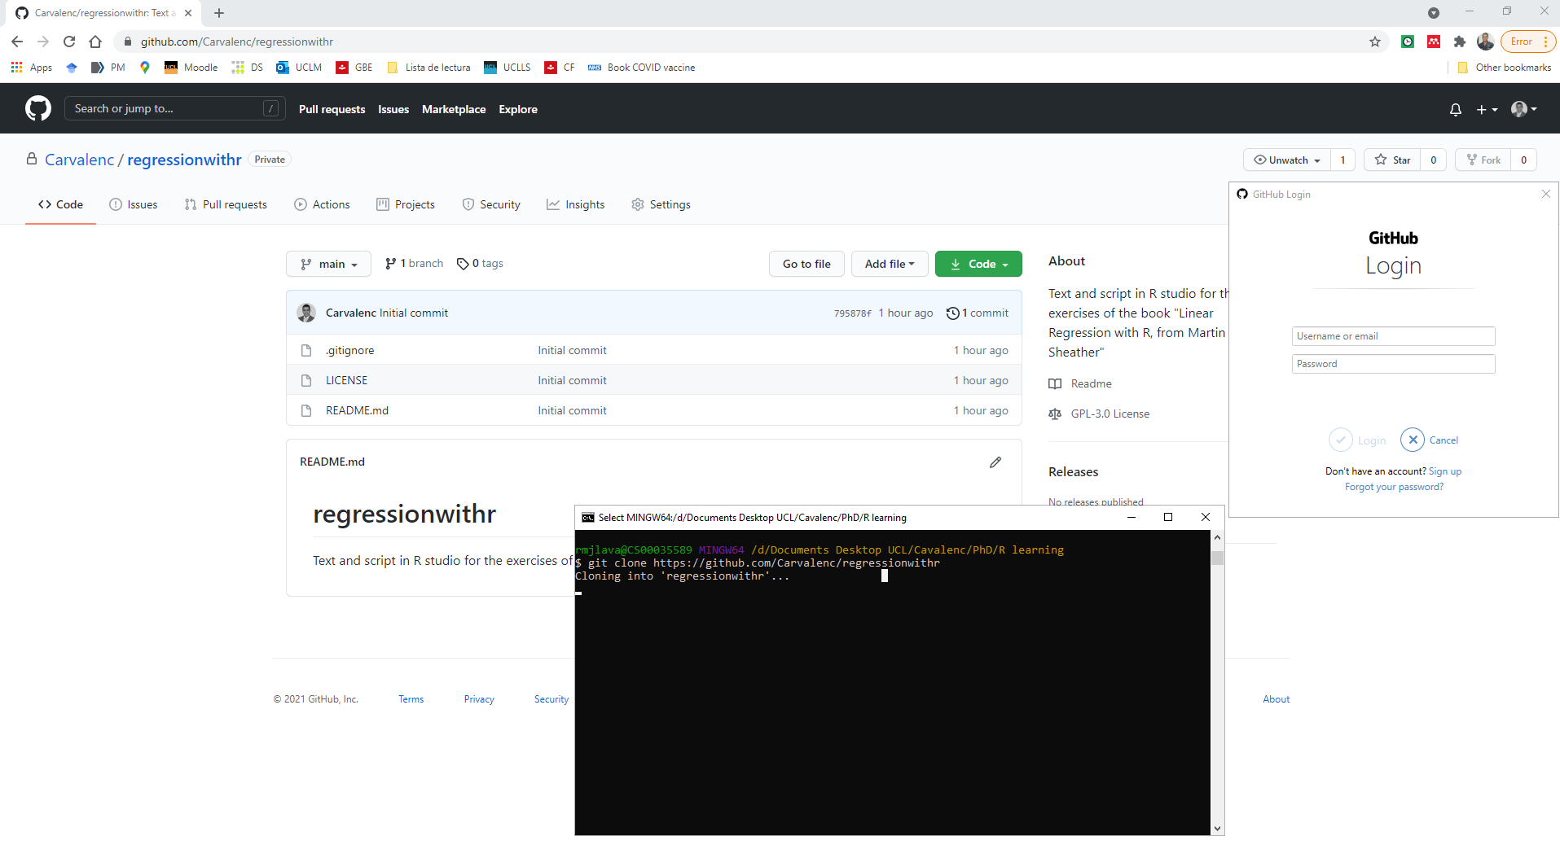
Clone the repository

Slide 16
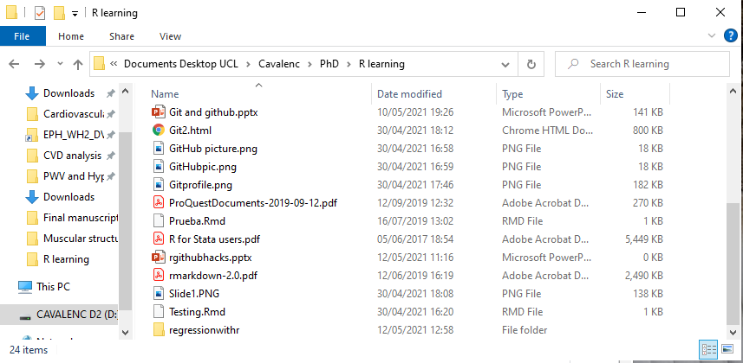
Now we can see the cloned repository

Slide 17
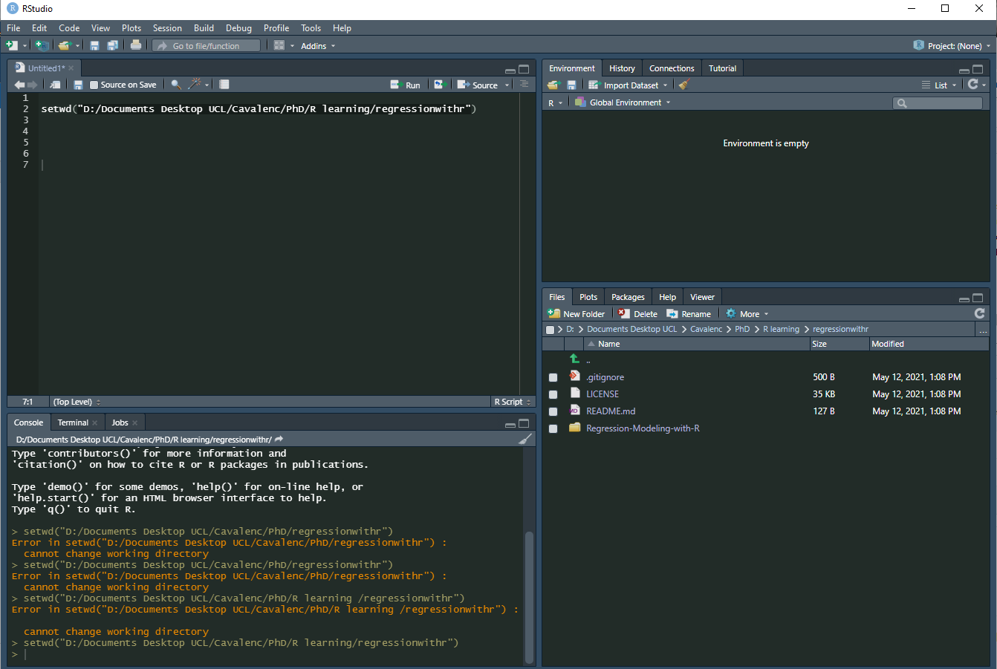

Slide 18

Useful resources:
The Git book
https://git-scm.com/book/en/v2
Set up Git course
https://docs.github.com/en/get-started/quickstart/set-up-git

