Slide 1
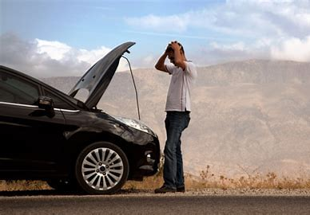
Remaining Useful Life
OPA Towobola
4 Dec 2020

Slide 2
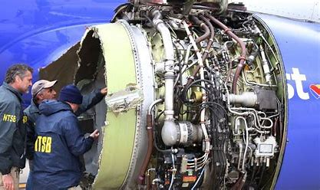
Wear and tear
Engines and other mechanical systems have limited life
Predictive maintenance can help optimize spending

Slide 3
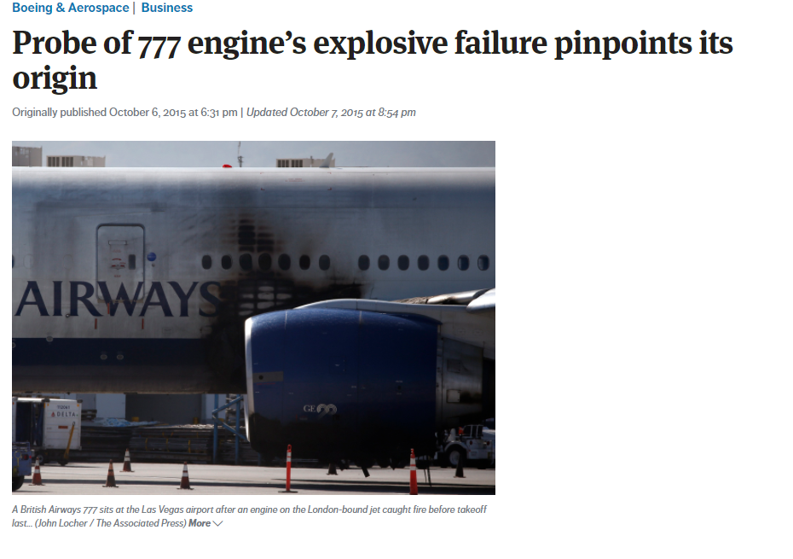
Overview
Goals
Analysis
Results

Slide 4
Goals
Given a fairly standardized dataset
Determine a good model
Make forecasts
Predict Remaining Useful life

Slide 5
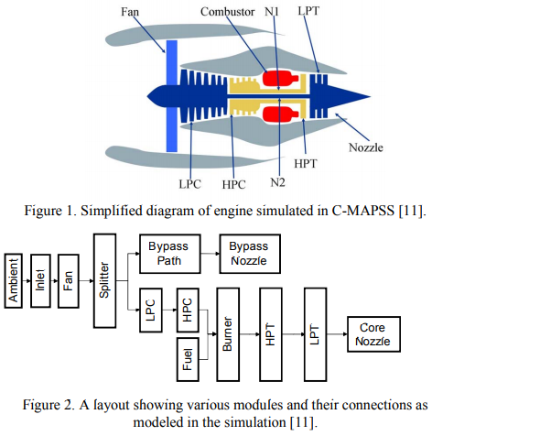
Data Set
100 engine units
modeled (data generated)
using MATLAB/Simulink CMAPPS
~350 time cycles
~20 sensor outputs
Presplit into training/test

Slide 6
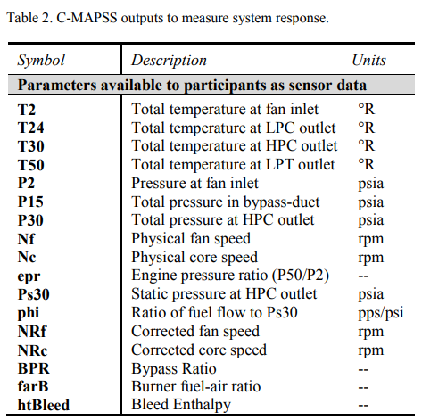
Analysis
column index description
0 unit number
1 time, in cycles
2 operational setting 1
3 operational setting 2
4 operational setting 3
5 sensor measurement 1
6 sensor measurement 2

Slide 7
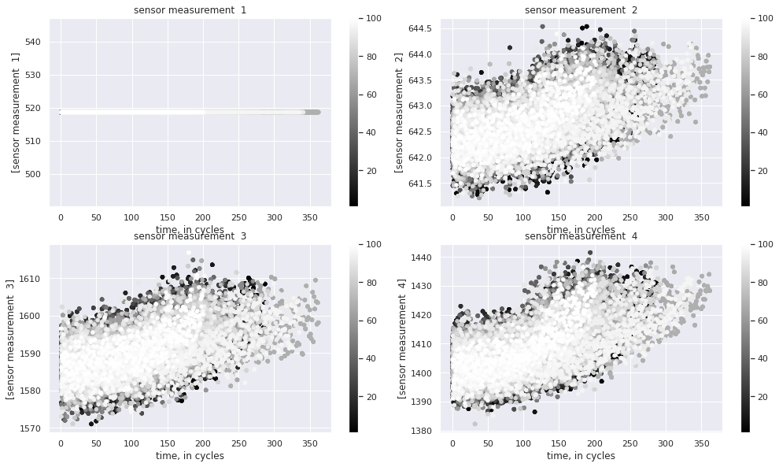

Slide 8
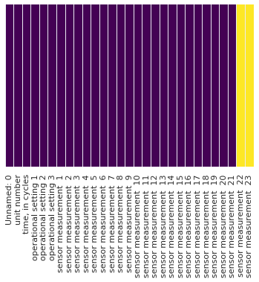
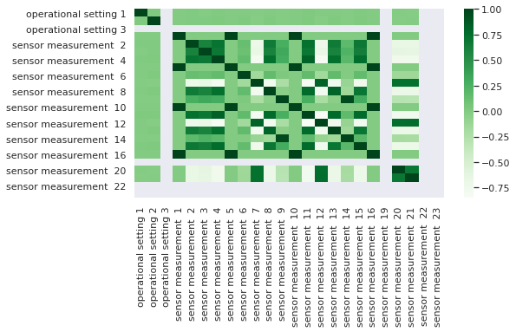
Exploration

Slide 9
AR I MA
Autoregression (p)
Integrated (d)
Moving Average (q)
Independent variables
Operational setting 1
Operational setting 2

Slide 10
Stationarity
Achieved by different levels of differencing
For sensor 2,
(KPSS stat= 0.00077,
p =0.1)

Slide 11
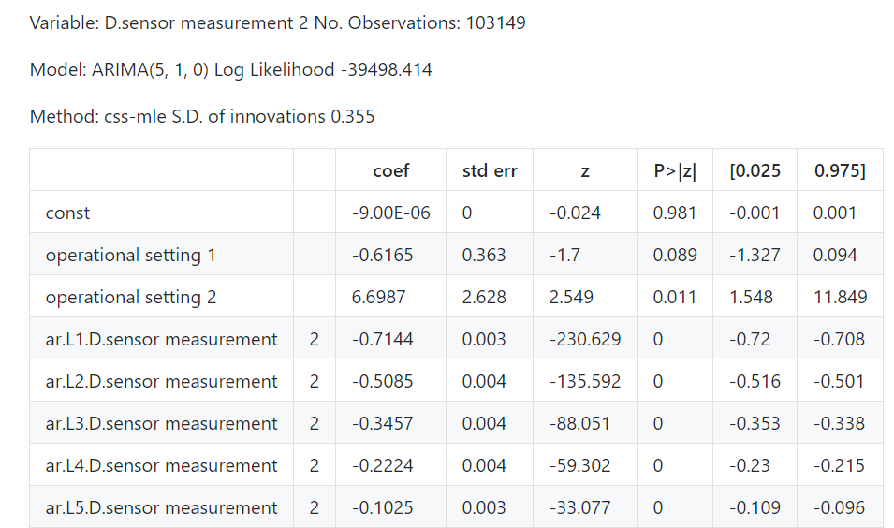

Slide 12
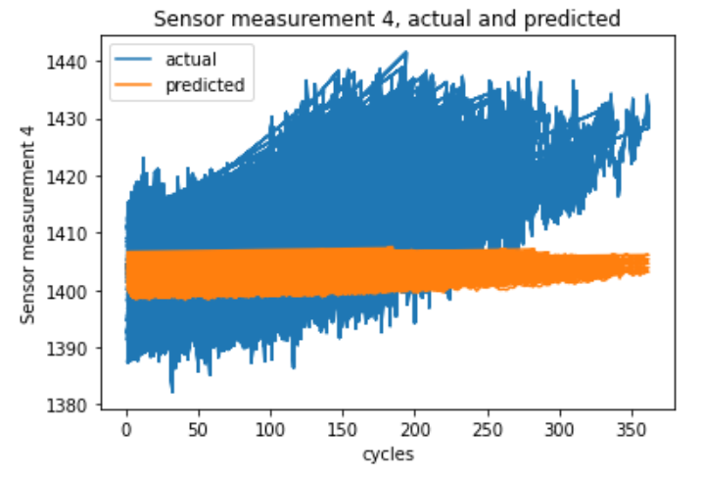
Results

Slide 13
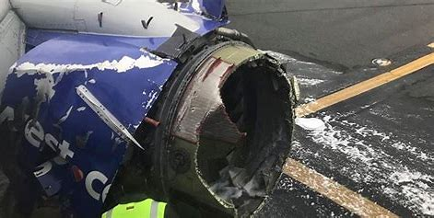
Summary
The ARIMA process is a useful one for creating models.
More work is needed to achieve greater accuracy

Slide 14
Thank you

