Slide 1

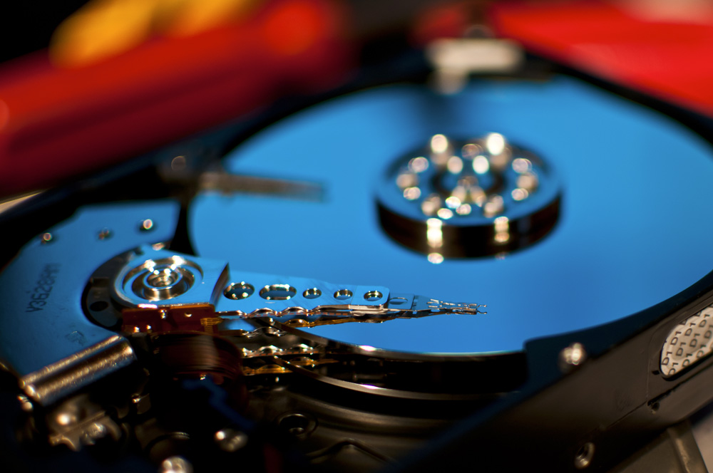
OPA TOWOBOLA
Hard Drive Reliability

Slide 2
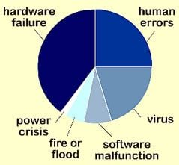
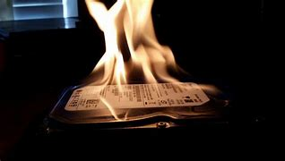
Top Causes of Hard Drive Data Loss ¹
1 https://sguru.org/hard-drive-failure-causes-solutions/
2. https://recoverit.wondershare.com/harddrive-errors/hard-drive-repair.html

Slide 3
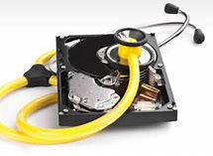
S.M.A.R.T. ? ¹
Self-Monitoring,
Analysis and
Reporting
Technology
;
Computer hard disk drive monitoring system
Detect and report various indicators of drive reliability
Anticipate imminent hardware failures.
1 https://en.wikipedia.org/wiki/S.M.A.R.T.

Slide 4
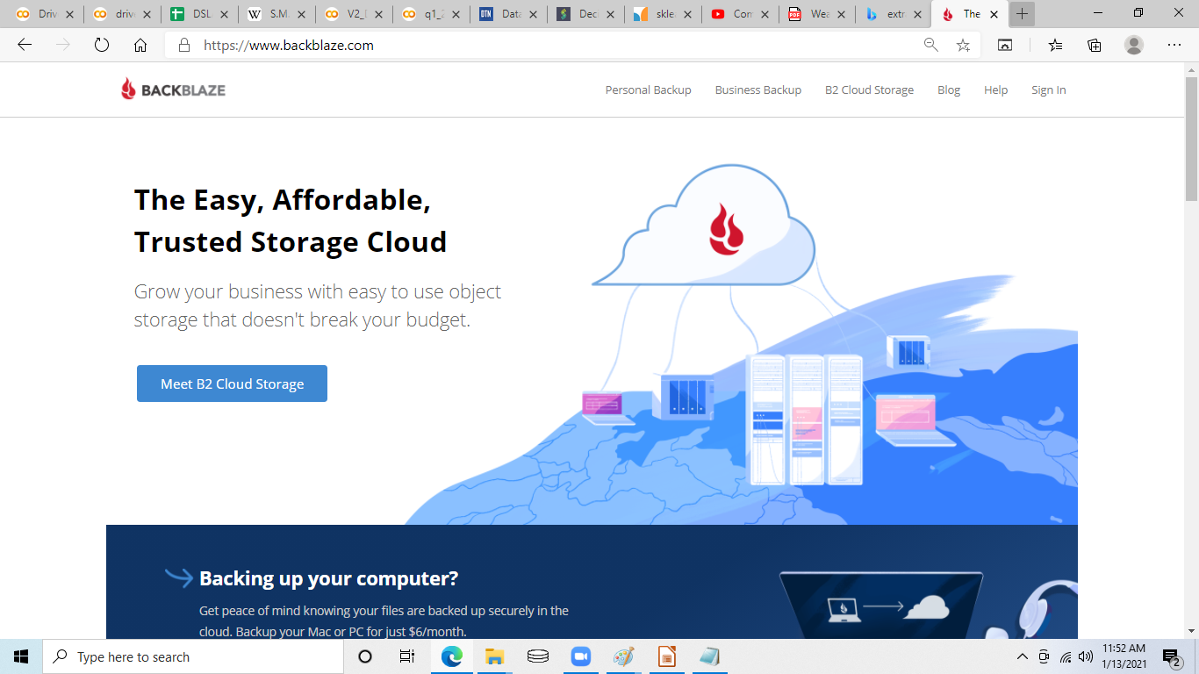
Data source
Every month
Since 2013,
1 comma separated values spreadsheet/month
1 row/day * ~100 thousand drives
More than 50 of the 255 S.M.A.R.T. metrics.

Slide 5
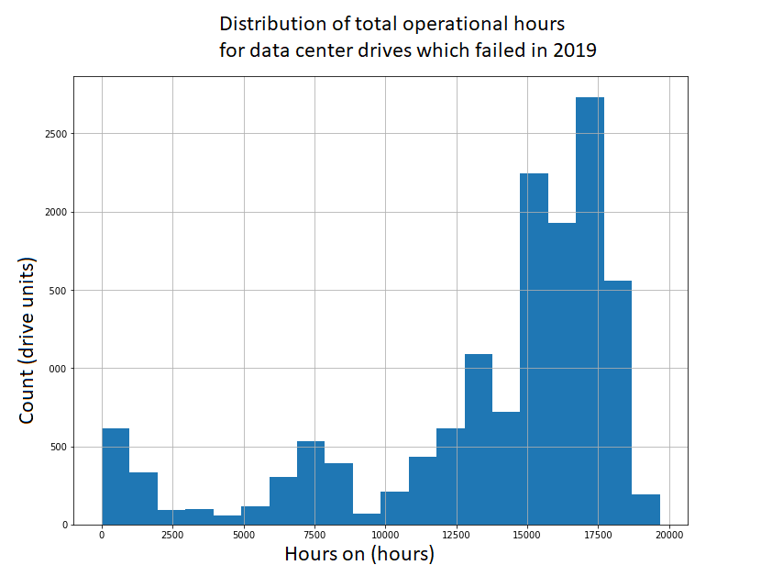

Slide 6
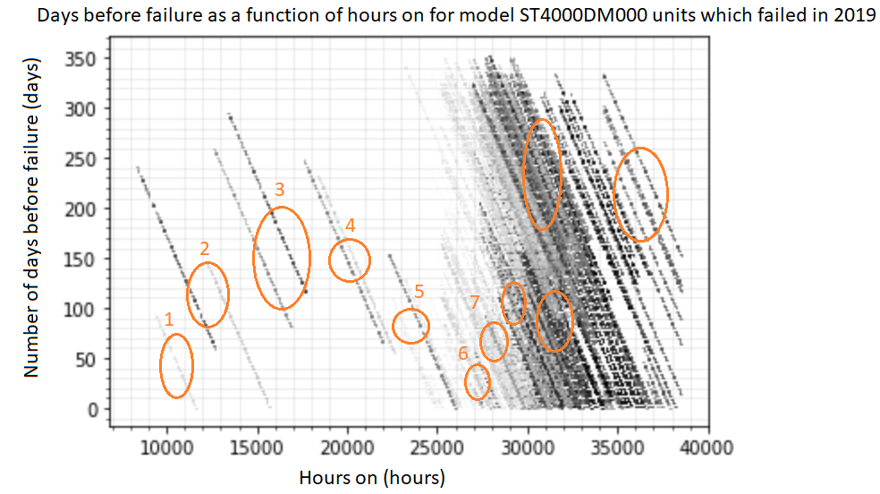
Unit Segregation by LifeSpan

Slide 7
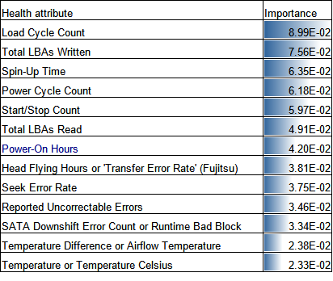
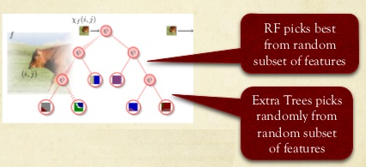
1 https://image.slidesharecdn.com/neuralnetworksinthewild-141028173746-conversion-gate01/95/neural-networks-in-the-wild-handwriting-recognition-19-638.jpg?cb=1414535504
Tree classification

Slide 8
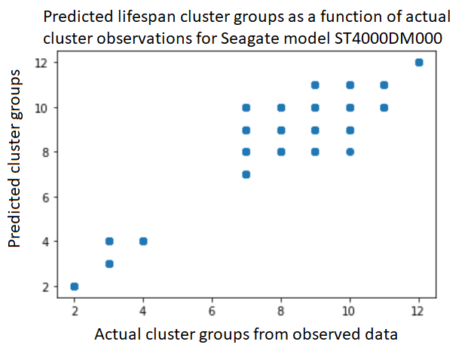
Algorithmic prediction of performance
Model prediction metrics | Value
CV average score: | 0.93
Accuracy: | 0.82
Algorithm prediction of performance clusters

Slide 9
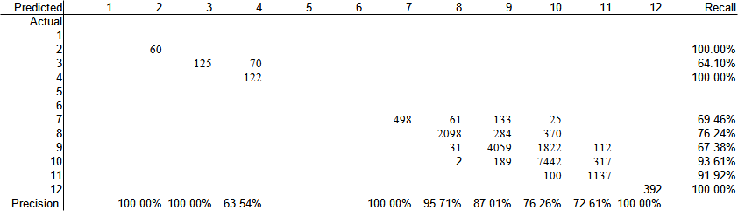
Conclusion
Extra trees algorithm
>60% success segregating lifespans
using SMART health attributes

Slide 10
Next steps
Expand the analysis to more models
Expand the analysis to more years

Slide 11
Reaching out
Opa Towobola
Workhead@hotmail.com
Linkedin/carvethefuture

Slide 12
Predicted ranking

Slide 13
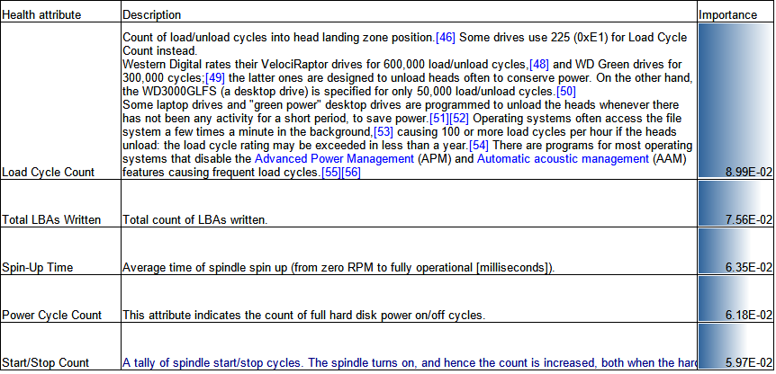

Slide 14
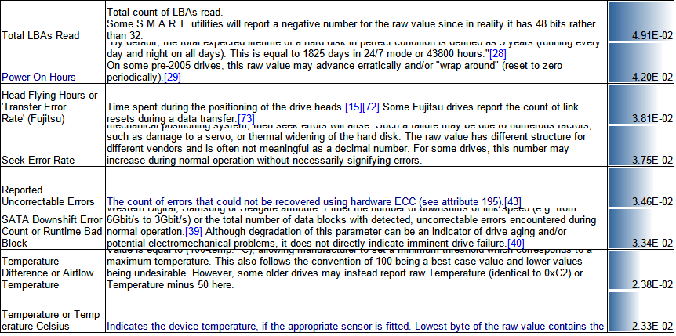

Slide 15
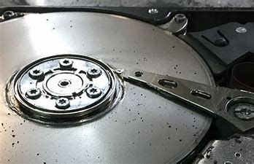

Slide 16
Top Causes of Hard Drive Data Loss ¹
Mishaps
Water Damage
Human Error
Unforeseen Mishaps
Extreme Energy (Thermal/Magnetic)
Possibly preventable
Virus or Faulty Software
Un-allocated Space Issue
Hardware Issues
Mechanical Flaws
Power Issues
Firmware Corruption
1 https://sguru.org/hard-drive-failure-causes-solutions/

Slide 17
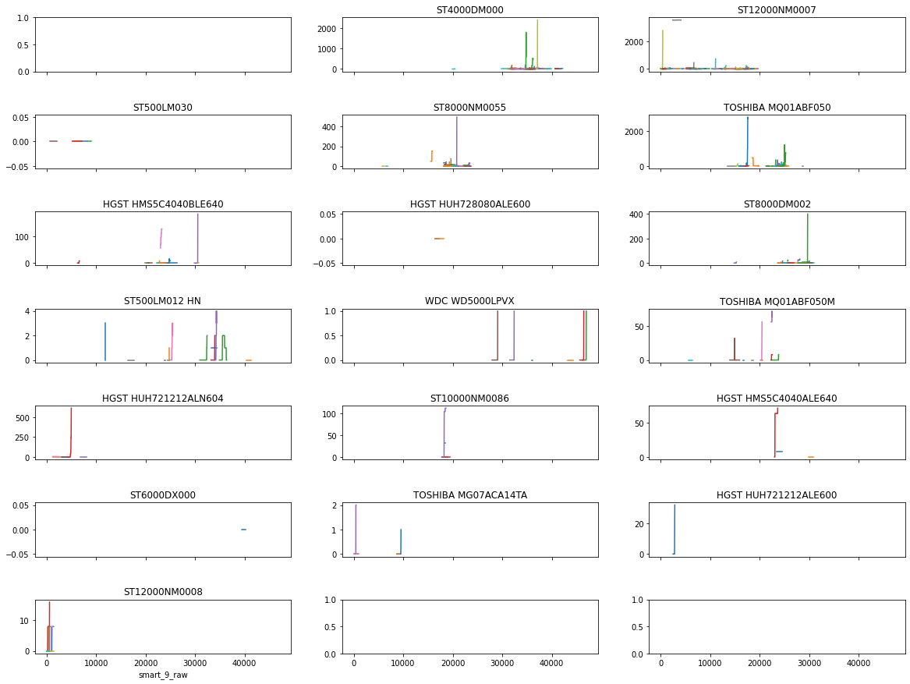

Slide 18
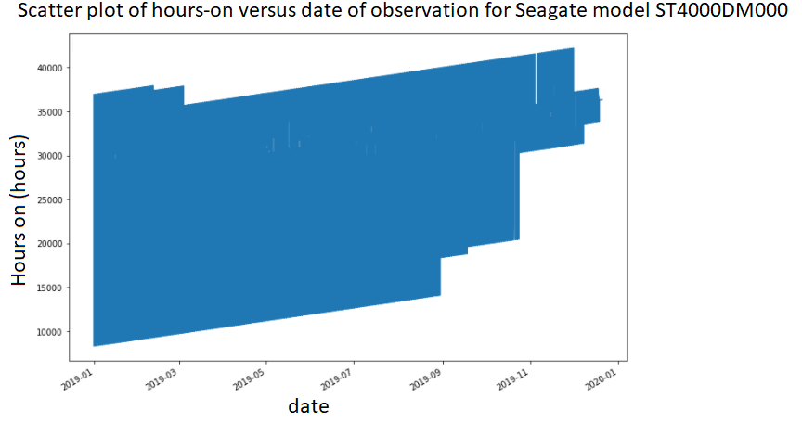
Hours on
Hours on
1 https://en.wikipedia.org/wiki/S.M.A.R.T.

Slide 19
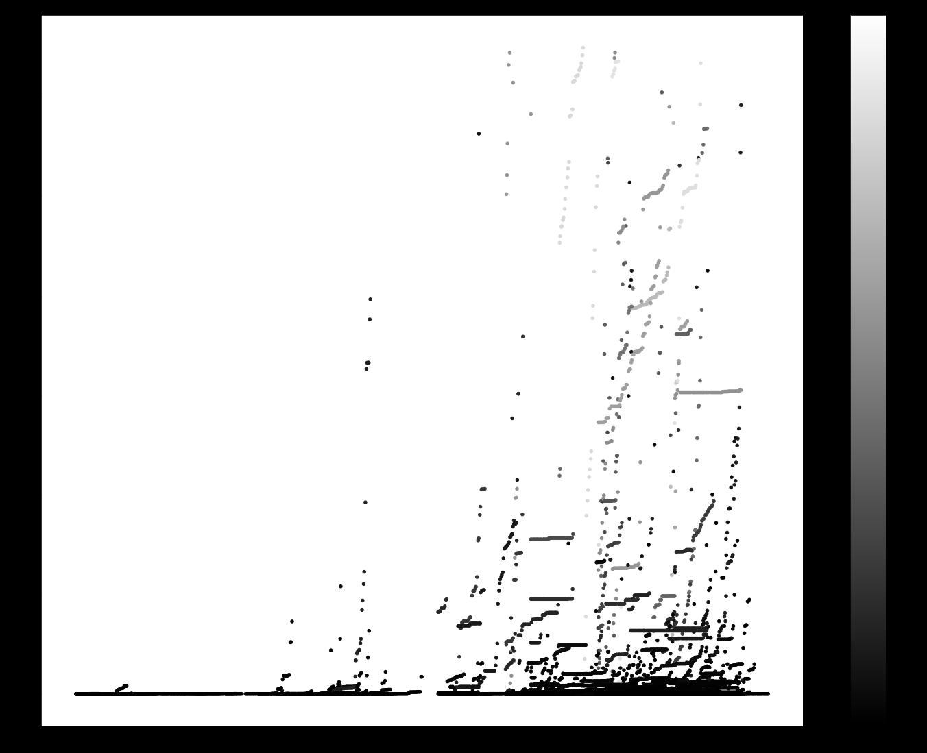
https://archive.org/details/car_000122

