Slide 1

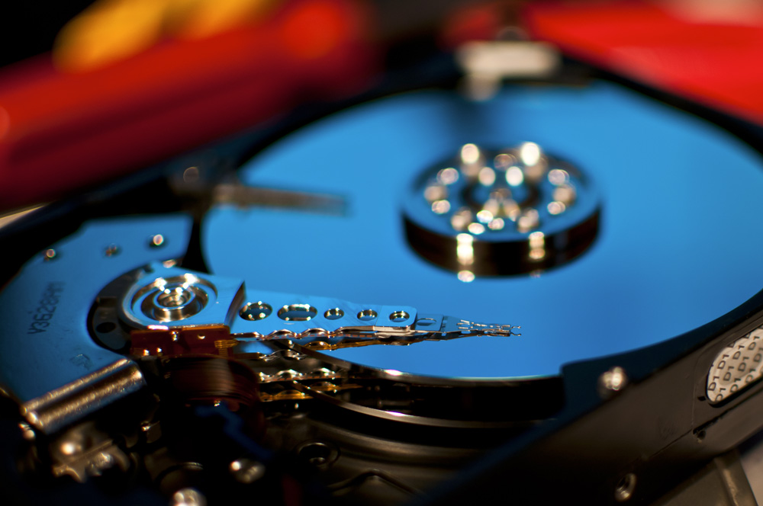
OPA TOWOBOLA
Hard Drive Reliability

Slide 2
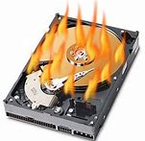
Top Causes of Hard Drive Failure ¹
Power Issues.
Firmware Corruption
Water Damage
Human Error
Virus or Faulty Software
Unallocated Space Issue
Hardware Issues
Mechanical Flaws
Unforeseen Mishaps
Extreme Energy (Thermal/Magnetic)
1 https://sguru.org/hard-drive-failure-causes-solutions/

Slide 3
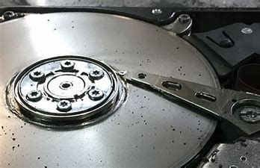

Slide 4
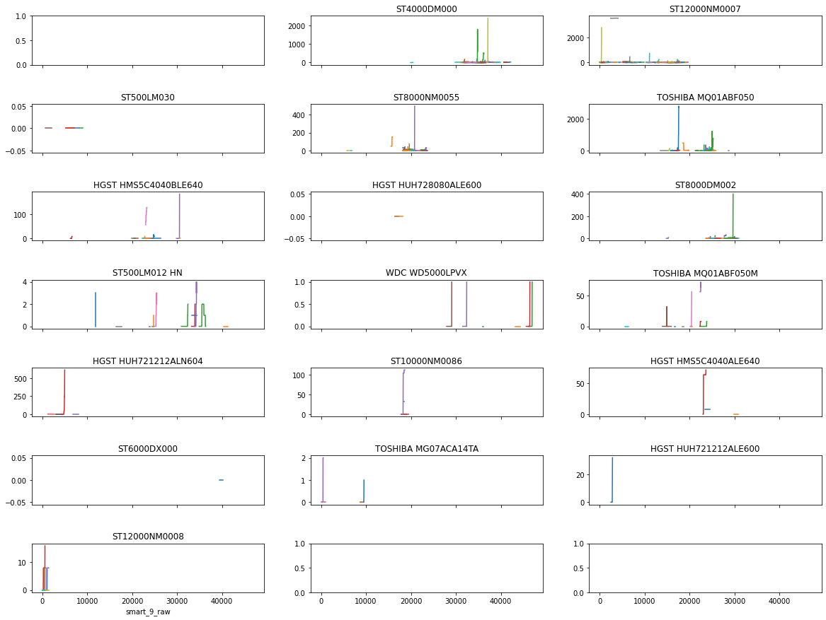

Slide 5
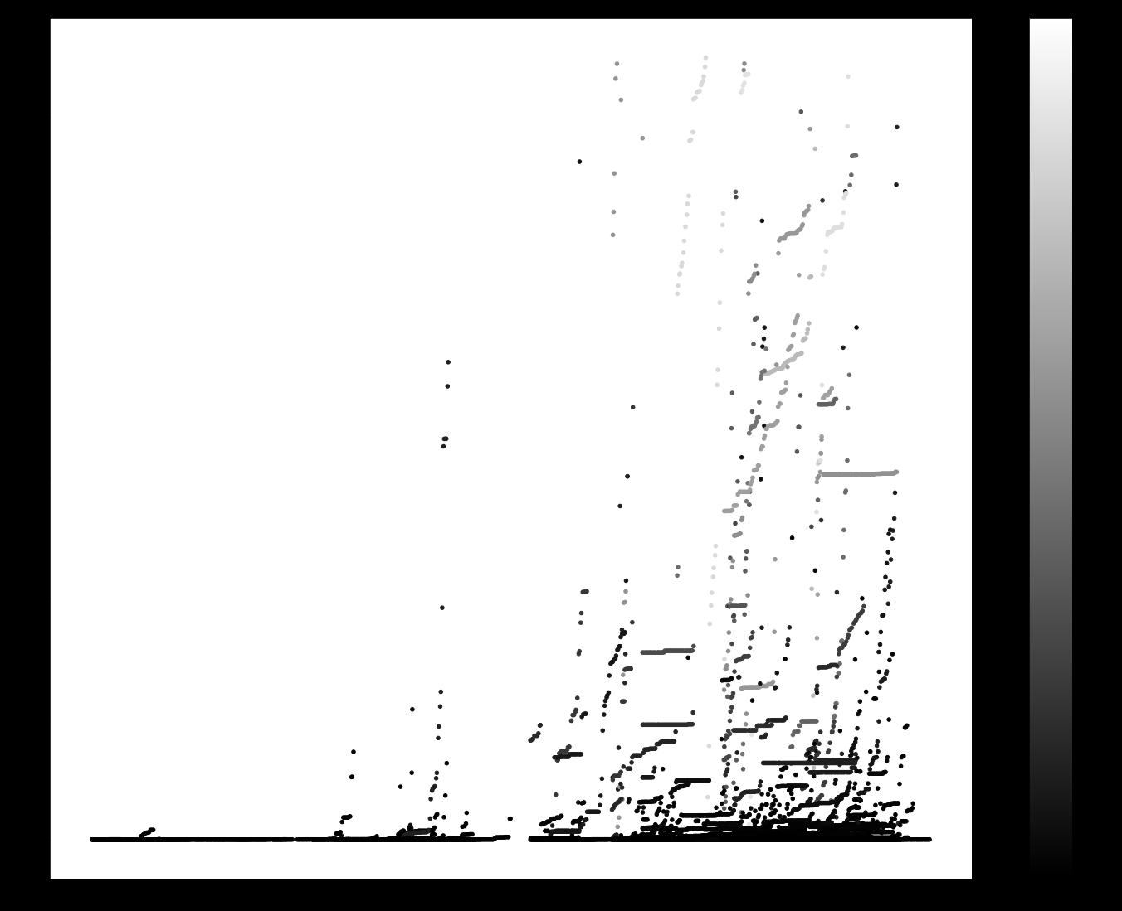
https://archive.org/details/car_000122

