Slide 1
Health and development trends in the modern era
OPA Towobola
30 October 2020

Slide 2
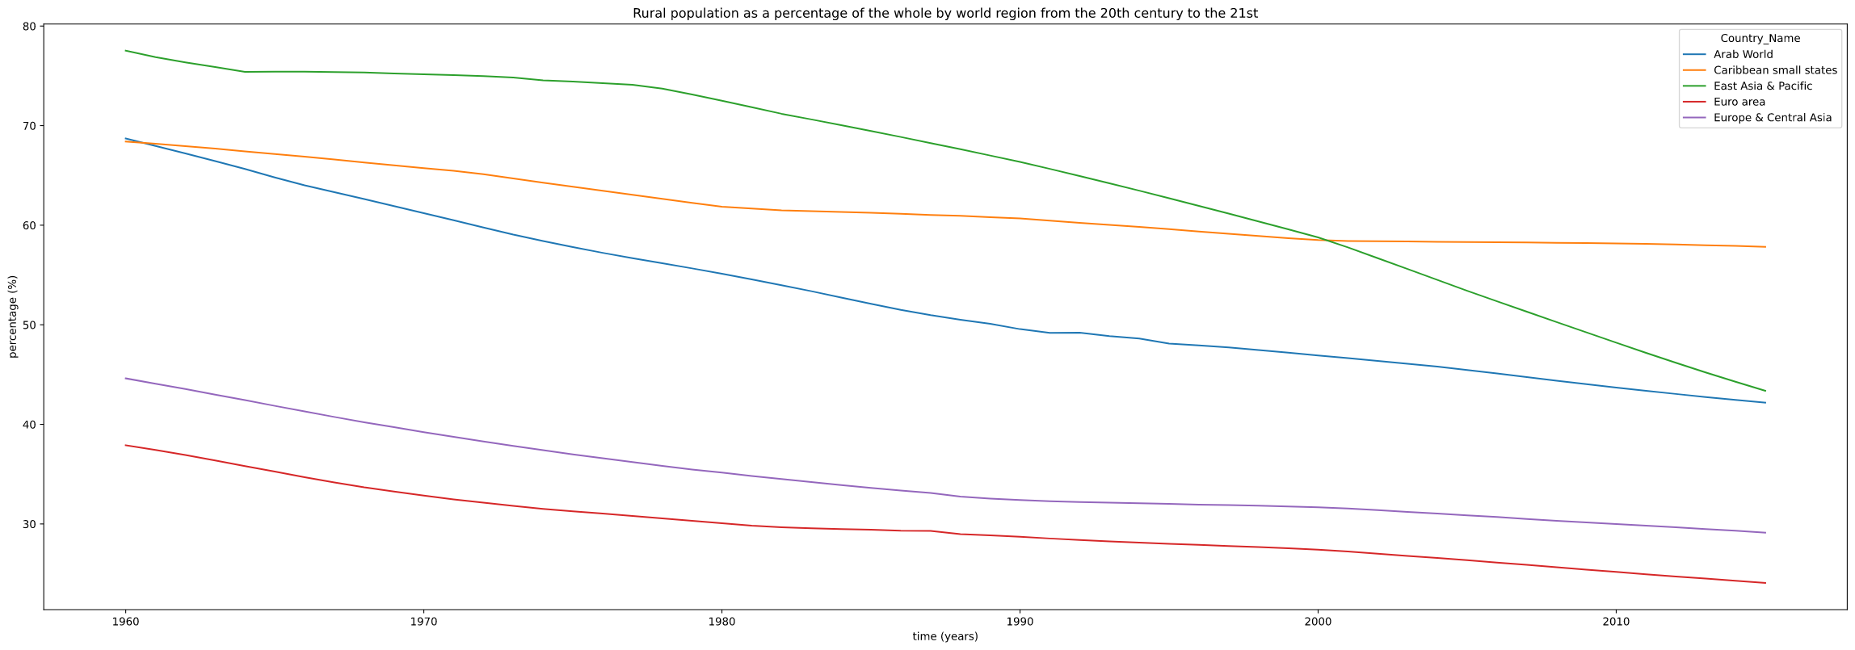
More people live in cities

Slide 3
Questions
What concerns arise as the world becomes more developed?

Slide 4
Background
Over the course of time, lifestyles have been stable for most cultures. However, in the last 40 years, with the advent of globalization, the pace of change has quickened across the globe.

Slide 5
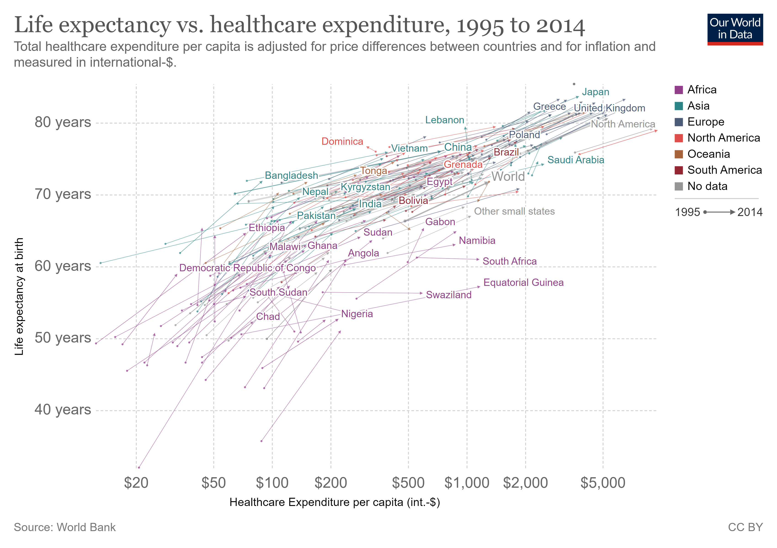
Life expectancy is rising

Slide 6
What goes in to health?
Biology and genetics
inherited conditions
Public policy and regulation
vaccination campaigns
Healthcare
timely treatment
diagnosis of disease
Habits
smoking
Social and environmental factors
exposure to crime,
pollution

Slide 7
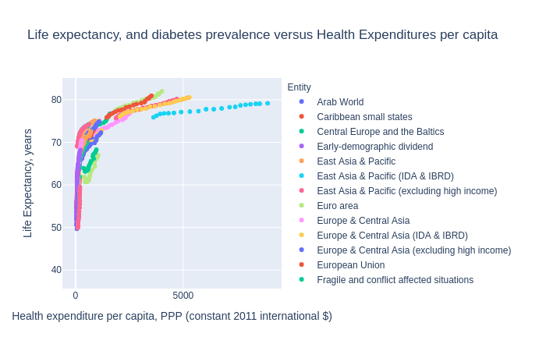
State-wide inputs

Slide 8
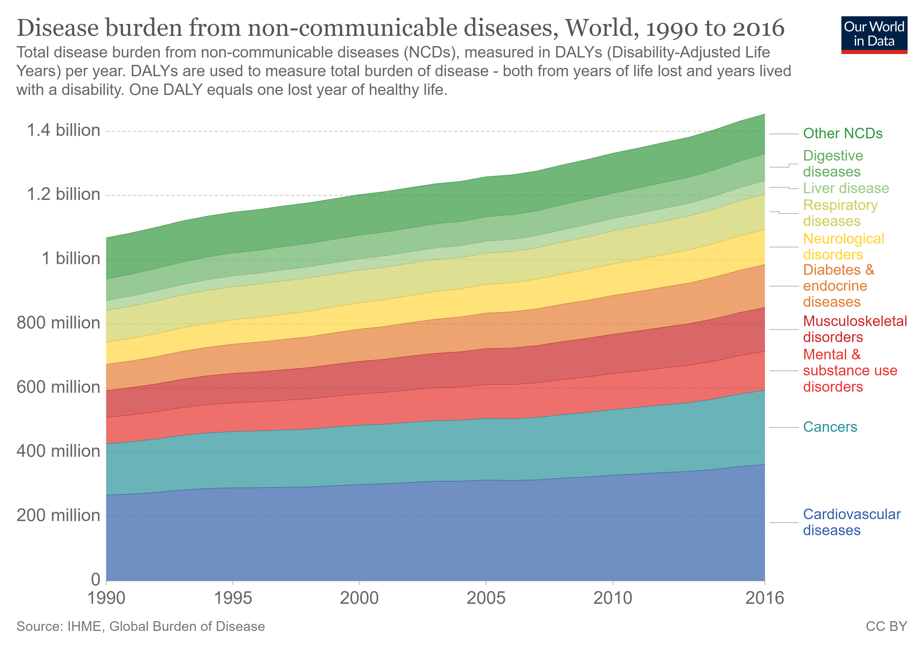
There are some declining healthcare outcomes
Non-communicable diseases appear to be exerting a greater impact

Slide 9
Test of means
Diabetes rate, covariates=['Health costs'])
Source SS DF MS F p-unc np2
0 Entity 106.34334520 5.317167 1.32301 0.29344 0.638207
1 Within 60.284876 15 4.018992 NaN NaN NaN
Life expectancy, covariates=['Health costs'])
Source SS DF F p-unc n2
0 Entity 27240.851033 35 200.211613 0.000000e+00 0.893857
1 Health costs 579.646235 1 149.107558 3.701995e-31 0.019020
2 Residual 2655.119455 683 NaN NaN NaN

Slide 10
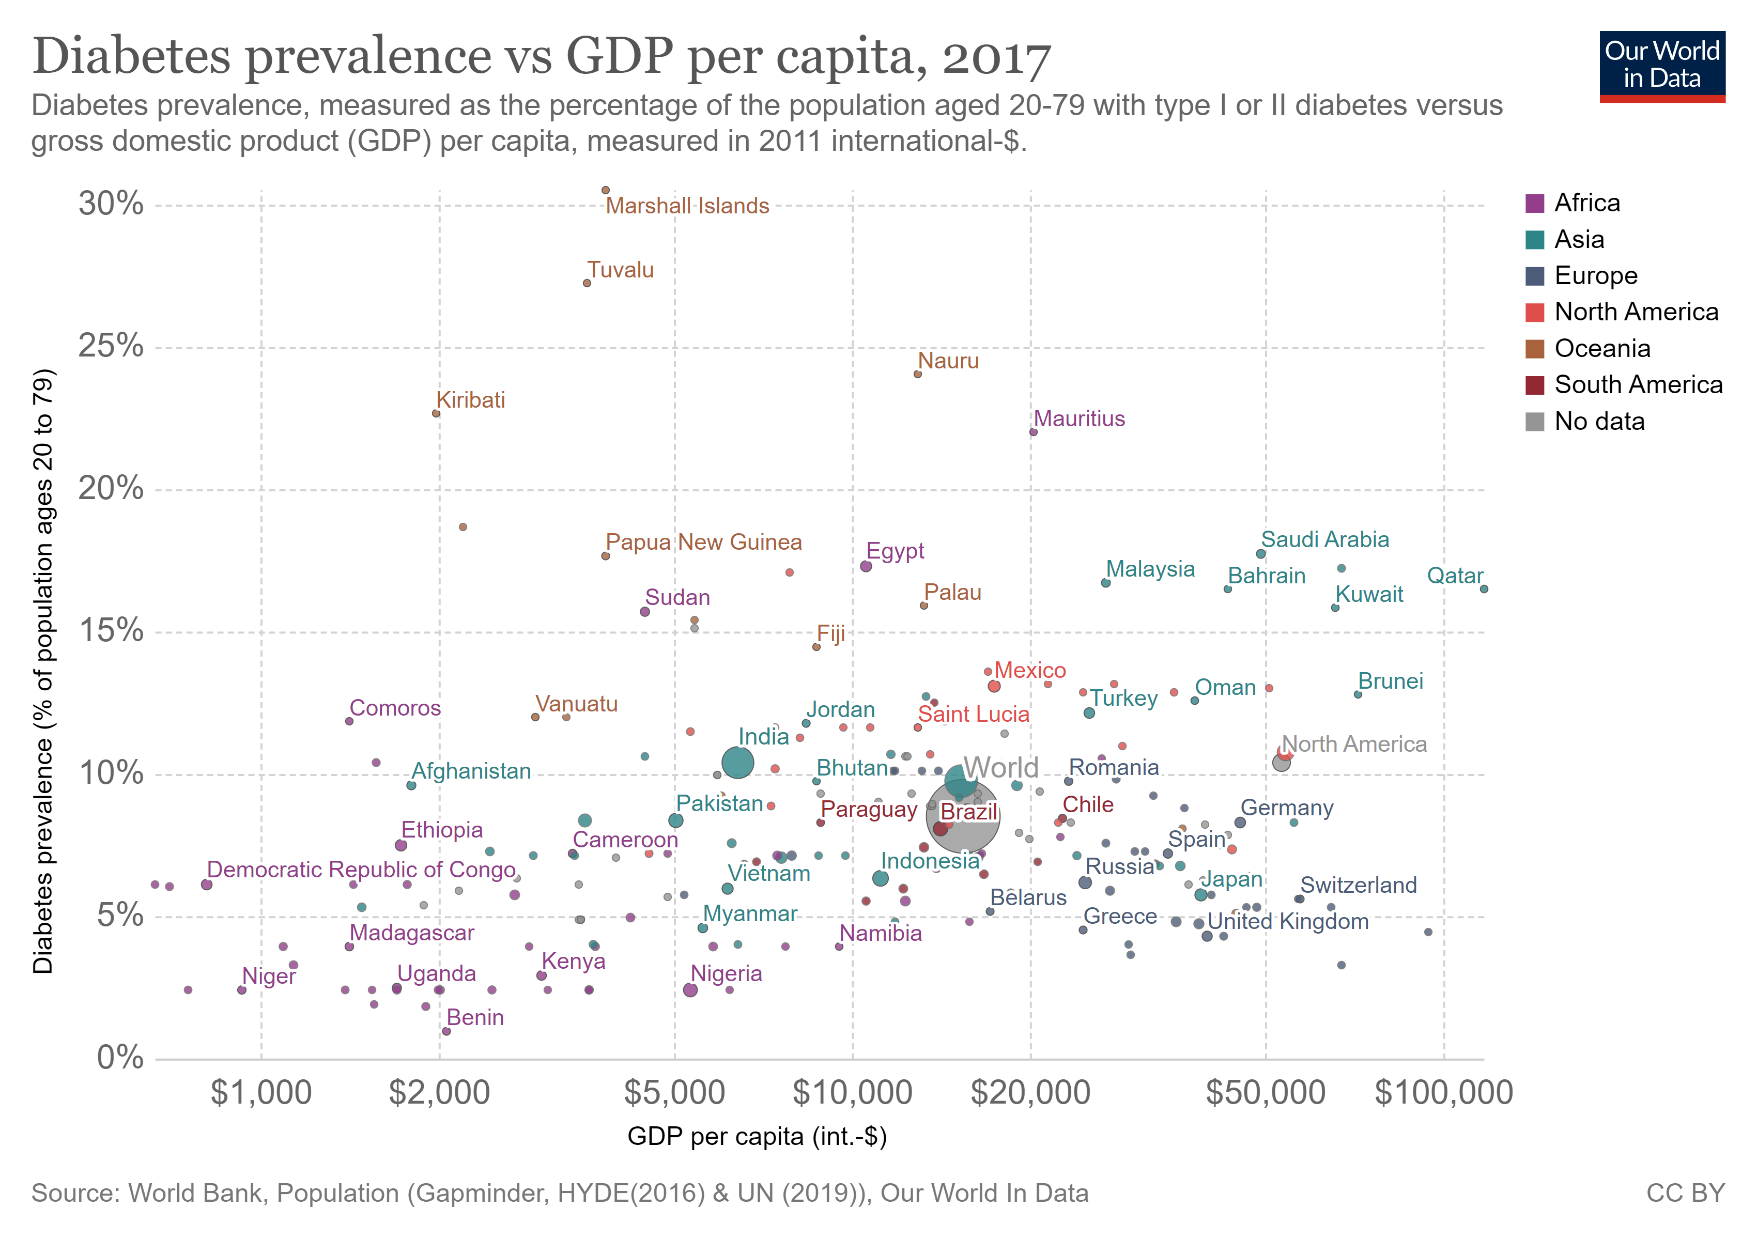
Diabetes on the increase

