Slide 1
Health trends in the modern era
OPA Towobola
30 October 2020

Slide 2
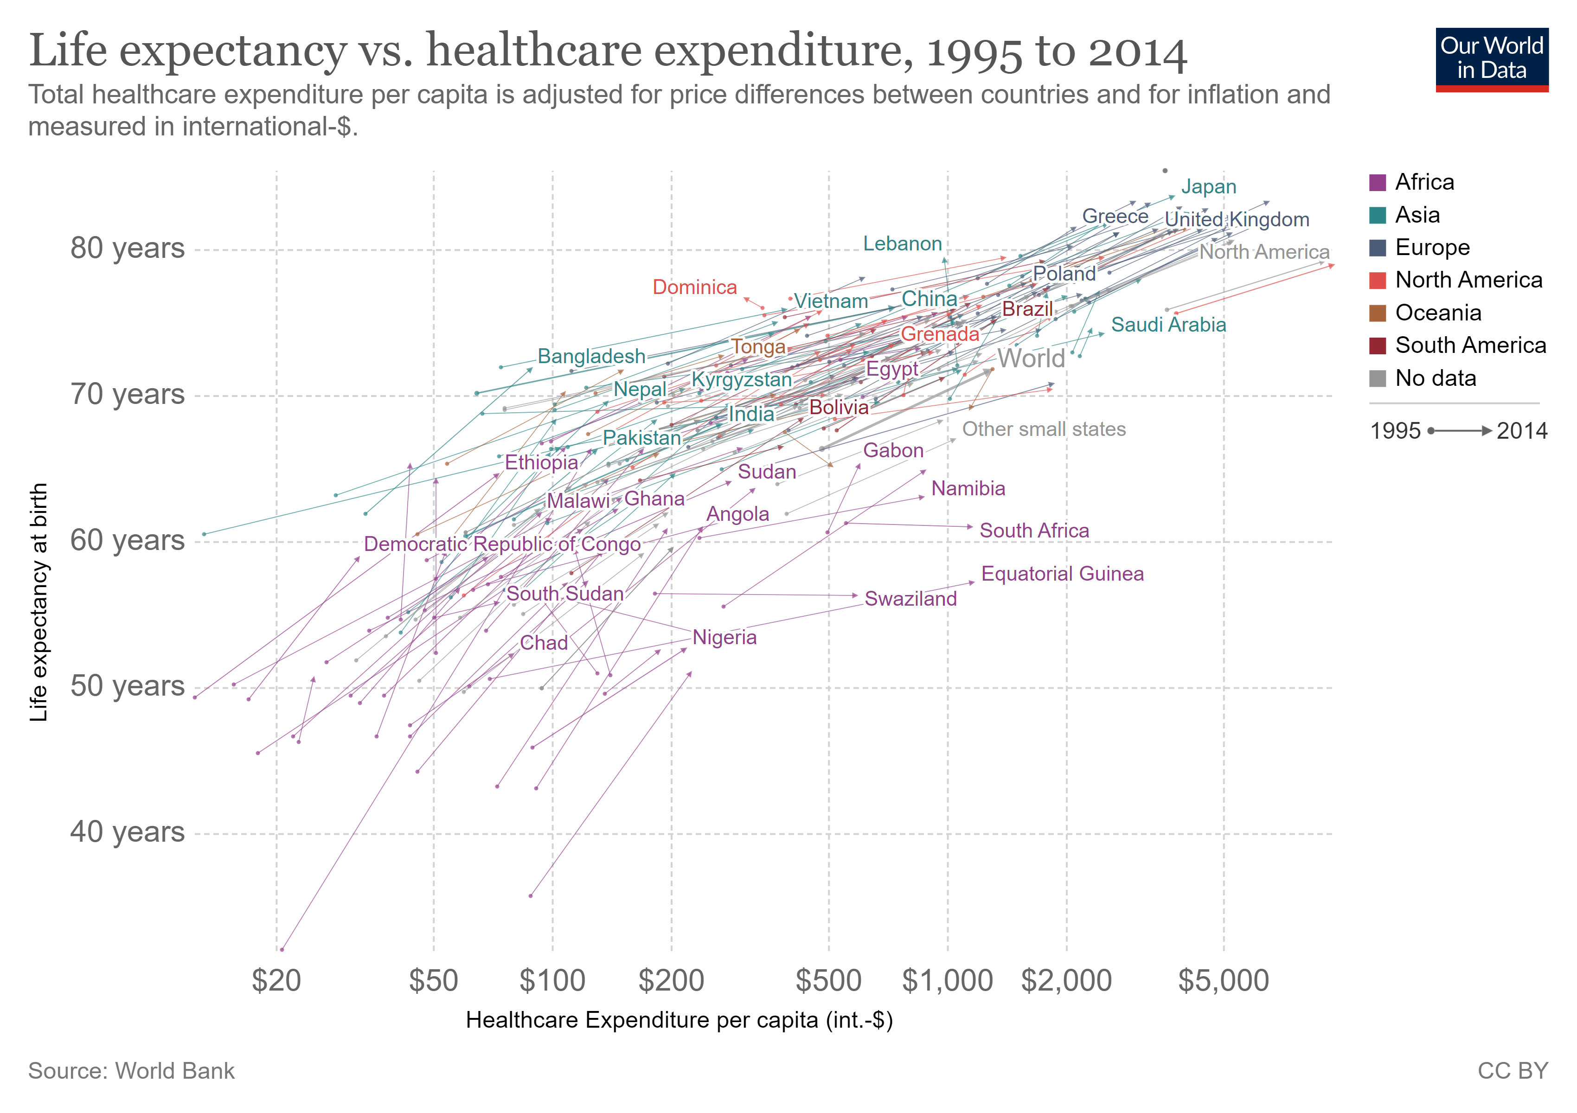
Life expectancy is rising
Biology and genetics
inherited conditions
Public policy and regulation
vaccination campaigns
Healthcare
timely treatment
diagnosis of disease
Habits
smoking
Social and environmental factors
exposure to crime,
pollution

Slide 3
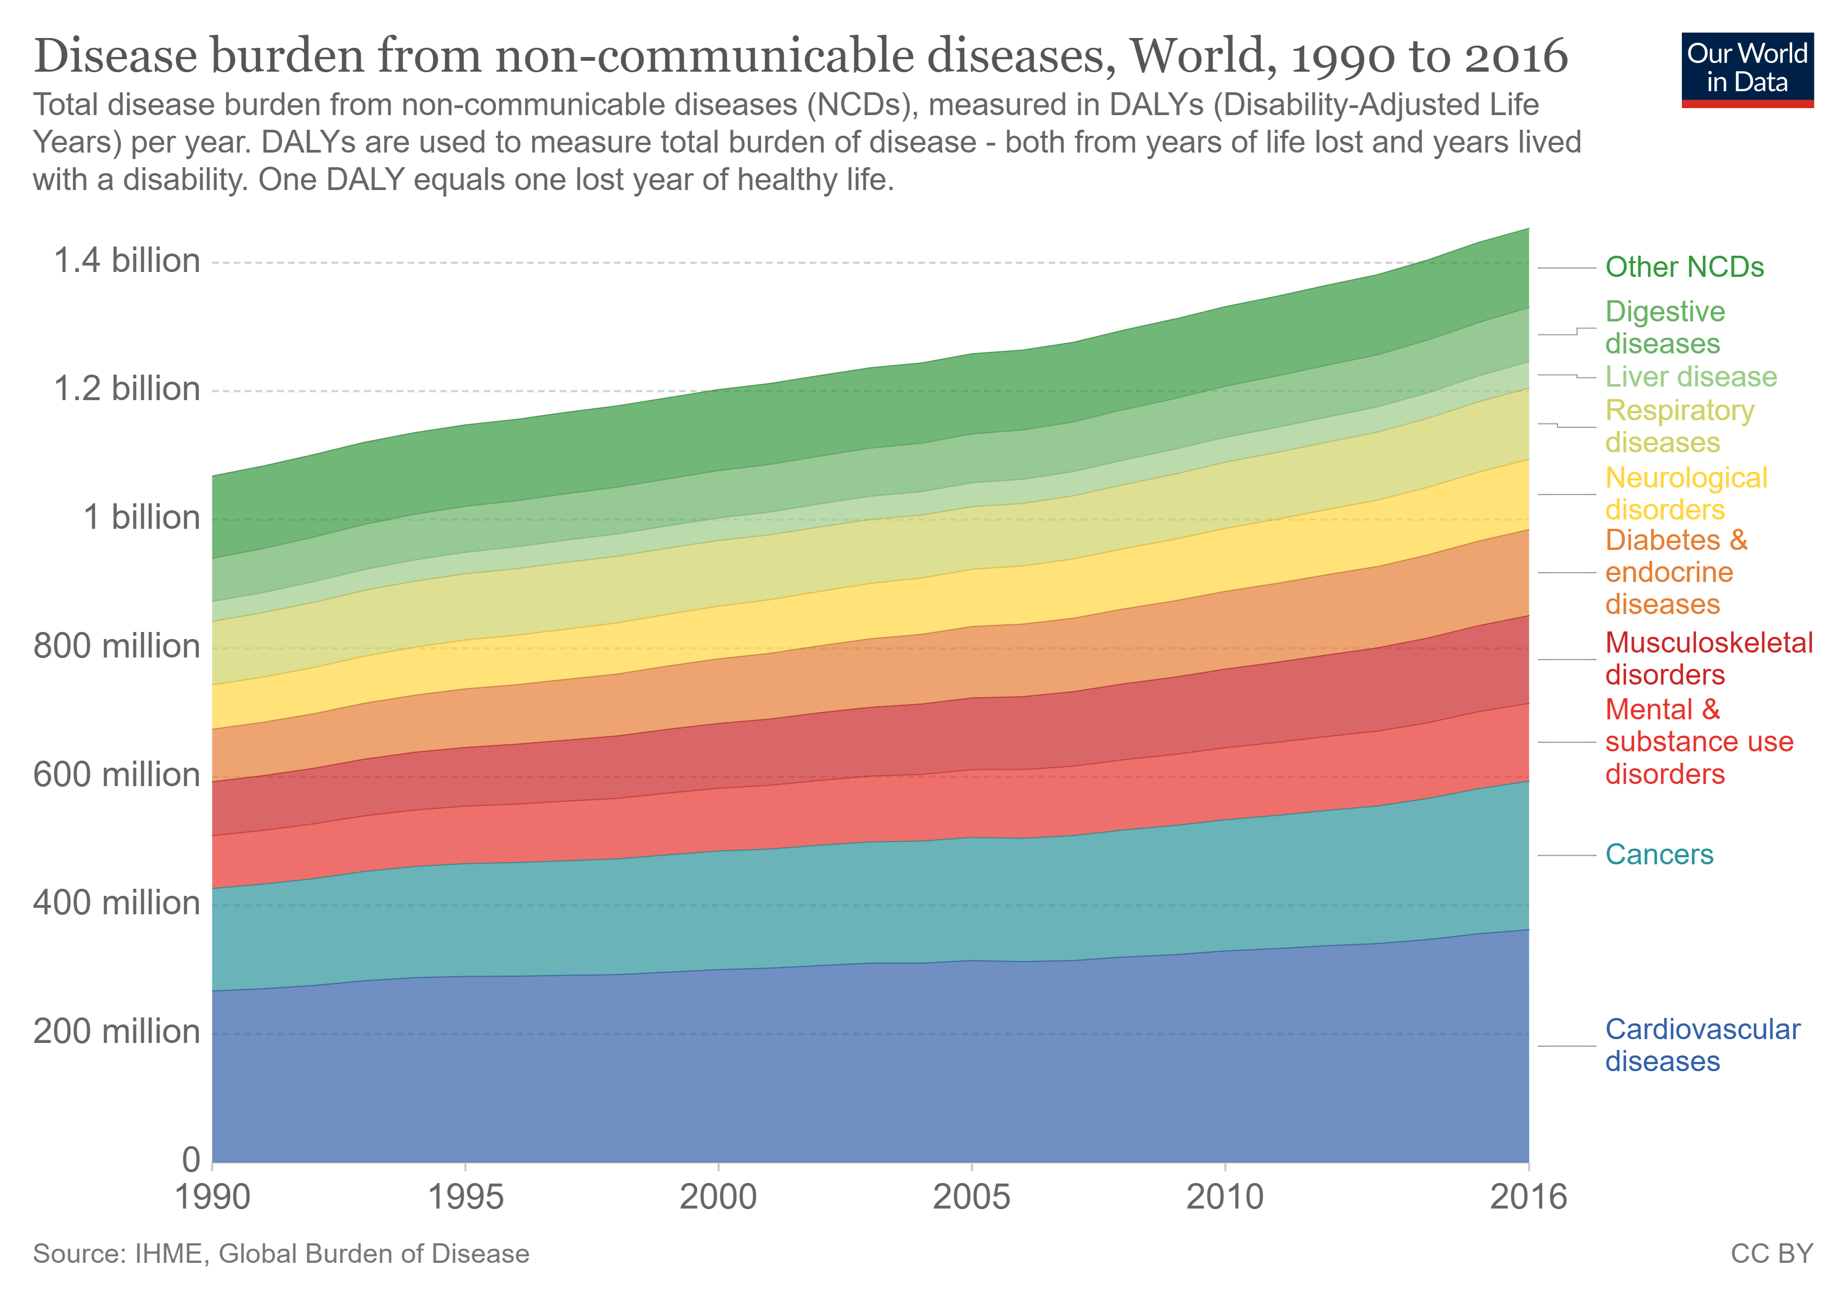
Some declining healthcare outcomes
For Non-communicable diseases

Slide 4
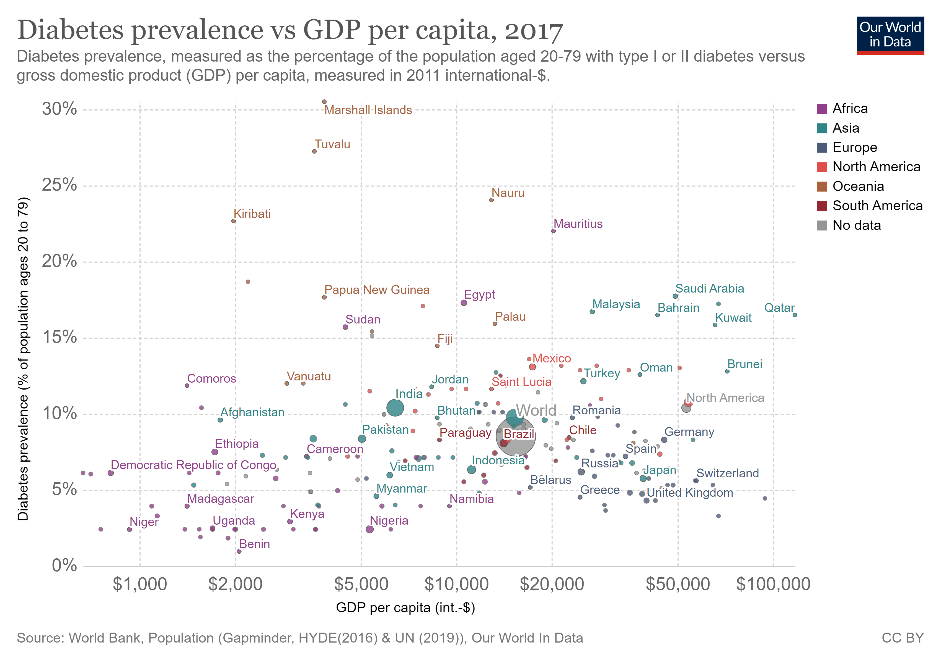
Diabetes on the increase

