Slide 1
P³
Public Personality Prediction:
What your public profile says about you.

Slide 2


Slide 3
What is MBTI?
Based on the theory of psychological types outlined by famous Psychologist Carl Jung.
Myers Briggs Type Indicator was developed by Isabel Myers Briggs to turn the theory into useful tool for anyone who wants to know more about themselves
The MBTI contains four binary choices that add up to sixteen unique personality types

Slide 4
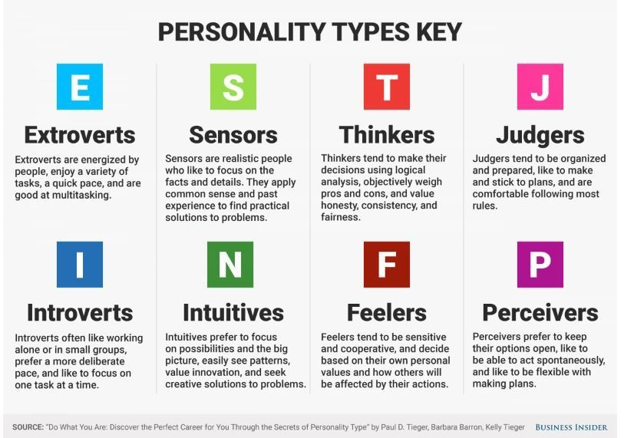
8 Indicators that together make 16 unique classifiers

Slide 5
Not Convinced?
MBTI is used in many businesses across the board in order to better understand their employees.
Management can use these tools to better communicate with, motivate, and manage their respective teams.
Some companies use the MBTI as a tool to help build a team that will work well together.

Slide 6
Let’s get into the weeds a bit
The data came from Kaggle aggregated from a forum called PersonalityCafe.
It consists of two whole features! The first features is a personality type while the second is an aggregation of 50 unique comments per row.
There are 8,675 rows of data that are all from unique individuals.
Is that enough features and data to make predictions?

Slide 7
More Weeds
I thought this was not enough data so working on inspiration from a couple of kernels on kaggle I derived additional values.
Values included exclamations, music, http, ellipses, questions marks, and words per comment.
It was here I made my first observations about the dataset showing a huge bias towards Introverts and Intuition indicators.
Let’s take a look!

Slide 8
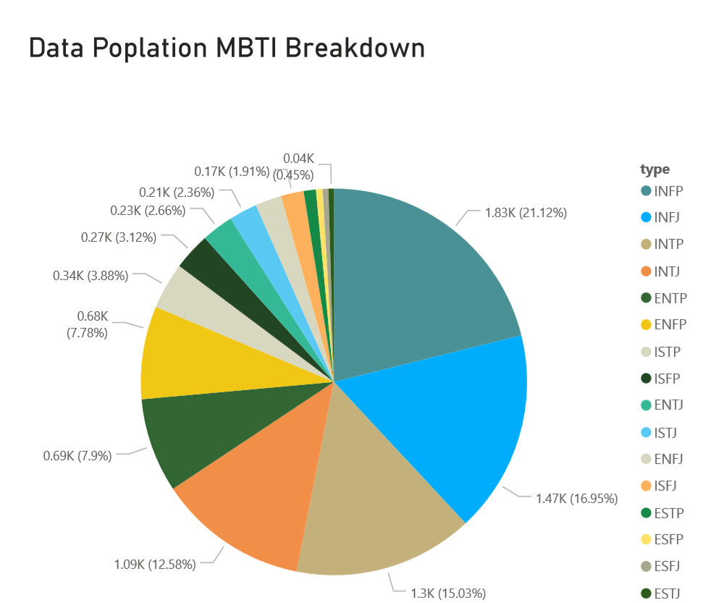
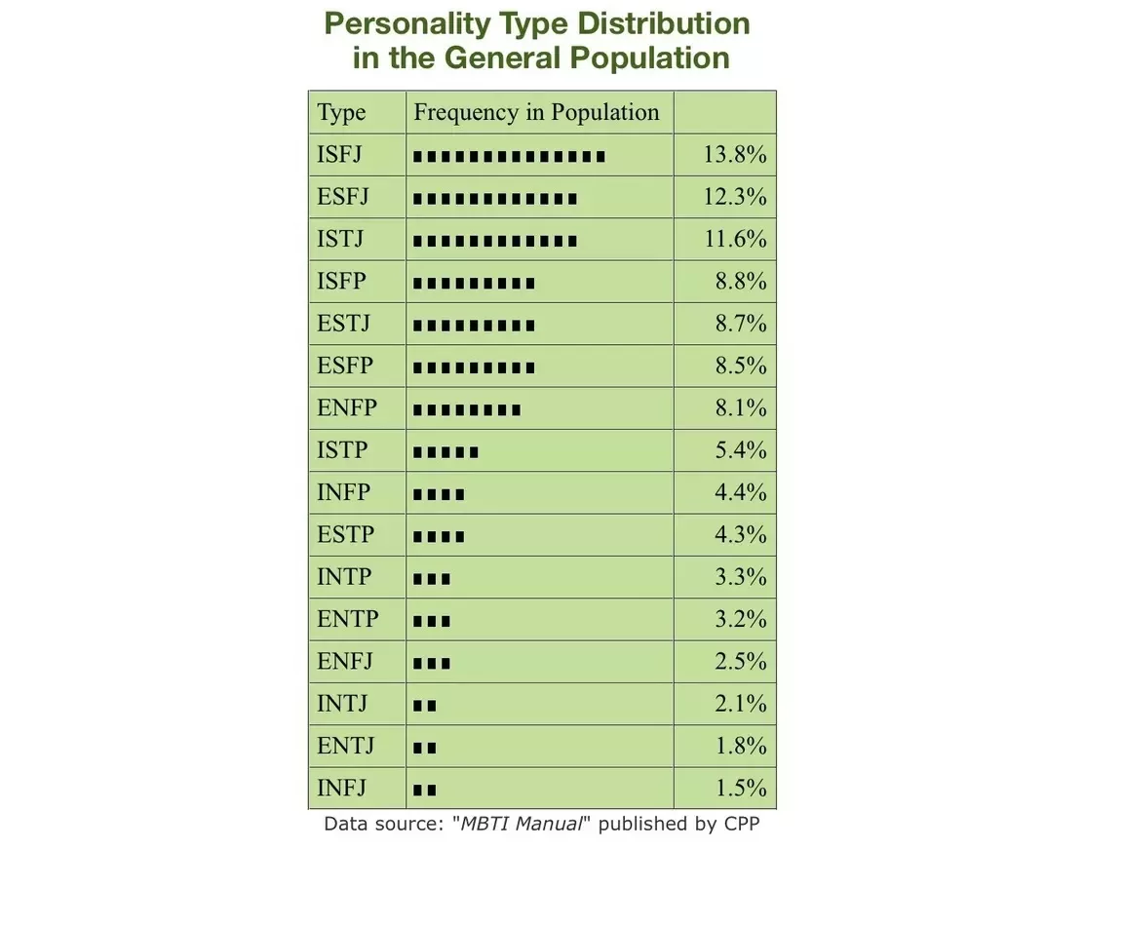
Kaggle Data MBTI vs General Population

Slide 9
Let’s build a model to Predict type
After observing some predecessors attempting to tackle this problem to the tune of making a model that predicted only 2.48%, I tried a different approach.
Split data into different features predicting I or E, N or S, T of F, and J or P.
Eventually just focused on literally using the vectorized posts to predict outcomes of the above binary choices.
Logistic Regression ended up being the best of the bunch including Logistic Regression, ADABoost, and Naive Bayes
Let’s check out the results

Slide 10
Areas to Grow
Try additional models
More featurization
UI
Plan to post iterations of the project on Github as I continue.

