Slide 1
MAN 7916 Session 7: (Large) Language Models
Aaron McKenny
2/18/2025

Slide 2
AGENDA
1 This week’s homework
2 This week’s readings and large language models
3 In class activity

Slide 3
Summative Homework Assignment
Let’s talk through it!

Slide 4
AGENDA
1 This week’s homework
2 This week’s readings and large language models
3 In class activity

Slide 5
Financial Times | Fyffe – Transformer Architecture
What are transformers and how do they differ from the traditional classifiers we saw last week?
What are some of the advantages of using transformers for classification?
What are some challenges associated with using transformers vs other text analysis methods?
Manual coding
Dictionary-based

Slide 6
Sequence–to–Sequence Models
What we have seen before:
Regression – series of inputs → single value output (continuous)
Classification – series of inputs → single value output (nominal)
How to tackle things like
Translation – Translate “Ayer, mi amigo me dio un libro hermoso.”
Conversational AI – How should I respond to a question from a user?

Slide 7
Seq2Seq: Translation Without Attention
Spanish: “Ayer, mi amigo me dio un libro hermoso.”
English “Yesterday, my friend me gave a book beautiful”
English “My friend gave me a beautiful book yesterday.
Translation doesn’t often work well when done word-by-word
Similar problems with other seq2seq NLP tasks (e.g., conversation)
Oversimplified

Slide 8
Imagine… Explain Harry Potter to a friend
No attention: “A kid finds out he’s a wizard and stops a villain”
Don’t get to refer back to different parts of the book
Only remember a single summary sentence in your head.
With Attention: "Harry learns he’s a wizard, goes to Hogwarts and gets sorted into Gryffindor, plays Quidditch, and stops Voldemort from stealing the Sorcerer’s Stone.“
Get to flip through different chapters while explaining
Focus on the most relevant details based on what your friend asks

Slide 9
Benefits of Self-Attention
Consider the entire text at once.
Dynamic importance – model learns which words matter most at each step.
Handles long texts better – don’t have to compress everything into one context vector
Multiheaded attention – understand different aspects of the text at once
Each attention head focuses on different relationships, improving accuracy.
Highlighting a textbook with one vs many different colored highlighters

Slide 10
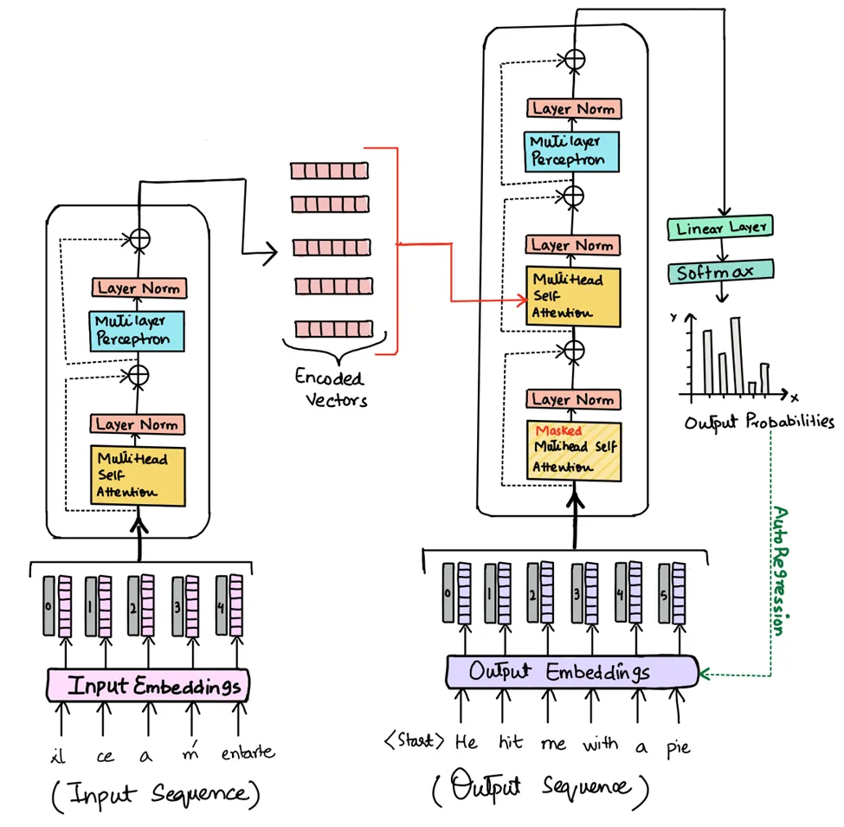
Transformers
Encoder (left half)
Turns input embeddings into contextualized vectors (meaning of input)
BERT, RoBERTa

Slide 11
Transformers
Decoder (right half)
Turns contextualized vectors into an output sequence, generating text step by step.
GPT, Gemini, DeepSeek

Slide 12
Transformers
Encoder-Decoder
Encoder reads entire text before decoding
Better with long documents, structured tasks
BART, T5

Slide 13
Jurafsky and Martin 2024 Chapters 11-12
What is a masked language model and why do we care?
How do the embeddings produced by masked language models improve upon other embedding approaches:
Word2Vec and GloVe, for example
What is prompting/prompt engineering?
How can we prompt decoder models to do things like classification?
What are some limitations?

Slide 14
Speer et al – Comparing encoder and decoder models
How do decoders and encoders compare with respect to classification?
What are some advantages and disadvantages of using decoder-only models?
What are some implications of this
For researchers?
For organizations?
What concerns do you have regarding the applications of decoder-only models

Slide 15
GPT LLM Training (at a glance)
Step 1. Data gathering (massive datasets)
Step 2. Tokenization: http://tiktokenizer.vercel.app/
Step 3. Training (next token prediction)
(After this stage, inference is possible)
Step 4. Post-training
(After this stage, the model is specialized. E.g., instruction following, conversation)

Slide 16
AGENDA
1 This week’s homework
2 This week’s readings and large language models
3 In class activity

