Slide 1
Seattle collision
Reducing the risk

Slide 2
Introduction/Business Problem
There has been to many accidents among people that ride cycles in the city of Seattle. This study is about reducing the risk for that group.

Slide 3
Data Source
For this work we will use the Washington State Department of Transportation Annual Collision Data Summary Reports to obtain information about Seattle’s Collision. This Dataset provide all the information about collision in the streets of Seattle from 2004 to today.

Slide 4
Data understanding
From the Data set we will isolate all the accidents that involve a car and a unicycle, bicycle, tricycle. We will try to find the relation between the collisions with light, weather, and road conditions. Also we will look at the location of the different accident and search for all possible correlation.

Slide 5
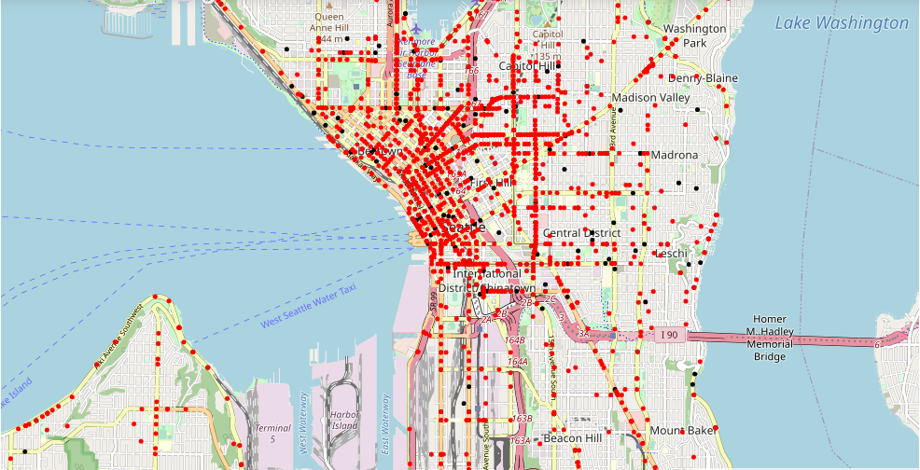
Map of the collisions

Slide 6
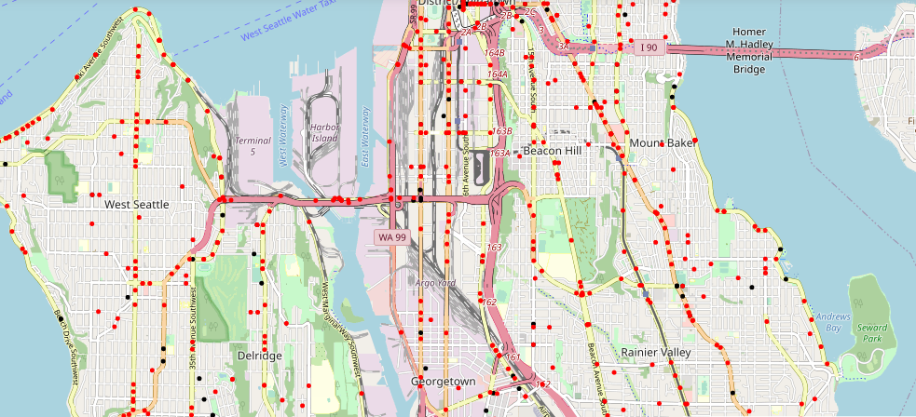
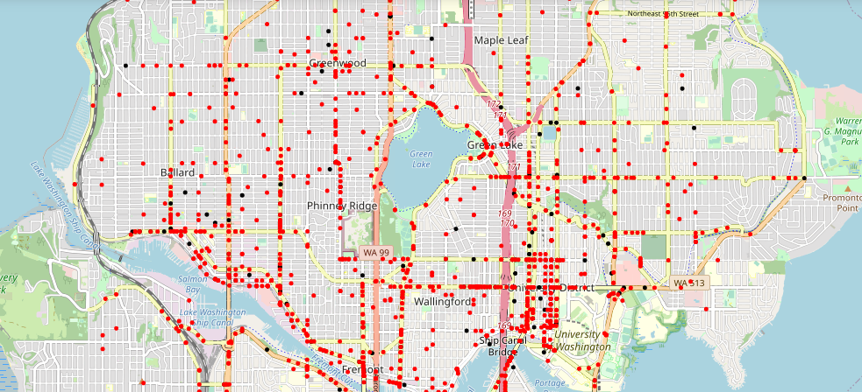

Slide 7
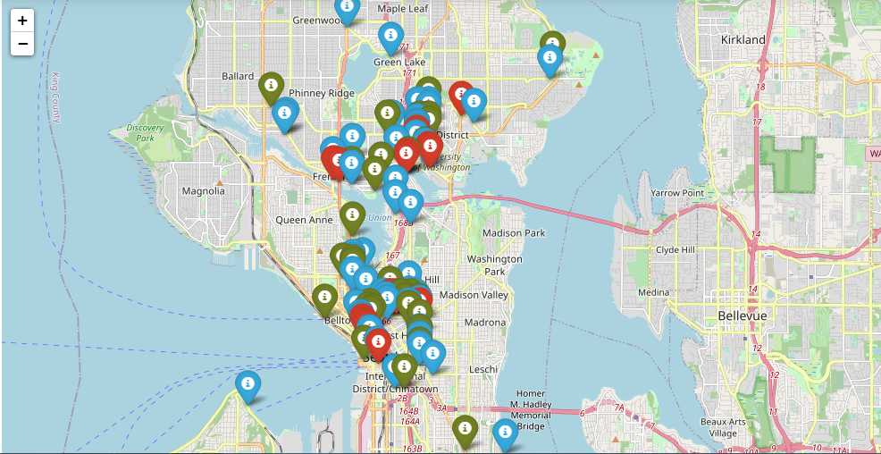
High risk area

Slide 8
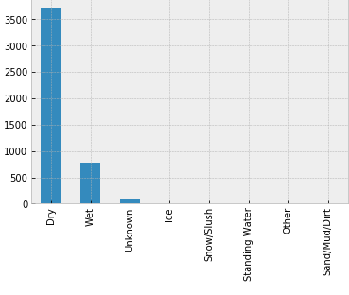
Collision and weather condition

Slide 9
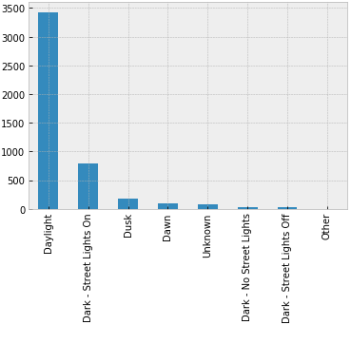
Collision and light condition

Slide 10
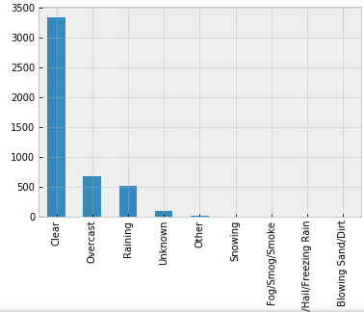
Collision and road condition

Slide 11
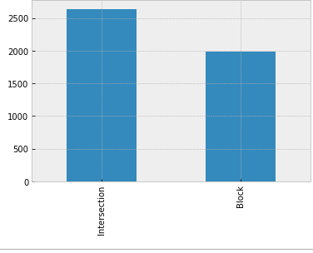
Collision location type

Slide 12
Modeling
Our first step is to divide the dataset in a training set that we can analyse and a test set for evaluation. Our test size will be 30% of the selected dataset. After we must find the neighbors with the higher accuracy.

Slide 13
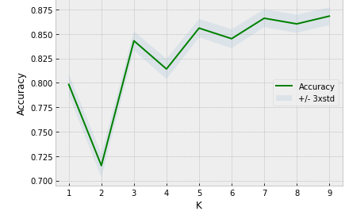
Best value for K

Slide 14
Result
The collisions are more related to the location than any other factors. They specially happened when the condition were perferct: daylight, road in good conditions and weather was nice.But we notice most of them occurred in the afternoon. We are missing to much data to make estimation with speed and lack of attention.Nonetheless,intersections represent a real danger for the cycles.

Slide 15
Discussion
We recommend to limit the circulation in the afternoon for any person riding a monocycle, bicyle,tricycle. Additionally, we suggest the city block some streets from them such as East Pine Street,2nd Avenue,12th Avenue, Roosevelt Way Northeast. If that not possible, give them a exclusive access for a certain period of time. In that decision, our model with 86% accuracy can help predict future collision and there severity and prevent most of the accident given the location.

Slide 16
Conclusion
In our report about Seattle collision we discover how some factors affected the number of accident in that city. Two of them particularly, latitude and longitude, create a map where it possible to comprehend the gravity of the situation. That is the reason why we build a model with them at the center to evaluate and reduce those accidents. In the discussion panel, we offer some advices for the city to prevent them.

