Slide 1
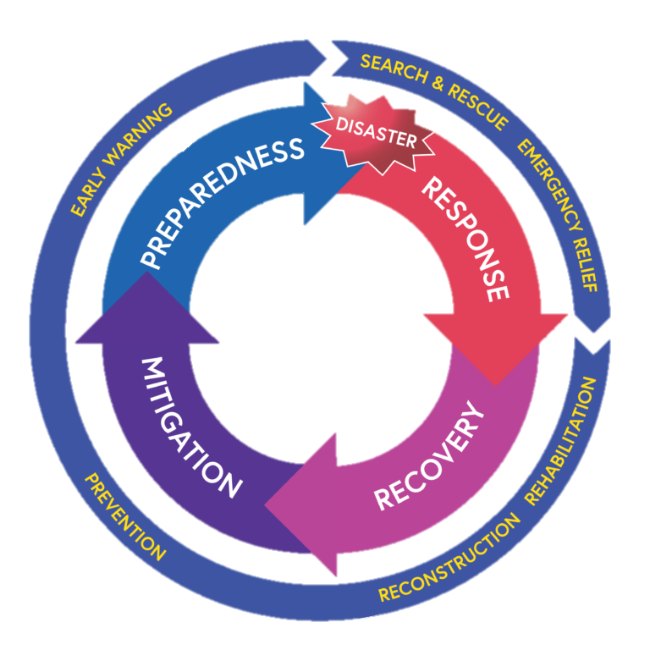
Disaster management
By: Praval Yadav
Class: IX A {2023-24}

Slide 2
What is disaster management and what are its components?
Disaster Management refers to the measures taken for the safety and protection of life and property from natural or man-made disasters. This means being prepared for disasters, fighting disasters effectively, ensuring the safety of life during disasters and helping in rebuilding society after the disaster. Failure to create and apply a plan could lead to damage to life, assets and lost revenue. Emergency management is also used, sometimes interchangeably, with the term disaster management, particularly in the context of biological and technological hazards and for health emergencies. While there is a large degree of overlap, an emergency can also relate to hazardous events that do not result in the serious disruption of the functioning of a community or society.
Phases of disaster management:-
3.1 Disaster Prevention {Mitigation}
3.2 Disaster Preparedness {Preparedness}
3.3 Disaster Response/Relief
3.4 Disaster Recovery

Slide 3
The Imphal earthquake of 2016
The M 6.7 Imphal Earthquake of 4 January 2016 caused devastation in Manipur state and adjoining areas. This event presented another opportunity to understand the earthquake risk of the affected region as well as of the North-Eastern Himalayan region, which have similar patterns of seismicity, built environment and construction practices. Many dramatic collapses and damages, especially to publicly-funded buildings were disproportionate to the observed intensity of shaking. This was primarily due to poor compliance with seismic codes, inferior quality of raw materials and shoddy workmanship. Consequently, the seismic risk in the region is growing at an alarming pace with increasing inventory of vulnerable construction. This article discusses seismic performance
THE M 6.7 earthquake of 4 January 2016 struck at 04:35 am IST with its epicentre located in the Tamenglong district (24.83°N 93.66°E) of Manipur about 30 km west of the state capital Imphal (Figure 1). The earthquake was strongly felt in all north-eastern states of India, Bangladesh and Myanmar. The worst affected regions were Imphal, Tamenglong, Noney and Thoubal. A few aftershocks of magnitude less than 4.0 were also felt within a day of the main shock. A part of north-east India, especially Assam, Nagaland and Mizoram also experienced intense shaking during this earthquake. Eight people were reported dead in India, five in Bangladesh, and nearly 200 people were injured. We undertook a reconnaissance survey of the earthquake affected regions during 14–17 January and visited Imphal and adjoining areas. We visited the affected areas again after three months to see the condition of the damaged structures and whether any restoration work was taken up by the authorities.
The earthquake occurred as a result of strike–slip faulting in the plate boundary region between the Indian and Burmese plate. A recent study showed that this event could be an extension of the Kopili fault running from the Bhutan Himalaya between the Shillong plateau and Mikir Hills. The boundary region has a history of experiencing large earthquakes: 19 earthquakes of magnitude larger than 6 have occurred within 250 km of this earthquake over the past century. The largest event was M 8.0 in 1946 on the Sagaing fault, about 220 km to the southeast of the 2016 earthquake. Another event of M 7.5 in January 1869, referred to as ‘1869 Cachar earthquake’ and located ~110 km northwest of the 2016 event caused widespread damage in Imphal City . Based on the paleo seismological studies, this event was also related to the Kopili fault4 . Other nearby damaging events included a M 7.3 earthquake, 150 km to the east of the 2016 event in the Indo-Burma region in August 1988 (refs 3, 5), and a M 6.0 earthquake 90 km to the southwest in December 1984 causing several fatalities and injuries6

Slide 4
The Imphal earthquake of 2016
Following are the activities carried out as part of emergency response effort:
Meetings with District Administration and civil society organisations: We have conducted meetings and civil society bodies to identify most affected villages in Tausem, Nungba, and Tamenglong sub-divisions of Tamenglong district. Selection criteria of villages under the project include: (a) remoteness of the village and are not very well connected by road and (b) not-reached out by any NGOs and the Government. These meetings and our preliminary impact assessment visits in the affected villages has enabled us to finalise list of 14 villages where project was implemented.
Damage assessment and village meetings: We have conducted house to house visit to identify the worst affected houses in association with Village Authority and women’s groups in the village. We have ensured that the Village Authority and women groups select the poorest and most vulnerable families through door to door visit. Two rounds of meetings were carried out to finalise list of beneficiaries of the project. After endorsement of the Village Authority, we have prepared village-wise list of beneficiaries, whose houses were partially or totally damaged.
Community awareness programs on Earthquake Seismic Zone V and safety and precautionary measures: The interventions provided opportunity to provide awareness on Earthquake Seismic Zone V and safety and precautionary measures among communities during the community meetings that were held to implement the project activities. Village leaders, women leaders, teachers and other community members attended the meeting.
Orientation of masons and carpenters on Earthquake Seismic Zone V and shelter construction with DRR features: To start repairing and construction of shelters, we organised cluster wise orientation of masons and carpenters on shelter construction with Disaster Risk Reduction features. Manipur being in the Earthquake Zone V, which most of the carpenters and masons are not aware, they were given awareness on what is Earthquake Zone V. They were given orientation on retrofitting and other DRR features in repairing and construction of the houses. We have also promoted use of locally available materials for construction of house.

Slide 5
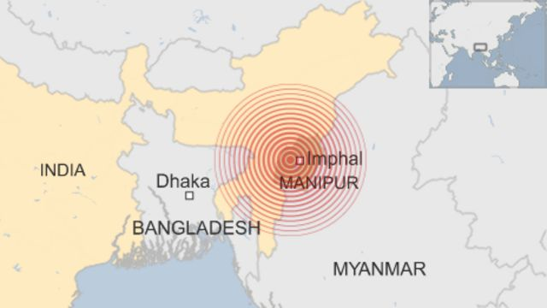
MAP FOR THE AREAS AFFECTED BY THE INCIDENT

Slide 6
THE LANDSLIDE OF MANIPUR {2022}
large landslide occurred in Noney district of the Indian state of Manipur near the Tupul railway construction site on the night of 30 June 2022. It killed 58 people and three people were missing. Eighteen people were injured. Twenty-nine Indian army personnel and 29 civilians were among the deceased. Of the missing three people, two were civilians and one was an Indian Army personnel.
Landslide
The landslide occurred in the district of Noney, at 107 Territorial Army Camp, near the Tupul railway construction site of the Jiribam-Imphal line of Indian railways. The initial eight confirmed fatalities were members of the territorial army. The group acted as security personnel for a railroad construction that would connect Jiribam railway station to Manipur's capital city Imphal. The landslide occurred near the ijei river where it created a dam. Rescuers believed it could lead to major flooding if the dam gave way, causing a larger disaster. The landslide was attributed to weak soil due to prolonged exposure, rain and human factors. Experts at Manipur university said that nearly all landslides in the region have been caused by the poor lithology—fractured rocks, steep slopes and unstable mass were contributing factors. It was likely that the water-clogged soil liquefied and destabilized, causing the landslide.
Rescue and recovery
The government of Manipur mobilized the National Disaster Response Force and State Disaster Response Force to coordinate rescue missions. Over 250 soldiers, rescuers and police officers were involved. Bulldozers and excavators were used to find bodies in the nearby river. Search and rescue operations by the Assam Rifles and Territorial Army went underway to find between 50 and 72 missing individuals. Twenty-three to 43 of the missing were Territorial Army soldiers. By July 2, the bodies of 34 people were recovered. At least 28 people remained missing. Nineteen people were rescued, including 13 Territorial Army soldiers and five civilians. Rescuers said the search for more people would continue into the night. The injured were taken to the Noney Army Medical unit for treatment.

Slide 7
THE LANDSLIDE OF MANIPUR {2022}
Rescue and recovery
By July 3, the total death toll was 42, while another 20 remained missing. At least 27 were members of the Territorial Army, and 15 civilians were among those killed. Unfavourable weather conditions and new landslides further complicated the efforts. Rockslides were reported during rescue operations. Rescuers used radar and a search and rescue dog to locate potential survivors that were buried. Works were also ongoing to remove debris blocking the Ijei river to empty a landslide-dammed lake. By July 20, the total death toll reached 56, with five people still missing. The deceased included 29 Indian Army personnel and 27 civilians. On 20 July 2022, the rescue operation was officially called off with five bodies still missing. On 23 July 2022, two more bodies were recovered from the landslide site by local people with the help of the Indian railways authority, three days after the search operation was officially called off.
Response
Officials warned residents in Noney district against approaching the Ijei river due to the possibility of a flood. The Chief minister of Manipur, N. Biren Singh, said that ₹5,00,000 would be given to the families of those killed as an ex gratia, while ₹50000 be given to the injured. Travellers were told to avoid National highway 37. On 20 July 2022, a memorandum of understanding (MoU) was signed between Northeast frontier railways, Noney district administration, and Makhuam village authority. As per the MoU, a joint survey would be carried out by the three sides on the extent of damage caused by the incident and the estimate shall be submitted to the Railways for compensation. Indian railways would also carry out extensive discussions with institutions such as IIT Guwahati and Manipur University so that railway projects on hilly terrain in the state can be better monitored for early warning to prevent such incidents in the future.
What caused the 2022 Manipur landslide?
Experts at Manipur University said that nearly all landslides in the region have been caused by the poor lithology—fractured rocks, steep slopes and unstable mass were contributing factors. It was likely that the water-clogged soil liquefied and destabilized, causing the landslide.

Slide 8
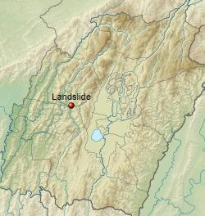
MAP FOR THE AREAS AFFECTED BY THE INCIDENT

Slide 9
The incident of Chernobyl
The Chernobyl Power Complex, lying about 130 km north of Kiev, Ukraine, and about 20 km south of the border with Belarus, consisted of four nuclear reactors of the RBMK-1000 design. (Units 1 and 2 were constructed between 1970 and 1977, while units 3 and 4 of the same design were completed in 1983. Two more RBMK reactors were under construction at the site at the time of the accident. To the southeast of the plant, an artificial lake of some 22 square kilometres, situated beside the river Pripyat, a tributary of the Dnieper, was constructed to provide cooling water for the reactors.
The April 1986 disaster at the Chernobyl nuclear power plant in Ukraine was the product of a flawed Soviet reactor design coupled with serious mistakes made by the plant operators. It was a direct consequence of Cold War isolation and the resulting lack of any safety culture. The accident destroyed the Chernobyl 4 reactor, killing 30 operators and firemen within three months and several further deaths later. One person was killed immediately and a second died in hospital soon after as a result of injuries received. Another person is reported to have died at the time from a coronary thrombosis. Acute radiation syndrome (ARS) was originally diagnosed in 237 people onsite and involved with the clean-up and it was later confirmed in 134 cases. Of these, 28 people died as a result of ARS within a few weeks of the accident. Nineteen more workers subsequently died between 1987 and 2004, but their deaths cannot necessarily be attributed to radiation exposure. Nobody offsite suffered from acute radiation effects although a significant, but uncertain, fraction of the thyroid cancers diagnosed since the accident in patients who were children at the time are likely to be due to intake of radioactive iodine fallout. Furthermore, large areas of Belarus, Ukraine, Russia, and beyond were contaminated in varying degrees.

Slide 10
The incident of Chernobyl
How does the Chernobyl incident affect humans?
Psychological or mental health problems. According to several international studies, people exposed to radiation from Chernobyl have high anxiety levels and are more likely to report unexplained physical symptoms and poor health.
How did Chernobyl affect the environment?
Radionuclides were scattered in the vicinity of the plant and over much of Europe. The Chernobyl fallout had a major impact on both agricultural and natural ecosystems in Belarus, Russia and Ukraine, as well as in many other European countries. Radionuclides were taken up by plants and later by animals
How many people died in Chernobyl?
The official death toll directly attributed to Chernobyl that is recognized by the international community is just 31 people with the UN saying it could be 50. However, hundreds of thousands of “liquidators” were sent in to put out the fire at the nuclear power plant and clean up the Chernobyl site afterwards.
How did Chernobyl affect the economy?
The agricultural sector is the area of the economy that was worst hit by the effects of the Chernobyl accident. Large areas of agricultural land were removed from service, and timber production was stopped in many forests. In addition, many farmers could not sell foodstuffs because they were contaminated.
How could Chernobyl disaster be prevented?
The answer is simple: An automatic safety interlock would have prevented the start of the test until the 700 MWt limit was reached. Unfortunately, automatic safety interlocks can prevent accidents only if they exist and can't be deactivated by the operators.

Slide 11
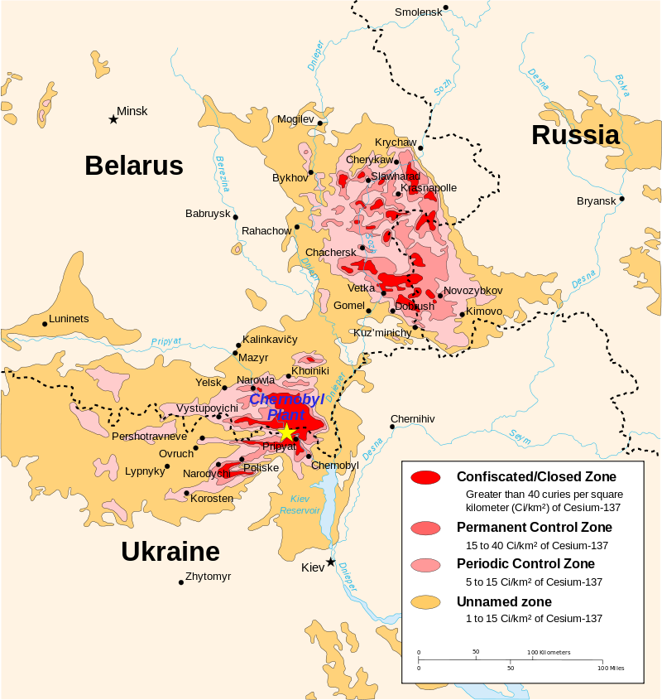
MAP FOR THE AREAS AFFECTED BY THE INCIDENT

Slide 12
Thank you

