Slide 1
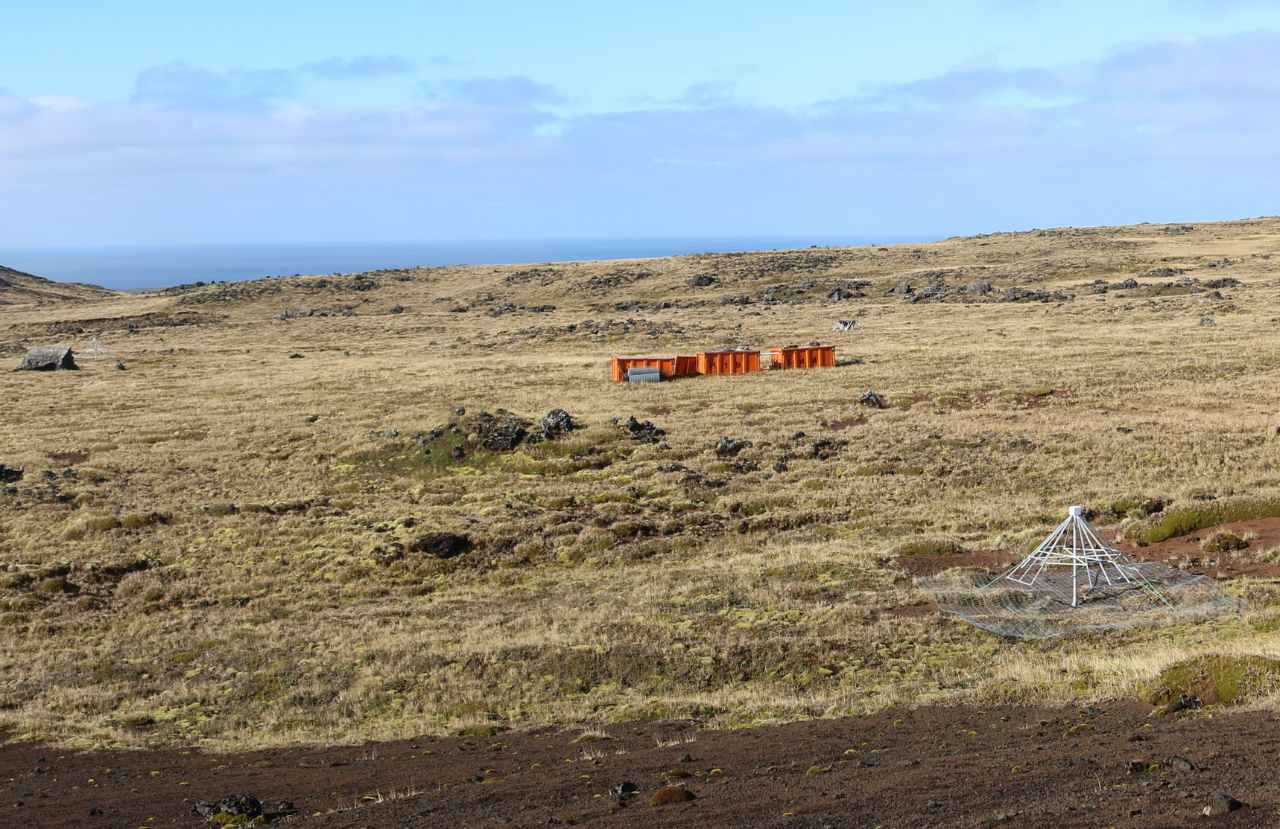
Element1
Command module
110 meters
Element2

