Slide 1
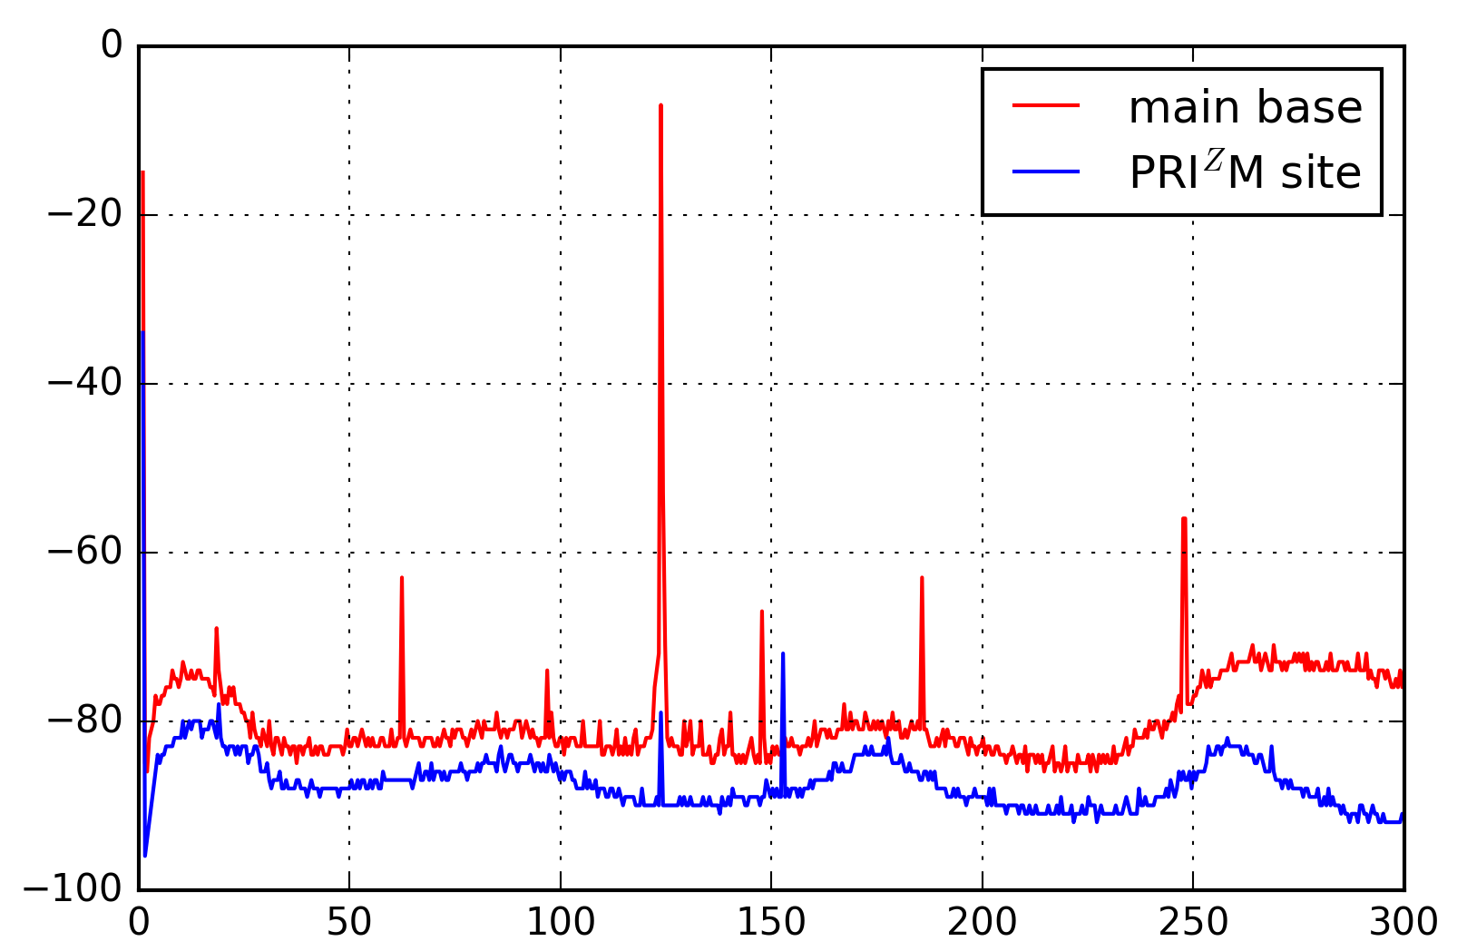
Amplitude [dBm]
Frequency [MHz]

