Slide 1

PROPOSED SELECTIONS
SANITARYWARE |
June 23, 2025
PP-YR25-0301
Alok

Slide 2


Slide 3
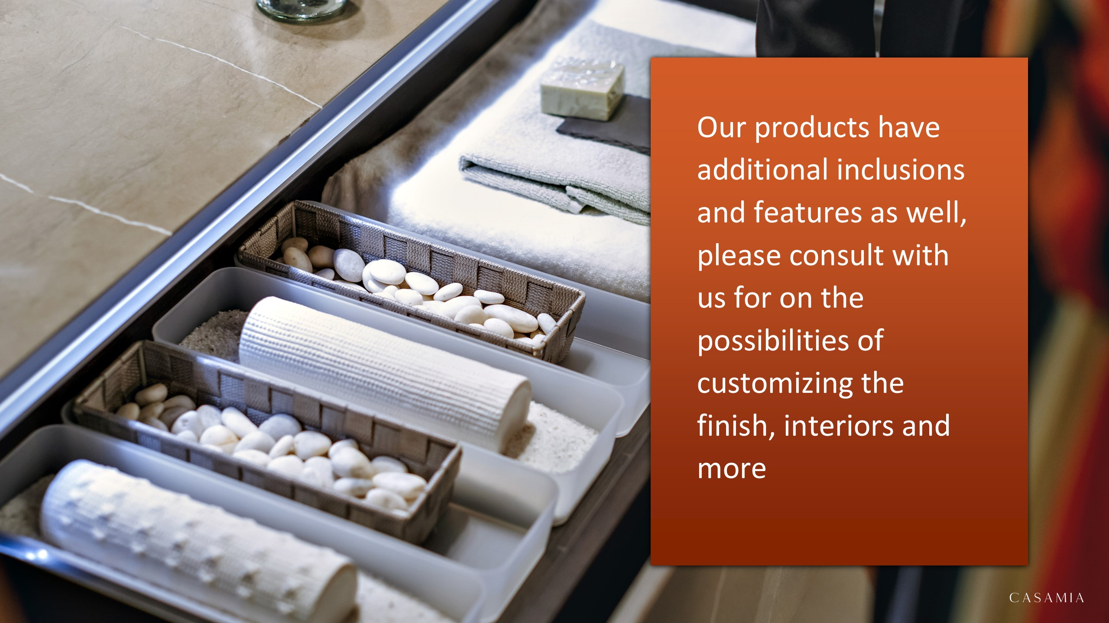

Slide 4

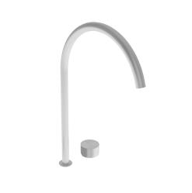
Master Room
#A33 – Falper Acquifero 2-Hole Deck Mounted Basin Mixer with Built-in part (Arco Deck Mounted Spout Art. GRF00000000SP and Acquifero Deck Mounted Mixer Flow Control Art. GVG00000000SP included) Brushed Stainless Steel h495mm
#A33 – Falper Acquifero 2-Hole Deck Mounted Basin Mixer with Built-in part (Arco Deck Mounted Spout Art. GRF00000000SP and Acquifero Deck Mounted Mixer Flow Control Art. GVG00000000SP included) Brushed Stainless Steel h495mm

Slide 5


