Slide 1

PROPOSED SELECTIONS
SANITARYWARE |
June 23, 2025
PP-YR25-0303
ENBD

Slide 2


Slide 3
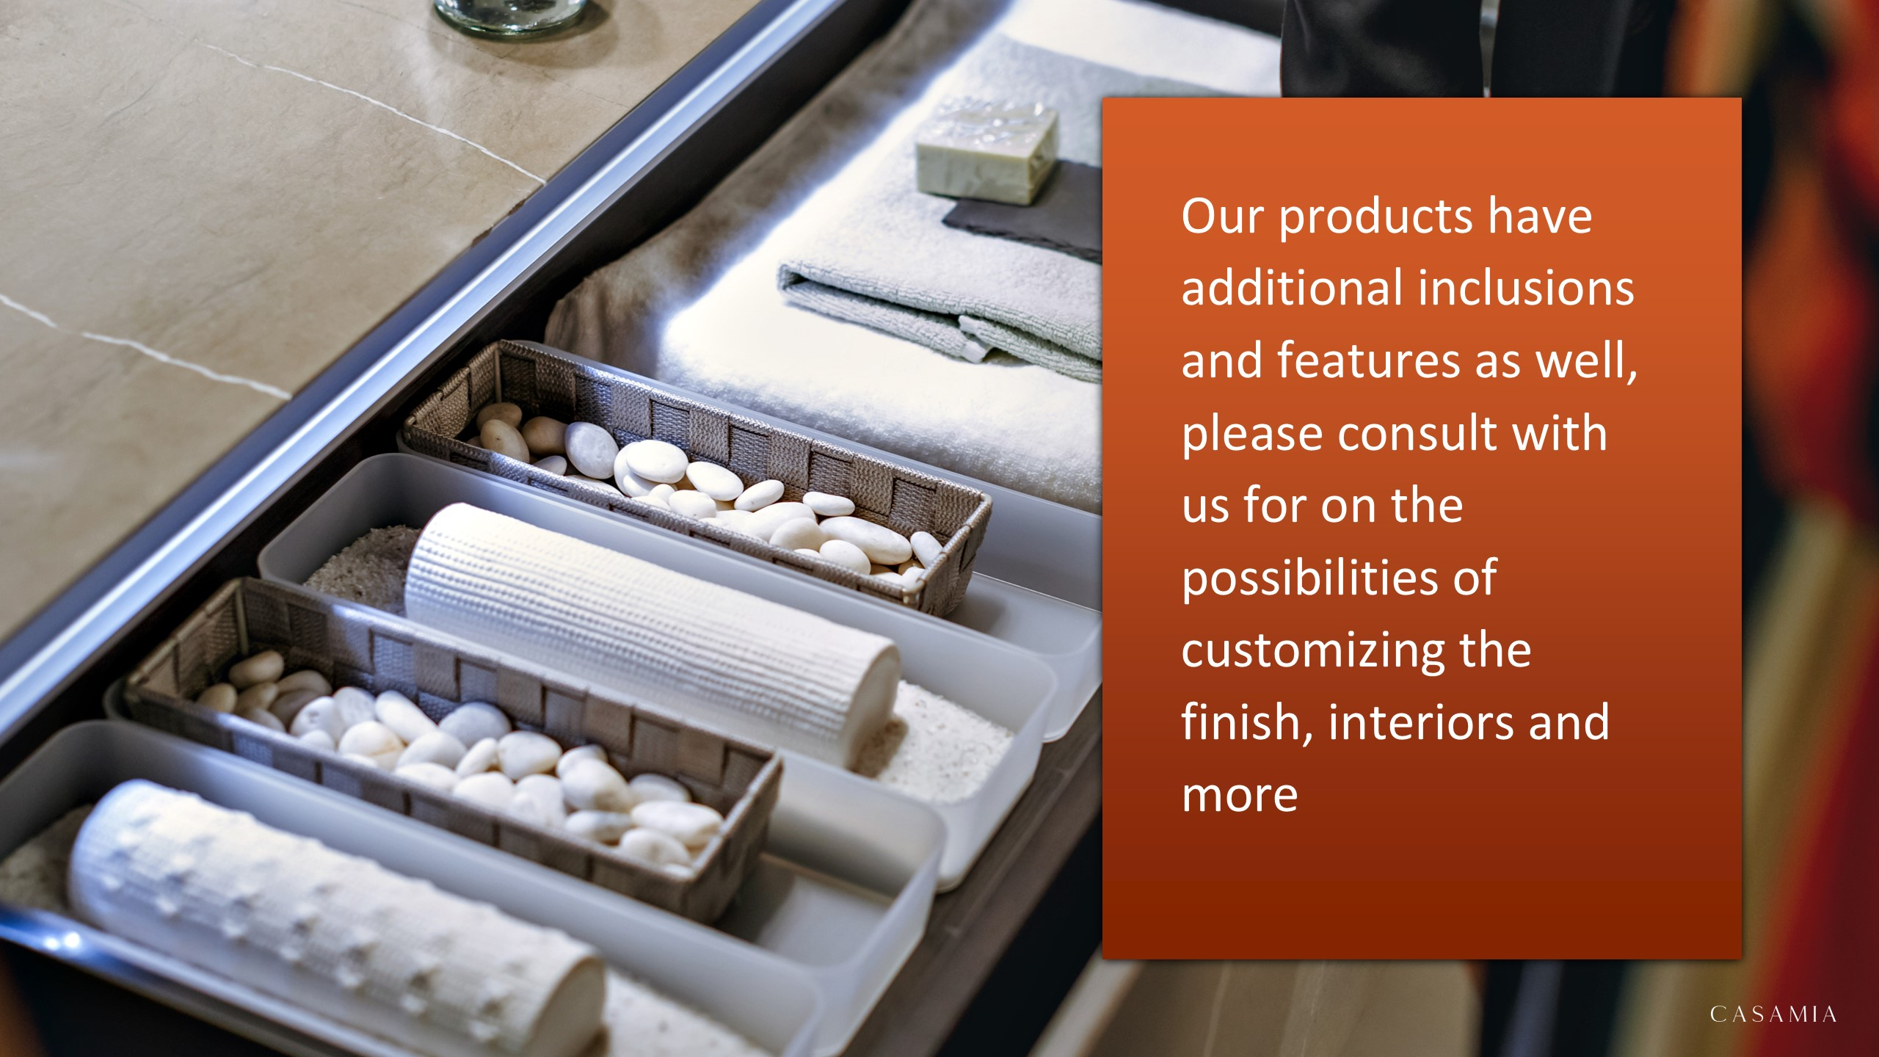

Slide 4

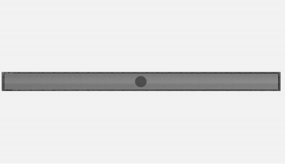
masters bathroom
59150 –
59036 –
54139 –
E80-304-NAT – IWW Plumbing E80 Linear Tile-in Shower Drain in Stainless Steel 304 Natural L813mm

Slide 5


