Slide 1

PROPOSED SELECTIONS
SANITARYWARE |
June 23, 2025
PP-YR25-0305
ENBD

Slide 2


Slide 3
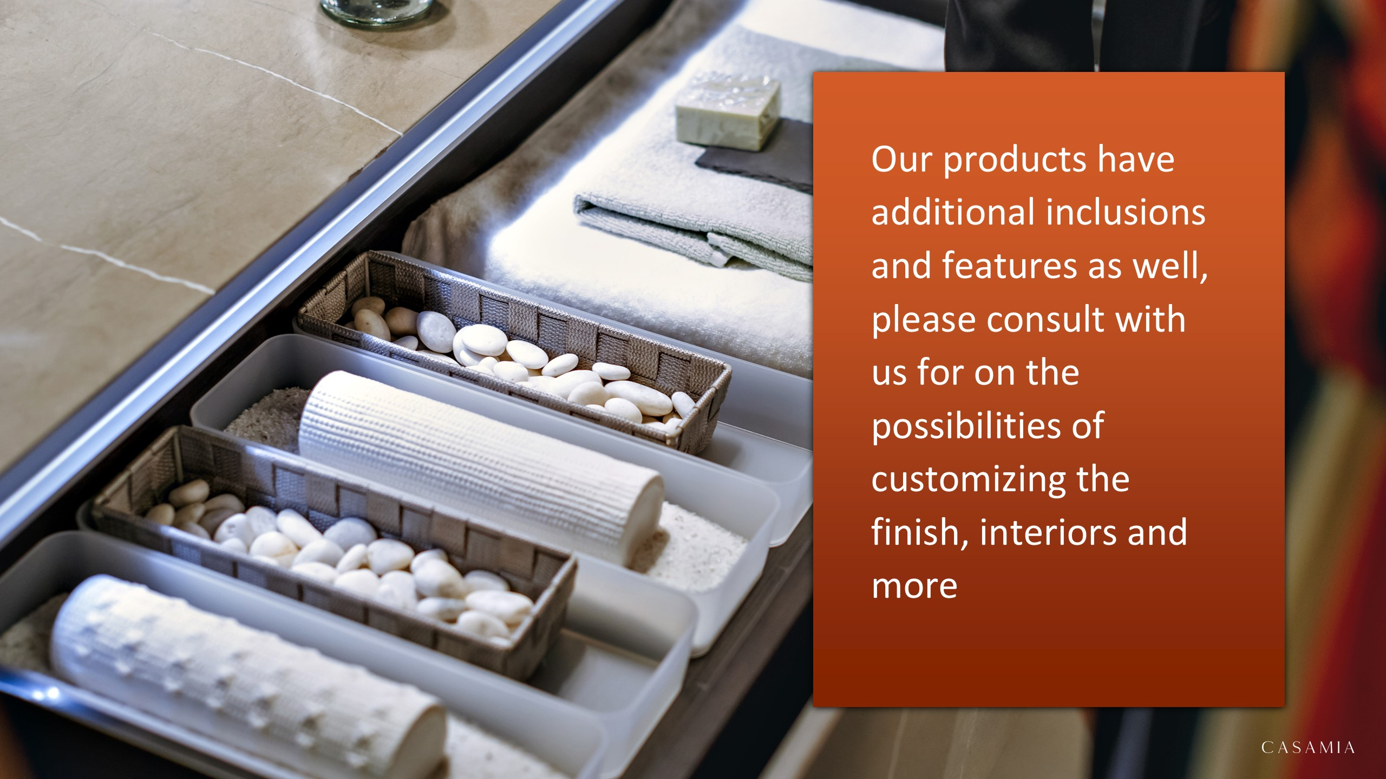

Slide 4


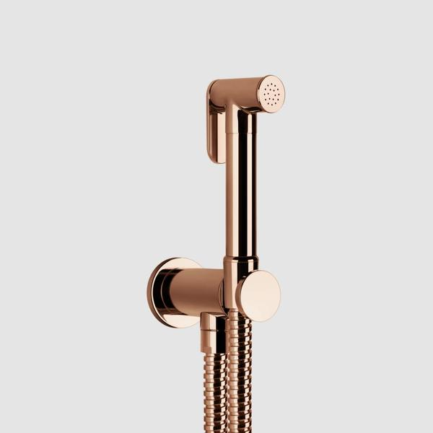
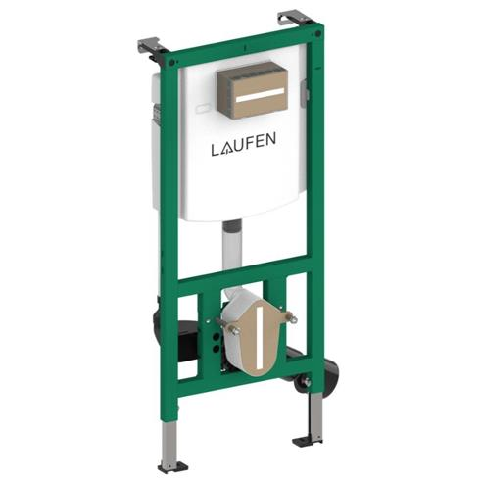
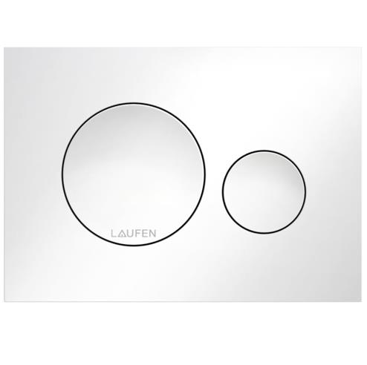
masters bathroom
E13-304-ABS – IWW Plumbing E13 Square Tile-in Shower Drain in ABS (4-inch outlet) 133x133mm
14331030 – Gessi Trasparenze Shut-off Set with Wall Mounted Handshower Holder with Water Outlet and Flexible Hose Copper PVD (Customised)
H9201100000001 – Laufen Ineolink Concealed Cistern for Wall Hung WC and Shower WC 500x135x1120mm
H9001140000001 – Laufen Ineo Moon Dual Flush Plate White 203x145mm

Slide 5


