Slide 1

PROPOSED SELECTIONS
SANITARYWARE |
June 23, 2025
PP-YR25-0307
ENBD

Slide 2


Slide 3
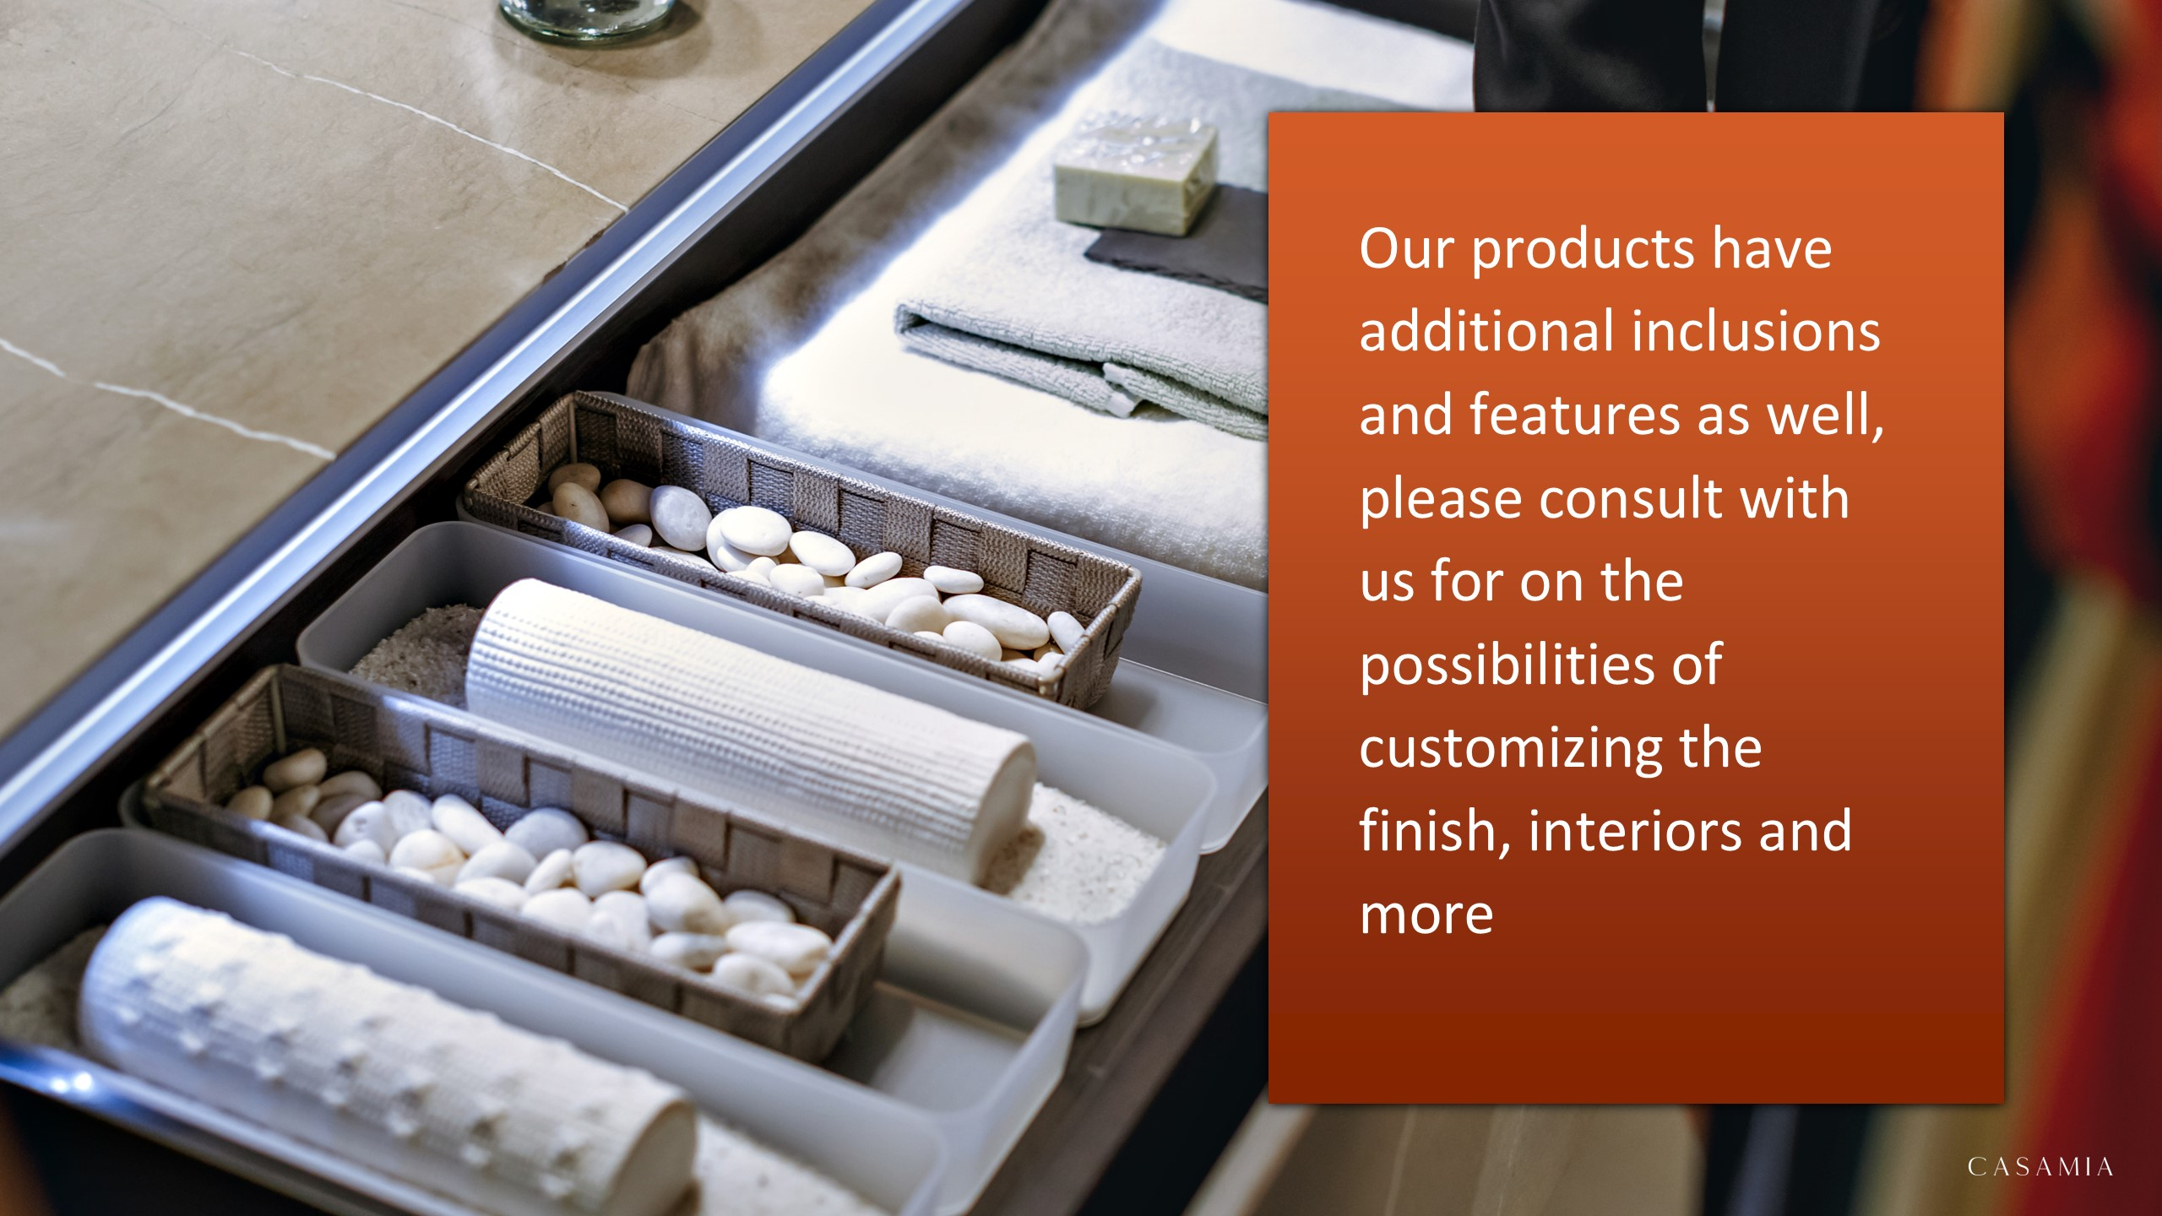

Slide 4

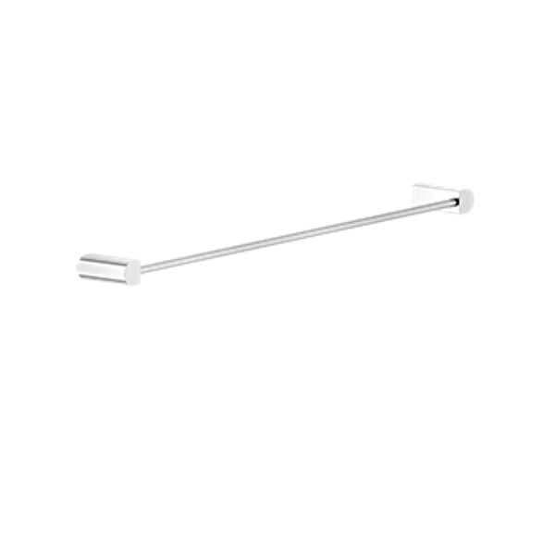
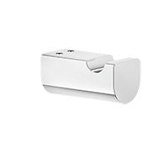
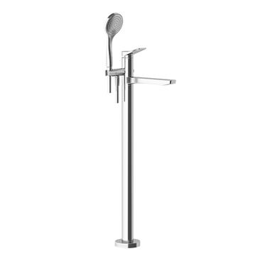
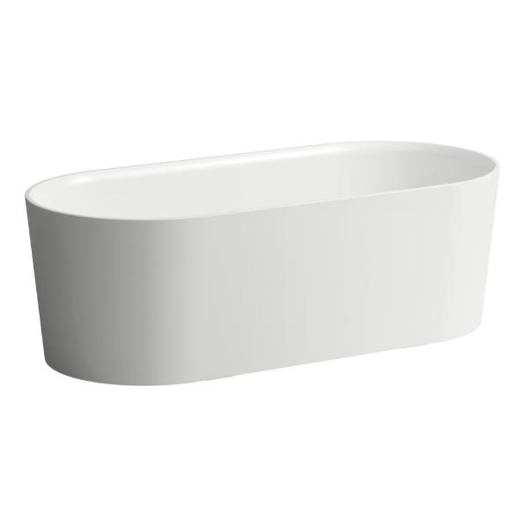
masters bathroom
59403726 – Gessi Rilievo Wall Mounted Towel Rail Warm Bronze Brushed PVD
59521726 – Gessi Rilievo Wall Mounted Hook Warm Bronze Brushed PVD
59131726 – Gessi Rilievo Freestanding Bath Mixer with Handshower, Handshower Holder with Water Outlet, Flexible Hose and Spout (Exposed part only, built-in part Art. 46189 to be ordered separately) Warm Bronze Brushed PVD h954mm
H2302820000001 – Laufen Val Freestanding Bathtub , made of Sentec solid surface, with integrated overflow and feet White 1600x750x520mm

Slide 5


