Slide 1

PROPOSED SELECTIONS
SANITARYWARE |
June 24, 2025
PP-YR25-0309
Jasminder

Slide 2


Slide 3
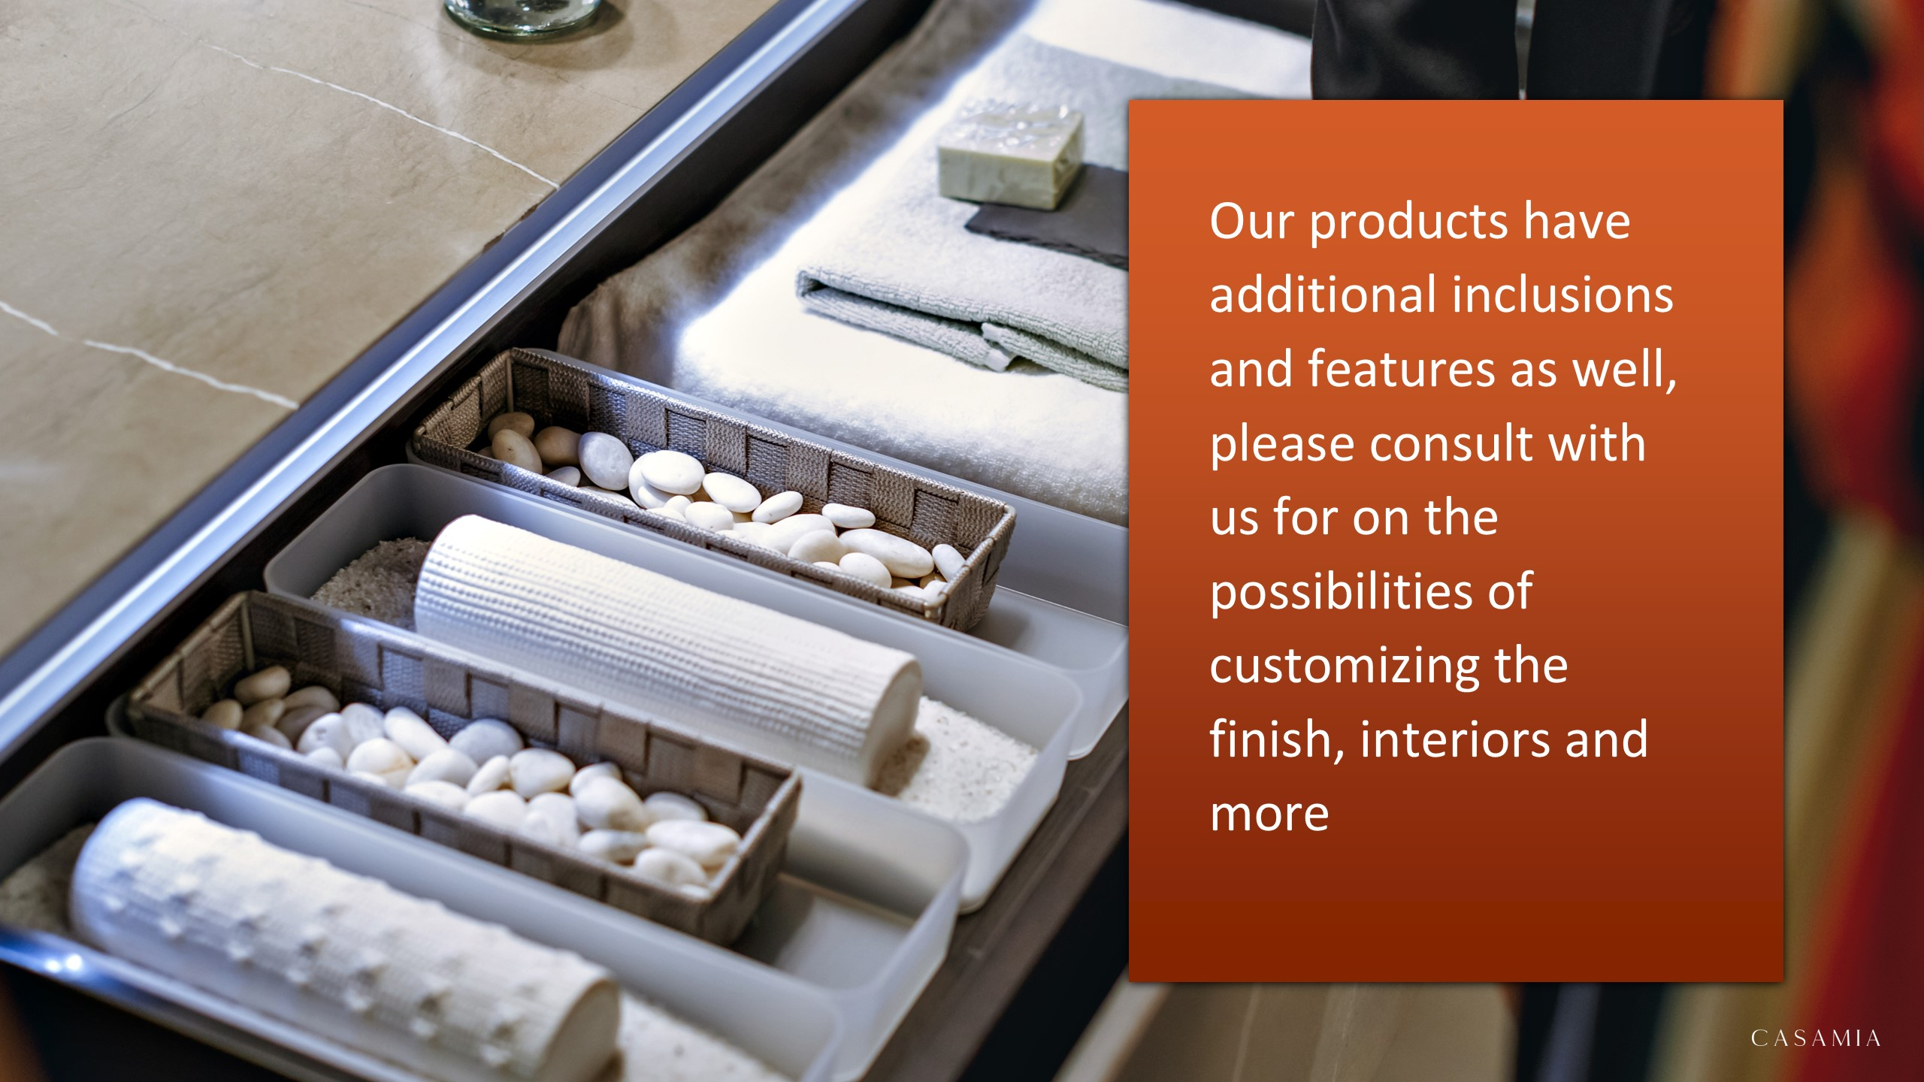

Slide 4

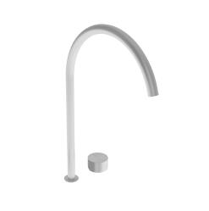
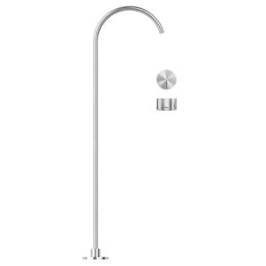
Room
#A33 – Falper Acquifero 2-Hole Deck Mounted Basin Mixer with Built-in part (Arco Deck Mounted Spout Art. GRF00000000SP and Acquifero Deck Mounted Mixer Flow Control Art. GVG00000000SP included) Brushed Stainless Steel h495mm
#A52 – Falper Aquifero Washbasin Set with Freestanding Spout Art. GRH0000000SP and Hydroprogressive Flow Control Art. GVB0000000SP Brushed Stainless Steel H1127mm
#A35 –

Slide 5
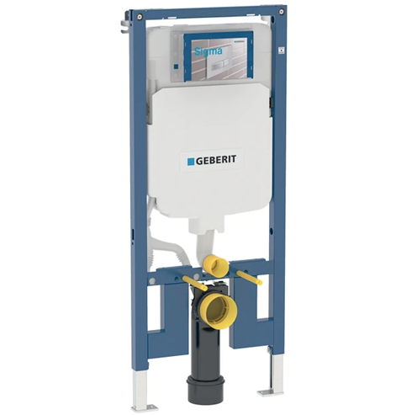
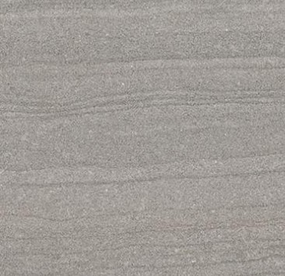
Bathroom
111.796.00.1 – Geberit Duofix Sigma Concealed Cistern 8cm for Wall Hung WC H114cm
E1CK – Ergon Stone Project Falda Grey Natural Rett 60x120cm 10mm

Slide 6


