Slide 1

PROPOSED SELECTIONS
SANITARYWARE |
June 25, 2025
PP-YR25-0310
64646

Slide 2


Slide 3
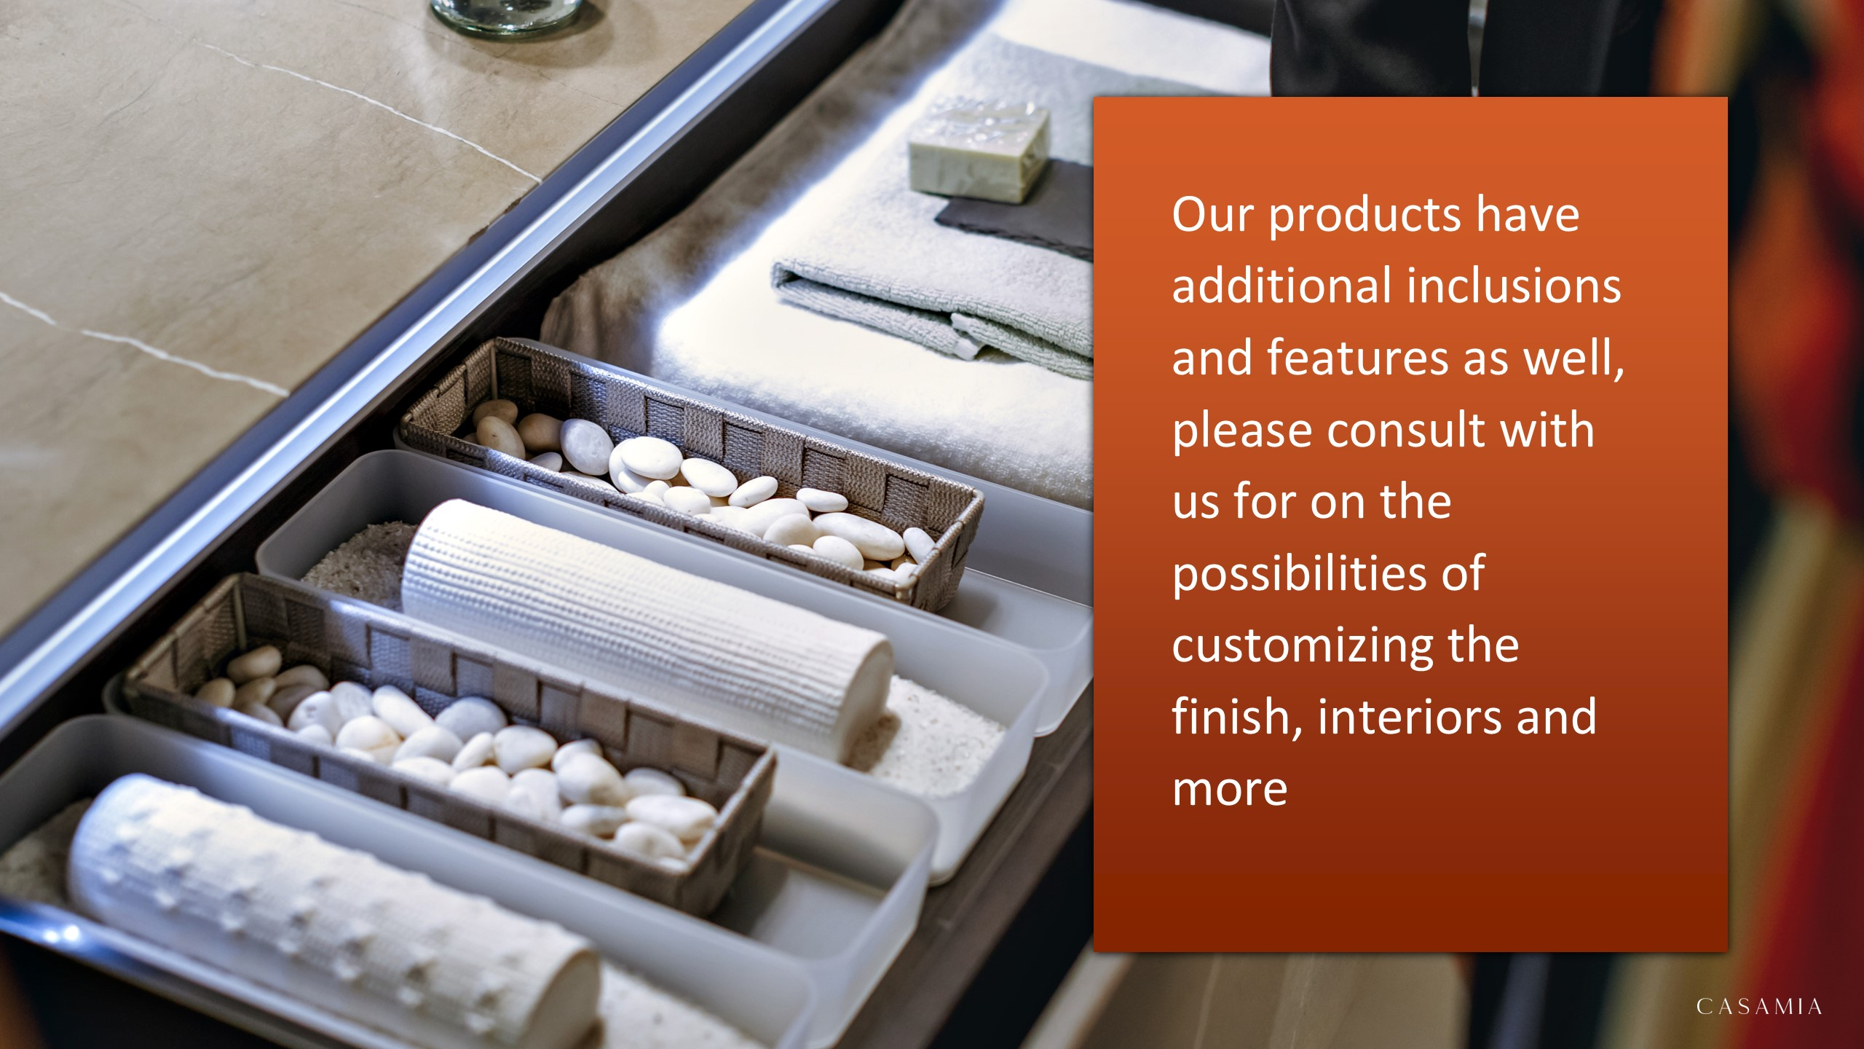

Slide 4

asdasdasdsada
sdasdasdadss –

Slide 5


