Slide 1

PROPOSED SELECTIONS
SANITARYWARE |
June 26, 2025
PP-YR25-0311
My Room

Slide 2


Slide 3
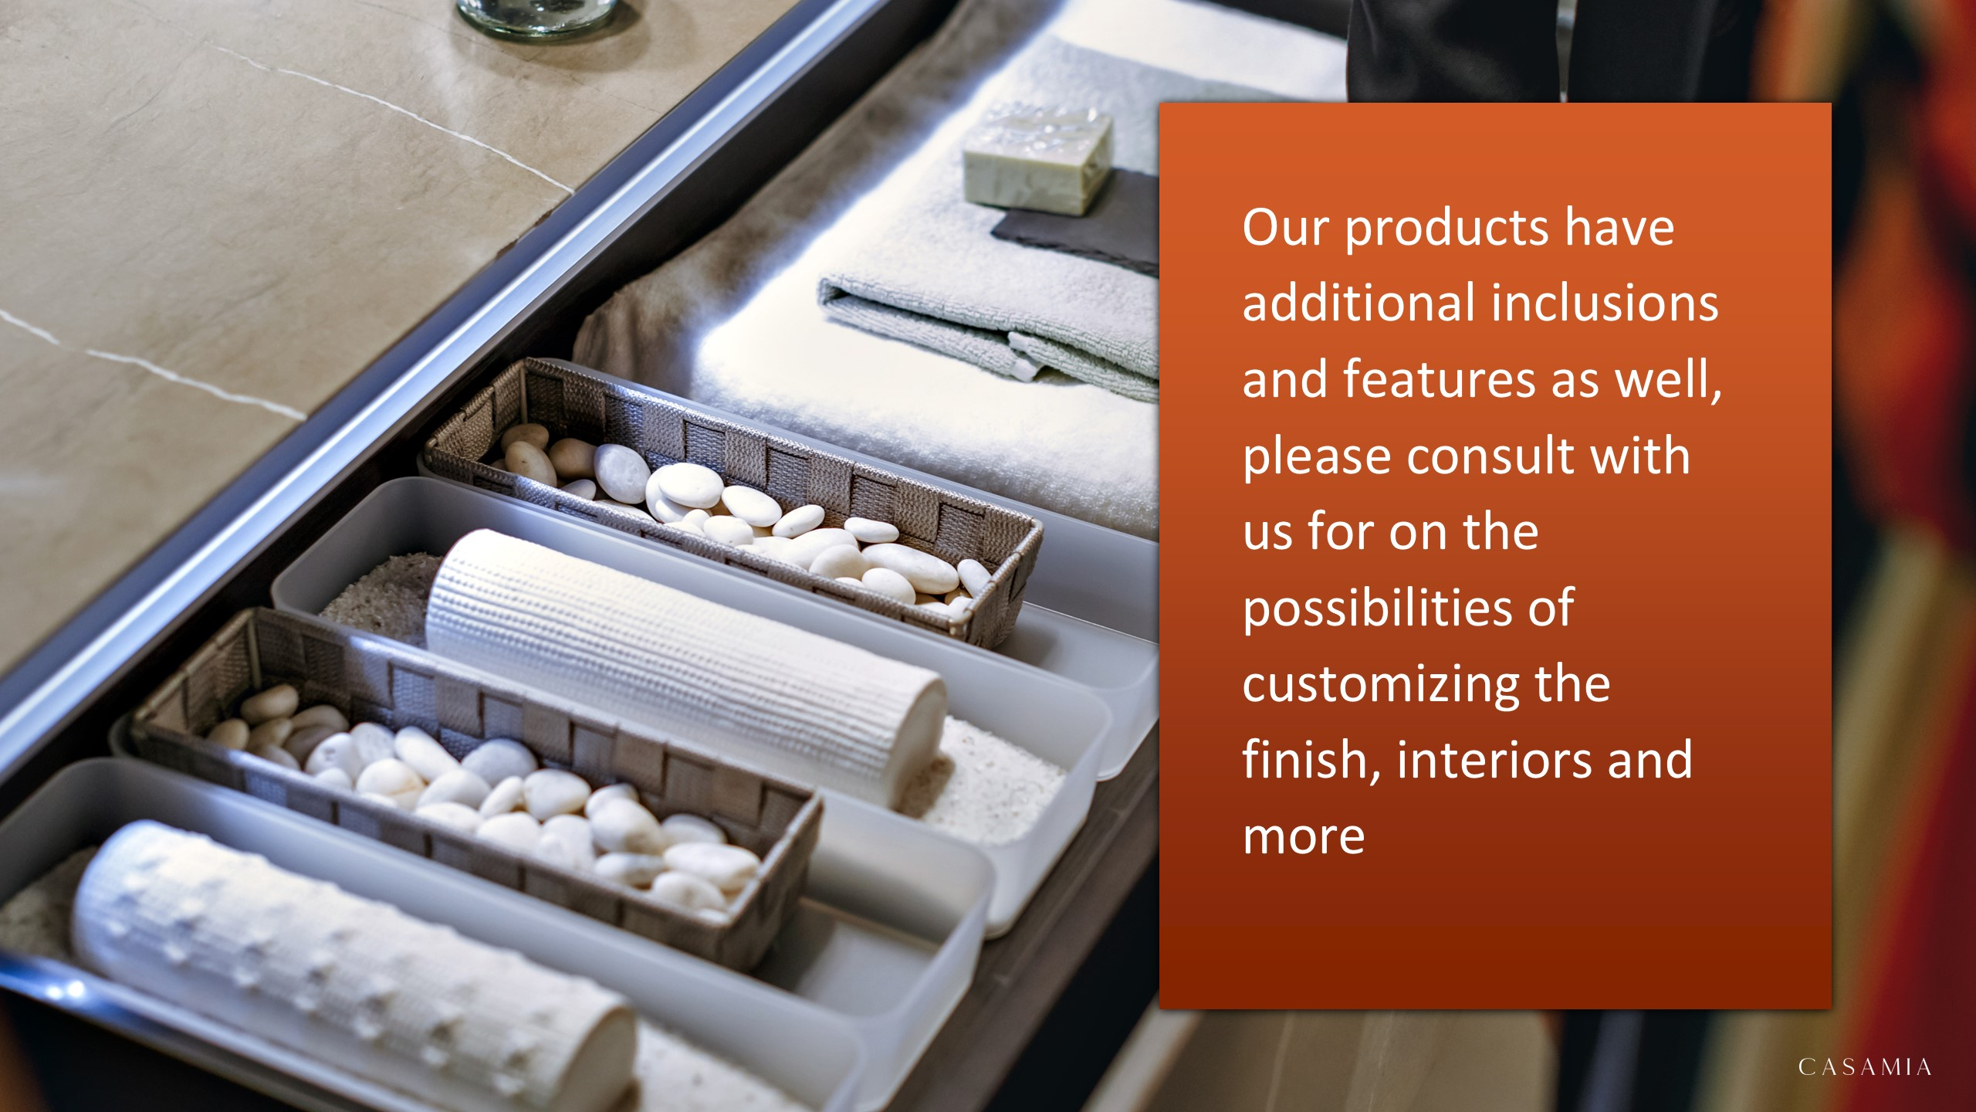

Slide 4

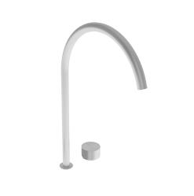
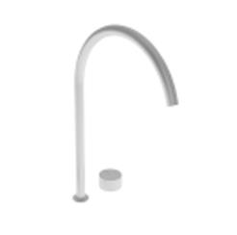
Bathroom
#A33 – Falper Acquifero 2-Hole Deck Mounted Basin Mixer with Built-in part (Arco Deck Mounted Spout Art. GRF00000000SP and Acquifero Deck Mounted Mixer Flow Control Art. GVG00000000SP included) Brushed Stainless Steel h495mm
#A36 – Falper Acquifero 2-Hole Deck Mounted Basin Mixer (with Spout Art. GRF00000000PM and Flow Control Art. GVH00000000PM) Matt Black 35cm

Slide 5


