Slide 1

PROPOSED SELECTIONS
SANITARYWARE |
July 01, 2025
PP-YR25-0312
asdfasdf

Slide 2


Slide 3
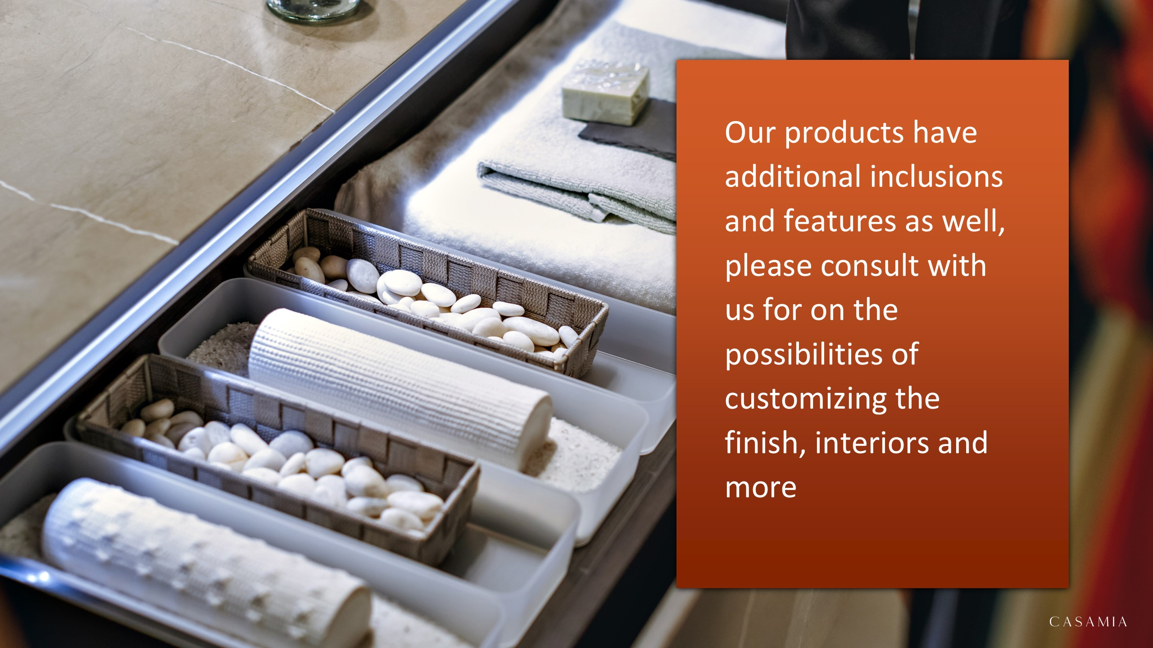

Slide 4

sadfasdf
asdfasdfasdf –

Slide 5


